Slide 1
Listen to your heart
Politecnico di Milano
16/07/2016
Alberti Chiara achiara1995@gmail.com
Nicolò Bachetti nicolo.bachetti@gmail.com
Sara Bellocco sara.belloco35@gmail.com
Angela Colella angela.colella95@gmail.com
Angela Colombo angelac951@alice.it

Slide 2
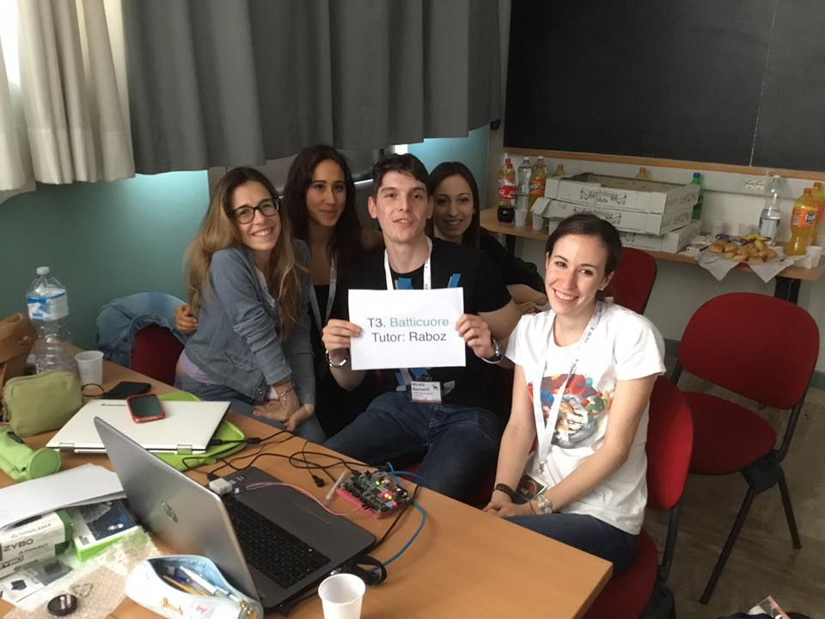
Team 3
Angela
Nicolò
Sara
Chiara
Angela

Slide 3


Context

Slide 4
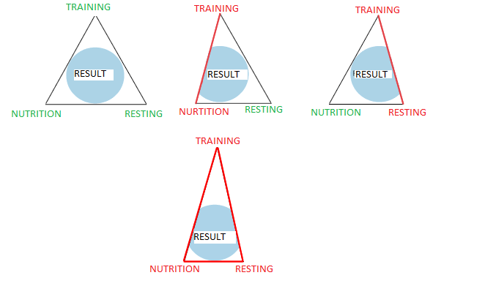
Problem

Slide 5
Our solution
Heart Rate
Monitoring
Giving advices and suggestion
Heart Rate Variation
Oxygen Hemoglobin level

Slide 6
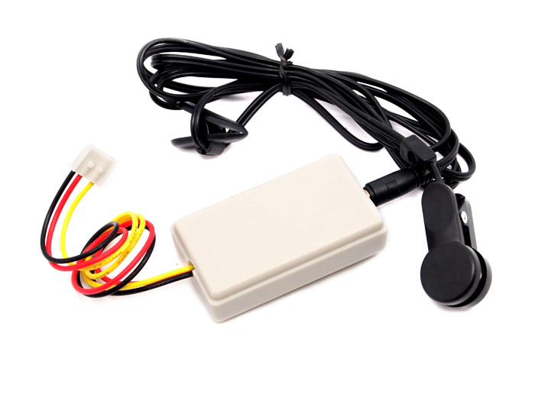
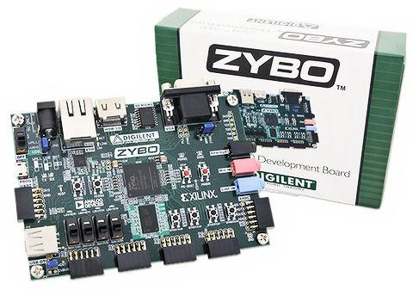
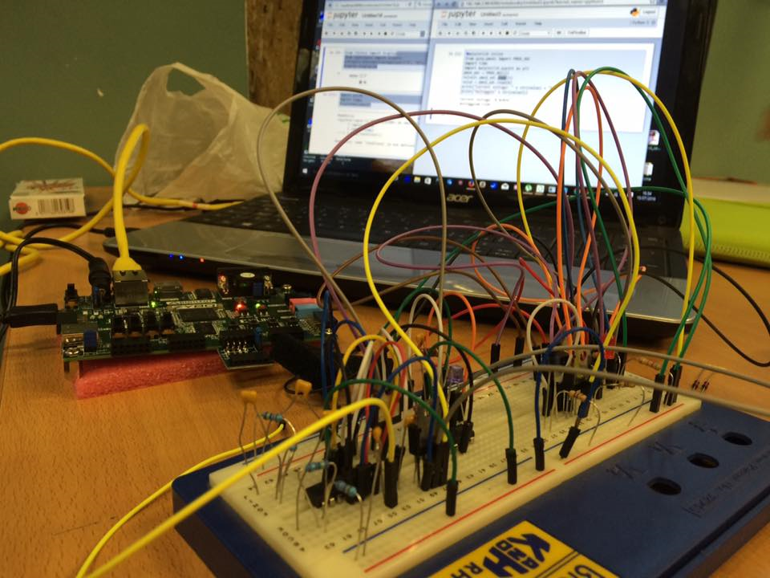
How we did it:
Pulse Oximeter
Heart Rate ear-clip sensor
ZYBO Board

Slide 7
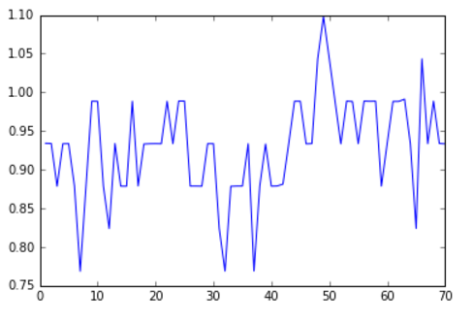
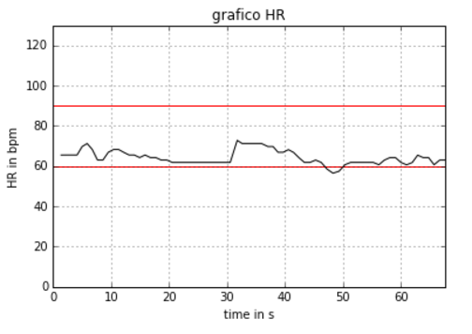
Heart Rate Plot
Heart Rate Variabity Plot

Slide 8
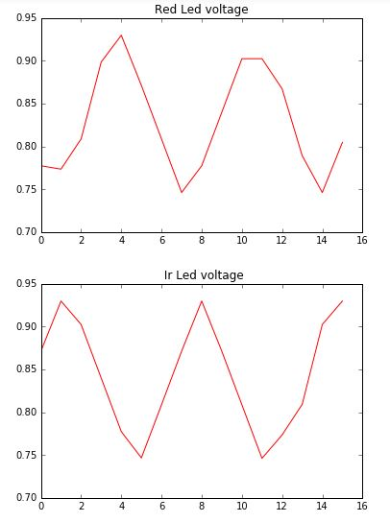
Aortic Pressure values

Slide 9
We hope that this instrument will allow people
to gain knowledge of the limits of their body
and how to train it
Thank you for listening!
You can find our project at:
https://github.com/AngCol/xph-project

