Slide 1
Chapter 1

Slide 2
1
Magnetic EE Core (Mn-Zn)
2
2
Aluminum (attached to dead space)
5
1
4
3
Flatwise Windings
3
4
TIM
5
Allocation for Terminals
Chapter 1

Slide 3
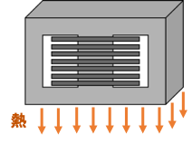
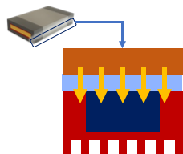
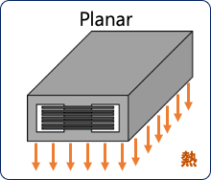
Rectangular, flat windings
Spatial
Edgewise
Copper
TIM
Thermal Conduction
Aluminum
Core
Trans. Side View
Trans. Front View
Dead space heat extraction
High window-fill factor winding
Wide cooling area
More contact from heat source will lead to more effective extraction.

Slide 4
Chapter 3

Slide 5
Rectangular, flat windings
Spatial
Edgewise
Flatwise (proposed)
Winding
TIM
Heat
Thermal Conduction
Aluminum
Planar (proposed)
Core
Coolant
Trans. Side View
Trans. Front View
Dead space heat extraction
High window-fill factor winding
Heat
More contact from heat source will lead to more effective extraction.
Wide cooling area

Slide 6
Rectangular, flat windings
Spatial
Edgewise
Flatwise (proposed)
Winding
TIM
Heat
Thermal Conduction
Aluminum
Planar (proposed)
Core
Coolant
Trans. Side View
Trans. Front View
Dead space heat extraction
High window-fill factor winding
Heat
More contact from heat source will lead to more effective extraction.
Wide cooling area

Slide 7
Edgewise
Flatwise
Winding
TIM
Thermal Conduction
Thermal Conduction
Aluminum
Core
Coolant
Trans. Side View
Trans. Front View
Dead space heat extraction
High window-fill factor winding

Slide 8
Winding
TIM
Thermal Conduction
Aluminum
Core
Coolant
Trans. Side View
Trans. Front View
Dead space heat extraction
High window-fill factor winding

Slide 9


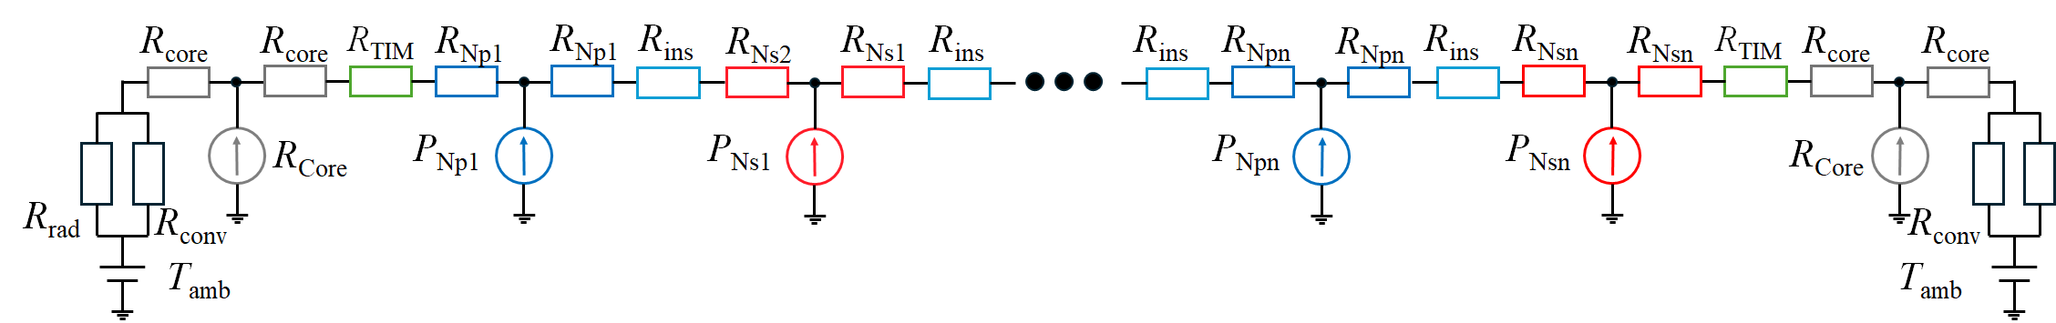
R_{core}
R_{core}
R_{TIM}
R_{Np1}
R_{Np1}
R_{ins}
R_{Ns2}
R_{Ns2}
R_{ins}
R_{ins}
R_{Npn}
R_{Npn}
R_{ins}
R_{Nsn}
R_{Nsn}
R_{TIM}
R_{core}
R_{core}
P_{Core}
P_{Np1}
P_{Ns1}
P_{Npn}
P_{Nsn}
P_{Core}
R_{rad}
R_{conv}
R_{conv}
R_{rad}
T_{amb}
T_{amb}
Edgewise-wound Transformer
inside
High R_{TH}
ambient
Flatwise-wound Transformer (proposed)
inside
Low R_{TH}
ambient
P_{Nsn}
R_{Nsn}
R_{Nsn}
R_{ins}
P_{Npn}
R_{core}
R_{core}
R_{TIM}
R_{TIM}
R_{core}
R_{core}
R_{Npn}
R_{Npn}
R_{Ns2}
R_{Ns1}
P_{core}
P_{Ns1}
P_{core}
R_{rad}
R_{conv}
R_{ins}
R_{conv}
R_{rad}
R_{Np1}
R_{Np1}
T_{amb}
T_{amb}
P_{Np1}

Slide 10
R_{core}
R_{core}
R_{TIM}
R_{Np1}
R_{Np1}
R_{ins}
R_{Ns2}
R_{Ns2}
R_{ins}
R_{ins}
R_{Npn}
R_{Npn}
R_{ins}
R_{Nsn}
R_{Nsn}
R_{TIM}
R_{core}
R_{core}
P_{Core}
P_{Np1}
P_{Ns1}
P_{Npn}
P_{Nsn}
P_{Core}
R_{rad}
R_{conv}
R_{conv}
R_{rad}
T_{amb}
T_{amb}
Edgewise-wound Transformer
inside
High R_{TH}
ambient
Flatwise-wound Transformer (proposed)
inside
Low R_{TH}
ambient
P_{Nsn}
R_{Nsn}
R_{Nsn}
R_{ins}
P_{Npn}
R_{core}
R_{core}
R_{TIM}
R_{TIM}
R_{core}
R_{core}
R_{Npn}
R_{Npn}
R_{Ns2}
R_{Ns1}
P_{core}
P_{Ns1}
P_{core}
R_{rad}
R_{conv}
R_{ins}
R_{conv}
R_{rad}
R_{Np1}
R_{Np1}
T_{amb}
T_{amb}
P_{Np1}

Slide 11
R_{core}
R_{core}
R_{TIM}
R_{Np1}
R_{Np1}
R_{ins}
R_{Ns2}
R_{Ns2}
R_{ins}
R_{ins}
R_{Npn}
R_{Npn}
R_{ins}
R_{Nsn}
R_{Nsn}
R_{TIM}
R_{core}
R_{core}
P_{Core}
P_{Np1}
P_{Ns1}
P_{Npn}
P_{Nsn}
P_{Core}
R_{rad}
R_{conv}
R_{conv}
R_{rad}
T_{amb}
T_{amb}
inside
High R_{TH}
ambient
inside
Low R_{TH}
ambient
P_{Nsn}
R_{Nsn}
R_{Nsn}
R_{ins}
P_{Npn}
R_{core}
R_{core}
R_{TIM}
R_{TIM}
R_{core}
R_{core}
R_{Npn}
R_{Npn}
R_{Ns2}
R_{Ns1}
P_{core}
P_{Ns1}
P_{core}
R_{rad}
R_{conv}
R_{ins}
R_{conv}
R_{rad}
R_{Np1}
R_{Np1}
T_{amb}
T_{amb}
P_{Np1}

Slide 12

PSSP
Full
None
Interwinding Capacitance | 396.03 pF | 632.89 pF | 107.22 pF
AC Resistance
Manufacturability

Slide 13
Flatwise-wound Transformer (Proposed)
Edgewise-wound Transformer
95.00 mm
(w_{win} )
(w_{win} )
78.00 mm
19.00mm
52.00 mm
27.50 mm
52.00 mm
55.00 mm
(w_{wire} )
0.50 mm
0.50 mm
(l_{win} )
38.00 mm
(d_{inter} )
(l_{win} )
1.00 mm
1.00 mm
7.00 mm
(d_{TIM} )
0.50 mm
(d_{TIM} )
(h_{wire} )
1.00 mm
(h_{wire} )
7.00 mm
0.50 mm
1.00 mm
(d_{clear} )
(d_{inter} )
(w_{wire} )
(d_{clear} )

Slide 14



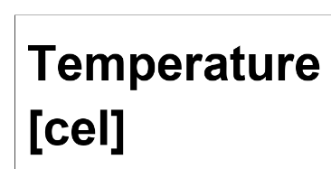



0.9658 W
0.9739 W
2.3590 W
1.8854 W
0.0843 W
0.0513 W
Total: 3.4088 W
Total: 2.9106 W
45 $°$C
57 $°$C
More even heat distribution observed.
Heat is trapped in windings.

Slide 15
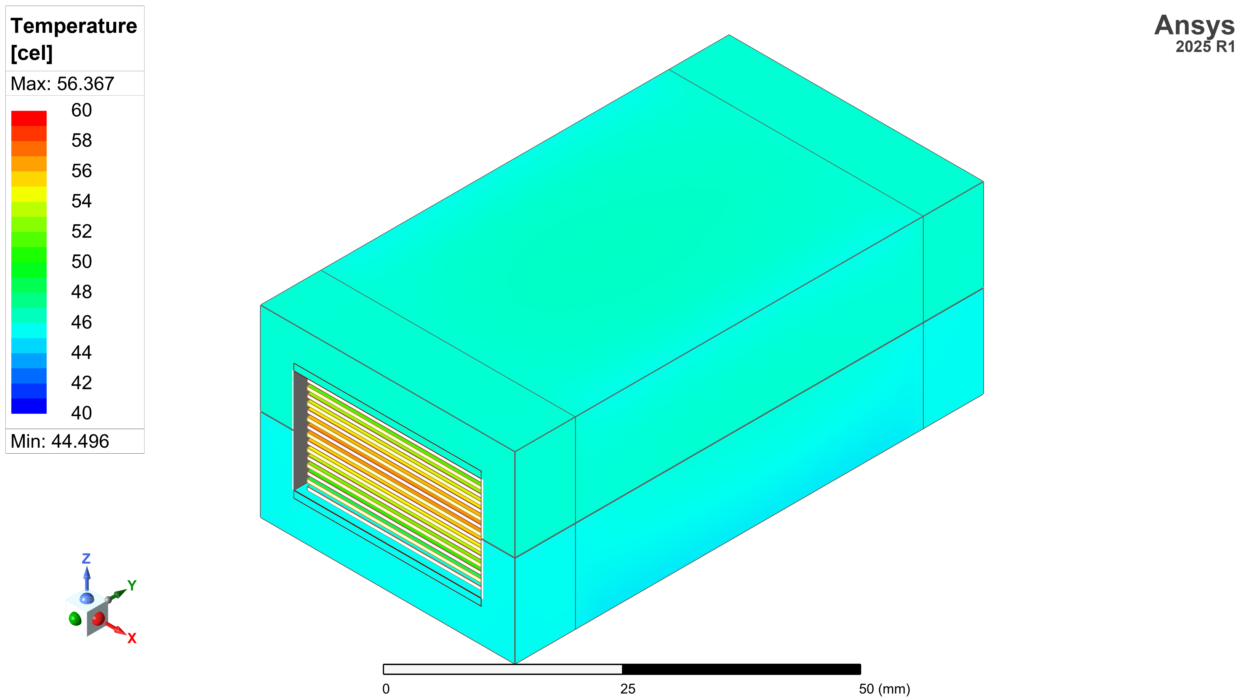
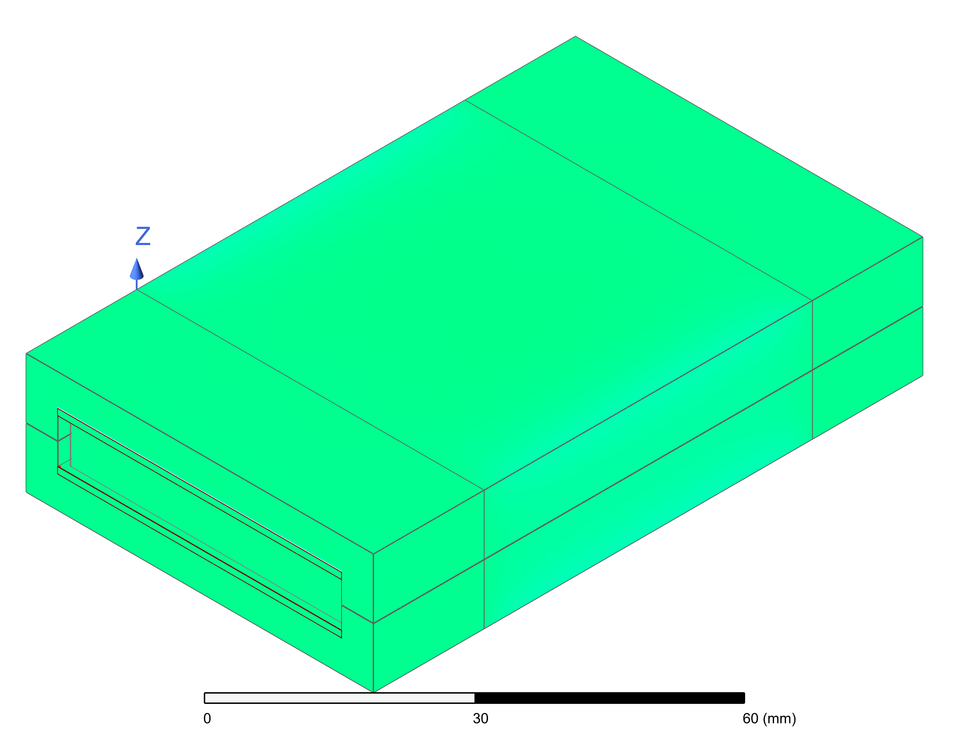
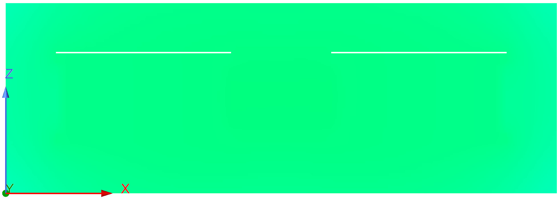
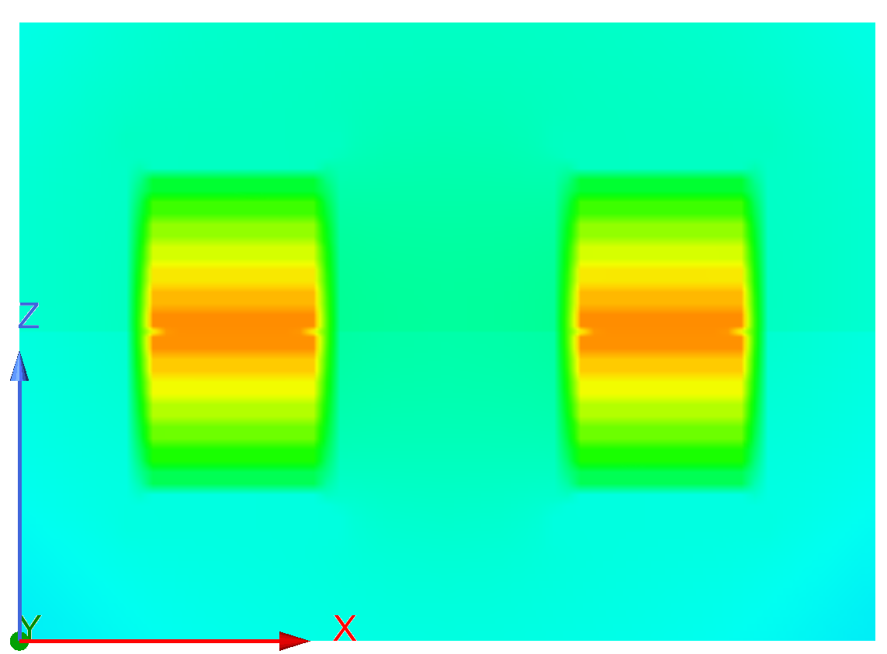


*ambient: 25 $°$C
0.9658 W
0.9739 W
Temp [$°$C]
2.3590 W
1.8854 W
0.0843 W
0.0513 W
Flatwise (proposed)
Total: 3.4088 W
Total: 2.9106 W
Edgewise
47 $°$C
57 $°$C
Cross-section
More even heat distribution observed.
Cross-section
Heat is trapped in windings.

Slide 16



*ambient: 25 $°$C
0.9658 W
0.9739 W
Temp [$°$C]
2.3590 W
1.8854 W
0.0843 W
0.0513 W
Flatwise (proposed)
Total: 3.4088 W
Total: 2.9106 W
Edgewise
47 $°$C
57 $°$C
Cross-section
More even heat distribution observed.
Cross-section
Heat is trapped in windings.

Slide 17
To Converter
To Converter
Trans.
Trans.
Cotton
TIM
Thermally Insulated Chamber
Fan
Natural Cooling
Forced Air Cooling through Heat Sink

Slide 18
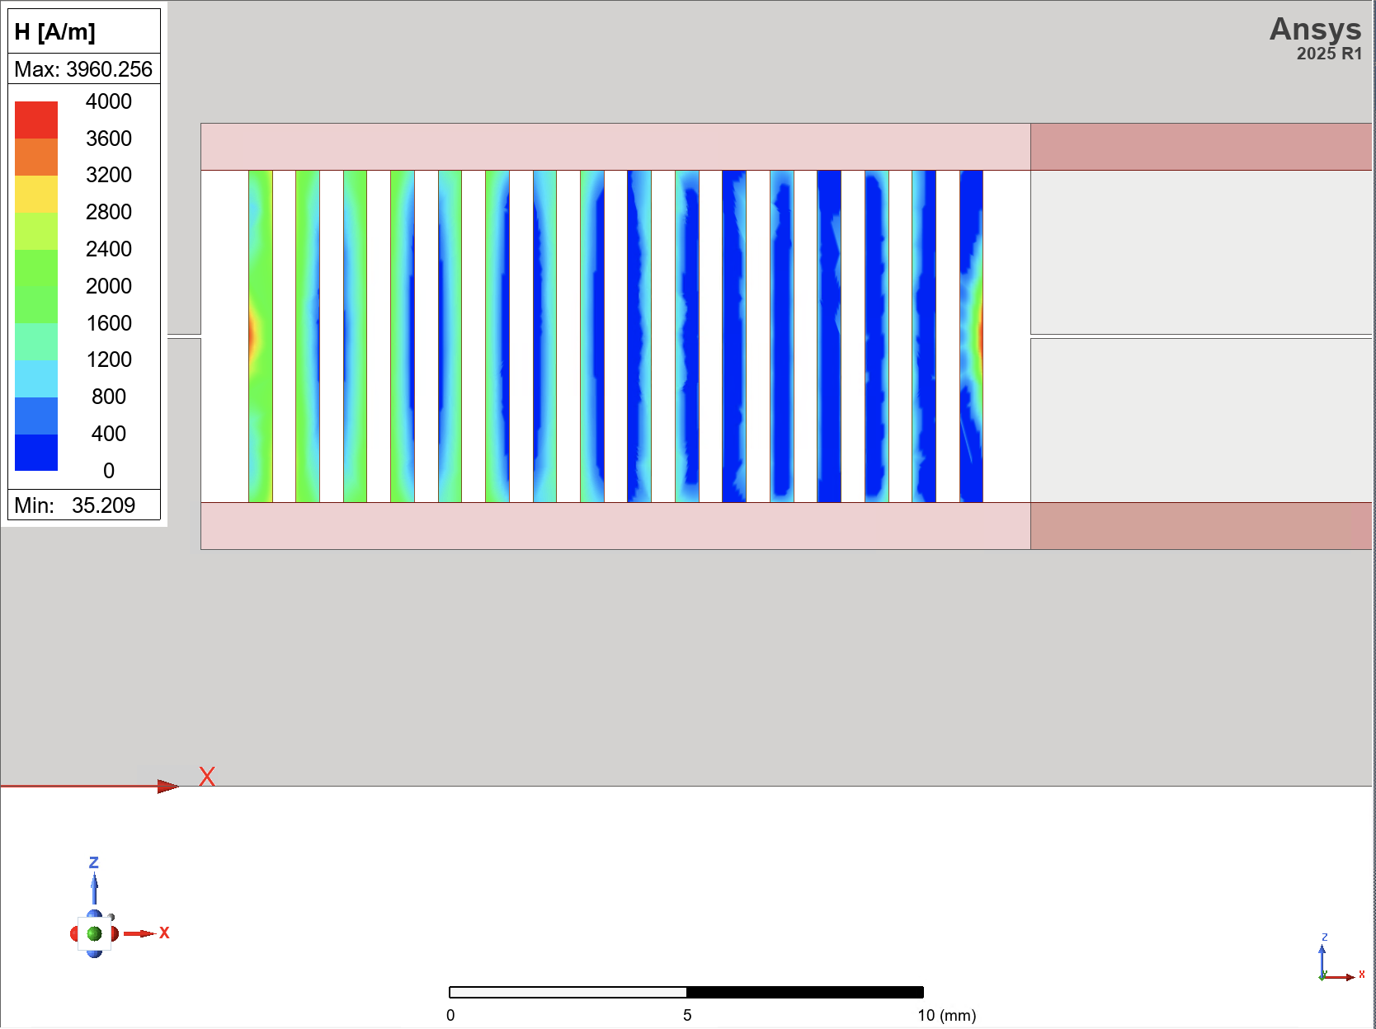
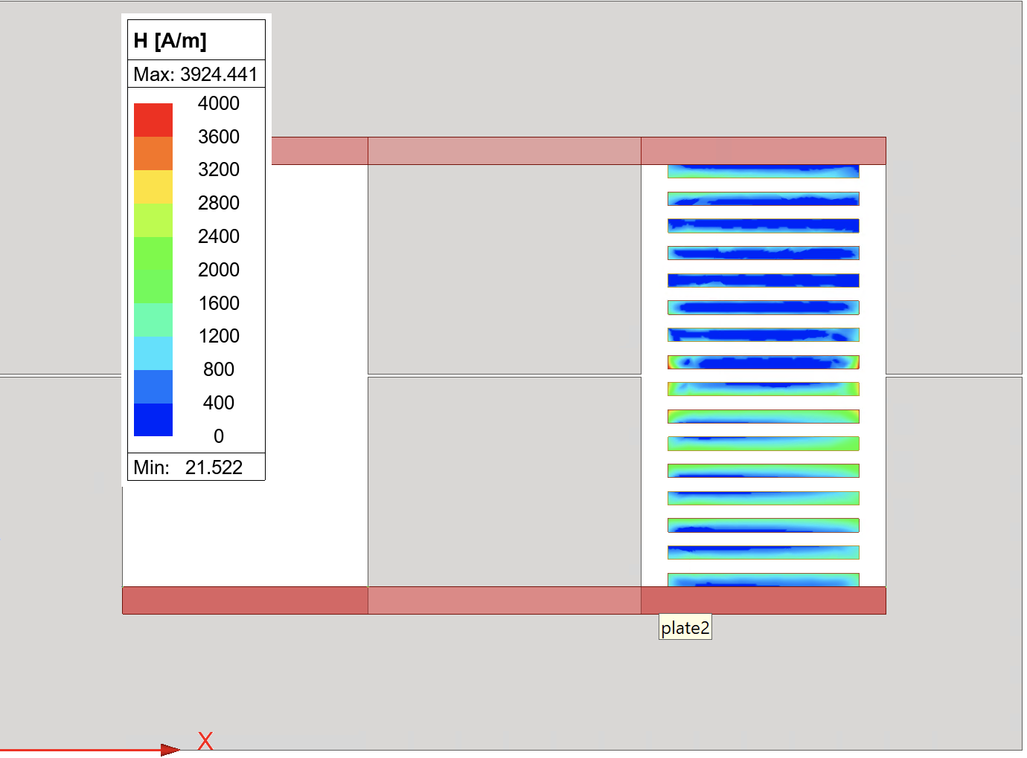

Slide 19
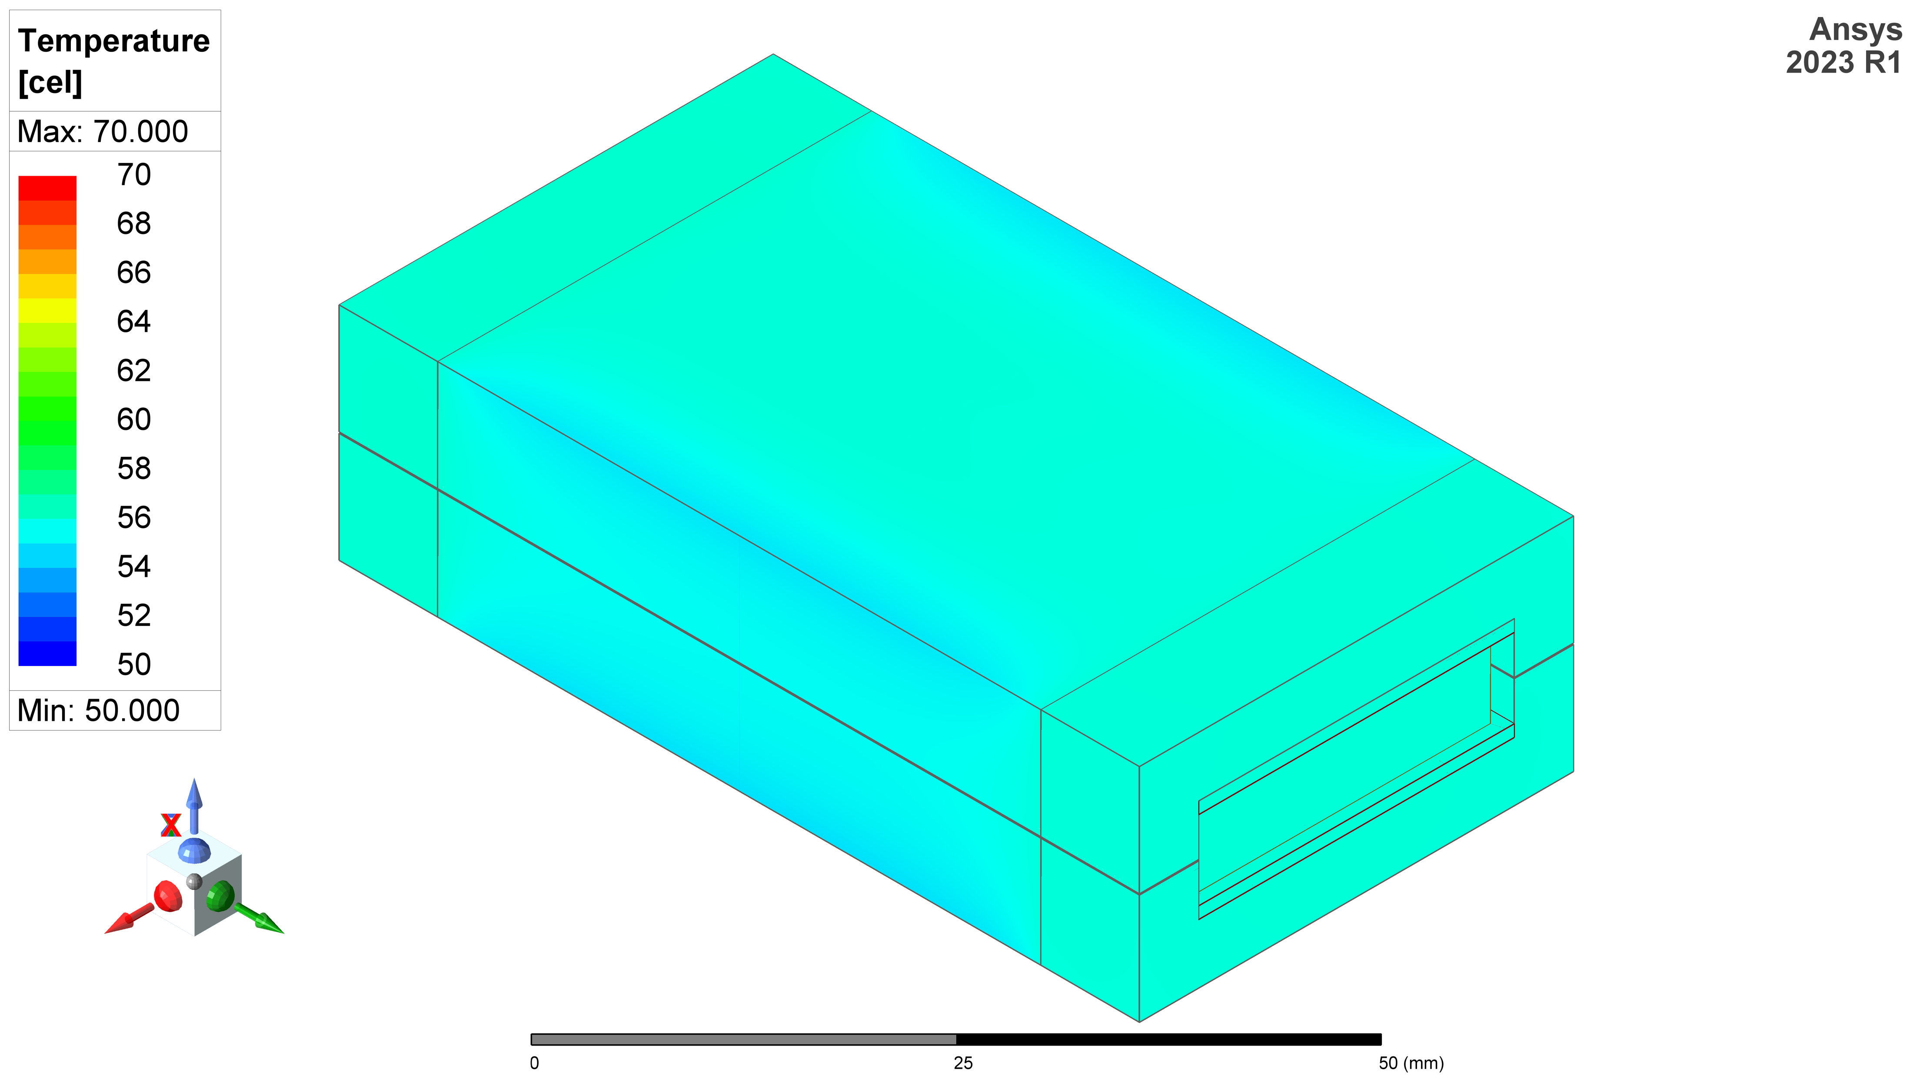
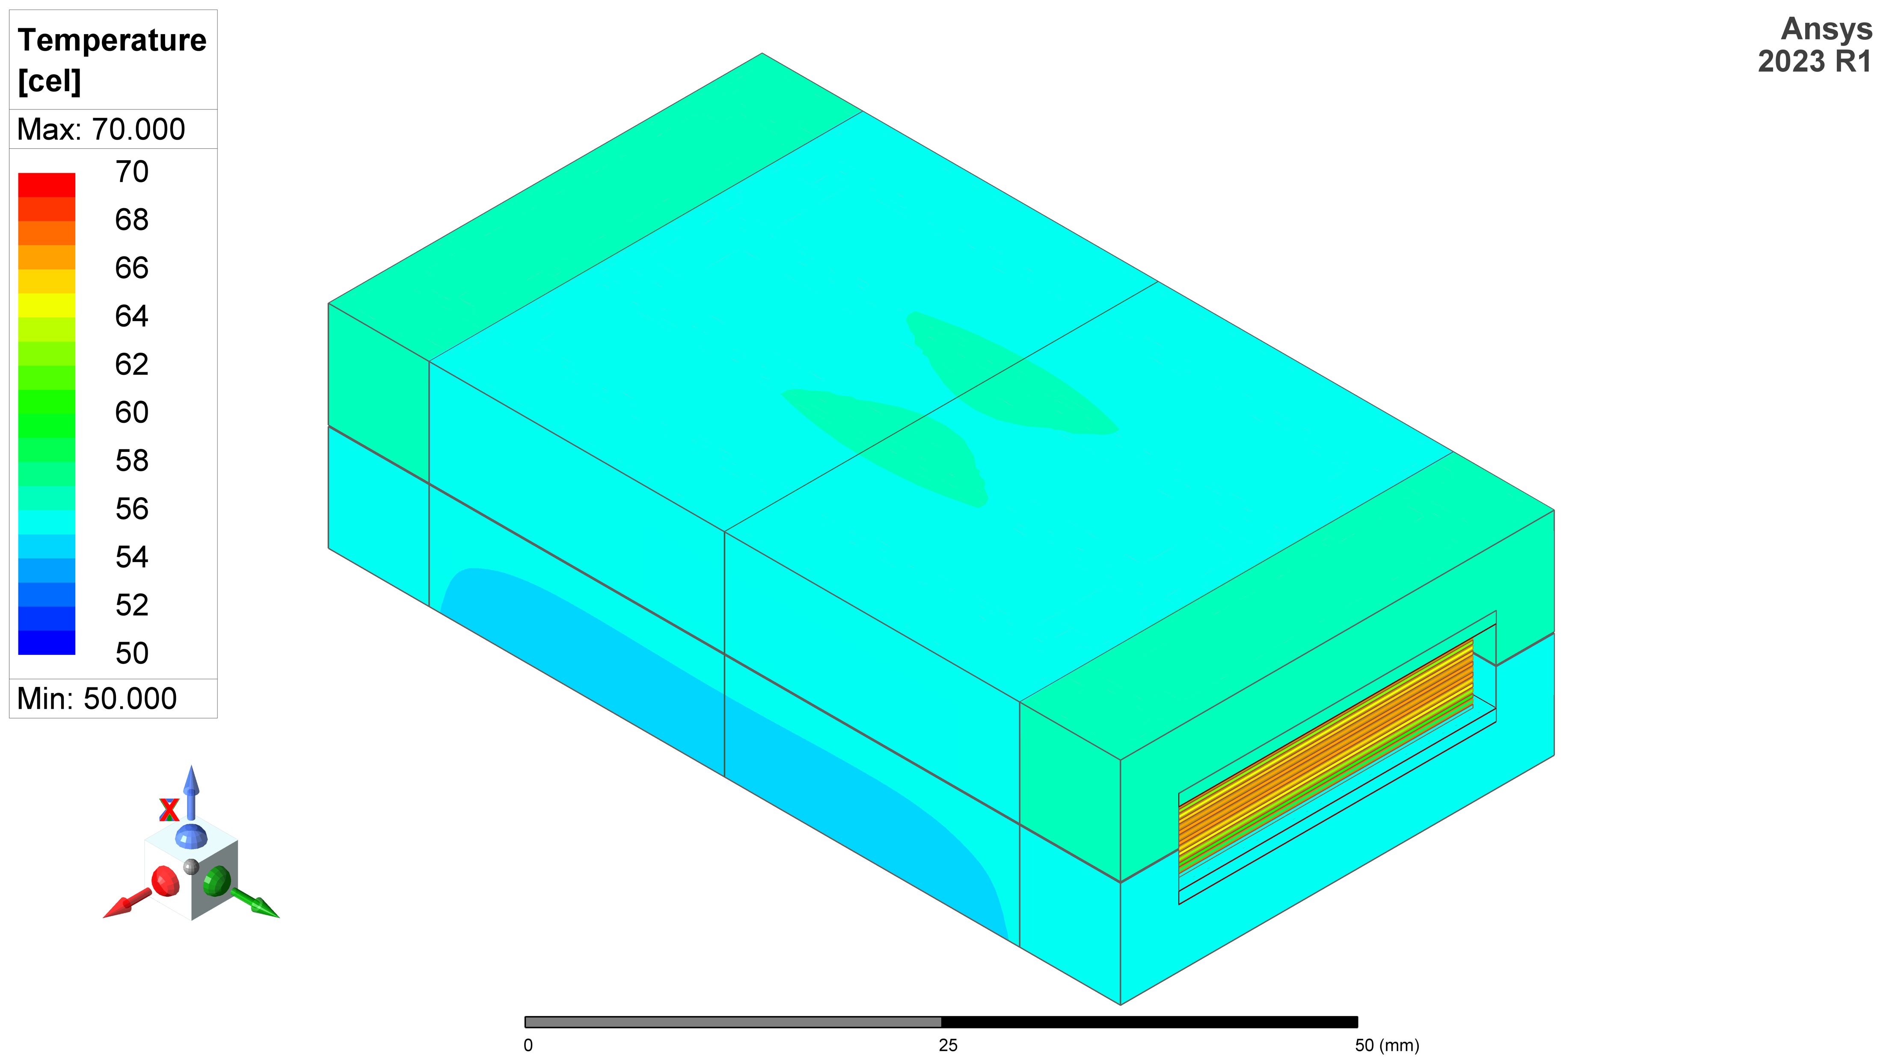
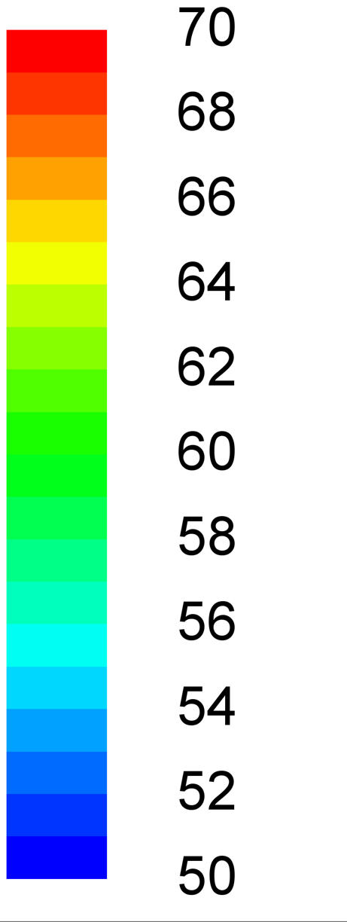

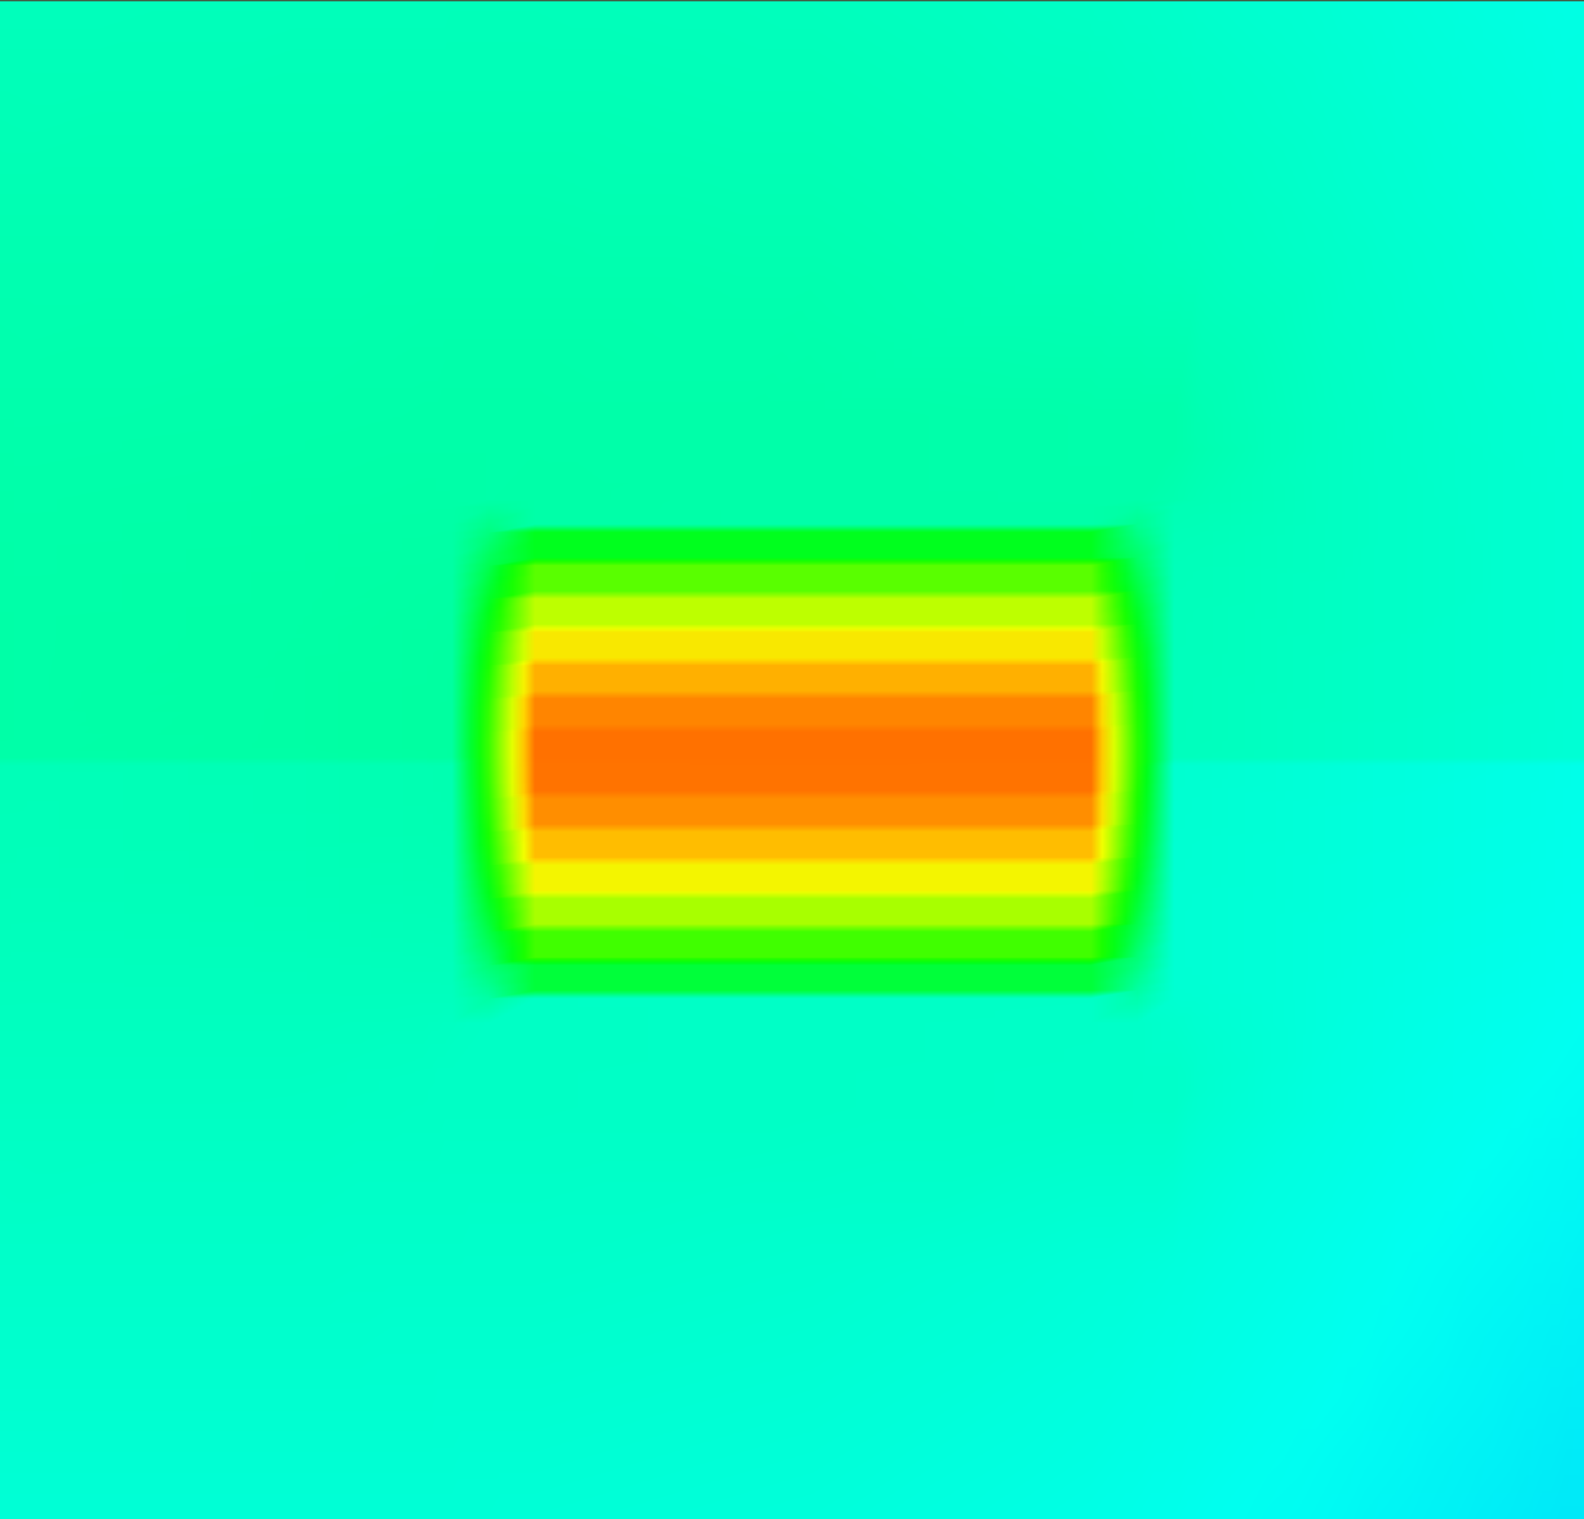
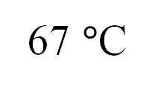
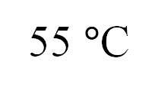
*ambient: 25 $°$C
Temp [$°$C]
55 $°$C
67 $°$C
Cross-section
Cross-section
Flatwise
Edgewise

Slide 20
*ambient: 25 $°$C
Temp [$°$C]
55 $°$C
67 $°$C
Cross-section
Cross-section
Flatwise
Edgewise

Slide 21
ICMASS
Edgewise
Flatwise
Thermal Conduction
TIM
Figure 1 Rectangular Winding Configurations for Transformers
Edgewise Windings
Flatwise Windings
Edgewise Windings
Corner View
Corner View

Slide 22



Edgewise-wound Transformer
(conventional)
巻線
熱
Edgewise
(conventional)
中
高熱抵抗
57 $°$C
*ambient: 25 $°$C
コア
Temp [$°$C]
外
Cross-section
Flatwise-wound Transformer (proposed)
Flatwise (proposed)
巻線
中
熱
47 $°$C
低熱抵抗
コア
外
Cross-section

Slide 23
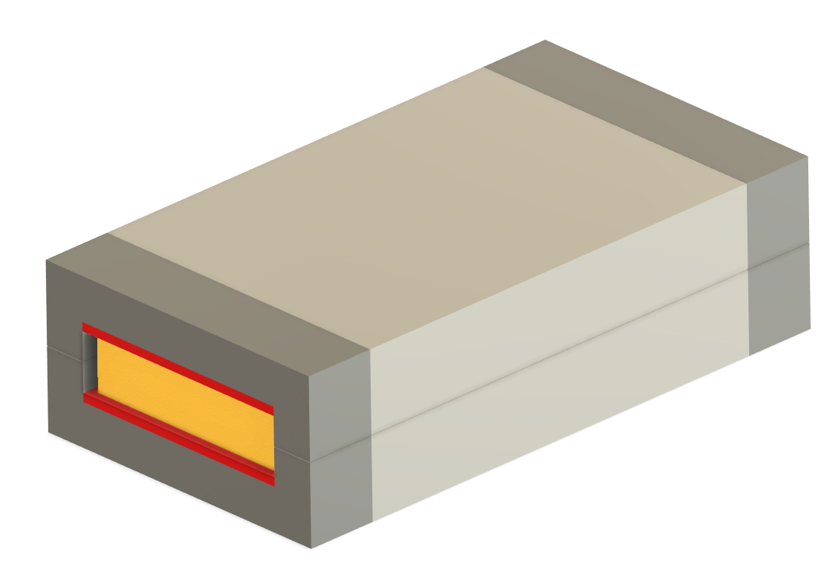
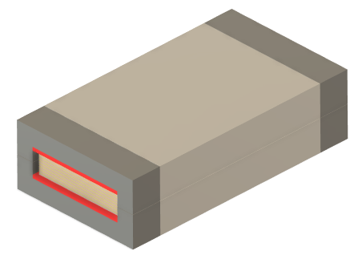

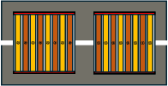
Edgewise-wound Transformer
Flatwise-wound Transformer (proposed)
2
2
1
1
5
5
4
3
3
Trans. Cross Section
Trans. Cross Section
1
Magnetic EE Core
3
Transformer Winding
5
Terminal Allocation
2
Aluminum at exposed ends (dead space)
4
TIM (Silicon-based, soft)

Slide 24
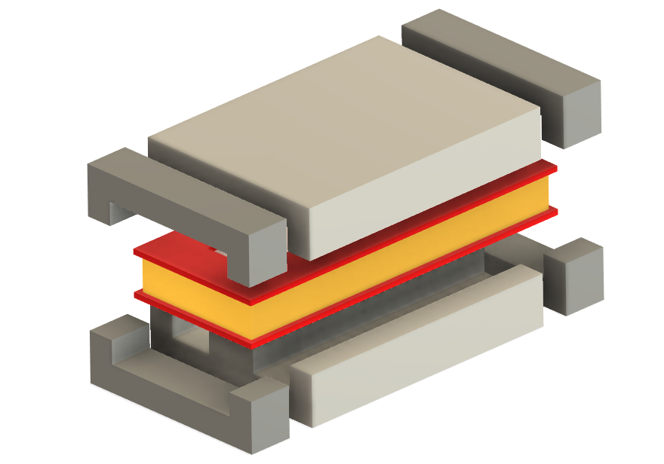
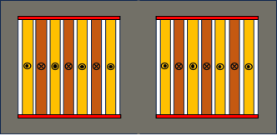
Flatwise-wound Transformer (proposed)
2
1
5
3
4
Trans. Cross Section
1
Magnetic EE Core
3
Transformer Winding
5
Terminal Allocation
2
Aluminum at exposed ends (dead space)
4
TIM (Silicon-based, soft)

Slide 25
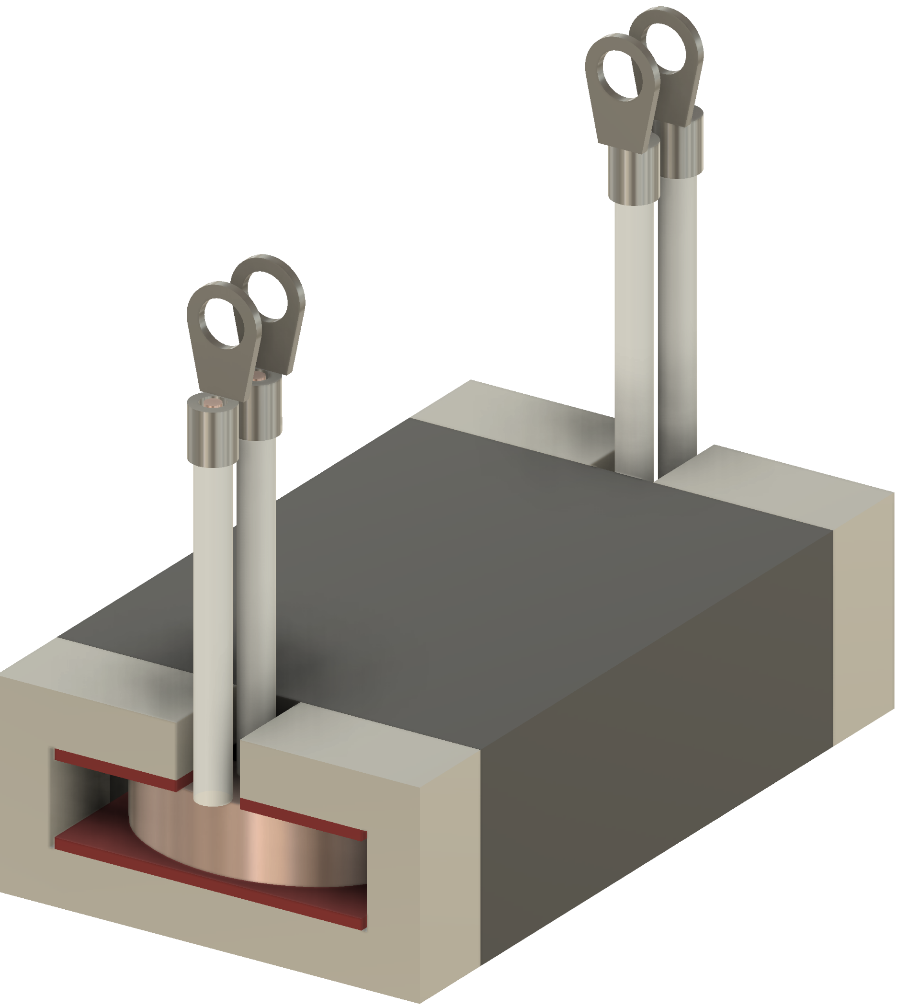
3
4
Trans. Cross Section
1
Magnetic EE Core
3
Transformer Winding
5
Terminal Allocation
2
Aluminum at exposed ends (dead space)
4
TIM (Silicon-based, soft)

Slide 26
R_{core}
R_{core}
R_{TIM}
R_{Np1}
R_{Np1}
R_{ins}
R_{Ns2}
R_{Ns2}
R_{ins}
R_{ins}
R_{Npn}
R_{Npn}
R_{ins}
R_{Nsn}
R_{Nsn}
R_{TIM}
R_{core}
R_{core}
P_{Core}
P_{Np1}
P_{Ns1}
P_{Npn}
P_{Nsn}
P_{Core}
R_{rad}
R_{conv}
R_{conv}
R_{rad}
T_{amb}
T_{amb}
Edgewise-wound Transformer
inside
High R_{TH}
ambient
Flatwise-wound Transformer
inside
Low R_{TH}
ambient
P_{Nsn}
R_{Nsn}
R_{Nsn}
R_{ins}
P_{Npn}
R_{core}
R_{core}
R_{TIM}
R_{TIM}
R_{core}
R_{core}
R_{Npn}
R_{Npn}
R_{Ns2}
R_{Ns1}
P_{core}
P_{Ns1}
P_{core}
R_{rad}
R_{conv}
R_{ins}
R_{conv}
R_{rad}
R_{Np1}
R_{Np1}
T_{amb}
T_{amb}
P_{Np1}

Slide 27
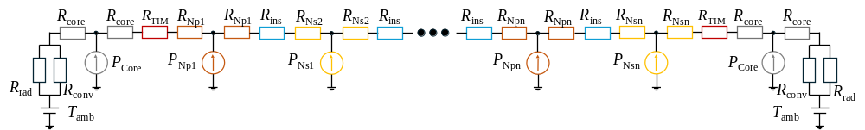
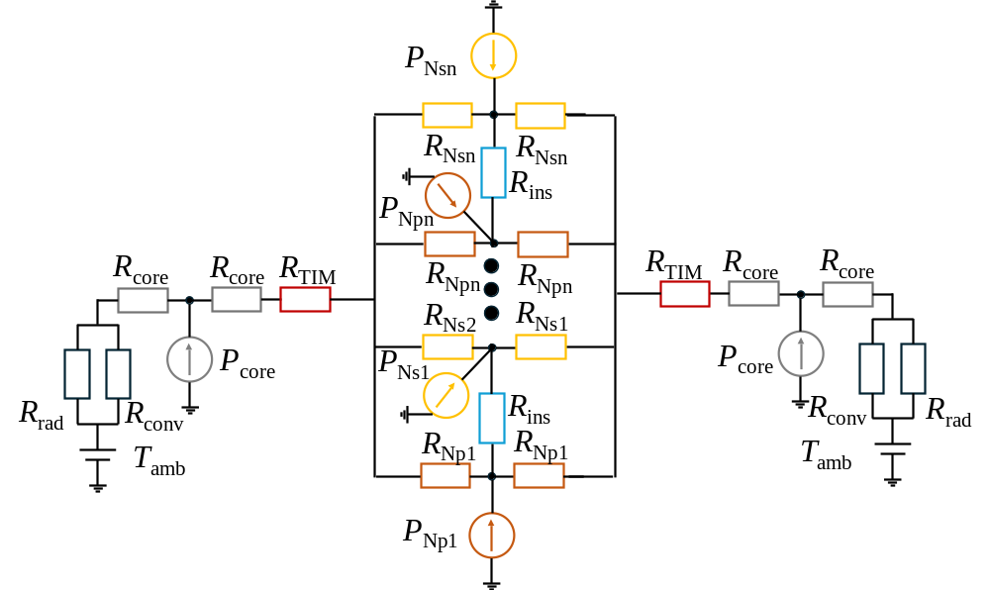
P_{Nsn}
R_{Nsn}
R_{Nsn}
R_{core}
R_{core}
R_{TIM}
R_{Np1}
R_{Np1}
R_{ins}
R_{Ns2}
R_{Ns2}
R_{ins}
R_{ins}
R_{Npn}
R_{Npn}
R_{ins}
R_{Nsn}
R_{Nsn}
R_{TIM}
R_{core}
R_{core}
R_{ins}
P_{Npn}
inside
P_{Core}
P_{Np1}
P_{Ns1}
P_{Npn}
P_{Nsn}
P_{Core}
R_{core}
R_{core}
R_{TIM}
R_{TIM}
R_{core}
R_{core}
High R_{TH}
R_{Npn}
R_{Npn}
R_{rad}
R_{conv}
R_{conv}
R_{rad}
R_{Ns2}
R_{Ns1}
ambient
T_{amb}
T_{amb}
P_{core}
P_{Ns1}
P_{core}
R_{rad}
R_{conv}
R_{ins}
R_{conv}
R_{rad}
R_{Np1}
R_{Np1}
T_{amb}
T_{amb}
inside
P_{Np1}
Low R_{TH}
ambient

Slide 28
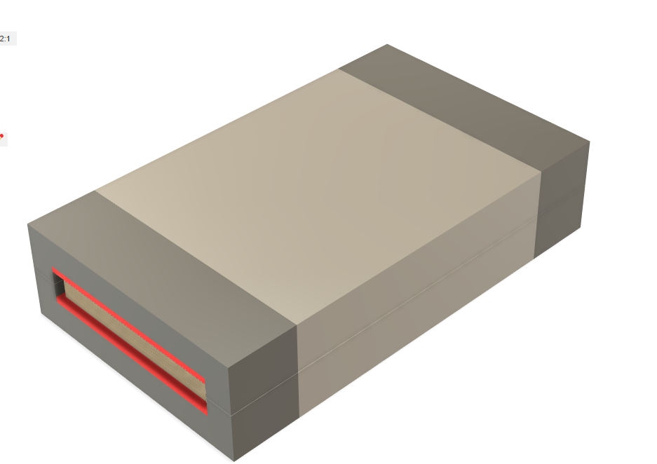
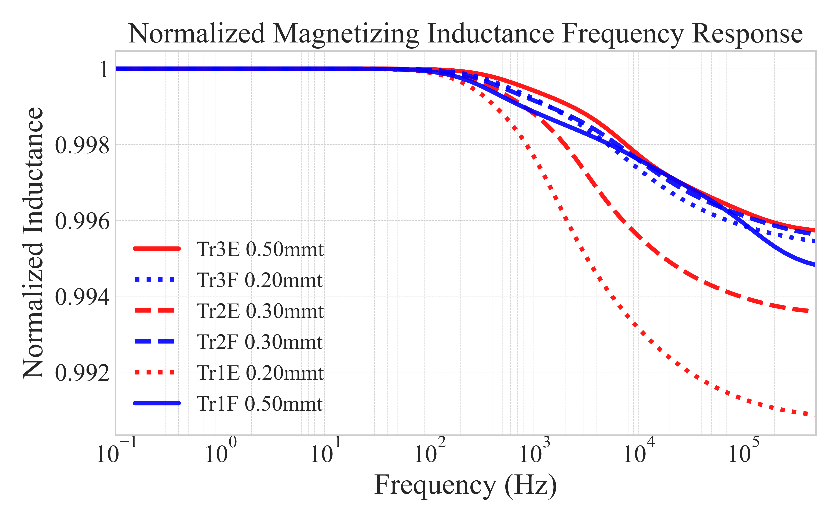
Edgewise-wound Transformer
l_{trans}
(w_{win} )
h_{trans}
w_{trans}
0.10 mm
(l_{win} )
(d_{inter} )
1.00 mm
(h_{wire} )
(d_{TIM} )
(w_{wire} )
1.00 mm
(d_{clear} )
Flatwise-wound Transformer (proposed)
l_{trans}
(w_{win} )
h_{trans}
w_{trans}
(l_{win} )
(w_{wire} )
1.00 mm
(h_{wire} )
(d_{TIM} )
1.00 mm
0.10 mm
(d_{clear} )
(d_{inter} )

Slide 29
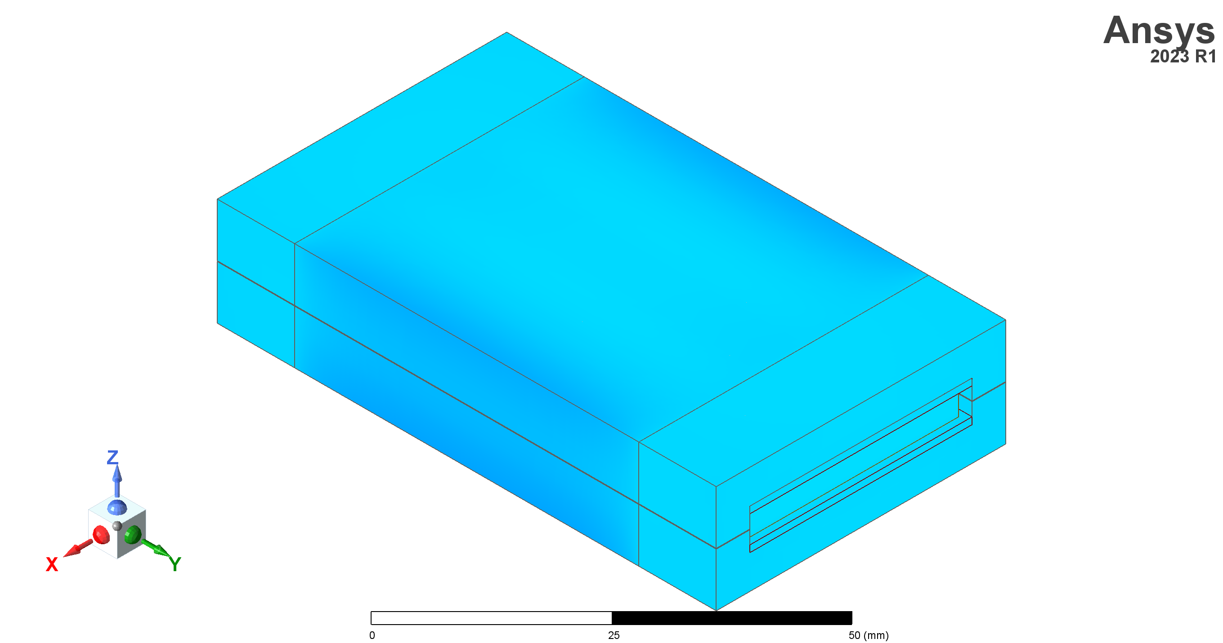
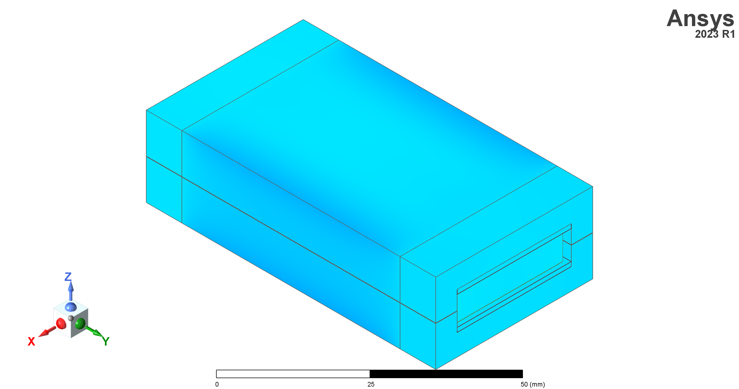
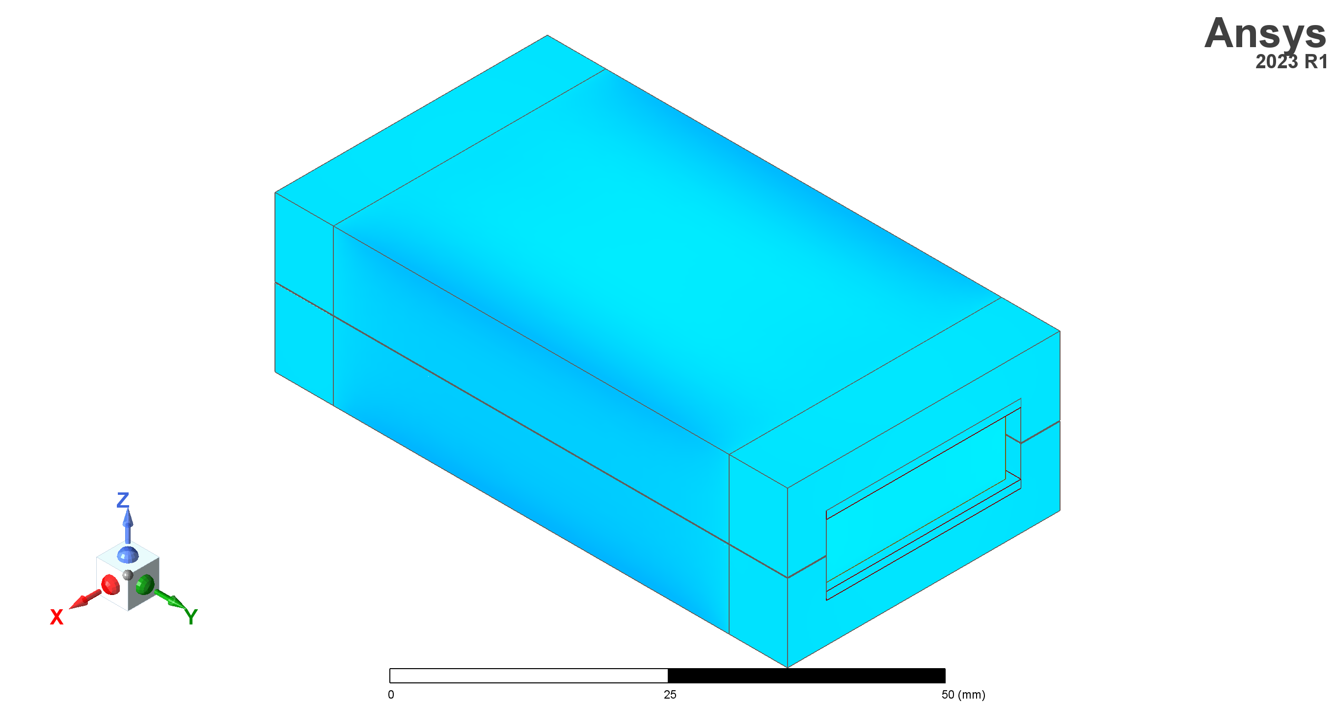
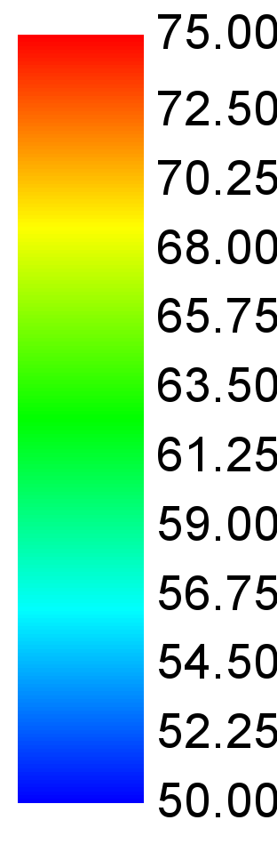
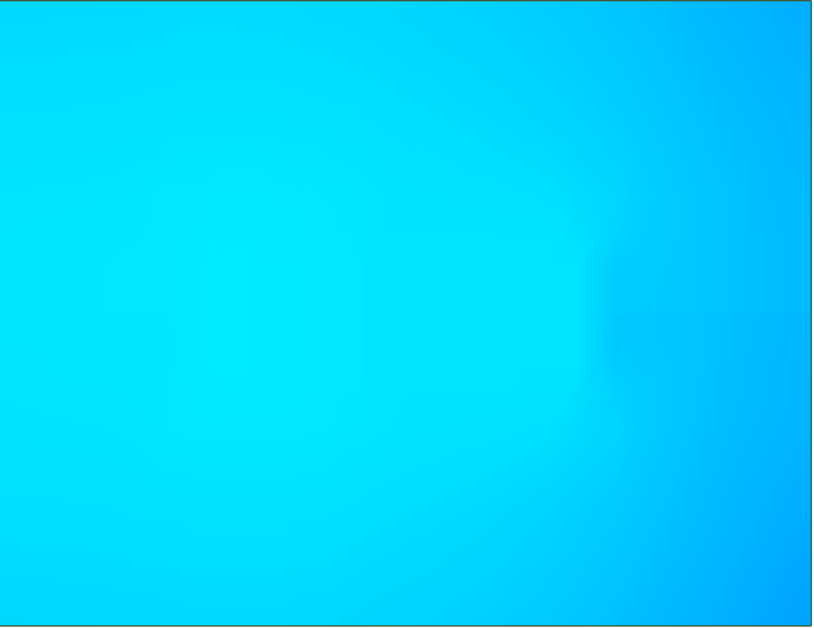
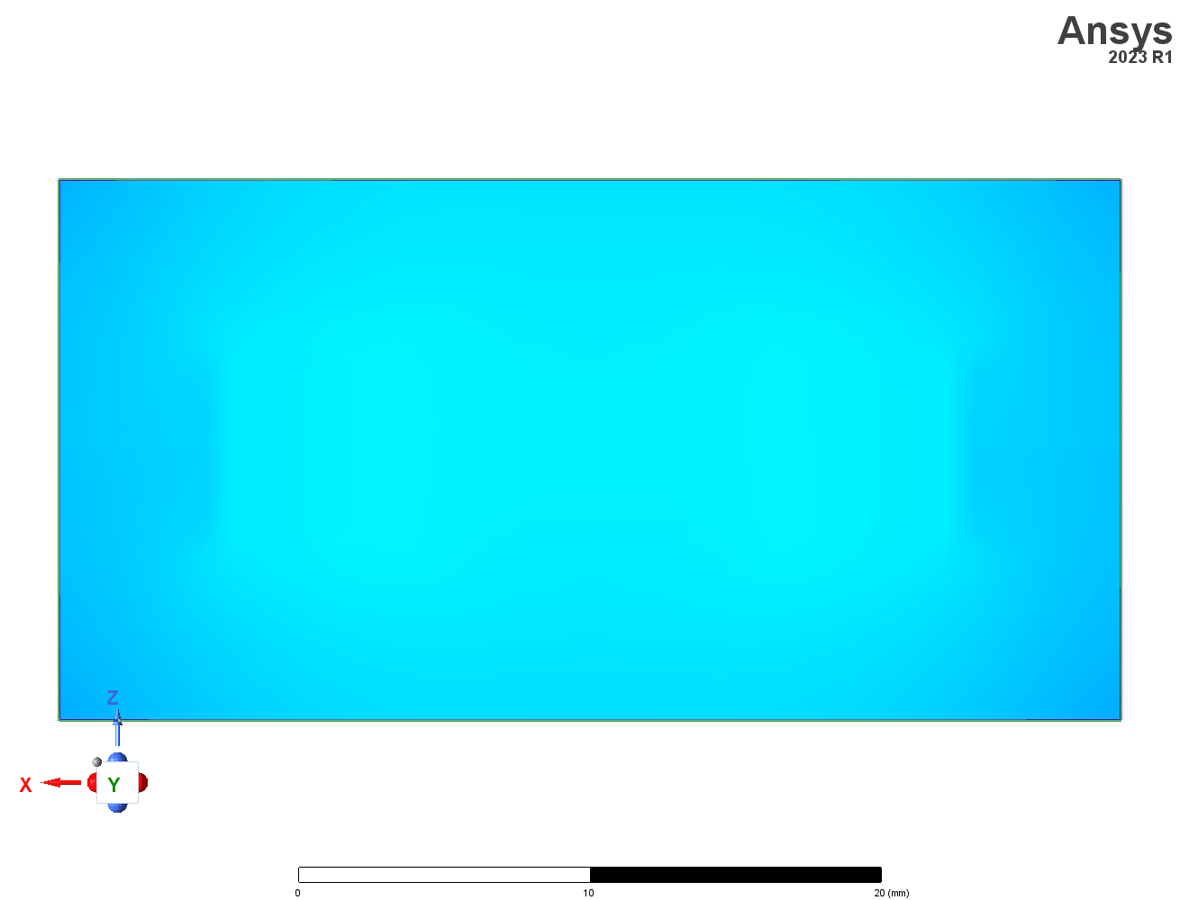
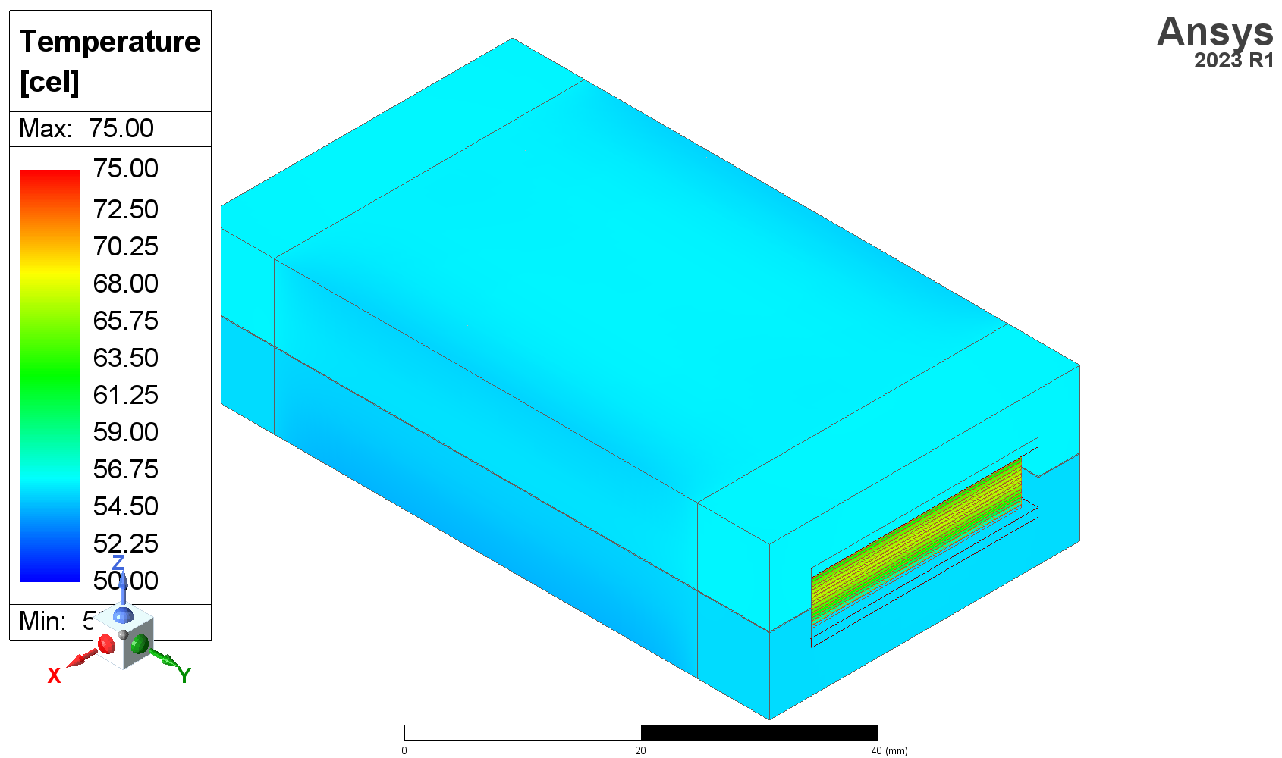
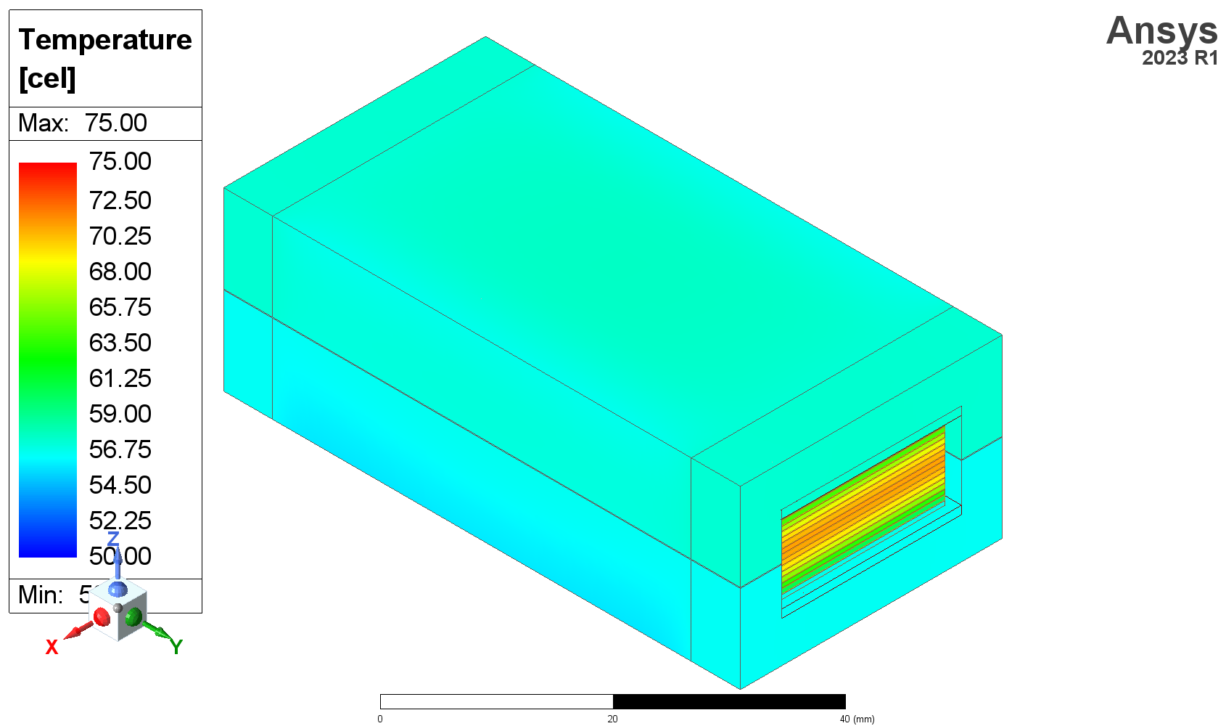
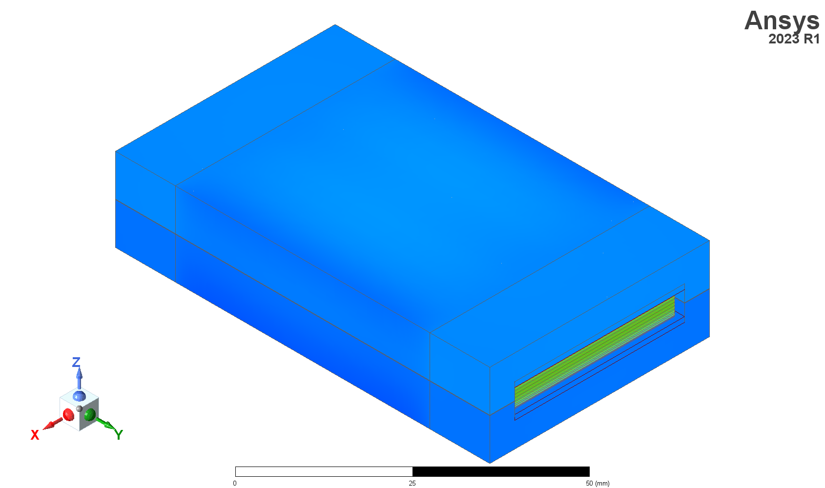
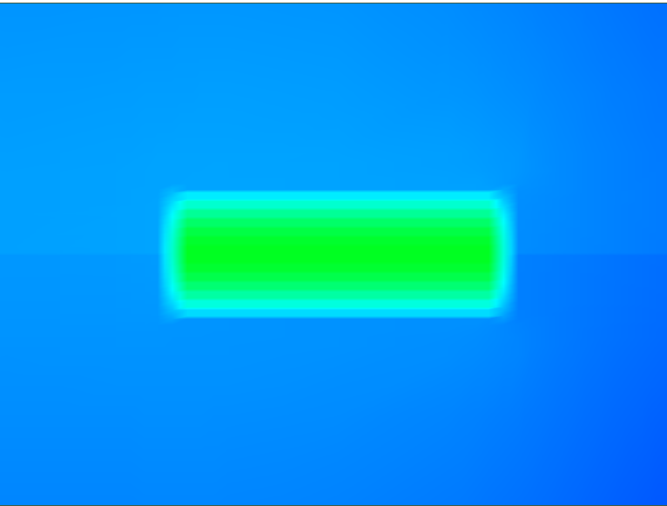
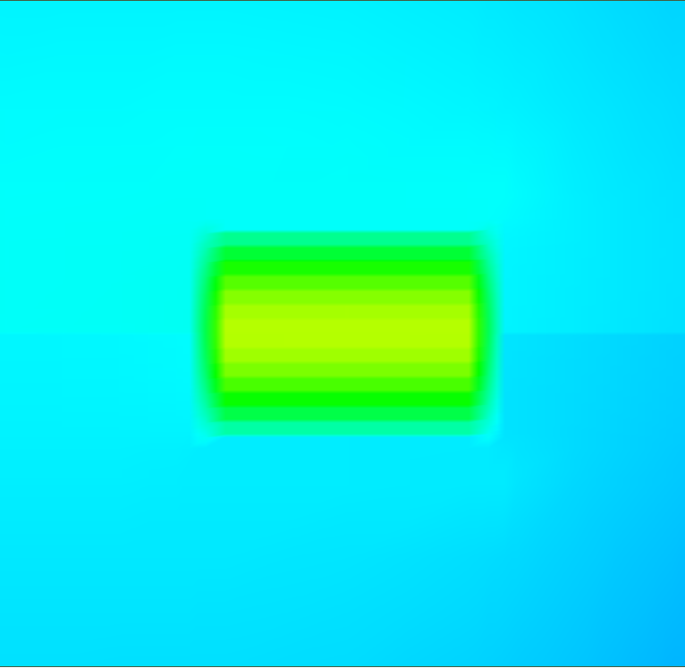
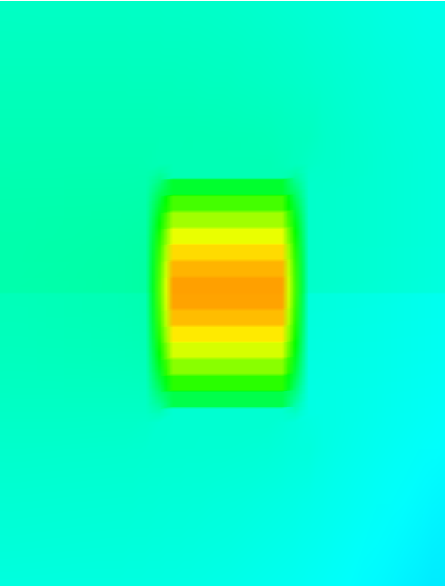
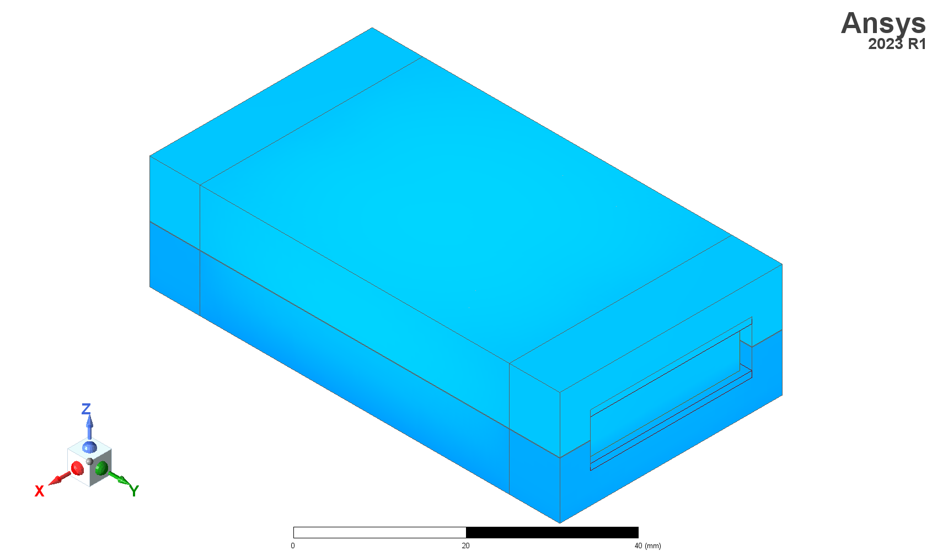

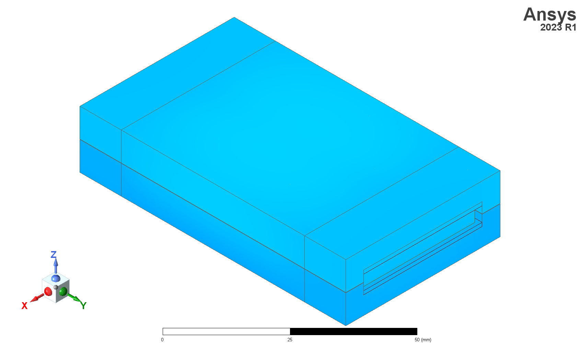
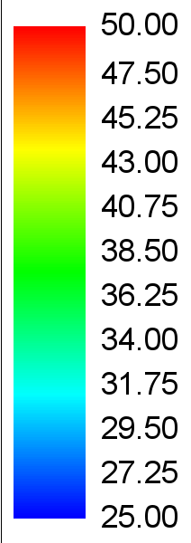
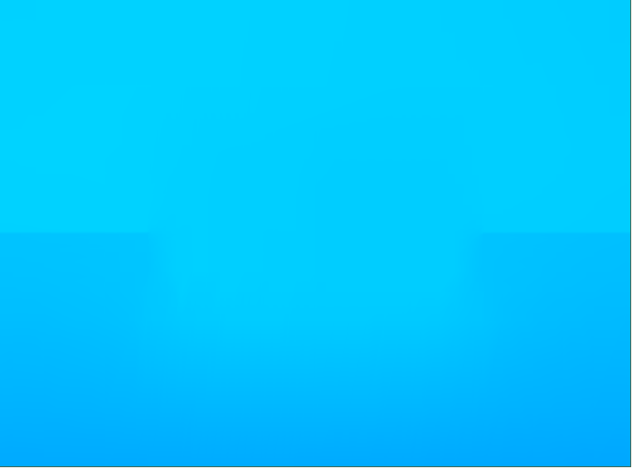
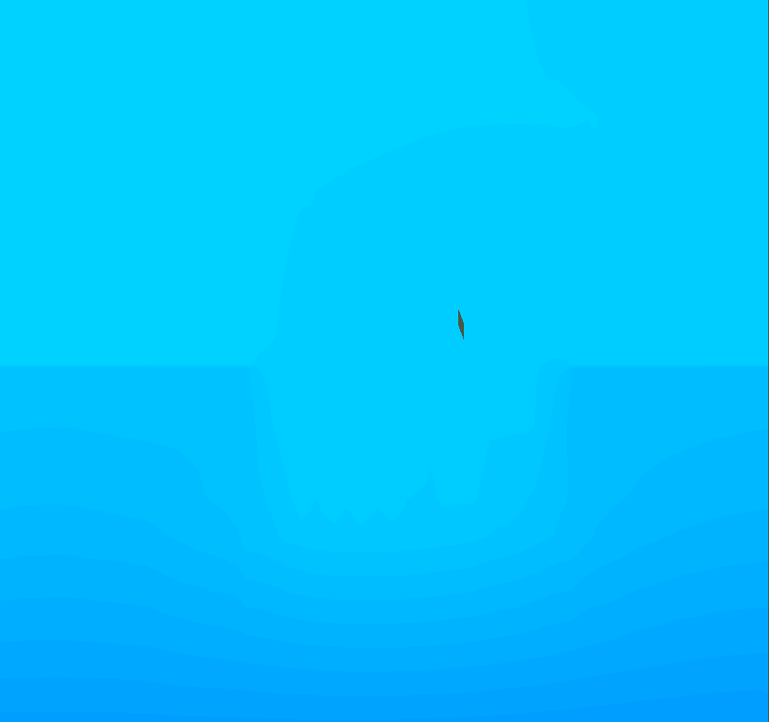
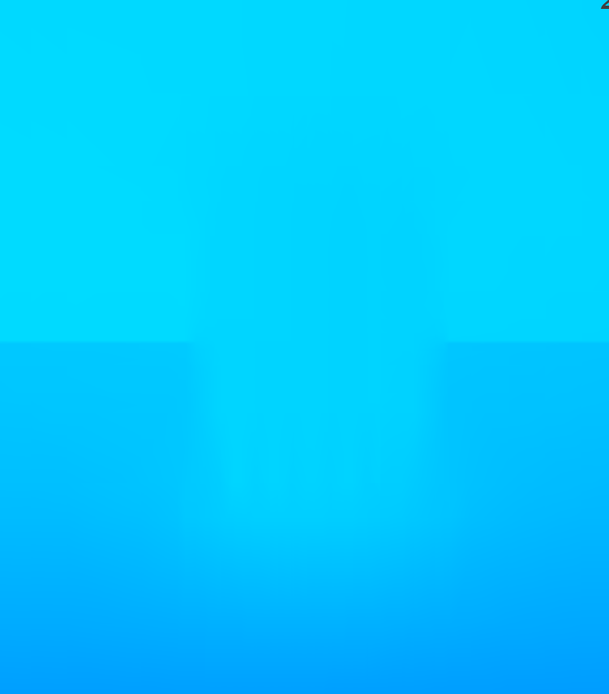
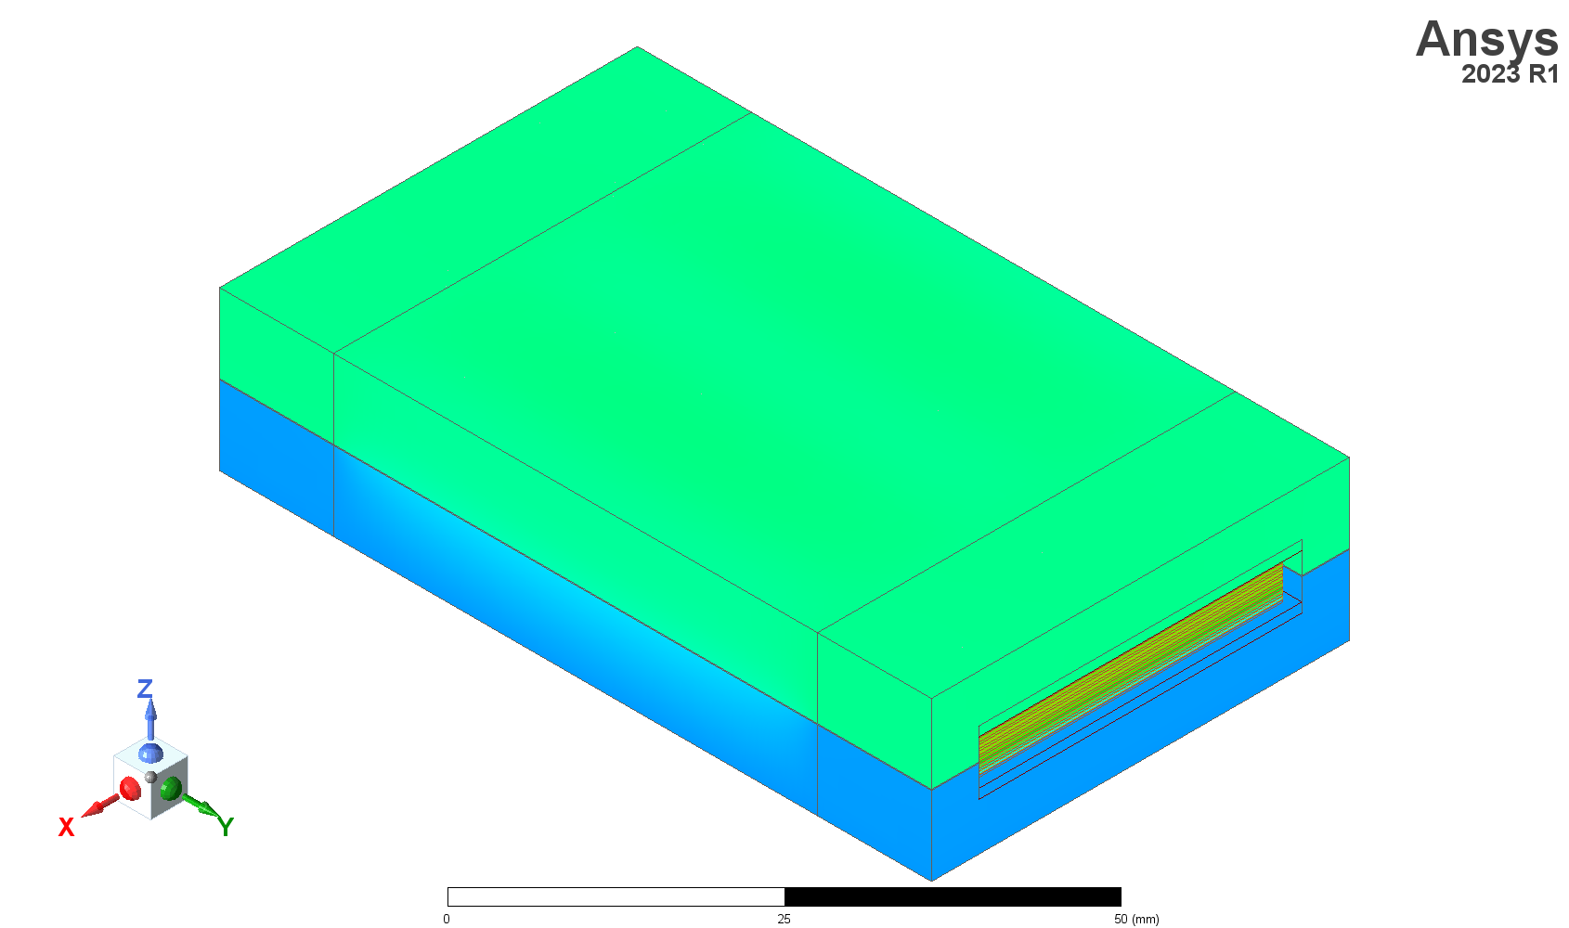
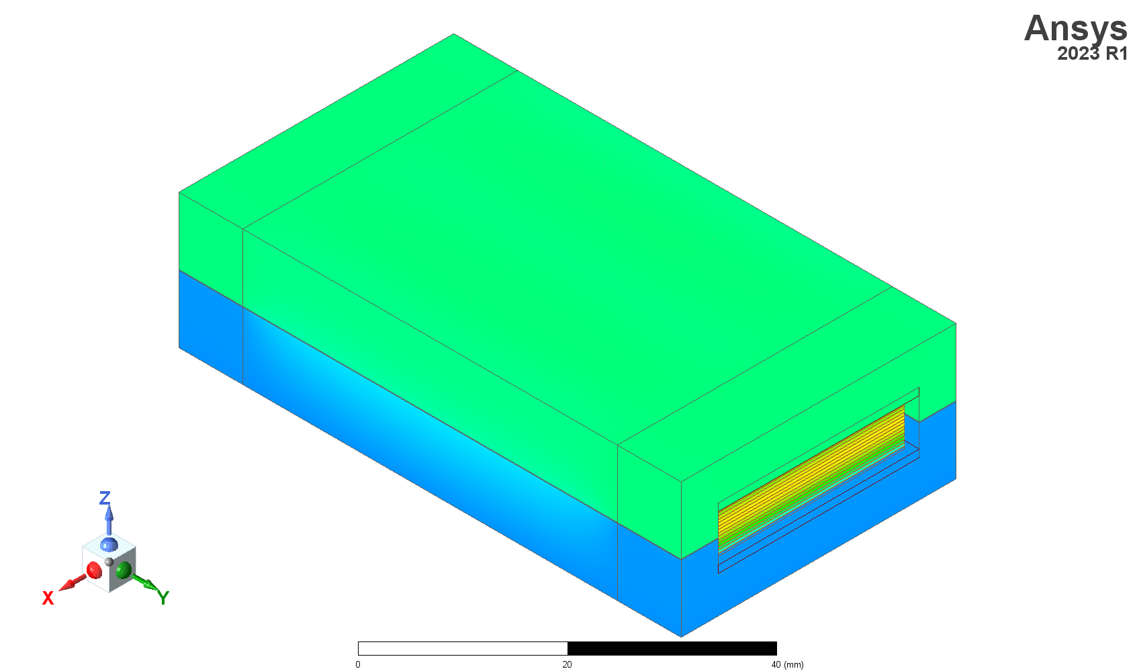
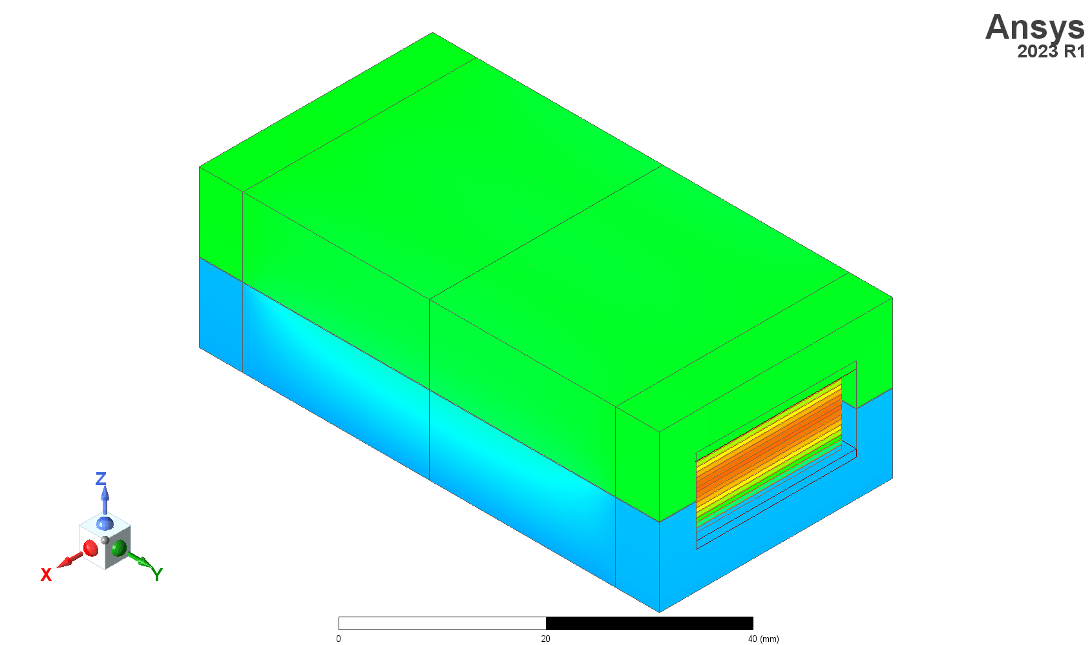
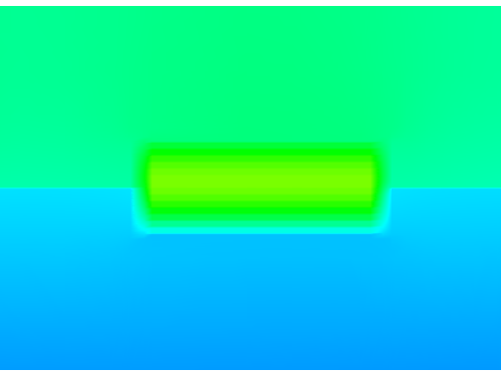
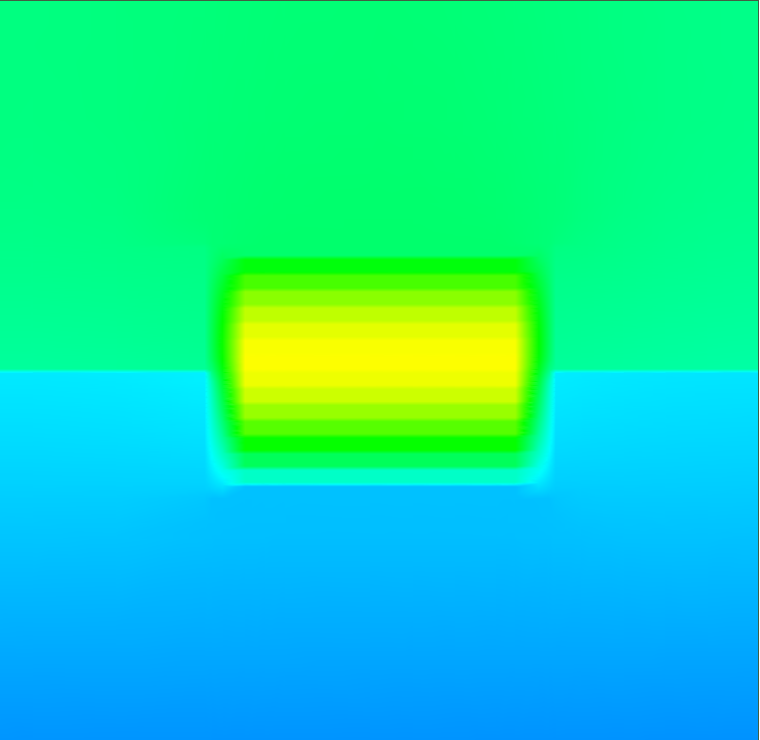

















Flatwise
Temp [$°$C]
56.1 $°$C
56.0 $°$C
55.8 $°$C
Cross-section
Cross-section
Cross-section
Tr1F
Tr2F
Tr3F
(a)
Edgewise
61.6 $°$C
66.9 $°$C
70.9 $°$C
Cross-section
Cross-section
Cross-section
*ambient: 25 $°$C
Tr1E
Tr2E
Tr3E
(b)
Flatwise
Temp [$°$C]
30.4 $°$C
30.2 $°$C
30.2 $°$C
Cross-section
Cross-section
Cross-section
Tr1F
Tr2F
Tr3F
(c)
Edgewise
40.5 $°$C
43.6 $°$C
47.3 $°$C
Cross-section
Cross-section
Cross-section
*ambient: 25 $°$C
Tr1E
Tr2E
Tr3E
(d)

Slide 30


Temp [$°$C]
56.0 $°$C
66.9 $°$C
Cross-section
Cross-section
*ambient: 25 $°$C
Flatwise
Temp [$°$C]
30.4 $°$C
30.2 $°$C
30.2 $°$C
Cross-section
Cross-section
Cross-section
Tr1F
Tr2F
Tr3F
(c)
Edgewise
40.5 $°$C
43.6 $°$C
47.3 $°$C
Cross-section
Cross-section
Cross-section
*ambient: 25 $°$C
Tr1E
Tr2E
Tr3E
(d)

Slide 31


Temp [$°$C]
30.2 $°$C
43.6 $°$C
Cross-section
Cross-section
*ambient: 25 $°$C
Flatwise
Temp [$°$C]
30.4 $°$C
30.2 $°$C
30.2 $°$C
Cross-section
Cross-section
Cross-section
Tr1F
Tr2F
Tr3F
(c)
Edgewise
40.5 $°$C
43.6 $°$C
47.3 $°$C
Cross-section
Cross-section
Cross-section
*ambient: 25 $°$C
Tr1E
Tr2E
Tr3E
(d)

Slide 32




Temp [$°$C]
56.0 $°$C
66.9 $°$C
Cross-section
Cross-section
*ambient: 25 $°$C
Flatwise
Temp [$°$C]
30.4 $°$C
30.2 $°$C
30.2 $°$C
Cross-section
Cross-section
Cross-section
Tr1F
Tr2F
Tr3F
(c)
Edgewise
40.5 $°$C
43.6 $°$C
47.3 $°$C
Cross-section
Cross-section
Cross-section
*ambient: 25 $°$C
Tr1E
Tr2E
Tr3E
(d)

Slide 33

Temp [$°$C]
30.2 $°$C
43.6 $°$C
Cross-section
Cross-section
*ambient: 25 $°$C
Flatwise
Temp [$°$C]
30.4 $°$C
30.2 $°$C
30.2 $°$C
Cross-section
Cross-section
Cross-section
Tr1F
Tr2F
Tr3F
(c)
Edgewise
40.5 $°$C
43.6 $°$C
47.3 $°$C
Cross-section
Cross-section
Cross-section
*ambient: 25 $°$C
Tr1E
Tr2E
Tr3E
(d)

Slide 34
Decision of Circuit Parameters
Select Winding Strategy and set transformer constraints
Choose transformer geometry and winding geometry
Losses Balanced?
Aspect Ratio Acceptable?
Thermal simulation of transformer
Calculate winding and core losses
Meets all requirements (thermal, ZVS operational)?
Simulation of parasitic components (capacitance and leakage inductance)

Slide 35
Decision of Circuit Parameters
Selection of winding strategy and transformer constraints
Selection of transformer and winding geometry
N
Losses balanced?
Aspect ratio acceptable?
Y
Y
N
Calculation of winding and core losses
Meets requirements?
(thermal, ZVS operational)
N
Thermo-magnetic simulation of transformer
Simulation of parasitic components (capacitance and leakage inductance)
Y
Transformer design is acceptable

Slide 36
Decision of Circuit Parameters
Selection of winding strategy and transformer constraints
Selection of transformer and winding geometry
N
Losses balanced?
Aspect ratio acceptable?
Y
Y
N
Calculation of winding and core losses
Meets requirements?
(thermal, ZVS operational)
N
Thermo-magnetic simulation of transformer
Simulation of parasitic components (capacitance and leakage inductance)
Y
Transformer design is acceptable

Slide 38
Winding Start
Winding End
P1
P2
S1
S2
P1
S1
S2
P2
P1
S1
P2
S2
tight bends
(a)
(b)
(c)

Slide 39

Transformer Terminals
Aluminum at exposed ends (dead space)
EE Core
Transformer Windings
Primary
Secondary
TIM (Silicon-based, soft)

Slide 40



Transformer Terminals
Aluminum at exposed ends (dead space)
EE Core
Transformer Windings
Primary
Secondary
TIM (Silicon-based, soft)

Slide 41

Transformer Terminals
Aluminum at exposed ends (dead space)
EE Core
Transformer Windings
Primary
Secondary
TIM (Silicon-based, soft)

Slide 42
Transformer Terminals
Transformer Windings
Aluminum at exposed ends (dead space)
EE Core
Primary
Secondary
TIM (Silicon-based, soft)

Slide 43
Transformer Terminals
Transformer Windings
Aluminum at exposed ends (dead space)
EE Core
Primary
Secondary
TIM (Silicon-based, soft)

Slide 44
Transformer Terminals
Aluminum at exposed ends (dead space)
EE Core
Transformer Windings
Primary
Secondary
TIM (Silicon-based, soft)

Slide 45
Spatial
Winding
Thermal Conduction
TIM
Heat
Aluminum
Planar (proposed)
Core
TIM
Coolant
Trans. Side View
Dead space heat extraction
Heat
More contact from heat source will lead to more effective extraction.
Wide cooling area

Slide 46
inside
Low R_{TH}
inside
ambient
High R_{TH}
ambient
R_{core}
R_{core}
R_{TIM}
R_{Np1}
R_{Np1}
R_{ins}
R_{Ns2}
R_{Ns2}
R_{ins}
P_{Nsn}
P_{Core}
P_{Np1}
P_{Ns1}
R_{Nsn}
R_{Nsn}
R_{ins}
R_{rad}
R_{conv}
P_{Npn}
T_{amb}
R_{core}
R_{core}
R_{TIM}
R_{TIM}
R_{core}
R_{core}
R_{Npn}
R_{Npn}
R_{core}
R_{core}
R_{TIM}
R_{Nsn}
R_{Nsn}
R_{ins}
R_{Npn}
R_{Npn}
R_{ins}
R_{Ns2}
R_{Ns1}
P_{core}
P_{Ns1}
P_{core}
P_{Core}
P_{Nsn}
P_{Npn}
R_{rad}
R_{conv}
R_{ins}
R_{conv}
R_{rad}
R_{Np1}
R_{Np1}
T_{amb}
R_{conv}
T_{amb}
R_{rad}
T_{amb}
P_{Np1}

Slide 47
inside
Low R_{TH}
inside
ambient
High R_{TH}
ambient
R_{core}
R_{core}
R_{TIM}
R_{Np1}
R_{Np1}
R_{ins}
R_{Ns2}
R_{Ns2}
R_{ins}
P_{Nsn}
P_{Core}
P_{Np1}
P_{Ns1}
R_{Nsn}
R_{Nsn}
R_{ins}
R_{rad}
R_{conv}
P_{Npn}
T_{amb}
R_{core}
R_{core}
R_{TIM}
R_{TIM}
R_{core}
R_{core}
R_{Npn}
R_{Npn}
R_{core}
R_{core}
R_{TIM}
R_{Nsn}
R_{Nsn}
R_{ins}
R_{Npn}
R_{Npn}
R_{ins}
R_{Ns2}
R_{Ns1}
P_{core}
P_{Ns1}
P_{core}
P_{Core}
P_{Nsn}
P_{Npn}
R_{rad}
R_{conv}
R_{ins}
R_{conv}
R_{rad}
R_{Np1}
R_{Np1}
T_{amb}
R_{conv}
T_{amb}
R_{rad}
T_{amb}
P_{Np1}

Slide 48
inside
Low R_{TH}
inside
ambient
High R_{TH}
ambient
P_{Nsn}
R_{core}
R_{core}
R_{TIM}
R_{Np1}
R_{Np1}
R_{ins}
R_{Ns1}
R_{Ns1}
R_{ins}
R_{Nsn}
R_{Nsn}
P_{Np1}
P_{Ns1}
P_{Npn}
P_{Core}
R_{ins}
R_{rad}
R_{conv}
T_{amb}
R_{TIM}
R_{core}
R_{core}
R_{core}
R_{core}
R_{TIM}
R_{Npn}
R_{Npn}
R_{core}
R_{core}
R_{TIM}
R_{Nsn}
R_{Nsn}
R_{ins}
R_{Npn}
R_{Npn}
R_{ins}
R_{Ns1}
R_{Ns1}
P_{core}
P_{core}
P_{Core}
P_{Nsn}
P_{Npn}
R_{rad}
R_{conv}
R_{ins}
R_{rad}
R_{conv}
P_{Ns1}
T_{amb}
T_{amb}
R_{rad}
R_{conv}
T_{amb}
R_{Np1}
R_{Np1}
P_{Np1}

Slide 49
inside
Low R_{TH}
inside
ambient
High R_{TH}
ambient
P_{Nsn}
R_{core}
R_{core}
R_{TIM}
R_{Np1}
R_{Np1}
R_{ins}
R_{Ns1}
R_{Ns1}
R_{ins}
R_{Nsn}
R_{Nsn}
P_{Np1}
P_{Ns1}
P_{Npn}
P_{Core}
R_{ins}
R_{rad}
R_{conv}
T_{amb}
R_{TIM}
R_{core}
R_{core}
R_{core}
R_{core}
R_{TIM}
R_{Npn}
R_{Npn}
R_{core}
R_{core}
R_{TIM}
R_{Nsn}
R_{Nsn}
R_{ins}
R_{Npn}
R_{Npn}
R_{ins}
R_{Ns1}
R_{Ns1}
P_{core}
P_{core}
P_{Core}
P_{Nsn}
P_{Npn}
R_{rad}
R_{conv}
R_{ins}
R_{rad}
R_{conv}
P_{Ns1}
T_{amb}
T_{amb}
R_{rad}
R_{conv}
T_{amb}
R_{Np1}
R_{Np1}
P_{Np1}

Slide 50
P_{Nsn}
R_{Nsn}
R_{Nsn}
R_{ins}
P_{Npn}
inside
inside
R_{TH}
R_{core}
R_{core}
R_{TIM}
R_{TIM}
R_{core}
R_{core}
Heat flow
R_{TH}
High R_{TH}
R_{Npn}
R_{Npn}
High R_{TH}
R_{TH}
R_{Ns2}
R_{Ns1}
ambient
ambient
P_{core}
P_{Ns1}
P_{core}
R_{rad}
R_{conv}
R_{ins}
R_{conv}
R_{rad}
R_{Np1}
R_{Np1}
T_{amb}
T_{amb}
inside
P_{Np1}
R_{TH}
R_{TH}
R_{TH}
R_{TH}
R_{TH}
R_{TH}
Low R_{TH}
ambient
Heat flow

Slide 51
Temp [$°$C]
56.1 $°$C
56.0 $°$C
55.8 $°$C
Cross-section
Cross-section
Cross-section
Tr1F
Tr2F
Tr3F
(a)
61.6 $°$C
66.9 $°$C
70.9 $°$C
Cross-section
Cross-section
Cross-section
Tr1E
Tr2E
Tr3E
(b)
Temp [$°$C]
30.4 $°$C
30.2 $°$C
30.2 $°$C
Cross-section
Cross-section
Cross-section
Tr1F
Tr2F
Tr3F
(c)
40.5 $°$C
43.6 $°$C
47.3 $°$C
Cross-section
Cross-section
Cross-section
Tr1E
Tr2E
Tr3E
(d)

Slide 52
l_{trans}
(w_{win} )
h_{trans}
w_{trans}
0.10 mm
(l_{win} )
(d_{inter} )
1.00 mm
t
(d_{TIM} )
1.00 mm
(d_{clear} )
l_{trans}
(w_{win} )
h_{trans}
w_{trans}
t
(l_{win} )
1.00 mm
(d_{TIM} )
1.00 mm
0.10 mm
(d_{clear} )
(d_{inter} )

Slide 53
Chapter 5

