Slide 1
Healthy Coding Habit Cultivating System
Team Guardian💪(15):
Ang Li Sen Luo Xuan’ang Chen

Slide 2
Outline
Overview & Goals
Philpsophy
Design Specification
Architecture
Engineering
Configuration Software
Input Devices
Results
Reflection
Future Work

Slide 3
1. Overview & Goals

Slide 4
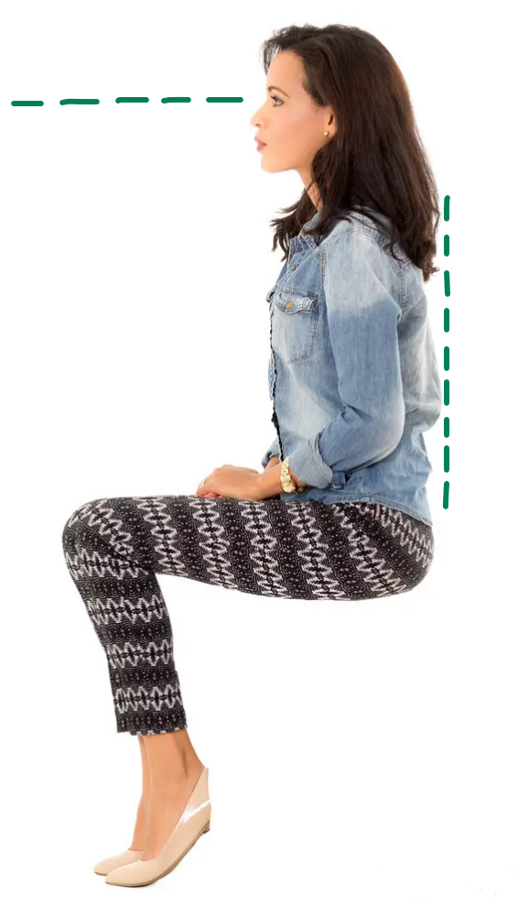
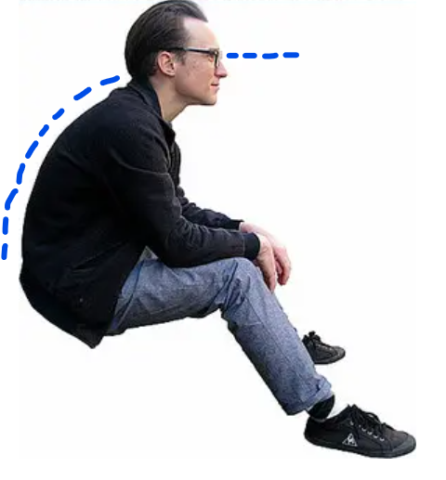
Overview & Goals
To help users form a optimal sitting posture and protect long-term health, we designed...
Real-time Posture Detector
Eye-to-screen Distance Monitor
Work-relax Balance Reminder
Pomodoro Technique

Slide 5
2. Philpsophy

Slide 6
Philosophy
Consider the functionality of the embedded system, we need:
Readability
Timeliness
While regarding of the design concepts, we suppose it to have:
User-friendliness
Modularity
E. Chen et al., "Advances and Future Prospects of Spin-Transfer Torque Random Access Memory," in IEEE Transactions on Magnetics, vol. 46, no. 6, pp. 1873-1878, June 2010, doi: 10.1109/TMAG.2010.2042041.

Slide 7
3. Design Specification

Slide 8
Design Specification
Input Devices:
HC- SR04: Ultrasonic Distance module
LSM6DSO 6DOF: Accelerometer
MCU:
RP-2040
Output:
ST7735S: 1.8 Inch TFT LCD screen module
LED

Slide 9
4. Architecture

Slide 10
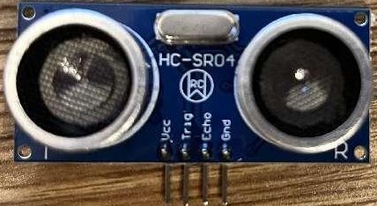
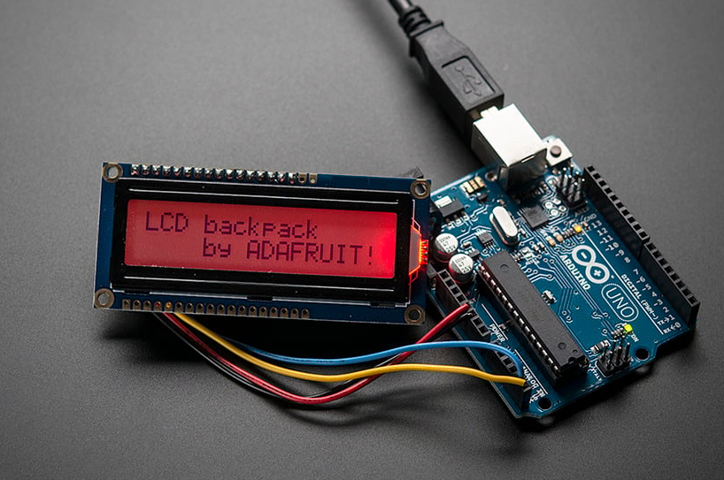
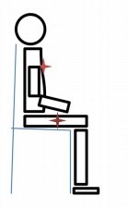
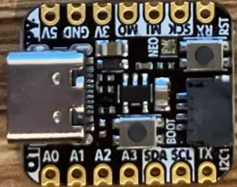
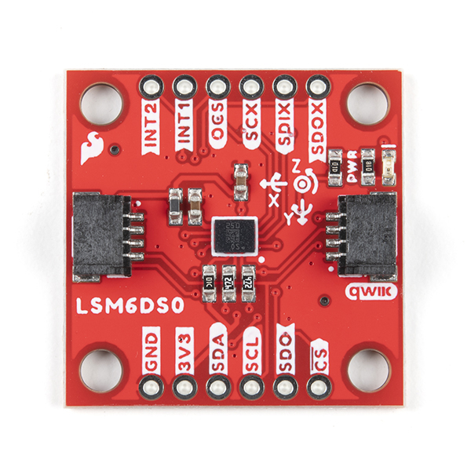
Team Guardian💪
HC- SR04
LCD
Distance
RP-2040
Mouse
Keyboard
(Joystick mode)
LSM6DSO
Angle
Serial

Slide 11
The End

