Slide 1
Turn data into insights

Slide 2
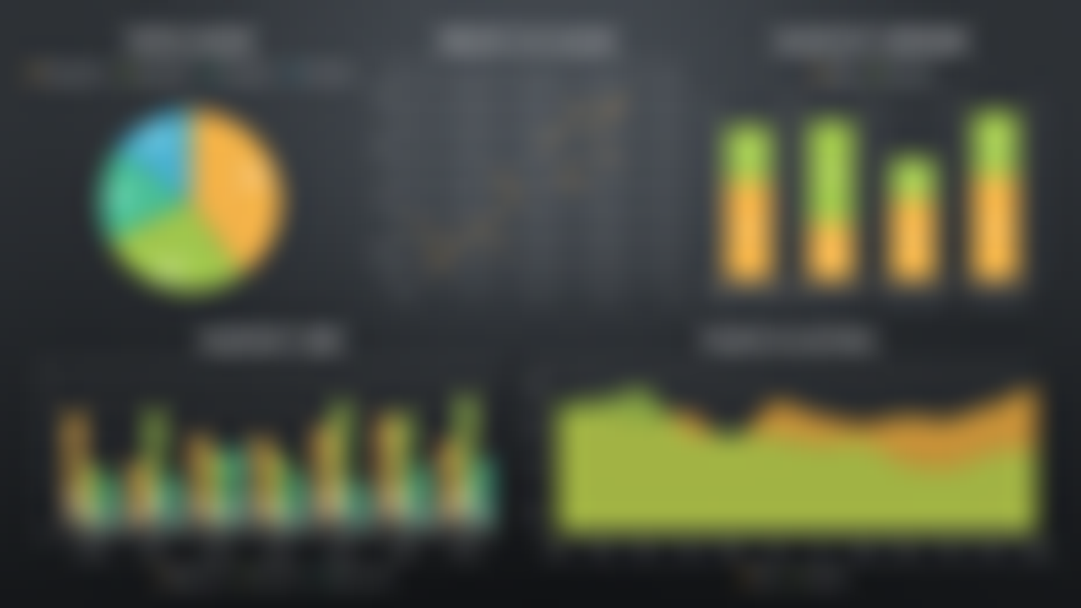

Turn data into insights

