Slide 1

Enhancing Search Engine Relevance for Video Subtitles

Slide 2
About me
Hello, I'm Angad Gupta, currently pursuing a Bachelor of Technology (B-Tech) degree in Computer Engineering at RK University.
I want to learn data science because it's incredibly useful. It has a big impact on different industries and can help find important information in complicated data. Learning about data science is not just interesting, but it also gives me lots of chances to work in cool areas like artificial intelligence, machine learning, and predictive analytics.
While I haven't gained any professional work experience yet, I am eager to apply my theoretical knowledge in practical settings and contribute meaningfully to projects.
Below are my GitHub and LinkedIn profiles:
GitHub: https://github.com/Angad143
LinkedIn: https://www.linkedin.com/in/angad-gupta143/

Slide 3
AGENDA
Background and Objectives
Keyword-based vs Semantic Search Engines
Part 1: Ingesting Documents
a. Reading Data
b. Cleaning Steps and Vectorization Techniques
c. Document Chunker and Storing Embeddings
Part 2: Retrieving Documents
a. Preprocessing Query
b. Creating Query Embedding
c. Cosine Similarity Calculation and Returning Relevant Documents

Slide 4
Background:
Introduction to the project's context in the digital content landscape.
Importance of effective search engines for user connectivity.
Google's commitment to seamless search experiences.
Project focus on improving search relevance for video subtitles.
Objective:
Development goal of an advanced search engine algorithm.
Specific emphasis on subtitle content.
Utilization of natural language processing and machine learning techniques.

Slide 5
Keyword-based vs Semantic Search Engines
Keyword-based Search Engines:
These search engines rely primarily on exact matches between the user's query and the indexed documents.
Traditional search engines like early versions of Google or Bing predominantly operated as keyword-based search engines.
Semantic Search Engines:
Semantic search engines aim to understand the meaning and context behind the user's query and the content of indexed documents.
They employ advanced NLP and machine learning techniques to comprehend the semantic relationships between words and phrases.
Modern search engines like Google's latest algorithms incorporate semantic search capabilities to enhance search relevance and user experience.

Slide 6
Core Logic:
Data Preprocessing
Detail the steps involved in preprocessing data, including potential cleaning tasks like removing timestamps.
Vectorization
Explain the different methods experimented with, such as Bag-of-Words/TFIDF and BERT-based Sentence transformers, to generate text vectors.
Document Chunker
Describe the need for document chunking and its benefits.
Explain how overlapping windows are utilized to mitigate context loss.
Data:
Instructions for accessing and handling subtitle data.
Importance of understanding data structure through README.txt.
Steps for decoding files and potential down sampling for resource management.

Slide 7
Step by Step Process
Part 1: Ingesting Documents:
Reading Data
Process of accessing and decoding the database file.
Ensures readability and usability of the subtitle data.
Cleaning Steps
Detailed procedures to remove noise and irrelevant information from subtitle documents.
Includes tasks like timestamp removal and formatting consistency checks.
Vectorization Techniques
Experimentation with BOW/TFIDF and BERT-based Sentence Transformers.
Converts textual data into numerical representations suitable for machine learning.

Slide 8
Document Chunker
Concept and implementation of breaking down large documents into smaller chunks.
Ensures efficient processing and analysis by mitigating information loss.
Storing Embeddings
Process of storing generated embeddings in a ChromaDB database.
Facilitates efficient storage and retrieval of embeddings for downstream tasks.
Part 2: Retrieving Documents:
Preprocessing Query
Necessary preprocessing steps for user search queries.
Tasks include lowercasing, tokenization, stopword removal, HTML Tags, and stemming/ lemmatization.

Slide 9
Creating Query Embedding
Generation of query embeddings to represent semantic meaning numerically.
Utilizes the same vectorization technique as document embeddings (e.g., BERT-based Sentence Transformers).
Cosine Similarity Calculation
Computation of cosine similarity scores between query embedding and document embeddings.
Higher scores indicate greater similarity and relevance between the query and a document.
Returning Relevant Documents
Utilization of cosine similarity scores to rank documents by relevance.
Presentation of the most relevant documents to the user based on similarity scores.

Slide 10
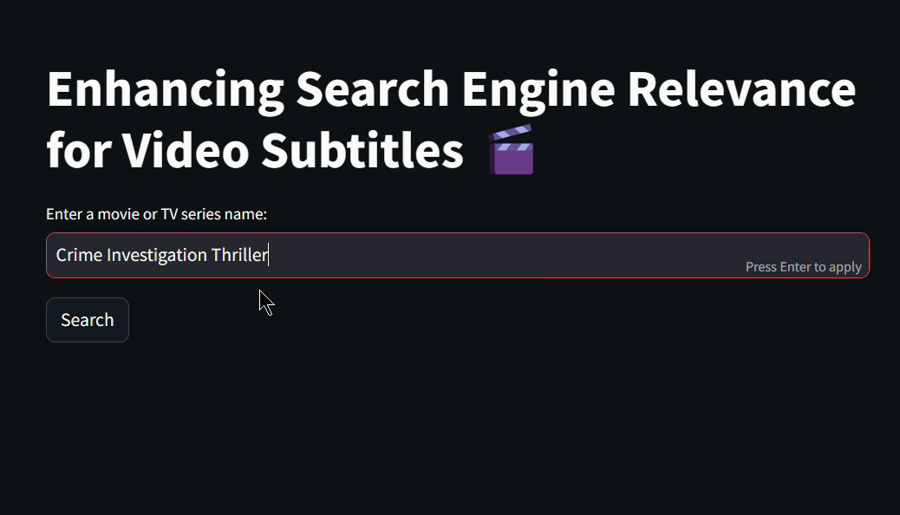
Results:

Slide 11
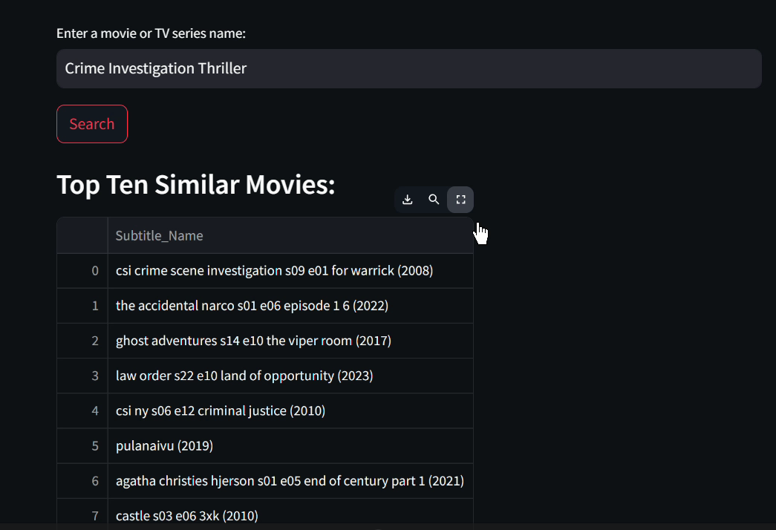

Slide 12
Conclusion:
In conclusion, our project on enhancing search engine relevance for video subtitles marks a significant leap forward in digital content accessibility. By leveraging advanced NLP and ML techniques, we've developed a robust search engine that not only understands user queries' context but also delivers precise and relevant results. Through meticulous preprocessing and innovative approaches like document chunking, we've streamlined the search process, making video content more accessible and user-friendly. Our project paves the way for future advancements in video content search, promising a more seamless and intuitive multimedia experience.

Slide 13

THANK YOU

