Slide 1
Mutual Fund Analytics Platform
Bluestock Fintech Capstone Project
Prepared By:
Angad Shukla
June 2026

Slide 2
Problem Statement & Objectives
Problem Statement
Investors often face difficulty in analysing mutual fund performance, risk exposure, sector concentration and investment trends due to large volumes of financial data.
Objectives
• Build automated ETL pipeline
• Create SQLite database
• Perform EDA
• Calculate performance metrics
• Build Power BI dashboard
• Analyse investor behaviour
• Generate actionable insights

Slide 3
Data Sources
Datasets Used
• 01 Fund Master -40 Funds
• 02 NAV History -46,000 NAV Records
• 03 AUM Data -32,778 Transactions
• 04 SIP Inflows -5,000 Investors
• 05 Category Inflows -10 Fund Houses
• 06 Industry Folio Count
• 07 Scheme Performance
• 08 Investor Transactions
• 09 Portfolio Holdings
• 10 Benchmark Indices

Slide 4
Architecture
Raw CSV Data
↓
Data Cleaning
↓
SQLite Database
↓
EDA & Analytics
↓
Power BI Dashboard
↓
Business Insights

Slide 5
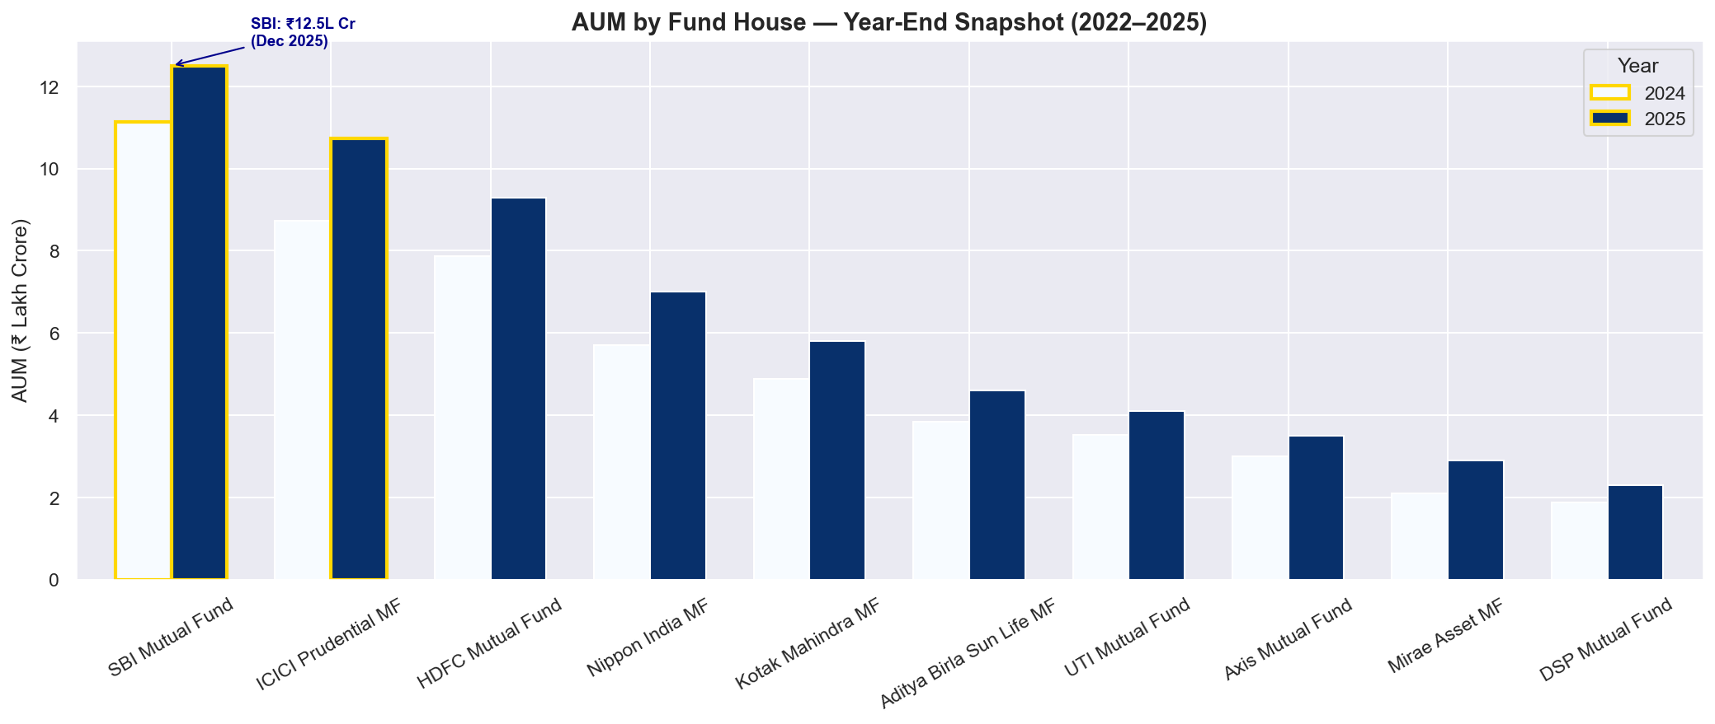
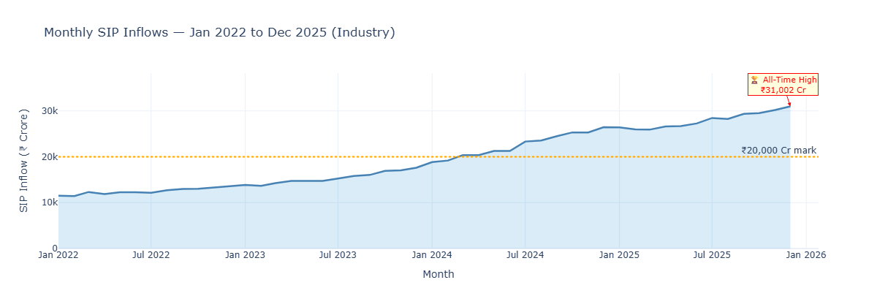
EDA Highlights
• Industry AUM increased steadily.
• SIP inflows reached ₹31,002 Cr.
• Retail participation increased significantly.

Slide 6
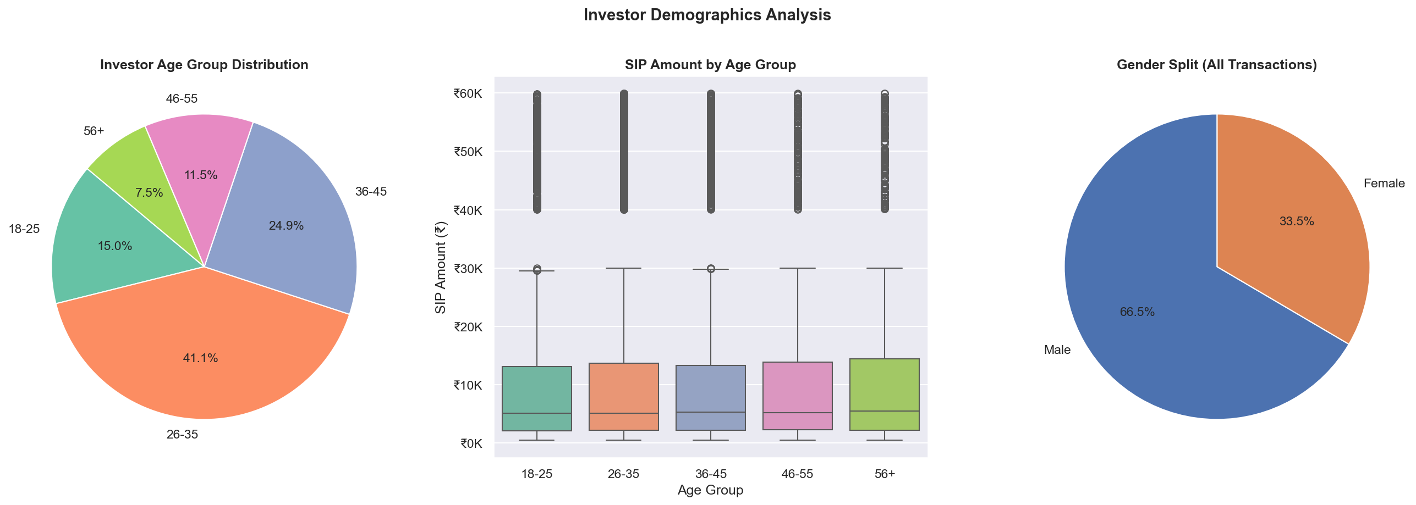
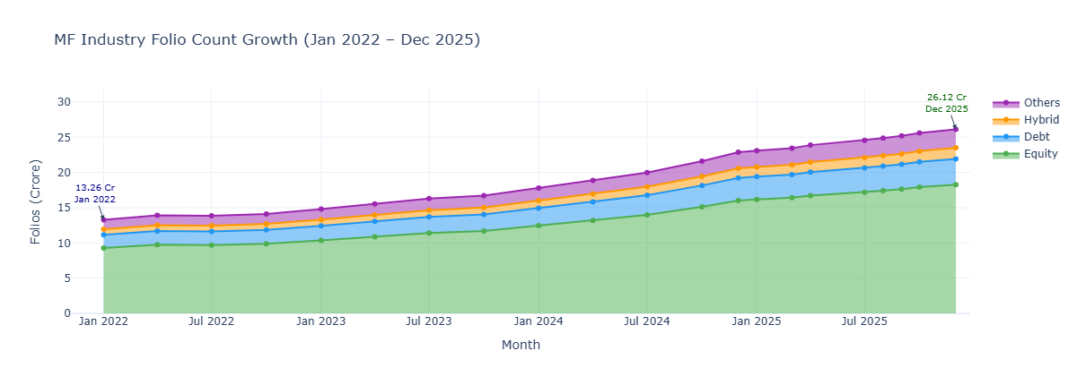
• Young investors dominate SIP participation.
• Folio count increased continuously.

Slide 7
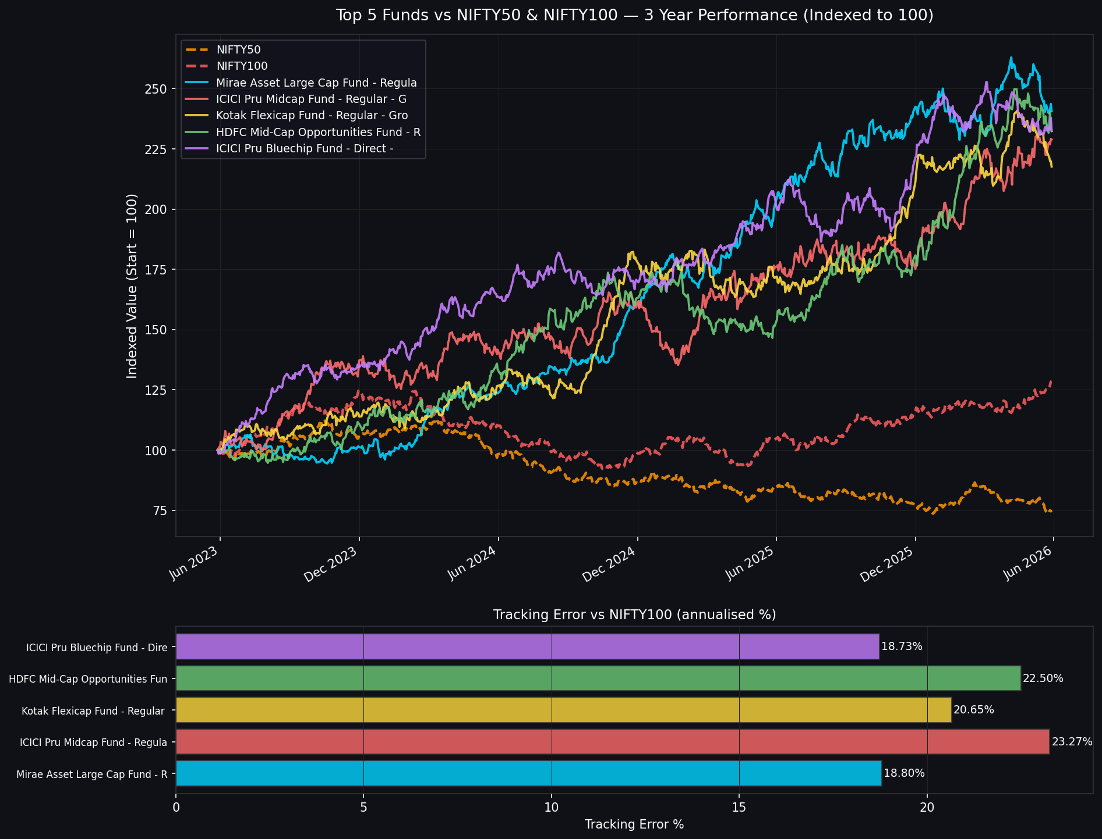
Performance Analytics
• Small-cap funds delivered highest returns.
• Debt funds showed lower volatility.
• Benchmark comparison highlighted outperformers.

Slide 8
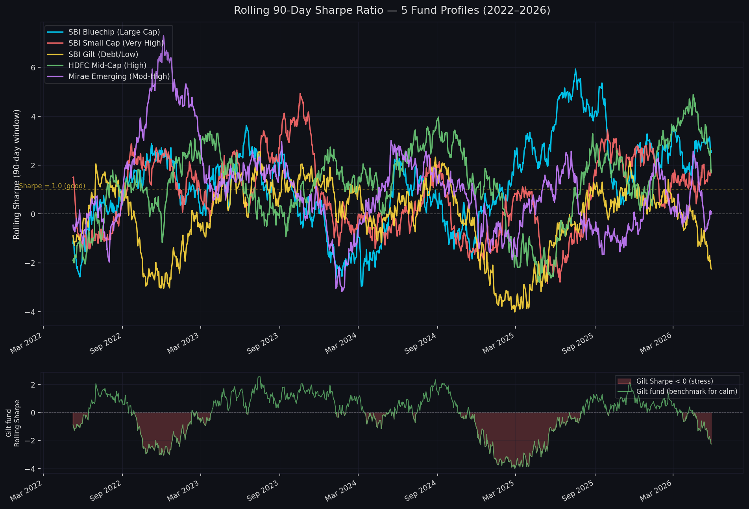
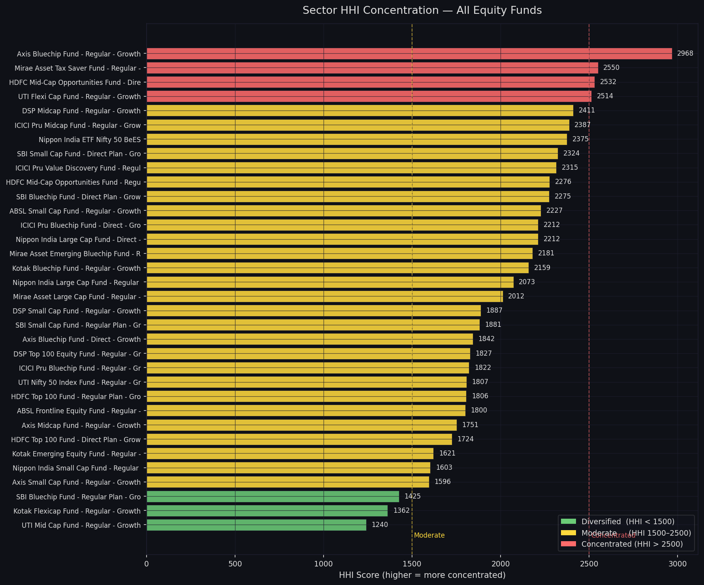
Advanced Analytics
• Rolling Sharpe ratio revealed risk-adjusted consistency.
• HHI identified highly concentrated portfolios.

Slide 9
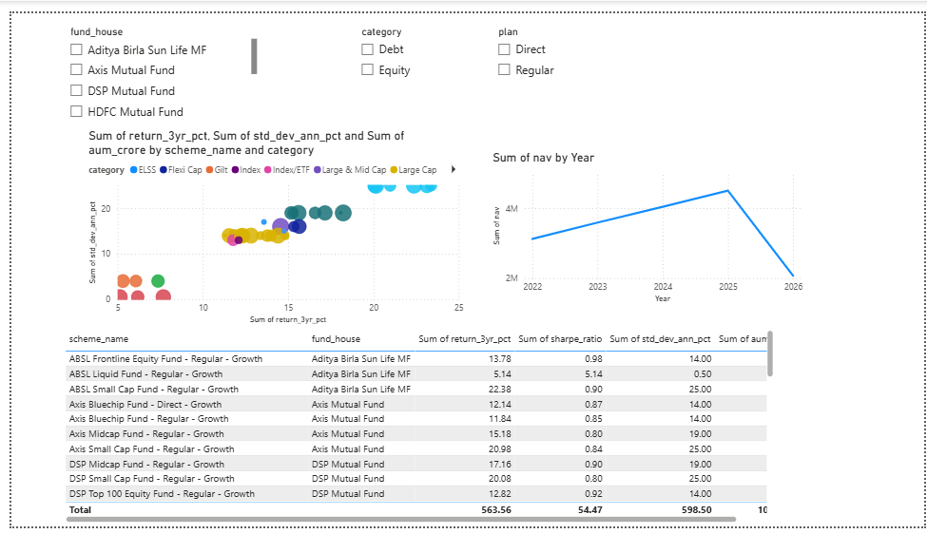
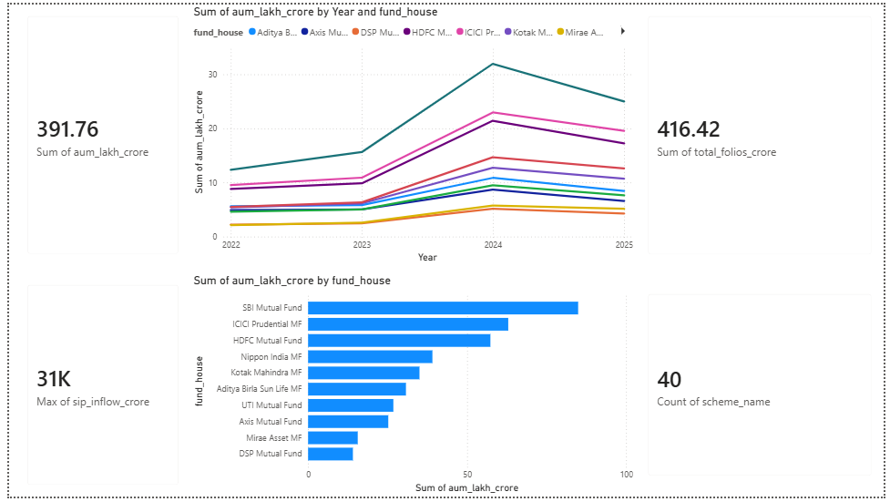
Dashboard Overview

Slide 10
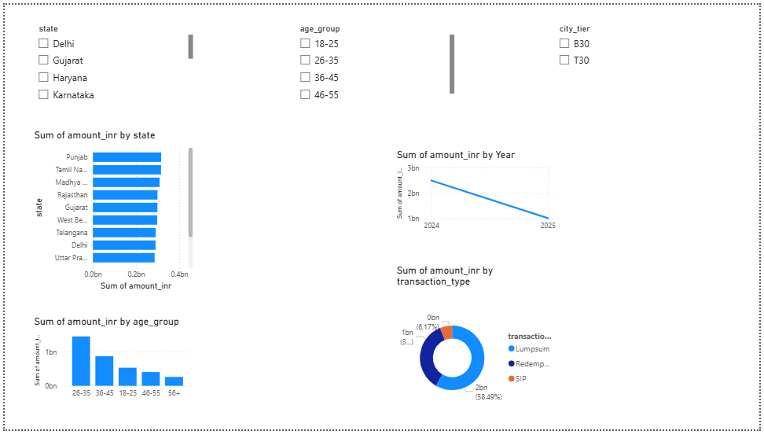
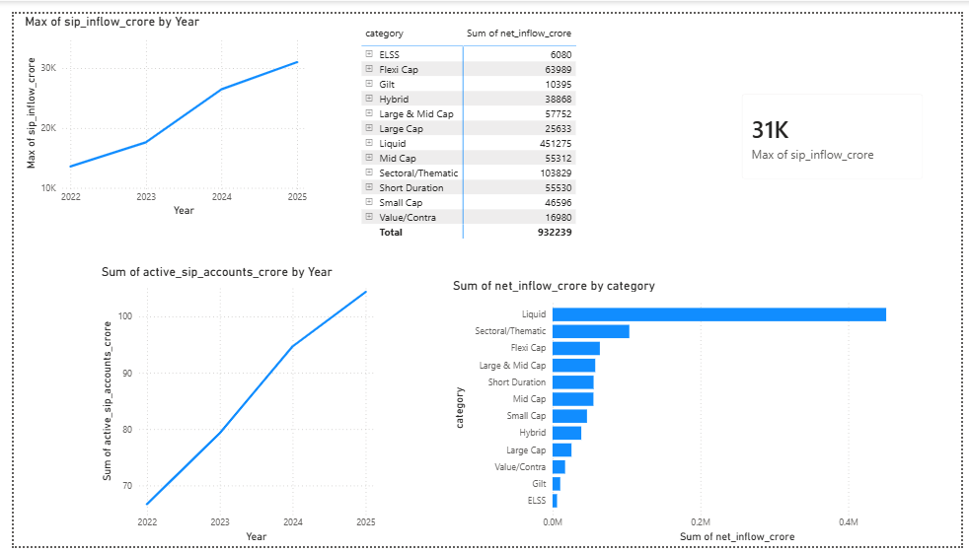

Slide 11
Key Findings
• SIP inflows reached ₹31,002 Cr by Dec 2025.
• SBI Mutual Fund recorded highest AUM.
• Small-cap funds generated highest returns.
• ICICI Prudential Liquid Fund showed best Sharpe Ratio.
• 97.8% investors were flagged at-risk in SIP continuity analysis.
• UTI Mid Cap Fund showed highest diversification.

Slide 12
Thank You
Angad Shukla
Bluestock Fintech Capstone Project

