Slide 1
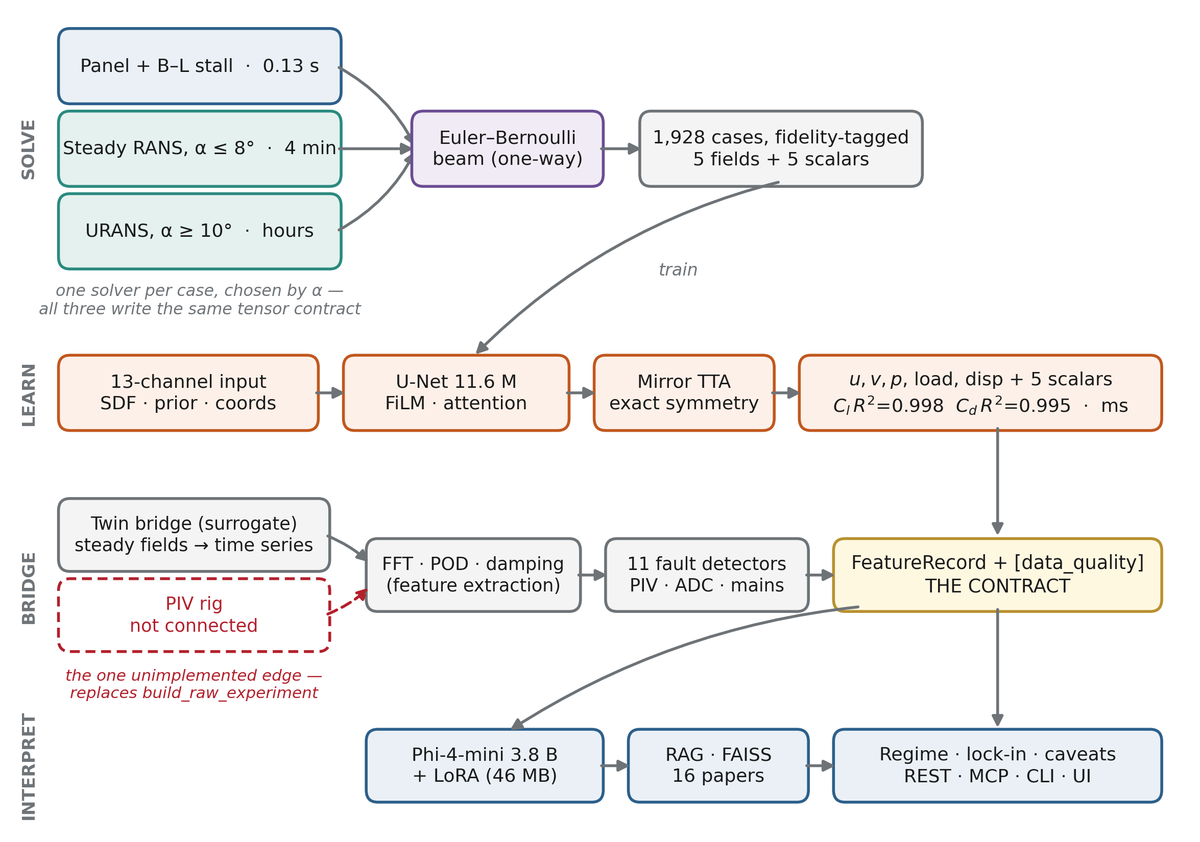


Computational Half: Geometry → Interpreted Experiment
Three solvers, one tensor contract, chosen per case by incidence — panel + Beddoes–Leishman stall (0.13 s), steady RANS below stall (~4 min), URANS above it (hours).
1,928 fidelity-tagged cases: 107 NACA sections × 18 angles, five fields (u, v, p, load, disp) and five scalars (Cl, Cd, Cm, w_max, twist) per case.
A U-Net surrogate learns geometry → fields, replacing the solver at inference: milliseconds instead of minutes.
The twin bridge turns steady fields into a time-resolved experiment record, screened by 11 instrumentation-fault detectors.
A LoRA-tuned Phi-4-mini (3.8 B) reads that record and interprets it — flow regime, shedding frequency, lock-in — with RAG over 16 FSI papers.
The PIV rig is the one unconnected edge. It would replace the synthetic record; nothing downstream changes.
Panel, RANS and URANS all write the same .npz contract, so one network trains on all of them.
8/9/2026
Visualization, modeling & Simulation, digital-Twin, and Artificial intelligence (ViSTA) Lab
https://www.vistalab.site
Notes:
The system has two halves. The sensor half turns a shape into physics; the interpreter half turns physics into words. Everything meets at one data structure, the FeatureRecord. Panel method runs in a tenth of a second and is rough; RANS takes four minutes and is accurate below stall; URANS takes hours and is the only thing that works past stall, because past stall there is no steady answer to converge to. All three write the same file format, which is what lets one network learn from all of them.

Slide 2
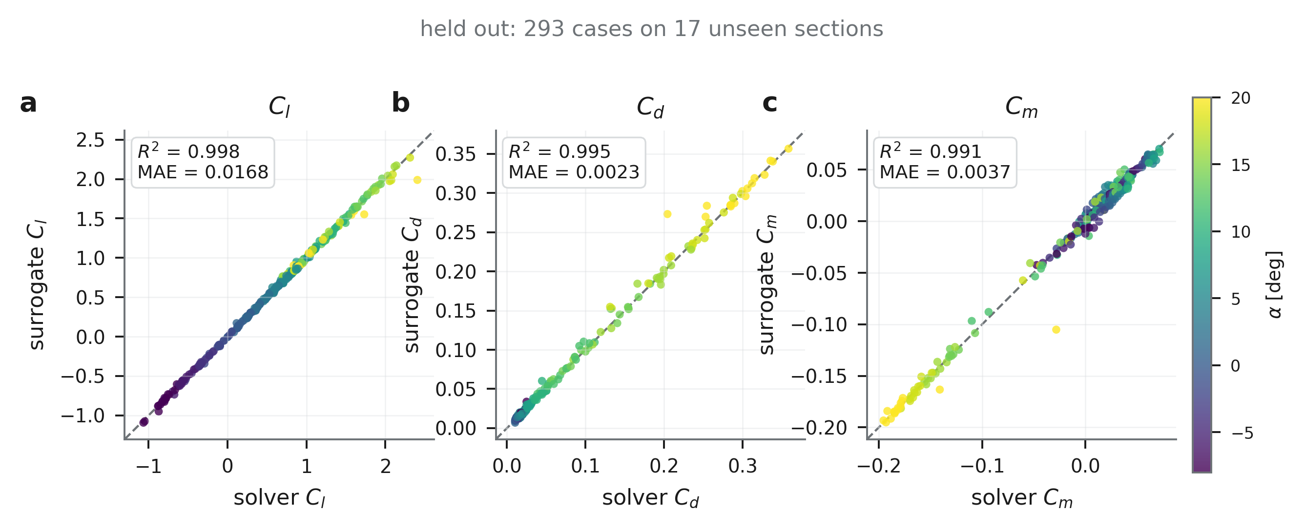
U-Net Surrogate: Shape → Flow Fields and Coefficients
11.59 M parameters · 13-channel input including an inviscid panel prior · FiLM conditioning on α, Re and fidelity · bottleneck attention · physics-informed loss · exact-mirror test-time averaging — trained on one MacBook.
0.998
0.995
2.3%
ms vs 4 min
Cl R² on 293 held-out cases
(MAE 0.0168)
Cd R²
(MAE 0.0023)
u-field relative RMSE
(p 10.8%, load 7.9%)
surrogate vs steady RANS
per case
8/9/2026
Visualization, modeling & Simulation, digital-Twin, and Artificial intelligence (ViSTA) Lab
https://www.vistalab.site
Notes:
Splits hold out whole airfoil shapes, not individual angles — splitting by case would put the same shape in train and test at neighbouring incidences and inflate the score. 76 train / 14 val / 17 test foils; NACA 0009 is pinned to test. Validation and test agree to within a few percent on every channel, so this is not a lucky draw. The inviscid prior is the key design choice: the panel solution is fed in as an input channel, so the network predicts the viscous correction rather than the whole flow, and the stagnation point, circulation and far field arrive already exact. Test-time mirror averaging is one extra forward pass and no retraining: it cuts lift error 17% and displacement error 18%.

Slide 3
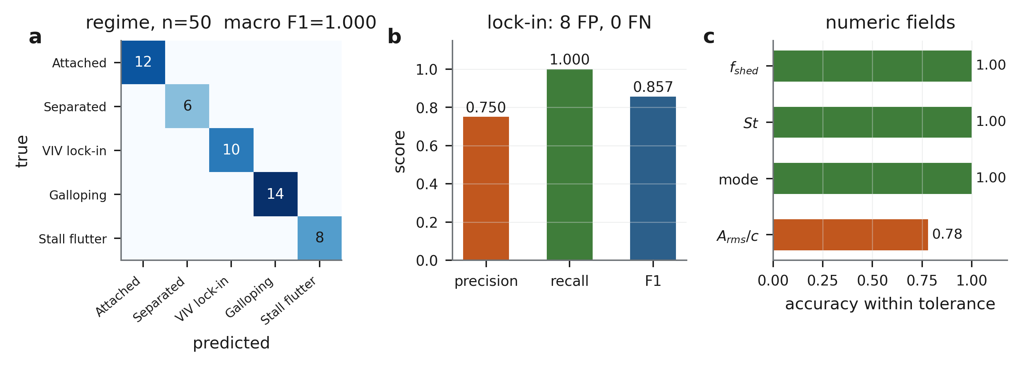
Small Language Model Interpreter
Phi-4-mini-instruct (3.8 B) + LoRA adapter (46 MB), fine-tuned with MLX on Apple Silicon · scored on 50 held-out records split by experiment ID, so no experiment appears in both train and test.
1.000
0.857
0.945
50 / 50
regime macro F1
(5 classes, n = 50)
lock-in F1
precision 0.750 / recall 1.000
average numeric-field accuracy
(f_shed, St, mode all 1.00)
records parsed into the
six-part structured format
Reading it honestly: regime classification is saturated — that says the generated test set is not discriminative at n = 50, so a harder test set is the next step, not a better model. Lock-in over-fires: zero misses, eight false calls. RAG in the training mix did not help (F1 0.840 vs 0.857); retrieval at inference is a separate, still-enabled mechanism.
8/9/2026
Visualization, modeling & Simulation, digital-Twin, and Artificial intelligence (ViSTA) Lab
https://www.vistalab.site
Notes:
The interpreter reads a FeatureRecord — frequencies, amplitudes, POD energies, damping — and writes a fixed six-part interpretation: regime, evidence, numbers, lock-in call, caveats, next measurement. Trained with LoRA on MLX, so the whole thing fits on a laptop; the adapter is 46 MB against a 3.8 billion parameter base. The number to quote is lock-in F1, not regime F1: perfect recall with 0.750 precision means the model never misses a lock-in and over-calls eight of them, which is the same bias the rule-based labeller has — so the model inherited it rather than inventing it. Amplitude is the one weak field at 0.78, judged on a strict absolute tolerance.

