Slide 1
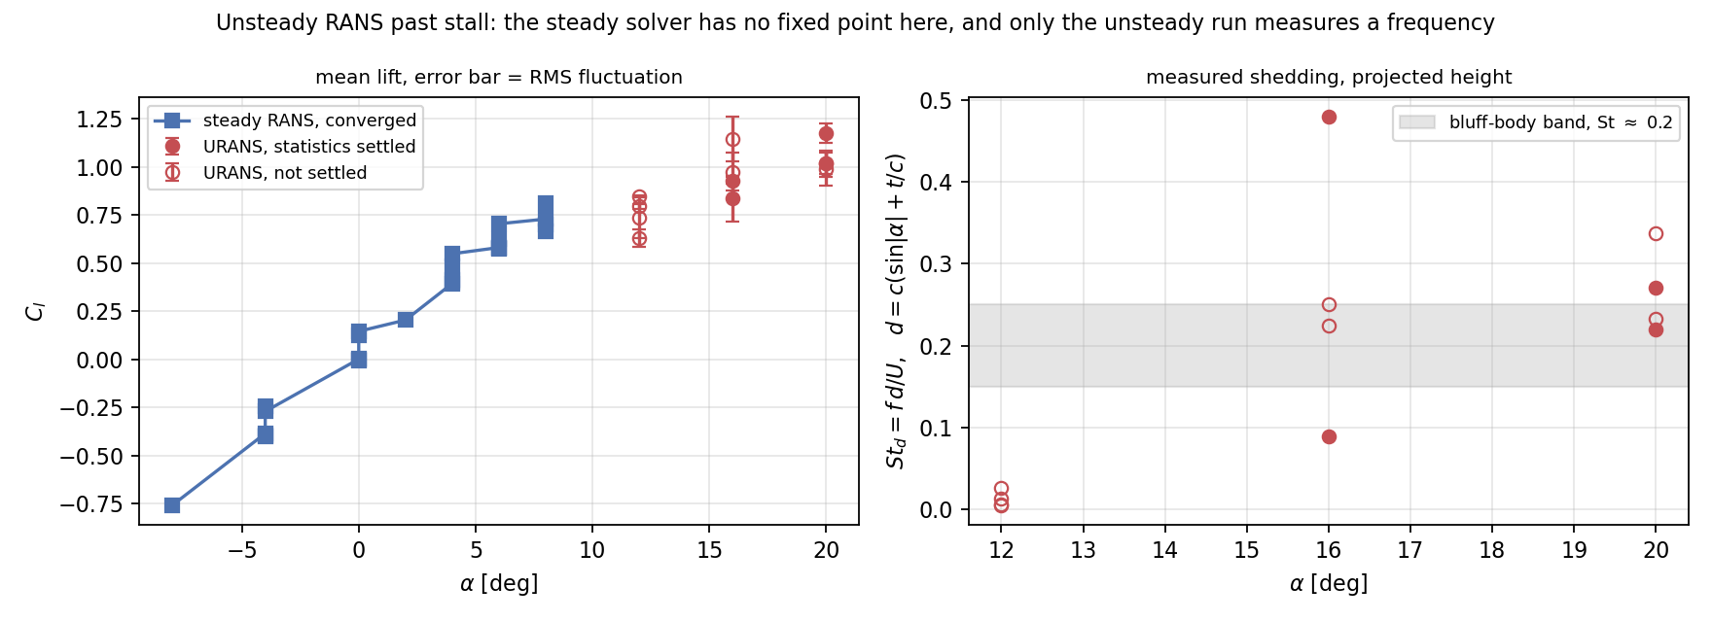
STEP 1 — HIGH-FIDELITY DATA
Past stall, the steady solver has nothing to converge to
12 URANS cases · pimpleFoam, k-ω SST · 4 training-split sections at α = 12°, 16°, 20° · 31.9 solver-hours. NACA 0009 stays in test.
12 cases
St_d ≈ 0.2
α ≥ 10°
+20 RANS
URANS at deep stall, 4 of them statistically settled
measured shedding lands in the bluff-body band — physics, not a fit
where every steady RANS run hit the iteration cap
steady cases below stall added in the same sweep
Notes:
Steady RANS is valid to alpha 8. Above that there is no fixed point, so every steady case stalled 2-3 decades above tolerance. URANS gives a time-resolved answer AND a measurable shedding frequency. St_d in the 0.15-0.25 bluff-body band is the sanity check that the unsteady runs are real.

Slide 2
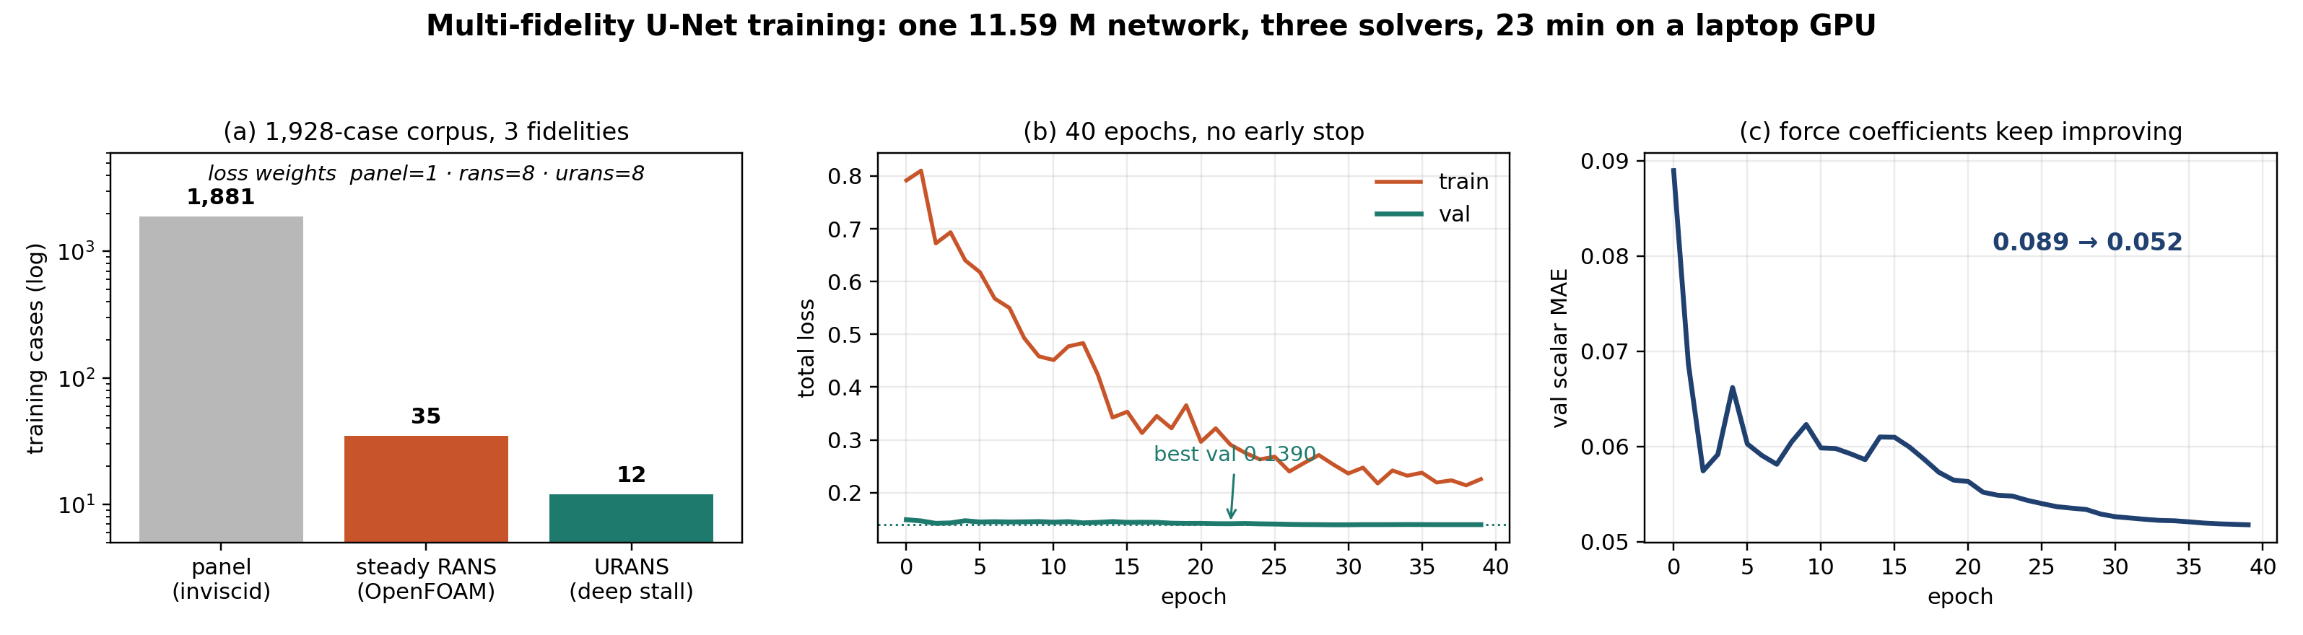
STEP 2 — MULTI-FIDELITY TRAINING
One U-Net, three solvers, fidelity as a conditioning input
13-channel input (SDF + panel prior); α, Re and the fidelity code enter by FiLM, not as image channels. High-fidelity rows carry 8× loss weight so 47 cases can move a 1,928-case fit.
1,928
11.59 M
8×
23 min
cases · 107 sections · 18 incidences
parameters, self-attention at the 8×8 bottleneck
loss weight on RANS + URANS rows
40 epochs, MPS, one laptop — no cluster
Notes:
The point of the fidelity code: the network is told which solver produced a row, so it can learn a systematic offset instead of averaging the two into mush. Val loss is flat because the val split is 93% panel - the panel task was already solved. The signal to watch is the scalar MAE, which halves.

Slide 3
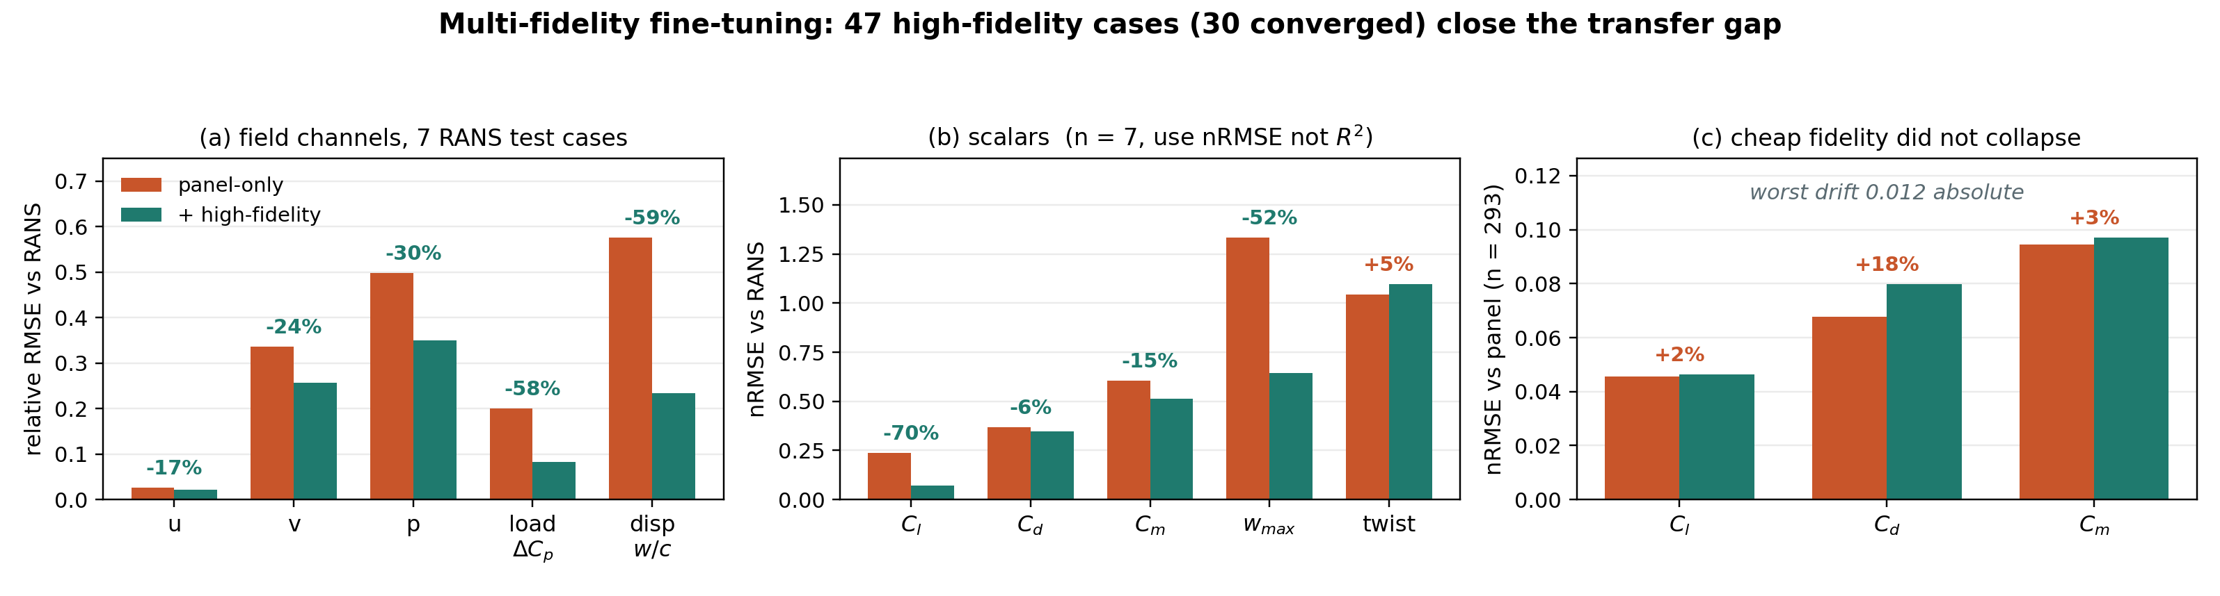
STEP 3 — RESULT
47 high-fidelity cases close the transfer gap
Same checkpoint pair, evaluated on 7 converged RANS test cases (NACA 0009, held out by shape) and on 293 panel test cases.
−70%
−59%
−58%
< 3%
Cl nRMSE vs RANS: 0.237 → 0.071
displacement rel. RMSE: 0.576 → 0.234
surface load rel. RMSE: 0.200 → 0.083
panel accuracy drift — no catastrophic forgetting
Caveat: no URANS rows land in the test split — the URANS claim rests on training rows and the val split. Twist is the one channel that got worse (+5%).
Notes:
Say the caveat before a judge finds it. Also: n=7, so R^2 is not meaningful on this sample - report nRMSE. Panel channels within 3 percent proves the fine-tune did not trade the cheap fidelity away.

