Slide 1
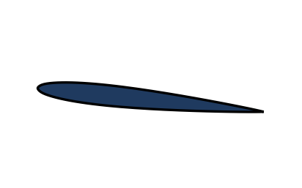
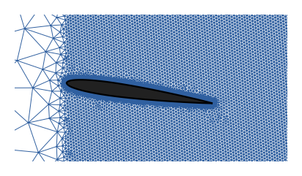
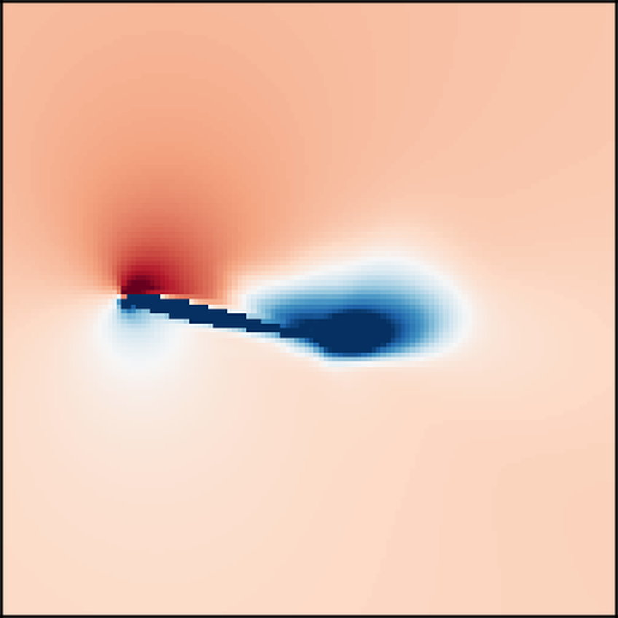


Workflow for the Agentic AI
“VIV lock-in. Shedding has synchronised with the structure, driving a saturated limit cycle.”
Shape and angle
Digital Twin Simulation
3D U-Net
Small Language Model (SLM)
model inputs
panel method, RANS or URANS by angle:
0.13 s to hours per case
learns from 1,928 solved cases and
gives the same answer in milliseconds
reads the numbers and writes
the interpretation
Running a solver for every shape and every angle is unfeasible (each case can take hours and can fail). We ran it 1,928 times and kept every answer.
A network trained on those answers reproduces them in milliseconds, so a sweep of shapes and angles runs live instead of overnight.
The Small Language Model (SLM) can automatically analyze the results, check for noise, and write an interpretable report.
Now running on real PIV
200 DaVis frames of NACA0009 at 17.2° go through the same code path as the generated records, with no changes downstream. Load-cell and strain channels are still to be added.
8/9/2026
Visualization, modeling & Simulation, digital-Twin, and Artificial intelligence (ViSTA) Lab
https://www.vistalab.site
Notes:
Solvers are accurate but slow, so we ran them 1,928 times, trained a 3D U-Net on the results, and now get the same answer in milliseconds. The SLM then reads the answer and writes it up. The one missing piece is the rig itself; everything downstream is built and tested on generated data, so connecting it is a substitution rather than a redesign.

Slide 2
Synthetic Data vs Real PIV Data
Both become the same record and run through the same code. They differ in what was actually measured.
Synthetic (Data/synthetic.py)
Real PIV (Exports/)
Where it comes from
A seeded generator: any number of runs, on demand
One DaVis export: NACA0009 at 17.2°, a single run
Sampling
8 s of signal at 400 Hz, plus 64 PIV snapshots
13.3 s at 15 Hz, 200 frames
Spatial resolution
12 × 12 velocity grid
152 × 127 vectors, 1.67 mm spacing
Channels present
Wake, structure and forces, all of them
Wake only. Structure and force channels read zero
Regime label
Known, because the generator built it in
None. The regime has to be inferred
Coverage
All five regimes, including ones never run on the rig
Deep stall at one angle
Identical for both: the freestream velocity is the same rig constant (1.569 m/s, a 20 GPM pump through a 32 mm nozzle) · the same feature extraction runs on both, FFT for shedding frequency and POD for wake structure · both land in the same FeatureRecord · both pass through the same eleven fault detectors and the same physics validators · the same SLM reads both.
8/9/2026
Visualization, modeling & Simulation, digital-Twin, and Artificial intelligence (ViSTA) Lab
https://www.vistalab.site
Notes:
The point of this slide is that the two data sources are interchangeable from feature extraction onward. That was the design goal: the schema and the extractor were written against a future real source, and when the real source arrived nothing downstream had to change. The differences are all upstream, and they are differences in what the instrument captured. The generated records are complete because the generator writes every channel; the PIV export is wake-only because a load cell and strain tracking were not part of that run. That single gap is what breaks the SLM two slides later.

Slide 3
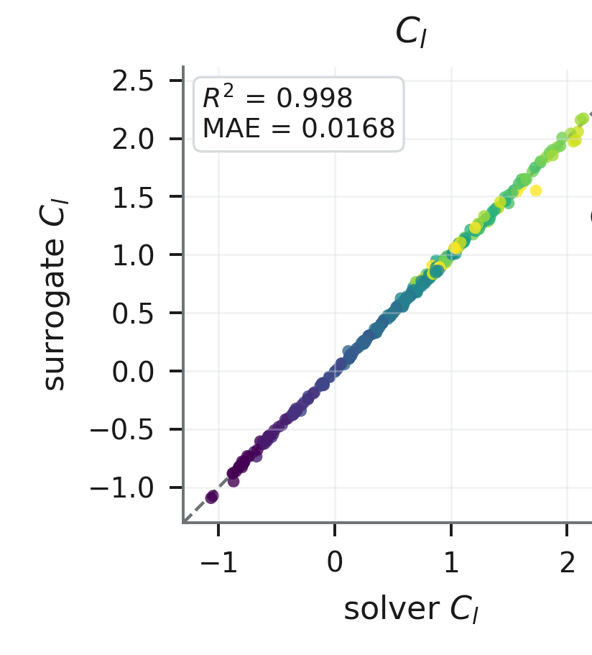
3D U-Net Accuracy vs. Digital Twin
Same answer, four orders of magnitude faster, and it returns one at angles where the solver has no steady solution to converge to.
Time per case
Cases that fail to converge
The twin picks its solver per case, so its real average is 49 s. The network answers in 0.01 s.
Past stall no steady solution exists, so RANS limit-cycles into its iteration cap. Switching to URANS there recovers most of it. The network always returns a field; whether it is right up there is the accuracy question on the left.
Why multi-fidelity, and why replace it. No single solver covers the range: the panel method is fast but approximate, RANS is accurate only below stall, URANS is the only thing that works above it and costs hours. Choosing per case is what makes the sweep possible at all, and the full 1,928-case sweep still takes about 26 hours. The network reproduces the same sweep in 19 seconds, and returns an answer at every angle.
One dot per test case: across is the solver's lift, up is the network's.
293 cases on 17 airfoil shapes never used in training.
8/9/2026
Visualization, modeling & Simulation, digital-Twin, and Artificial intelligence (ViSTA) Lab
https://www.vistalab.site
Notes:
Three claims, three pieces of evidence. The twin is multi-fidelity by design: 1,881 of the 1,928 cases were solved with the panel method, 35 with steady RANS, 12 with URANS, chosen by incidence, which is why its average cost is 49 seconds rather than any one solver's number. Left: it agrees with the solver on shapes it never saw, 293 cases, 17 held-out airfoils. Middle: log scale, so each gridline is a factor of ten; the network is four orders of magnitude faster than steady RANS. Right: the honest one. Of 35 RANS cases, 26 converged and 9 did not, and every failure sits at 8 degrees or above; from 10 to 20 degrees, all eight failed. That is not a tuning problem, massively separated flow has no steady solution to converge to, so simpleFoam limit-cycles until it hits the iteration cap. URANS is the fallback there and 8 of its 12 cases were flagged for short averaging windows or drift. The network returns a field at every angle, and the caveat is that returning one is not the same as being right; the field pictures for that are in the paper. One more caveat worth saying out loud: everything here is accuracy against the solver, not against experiment.

Slide 4
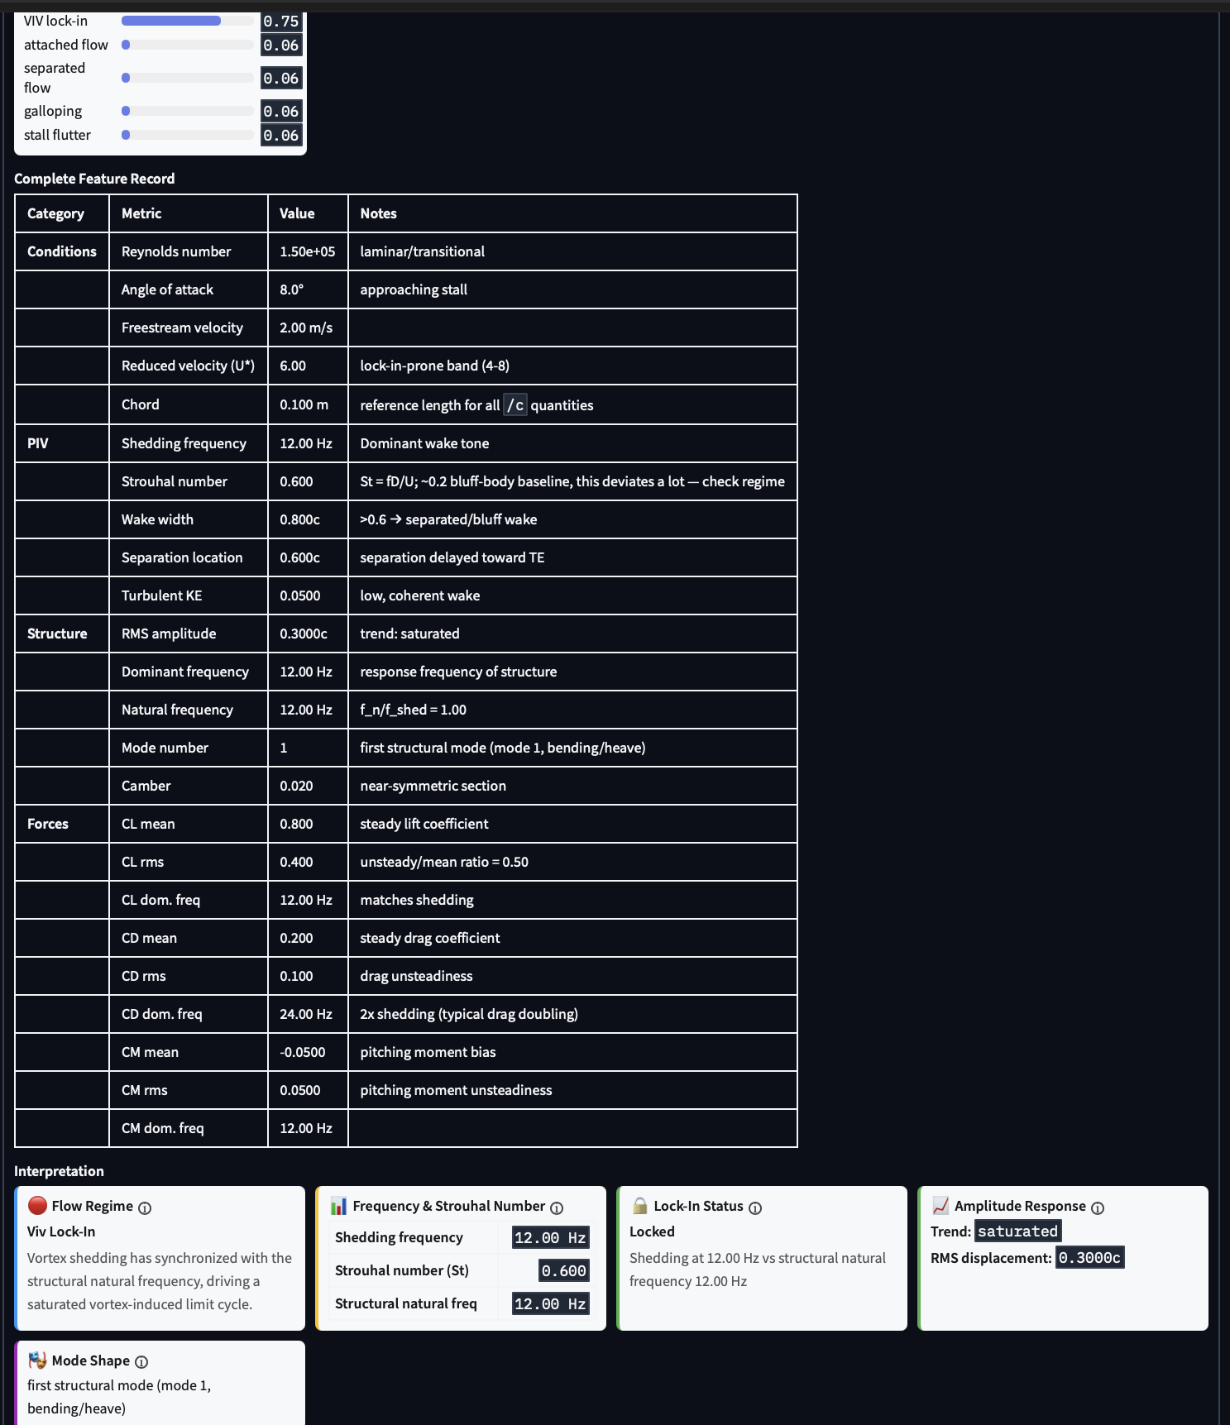
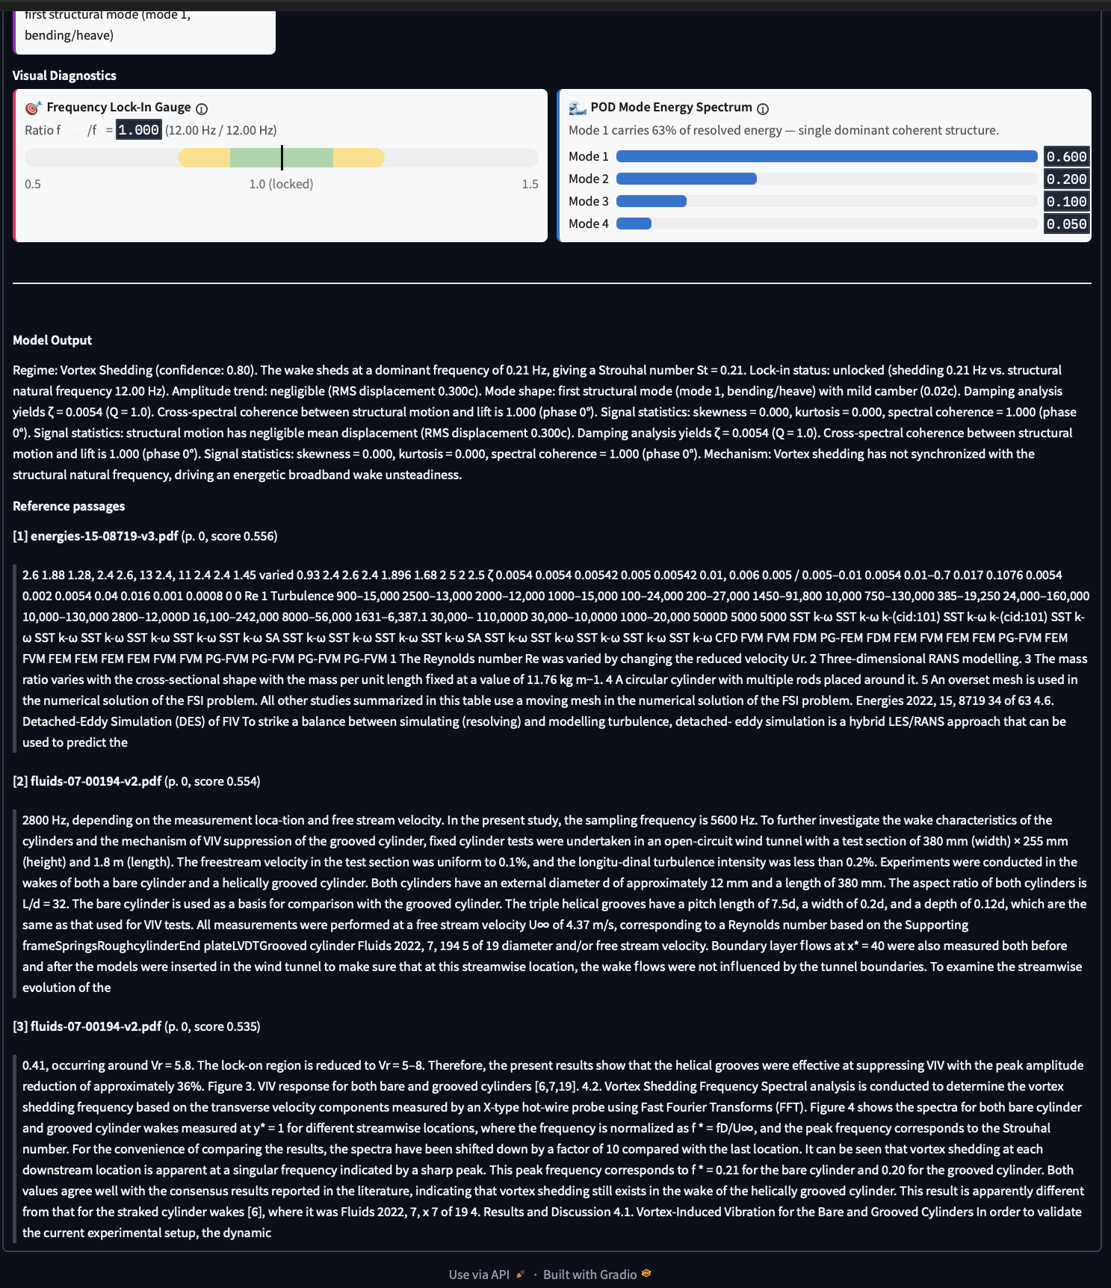
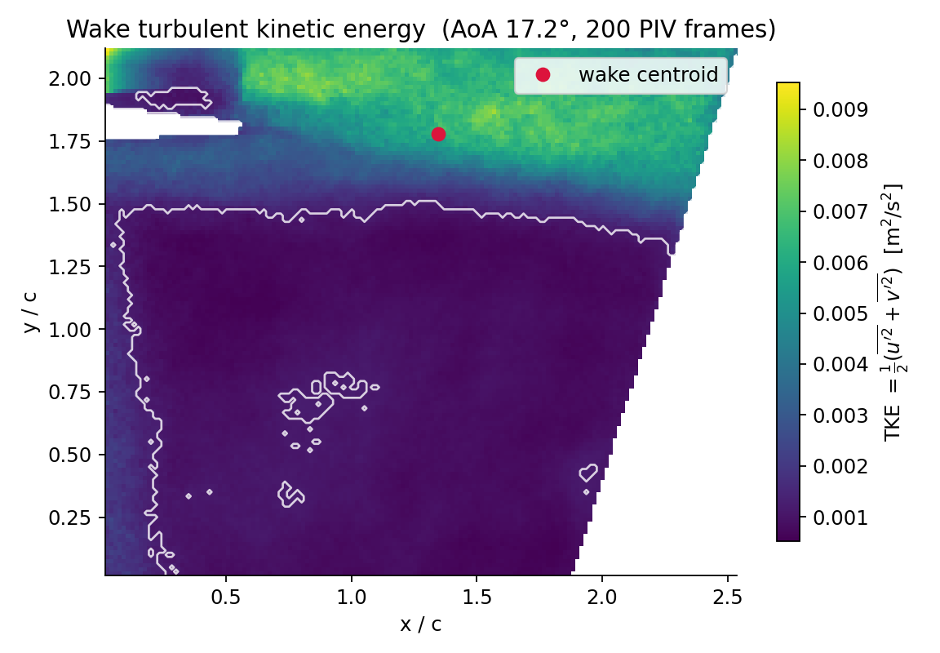
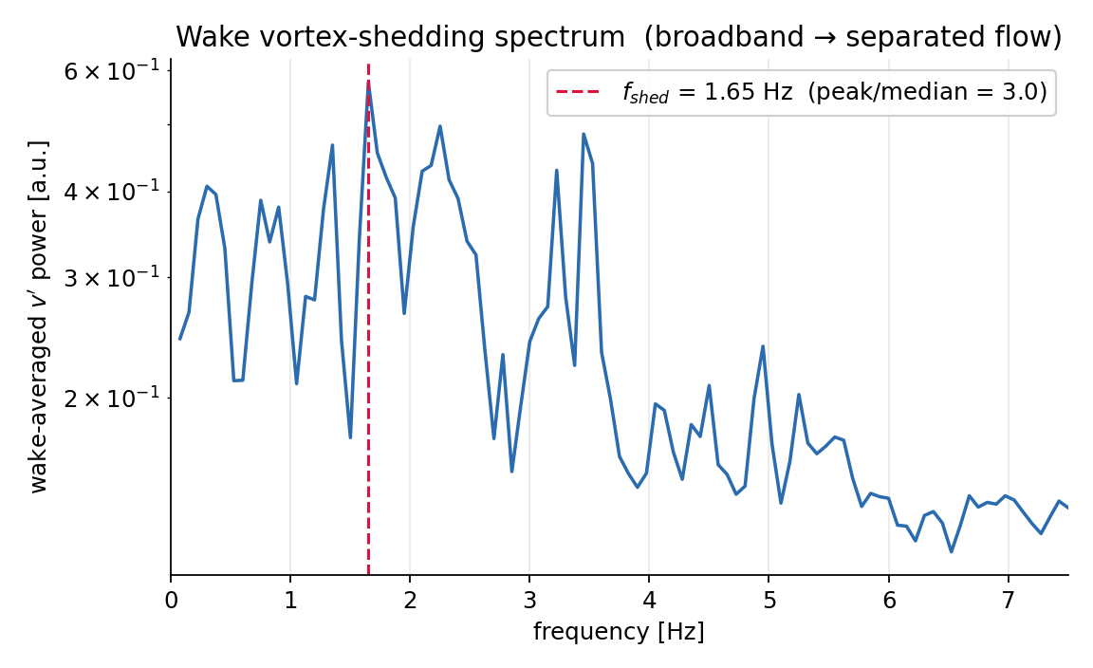
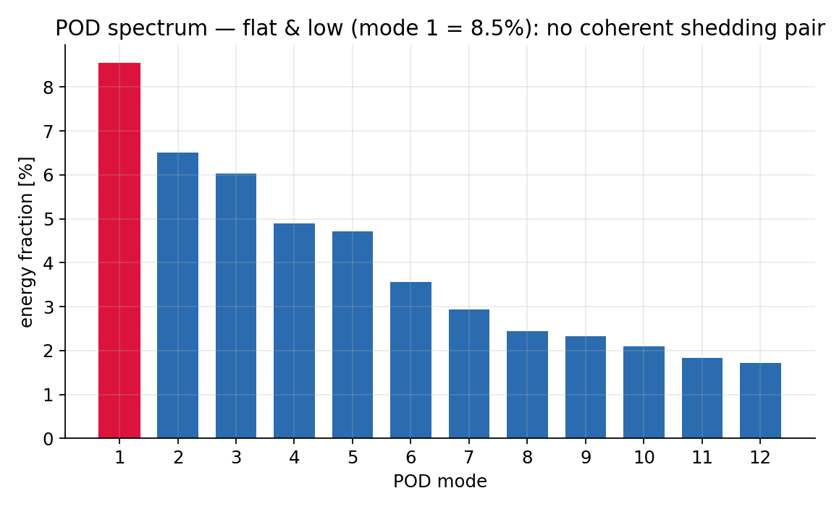
Small Language Model
A local web interface: load a record, get the regime, the evidence behind it, a lock-in call, and the literature passages the answer was grounded in.
What it produces
Flow regime with a confidence, the frequency comparison that justifies the lock-in call, amplitude trend, mode shape, and the mechanism in one paragraph. Retrieved passages from 16 FSI papers are shown underneath, so every claim can be traced.
How it scores
On 50 held-out generated records: every regime correct, no lock-in ever missed, eight called that were not there, and 94.5% of the reported numbers within tolerance.
From raw PIV to a written answer, in one run
Feature record and interpretation cards
Lock-in gauge, POD spectrum, model output with citations
wake energy
shedding spectrum
POD modes
Separated flow, deep stall. Shedding 1.65 Hz, St = 0.105, wake 0.65c. Measured from 200 real frames, then written up automatically.
8/9/2026
Visualization, modeling & Simulation, digital-Twin, and Artificial intelligence (ViSTA) Lab
https://www.vistalab.site
Notes:
This is the interface a researcher actually uses: python cli.py ui. Load a record, press interpret. The model is Phi-4-mini with a 46 MB LoRA adapter, running locally, no cloud. Two things to point out. First, it does not just classify: it cites the frequency comparison behind the lock-in call and shows the retrieved paper passages, so the answer is traceable. Second, the honest result: on the real PIV record it claimed lock-in with full confidence, using a structural channel that was never measured and reads zero. The deterministic validators rejected that answer and the rule-based classifier gave separated, which is what the wake measurements say. The trust layer under the model is what makes the output usable.

