Slide 1
More on HTML
Department of Computer Science and Engineering
Chitkara University, Punjab

Slide 2
Text Formatting Tags
Formatting elements were designed to display special types of text:
<b> - Bold text
<strong> - Important text
<i> - Italic text
<em> - Emphasized text
<mark> - Marked text
<small> - Smaller text
<del> - Deleted text
<ins> - Inserted text
<sub> - Subscript text
<sup> - Superscript text

Slide 3
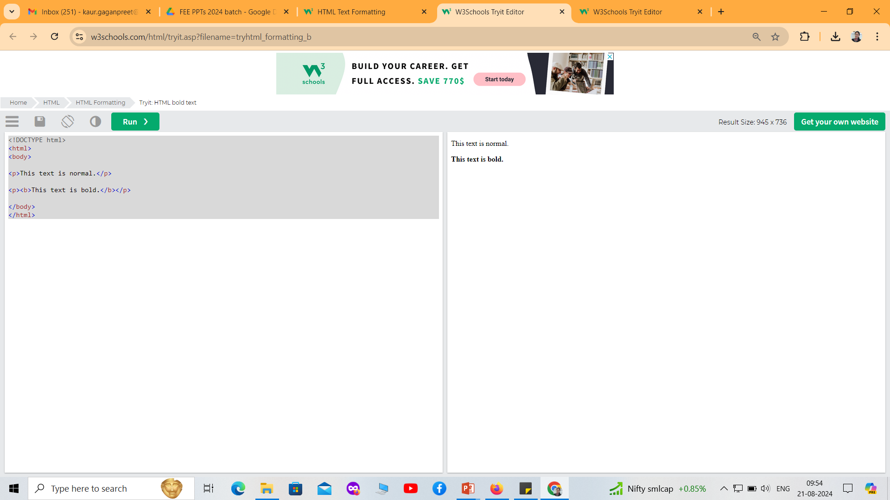
Text Formatting Tags: Example
<!DOCTYPE html>
<html>
<body>
<p>This text is normal.</p>
<p><b>This text is bold.</b></p>
</body>
</html>

Slide 4
HTML Quotation and Citation Elements
Tag | Description
<abbr> | Defines an abbreviation or acronym
<address> | Defines contact information for the author/owner of a document
<bdo> | Defines the text direction
<blockquote> | Defines a section that is quoted from another source
<cite> | Defines the title of a work
<q> | Defines a short inline quotation

Slide 5
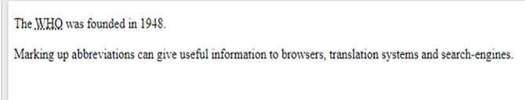
<abbr> Tag
HTML <abbr> for Abbreviations
The HTML <abbr> tag defines an abbreviation or an acronym, like "HTML", "CSS", "Mr.", "Dr.", "ASAP", "ATM".
Marking abbreviations can give useful information to browsers, translation systems and search-engines.
<!DOCTYPE html>
<html>
<body>
<p>The <abbr title="World Health Organization">WHO</abbr> was founded in 1948.</p>
<p>Marking up abbreviations can give useful information to browsers, translation systems and search-engines.</p>
</body>
</html>

Slide 6
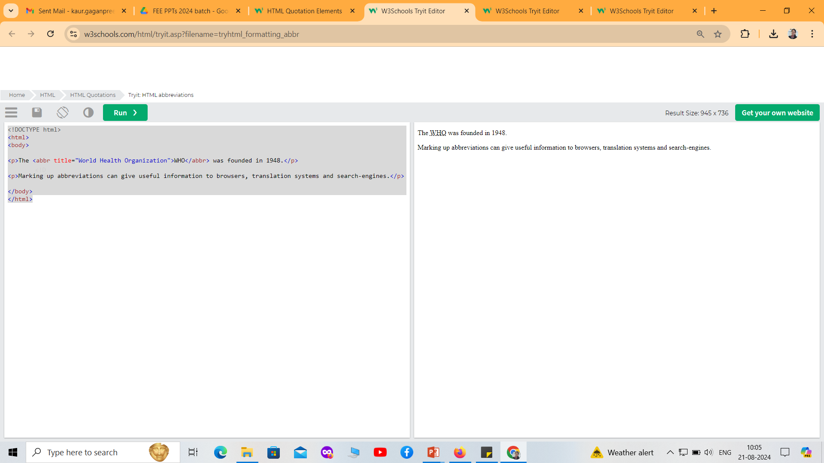
<abbr> Tag

Slide 7
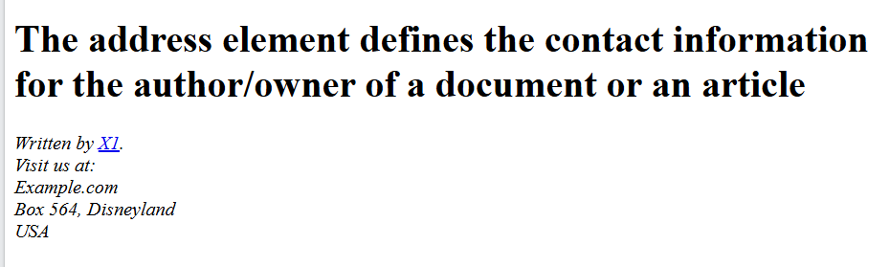
<address> Tag
The HTML <address> tag defines the contact information for the author/owner of a document or an article.
The contact information can be an email address, URL, physical address, phone number, social media handle, etc.
<!DOCTYPE html>
<html>
<body>
<h1>The address element defines the contact information for the author/owner of a document or an article</h1>
<address>
Written by <a href="X1:webmaster@example.com">X1</a>.<br>
Visit us at:<br>
Example.com<br>
Box 564, Disneyland<br>
USA
</address>
</body>
</html>

Slide 8
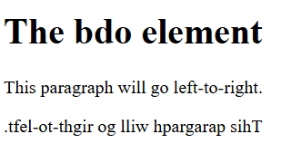
<bdo> Tag
BDO stands for Bi-Directional Override.
The <bdo> tag is used to override the current text direction.
<!DOCTYPE html>
<html>
<body>
<h1>The bdo element</h1>
<p>This paragraph will go left-to-right.</p>
<p><bdo dir="rtl">This paragraph will go right-to-left.</bdo></p>
</body>
</html>

Slide 9
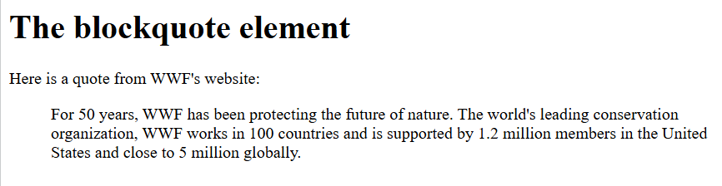
<blockquote> Tag
The <blockquote> tag specifies a section that is quoted from another source.
Browsers usually indent <blockquote> elements (look at example below to see how to remove the indentation).
<!DOCTYPE html>
<html>
<body>
<h1>The blockquote element</h1>
<p>Here is a quote from WWF's website:</p>
<blockquote cite="http://www.worldwildlife.org/who/index.html">
For 50 years, WWF has been protecting the future of nature. The world's leading conservation organization, WWF works in 100 countries and is supported by 1.2 million members in the United States and close to 5 million globally.
</blockquote>
</body>
</html>

Slide 10
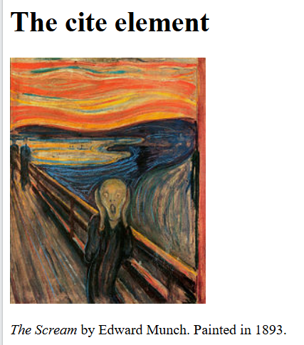
<cite> Tag
The <cite> tag defines the title of a creative work (e.g. a book, a poem, a song, a movie, a painting, a sculpture, etc.).
Note: A person's name is not the title of a work.
The text in the <cite> element usually renders in italic.
<!DOCTYPE html>
<html>
<body>
<h1>The cite element</h1>
<img src="img_the_scream.jpg" width="220" height="277" alt="The Scream">
<p><cite>The Scream</cite> by Edward Munch. Painted in 1893.</p>
</body>
</html>

Slide 11
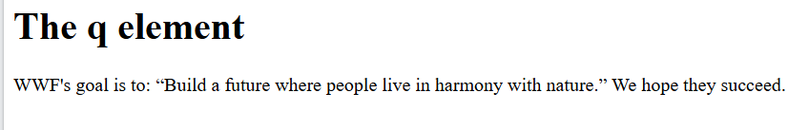
<q> Tag
The <q> tag defines a short quotation.
Browsers normally insert quotation marks around the quotation.
Note: Use <blockquote> for long quotations.
<!DOCTYPE html>
<html>
<body>
<h1>The q element</h1>
<p>WWF's goal is to:
<q>Build a future where people live in harmony with nature.</q>
We hope they succeed.</p>
</body>
</html>

Slide 12
The <div> tag
The <div> tag defines a division or a section in an HTML document.
The <div> tag is used as a container for HTML elements - which is then styled with CSS or manipulated with JavaScript.
The <div> tag is easily styled by using the class or id attribute.
<!DOCTYPE html>
<html>
<head>
<style>
.myDiv {
border: 5px outset black;
background-color: lightgreen;
text-align: center;
}
</style>
</head>

Slide 13
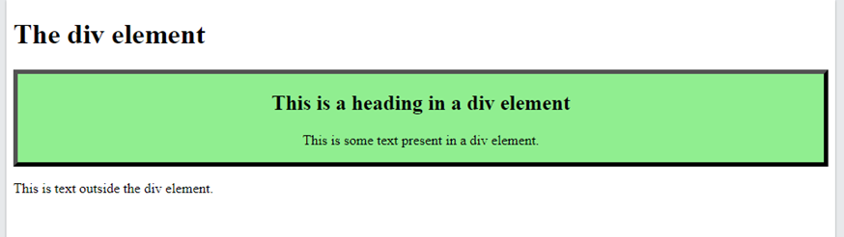
<body>
<h1>The div element</h1>
<div class="myDiv">
<h2>This is a heading in a div element</h2>
<p>This is some text present in a div element.</p>
</div>
<p>This is text outside the div element.</p>
</body>
</html>
A <div> section in a document that is styled with CSS:

Slide 14
Block-level Elements
A block-level element always starts on a new line, and the browsers automatically add some space (a margin) before and after the element.
A block-level element always takes up the full width available (stretches out to the left and right as far as it can).
Two commonly used block elements are: <p> and <div>.
The <p> element defines a paragraph in an HTML document.
The <div> element defines a division or a section in an HTML document.
The <span> Element
The <span> element is an inline container used to mark up a part of a text, or a part of a document.
The <span> element has no required attributes, but style, class and id are common.

Slide 15
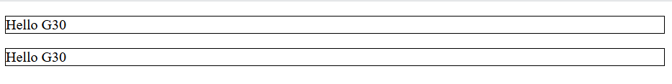
<!DOCTYPE html>
<html>
<body>
<p style="border: 1px solid black">Hello G30</p>
<div style="border: 1px solid black">Hello G30</div>
</body>
</html>

Slide 16
Inline Elements
An inline element does not start on a new line.
An inline element only takes up as much width as necessary.
<!DOCTYPE html>
<html>
<body>
<p>This is an inline span <span style="border: 1px solid black">Hello World</span> element inside a paragraph.</p>
</body>
</html>
Output:
This is an inline span Hello World element inside a paragraph.

Slide 17
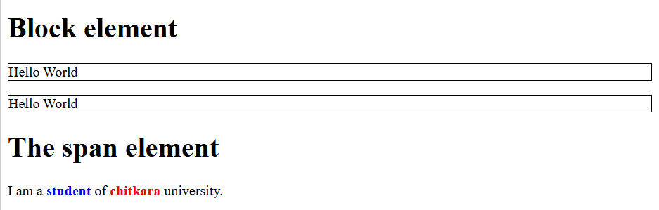
<!DOCTYPE html>
<html>
<body>
<h1>Block element</h1>
<p style="border: 1px solid black">Hello World</p>
<div style="border: 1px solid black">Hello World</div>
<h1>The span element</h1>
<p>I am a <span style="color:blue;font-weight:bold;">student</span> of <span style="color:red;font-weight:bold;">chitkara</span> university.</p>
</body>
</html>

Slide 18
HTML Semantic Elements
What are Semantic Elements?
A semantic element clearly describes its meaning to both the browser and the developer.
Examples of non-semantic elements: <div> and <span> - Tells nothing about its content.
Examples of semantic elements: <form>, <table>, and <article> - Clearly defines its content.

Slide 19
HTML Hyper Links
HTML links are hyperlinks.
You can click on a link and jump to another document.
When you move the mouse over a link, the mouse arrow will turn into a little hand.
Note: A link does not have to be text. A link can be an image or any other HTML element!
<a> is called anchor tag
HTML Links – Syntax
The HTML <a> tag defines a hyperlink. It has the following syntax:
<a href="url">link text</a>
The most important attribute of the <a> element is the href attribute, which indicates the link's destination.
The link text is the part that will be visible to the reader.
Clicking on the link text, will send the reader to the specified URL address.
<p><a href="https://www.google.co.in/">Visit Google !</a></p>

Slide 20
Absolute URLs vs. Relative URLs
Above examples are using an absolute URL (a full web address) in the href attribute.
A local link (a link to a page within the same website) is specified with a relative URL (without the "https://www" part):
<!DOCTYPE html>
<html>
<body>
<h2>Absolute URLs</h2>
<p><a href="https://www.google.com/">Google</a></p>
<h2>Relative URLs</h2>
<p><a href="html_images.asp">HTML Images</a></p>
<p><a href="/css/default.asp">CSS Tutorial</a></p>
</body>
</html>

Slide 21
HTML <table> Tag
An HTML table consists of one <table> element and one or more <tr>, <th>, <td> elements.
<tr> : The <tr> element defines a table row
<th> : The <th> element defines a table header
<td> : The <td> element defines a table cell

Slide 22
Example
<!DOCTYPE html>
<html>
<head>
<style>
table, th, td {
border: 1px solid black;
border-collapse: collapse;
}
</style>
</head>
<body>
<h1>Table with Collapsed Borders</h1>
<table>
<tr>
<th>Month</th>
<th>Savings</th>
</tr>
<tr>
<td>January</td>
<td>$100</td>
</tr>
<tr>
<td>February</td>
<td>$80</td>
</tr>
</table>
</body>
</html>
Month | Savings
January | $100
Feb | $80

Slide 23
HTML <caption> Tag
The <caption> tag defines a table caption.
The <caption> tag must be inserted immediately after the <table> tag.
<!DOCTYPE html>
<html>
<head>
<style>
table, th, td {
border: 1px solid black;
}
body
{
background-image: url('image.jpg');
}
</style>
</head>
<body>
<table>
<caption style="text-align:right">My savings</caption>
<tr>
<th>Month</th>
<th>Savings</th>
</tr>
<tr>
<td>January</td>
<td>$100</td>
</tr>
</table>
<br>
<table>
<caption style="caption-side:bottom">My savings</caption>
<tr>
<th>Month</th>
<th>Savings</th>
</tr>
<tr>
<td>January</td>
<td>$100</td>
</tr>
</table>
</body>
</html>

Slide 24
HTML <colgroup> Tag
The <colgroup> tag specifies a group of one or more columns in a table for formatting.
The <colgroup> tag is useful for applying styles to entire columns, instead of repeating the styles for each cell, for each row.
Note: The <colgroup> tag must be a child of a <table> element, after any <caption> elements and before any <thead>, <tbody>, <tfoot>, and <tr> elements.

Slide 25
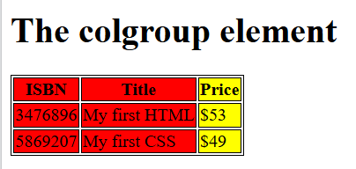
HTML <colgroup> Tag
<!DOCTYPE html>
<html>
<head>
<style>
table, th, td {
border: 1px solid black;
}
</style>
</head>
<body>
<h1>The colgroup element</h1>
<table>
<colgroup>
<col span="2" style="background-color:red">
<col style="background-color:yellow">
</colgroup>
<tr>
<th>ISBN</th>
<th>Title</th>
<th>Price</th>
</tr>
<tr>
<td>3476896</td>
<td>My first HTML</td>
<td>$53</td>
</tr>
<tr>
<td>5869207</td>
<td>My first CSS</td>
<td>$49</td>
</tr>
</table>
</body>
</html>

Slide 26
How to Add a Border
To add a border, use the CSS border property on table, th, and td elements:
<style>
table, th, td {
border: 1px solid black;
}
</style>
Collapsed Table Borders
<style>
table, th, td { border: 1px solid black; border-collapse: collapse; }
</style>
Style Table Borders
<style>
table, th, td { border: 1px solid white; border-collapse: collapse; } th, td { background-color: #96D4D4; }
</style>
Round Table Borders
<style>
table, th, td { border: 1px solid black; border-radius: 10px; }
</style>

Slide 27
HTML Table - Cell Padding
Cell padding is the space between the cell edges and the cell content.
By default the padding is set to 0.
To add padding on table cells, use the CSS padding property:
Examples
th, td {
padding: 15px;
}
th, td { padding-top: 10px; padding-bottom: 20px; padding-left: 30px; padding-right: 40px; }

Slide 28
HTML Table - Cell Spacing
Cell spacing is the space between each cell.
By default the space is set to 2 pixels.
To change the space between table cells, use the CSS border-spacing property on the table element:
Example
table {
border-spacing: 30px;
}

Slide 29
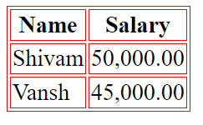
Tables – bordercolor
we can also set border color also using bordercolor attribute.
<html>
<head>
<title>HTML Tables</title> </head>
<body>
<table border="1"bordercolor="red" >
<tr>
<th>Name</th>
<th>Salary</th>
</tr>
<tr>
<td>Shivam</td>
<td>50,000.00</td>
</tr>
<tr>
<td>Vansh</td>
<td>45,000.00</td>
</tr>
</table>
</body>
</html>

Slide 30
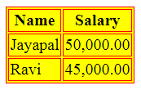
Tables – Backgrounds
Tables Backgrounds
bgcolor attribute − we can set background color for whole table or just for one cell.
background attribute − we can set background image for whole table or just for one cell.
<html>
<head>
<title>HTML Tables</title> </head>
<body>
<table border="1"bgcolor="yellow">
<tr>
<th>Name</th>
<th>Salary</th>
</tr>
<tr>
<td>Jayapal</td>
<td>50,000.00</td>
</tr>
<tr>
<td>Ravi</td>
<td>45,000.00</td>
</tr>
</table>
</body>
</html>

Slide 31
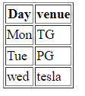
Tables – table body <tbody>
HTML <tbody> tag is used to group the table rows (<tr>) together, which indicates that this is body part of a table (<table>).
The <tbody> tag must be a child of <table> element.
The <tbody> is used along with <thead> and <tfoot> which shows the different part of the table that are table head, table body, and table footer, however, it does not affect the layout of the table.
<!DOCTYPE html>
<html>
<h1>The thead, tbody, and tfoot elements</h1>
<table border="1">
<thead>
<tr>
<th>Day</th>
<th>venue</th>
</tr>
</thead>
<tbody>
<tr>
<td>Mon</td>
<td>TG</td>
</tr>
<tr>
<td>Tue</td>
<td>PG</td>
</tr>
</tbody>
<tfoot>
<tr>
<td>wed</td>
<td>tesla</td>
</tr>
</tfoot>
</table>
</body>
</html>

Slide 32
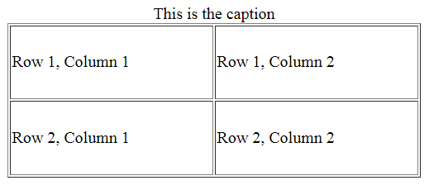
Tables- Height and Width attributes
We can set a table width and height using width and height attributes.
Specify table width or height in terms of pixels or in terms of percentage of available screen area.
Table Caption
The caption tag will serve as a title or explanation for the table and it shows up at the top of the table. This tag is deprecated in newer version of HTML/XHTML
<html>
<head>
<title>HTML Table Width/Height</title>
</head>
<body>
<table border = "1" width = "400" height = "150">
<caption>This is the caption</caption>
<tr>
<td>Row 1, Column 1</td>
<td>Row 1, Column 2</td>
</tr>
<tr>
<td>Row 2, Column 1</td>
<td>Row 2, Column 2</td>
</tr>
</table>
</body>
</html>

