Slide 1
Movie Recommendation System
Presented By:
A.Abhinay (R170441)
V.Hari krishna (R170448)

Slide 2
Abstract:
Showing the movie recommendations is essential so that the user need not waste a lot of time searching for the content which he/she might like.
From this, movie recommendation system plays an important role to get personalized movie recommendations.
In this Project the recommendations are made using “Content-based filtering” which are using a “text to vector conversion” technique to find the similarity between the vectors.

Slide 3
Objectives:
Build a movie recommendation system based on ‘TMDB’ dataset.
We wish to integrate the aspects of personalization of user with the overall features of movie such as genre, popularity etc.
Providing the accurate and most confined results by using the distance between two vector models and graph plottings.
Classifying the user interested movies and recommend them to their searches fast with the help of libraries and softwares such as pip and pandas etc.
Notes:
Implemented popularity model, content based model, collaborative filtering model and latent factor based model and combining the above to form a hybrid model.
Hyperparameter tuning, testing accuracy and evaluation of recommendations of each model

Slide 4
Introduction:
Due to abundance of information till 21st century and rate of information flowing over the internet there is lot of confusion what to consume and what not consume.
So we need to filter the data in order to consume it, because generally we are not interested in each and everything available to us.
In order to filter the data, we need some filtering techniques.
By filtering the huge amount of data, user need not to waste a lot of time searching for the content which he might like on internet.

Slide 5
What is a recommender system?
A Recommender system is a simple algorithm whose aim is to provide the most relevant information to a user by discovering patterns in a dataset. The algorithm rates the items and shows the user the items that they would rate highly. An example of recommendation is when you visit amazon and you notice that some items are being recommended to you or when Netflix recommends certain movies to you. They are also used by the Music streaming applications such as Spotify and Jiosaavn to recommend music that you might like.

Slide 6
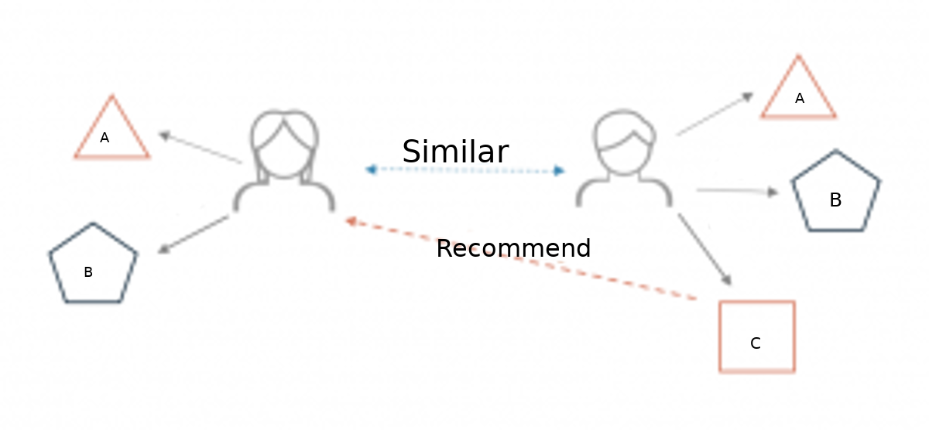
Below is a very simple illustration of how recommender system work in the context of a movie recommendation.

Slide 7
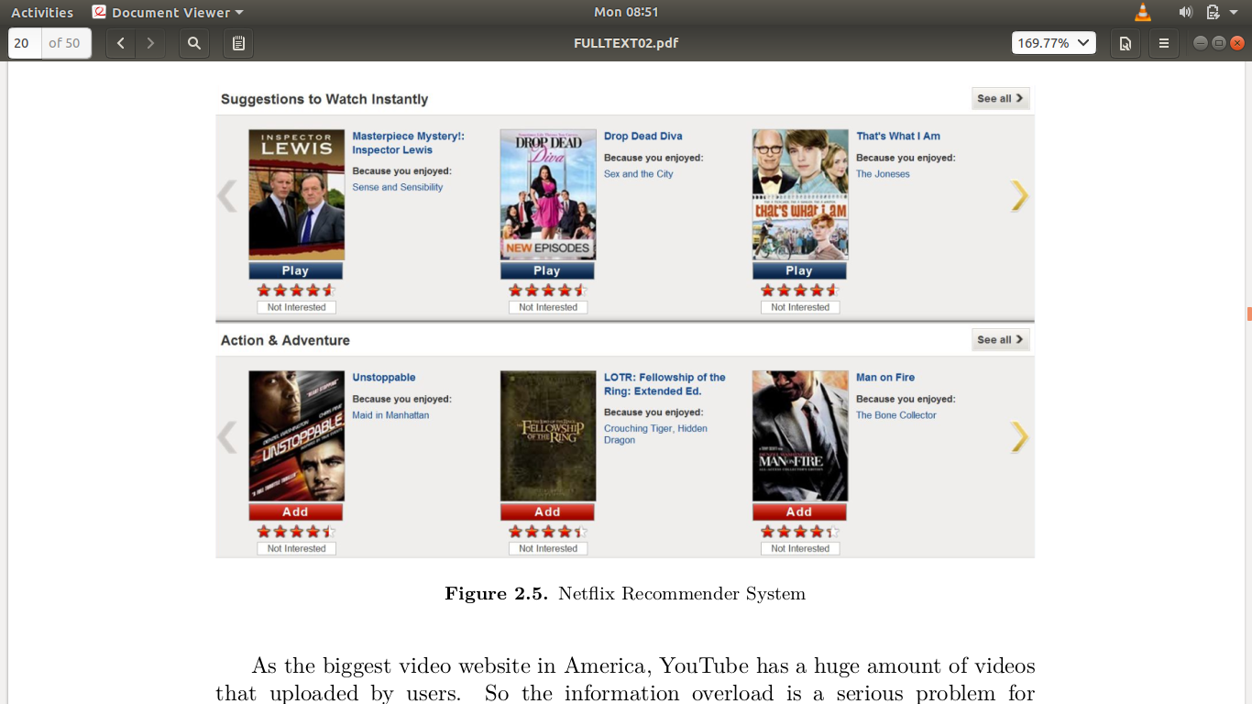
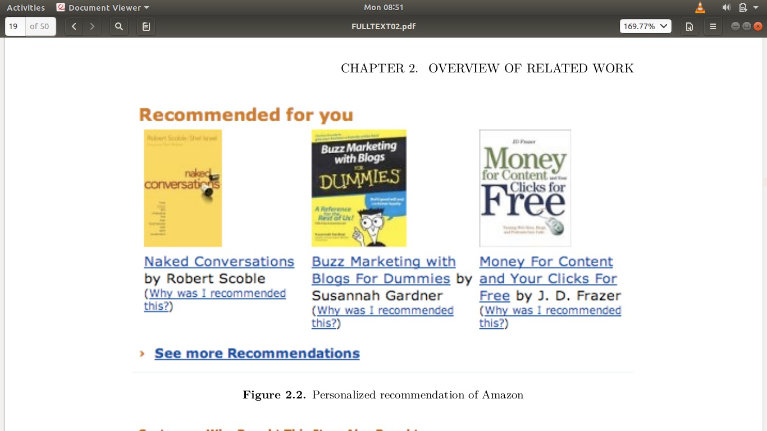

Slide 8
Proposed Methodology
We need to perform preprocessing on the dataset and combine the relevant features.
Later we need to convert the text from that particular features into vectors.
Later we need to find the similarity between the vectors.

Slide 9
Different types of recommendation techniques:
There are different types of filtering techniques or movie recommendation algorithms available.
Popularity Based Model
Collaborative based Filtering
Content based Filtering
Hybrid Model

Slide 10
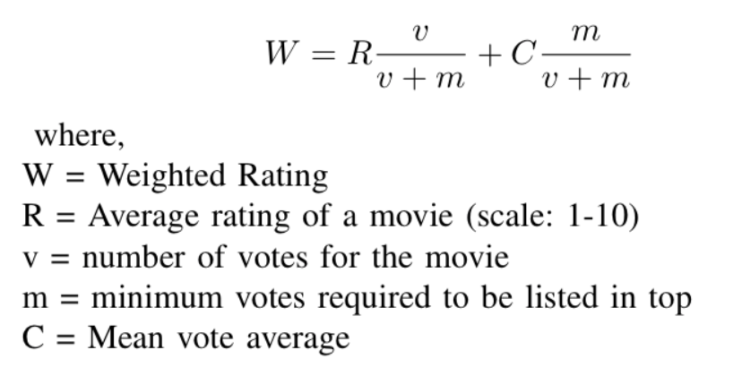
Popularity Model
It is a type of recommendation system which works on the principle of popularity and or anything which is in trend.
These systems check about the product or movie which are in trend or most popular among the users and directly recommend those.
Computed on:

Slide 11
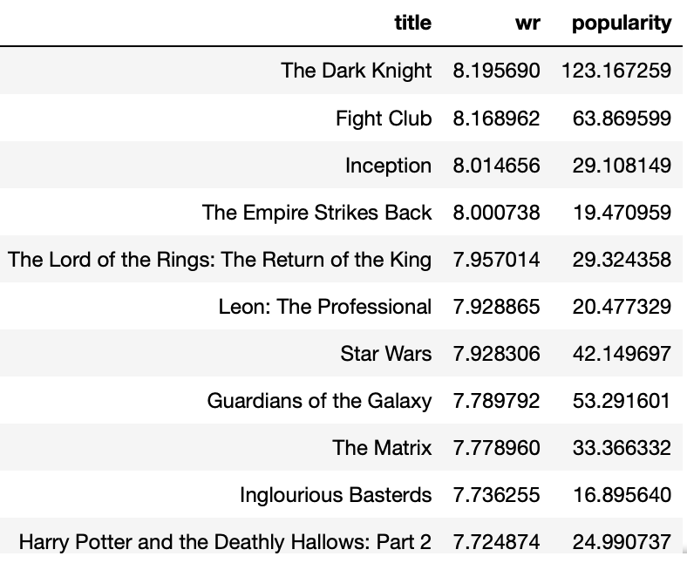
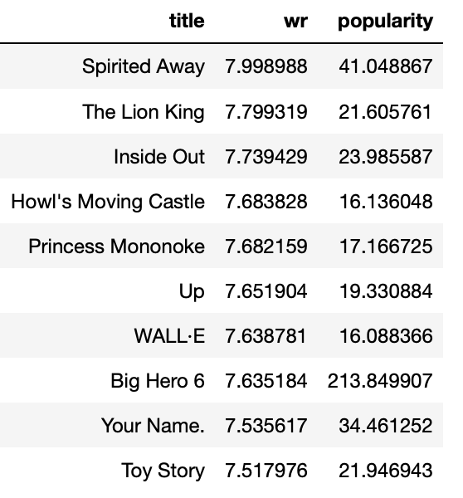
Action Movies
Animated Movies

Slide 12
Collaborative Filtering
Collaborative filtering is the most famous algorithm in the recommender systems.
Here the two similar user likings acts as a recommender to each other. Like, we two users watch comedy movies so if a new comedy stuff appears and is watched by user A it will also be recommended to User B.
For example, if A and B like the same movies and a new movie came out that A like, then we can recommend that movie to the B because A and B seem to like the same movies.
Notes:
Pearson Baseline: This method computes the Pearson correlation coefficient between all pairs of users (or items) using baselines for centering instead of means.

Slide 13
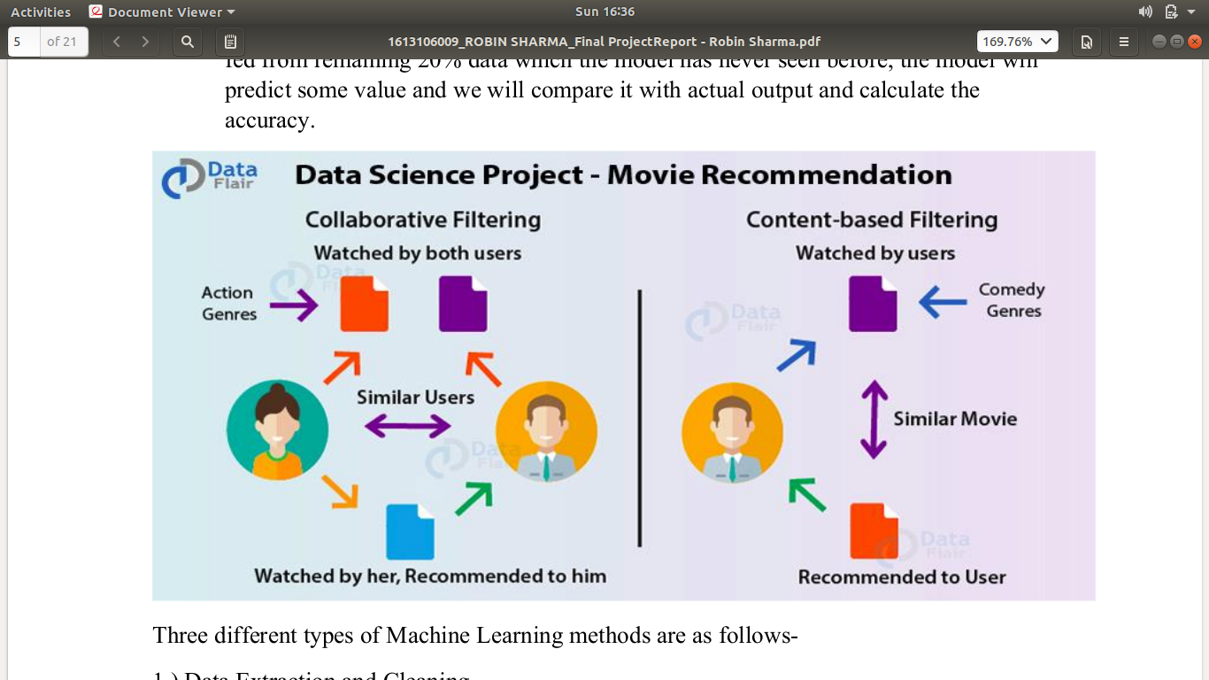

Slide 14
Collaborative Filtering Types:
Collaborative filtering is again divided into two types based on the user and item.
User-based collaborative algorithm: Here it is considered that a user will like the items that are liked by users with whom have similar taste.
Simply speaking, given user u and v, N (u) and N (v) are items set liked by u and v respectively. So the similarity of u and v can be simply defined as:
Item-based collaborative algorithm: Here it assumes users will like items that are similar with items that the user liked before.
Assume N (i) and N (j) are user sets who like i and j respectively. So the similarity of i and j can be defined as:

Slide 15
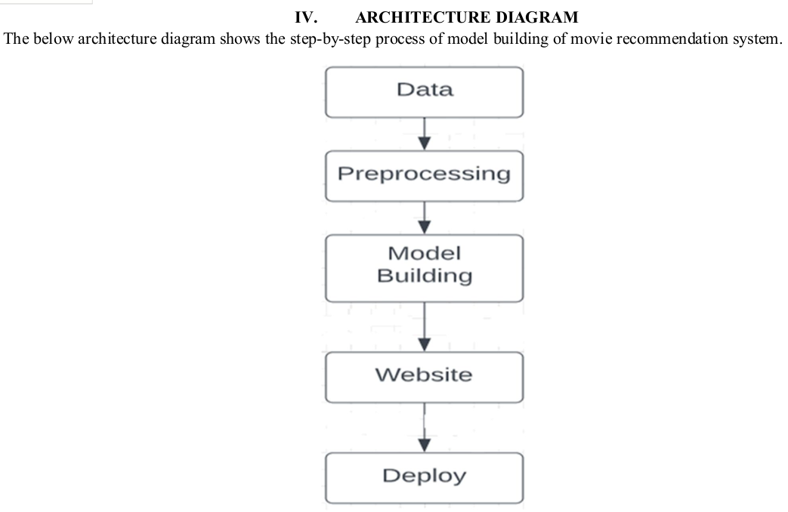

Slide 16
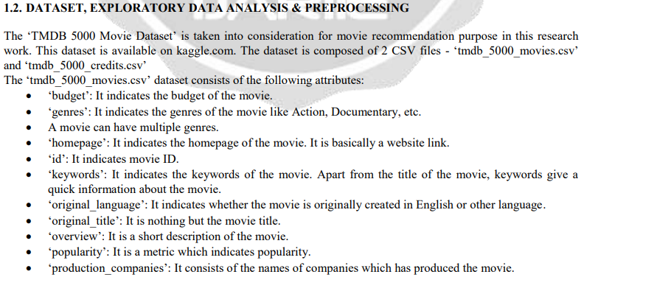
DataSet
TMDB 5000 movie dataset.
TMDB 5000 credits dataset.
Notes:
The primary dataset used for this project is the movielens review dataset. consisting of 27,753,444 reviews over 58,098 different movies by 283,228 users.

Slide 17
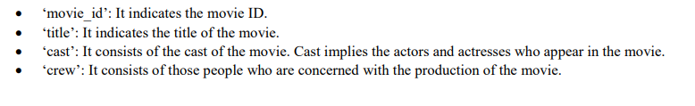

Slide 18
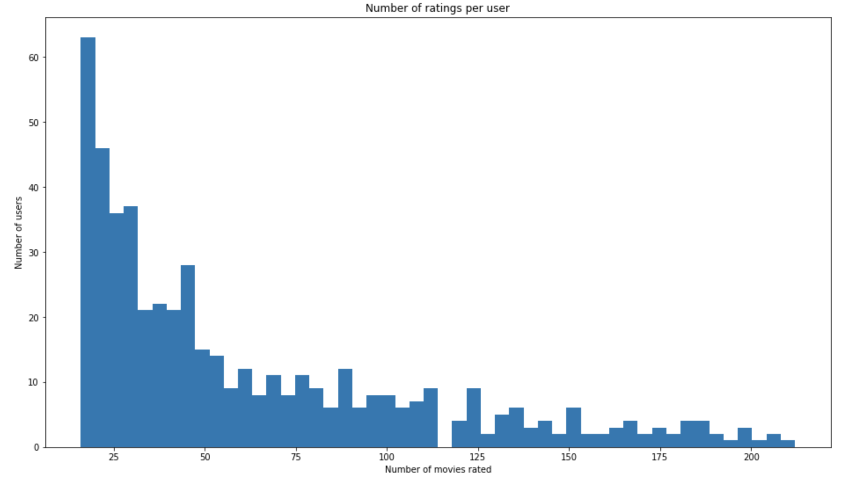
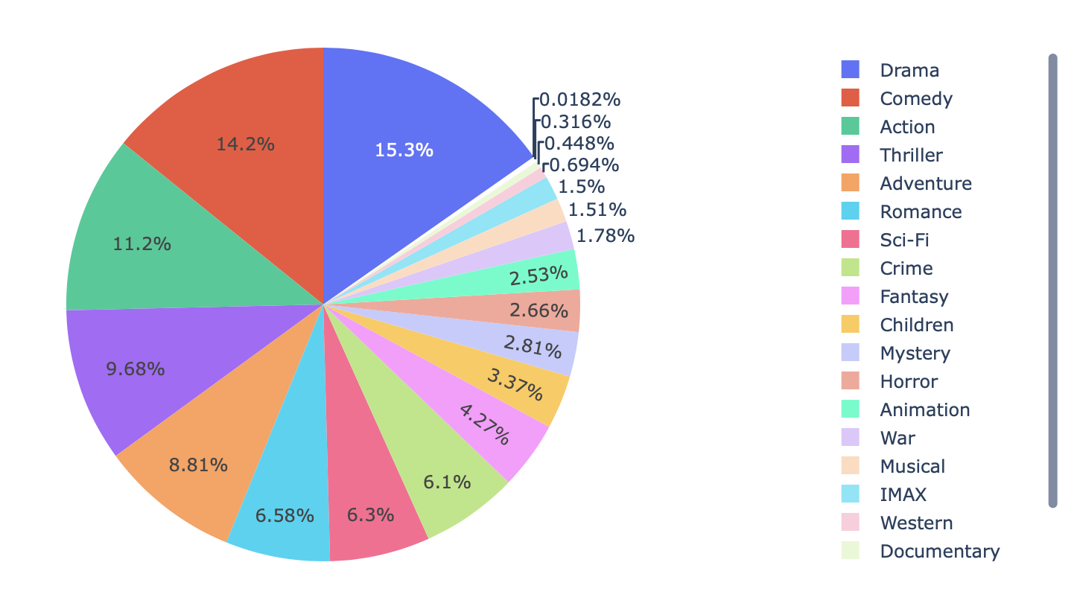
Data Analysis
Number of ratings per user:
Genre Distribution:

Slide 19
Content-Based Recommendation
Here the similar movies are been recommended to the user according to his previous content search.
The core idea of content-based recommender system is to calculate the similarity between the items.
There are lot of methods to model items and the most famous one is “vector space model”.
Movie recommendation model recommends based on these features of the movie.
Title, overview of the movie, genres, keywords , cast , director.

Slide 20
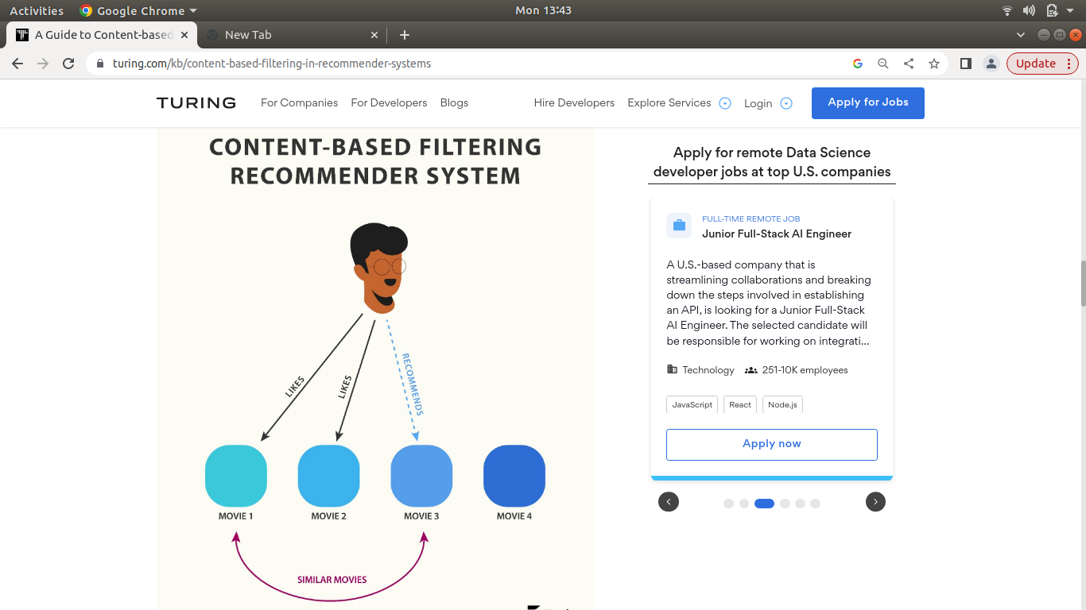

Slide 21
Example
Suppose I am a big fan of the Harry Potter series and watch only such kind of movies on the internet.
When my data will be gathered from Google or wikipedia, it will be found out that I am a fan of fantasy movies.
Therefore, my recommendation will be filled with fantasy movies. Among all the movies the ones best for me will be curated and then recommend for me.
Suppose there are two movies, one is fantastic beasts and other is shawshank redemption, then according to my preference fantastic beasts will be recommend to me.

Slide 22
How does it work..?
1. The content-based recommendation system works on the “vectorization”.
2. We convert movie tag in vector form.
3. We use ‘Bag of Words’ technique to convert text into vector.
4. The bag of words technique involves breaking down movie titles, descriptors, and reviews into individual words, or “tokens.” These tokens are then counted and used to create a vector representation of the movie.

Slide 23
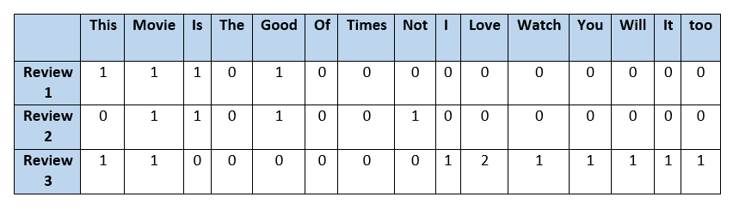
Bag of words
Extracts 5000 most common words from the all movie tags.
Counts these words in each movie, these word counts numbers represent a vector for each movie.

Slide 24
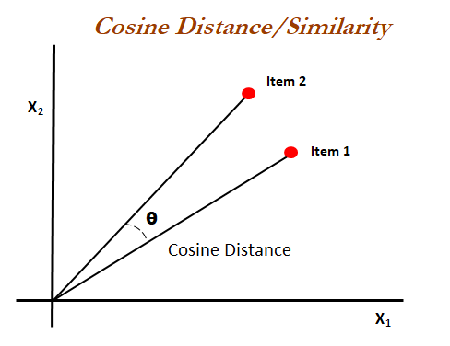

Slide 25
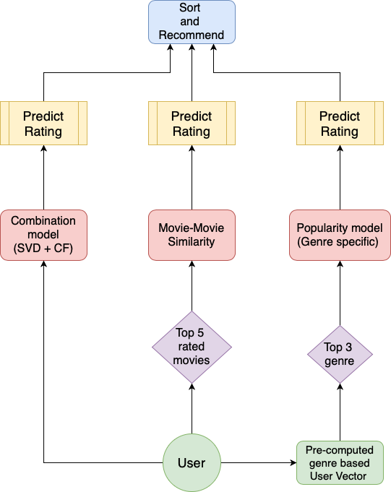
Hybrid Model
Hybrid Recommender System is more and more popular currently.
Combining collaborative filtering and content-based filtering can be more effective in recommendations of items to the users.
There are many ways to implement hybrid model: by simply combine the results of CF and CB recommendations.

Slide 26
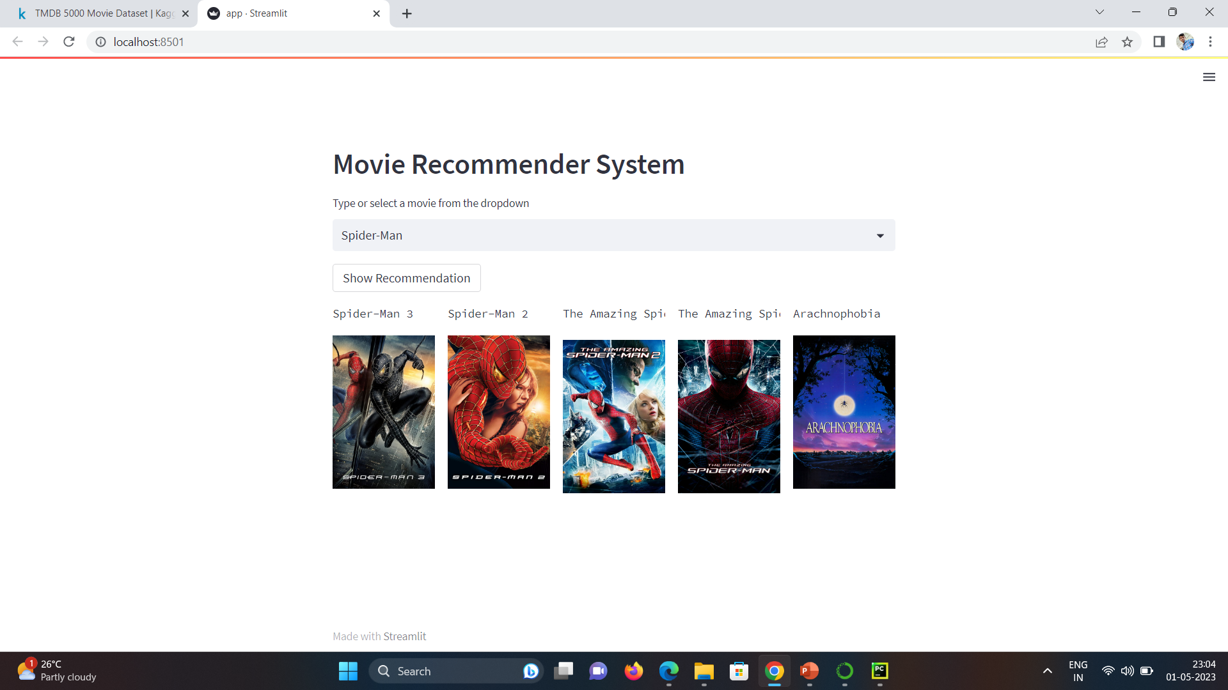
Result

Slide 27


