Slide 1


ColdFire
Your Personal Study Assistant…
Team Members:
Dakshal Shah
Nicholas Kumia
Angana Kanbid

Slide 2
Application Idea
An Android Application that:
lets the user share and view study material of their subject of interest.
Main Objective:
Create a Plan of Study for current Graduate Students of Computer Science Department.
Scalable to different Departments!

Slide 3
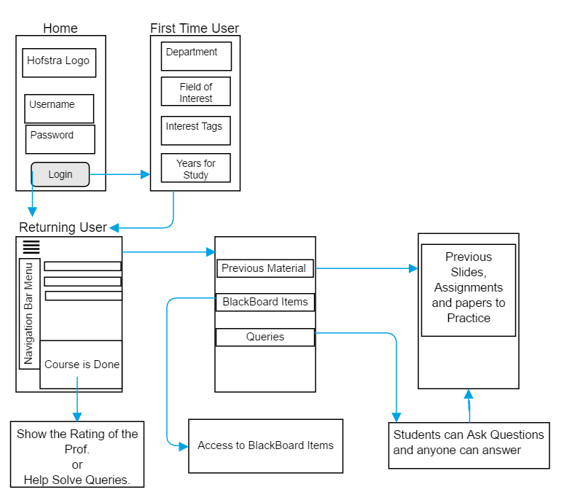


Slide 4
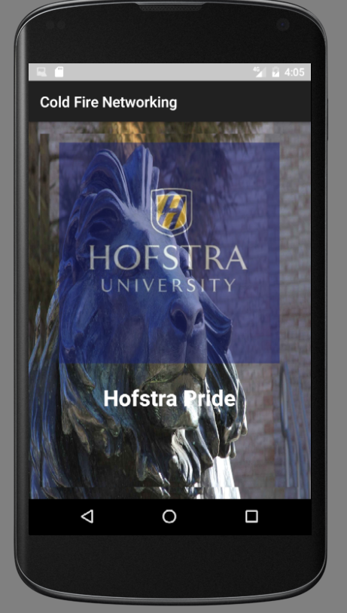
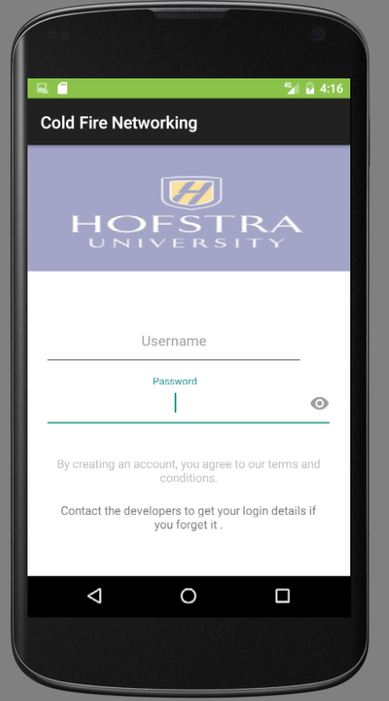
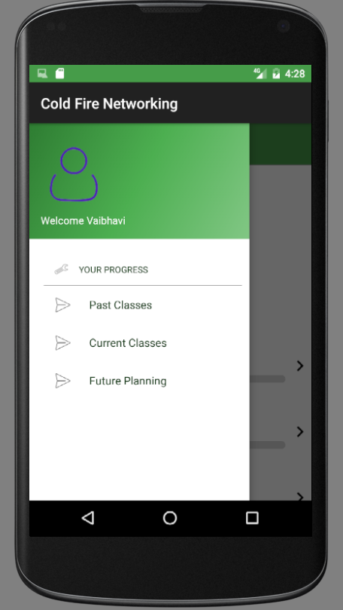
Login Page
App Description
Splash Page
Fetching Users’ Interests

Slide 5
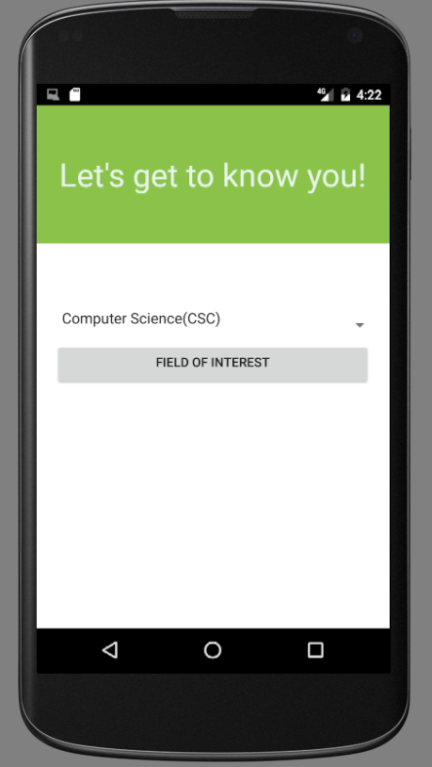
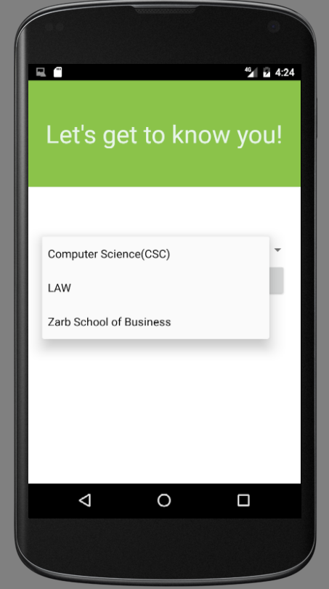
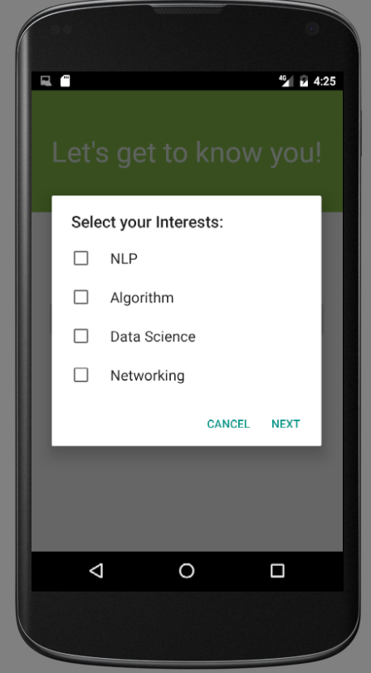
Fetching User Interests

Slide 6
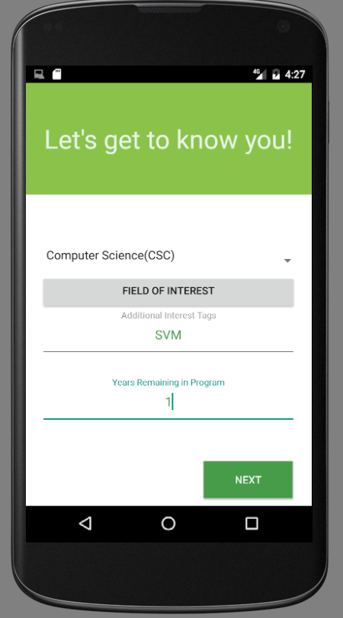
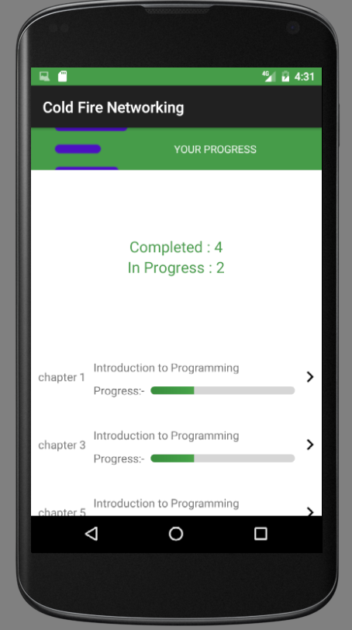

Slide 7
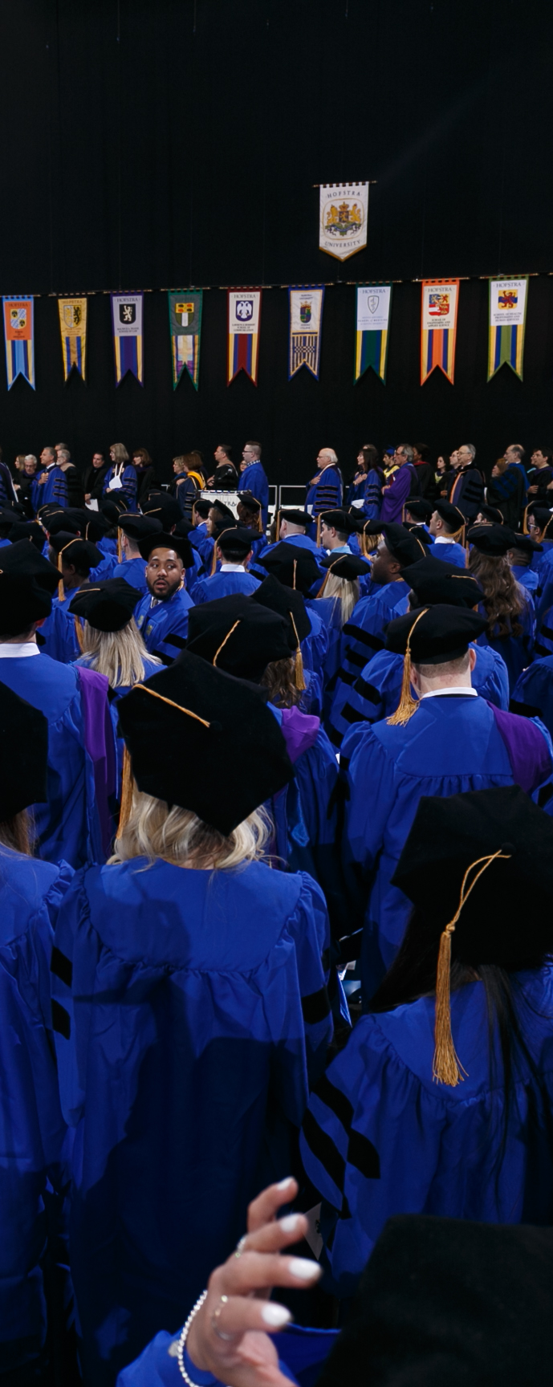
Future:
Its developed towards Computer Science Graduate Students and their respective courses.
In future we expect to upgrade this application with subjects of all departments in Hoftsra University.
We expect to targets all Hofstra Students.
In future, we would like to Add the Feature of:
“Rating the Professors”
“Sharing academic resources with fellow colleagues”
“Solving Queries” (Answering FAQs)

Slide 8

Thank You

