Slide 1


ColdFire
Your Personal Study Assistant…
Team Members:
Dakshal Shah
Nicholas Kumia
Angana Kanbid

Slide 2
Application Idea
Cold Fire is an Android Application that lets the user share and view study material of their subject of interest.
Main Objective of Application is to create a Schedule for….
At present the application is made focusing Hofstra University Graduate Students of Computer Science Department.

Slide 3
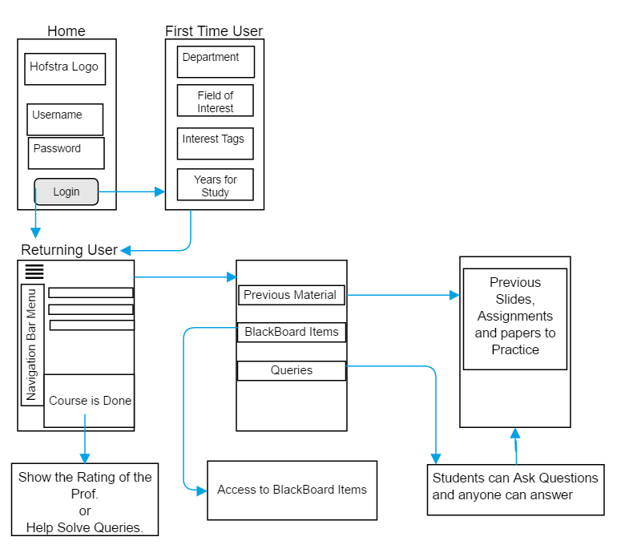


Slide 4
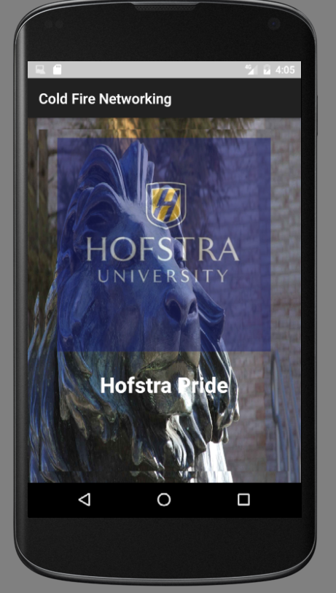
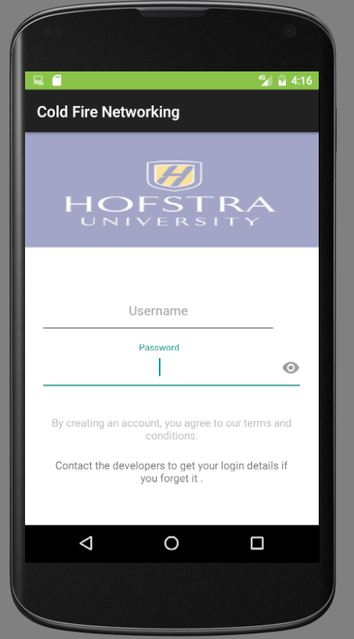
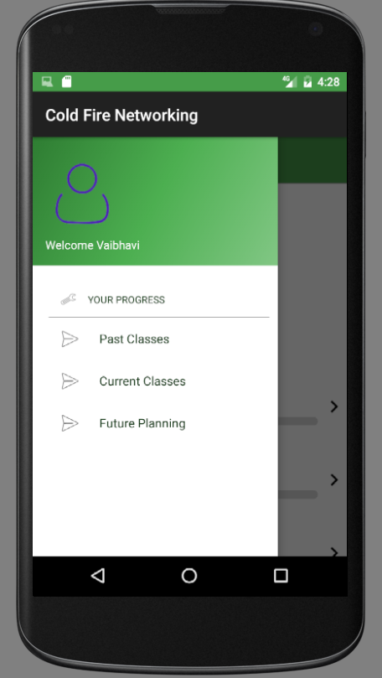
Login Page
App Description
Splash Page
Fetching Users’ Interests

Slide 5
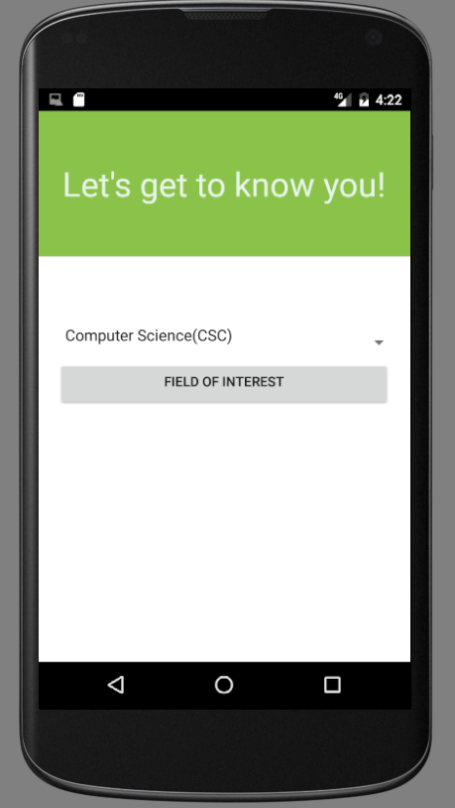
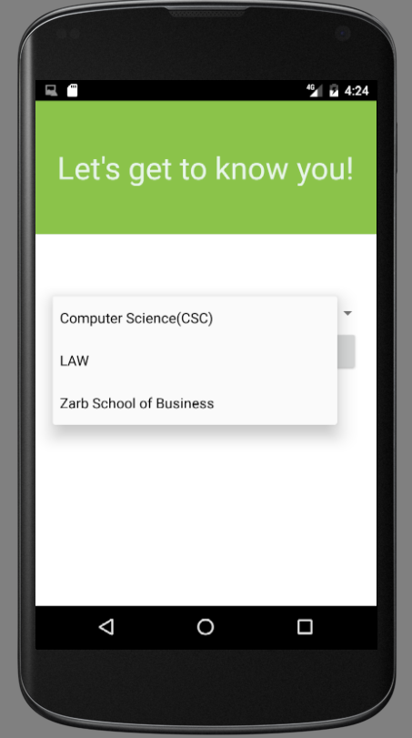
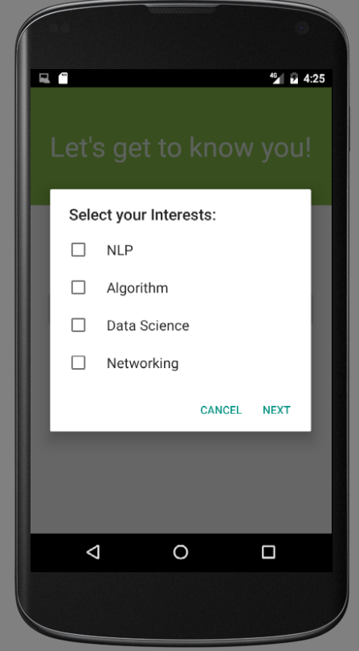
Fetching User Interests

Slide 6
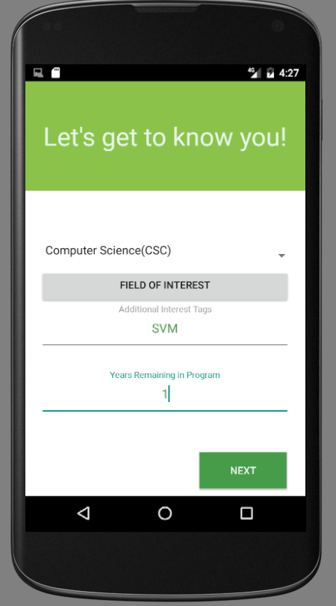
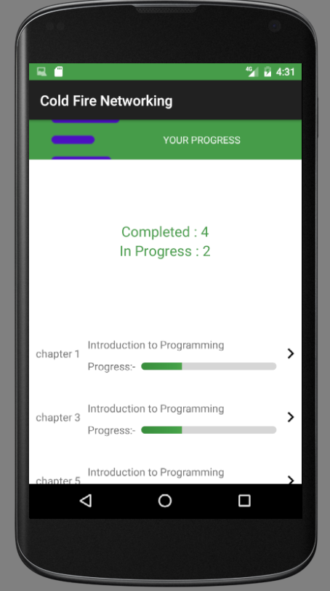

Slide 7
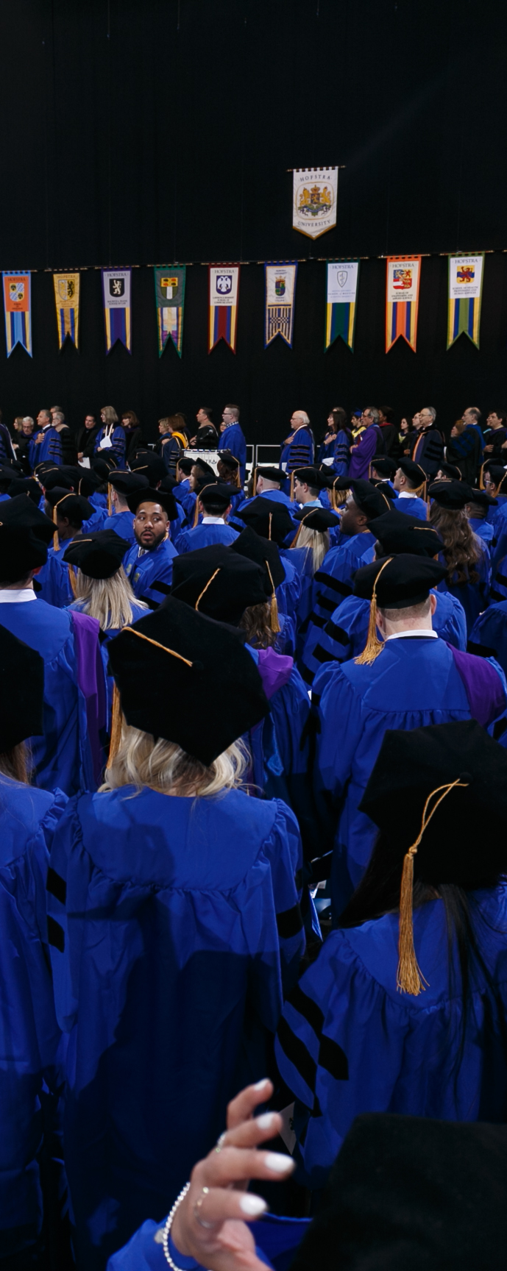
Future:
At Present its Developed focusing towards Computer Science Graduate Students and their respective courses.
In future we expect to upgrade this application with subjects of all departments in Hoftsra University.
We expect to Targets All Hofstra Students.
In future we would like to Add the Feature of “Rating the Professors” and “Solving Queries”.

Slide 8

Thank You

