Slide 1

Smart Interview Assistant: An AI-Powered Evaluation and Feedback System
Tanveer Angane (22106057)
Sudhiksha Aradhyula (22106010)
Siddharth Chaurasiya (22106060)
Anish Gawade (22106109)
Major Project Guide Name: Prof. Adesh Hardas

Slide 2
Outline
Introduction
Literature Survey of the existing systems
Limitations of the existing systems
Problem statement and Objective
Proposed System
Experimental Setup
Implementation
Conclusion and future work
References
Research Paper Publication / Patent/ Copyright status

Slide 3
Introduction
In today's competitive job market, interviews are a crucial step for evaluating a candidate's skills and personality.
Traditional interview methods often suffer from challenges such as scheduling conflicts, subjective evaluations, and a lack of detailed feedback for candidates.
The rapid advancements in Artificial Intelligence (AI) and Natural Language Processing (NLP) provide new opportunities to transform the recruitment process.
Smart Interview Assistant is designed to address these issues by integrating AI-powered question generation, resume parsing, and real-time feedback analysis.

Slide 4
Motivation
Problem Gap: The traditional interview process is time-consuming, biased, and lacks detailed feedback. Existing AI tools offer only partial solutions, failing to provide a comprehensive, transparent, and affordable platform.
Market Need: A significant gap exists for a system that can generate personalized, resume-based questions, conduct AI-driven interviews, and provide objective feedback on both verbal and non-verbal cues.
Technological Opportunity: Advances in AI and NLP present a unique opportunity to automate interviews, generate personalized questions, and provide data-backed feedback.
Affordability: Commercial solutions are expensive and not feasible for small companies or academic institutions, creating a need for an affordable alternative

Slide 5
Objective
AI-Powered Platform: To design an AI-powered interview platform that integrates video/audio recording, transcription, and question generation.
Resume Parsing: To develop a resume parser that extracts candidate details and generates personalized interview questions.
Real-time Feedback: To implement real-time feedback mechanisms based on clarity, confidence, body language, and emotions.
Affordability and Fairness: To ensure fairness, transparency, and affordability by leveraging open-source models and APIs.
Comprehensive Reporting: To generate a comprehensive PDF report summarizing the candidate’s performance, strengths, and areas of improvement.
Deployment & Scalability Objectives: Achieve production-ready deployment on Firebase hosting.

Slide 6
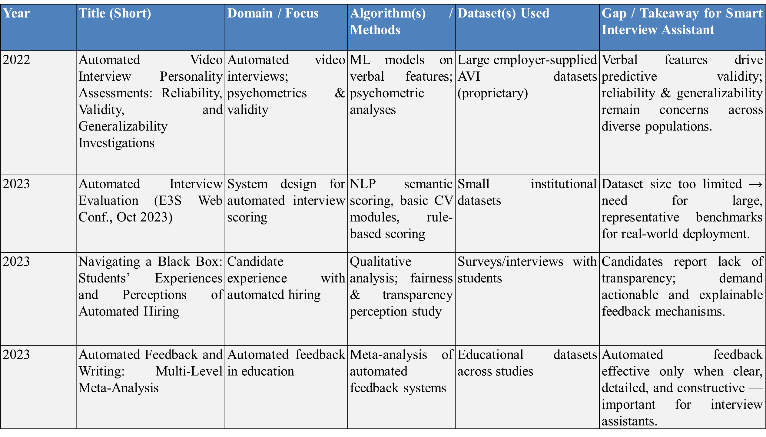
Literature Survey

Slide 7
Year | Title (Short) | Domain / Focus | Algorithm(s) / Methods | Dataset(s) Used | Gap / Takeaway for Smart Interview Assistant
2023 | Fairness in AI-Driven Recruitment: Challenges, Metrics, Mitigations | Survey on fairness & bias in recruitment | Review of fairness metrics, adversarial debiasing, auditing methods | Meta-analysis of AI recruitment systems | Lack of standardized fairness audits → must integrate fairness checks and bias mitigation in AI hiring tools.
2024 | Are Automated Video Interviews Smart Enough? Behavioral Modes, Reliability, Validity, and Bias | Multi-modal interview evaluation (verbal, paraverbal, nonverbal) | ML-based multi-modal behavior analysis | Proprietary annotated interview datasets | Verbal cues outperform nonverbal for validity; careful feature selection and validation are needed.
2024 | Improving Automated Scoring of Prosody in Oral Reading Fluency (Frontiers in Education, 2024) | Speech/prosody assessment | Deep learning for prosodic feature extraction and fluency scoring | Academic oral reading corpora | Prosody scoring still weak for spontaneous conversational speech (as in interviews).
2024 | Large Language Model-Powered Automated Assessment (Systematic Review, 2018–2024) | LLM-based assessment & feedback | Survey of LLM scoring and feedback generation | Aggregated datasets from 2018–2024 studies | LLMs generate human-like feedback but risk inconsistency, rubric misalignment, and bias without monitoring.

Slide 8
Limitations of Existing System
Bias in Evaluation: Many current AI platforms have been criticized for evaluations that are biased by factors like gender, race, or accent
High Cost: Commercial solutions are often expensive, making them inaccessible for small companies and academic institutions.
Limited Feedback: Existing systems typically only provide textual feedback and lack detailed analysis of non-verbal cues like body language and expressions.
Poor Integration: Many tools focus on a single aspect (e.g., transcription or video recording) instead of offering a complete, end-to-end solution
Lack of Customization: Few platforms can generate interview questions that are personalized based on a candidate's resume

Slide 9
Problem Statement
To create a comprehensive, transparent, and affordable AI-driven system that overcomes the limitations of traditional interviews and existing partial solutions by providing detailed, objective feedback to both candidates and recruiters.

Slide 10
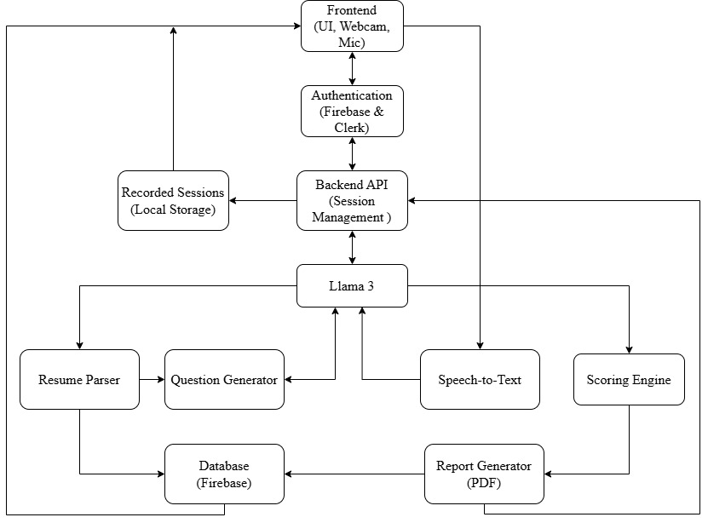
System Design

Slide 11
System Design
System Design: The proposed system will be a seamless, cloud-hosted platform that integrates several key components.
Key Components:
Resume Parser: Extracts candidate details to generate customized interview questions.
Speech-to-Text Transcription: Transcribes real-time audio from interviews.
AI-Powered Question Generation: Creates role-specific and personalized questions.
Real-time Feedback Analysis: Evaluates communication clarity, confidence, and body language.
Facial Expression Analysis: Analyzes emotions and expressions.
Comprehensive PDF Report: Summarizes performance, strengths, and areas for improvement for both candidates and recruiters.

Slide 12







Technology used
Software Requirements:
Frontend: React 18 with TypeScript, Vite, TailwindCSS, shadcn-ui components
Backend Services: Firebase Cloud Functions (Node js)
Database: Firebase Firestore (NoSQL database)
AI Services: Ollama with Llama 3 model (local AI processing), Google Gemini API (cloud AI fallback)
Hardware Requirements:
Client Side: Intel i5 or equivalent, 8 GB RAM and a 720p HD webcam, Microphone (Built-in).
Server-Side: Firebase Cloud Platform, Cloud Functions with 2 GB RAM, Firestore with automatic scaling

Slide 13
Technology used
AI Models Used:
Model: llama3:latest (8B parameters)
Size: 4.7 GB download
Purpose: Interview question generation, answer evaluation, resume parsing
Google Gemini API (Cloud Fallback):
Model: gemini-1.5-flash
Type: Cloud-based LLM API
Purpose: Backup AI service when Ollama unavailable

Slide 14
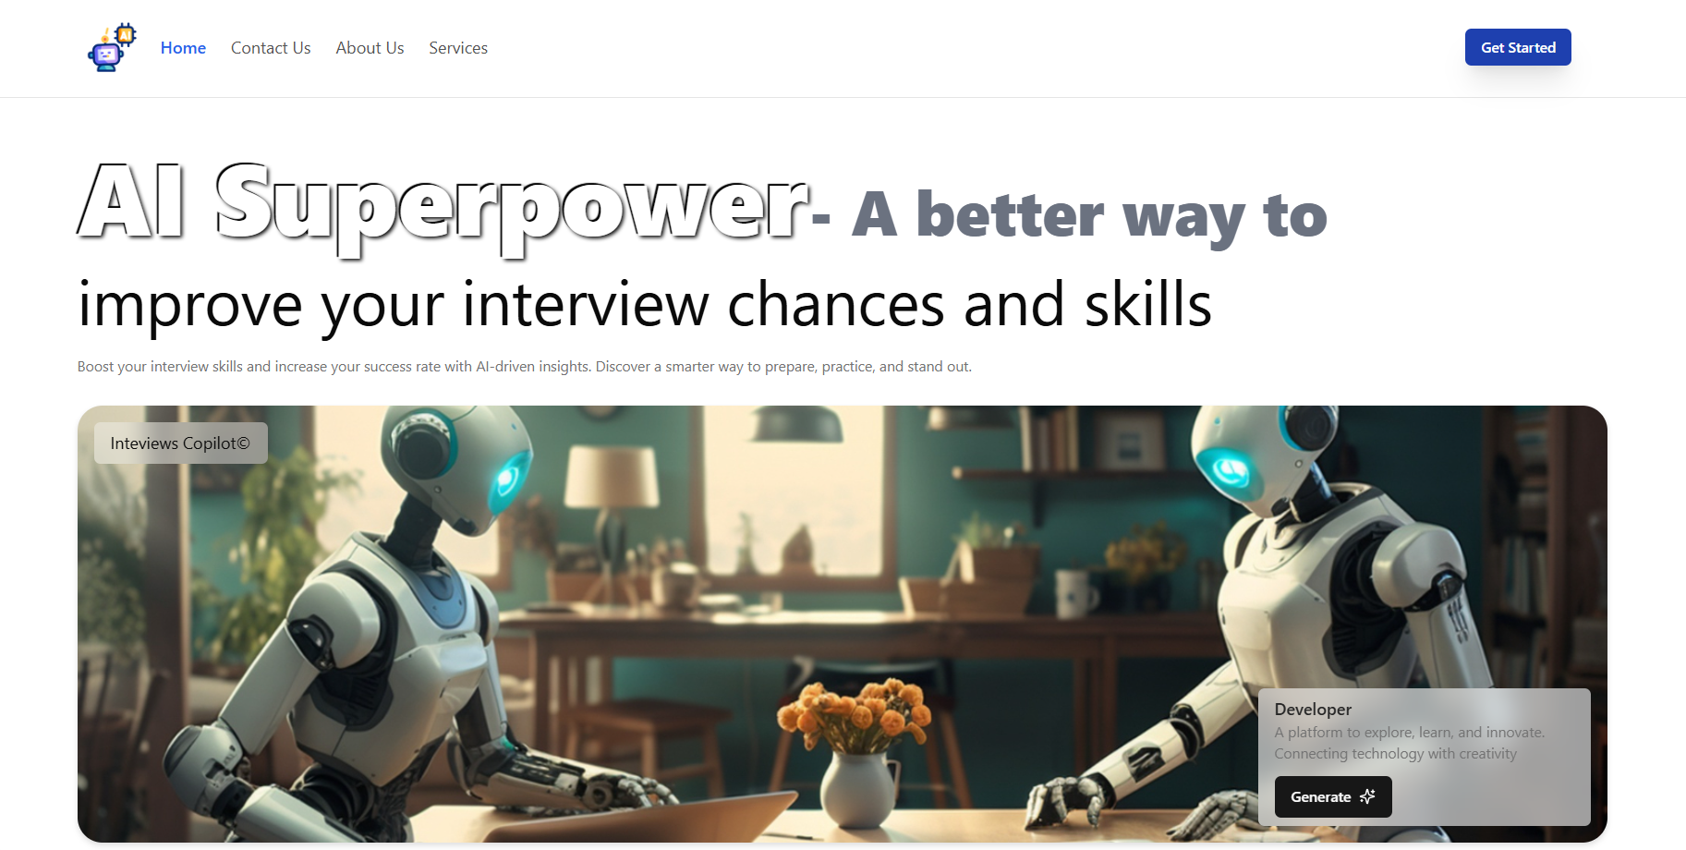
Implementation

Slide 15
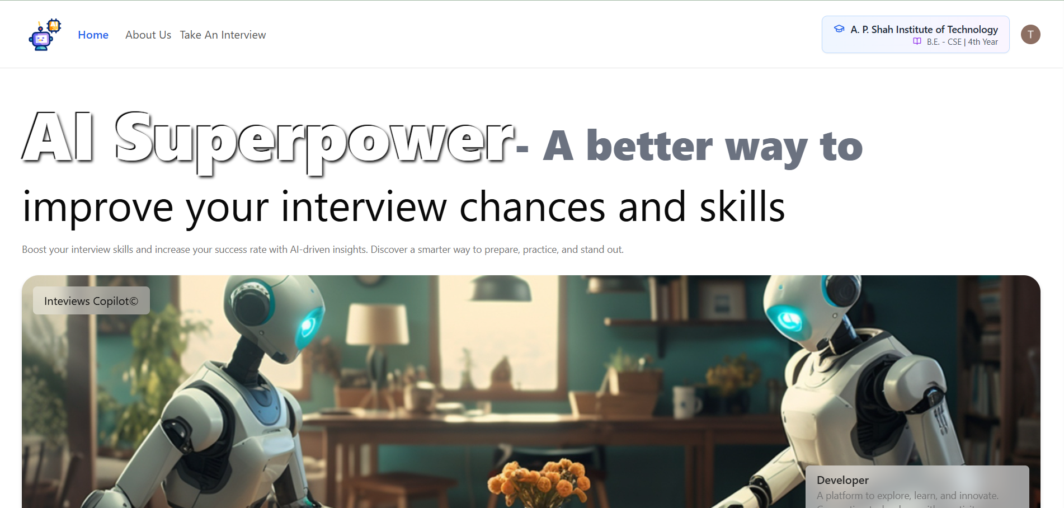

Slide 16
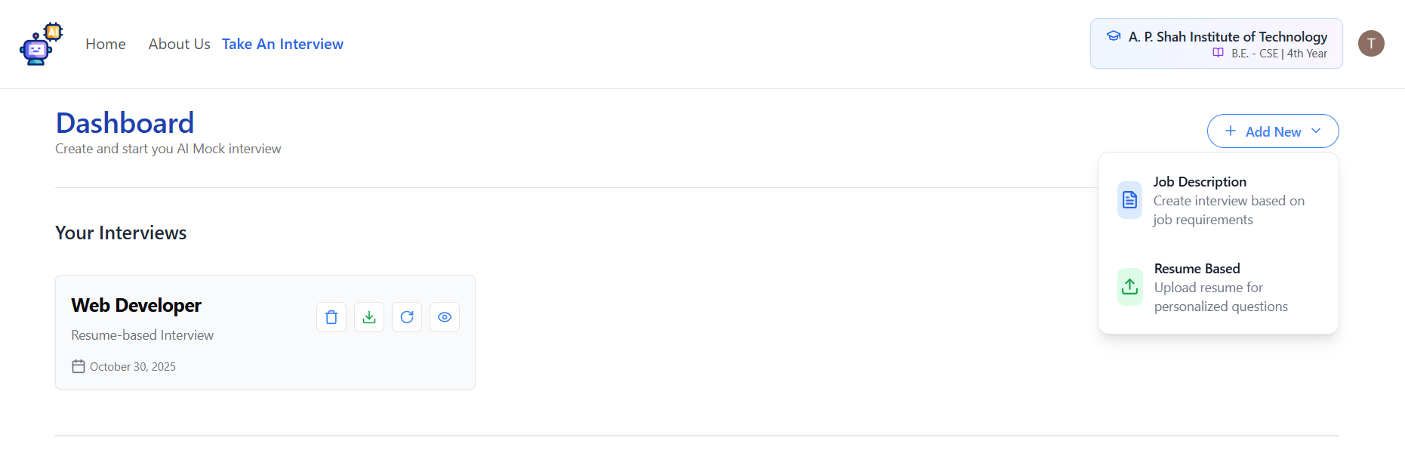

Slide 17
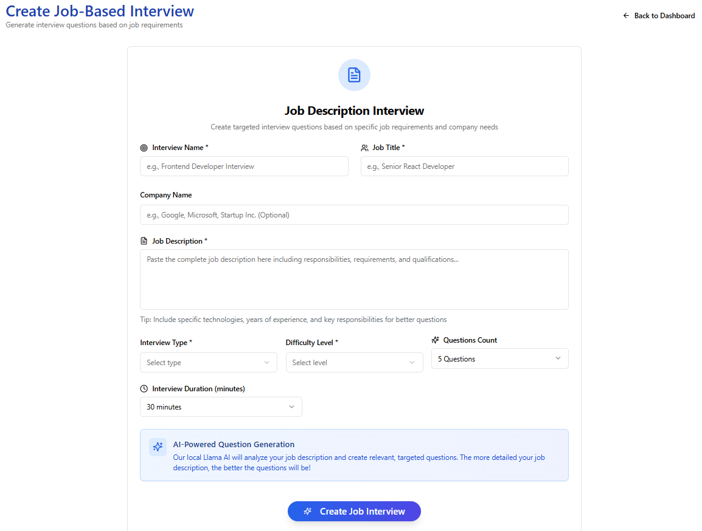

Slide 18
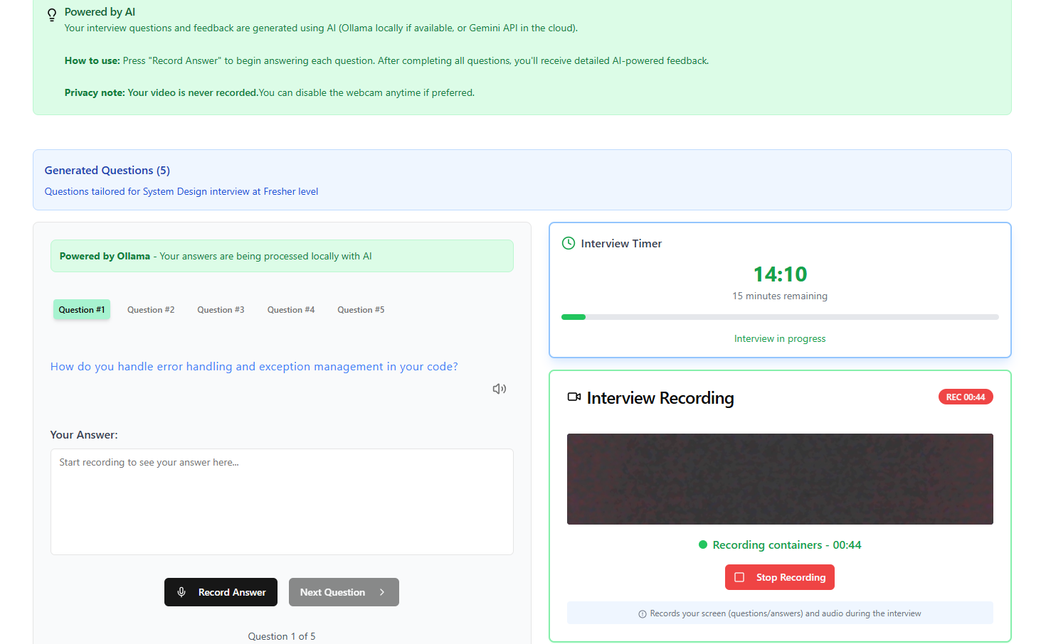

Slide 19
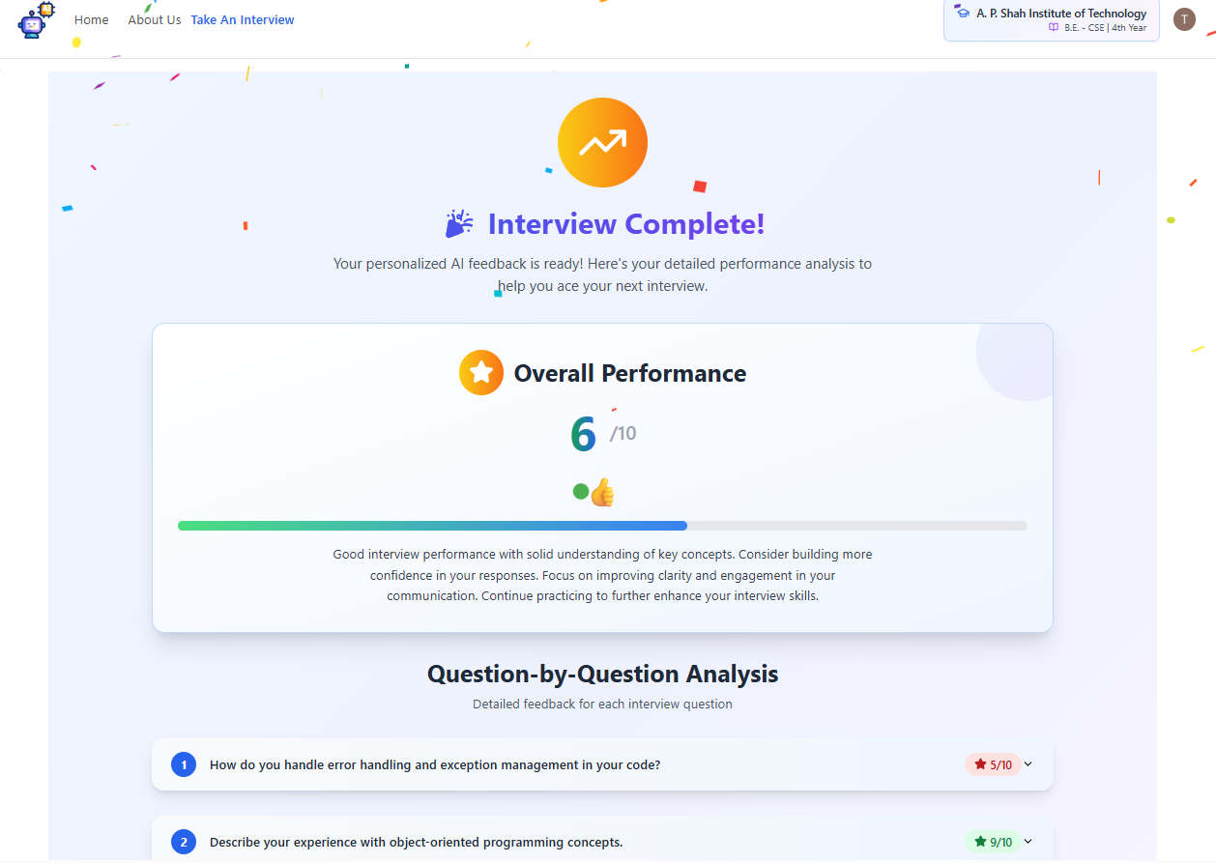

Slide 20
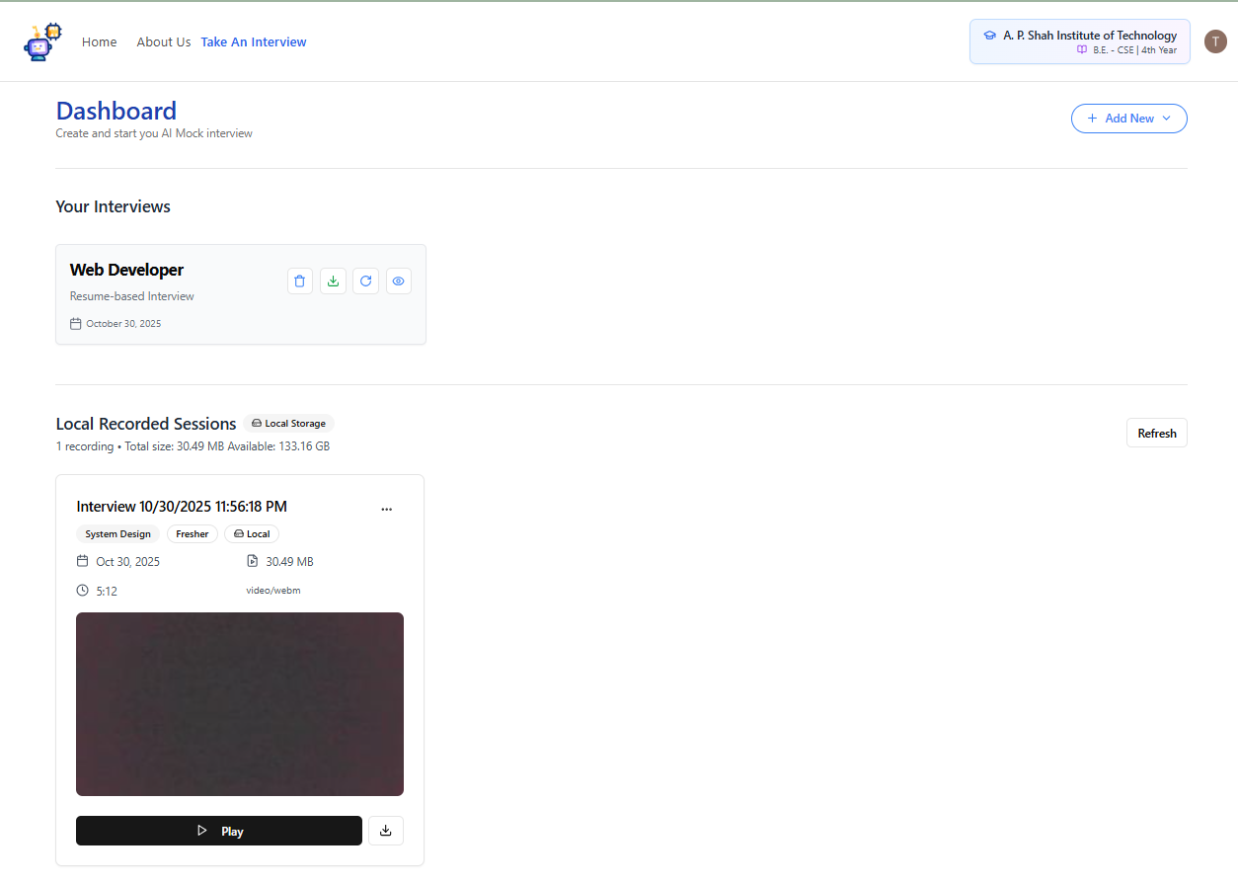

Slide 21
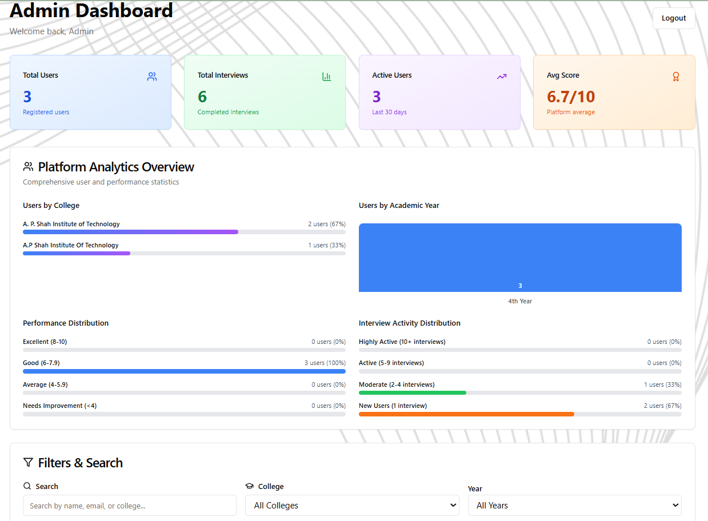

Slide 22
Expected Outcome
Benefits for Candidates:
A platform for practicing interviews with instant feedback.
Improved communication and confidence.
Identification of personal strengths and weaknesses.
• Benefits for Educational Institutions:
Provides an automated training platform for students preparing for campus placements
Tracks student progress and performance metrics for institutional analytics.
Technical & Operational Outcomes:
Successful implementation of hybrid AI system (local Ollama + cloud Gemini)
90%+ accuracy in interview question generation and feedback evaluation

Slide 23
Conclusion
The AI Mock Interview Platform successfully addresses the critical gaps in traditional interview preparation by delivering a comprehensive, intelligent solution that combines realistic practice simulations, personalized question generation, multi-dimensional performance analysis, and detailed actionable feedback. By leveraging advanced AI technologies including local Ollama integration and cloud-based Gemini API, the platform ensures accessibility, affordability, and privacy while maintaining high accuracy and reliability.

Slide 24
References

Slide 25
THANK YOU

