Slide 1

Real Time Object Detection using Computer Vision
By
Tanveer Angane (22106057)
Siddharth Chaurasiya (22106060)
Anish Gawade (22106109)
Under the Guidance of
Prof. Bharti Khemani

Slide 2
Outline
INTRODUCTION
LITERATURE SURVEY OF THE EXISTING SYSTEMS
LIMITATIONS OF THE EXISTING SYSTEM
PROBLEM STATEMENT
PROPOSED SYSTEM DESIGN
FRAMEWORK/ALGORITHM
TECHNOLOGIES STACK FOR PROPOSED SYSTEM
IMPLEMENTATION
CONCLUSION
REFERENCES

Slide 3
INTRODUCTION
Real-time object detection using IoT and computer vision enables smart devices to identify, track, and analyze objects with high accuracy and speed.
This technology leverages AI-powered deep learning models like YOLO to process visual data from cameras and sensors in real time.
AI-powered smart cameras analyze traffic flow, detect violations, and improve road safety. Autonomous vehicles also rely on object detection to navigate, identify pedestrians, and avoid collisions.
AI models continue to evolve, and edge computing technology advances, the adoption of smart vision-based IoT systems will increase across various sectors.
This technology is paving the way for a future where machines can perceive and react to their surroundings with human-like intelligence.

Slide 4
This project aims to address the following key objectives:
Develop Smart Systems – Enable AI-powered automation for real-time object identification and decision-making.
Enhance Road Safety – Detect violations, accidents, and obstacles to prevent collisions.
Improve Traffic & Transportation – Implement smart traffic monitoring, vehicle tracking, and autonomous navigation for safer roads.
Facilitate Real-Time Decision-Making – Use edge computing and IoT networks for instant data processing and response.

Slide 5
LITERATURE SURVEY
SR. NO.
PAPER NAME
AUTHORS
PROS
CONS
Real-time object detection method based on improved YOLOv4-tiny
Zicong Jiang, Liquan Zhao, Shuaiyang Li, Yanfei Jia
Faster Detection Speed
Enhanced Feature Extraction
Potential Trade-off in Accuracy
Increased Architectural Complexity
1.

Slide 6
LITERATURE SURVEY
 |  | D.M. Gavrila; V. Philomin
SR. NO.
PAPER NAME
AUTHORS
PROS
CONS
Limited to Shape-Based Detection
Hardware-Specific Implementation Challenges
Real-time object detection for "smart" vehicles
Efficient Shape-Based Detection
High-Speed Performance
2.

Slide 7
LITERATURE SURVEY
 |  | Alev Dilek Aydin
SR. NO.
PAPER NAME
AUTHORS
PROS
CONS
Design and implementation of real-time object detection system based on single-shoot detector and OpenCV
High Accuracy and Efficiency
Use of Pre-Trained Models and Freely Available Datasets
Hardware Limitations
Potential Trade-Off Between Speed and Accuracy
3.

Slide 8
LITERATURE SURVEY
 | Multiple Object Recognition Using OpenCV | Khairul Shafee Kalid Muhammad Zulhilmi Bachok Md Akhir Mohd Sharif
SR. NO.
PAPER NAME
AUTHORS
PROS
CONS
Effective for Agricultural Monitoring
High Classification Accuracy with Neural Networks
Dependency on Image Quality and Environmental Factors
Computational Complexity for Real-Time Processing
4.

Slide 9
LIMITATIONS OF EXISTING SYSTEM
Latency Issues: Processing large amounts of data in real-time can cause delays, especially when relying on cloud-based processing instead of edge computing.
Limited Accuracy: Challenges in detecting small, fast-moving, or overlapping objects
High Cost Implementing AI-powered IoT systems requires expensive hardware (cameras, sensors, edge devices) and software.
Energy Consumption: Continuous processing of high-resolution images and video feeds consumes significant power, making battery-operated IoT devices less efficient.

Slide 10
PROBLEM STATEMENT:
High Latency & Processing Limitations
Scalability & Integration Issues
Security & Privacy Risks
Maintenance Costs.

Slide 11
Proposed System Design

Slide 12
FRAMEWORK / ALGORITHM
YOLO : YOLO (You Only Look Once) is a real-time object detection algorithm that detects multiple objects in an image or video in a single pass through a neural network. It is one of the most popular and fastest object detection models, widely used in applications like autonomous vehicles, security surveillance, and medical imaging.
Model | Speed | Accuracy | Best For
YOLOv8 | 95% | 85% | Fast, high accuracy
SSD | 80% | 75% | Lightweight, good accuracy
EfficientDet | 70% | 90% | High accuracy, lightweight
CenterNet | 85% | 88% | Pose and object detection
Faster R-CNN | 40% | 92% | High accuracy (not real-time)
RetinaNet | 30% | 91% | Small object detection

Slide 13
TECHNOLOGY USED:
Python Library:
ultralytics (YOLO) → This imports YOLOv10 for real-time object detection.
cvzone → Simplifies computer vision tasks like adding text and bounding boxes.
cv2 (OpenCV) → Used for handling video input, displaying frames, and drawing rectangles.
IoT Hardware:
ESP32
Raspberry Pi
Frontend :
Flask – for dashboard

Slide 14

Implementation:

Slide 15
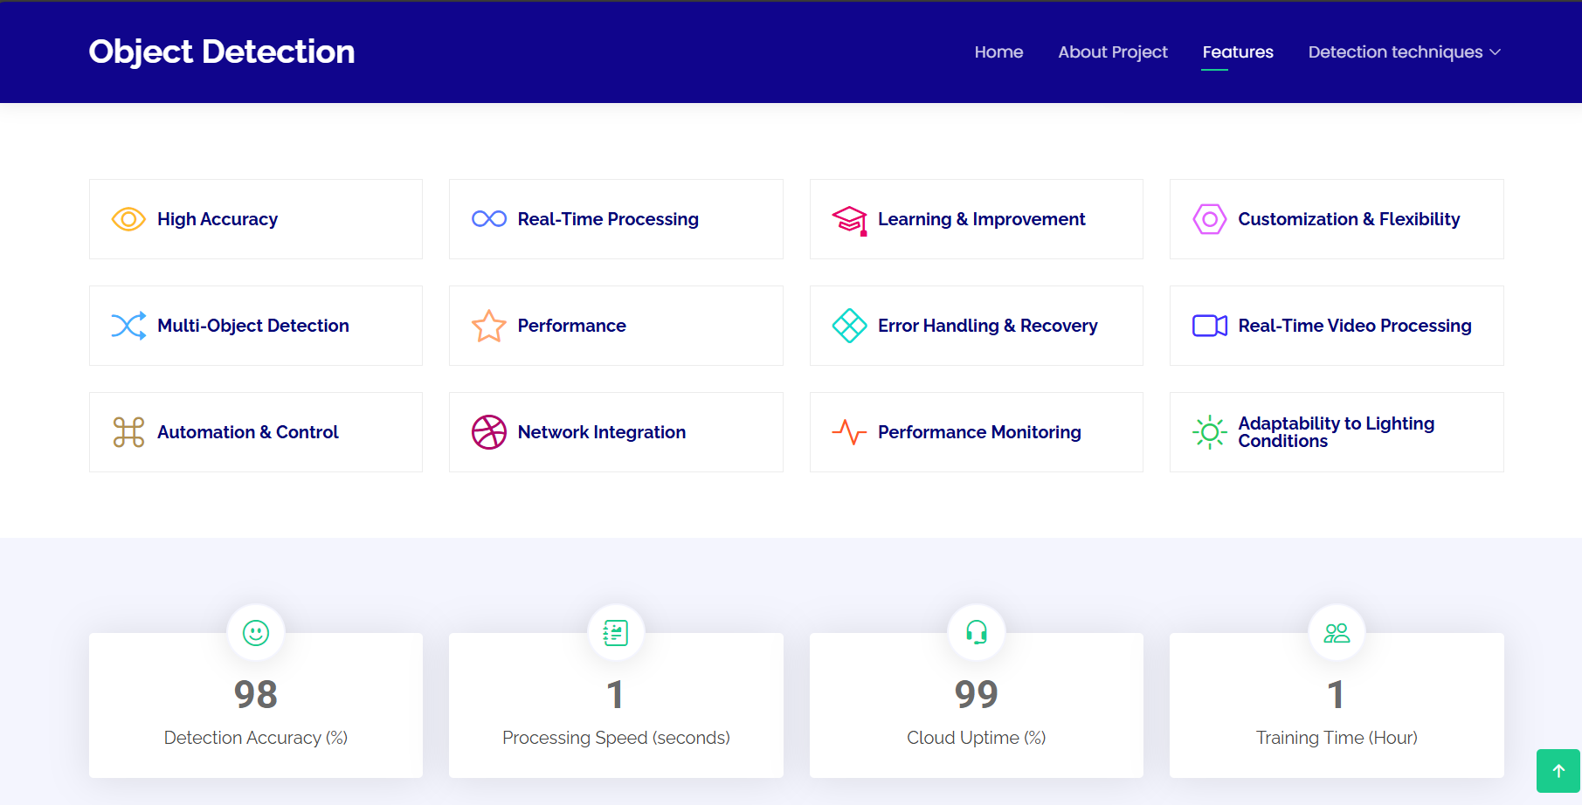
Implementation:

Slide 16
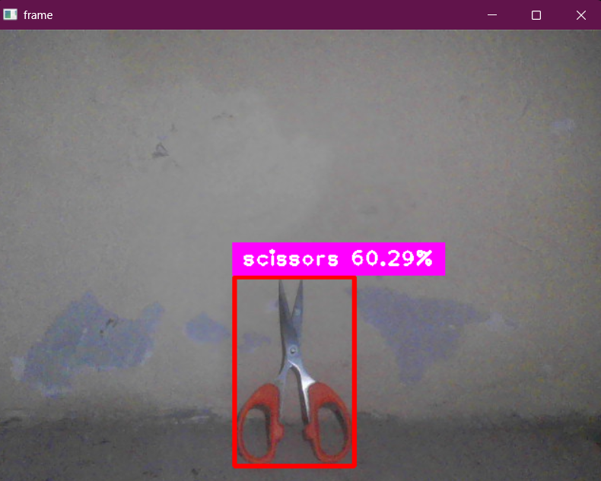
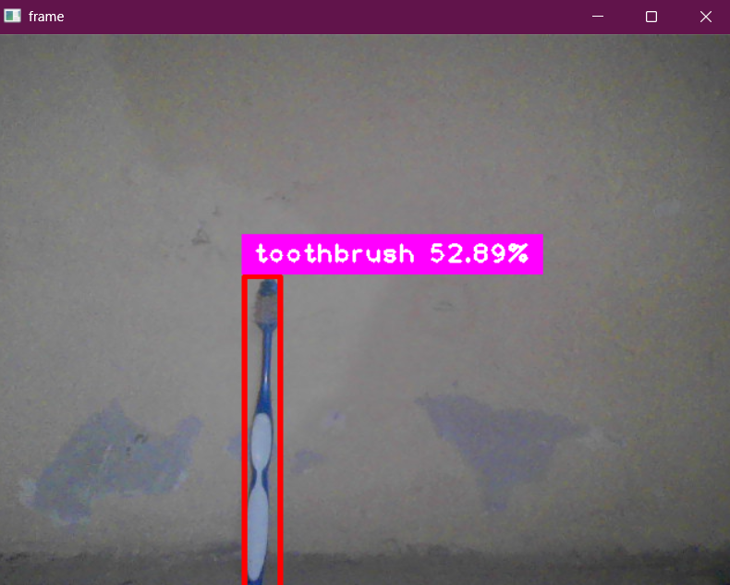
Implementation:

Slide 17
CONCLUSION:
Real-time object detection using IoT and computer vision enhances automation, security, and decision-making across industries. While challenges like high computation, network dependency, and security risks exist, advancements in AI, edge computing, and IoT infrastructure are improving efficiency. By addressing these limitations, this technology can drive smarter, safer, and more connected systems, shaping the future of intelligent automation.

Slide 18
REFERENCE
Henrique, B. M., Sobreiro, V. A., & Kimura, H. (2019). Literature review: Machine learning techniques applied to financial market prediction. Expert Systems with Applications, 124, 226-251.[1]
Baliyan, Kartik, Shubham Vishnoi, and Swati Sharma. "Financial Tracker using NLP." International Journal of Engineering and Management Research 11.3 (2021): 124-125.[2]
Aydin, Alev Dilek, and Seyma Caliskan Cavdar. "Prediction of financial crisis with artificial neural network: an empirical analysis on Turkey." International journal of financial research 6.4 (2015): 36.[3]
Kalid, Khairul Shafee, Muhammad Zulhilmi Bachok, and Md Akhir Mohd Sharif. "Financial indicators tracker application (FIT)." 2012 International Conference on Computer & Information Science (ICCIS). Vol. 1. IEEE, 2012.[4]

Slide 19
Thank You!!!

