Slide 1
Idea
Even if our data doesn’t have joint marginals for all the variables available, we have information about the correlation between these variables available from some other dataset
How can we incorporate the correlation information into the synthetic generation process to help preserve the associations between variables?
Can we add it to the maximum entropy approach as an additional constraint? If so, how?

Slide 2
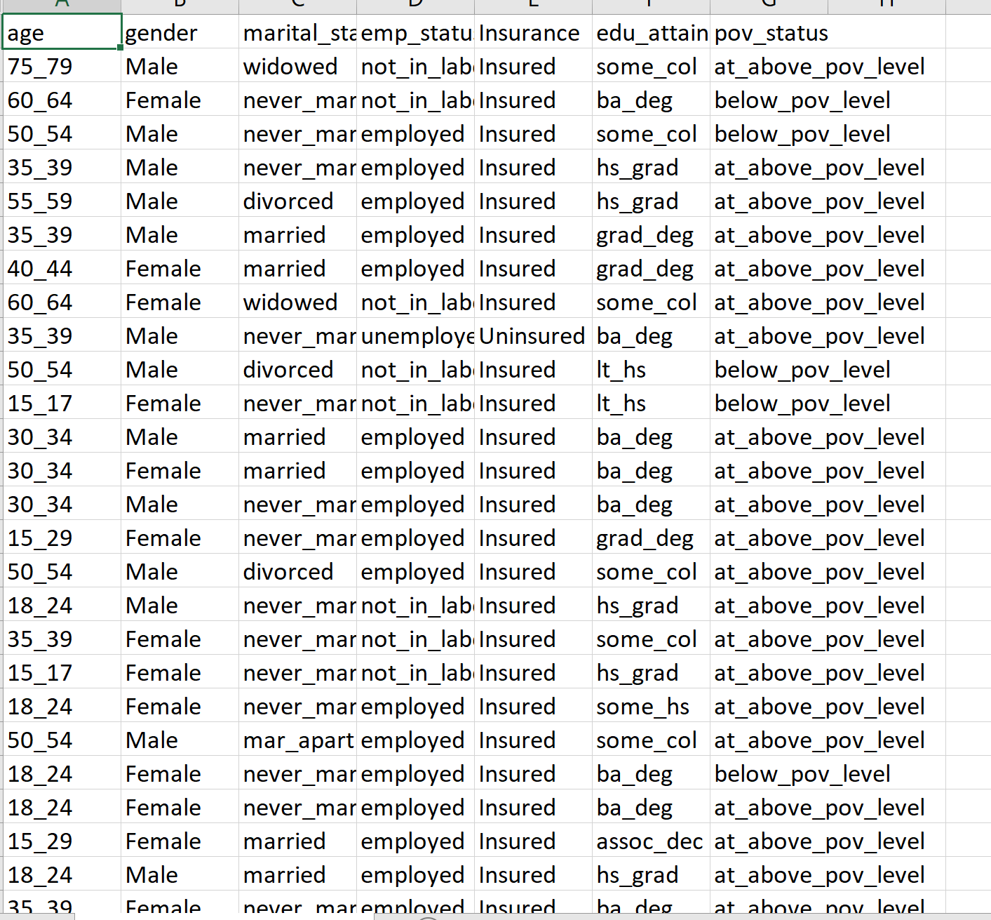
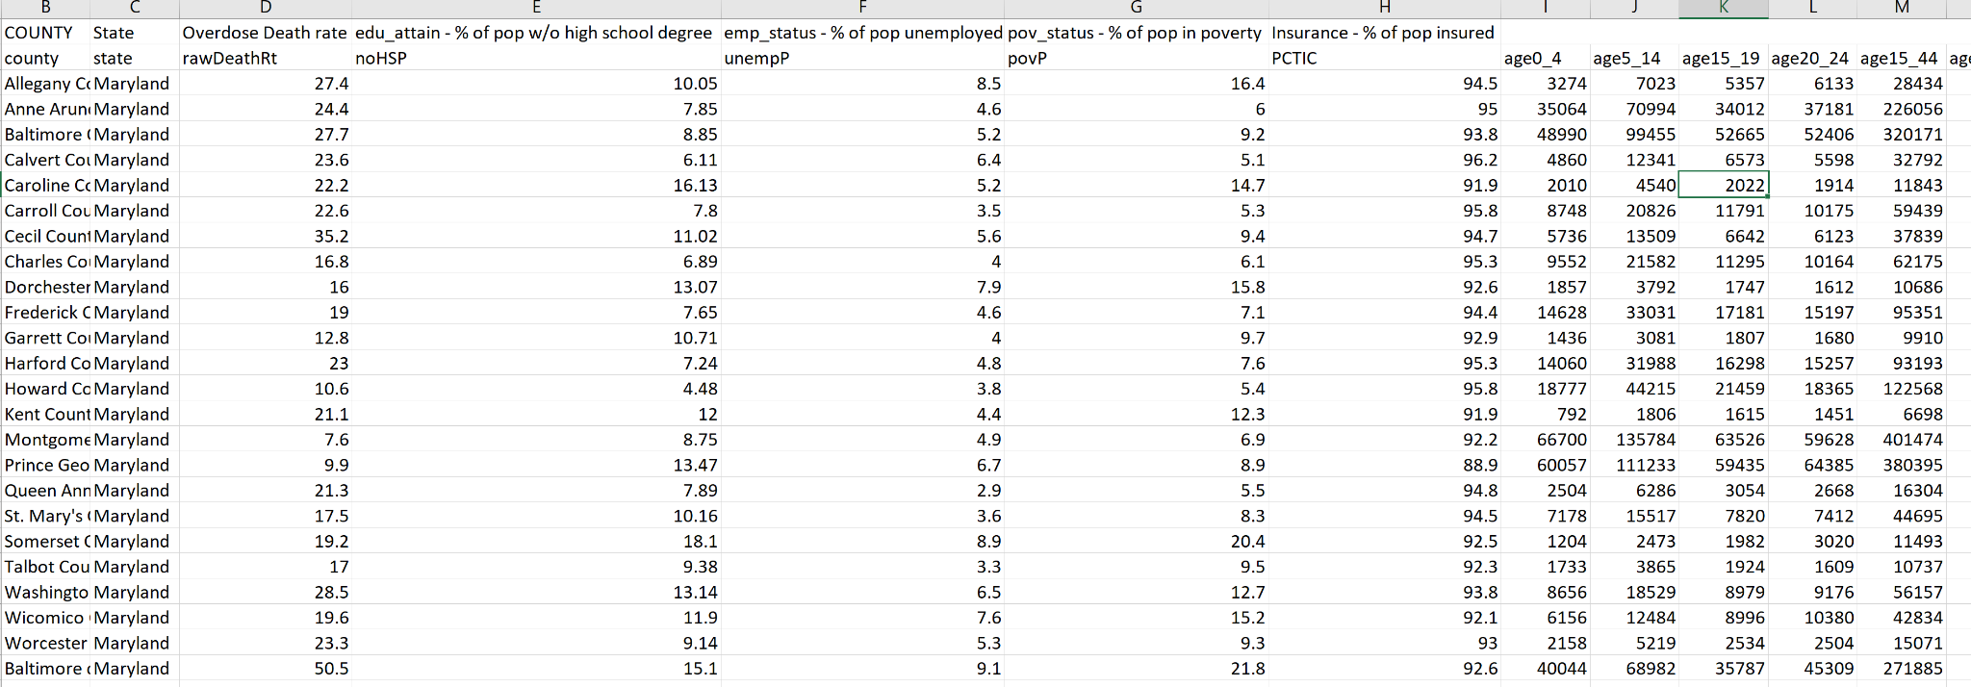
Sample of the generated synthetic data for one county
Sample macro data for multiple counties - From OEPS
Can we get the dependency structure from this macro dataset and use it to improve results for the micro dataset?

Slide 3
Idea
1) Can we just compute the correlation matrix for both datasets during the training process and minimize the normalized difference of the values using a loss function? This would be an additional constraint to the maximum entropy model
Few things make this difficult:
Although both datasets have some common variables, they are in different forms:
eg: Consider two variables edu_attain and Insurance:
Edu attain: In the microdata, edu attain is a categorical variable with different categories: Less than high school, grad school, undergrad, etc. In the macrodata, edu_attain is given by the variable noHSP representing the percentage of population without high school degree
Insurance: In the microdata, Insurance is a categorical variable with two categories: Insured and Uninsured. In the macrodata, Insurance is given by the variable PCTIC representing the percentage of population with Insurance
Thus, the association between these two variables are found differently in both datasets and do not return the same value

Slide 4
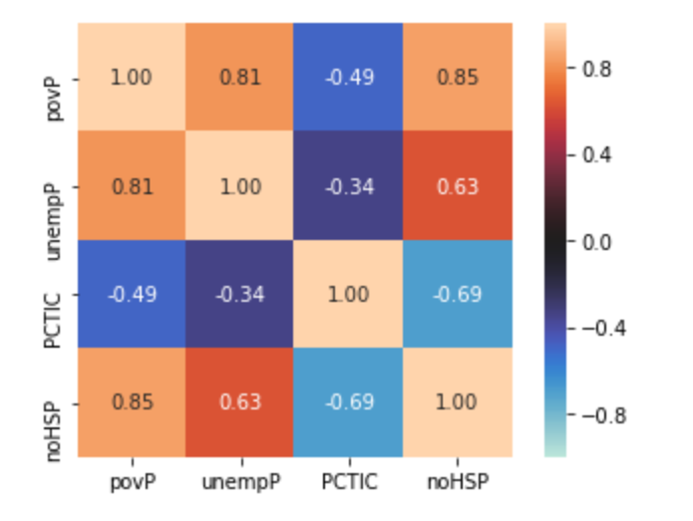
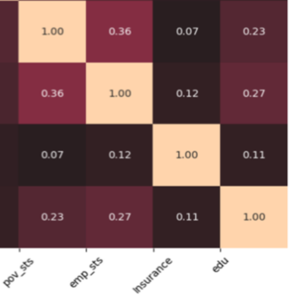
Example
Pearson’s correlation (-1 to 1) for continuous vs Cramer’s V (0 to 1) for categorical variables
Association of macrodata variables
Association of microdata variables

Slide 5
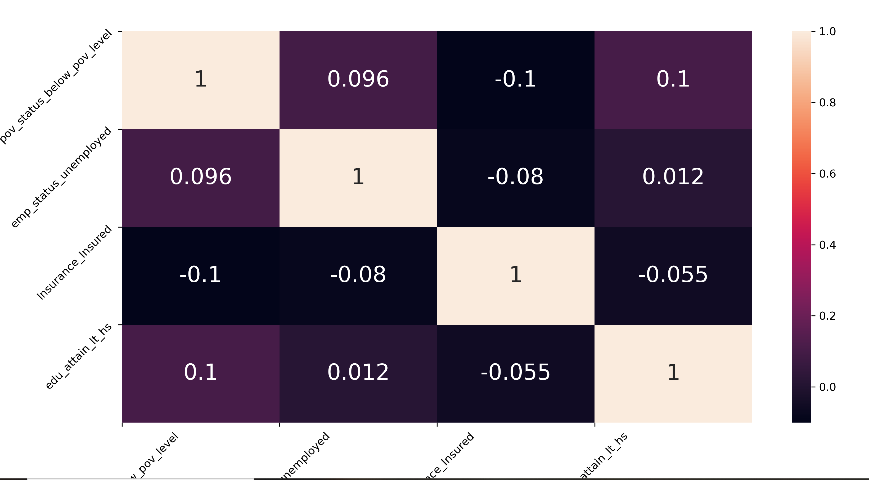
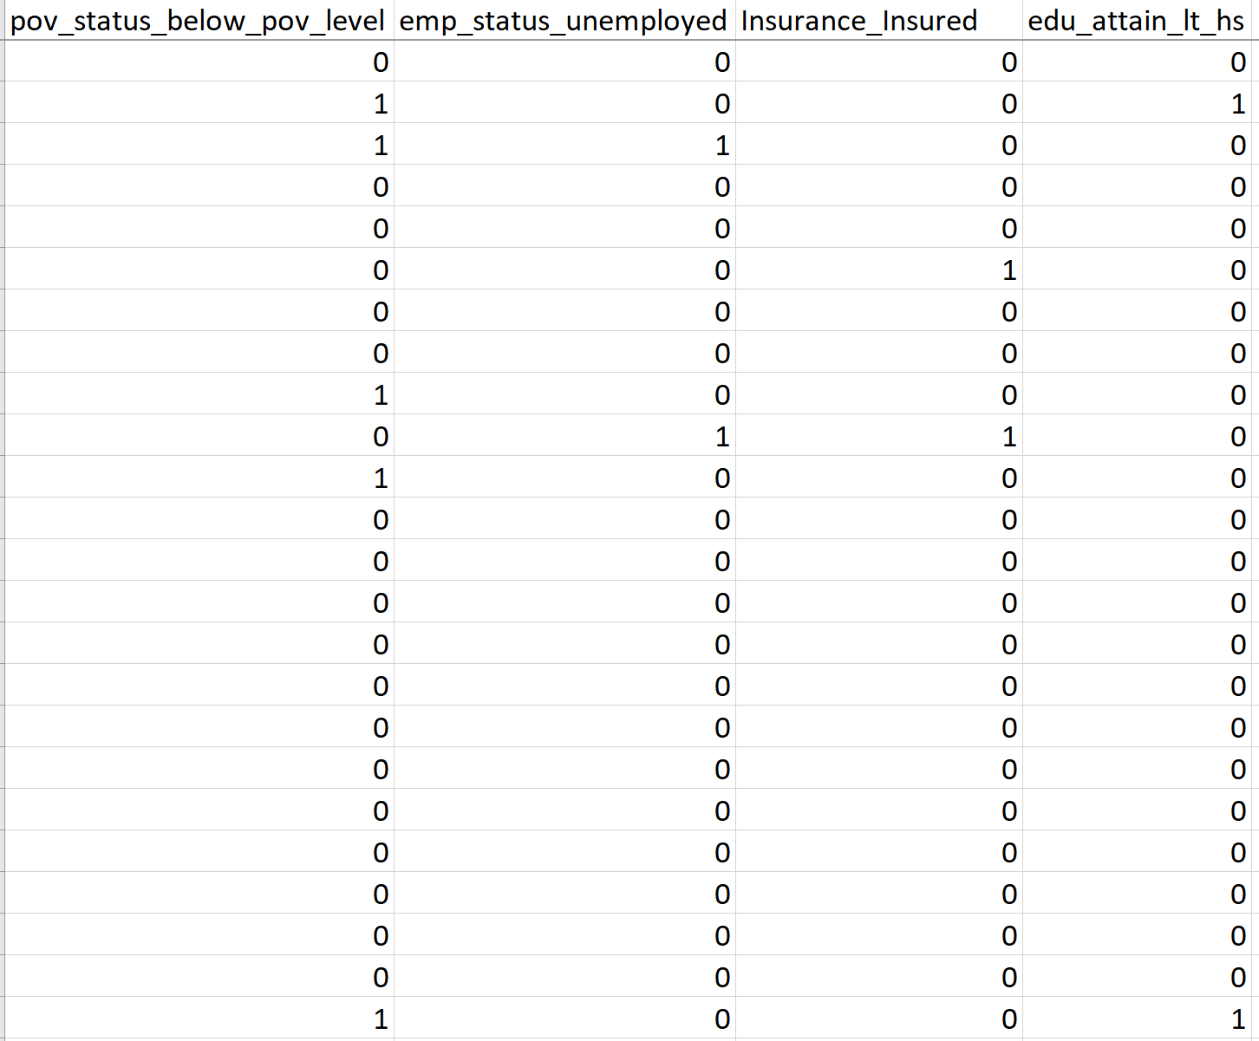
Idea
2) Will transforming the categorical variables to numerical help? That way we can find Pearson's correlation in both datasets.
We do so by one hot encoding the categorical variables in the microdata
Find correlations for only those categories that are included in the macro data. For instance, For edu_attain, only use the numerical correspondence for the category “Less than high school”. Because we have percentage of population without a high school degree (noHSP) in the macrodata
Association of macrodata variables
Association of microdata variables

Slide 6
Observation
In the previous plots, although the magnitudes are different, the relationships between variables are similar in macro and microdata. For instance, Insurance has a negative association with other variables in both datasets
But since we cannot directly use the correlation values in the loss function, how do we incorporate this information in our model?

