Slide 1
ASYNCHRONOUS ACTIVITY NO. 3
ASYNCHRONOUS ACTIVITY NO. 3
Name It, Draw It
Two-Way IUPAC Nomenclature of Alkanes, Cycloalkanes and Haloalkanes
Angel Stefanie C. Gutierrez
BSChE-3B

Slide 2

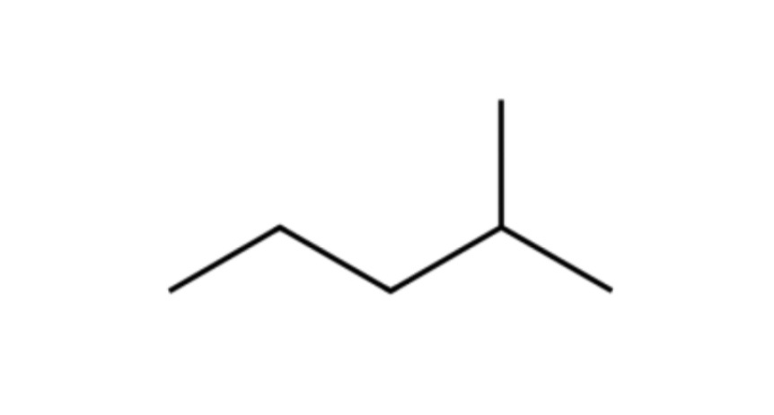
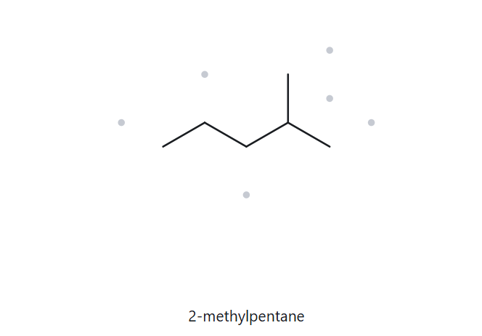



Part A : STRUCTURE → NAME
Card A01 FOUNDATION
Molecular Formula : C6H14
  NUMBERED PARENT
2, NAMING TRAIL
2. LEWIS STRUCTURE
Parent: Longest chain = 5 C → pentane.
Numbering: Left → right gives 4-methyl; right → left gives 2-methyl. The lower locant is 2, so number from the right.
Substituents: methyl on C2
4
2
5
3
1
3. MY NAME
4. THE ALKANE CHECK
2-methylpentane
Returned name:
2-methylpentane
MATCH
VERIFICATION STRIP
longest chain confirmed
lowest locants
alphabetical order
punctuation
formula counted

Slide 3
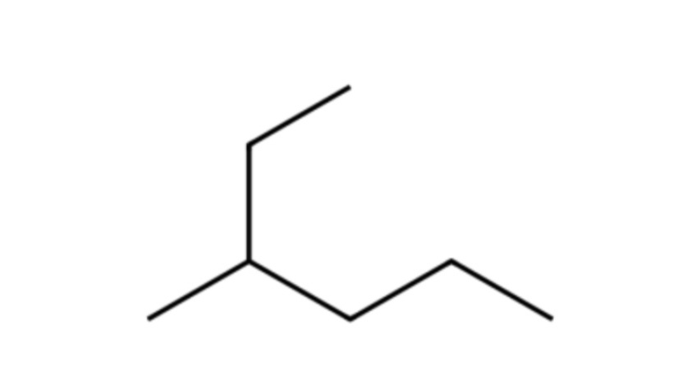
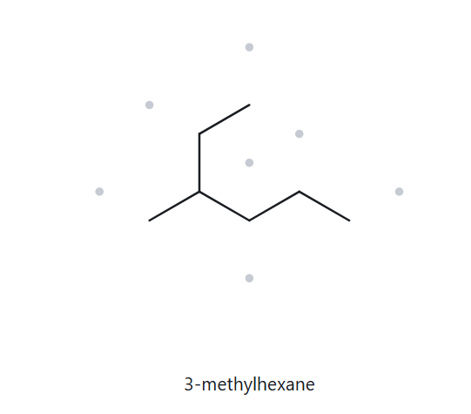
Part A : STRUCTURE → NAME
Card A02 FOUNDATION
Molecular Formula : C7H16
  NUMBERED PARENT
2. NAMING TRAIL
2. LEWIS STRUCTURE
Parent: Longest chain = 6 C → hexane.
Numbering: Left → right gives 3-methyl; right → left gives 4-methyl. The lower locant is 3, so number from the left.
Substituents: methyl on C3
1
2
3
5
4
6
3. MY NAME
4. THE ALKANE CHECK
3-methylhexane
Returned name:
3-methylhexane
MATCH
VERIFICATION STRIP
longest chain confirmed
lowest locants
alphabetical order
punctuation
formula counted

Slide 4
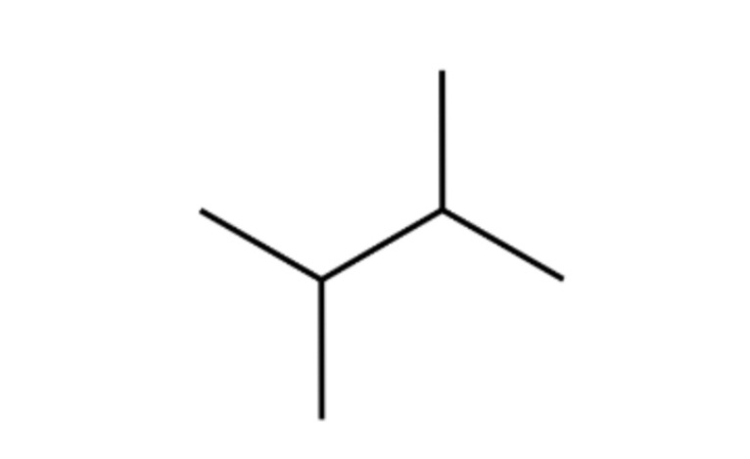
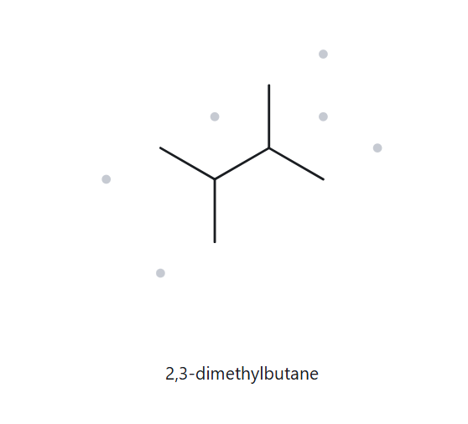
Part A : STRUCTURE → NAME
Card A03 FOUNDATION
Molecular Formula : C6H14
  NUMBERED PARENT
2. NAMING TRAIL
2. LEWIS STRUCTURE
Parent: Longest chain = 4 C → butane.
Numbering: Both directions give the same locant set: 2,3
Substituents: methyl on C2 and methyl on C3 → 2,3-dimethyl
1
2
3
4
3. MY NAME
4. THE ALKANE CHECK
2,3-dimethylbutane
Returned name:
2,3-dimethylbutane
MATCH
VERIFICATION STRIP
longest chain confirmed
lowest locants
alphabetical order
punctuation
formula counted

Slide 5
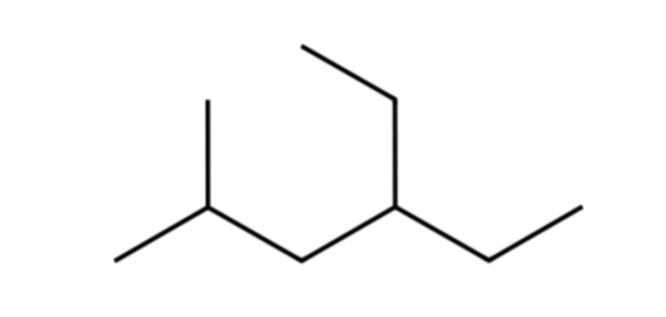
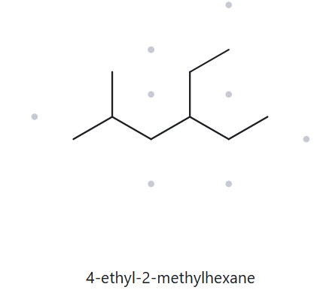
Part A : STRUCTURE → NAME
Card A04 DEVELOPING
Molecular Formula : C9H20
  NUMBERED PARENT
2. NAMING TRAIL
2. LEWIS STRUCTURE
Parent: Longest chain = 6 C → hexane.
Numbering: Left → right gives 2,4; right → left gives 3,5. The lower locant is 2, so number from the left.
Substituents: methyl on C2 and ethyl on C4 → 4-ethyl-2-methyl
2
4
5
6
1
3
3. MY NAME
4. THE ALKANE CHECK
4-ethyl-2-methylhexane
Returned name:
4-ethyl-2-methylhexane
MATCH
VERIFICATION STRIP
longest chain confirmed
lowest locants
alphabetical order
punctuation
formula counted

Slide 6
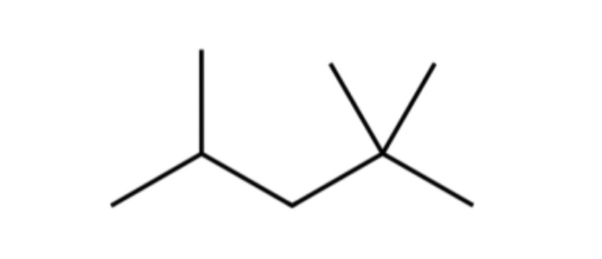
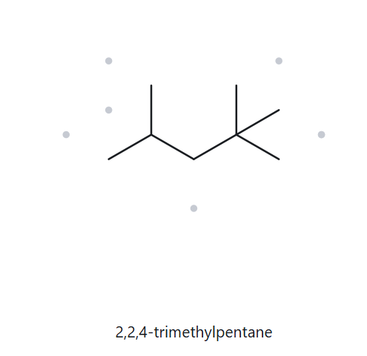
Part A : STRUCTURE → NAME
Card A05 DEVELOPING
Molecular Formula : C8H18
  NUMBERED PARENT
2. NAMING TRAIL
2. LEWIS STRUCTURE
Parent: Longest chain = 5 C → pentane.
Numbering: Left → right gives 2,2,4; right → left gives 2,4,4. The first point of difference keeps 2,2,4.
Substituents: methyl on C2, C2 and C4 → 2,2,4-trimethyl
1
4
2
5
3
3. MY NAME
4. THE ALKANE CHECK
2,2,4-trimethylpentane
Returned name:
2,2,4-trimethylpentane
MATCH
VERIFICATION STRIP
longest chain confirmed
lowest locants
alphabetical order
punctuation
formula counted

Slide 7
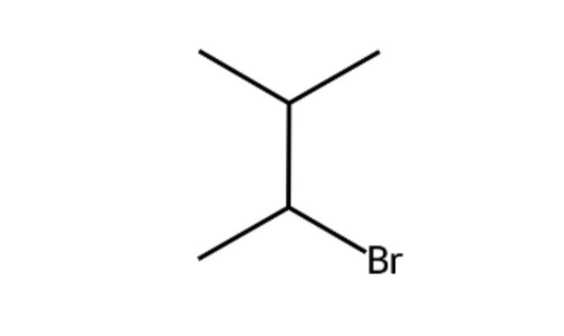
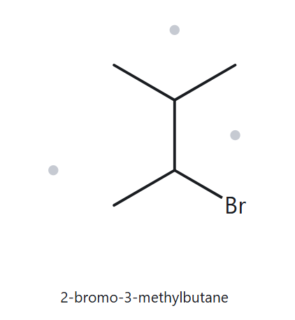
Part A : STRUCTURE → NAME
Card A06 DEVELOPING
Molecular Formula : C5H11Br
  NUMBERED PARENT
2. NAMING TRAIL
2. LEWIS STRUCTURE
Parent: Longest chain = 4 C → butane.
Numbering: Both directions give locants 2 and 3.
Substituents: bromo on C2; methyl on C3
4
3
2
1
3. MY NAME
4. THE ALKANE CHECK
2-bromo-3-methylbutane
Returned name:
2-bromo-3-methylbutane
MATCH
VERIFICATION STRIP
longest chain confirmed
lowest locants
alphabetical order
punctuation
formula counted

Slide 8
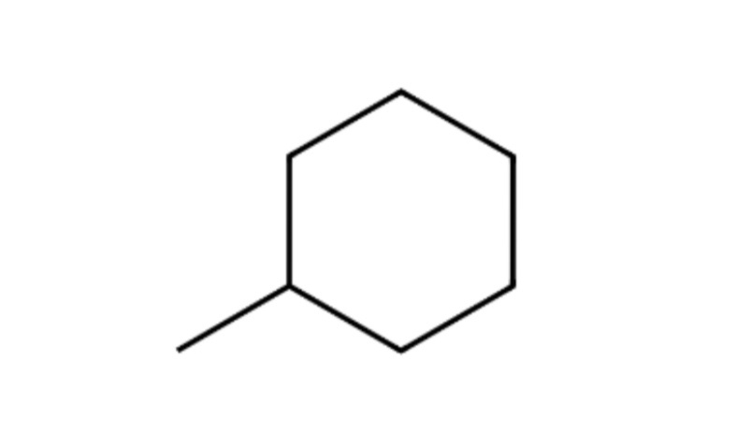
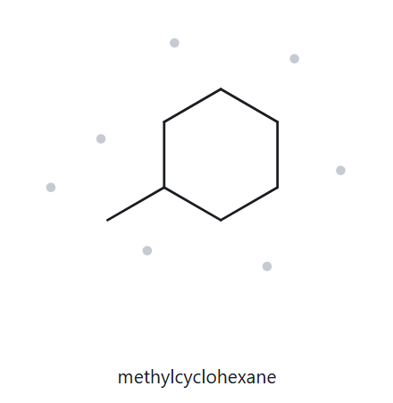
Part A : STRUCTURE → NAME
Card A07 DEVELOPING
Molecular Formula : C7H14
  NUMBERED PARENT
2. NAMING TRAIL
2. LEWIS STRUCTURE
Parent: The ring has 6 C → cyclohexane.
Numbering: Only one substituent is present, so a locant is unnecessary.
Substituents: methyl
3. MY NAME
4. THE ALKANE CHECK
methylcyclohexane
Returned name:
methylcyclohexane
MATCH
VERIFICATION STRIP
longest chain confirmed
lowest locants
alphabetical order
punctuation
formula counted

Slide 9
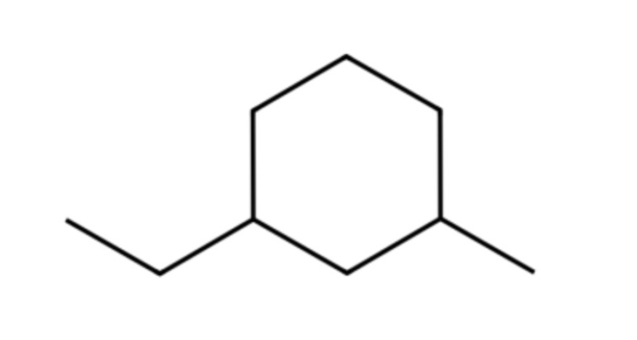
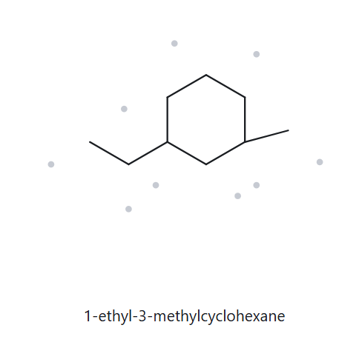
Part A : STRUCTURE → NAME
Card A08 CHALLENGE
Molecular Formula : C9H18
  NUMBERED PARENT
2. NAMING TRAIL
2. LEWIS STRUCTURE
5
Parent: The ring has 6 C → cyclohexane.
Numbering: The substituents can be numbered 1,3 either way.
Substituents: ethyl on C1; methyl on C3
6
4
1
3
2
3. MY NAME
4. THE ALKANE CHECK
1-ethyl-3-methylcyclohexane
Returned name:
1-ethyl-3-methylcyclohexane
MATCH
VERIFICATION STRIP
longest chain confirmed
lowest locants
alphabetical order
punctuation
formula counted

Slide 10
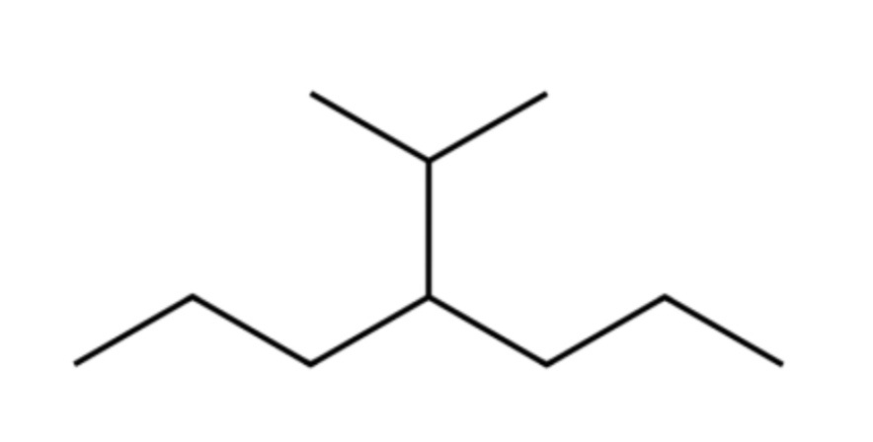
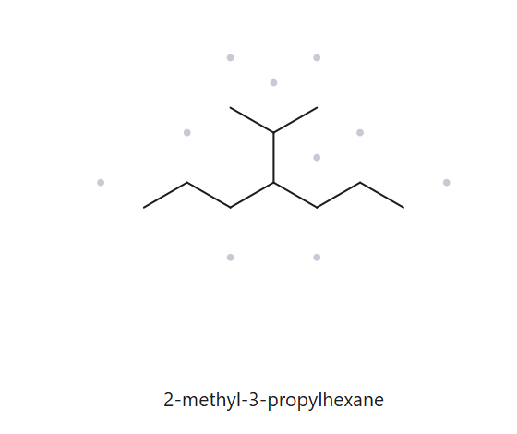

Part A : STRUCTURE → NAME
Card A09 CHALLENGE
Molecular Formula : C10H22
  NUMBERED PARENT
2. NAMING TRAIL
2. LEWIS STRUCTURE
Parent: Longest chain = 7 C → heptane.
Numbering: Left → right and right → left both give locant 4.
Substituents: propan-2-yl on C4.
2
6
4
1
3
5
7
3. MY NAME
4. THE ALKANE CHECK
4-(propan-2-yl)heptane
Returned name:
2-methyl-3-propylhexane
NOT MATCH
The longest continuous chain is 7 carbons (heptane), not 6. The upper branch is an isopropyl group, not separate methyl and propyl substituents.
VERIFICATION STRIP
longest chain confirmed
lowest locants
alphabetical order
punctuation
formula counted

Slide 11
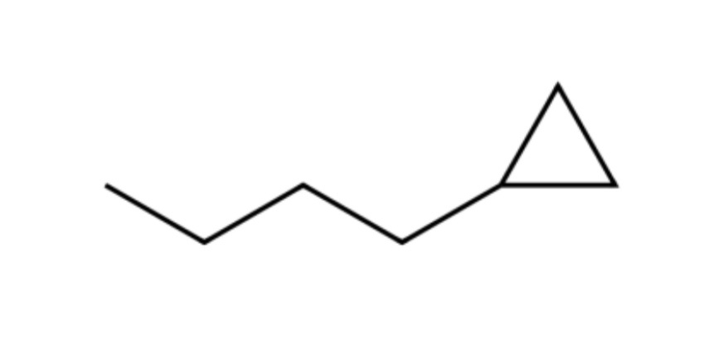
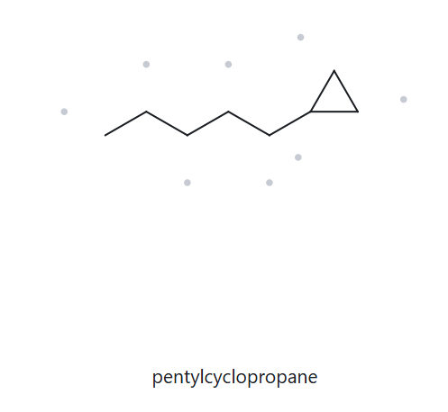
Part A : STRUCTURE → NAME
Card A10 CHALLENGE
Molecular Formula : C8H16
  NUMBERED PARENT
2. NAMING TRAIL
2. LEWIS STRUCTURE
Parent: The ring has 3 C → cyclopropane.
Numbering: Only one substituent is attached to the ring, so a locant is unnecessary.
Substituents: Pentyl attached to the ring.
3. MY NAME
4. THE ALKANE CHECK
pentylcyclopropane
Returned name:
pentylcyclopropane
MATCH
VERIFICATION STRIP
longest chain confirmed
lowest locants
alphabetical order
punctuation
formula counted

Slide 12
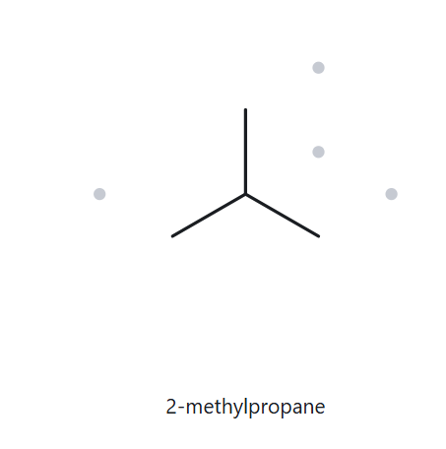
Part B : NAME → STRUCTURE
Card B01 FOUNDATION
Given Name : 2-methylpropane
  NAME DECODED
2. BOND-LINE STRUCTURE
2. LEWIS STRUCTURE
Parent: Propane → a 3-carbon chain.
Substituents: Methyl on C2.
Expected formula: 3 C; open chain → C₃H₈; add one methyl carbon → C₄H₁₀.
3. FORMULA CHECK
4. BACK CHECK
Counted formula: C₄H₁₀
Open chain: CₙH₂ₙ₊₂ = C₄H₁₀
Returned by The Alkane:
Same as the given name
VERIFICATION STRIP
parent length matches
substituent positions match
formula agrees
back-check recorded

Slide 13
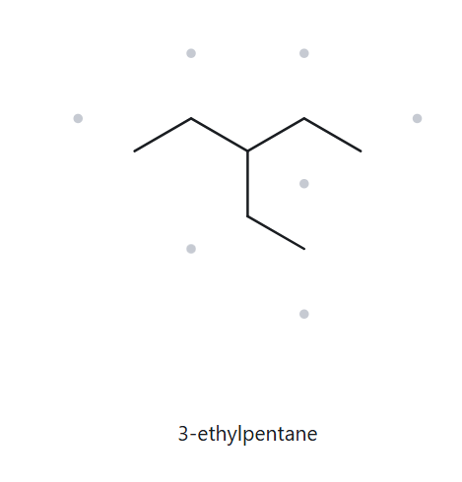
Part B : NAME → STRUCTURE
Card B02 FOUNDATION
Given Name : 3-ethylpentane
  NAME DECODED
2. BOND-LINE STRUCTURE
2. LEWIS STRUCTURE
Parent: Pentane → a 5-carbon chain.
Substituents: Ethyl on C3.
Expected formula: 5 + 2 = 7 C; open chain → C7H16.
3. FORMULA CHECK
4. BACK CHECK
Counted formula: C7H16
Open chain: CₙH₂ₙ₊₂ = C7H16
Returned by The Alkane:
Same as the given name
VERIFICATION STRIP
parent length matches
substituent positions match
formula agrees
back-check recorded

Slide 14
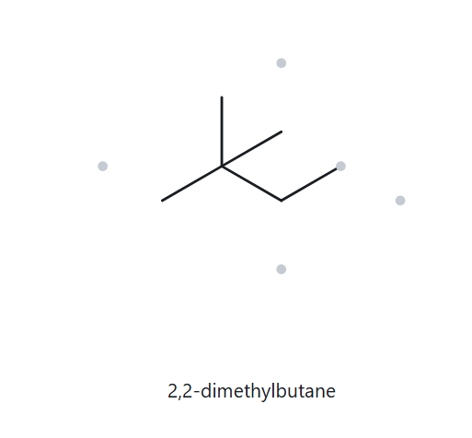
Part B : NAME → STRUCTURE
Card B03 FOUNDATION
Given Name : 2,2-dimethylbutane
  NAME DECODED
2. BOND-LINE STRUCTURE
2. LEWIS STRUCTURE
Parent: butane → a 4-carbon chain.
Substituents: 2 Methyl on C2.
Expected formula: 4 + 2 = 6 C; open chain → C₆H₁₄.
3. FORMULA CHECK
4. BACK CHECK
Counted formula: C₆H₁₄
Open chain: CₙH₂ₙ₊₂ = C₆H₁₄
Returned by The Alkane:
Same as the given name
VERIFICATION STRIP
parent length matches
substituent positions match
formula agrees
back-check recorded

Slide 15
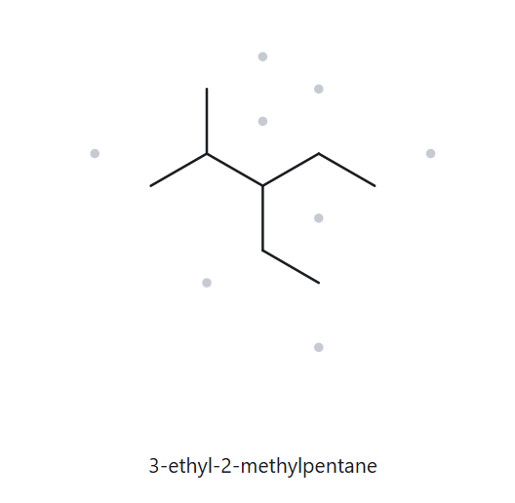
Part B : NAME → STRUCTURE
Card B04 DEVELOPING
Given Name : 3-ethyl-2-methylpentane
  NAME DECODED
2. BOND-LINE STRUCTURE
2. LEWIS STRUCTURE
Parent: Pentane → a 5-carbon chain.
Substituents: Methyl on C2 and ethyl in C3.
Expected formula: 5 + 1 + 2 = 8 C; open chain → C₈H₁₈.
3. FORMULA CHECK
4. BACK CHECK
Counted formula: C₈H₁₈
Open chain: CₙH₂ₙ₊₂ = C₈H₁₈
Returned by The Alkane:
Same as the given name
VERIFICATION STRIP
parent length matches
substituent positions match
formula agrees
back-check recorded

Slide 16
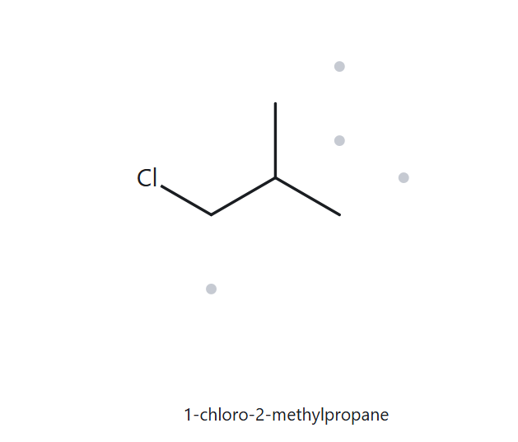
Part B : NAME → STRUCTURE
Card B05 DEVELOPING
Given Name : 1-chloro-2-methylpropane
  NAME DECODED
2. BOND-LINE STRUCTURE
2. LEWIS STRUCTURE
Parent: Propane → a 3-carbon chain.
Substituents: Chloro on C1; methyl on C2.
Expected formula: 3 + 1 = 4 C; open chain → C₄H₁₀; one H is replaced by Cl → C₄H₉Cl.
3. FORMULA CHECK
4. BACK CHECK
Counted formula: C₄H₉Cl
Open chain: CₙH₂ₙ₊₂ = C₄H₉Cl
Returned by The Alkane:
Same as the given name
VERIFICATION STRIP
parent length matches
substituent positions match
formula agrees
back-check recorded

Slide 17
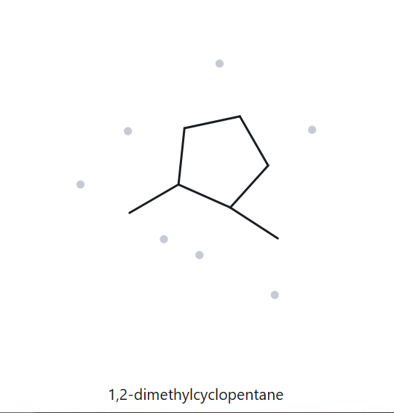
Part B : NAME → STRUCTURE
Card B06 DEVELOPING
Given Name : 1,2-dimethylcyclopentane
  NAME DECODED
2. BOND-LINE STRUCTURE
2. LEWIS STRUCTURE
Parent: Cyclopentane → a 5-carbon ring.
Substituents: Methyl on C1 and methyl on C2.
Expected formula: 5 + 2 = 7 C; one ring → C₇H₁₄.
3. FORMULA CHECK
4. BACK CHECK
Counted formula: C₇H₁₄
One ring: CₙH₂ₙ = C₇H₁₄
Returned by The Alkane:
Same as the given name
VERIFICATION STRIP
parent length matches
substituent positions match
formula agrees
back-check recorded

Slide 18
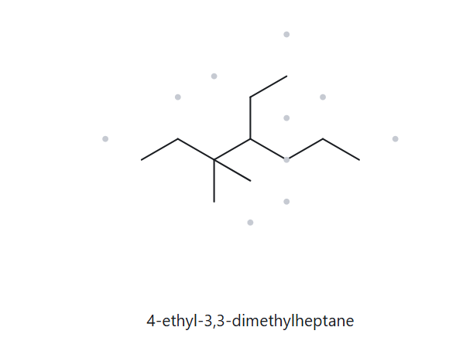
Part B : NAME → STRUCTURE
Card B07 DEVELOPING
Given Name : 4-ethyl-3,3-dimethylheptane
  NAME DECODED
2. BOND-LINE STRUCTURE
2. LEWIS STRUCTURE
Parent: Heptane → a 7-carbon chain.
Substituents: Two methyl groups on C3; ethyl on C4.
Expected formula: 7 + 2 + 2 = 11 C; open chain → C₁₁H₂₄.
3. FORMULA CHECK
4. BACK CHECK
Counted formula: C₁₁H₂₄
Open chain: CₙH₂ₙ₊₂ = C₁₁H₂₄
Returned by The Alkane:
Same as the given name
VERIFICATION STRIP
parent length matches
substituent positions match
formula agrees
back-check recorded

Slide 19
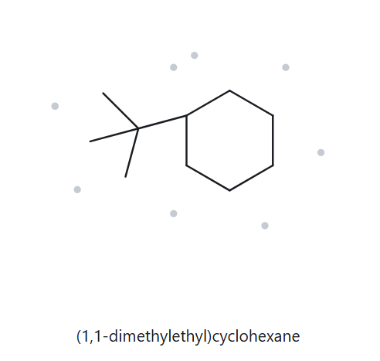
Part B : NAME → STRUCTURE
Card B08 CHALLENGE
Given Name : tert-butylcyclohexane
  NAME DECODED
2. BOND-LINE STRUCTURE
2. LEWIS STRUCTURE
Parent: Cyclohexane → a 6-carbon ring.
Substituents: Tert-butyl on C1. The tert-butyl group contains 4 carbons.
Expected formula: 6 + 4 = 10 C; one ring → C₁₀H₂₀.
3. FORMULA CHECK
4. BACK CHECK
Counted formula: C₁₀H₂₀
One ring: CₙH₂ₙ = C₁₀H₂₀
Returned by The Alkane:
Common name: tert-butyl
The Alkane writes: (1,1-dimethylethyl)
Same as the given name
VERIFICATION STRIP
parent length matches
substituent positions match
formula agrees
back-check recorded

Slide 20
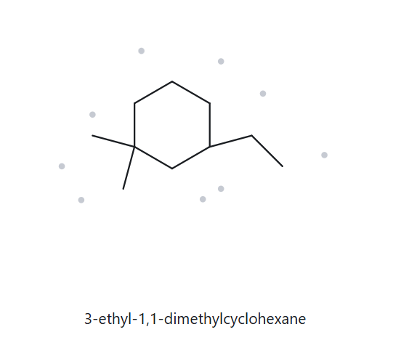
Part B : NAME → STRUCTURE
Card B09 CHALLENGE
Given Name : 3-ethyl-1,1- dimethylcyclohexane
  NAME DECODED
2. BOND-LINE STRUCTURE
2. LEWIS STRUCTURE
Parent: Cyclohexane → a 6-carbon ring.
Substituents: Two methyl groups on C1; ethyl on C3.
Expected formula: 6 + 2 + 2 = 10 C; one ring → C₁₀H₂₀.
3. FORMULA CHECK
4. BACK CHECK
Counted formula: C₁₀H₂₀
One ring: CₙH₂ₙ = C₁₀H₂₀
Returned by The Alkane:
Same as the given name
VERIFICATION STRIP
parent length matches
substituent positions match
formula agrees
back-check recorded

Slide 21
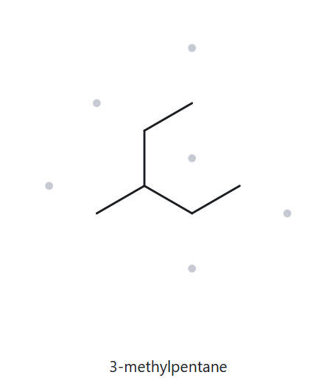
Part B : NAME → STRUCTURE
Card B10 CHALLENGE
Given Name : 2-ethylbutane
  NAME DECODED
2. BOND-LINE STRUCTURE
2. LEWIS STRUCTURE
Parent: Butane → a 4-carbon chain.
Substituents: Ethyl on C2.
Expected formula: 4 + 2 = 6 C; open chain → C₆H₁₄.
3. FORMULA CHECK
4. BACK CHECK
Returned by The Alkane:
Counted formula: C₆H₁₄
Open chain: CₙH₂ₙ₊₂ = C₆H₁₄
Correct name: 3-methylpentane
Rule broken: The given name does not use the longest continuous carbon chain. The correct parent has 5 carbons (pentane), with a methyl group on C3.
Given name is incorrect
VERIFICATION STRIP
parent length matches
substituent positions match
formula agrees
back-check recorded

