Slide 1
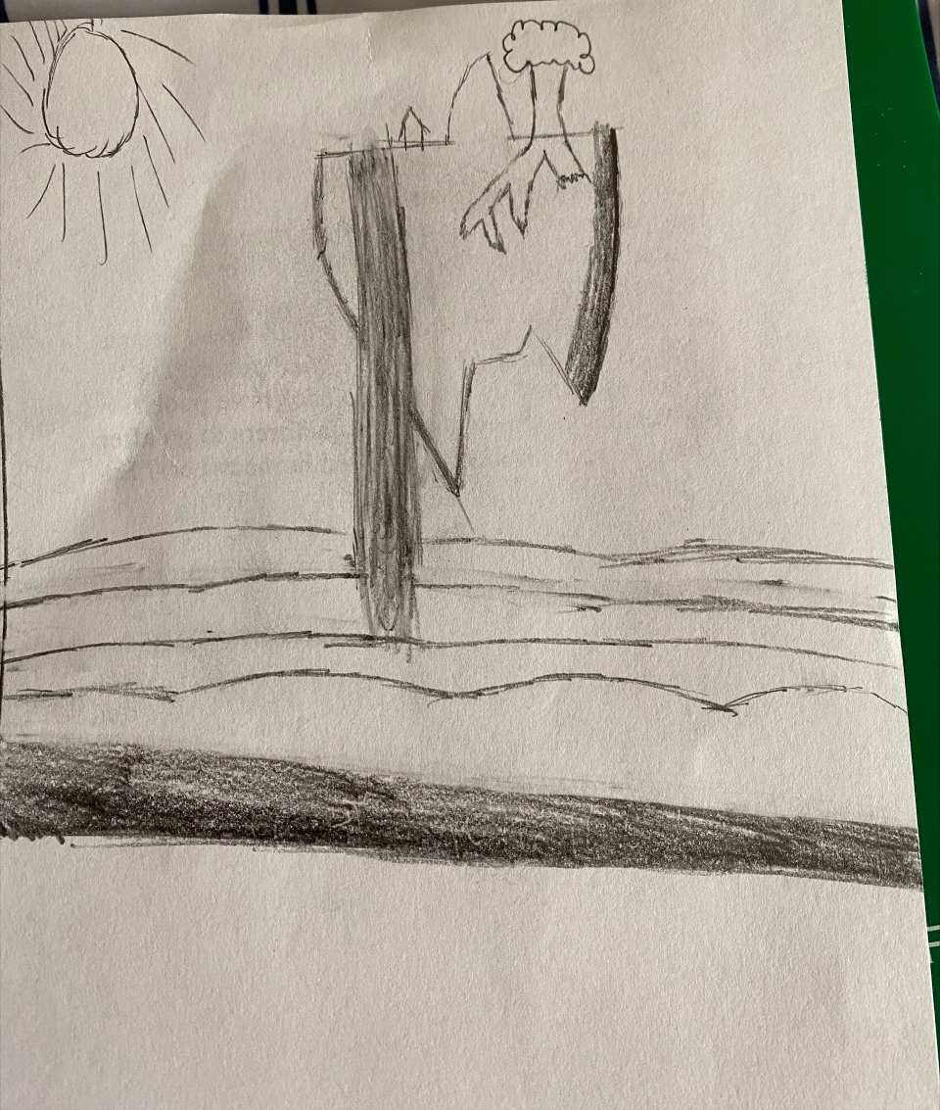
Artist #1
Real Name: Adrian Simmons
Alias: None
Style: A hand-drawn style of environments that is done over a relatively short time. Usually, pictures environments of the fantastical degree.
Age: 25 years of age, grew up in an average middle-class family living near New York City, New York.
Daily Life: Currently lives in New York City. Works in an Accounting company and is able to draw in her free time.
Teen Life: Used to be a quiet kid who enjoyed math and drawing. Had a few reliable friends and enjoyed sharing some of her early work with them.
Dream: To either become an artist full time, or to just be able to live in relative peace.
Fear: Arachnophobia (Spiders)
Favorite Memory: When going into rural New York state and seeing the mountainous views. Inspired her main style of environmental drawings.
An untitled drawing on the back of a paper

Slide 2
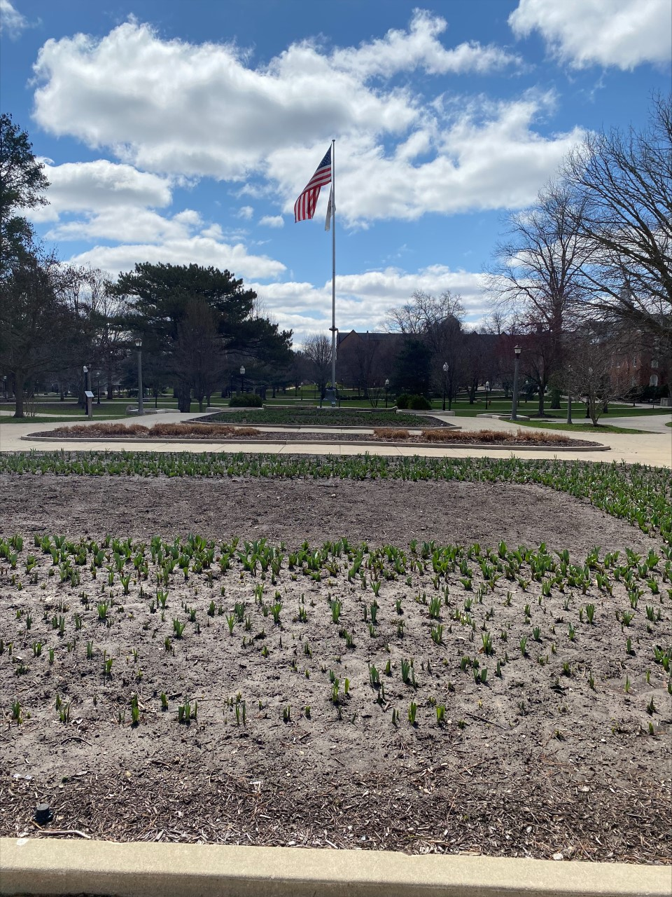
Artist #2
Real Name: Trevor Richardson
Alias: None
Style: Photography of various things in the world. Generally, of views that happen to catch his eye.
Age: 40 years old. Grew up in a rural Virginia town surrounded by nature and enjoyed the sights around his hometown.
Daily Life: Lives a nomadic life and wanders around the US taking pictures of things that catch his eye.
Teen Life: When in high school, he was extroverted and made friends with pretty much everyone he came across. Spent his senior year founding the school’s photography club.
Dream: To capture as much of the US in photographic form as possible for one person.
Fear: Athazagoraphobia (Fear of being forgotten)
Favorite Memory: When taking the first picture he could be proud of, around the banks of Lake Erie.
One of many photos from his previous visit to Illinois

Slide 3
Artist #3
Real Name: William Rowe
Alias: W. A. Rowe
Style: A fantasy writer who has dabbled into other styles such as sci-fi and horror. Became famous after his series of novels was adapted into a couple of movies.
Age: 60 years old. He was born into a poorer family but was still able to learn to read and write. He enjoyed the few books he was able to read and grew inspired by them. Daily Life: Lives a mostly quiet life aside from the hours he sets aside to write. Teen Life: Was most quiet in high school but wasn’t very afraid of having to speak up.
Dream: Just be able to finish his career in peace.
Fear: Liticaphobia (Fear of lawsuits)
Favorite Memory: When first meeting the fans of his work.
“…I arrived safely within the boundaries of Baskon with the sun high in the sky and the wind against my back. It was a small village nestled in the valley created by the great mountains of old around it. There were only about a dozen buildings that were apparent to me from my vantage on the nearby hill. As his Majesty has instructed me, I went around the town questioning its people on the local knight of the Kingdom assigned to protect this place. I heard much of this man, Sir Wilfred, from the townspeople. He had managed to become something of a legend in this quaint town due to his entirely pacifistic nature. One of the younger men I talked to told me how he hadn’t seen the man even draw his blade for over 10 years. It wasn’t long before the man himself appeared within the local tavern…”
Excerpt from his work, Journal of a Humble Knight Vol. 1

