Slide 1
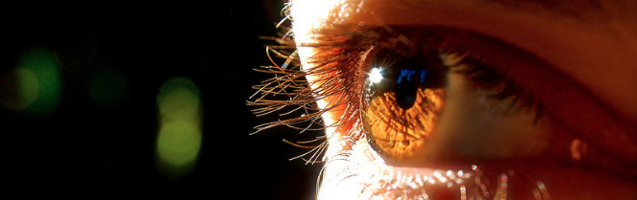
Procesamiento de Imágenes
Domingo Mery
Departamento de Ciencia de la Computación
Escuela de Ingeniería
Universidad Católica de Chile
Transformaciones geométricas & Interpolación
[ Capítulo 3 ]

Slide 2
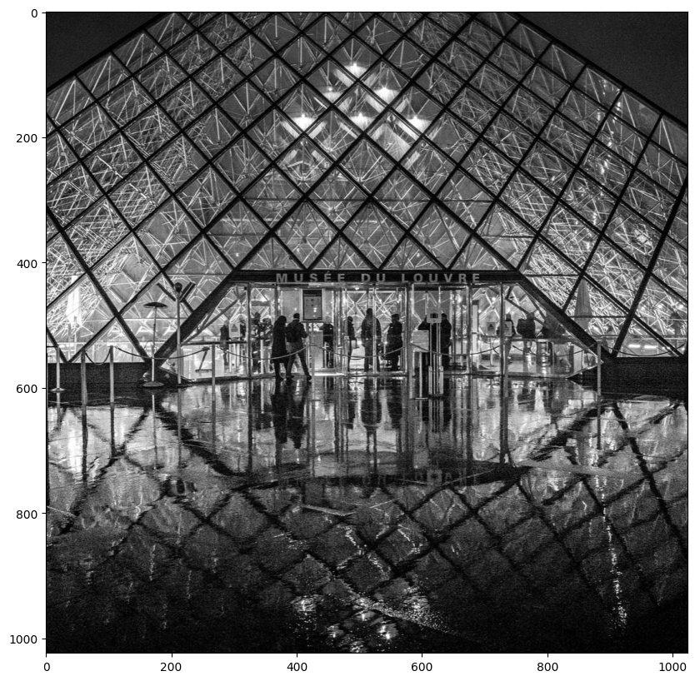

Slide 3
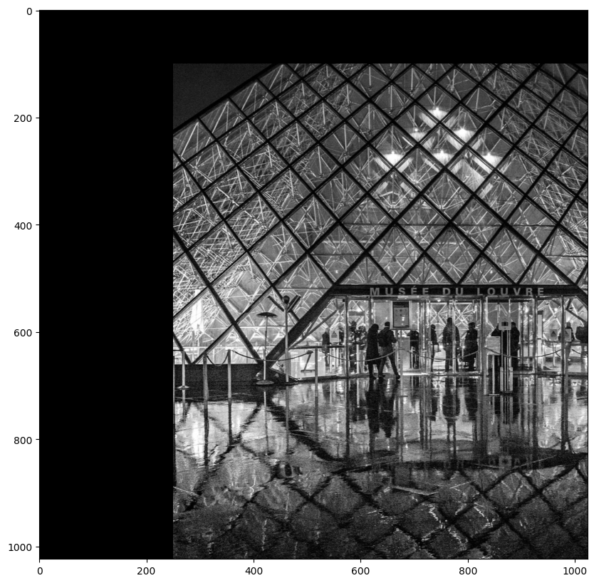

Slide 4
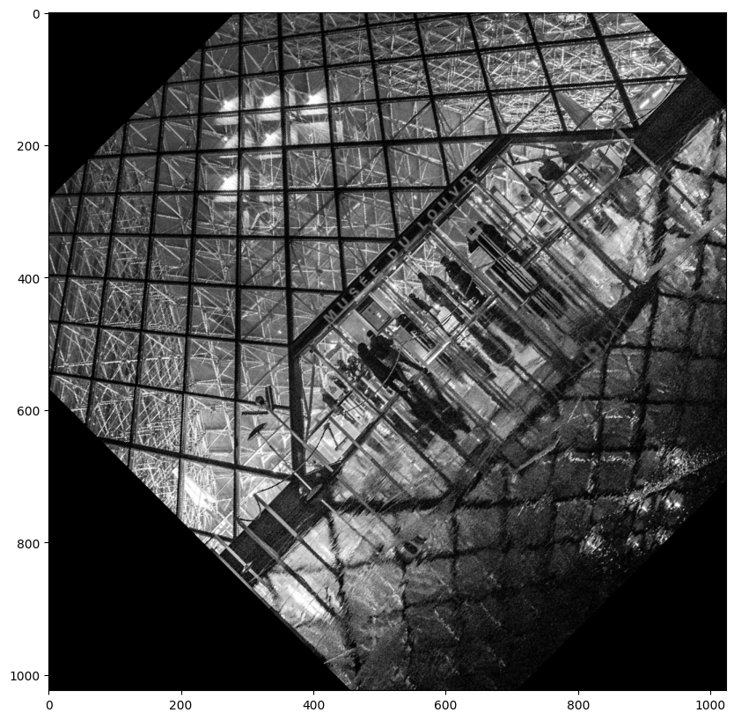

Slide 5
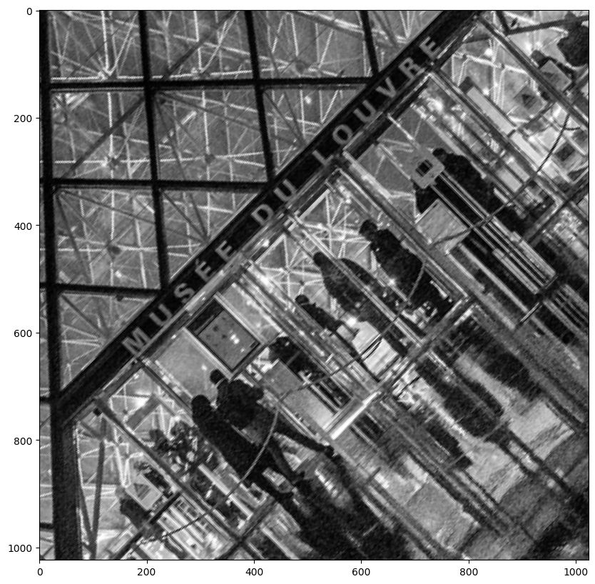

Slide 6
I
J
T

Slide 7
I
J
j
j₀
i₀
i
T

Slide 8
I
J
j
j₀
i₀
i
Coordinate Transformation:
i₀ = f_{i}(i,j)
j₀ = f_{j}(i,j)

Slide 9
j₀
j
i₀
i
Coordinate Transformation:
(Example: Translation)
i₀ = i + 1
j₀ = j + 2

Slide 10
j₀
j
i₀
Algorithm:
1) For each (i,j) of J compute (i₀,j₀).
2) J(i,j) = I(i₀,j₀)
i
Coordinate Transformation:
(Example: Translation)
i₀ = i + 1
j₀ = j + 2

Slide 11
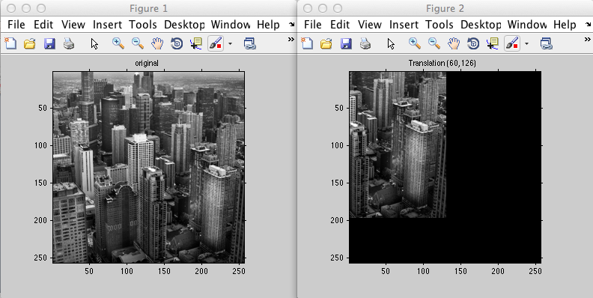

Slide 12
j₀
j
i₀
i
Coordinate Transformation:
(Example: Translation)
i₀ = i + 1.25
j₀ = j + 2.75

Slide 13
j₀
i₀
j
Algorithm:
1) For each (i,j) of J compute (i₀,j₀).
2) J(i,j) = interpolation {I(i₀,j₀)}
i
Coordinate Transformation:
(Example: Translation)
i₀ = i + 1.25
j₀ = j + 2.75

Slide 14
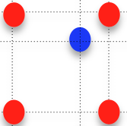
j₀
i₀
j
Algorithm:
1) For each (i,j) of J compute (i₀,j₀).
2) J(i,j) = interpolation {I(i₀,j₀)}
i
Coordinate Transformation:
(Example: Translation)
i₀ = i + 1.25
j₀ = j + 2.75

Slide 15
j₀
I₁
I₂
Nearest pixel
J(i,j) = interpolation {I(i₀,j₀)} = I₂
i₀
I₃
I₄

Slide 16
j₀
I₁
I₂
Nearest pixel
J(i,j) = interpolation {I(i₀,j₀)} = I₂
i₀
I₃
I₄

Slide 17
j₀
I₁
I₂
Bilinear interpolation
J(i,j) = interpolation {I(i₀,j₀)} =
AI₄+BI₃+CI₂+DI₁
A+B+C+D = 1
A B
C D
i₀
I₃
I₄

Slide 18
j₀
I₁
I₂
Bilinear interpolation
J(i,j) = interpolation {I(i₀,j₀)} =
AI₄+BI₃+CI₂+DI₁
A+B+C+D = 1
A B
C D
i₀
I₃
I₄

Slide 19
j₀
i₀
j
Algorithm:
1) For each (i,j) of J compute (i₀,j₀).
2) J(i,j) = interpolation {I(i₀,j₀)}
i
i₀ = i cosΘ+ j sinΘ +a
Coordinate Transformation:
(Example: Rotation &Translation)
j₀ = -i sinΘ+ j cosΘ + b

Slide 20
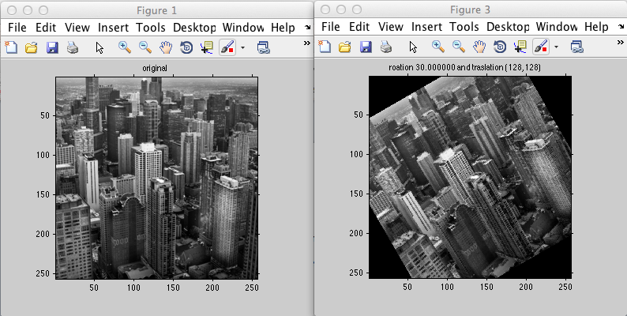

Slide 21
j₀
i₀
Algorithm:
1) For each (i,j) of J compute (i₀,j₀).
2) J(i,j) = interpolation {I(i₀,j₀)}
j
i
i₀ = s i cosΘ+ s j sinΘ +a
Coordinate Transformation:
(Example: Rotation & Translation
& Scale)
j₀ = - s i sinΘ+ s j cosΘ + b

