Slide 1
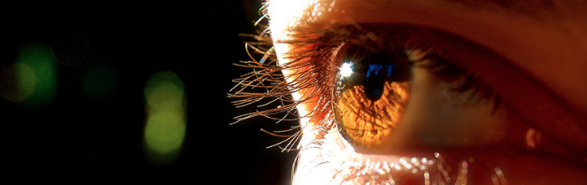
Procesamiento de Imágenes
Domingo Mery
Departamento de Ciencia de la Computación
Escuela de Ingeniería
Universidad Católica de Chile
Ecualización de Histogramas
[ Capítulo 3 ]

Slide 9
4
6
9
6
4
6
9
6
4
9
9
9
9
6
2
2
9
2
10
10
10
10
10
10
1
2
3
4
5
6
7
8
9
10
11
12

Slide 12
?

Slide 16
How to shift the bars, so that the difference between ideal accumulative function (red) and real accumulative function (blue) is minimal?

Slide 17
How to shift the bars, so that the difference between ideal accumulative function (red) and real accumulative function (blue) is minimal?
Error = 27 (circles)

Slide 18
How to shift the bars, so that the difference between ideal accumulative function (red) and real accumulative function (blue) is minimal?

Slide 19
How to shift the bars, so that the difference between ideal accumulative function (red) and real accumulative function (blue) is minimal?
Error = 15

Slide 20
How to shift the bars, so that the difference between ideal accumulative function (red) and real accumulative function (blue) is minimal?
Error = 27 (circles)

Slide 21
How to shift the bars, so that the difference between ideal accumulative function (red) and real accumulative function (blue) is minimal?
Error = 26 (circles)

Slide 22
How to shift the bars, so that the difference between ideal accumulative function (red) and real accumulative function (blue) is minimal?
Error = 23

Slide 23
How to shift the bars, so that the difference between ideal accumulative function (red) and real accumulative function (blue) is minimal?
Error = 20

Slide 24
How to shift the bars, so that the difference between ideal accumulative function (red) and real accumulative function (blue) is minimal?
Error = 17

Slide 25
How to shift the bars, so that the difference between ideal accumulative function (red) and real accumulative function (blue) is minimal?
Error = 15

Slide 26
ideal accumulative function (red)
[old] real accumulative function (blue)
[new] real accumulative function (green)
Error = 15 (green circles)

Slide 27
ideal accumulative function (red)
[old] real accumulative function (blue)
[new] real accumulative function (green)

Slide 29
Before

Slide 30
Before
After

Slide 31
Before
After

Slide 32
Before
After
4
6
9
6
4
6
3
5
8
5
3
5
9
6
4
9
9
9
8
5
3
8
8
8
9
6
2
2
9
2
8
5
1
1
8
1
10
10
10
10
10
10
11
11
11
11
11
11
1
2
3
4
5
6
7
8
9
10
11
12
1
2
3
4
5
6
7
8
9
10
11
12

Slide 33
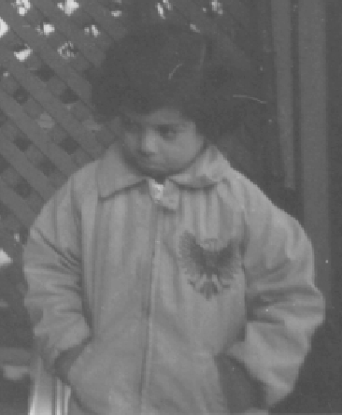
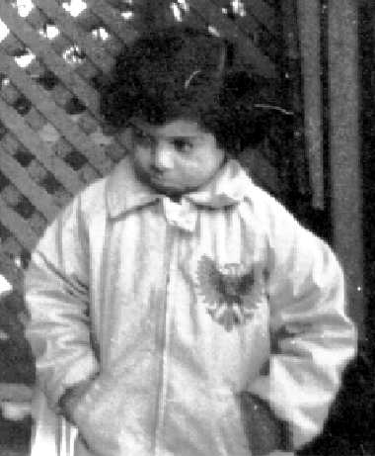
Before
After

Slide 34
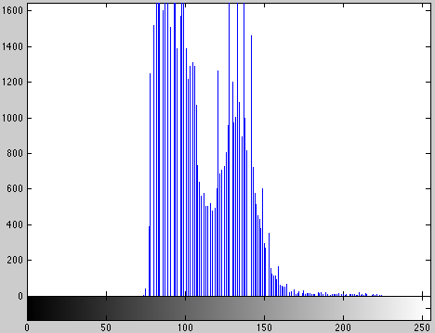
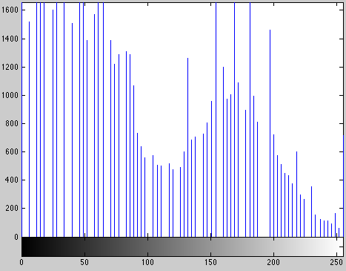
Before
After

Slide 35
How to split the bars, so that the difference between ideal accumulative function (red) and real accumulative function (blue) is minimal?

Slide 36
How to split the bars, so that the difference between ideal accumulative function (red) and real accumulative function (blue) is minimal?

Slide 37
sorted
before
after
4
6
9
6
4
6
9
6
4
9
9
9
9
6
2
2
9
2
10
10
10
10
10
10
2
2
2
4
4
4
6
6
6
6
6
9
9
9
9
9
9
9
10
10
10
10
10
10
1
1
2
2
3
3
4
4
5
5
6
6
7
7
8
8
9
9
10
10
11
11
12
12
Before
After
4
6
9
6
4
6
2
4
6
4
3
5
9
6
4
9
9
9
7
5
3
7
8
8
9
6
2
2
9
2
9
6
1
1
9
2
10
10
10
10
10
10
10
10
11
11
12
12
1
2
3
4
5
6
7
8
9
10
11
12
1
2
3
4
5
6
7
8
9
10
11
12

Slide 38
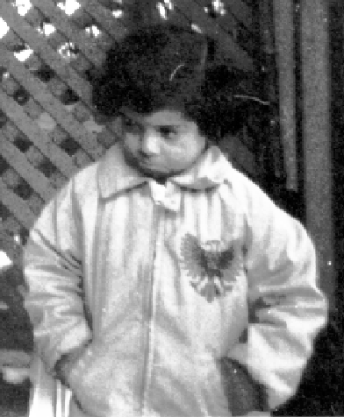
Before
After

Slide 39
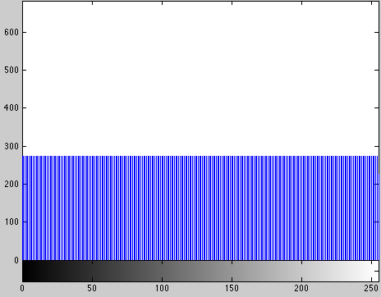
Before
After

Slide 40
Method 1
Method 2

