Slide 1
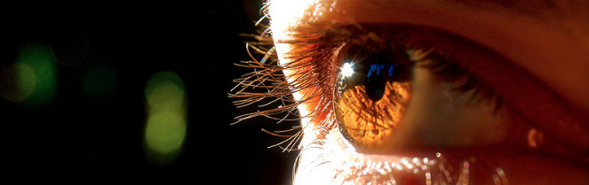
Procesamiento de Imágenes
Domingo Mery
Departmento de Ciencia de la Computación
Escuela de Ingeniería
Universidad Católica de Chile
Histogramas
[ Capítulo 3 ]

Slide 2
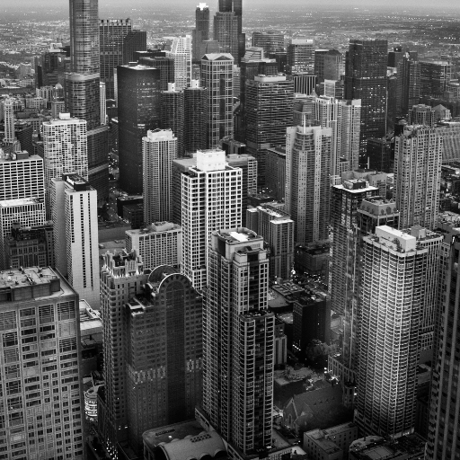
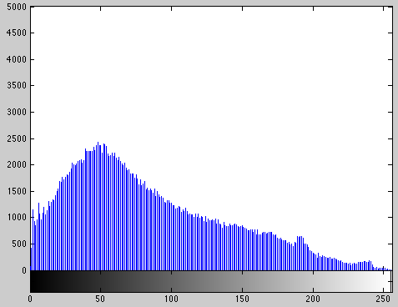
Image Histogram:
Representation that gives the number of pixels of the image for each grayvalue.
[ IMAGE ] [ HISTOGRAM ]

Slide 3
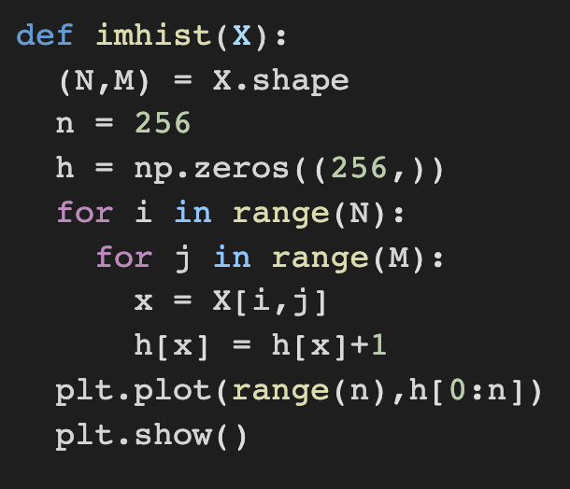
Image Histogram:
Representation that gives the number of pixels of the image for each grayvalue.
X
h
[ IMAGE ] [ HISTOGRAM ]

Slide 4
Example:
Image with 4x6 pixels and a grayscale with 12 grayvalues.

Slide 11
7
6
5
4
3
2
1
4
6
9
6
4
6
9
6
4
9
9
9
9
6
2
2
9
2
10
10
10
10
10
10
1
2
3
4
5
6
7
8
9
10
11
12

Slide 12
Image Histogram:
Representation that gives the number of pixels of the image for each grayvalue.
[ IMAGE ] [ HISTOGRAM ]

Slide 13
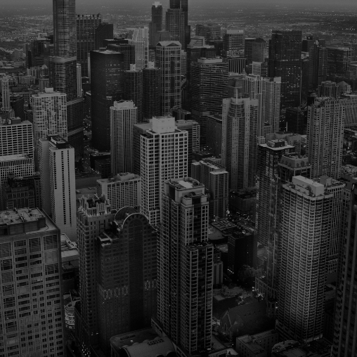
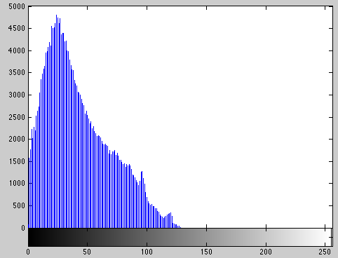
Image Histogram:
Representation that gives the number of pixels of the image for each grayvalue.
[ IMAGE ] [ HISTOGRAM ]

Slide 14
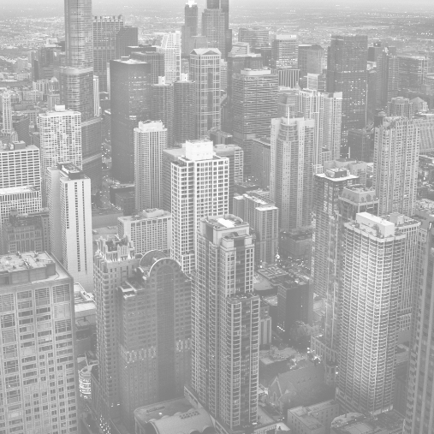
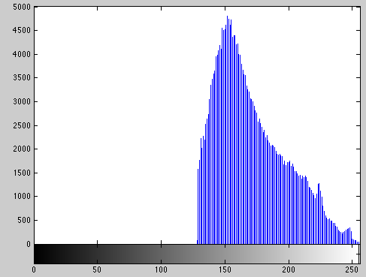
Image Histogram:
Representation that gives the number of pixels of the image for each grayvalue.
[ IMAGE ] [ HISTOGRAM ]

Slide 15
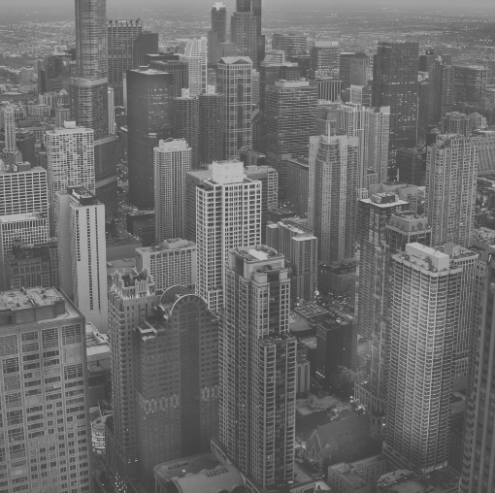
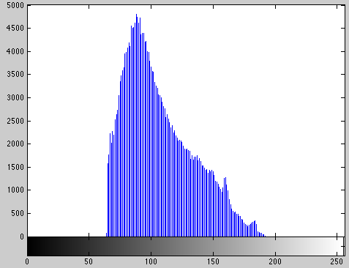
Image Histogram:
Representation that gives the number of pixels of the image for each grayvalue.
[ IMAGE ] [ HISTOGRAM ]

Slide 16
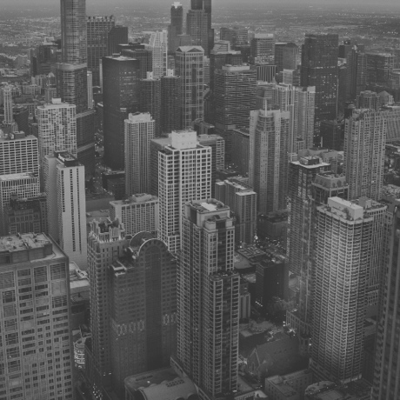

Slide 17
