Slide 1

Procesamiento de Imágenes
Based on Guodong Guo’s and Cornelia Fermüller slides
---------------------------------------
Domingo Mery
Departmento de Ciencia de la Computación
Escuela de Ingeniería
Universidad Católica de Chile
Detección de Bordes - Canny
[ Capítulo 8 ]

Slide 2
Edge is Where Change Occurs
Change is measured by derivative in 1D
Biggest change, derivative has maximum magnitude
Or 2nd derivative is zero.

Slide 3
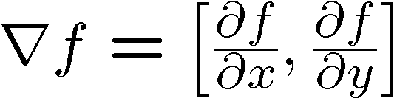
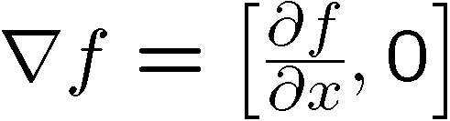
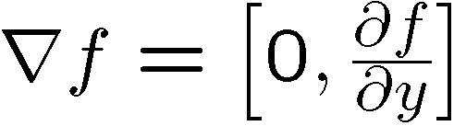
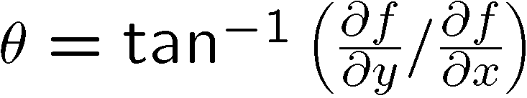
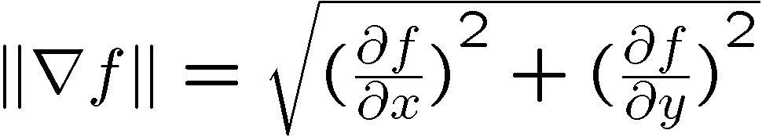
Image gradient
The gradient of an image:
The gradient points in the direction of most rapid change in intensity
The gradient direction is given by:
how does this relate to the direction of the edge?
The edge strength is given by the gradient magnitude

Slide 4
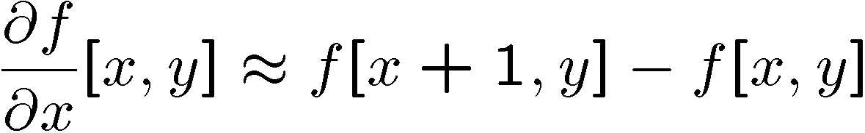
The discrete gradient
How can we differentiate a digital image f[x,y]?
Option 1: reconstruct a continuous image, then take gradient
Option 2: take discrete derivative (finite difference)
How would you implement this as a cross-correlation?

Slide 5
The Sobel operator
Better approximations of the derivatives exist
The Sobel operators below are very commonly used
-1 | 0 | 1
-2 | 0 | 2
-1 | 0 | 1
1 | 2 | 1
0 | 0 | 0
-1 | -2 | -1
The standard defn. of the Sobel operator omits the 1/8 term
doesn’t make a difference for edge detection
the 1/8 term is needed to get the right gradient value, however

Slide 6
Detecting Edges in Image
Sobel Edge Detector
Edges
Threshold
Image I

Slide 7
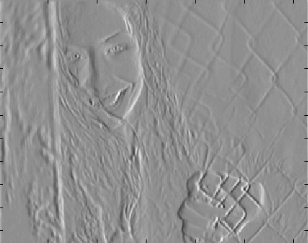
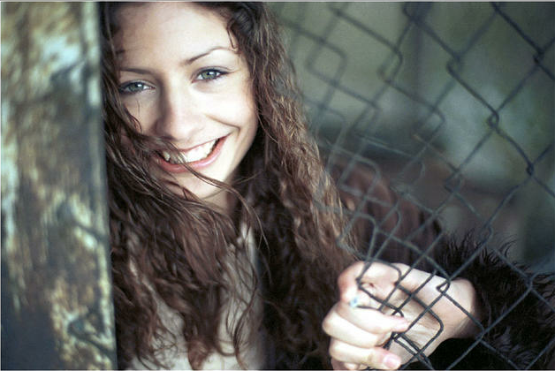
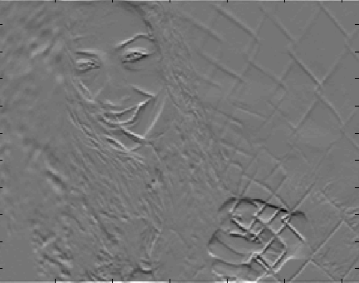
Sobel Edge Detector

Slide 8
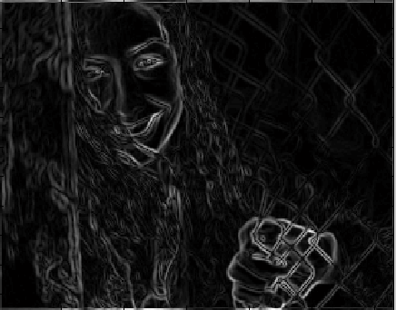
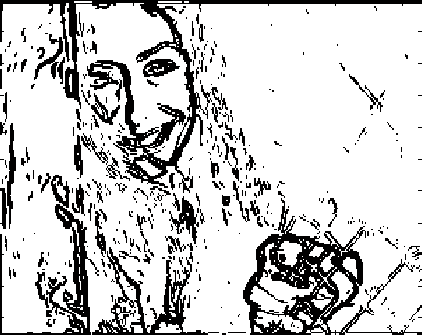
Sobel Edge Detector

Slide 9
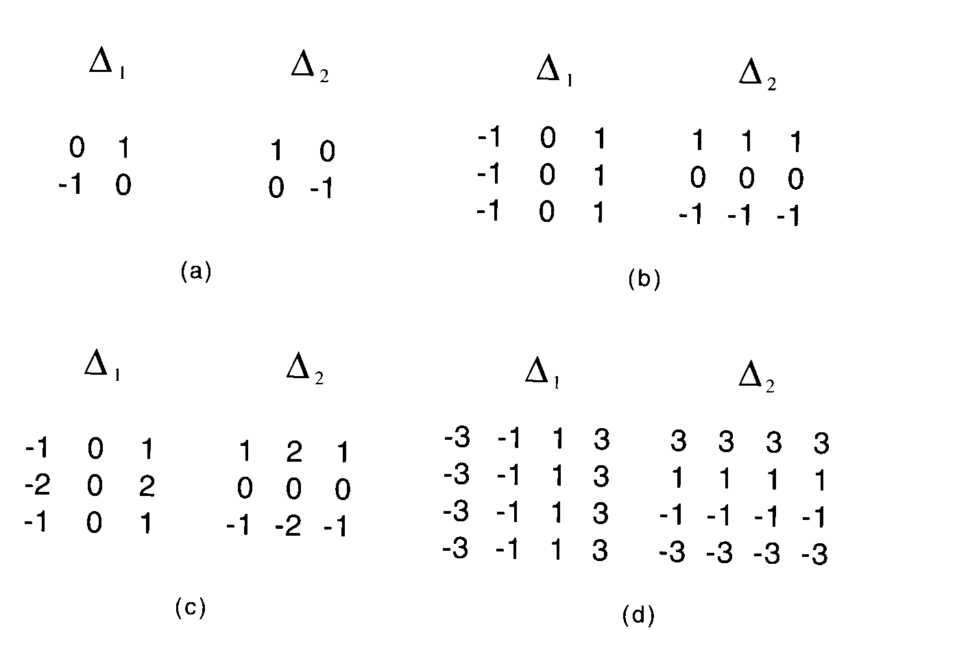
Gradient operators
(a): Roberts’ cross operator (b): 3x3 Prewitt operator
(c): Sobel operator (d) 4x4 Prewitt operator

Slide 10
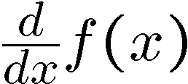
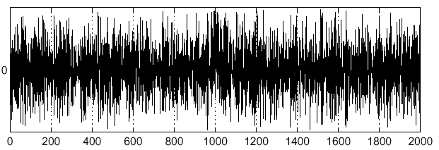
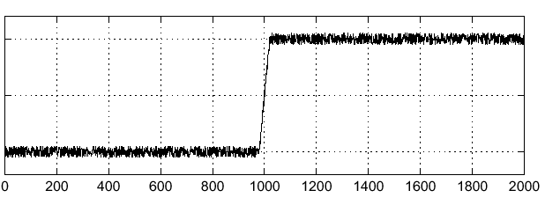
Effects of noise
Consider a single row or column of the image
Plotting intensity as a function of position gives a signal
Where is the edge?

Slide 11
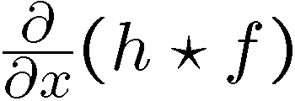
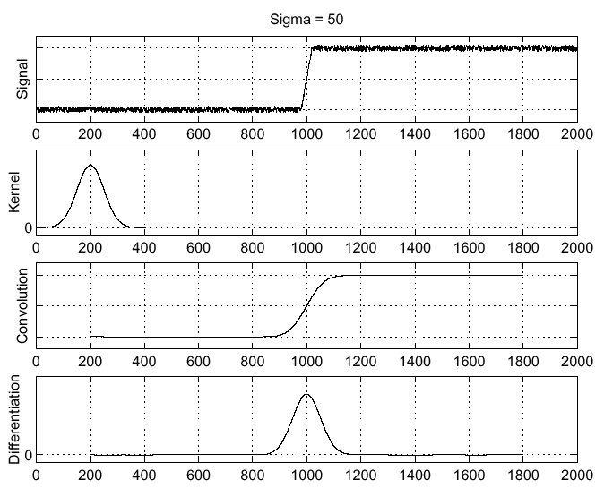
Solution: smooth first
Where is the edge?
Look for peaks in

Slide 12
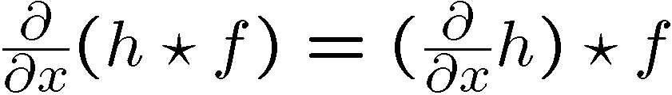
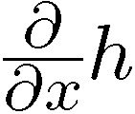
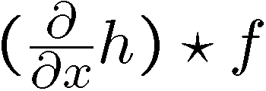
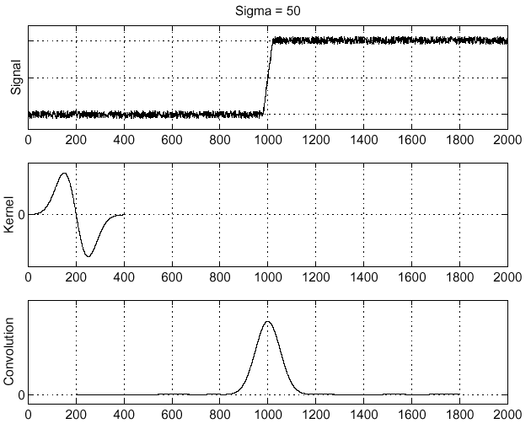
Derivative theorem of convolution
This saves us one operation:

Slide 13
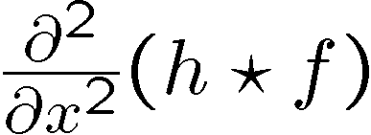
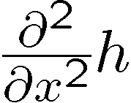
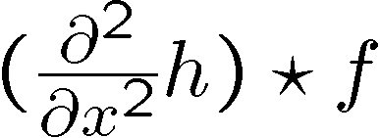
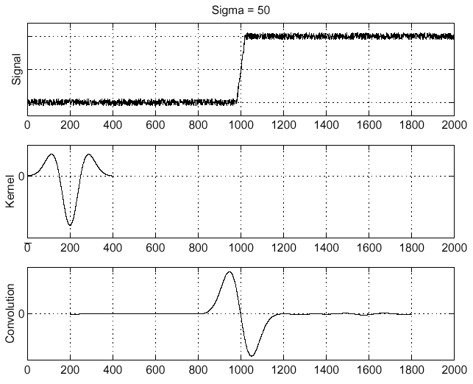
Laplacian of Gaussian
Consider
Laplacian of Gaussian
operator
Where is the edge?
Zero-crossings of bottom graph

Slide 14
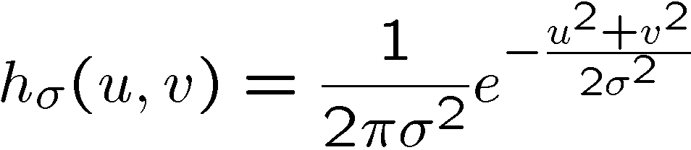
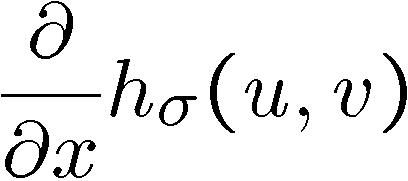
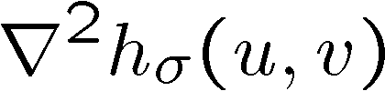
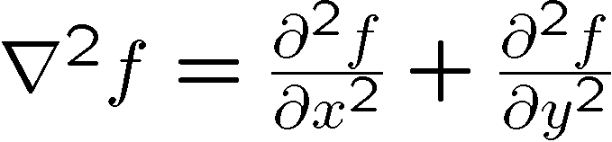
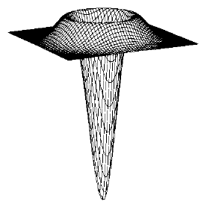
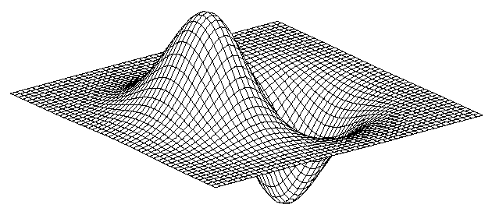
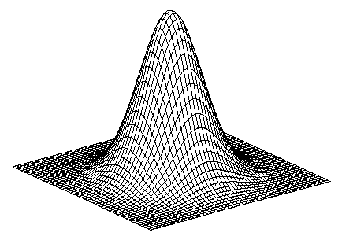
2D edge detection filters
Laplacian of Gaussian
Gaussian
derivative of Gaussian
is the Laplacian operator:

Slide 15
LoG Operator
Smooth by Gaussian
Use Laplacian to find derivatives

Slide 16
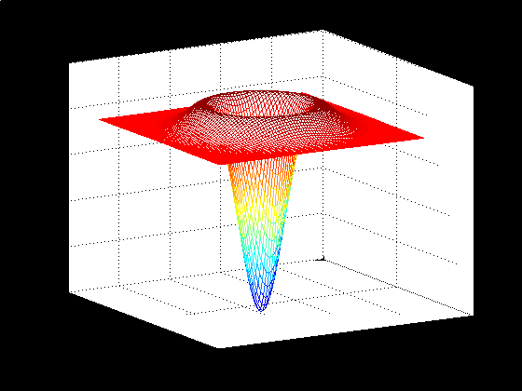
LoG Operator

Slide 17
LoG Operator
Y
X

Slide 18
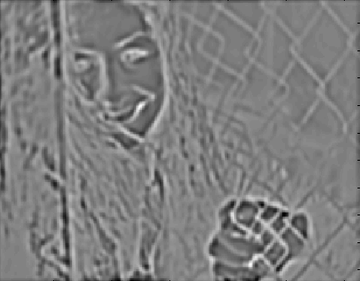
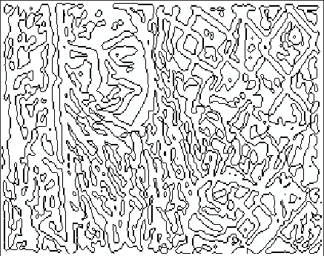
LoG Operator
Zero Crossings
Detection
Edge Image
Zero Crossings

Slide 19
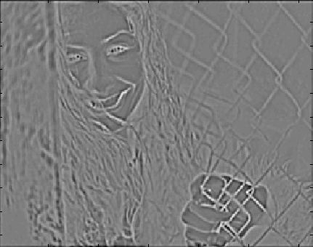
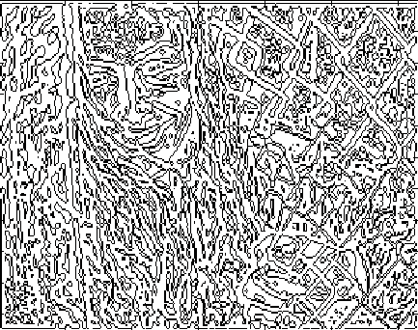
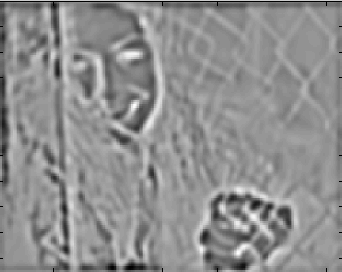
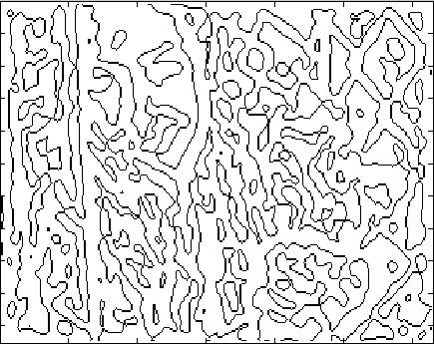
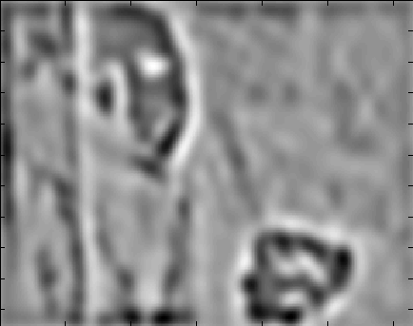
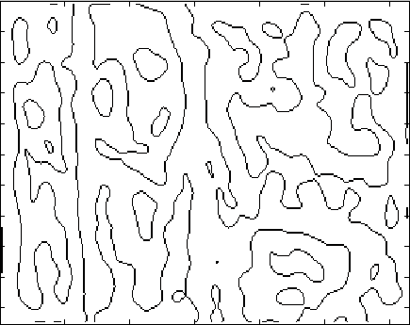

Slide 20
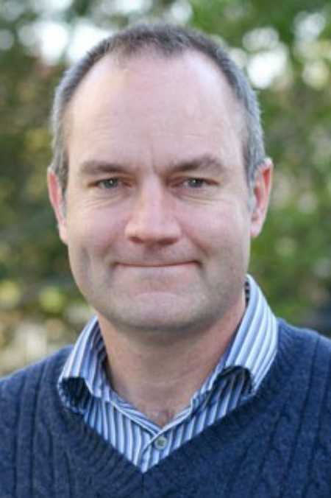
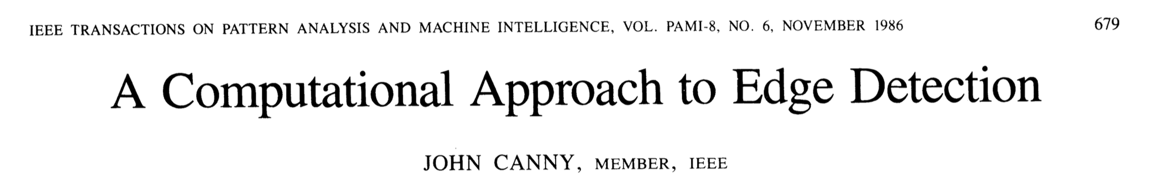
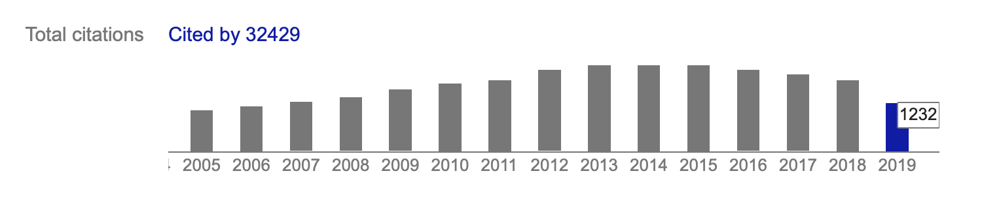
Canny Edge Detector
John Canny

Slide 21
Quality of an Edge Detector
Robustness to Noise
Localization
Too Many/Too less Responses
True Edge
Poor robustness to noise
Poor localization
Too many responses

Slide 22
Canny Edge Detector
Criterion 1: Good Detection: The optimal detector must minimize the probability of false positives as well as false negatives.
Criterion 2: Good Localization: The edges detected must be as close as possible to the true edges.
Single Response Constraint: The detector must return one point only for each edge point.

Slide 23
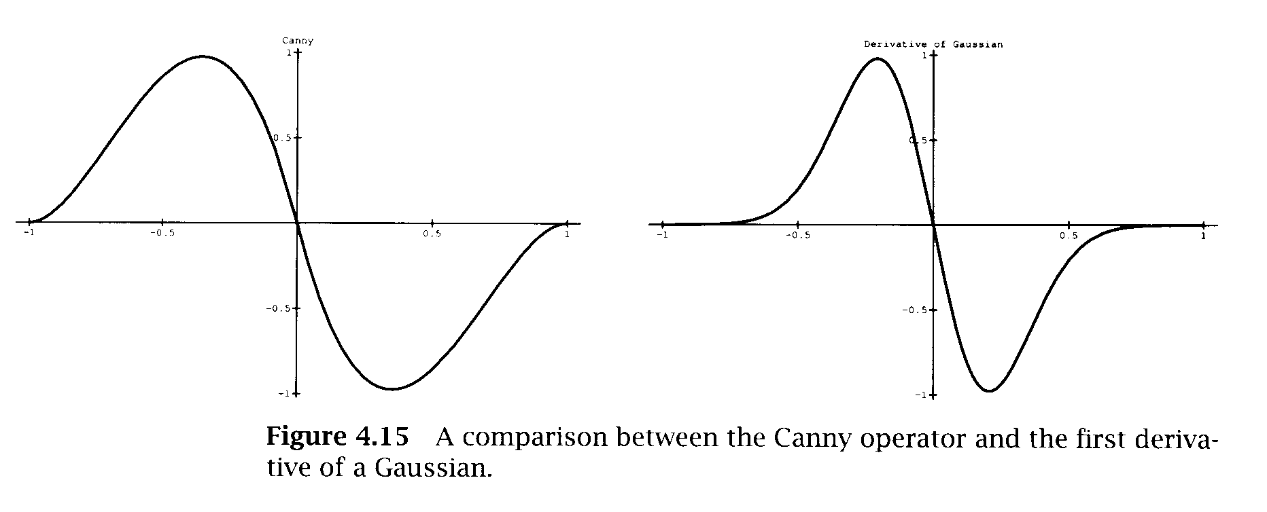
Canny Edge Detector
Difficult to find closed-form solutions.

Slide 24
Canny Edge Detector
Convolution with derivative of Gaussian
Non-maximum Suppression
Hysteresis Thresholding

Slide 25
Canny Edge Detector - Gaussian
Smooth by Gaussian
Compute x and y derivatives
Compute gradient magnitude and orientation

Slide 26
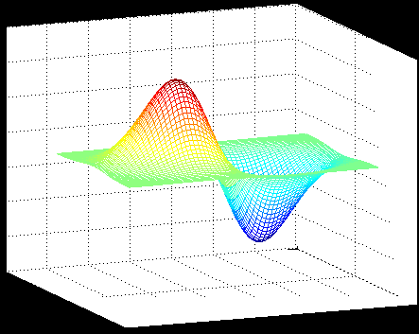
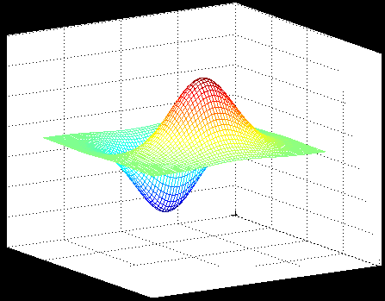
Canny Edge Detector - Gaussian

Slide 27
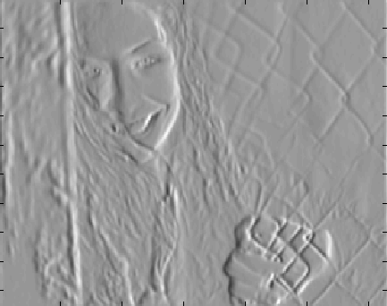
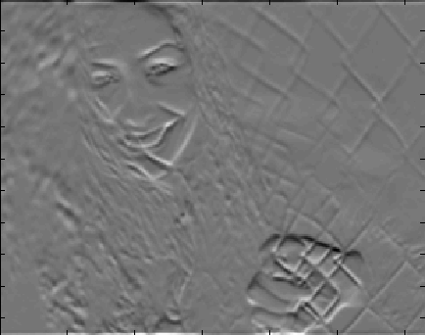
Canny Edge Detector - Gaussian

Slide 28

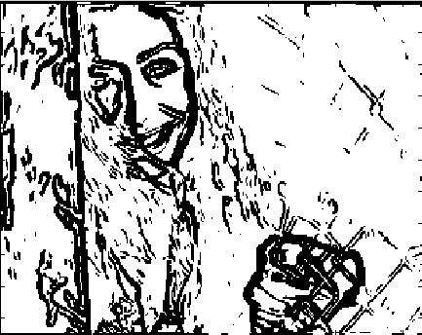
Canny Edge Detector - Gaussian

Slide 29


Canny Edge Detector - NMS
At every pixel, it suppresses the edge strength of the center pixel (by setting its value to 0) if its magnitude is not greater than the magnitude of the two neighbors in the gradient direction.
Non-Maximum Suppression (NMS)

Slide 30
Canny Edge Detector - NMS
Suppress the pixels in ‘Gradient Magnitude Image’ which are not local maximum

Slide 31
Canny Edge Detector - NMS

Slide 32


Canny Edge Detector - NMS

Slide 33
Hysteresis Thresholding
Canny Edge Detector - Hysteresis
GRADIENT
high
low

Slide 34
Canny Edge Detector - Hysteresis
If the gradient at a pixel is above ‘High’, declare it an ‘edge pixel’
If the gradient at a pixel is below ‘Low’, declare it a ‘non-edge-pixel’
If the gradient at a pixel is between ‘Low’ and ‘High’ then declare it an ‘edge pixel’ if and only if it is connected to an ‘edge pixel’ directly or via pixels between ‘Low’ and ‘ High’

Slide 35
Hysteresis Thresholding
Canny Edge Detector - Hysteresis
GRADIENT
high
EDGE
low

Slide 36
Thresholding without Hysteresis
Canny Edge Detector - Hysteresis
GRADIENT
EDGE
threshold

Slide 37

Canny Edge Detector - Hysteresis
With Hysteresis

Slide 38
Suggested Reading
Chapter 8, David A. Forsyth and Jean Ponce, "Computer Vision: A Modern Approach“
Chapter 4, Emanuele Trucco, Alessandro Verri, "Introductory Techniques for 3-D Computer Vision”
Canny, John (1986): "A computational approach to edge detection." IEEE Transactions on Pattern Analysis and Machine Intelligence, 6 (1986): 679-698.

