Slide 1
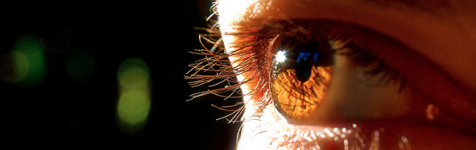
Procesamiento de Imágenes
Domingo Mery
Departmento de Ciencia de la Computación
Escuela de Ingeniería
Universidad Católica de Chile
Transformada de Haar
[ Capítulo 4 ]

Slide 2
The Viola/Jones Face Detector (2001)
A widely used method for real-time object detection.
Training is slow, but detection is very fast.
(Most slides from Paul Viola)

Slide 3
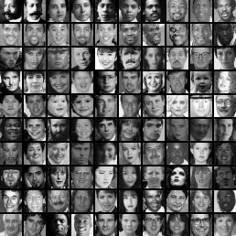
Classifier is Learned from Labeled Data
Training Data
5000 faces
All frontal
300 million non faces
9400 non-face images
Faces are normalized
Scale, translation
Many variations
Across individuals
Illumination
Pose (rotation both in plane and out)
Notes:
This situation with negative examples is actually quite common… where negative examples are free.

Slide 4
Key Properties of Face Detection
Each image contains 10 - 50 thousand locs/scales
Faces are rare 0 - 50 per image
1000 times as many non-faces as faces
Extremely small # of false positives: 10⁻⁶
Notes:
As I said earlier the classifier is evaluated 50,000
Faces are quite rare…. Perhaps 1 or 2 faces per image
A reasonable goal is to make the false positive rate less than the true positive rate...

Slide 5
AdaBoost
Given a set of weak classifiers
None much better than random
Iteratively combine classifiers
Form a linear combination
Training error converges to 0 quickly
Test error is related to training margin

Slide 6
AdaBoost
Weak
Classifier 1
Freund & Shapire
Weights
Increased
Weak
Classifier 2
Weak
classifier 3
Final classifier is
linear combination of weak classifiers

Slide 7
AdaBoost: Super Efficient Feature Selector
Features = Weak Classifiers
Each round selects the optimal feature given:
Previous selected features
Exponential Loss

Slide 8
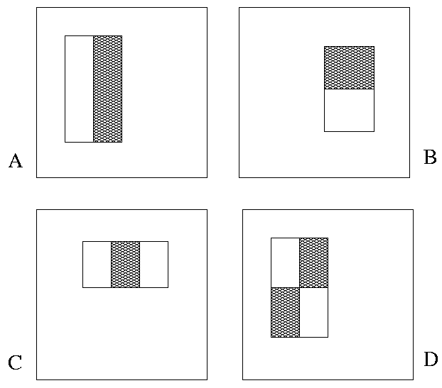
Boosted Face Detection: Image Features
“Rectangle filters”
Similar to Haar wavelets
Papageorgiou, et al.
60,000 features to choose from
Notes:
For real problems results are only as good as the features used...
This is the main piece of ad-hoc (or domain) knowledge
Rather than the pixels, we have selected a very large set of simple functions
Sensitive to edges and other critcal features of the image
** At multiple scales
Since the final classifier is a perceptron it is important that the features be non-linear… otherwise the final classifier will be a simple perceptron.
We introduce a threshold to yield binary features

Slide 9
The Integral Image
The integral image computes a value at each pixel (x,y) that is the sum of the pixel values above and to the left of (x,y), inclusive.
This can quickly be computed in one pass through the image
(x,y)

Slide 10
Computing Sum within a Rectangle
Let A,B,C,D be the values of the integral image at the corners of a rectangle
Then the sum of original image values within the rectangle can be computed:
sum = A – B – C + D
Only 3 additions are required for any size of rectangle!
This is now used in many areas of computer vision
D
B
C
A

Slide 11
Feature Selection
For each round of boosting:
Evaluate each rectangle filter on each example
Sort examples by filter values
Select best threshold for each filter (min Z)
Select best filter/threshold (= Feature)
Reweight examples
M filters, T thresholds, N examples, L learning time
O( MT L(MTN) ) Naïve Wrapper Method
O( MN ) Adaboost feature selector

Slide 12
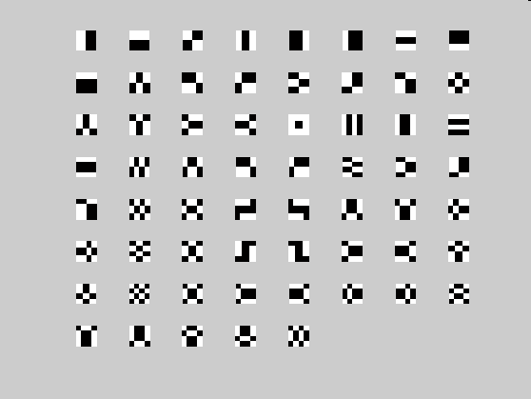
Haar Basis

Slide 13
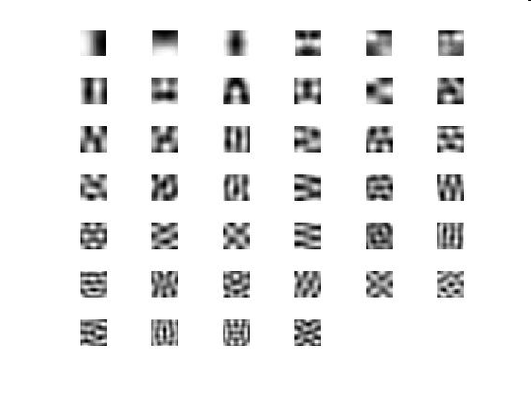
Haar * Faces

Slide 14
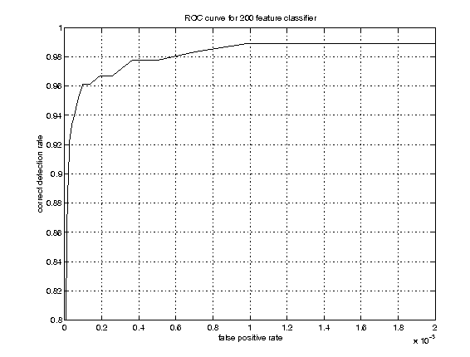




Example Classifier for Face Detection
A classifier with 200 rectangle features was learned using AdaBoost
95% correct detection on test set with 1 in 14084
false positives.
Not quite competitive...
ROC curve for 200 feature classifier

Slide 15
Building Fast Classifiers
Given a nested set of classifier hypothesis classes
Computational Risk Minimization
% False Pos
0
50
vs
false
neg
determined by
50 100
% Detection
T
T
T
IMAGE
SUB-WINDOW
T
Classifier 1
Classifier 2
Classifier 3
FACE
F
F
F
F
NON-FACE
NON-FACE
NON-FACE
NON-FACE
Notes:
In general simple classifiers, while they are more efficient, they are also weaker.
We could define a computational risk hierarchy (in analogy with structural risk minimization)…
A nested set of classifier classes
The training process is reminiscent of boosting…
- previous classifiers reweight the examples used to train subsequent classifiers
The goal of the training process is different
- instead of minimizing errors minimize false positives

Slide 16
Cascaded Classifier
IMAGE
SUB-WINDOW
50%
20%
2%
1 Feature
5 Features
20 Features
FACE
F
F
F
NON-FACE
NON-FACE
NON-FACE
A 1 feature classifier achieves 100% detection rate and about 50% false positive rate.
A 5 feature classifier achieves 100% detection rate and 40% false positive rate (20% cumulative)
using data from previous stage.
A 20 feature classifier achieve 100% detection rate with 10% false positive rate (2% cumulative)

Slide 17
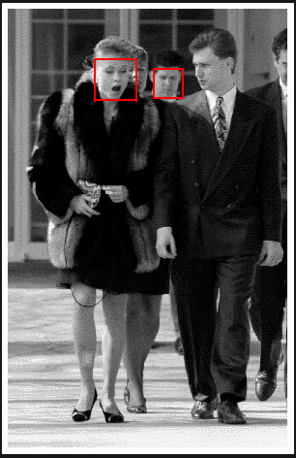
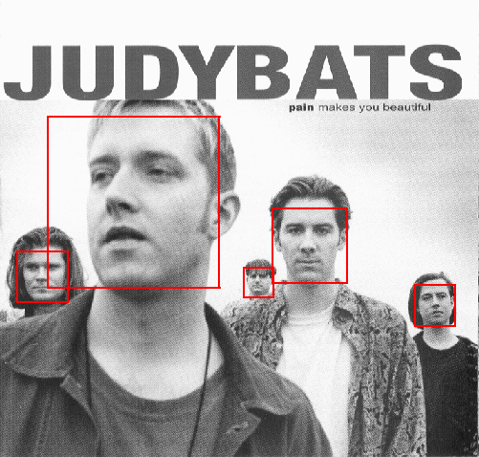
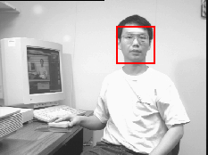
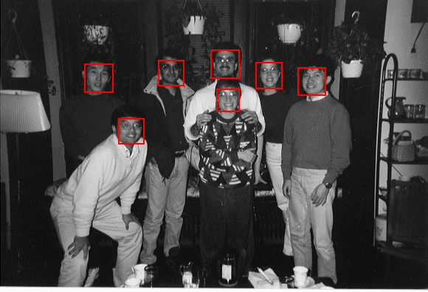
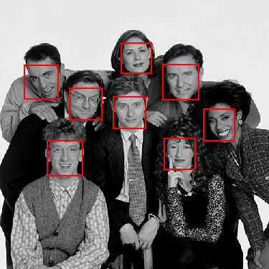
Output of Face Detector on Test Images

Slide 18
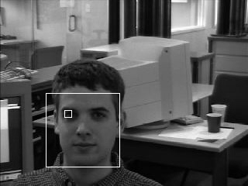
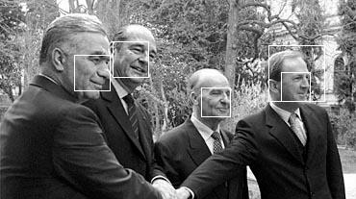
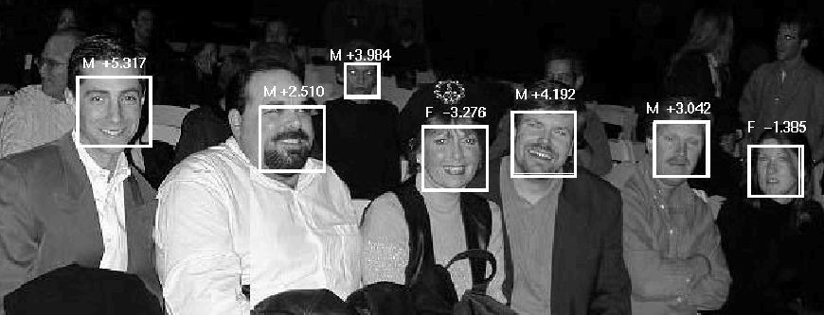
Solving other “Face” Tasks
Facial Feature Localization
Profile Detection
Demographic
Analysis

Slide 19

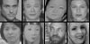
Feature Localization Features
Learned features reflect the task

Slide 20
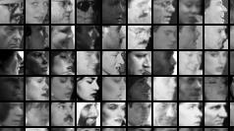
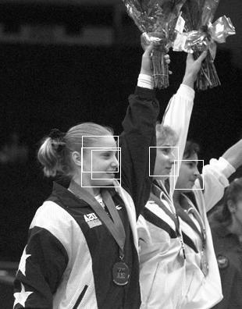
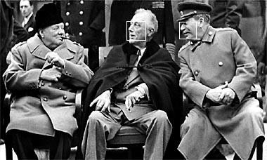
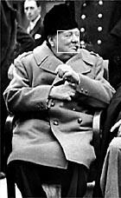
Profile Detection

Slide 21
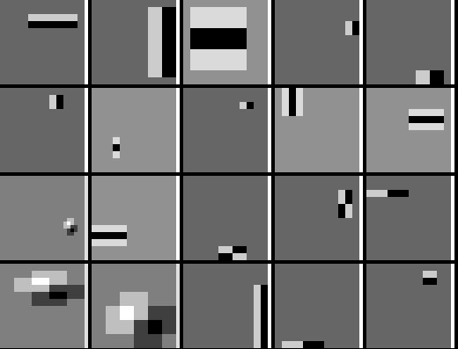
Profile Features

Slide 22
Review: Colour
Spectrum of illuminant and surface
Human colour perception (trichromacy)
Metameric lights, Grassman’s laws
RGB and CIE colour spaces
Uniform colour spaces
Detection of specularities
Colour constancy

Slide 23
Review: Invariant features
Scale invariance, using image pyramid
Orientation selection
Local region descriptor (vector formation)
Matching with nearest and 2nd nearest neighbours
Object recognition
Panorama stitching

Slide 24
Review: Classifiers
Bayes risk, loss functions
Histogram-based classifiers
Kernel density estimation
Nearest-neighbor classifiers
Neural networks
Viola/Jones face detector
Integral image
Cascaded classifier

