Slide 1
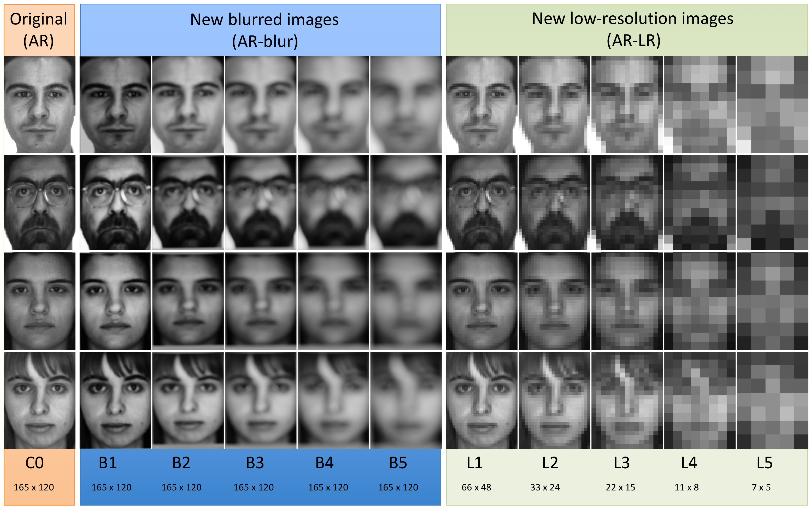

Slide 2
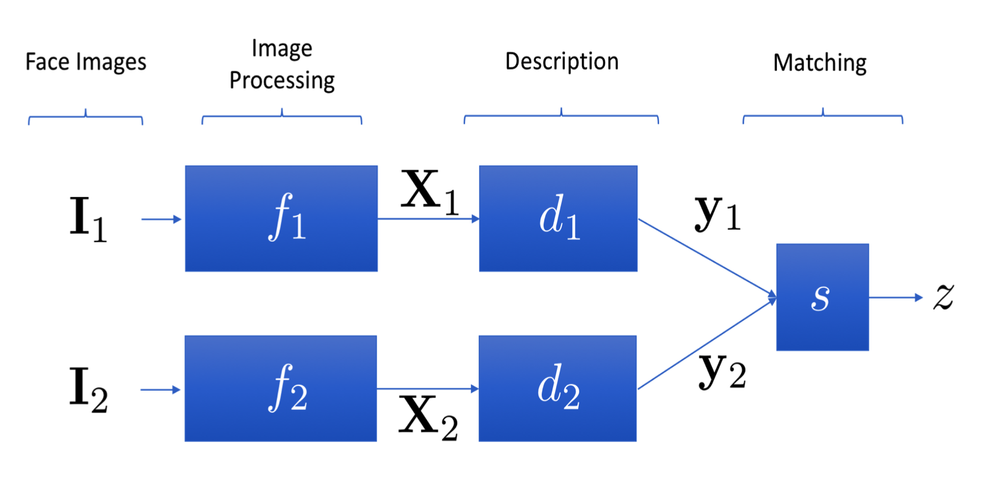

Slide 3






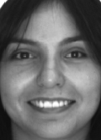
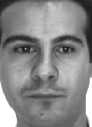
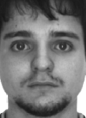



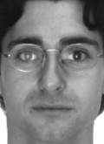
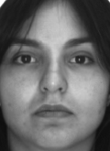
Experiments: 2 images from 100 subjects from AR dataset
(100 x 100 comparisons, classification knn-1)
1 2 3 4 5 6 ... 100
C0
C1
All Q1 images vs. all Q2 images = 100 positive comparisons
9.900 negative comparisons

Slide 4
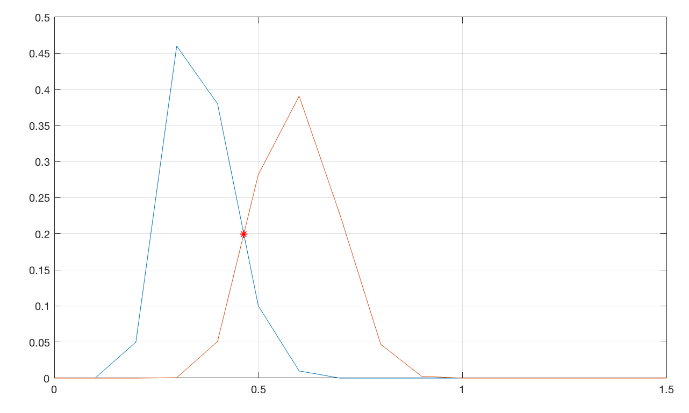
genuins
impostors
ERR = Equal Error Rate
z = difference of the norm

Slide 5
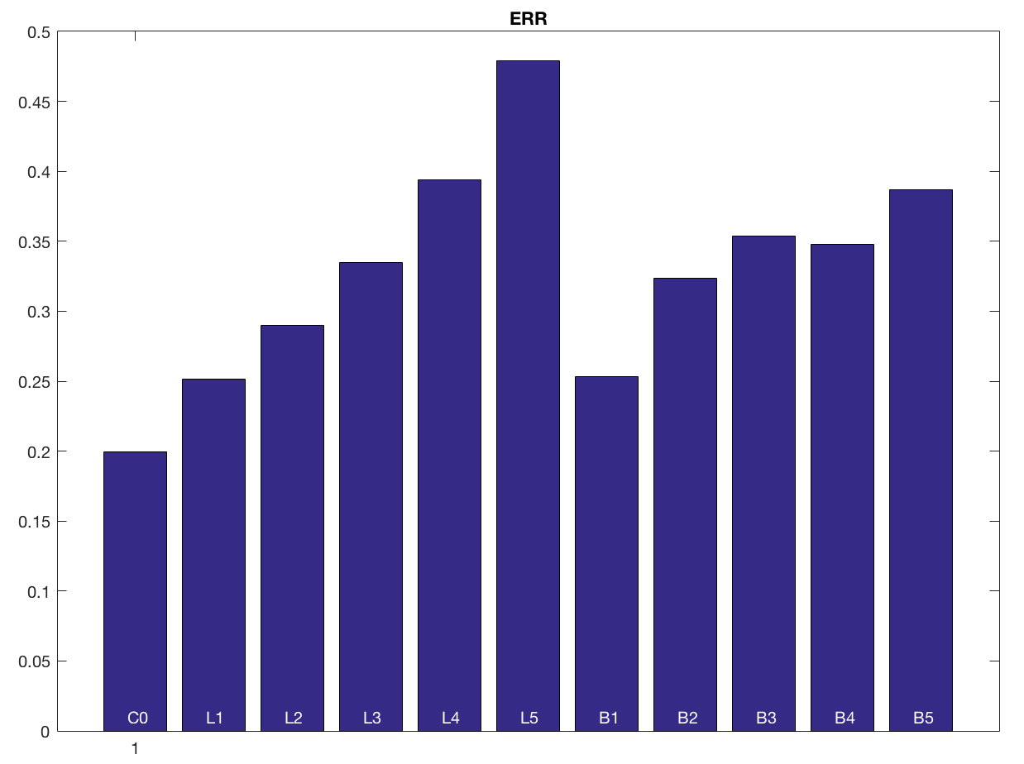

Slide 6
Diagrama de Bloques
Ejemplo de Imágenes Restauradas
Resultados
 | ERR |  | ERR
C0
L1 |  | B1
L2 |  | B2
L3 |  | B3
L4 |  | B4
L5 |  | B5
Grupo N: Nombre de los Integrantes

