Slide 1
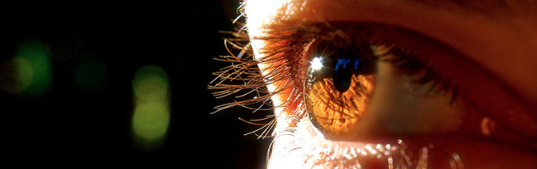
Procesamiento de Imágenes
Domingo Mery
Departmento de Ciencia de la Computación
Escuela de Ingeniería
Universidad Católica de Chile
Region Growing
[ Capítulo 8 ]

Slide 3
seed

Slide 5
Growing in 4
directions if it is allowed.

Slide 6
Growing in 4
directions if it is allowed.

Slide 7
1
Growing in 4
directions if it is allowed.
4
2
3

Slide 8
1
Growing in 4
directions if it is allowed.
4
2
3

Slide 9
1
Growing in 4
directions if it is allowed.
4
2
3

Slide 10
1
Growing in 4
directions if it is allowed.
4
2
3

Slide 11
1
Growing in 4
directions if it is allowed.
4
2
3

Slide 12
1
Growing in 4
directions if it is allowed.
4
2
3

Slide 13
1
Growing in 4
directions if it is allowed.
4
2
3

Slide 14
1
Growing in 4
directions if it is allowed.
4
2
3

Slide 15
1
Growing in 4
directions if it is allowed.
4
2
3

Slide 16
1
Growing in 4
directions if it is allowed.
4
2
3

Slide 17
1
Growing in 4
directions if it is allowed.
4
2
3

Slide 18
1
Growing in 4
directions if it is allowed.
4
2
3

Slide 19
1
Growing in 4
directions if it is allowed.
4
2
3

Slide 20
1
2
Growing in 4
directions if it is allowed.
7
3
6
4
5

Slide 21
1
2
Growing in 4
directions if it is allowed.
7
3
6
4
5

Slide 22
1
2
Growing in 4
directions if it is allowed.
7
3
6
4
5

Slide 23
1
2
Growing in 4
directions if it is allowed.
7
3
6
4
5

Slide 24
1
2
Growing in 4
directions if it is allowed.
7
3
6
4
5

Slide 25
1
2
Growing in 4
directions if it is allowed.
7
3
6
4
5

Slide 26
1
2
Growing in 4
directions if it is allowed.
7
3
6
4
5

Slide 27
1
2
Growing in 4
directions if it is allowed.
7
3
6
4
5

Slide 28
1
2
Growing in 4
directions if it is allowed.
7
3
6
4
5

Slide 29
1
2
Growing in 4
directions if it is allowed.
7
3
6
4
5

Slide 30
1
2
Growing in 4
directions if it is allowed.
7
3
6
4
5

Slide 31
Growing in 4
directions if it is allowed.

Slide 32
Growing in 4
directions if it is allowed.

Slide 33
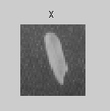
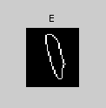

Example in Matlab
I = imread('rice.png');
X = I(155:194,125:160);
E = edge(x,'log',5e-3,2);
L = bwlabel(not(E),4);

