Slide 1
Introduction to Game Development
Shahnawaz Alam

Slide 2
About Me
Shahnawaz Alam
Developer, TCS Research (Kolkata)
Hobbyist Game Programmer

Slide 3
Introduction to Games
What do you mean by Game, technically?
Game Trivia : Science, Art and Business.
Difference between Application Software, Movie and Game?

Slide 4
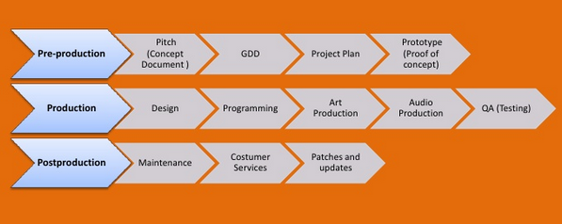
Game Facts
Avatar vs GTA 5 (Equal Revenue Generator).
Video Game market is highest in entertainment industry (More than Film Industry).
Games are simply complex.

Slide 5
Game: Behind the scene
Game works in loop (Programmatically)
Initialization //Initializing game assets and components
Loop //Loop with condition
Updates() //Updates the game parameters and component values
Render() //Draw frames on display (using on board graphics or GPU)
Loop ends //Loop ends with condition failing
Destroy //Destroying game objects to free the allocated memory

Slide 6
Cont. Game: Behind the scene
Every element is a GameObject in a scene possessing different functionality and components.
Games are rendered in frame per second depending upon the computing power of the device (Higher the GPU clock and graphics memory better the frame rate thus better performance).
We can visualize the scene using any one of the 2 views : Perspective and Orthogonal view.
Direct3D and/or OpenGL APIs are required for communication between game and graphics card, it is highly optimized for millions of computing per second.

Slide 7
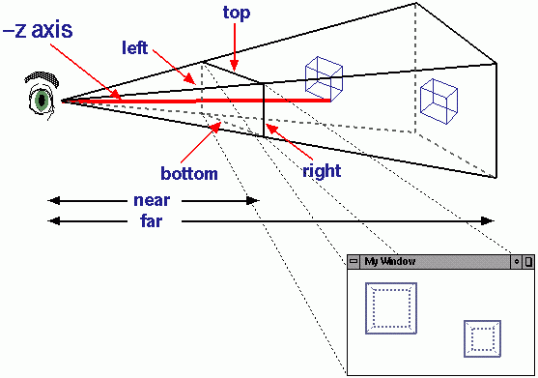
3D vs 2D Games
3D games are made up of 3D Models while 2D ones with Sprites.
3D games have depth visualization using 3D perspective projection.

Slide 8
Concept of Polygon, Texture and Sprites (Visual aspects of game)
Polygons are made up of vertex(smallest unit of graphics). They (Generally triangle) make up the 3D Models creating a mesh.
Texture is a 2D image scaled down for optimization of game. Textures are applied on 3D objects for visuals.
Sprites are also scaled down version of a 2D image but they are only used for 2D assets.

Slide 9
Computing Graphics
Vertex stores the xyz location in 3D space and pixel-light value.
Complex mathematical calculations which are part of physics engine are executed by GPU only and not by CPU (Direct3D/OpenGL helps here).
GPU also computes the Projection Matrix of 3D objects(3D vertex array) from scene to form a 2D frame to be displayed on screen.

Slide 10
Game Optimizations
There are two types of optimizations possible
CPU Optimization
1. “draw call counts” - CPU computes the light, shader parameters and creates drawing commands for GPU for every object created in frame.
2. Lower the draw call counts better the performance.
GPU Optimization
1. Use minimum number of triangles (vertices) per frame.
2. Try to keep number of UV mappings (2D image representation of a 3D model's surface) less.

Slide 11
Game Programming
Graphics programming (including shader development)
Animation
Physics simulation
AI and Gameplay
Audio
Networking

Slide 12
Game Engines
Game Engines, a framework which has inbuilt physics engine and rendering mechanism.
Simplification of complex game making procedure in optimized way.
Rendering systems are built upon API such as OpenGL and Direct3D which provide software abstraction of the graphics card.
Some of the advanced game engines are Unity3D, UDK etc.

Slide 13
Game Mathematics
There are various applications of mathematics in game programming,
Single and Multiple Point Collision Detection,
Computational Geometry,
Matrix Transformations,
3D Rotation are to name few.

Slide 14
Game Physics
It involves laws of physics into the game for making it appear more realistic to the observer.
Physics plays a vital role in process of game creation, though majorly engines have inbuilt physics engines, sometimes tweaking the physics is necessary for some special effects.
Physics Simulations (Rigid Body), Particle Systems, and Projectiles are a major part of the physics.

Slide 15
Platforms
Major targeted platforms
Personal Computers
Consoles (Xbox, PS)
Mobiles (iOS, Android, WP)
Web

Slide 16
Game Monetization
Advertisements
In-App Purchase
Sell your game

Slide 17
Game Ratings and Censorship
Game rating system is a system used for the classification of video games into suitability-related groups.
Entertainment Software Rating Board (ESRB) – for USA, Canada etc.
Pan European Game Information (PEGI) – for European countries.

Slide 18
Game Publishing
Publishing games can be done in two ways - either by self or via publishing companies.
Self publishing is majorly done on mobile platforms (iOS, Windows Phone, Android, Mozilla etc.)

Slide 19
Thank you
Any Questions?
Contact me
email: shaan@outlook.com
facebook: shaan.shahnawazalam

