Slide 1




DES to S-PLUS Hunting Faint Galaxies
Luis A. Gutiérrez-Soto
Instituto de Astrofísica de La Plata - CONICET-UNLP
S-PLUS Fornax meeting
May 30, 2025

Slide 2

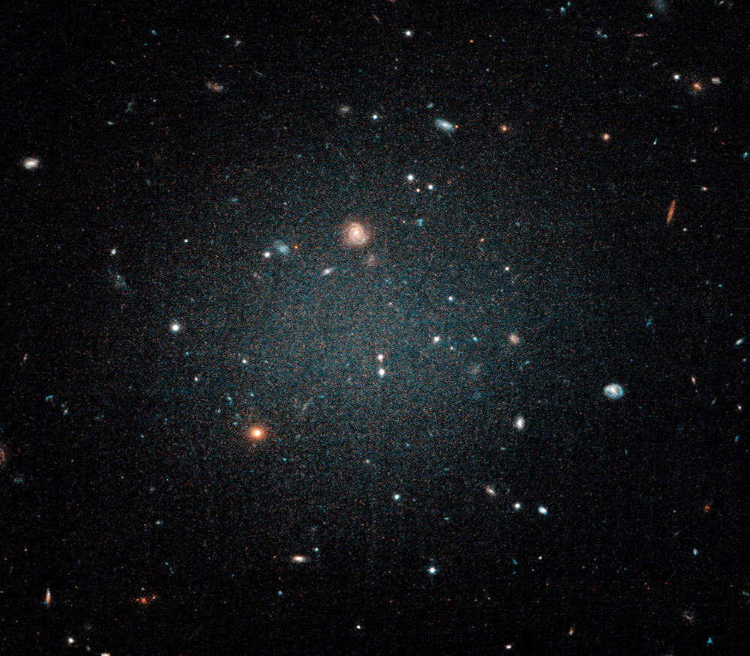
Context
Low-surface-brightness galaxies (LSBGs) have central surface brightness below the night‐sky level, making them notoriously hard to detect and catalog (Disney 1976; McGaugh et al. 1995; Bothun et al. 1997).
While they contribute only a few percent of local luminosity density, LSBGs may comprise ~15 % of today’s dynamical mass budget (Driver 1999; Minchin et al. 2004).
Pero su detección es difícil porque:
- Son 10-100x más difusas que el cielo de fondo
- Los métodos tradicionales fallan
- La inspección visual es inviable en grandes surveys"
A Hubble Space Telescope image of the galaxy NGC1052-DF2 which was first discovered with the Dragonfly Telescope Array. DF2 appears to be almost completely devoid of dark matter. Image: NASA; ESA; P. van Dokkum

Slide 3
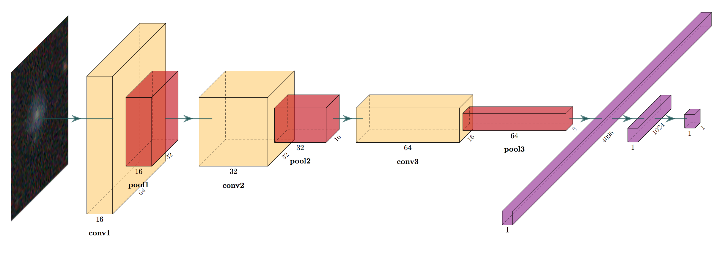
Context
Solución propuesta:
"DeepShadows (Tanoglidis et al. 2021) usa redes neuronales convolucionales
para distinguir LSBGs de artefactos con 92% de precisión"

Slide 4
Context
2024A&A...682A...4T
2024/02
cited: 8
quick access to full text links
quick links to lists of references, citations and more
quick links to data associated with this article
Shedding light on low-surface-brightness galaxies in dark energy surveys with transformer models

Slide 5

Context
The T80-Sul is equipped with a 12-filter system (five broadband filters: u, g, r, i, z, and seven narrowband filters, including J0660: Hα), enabling precise photometric studies of stars, galaxies, and transient phenomena. S-PLUS has already released Data Release 4 (DR4), covering approximately 3000 square degrees of the southern sky, which include high-latitude regions and an area within the disk.

Slide 6
Context
The T80-Sul is equipped with a 12-filter system (five broadband filters: u, g, r, i, z, and seven narrowband filters, including J0660: Hα), enabling precise photometric studies of stars, galaxies, and transient phenomena. S-PLUS has already released Data Release 4 (DR4), covering approximately 3000 square degrees of the southern sky, which include high-latitude regions and an area within the disk.
J0378: [O II]
J0395: Ca II H+K
J0410: Hδ
J0430: G band
J0515: Mg b triplet
J0660: Hα + [N II]
J0865: Ca Triplet

Slide 7
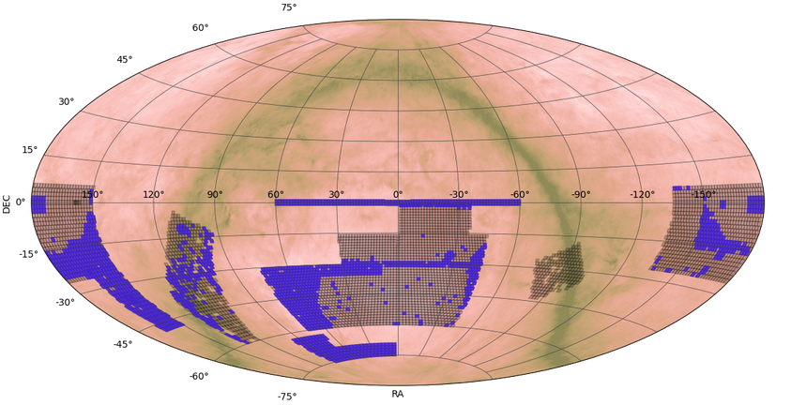
Context
The T80-Sul is equipped with a 12-filter system (five broadband filters: u, g, r, i, z, and seven narrowband filters, including J0660: Hα), enabling precise photometric studies of stars, galaxies, and transient phenomena. S-PLUS has already released Data Release 4 (DR4), covering approximately 3000 square degrees of the southern sky, which include high-latitude regions and an area within the disk.

Slide 8
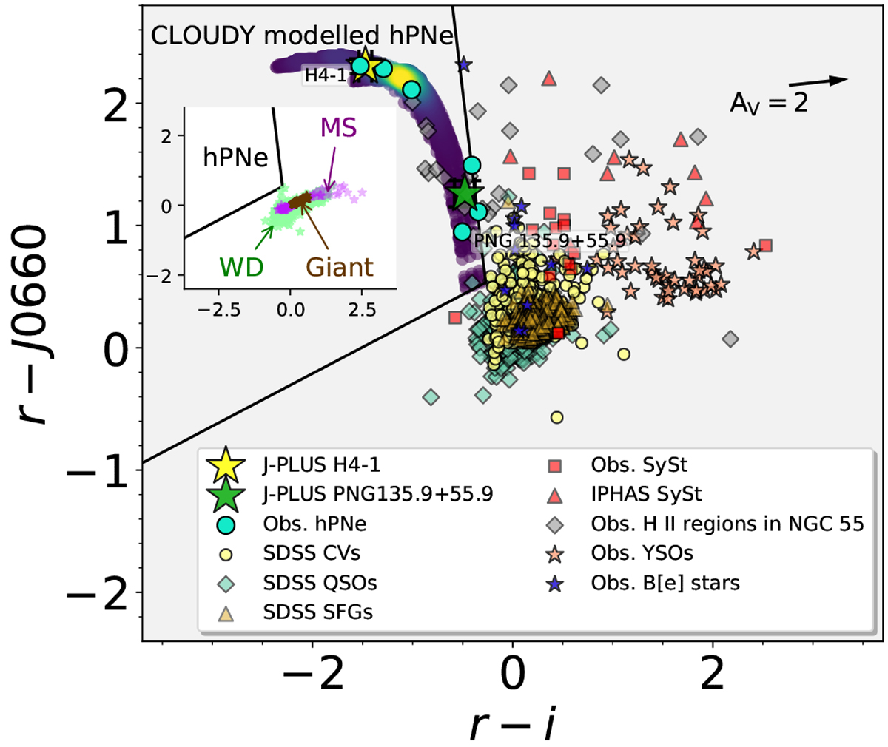
Tracing Halo Nebulae
Photometric Tools for Identifying Compact Planetary Nebulae
This study uses color–color diagrams, such as r – J0660 vs. r – i, alongside photometric spectra to effectively distinguish compact planetary nebulae from other emission-line objects. The approach, validated with J-PLUS and S-PLUS data, highlights its efficiency in searching for halo planetary nebulae.
Gutiérrez-Soto, Gonçalves, Akras, Cortesi, Lopez-Sanjuan, et al. (2020, A&A, 633, A123)

Slide 9
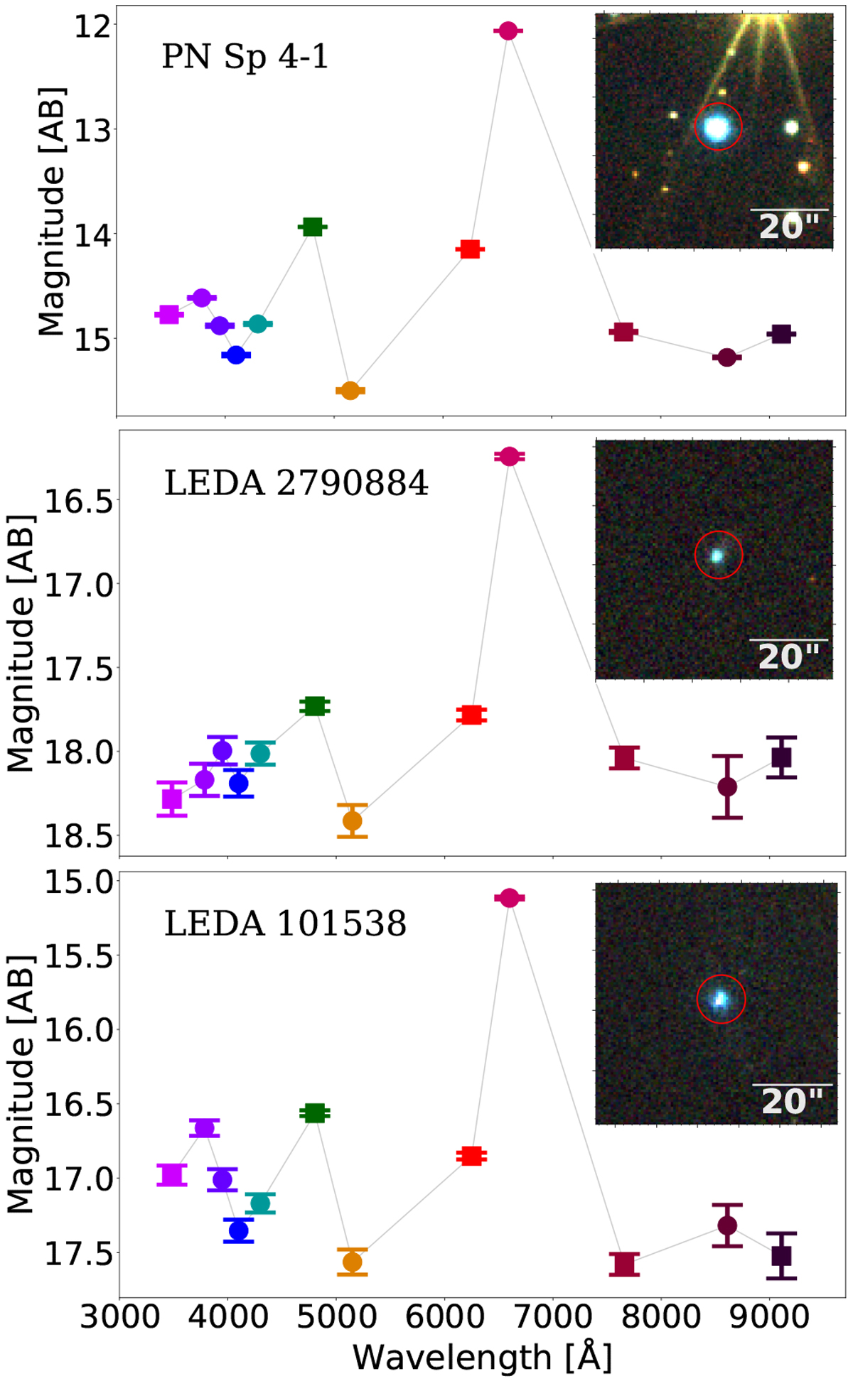
Tracing Halo Nebulae
Photometric Tools for Identifying Compact Planetary Nebulae
This study uses color–color diagrams, such as r – J0660 vs. r – i, alongside photometric spectra to effectively distinguish compact planetary nebulae from other emission-line objects. The approach, validated with J-PLUS and S-PLUS data, highlights its efficiency in searching for halo planetary nebulae.
J0660 filter
Gutiérrez-Soto, Gonçalves, Akras, Cortesi, Lopez-Sanjuan, et al. (2020, A&A, 633, A123)

Slide 10
Stellar Parameters for 5 Million Stars
Decoding the Milky Way’s Stellar Populations
Optimized machine learning algorithms to derive stellar parameters (T_eff, log g, [Fe/H]) and chemical abundances for millions of stars.
Ferreira Lopes, Gutiérrez-Soto, Ferreira Alberice, Monsalves, Hazarika, et al. (2025, A&A, 693, A306)

Slide 11
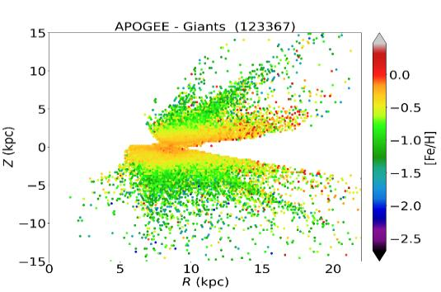
Stellar Parameters for 5 Million Stars
Decoding the Milky Way’s Stellar Populations
Optimized machine learning algorithms to derive stellar parameters (T_eff, log g, [Fe/H]) and chemical abundances for millions of stars. 🌟 Large-scale metallicity map of the Southern Milky Way ([Fe/H] spanning −2.5<[Fe/H]<+0.5). 🌌 Revealed a radial metallicity gradient.
Ferreira Lopes, Gutiérrez-Soto, Ferreira Alberice, Monsalves, Hazarika, et al. (2025, A&A, 693, A306)

Slide 12
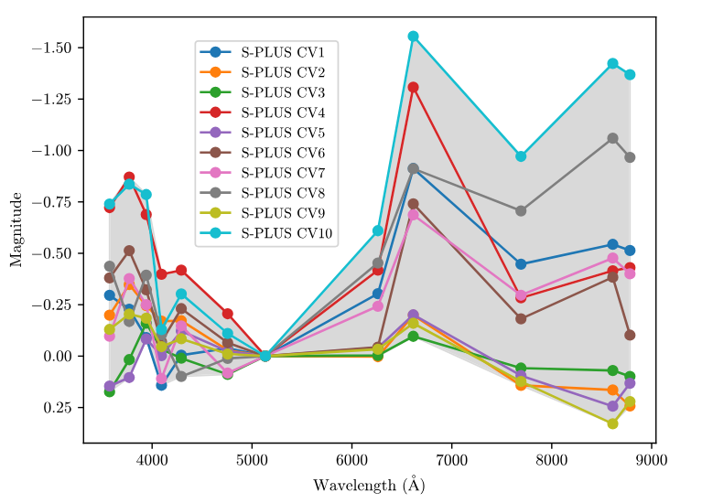
Unveiling Hidden Cataclysmic Variables
S-PLUS 12-Band Photometry Reveals a New Population
Using S-PLUS’s 12-band photometry, we discovered 10 new cataclysmic variables, including rare WZ Sge-type dwarf novae and low-luminosity intermediate polars. Gemini spectra (A) and Swift X-rays (B) validate these systems, missed by traditional surveys.
Lopes de Oliveira, de Araujo, Krabe, Mendes de oliveira, Mukai, Gutiérrez-Soto, et al. (2025, ApJL, 981, L1)

Slide 13
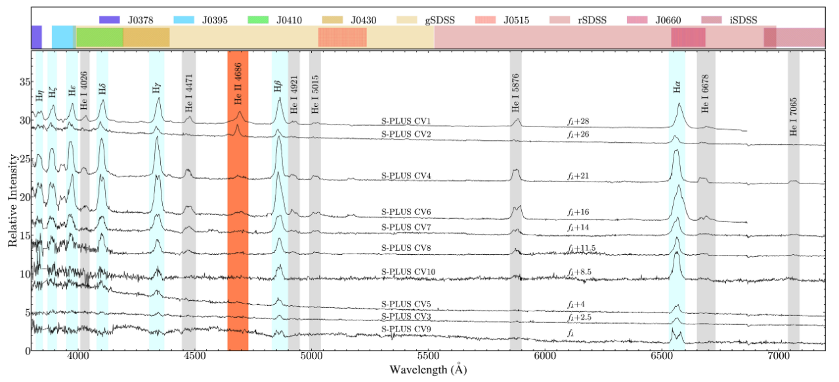
Unveiling Hidden Cataclysmic Variables
S-PLUS 12-Band Photometry Reveals a New Population
Using S-PLUS’s 12-band photometry, we discovered 10 new cataclysmic variables, including rare WZ Sge-type dwarf novae and low-luminosity intermediate polars. Gemini spectra (A) and Swift X-rays (B) validate these systems, missed by traditional surveys.
Lopes de Oliveira, de Araujo, Krabe, Mendes de oliveira, Mukai, Gutiérrez-Soto, et al. (2025, ApJL, 981, L1)

Slide 14
S-PLUS: Hα sources
Selecting and Classifying Hα Excess Point Sources Using S-PLUS

Slide 15
S-PLUS: Hα sources
Hα Emission: A Universal Tracer of Cosmic Activity
J0660 Filter: Capturing Hα
Hα at rest: λ = 6563 Å
Redshift range: z ≈ 0–0.15 (λ ≈ 6563–7500 Å)
Key Sources with Hα Emission:
Star-forming regions (H II regions, YSOs)
Stellar evolution: Planetary Nebulae (PNe),
Be stars, Symbiotic Stars (SySt)
Accretion/Activity: Cataclysmic
Variables (CVs), AGN
Transient phenomena: Supernovae (SN)

Slide 16
S-PLUS: Hα sources
Hα Emission: A Universal Tracer of Cosmic Activity
Origin of Hα Emission
Photon emission at 6563 Å: Hydrogen’s n=3 → n=2 transition.
Requires ionized gas (H⁺) + recombination.
Key Drivers of Hα
Birth:
Massive stars ionize H II regions (Orion Nebula).
Death:
PNe: Ionized shells around white dwarfs (Ring Nebula).
SN: Shocks heat gas, emitting Hα.
Accretion:
CVs, AGN, YSOs (e.g., jets, disks).
Why Hα Matters
Star formation: LHα​∝SFR.
Stellar evolution: Maps PN shells and Be star disks.
Low-metallicity galaxies: Less dust extinction → stronger Hα.

Slide 17
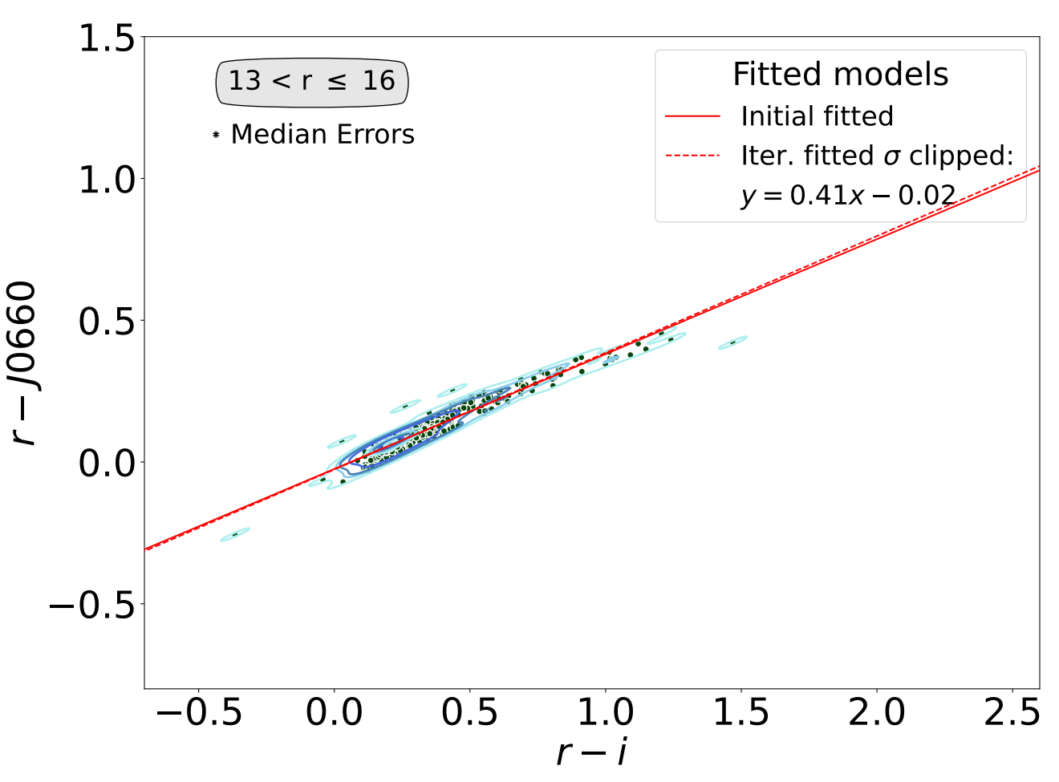
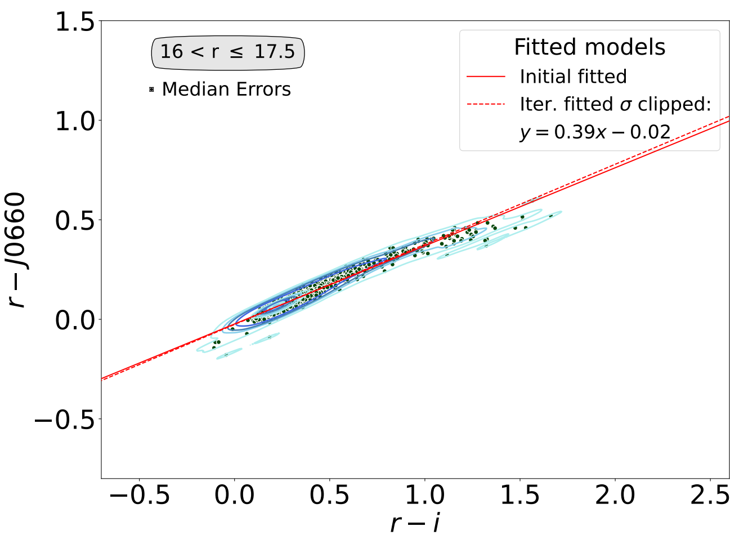
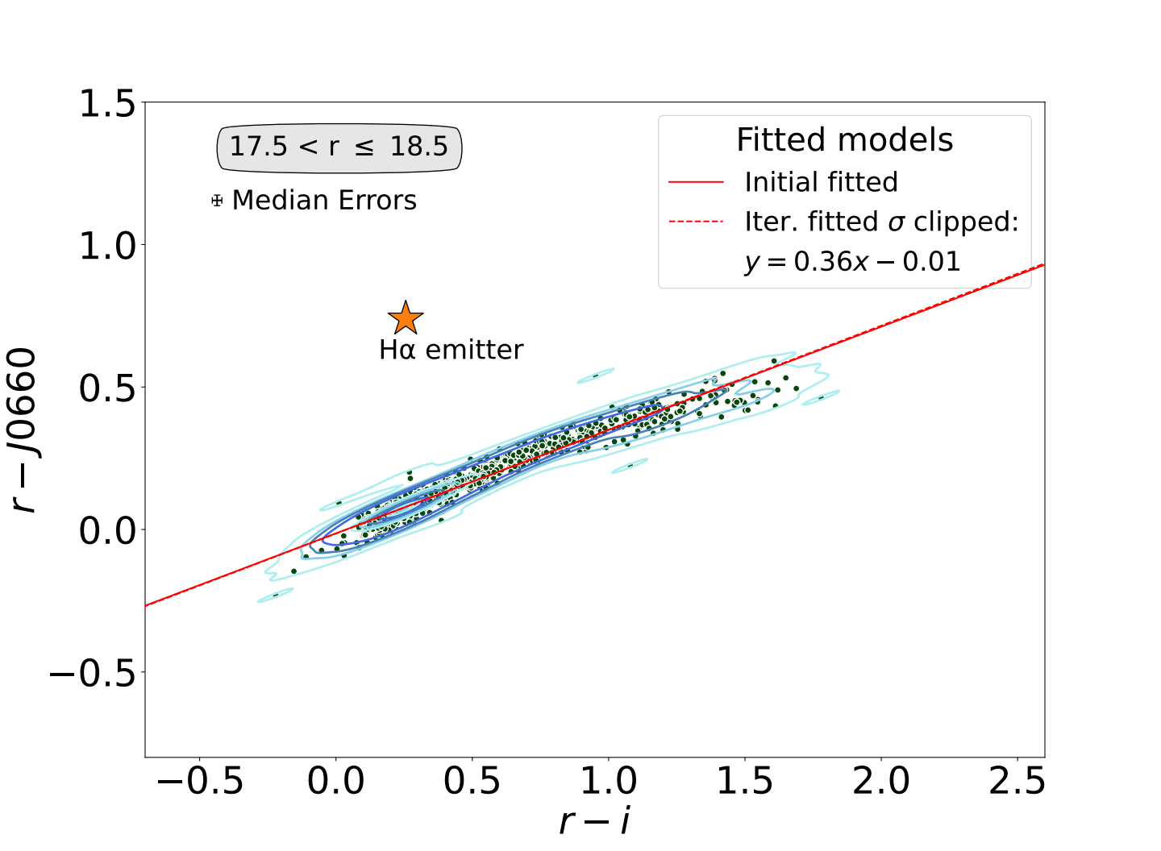
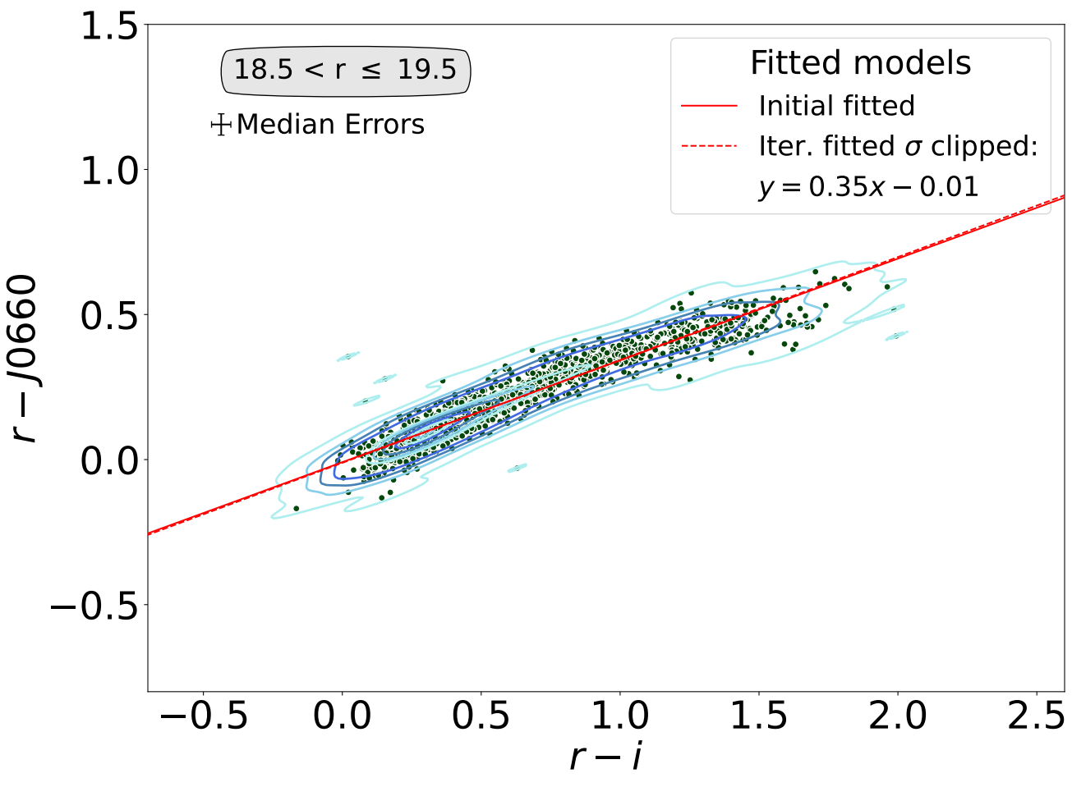
S-PLUS: Hα sources
Selecting the H𝛼 Excess Sources
The identification of H𝛼 excess sources was based on the method developed by Witham et al. (2008).
Iteratively fit the main stellar locus and select all Hα sources which lie more than 5σ away from the fitted locus .
Gutiérrez-Soto, Lopes de Oliveira, Akras, Gonçalves, Lomeli-Nunes, et al. (2025, A&A, 695, A104)

Slide 18
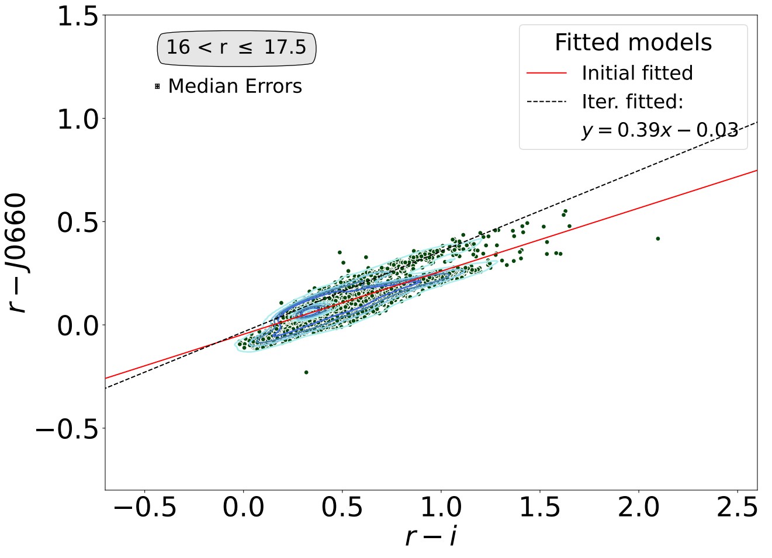
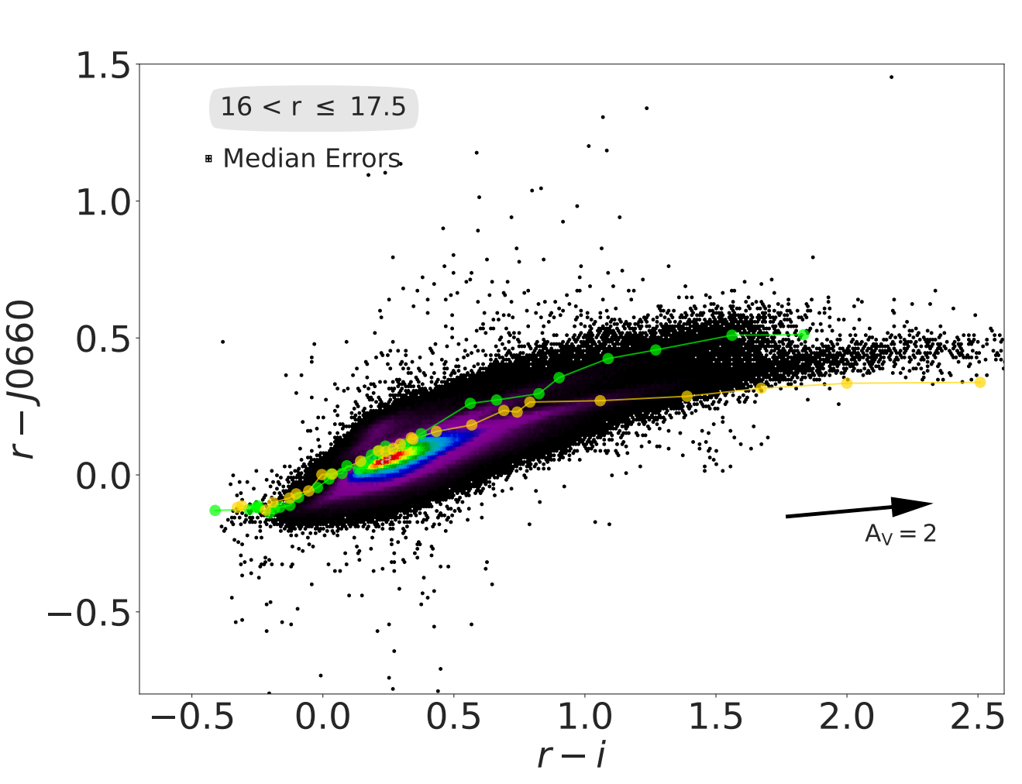
S-PLUS: Hα sources
Galactic Disk Challenges
Stellar Loci Duplication:
Disk fields show two stellar loci due to differential reddening and mixed populations (main-sequence stars and giants).
Fitting Issues:
Initial fit often aligns with the reddened locus, complicating H-alpha excess detection.
Solution:
Adjusted fit upward to align with the unreddened sequence.
Reverted to the original fit if adjustments worsened the accuracy.
Selecting the H𝛼 Excess Sources
Unreddened stellar locus
Dwarfs sinthetic track (Pickles 1998)
Reddened stellar locus
Giants

Slide 19
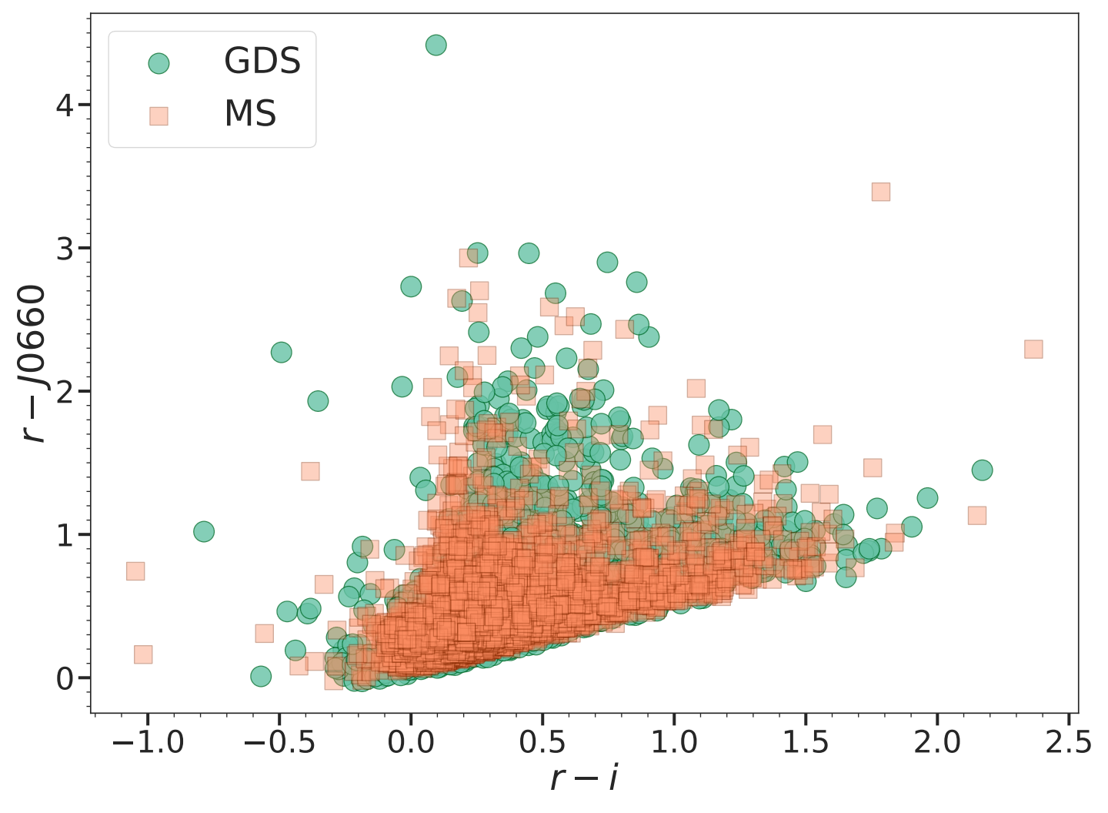
S-PLUS: Hα sources
Selecting the H𝛼 Excess Sources
Identification Criteria
Key Feature: Sources significantly above the locus of main-sequence/giant stars in the J0660 filter (Hα line excess).
Surveys & Outliers:
Main Survey (MS): 3,637 outliers identified.
Galactic Disk Survey (GDS): 3,734 outliers identified.
Object Types
Main Survey (MS)
Galactic Sources:
Cataclysmic Variables (CVs), binary systems, RR Lyrae stars, peculiar objects.
Extragalactic Sources:
Active Galactic Nuclei (AGNs), Quasi-Stellar Objects (QSOs) with redshifted emission lines aligned to J0660.
Galactic Disk Survey (GDS)
Star Formation & Young Objects:
Emission-line stars (Em*, Be*), Young Stellar Objects (YSOs: T Tauri, Herbig Ae/Be).
Nebular/Variable Sources:
Planetary nebulae, novae, reflection nebulae; cataclysmic variables, eclipsing binaries.
Note: The high prevalence of Em* and YSOs in GDS highlights active star formation processes in the Galactic disk.

Slide 20
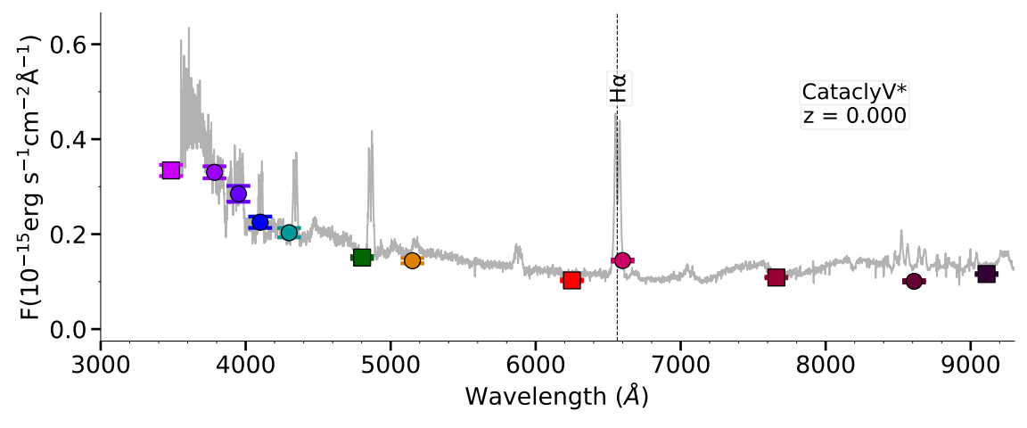
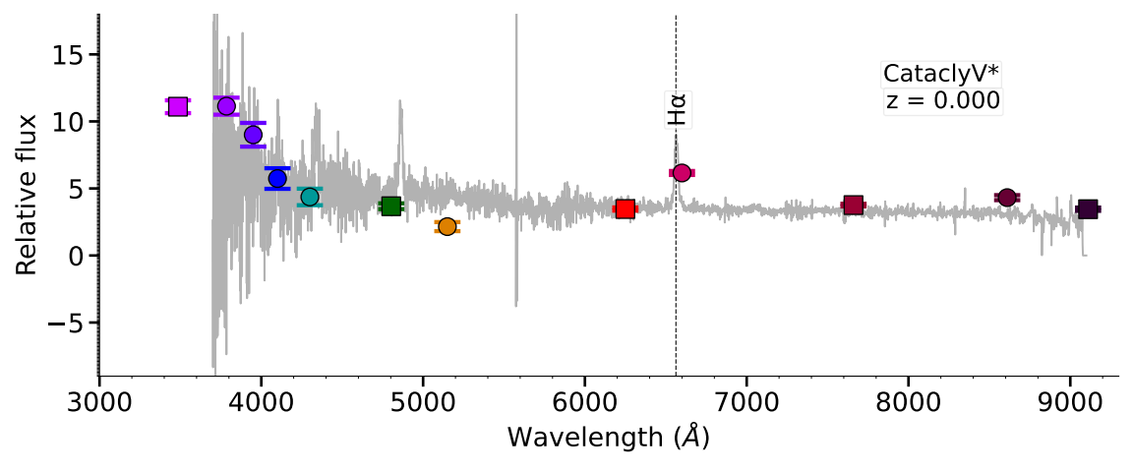
S-PLUS: Hα sources
Example of two Hα Emitters
SDSS
J0660 filter
LAMOST
Gutiérrez-Soto, et al. (2025)

Slide 21
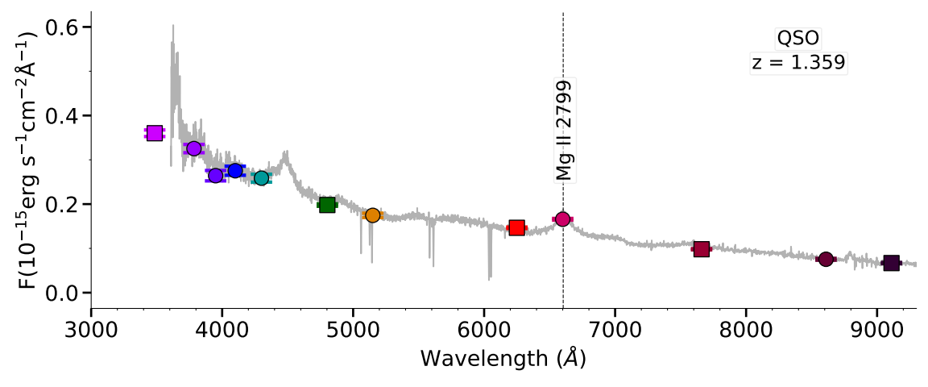
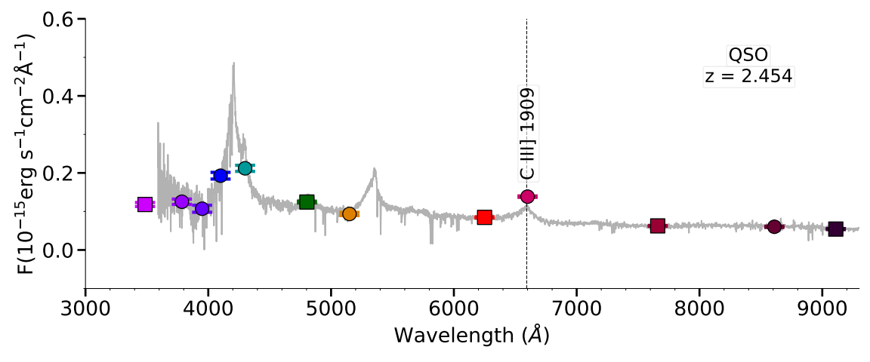
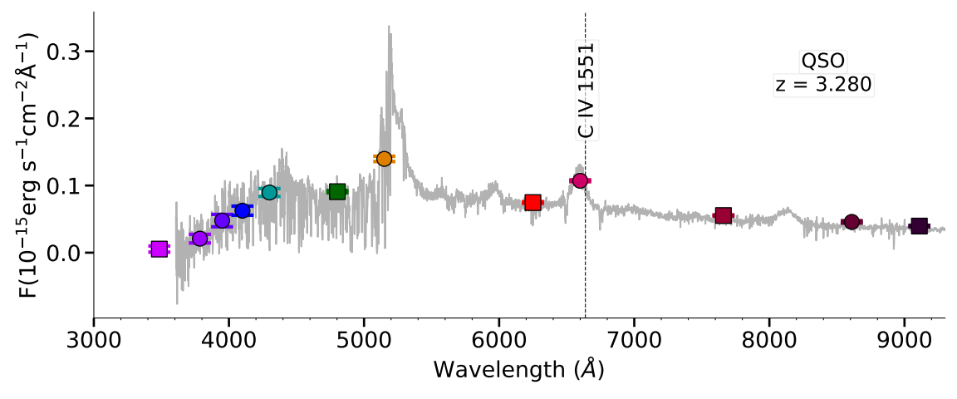
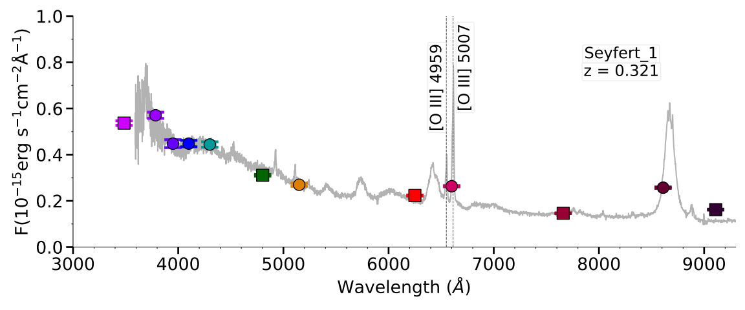
S-PLUS: Hα sources
Extragalactic Compact Sources
Our selection criteria effectively isolated compact sources, minimizing the inclusion of extended sources. In agreement with SIMBAD, only 23 AGN (3.1%) and 9 galaxies (1.2%) were identified in the main survey, while 143 QSOs (19.6%) were selected. The spectra of these QSOs and Seyfert galaxy show other emission lines that fall into the J0660 filter, resulting in a significant Hα excess.

Slide 22
S-PLUS: Hα sources
Machine Learning Approaches
We applied UMAP for dimensionality reduction on S-PLUS data and used HDBSCAN for clustering Hα excess sources. Two experiments were conducted: one using only the 66 S-PLUS colors and another incorporating WISE bands. The results revealed the formation of five distinct groups, effectively separating galactic and extragalactic sources.

Slide 23
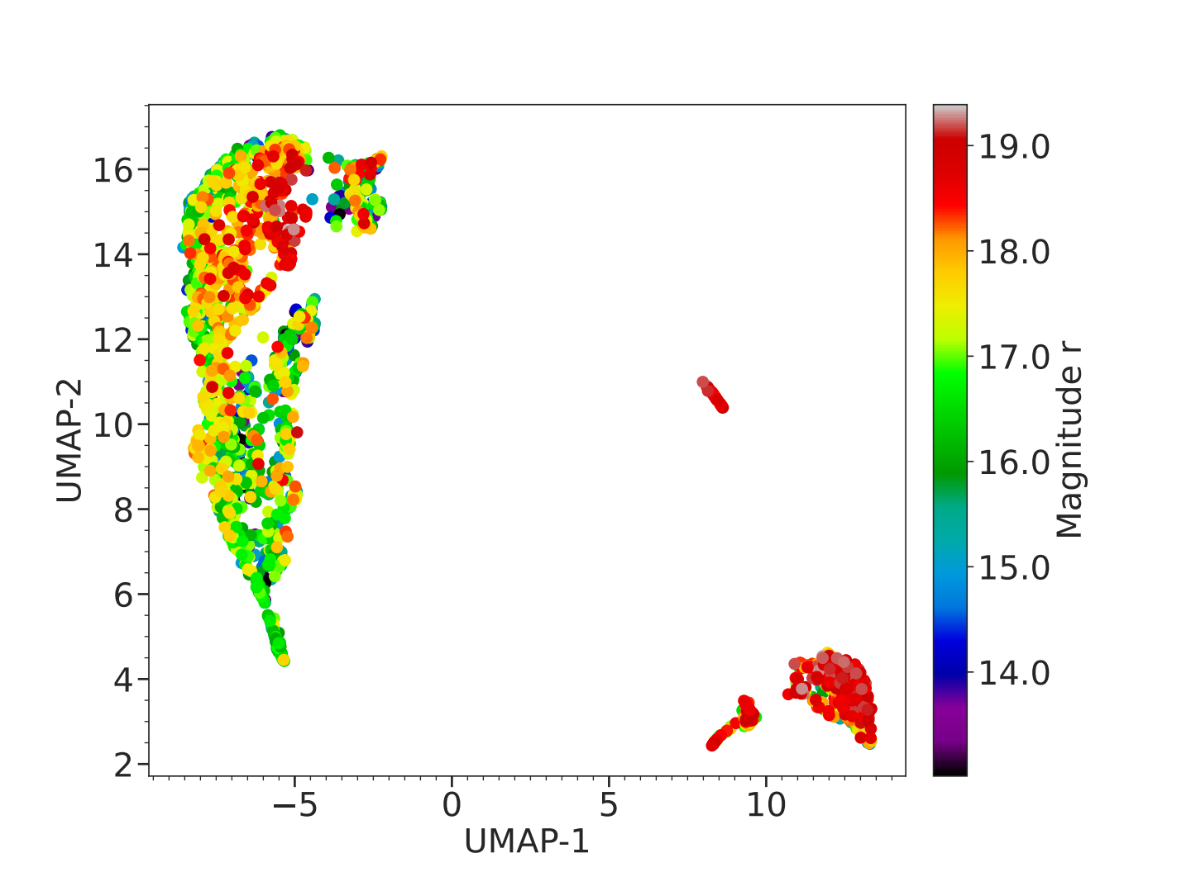
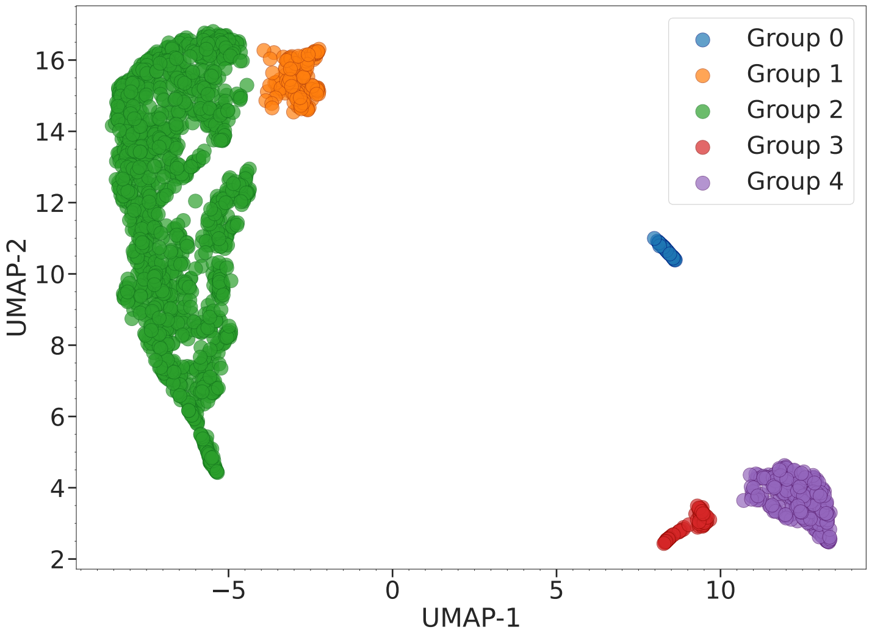
S-PLUS: Hα sources
Machine Learning Approaches
Only the 66 S-PLUS colors
Gutiérrez-Soto, et al. (2025)

Slide 24
S-PLUS: Hα sources
Machine Learning Approaches
Only the 66 S-PLUS colors
Galactic stars
RR lyrae
QSOs; redshift distribution peak around 2.45
QSOs; redshift 0.31 to 0.37
QSOs with peak in the redshift distribution around 1.35 and CV

Slide 25
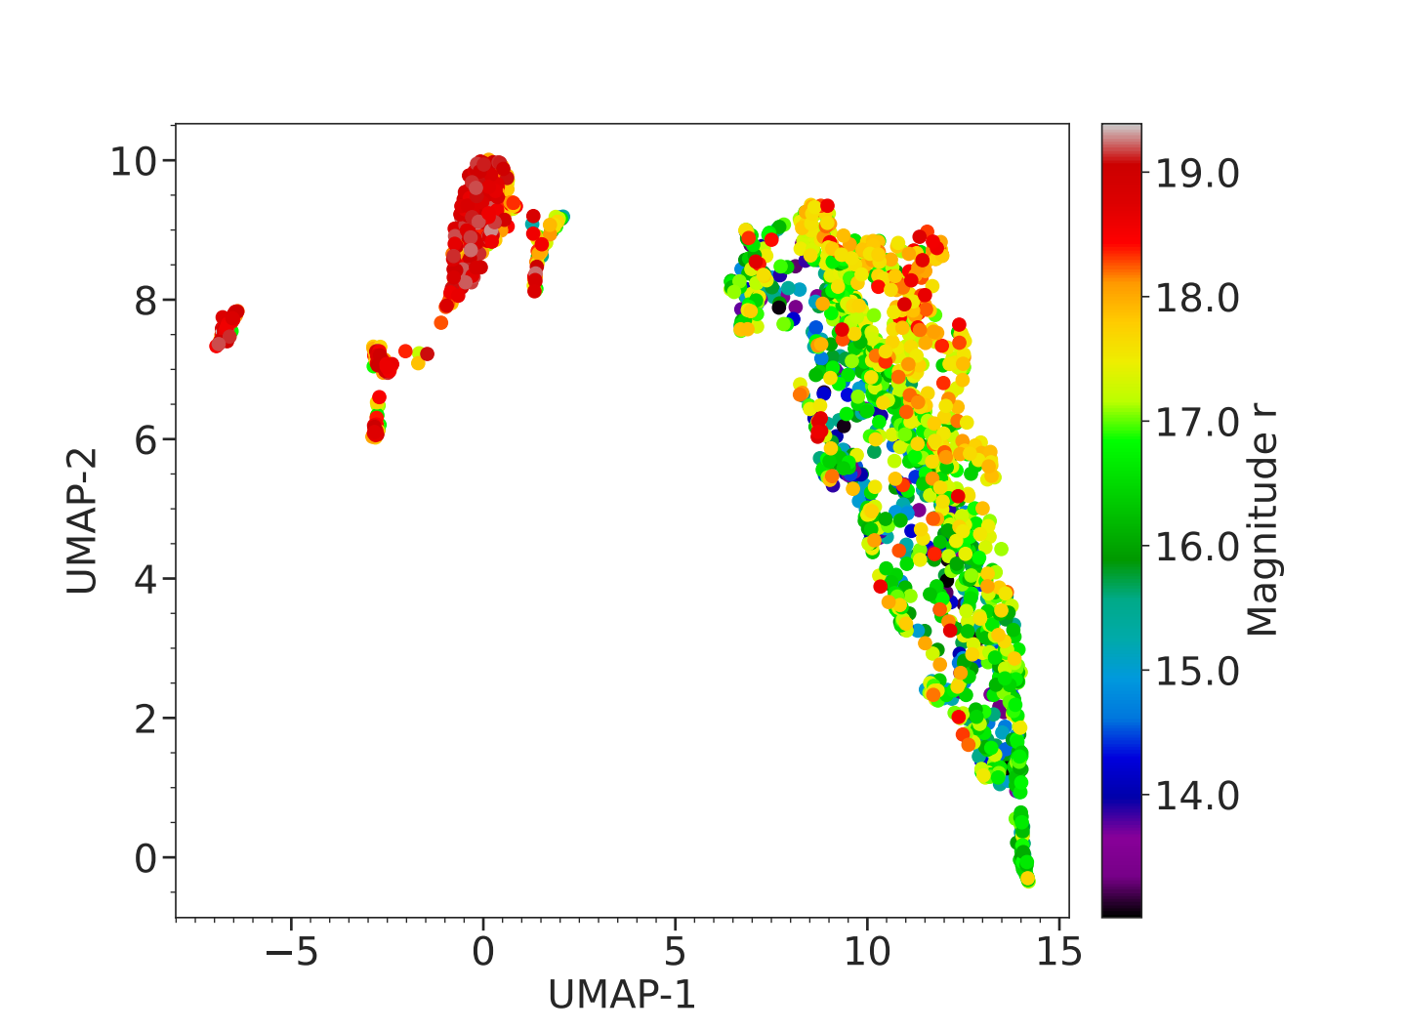
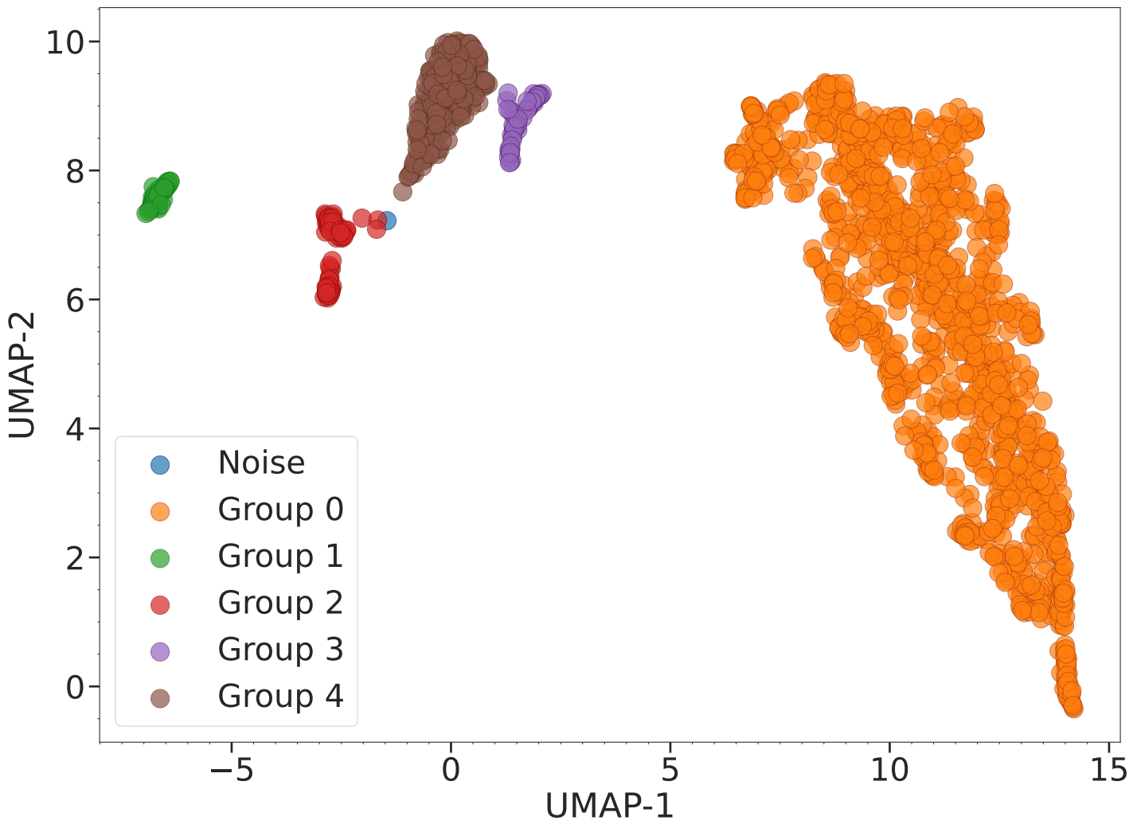
S-PLUS: Hα sources
Machine Learning Approaches
66 S-PLUS colors + WISE bands
Gutiérrez-Soto, et al. (2025)

Slide 26
S-PLUS: Hα sources
Machine Learning Approaches
66 S-PLUS colors + WISE bands
Galactic stars

Slide 27
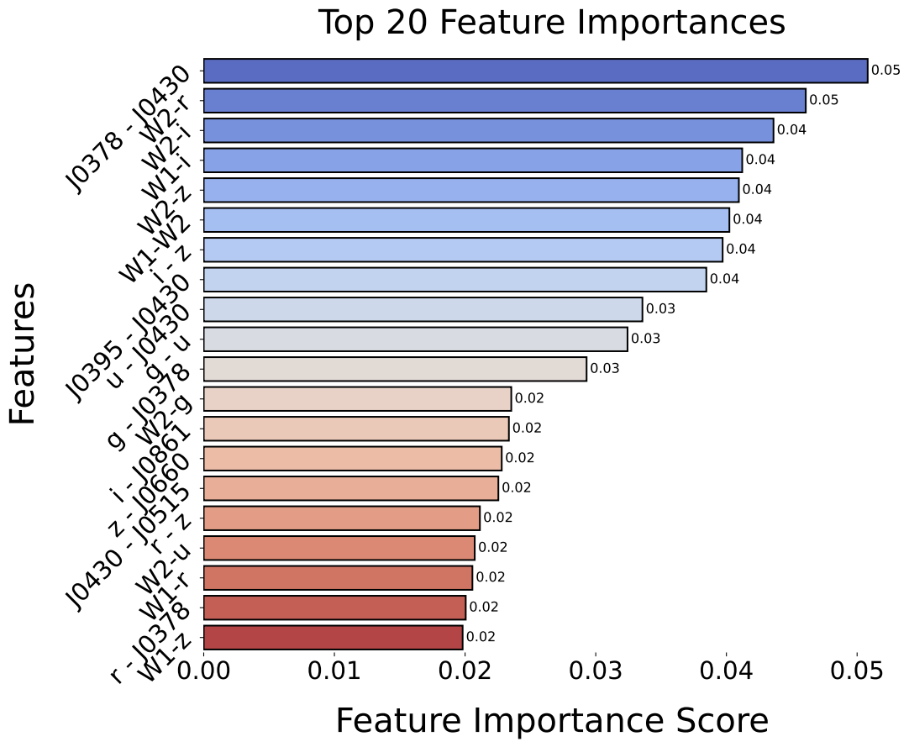
S-PLUS: Hα sources
Extracting Main Features: Color Analysis
Analysis: Key colors from S-PLUS and WISE filters identified by Random Forest as most influential in classifying Hα excess objects.
Results: Top 20 features contribute significantly to distinguishing between different object classes identified by UMAP + HDBSCAN.
Gutiérrez-Soto, et al. (2025)

Slide 28
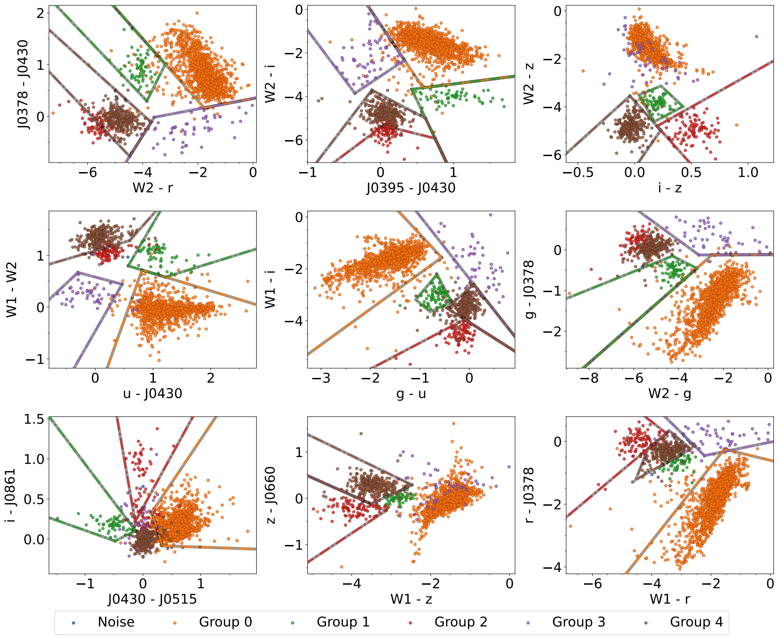
S-PLUS: Hα sources
Extracting Main Features: Color Analysis
Group 0:
Primarily Galactic stars.
Group 1:
Dominated by QSOs, with at a redshift of approximately 2.45.
Group 2:
Consists mostly of active galactic nuclei—QSOs, Seyfert 1
galaxies, and AGN —with at redshifts around 0.31–0.37.
Group 3:
Characterized by a predominance of cataclysmic variables.
Group 4:
A diverse mix featuring mainly QSOs and AGNs peak around
a redshift of 1.35.
Gutiérrez-Soto, et al. (2025)

Slide 29
Conclusions
Identification of H-alpha Excess Candidates:
7,371 candidates identified using the S-PLUS J0660 filter.
Distribution: 3,637 in the high-latitude main survey and 3,734 in the Galactic disk.
Classification of Objects:
Cross-referencing with SIMBAD: EM stars, YSOs, Be stars, CVs, PNe, QSOs, non-local galaxies, and RR Lyrae stars.
Machine Learning Techniques:
UMAP and HDBSCAN: Effective differentiation between Galactic and extragalactic objects
Challenges in distinguishing cataclysmic variables from QSOs or AGN with z ≈ 1.35.
Integration of WISE Data:
Improved separation of extragalactic and Galactic sources.
Random Forest Model:
WISE data crucial for identifying significant features.
Improved color-color diagrams and understanding of H-alpha related phenomena.

Slide 30
THANK!!
gsoto.angel@gmail.com

