Slide 1


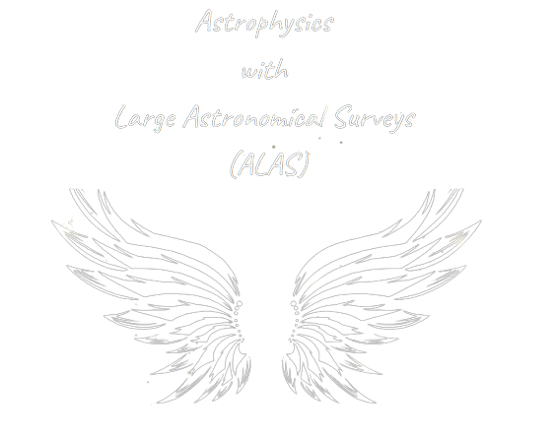

S-PLUS: An atlas of integrated Hα fluxes for planetary nebulae in the Magellanic Clouds
L. A. Gutiérrez-Soto, A. R. Lopes, A. V. Smith Castelli & F. R. Faifer
Instituto de Astrofísica de La Plata, CONICET-UNLP, Argentina
Galaxies Groups and Clusters III
May 15 - 19 2023, La Serena, Chile

Slide 2

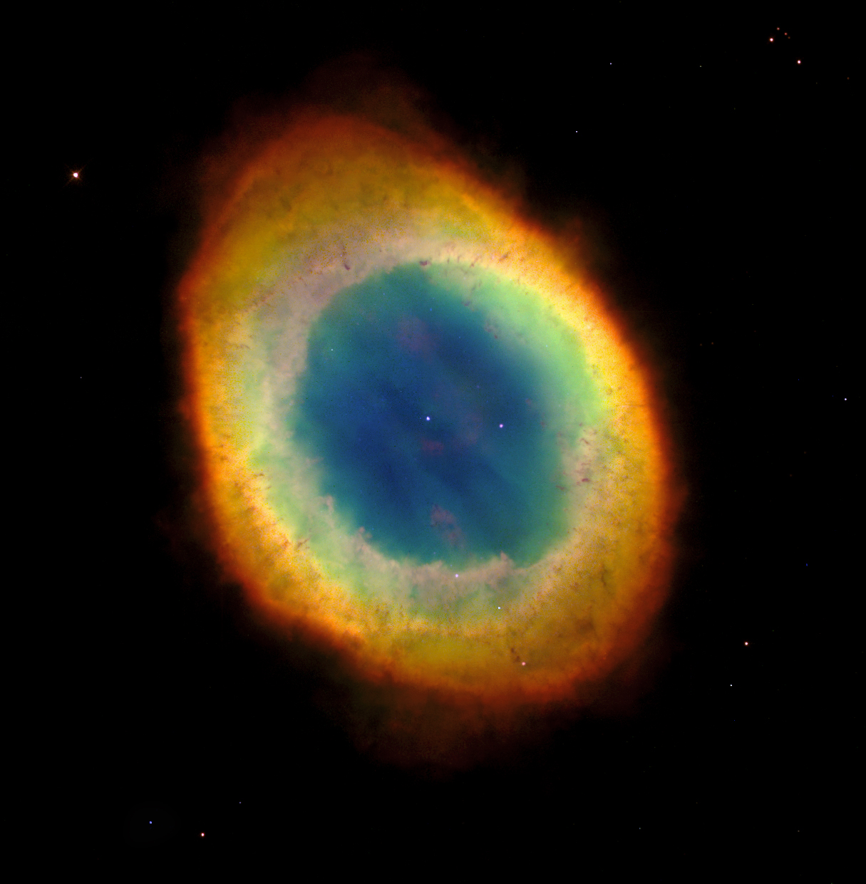
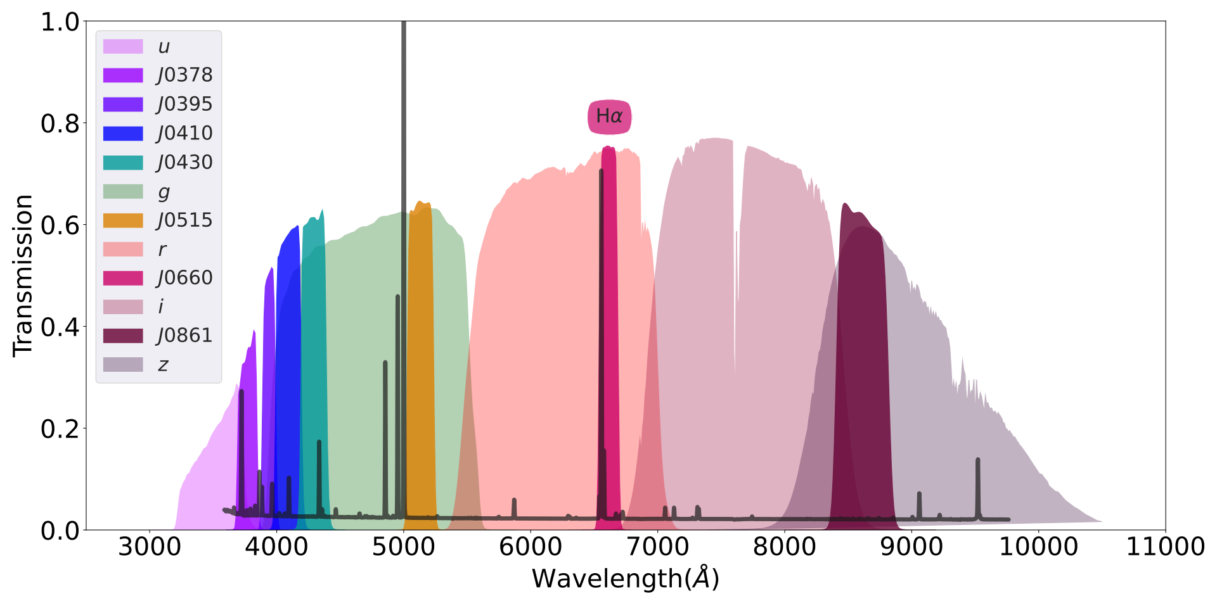
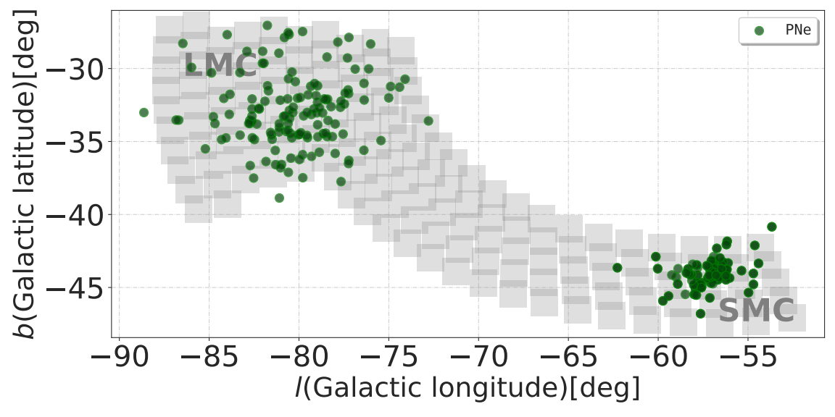
Context
Ring Nebula (Messier 57)
What are planetary nebulae?
About S-PLUS:
Planetary nebulae (PNe) are emission line nebulae that represent a short phase in the late evolution of low- and intermediate-mass stars.
Typical spectrum of a PN: the Hα and [N II] emission lines are detected by J0660 filter for sources with a redshift up to 0.015
PNe in the Magellanic Clouds
As part of its effort to map 9,000 square degrees of the Southern Hemisphere, the S-PLUS project (Mendes de Oliveira et al. 2019) has a crucial feature: images of the entire field captured using the Hα narrow-band J0660 filter.
The distribution of the planetary nebulae from the literature (green circles) in the Magellanic Clouds.
12 S-PLUS survey filter curves

Slide 3
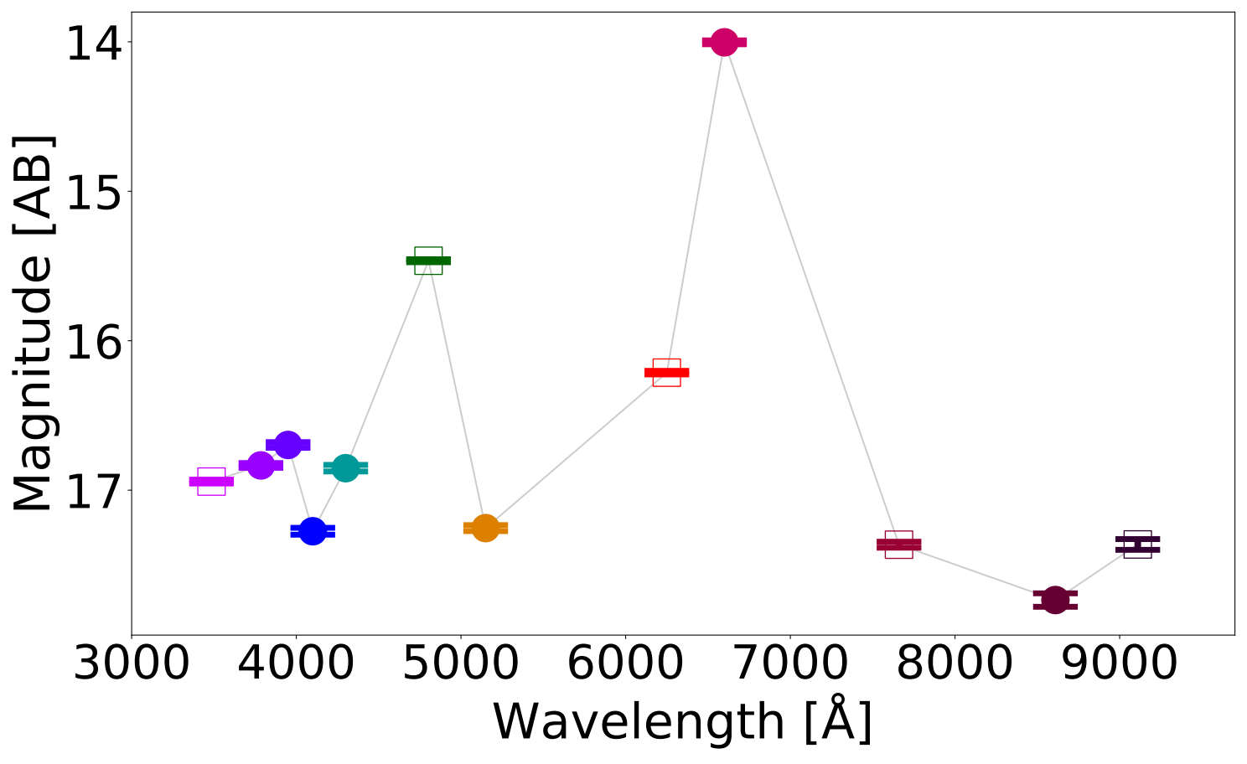
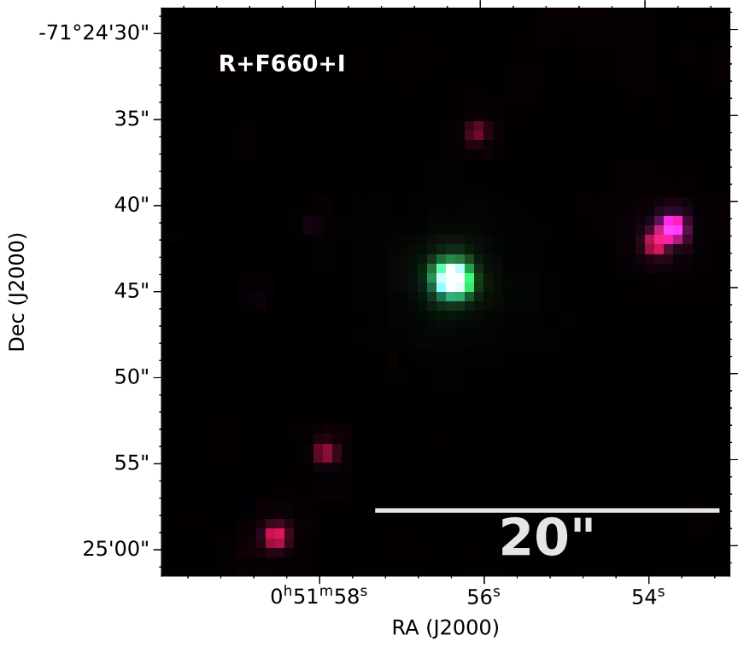
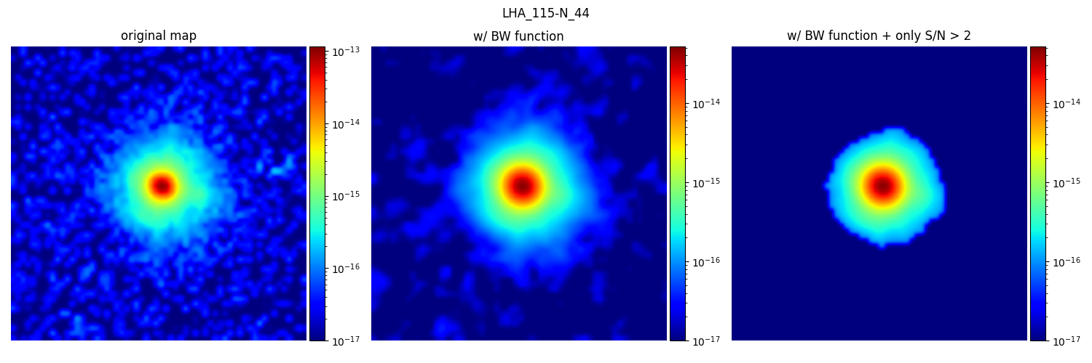
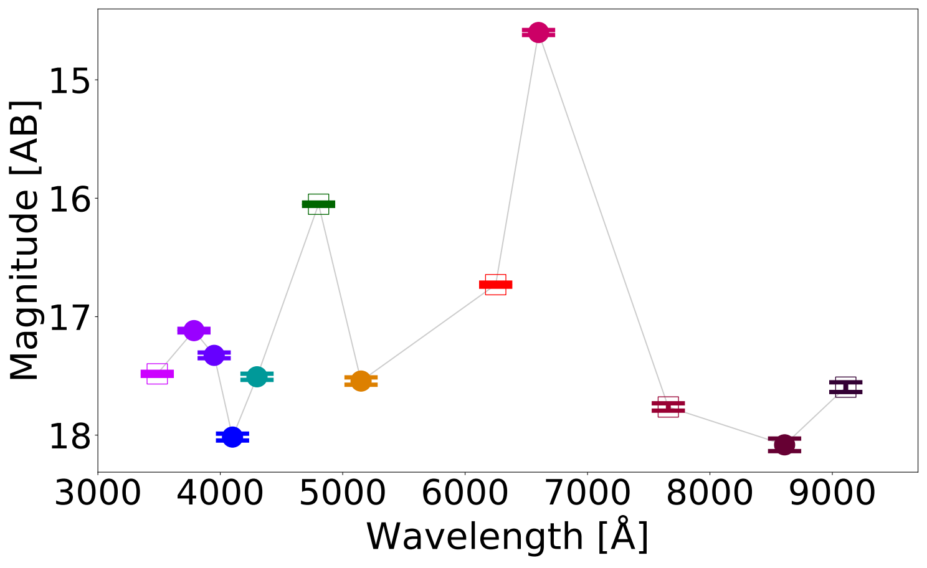
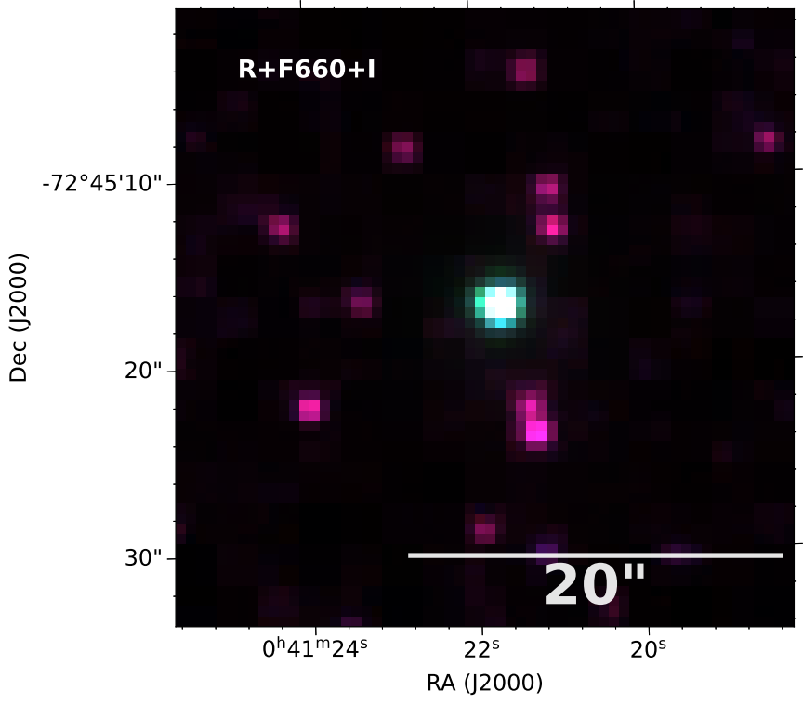

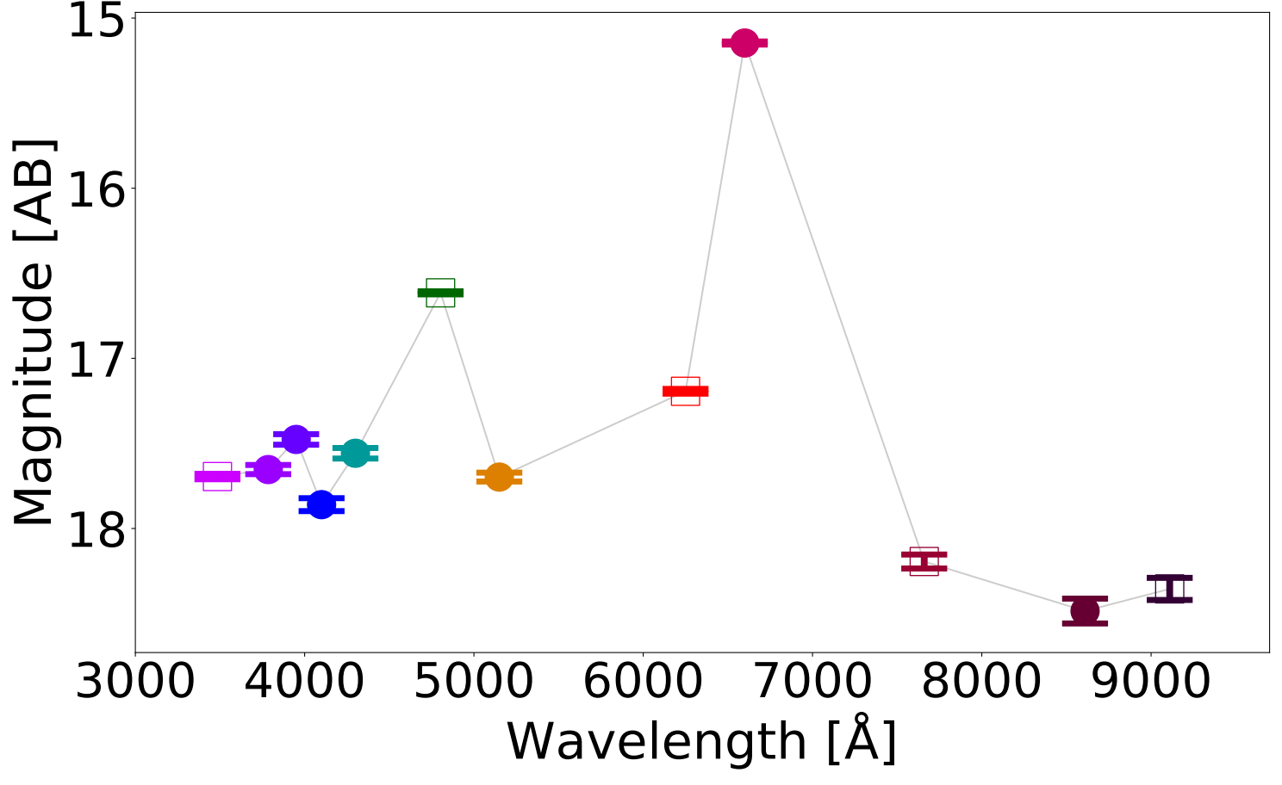
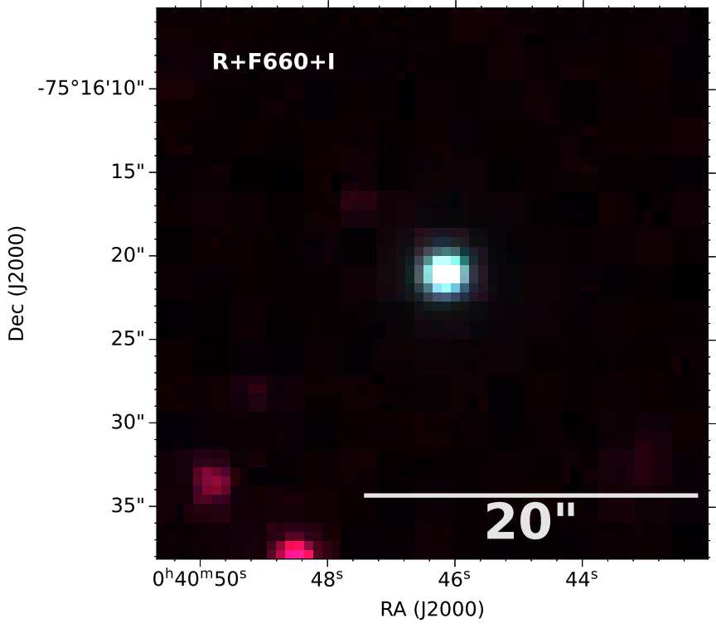
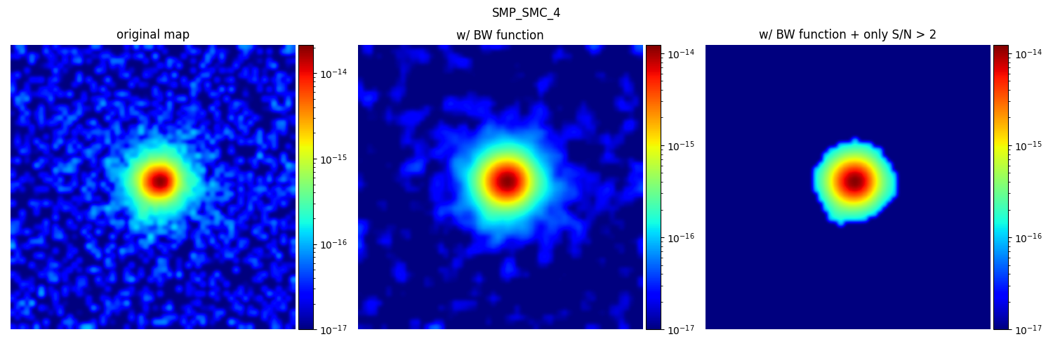
Hα flux PNe with S-PLUS data
Extracting Hα flux from photometric data
Photoespectra
RGB image
Hα flux map
LHA 115-N 44
LHA 115-N 5
J0660 filter: Hα + [N II]
g filter: [O III] is detected
SMP SMC 4
SMP SMC 4

