Slide 1


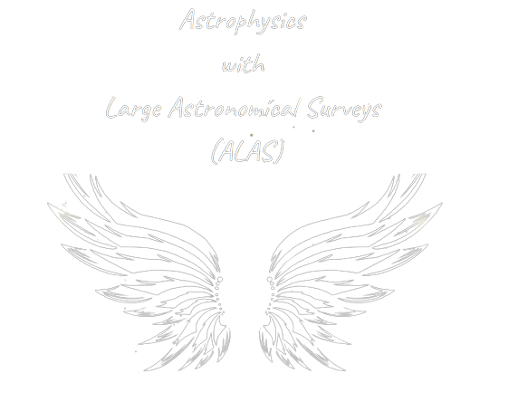



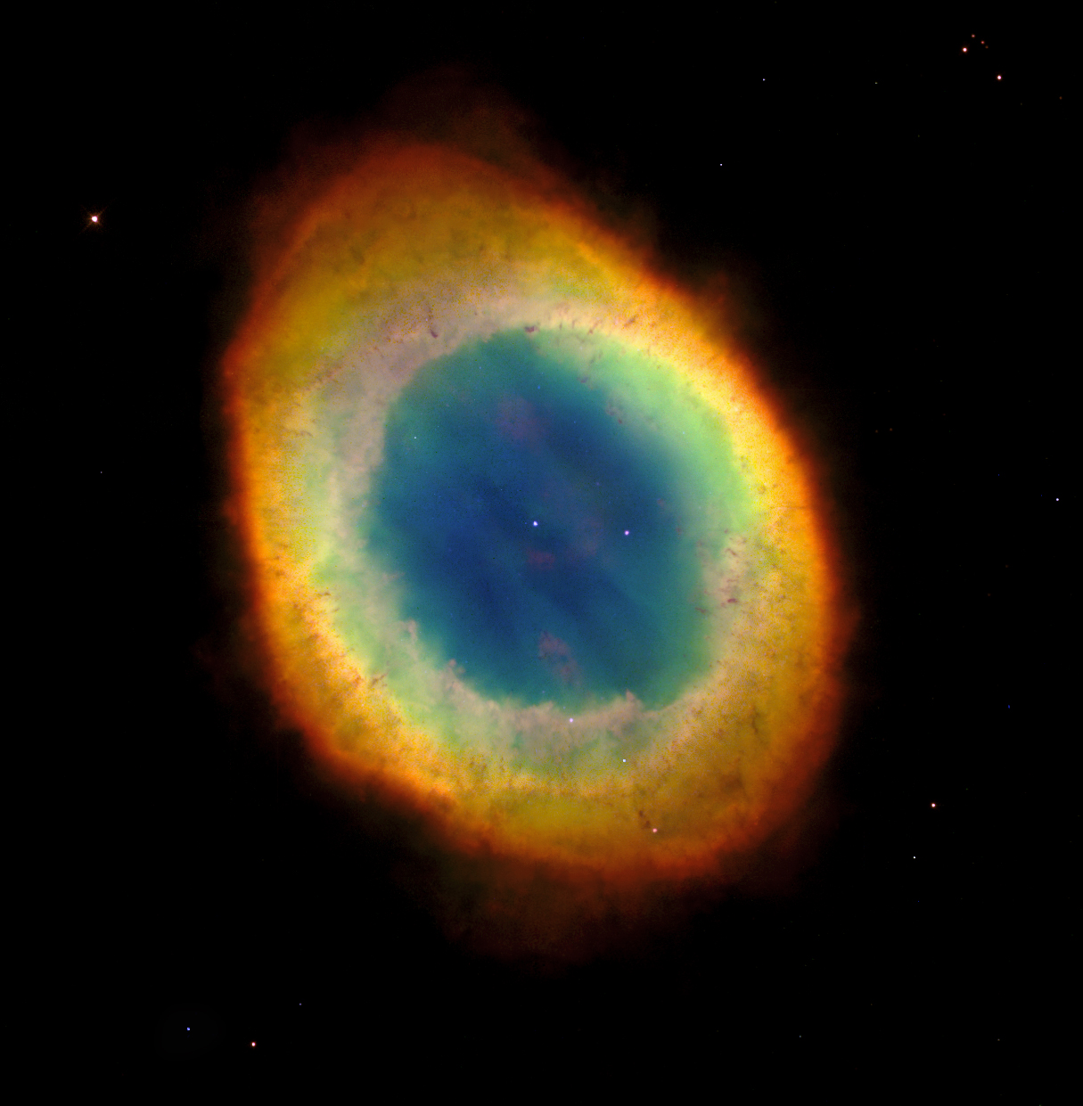
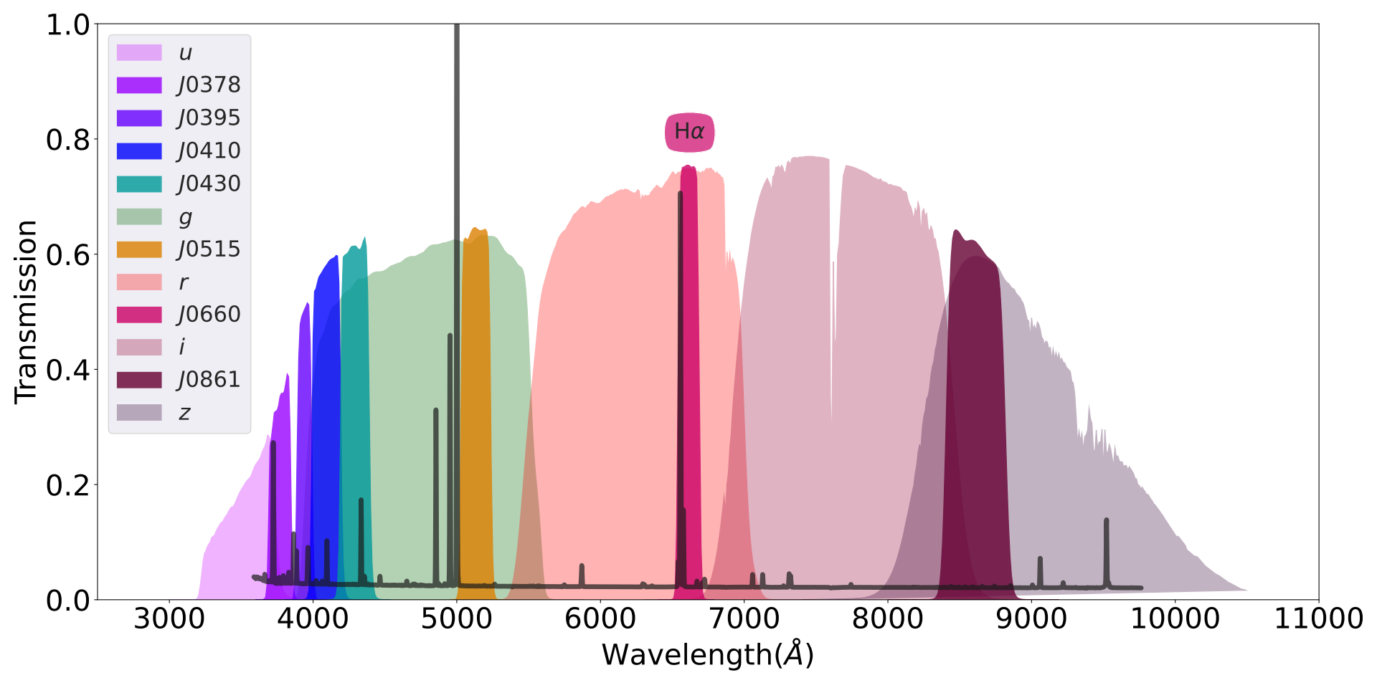
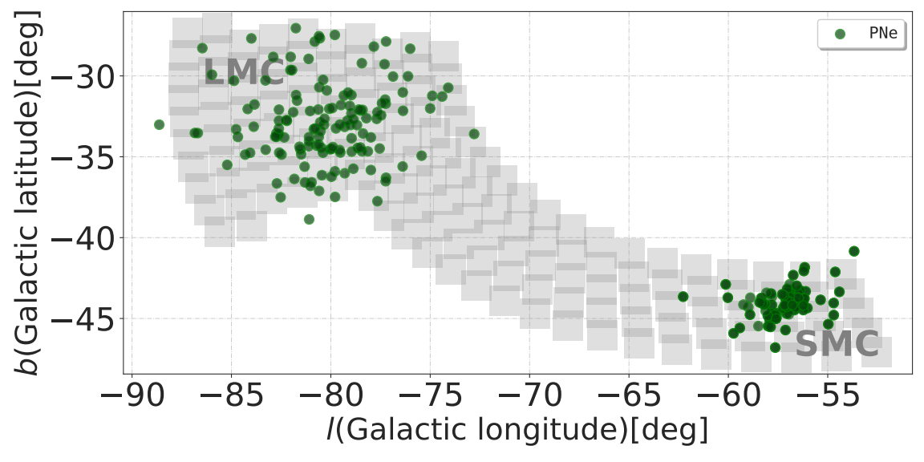
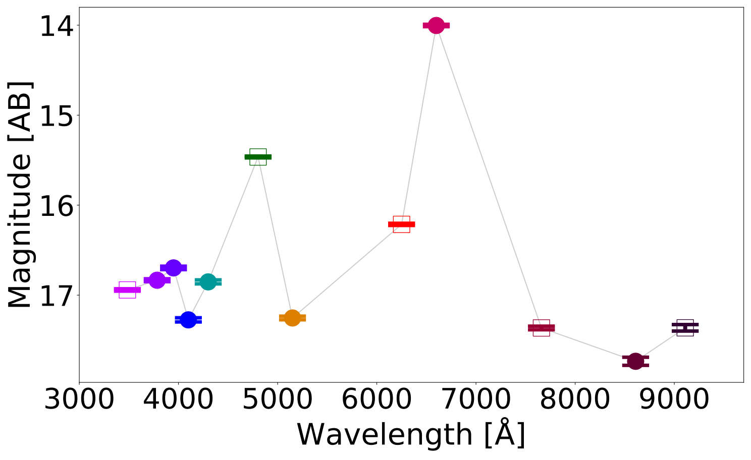
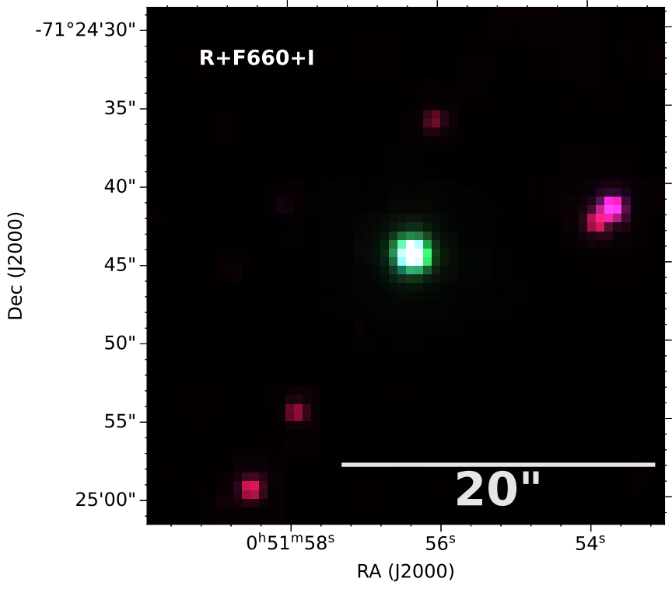
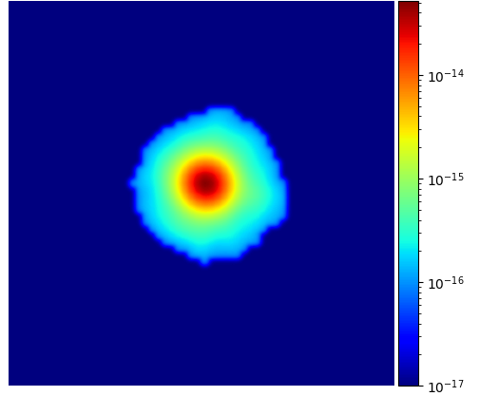
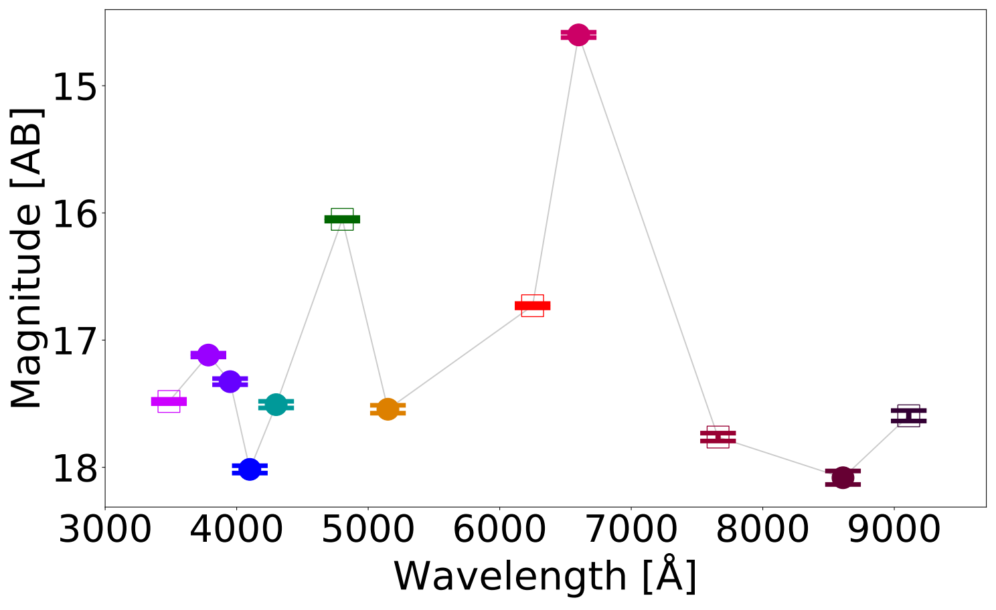
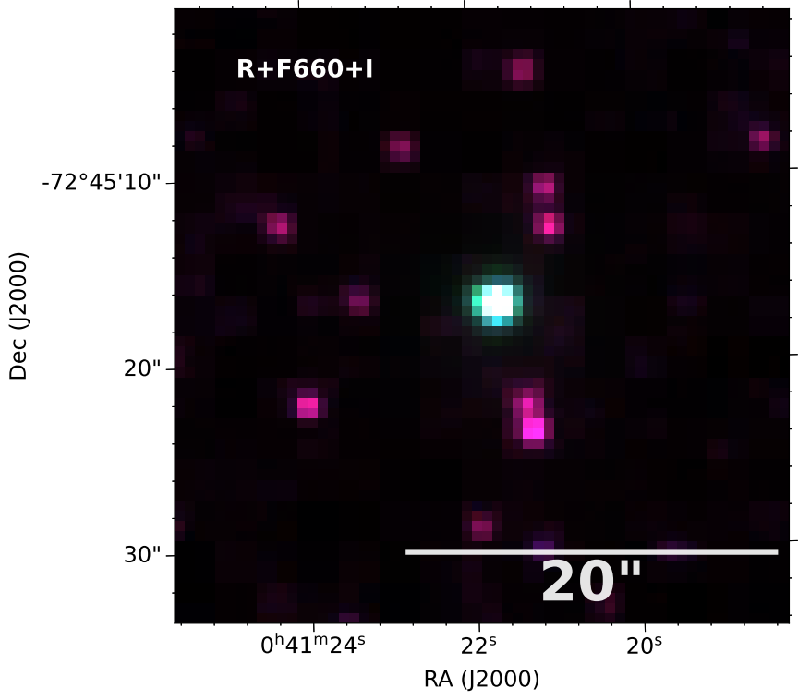

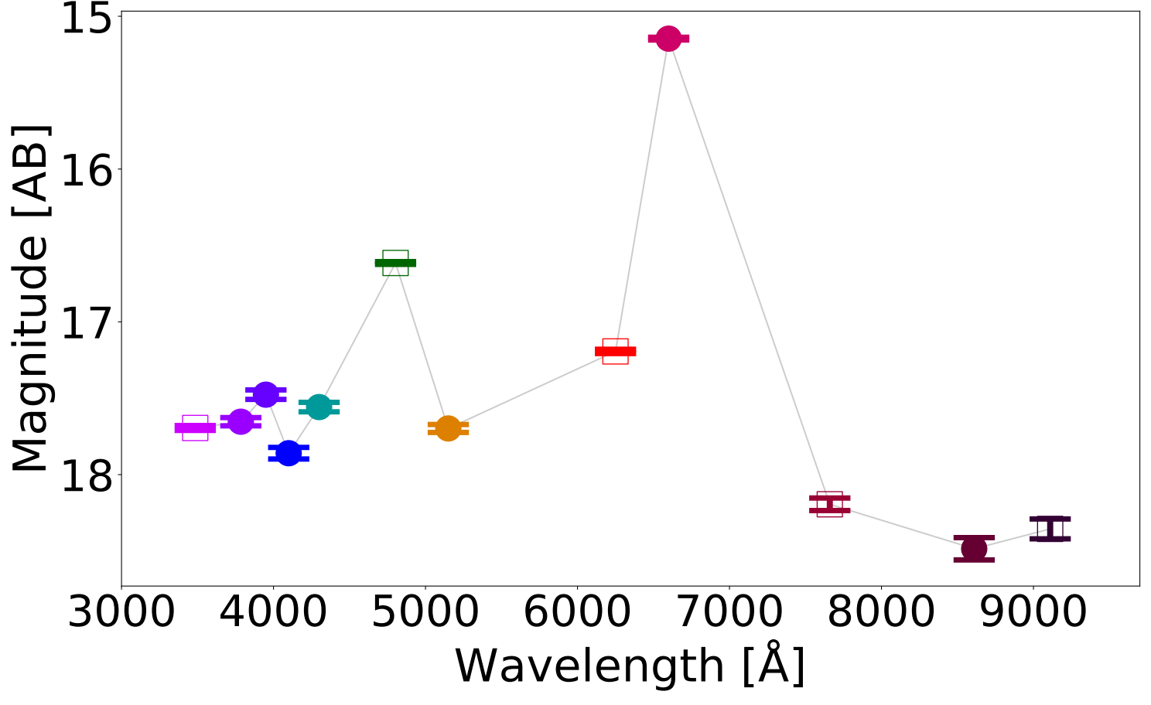
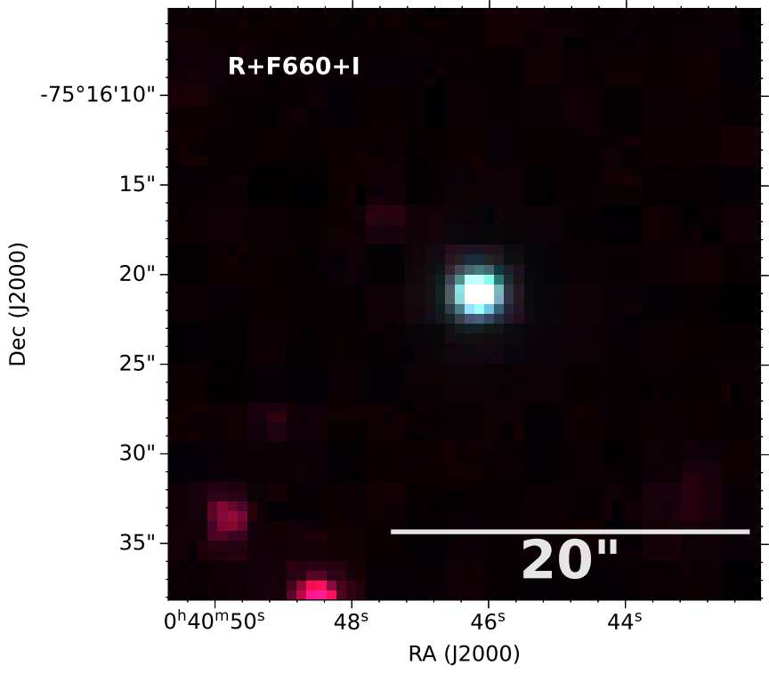
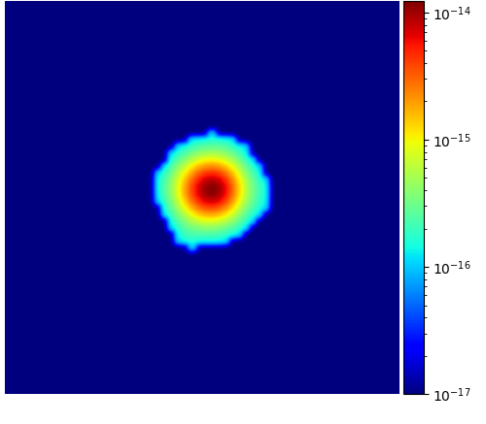

S-PLUS: An atlas of integrated Hα fluxes for planetary nebulae in the Magellanic Clouds
L. A. Gutiérrez-Soto, A. R. Lopes, A. V. Smith Castelli & F. R. Faifer
Instituto de Astrofísica de La Plata, CONICET-UNLP, Argentina
ABSTRACT
We present an atlas of Hα fluxes for planetary nebulae of the Magellanic Clouds (MC PNe) with measurements from the Southern Photometric Local Universe Survey (S-PLUS), a 12 band (7 narrow and 5 broad) imaging survey that allows us to perform an spatial analysis of the Hα emission. Aperture photometry on the continuum-subtracted images was performed to extract Hα + [N II] fluxes of the MC PNe observed by S-PLUS. The dust attenuation and [N II] contribution was corrected with empirical relations. Amongst its many applications, it can provide baseline data for photoionization and hydrodynamical modelling, and allow better estimates of Zanstra temperatures for PN central stars with accurate optical photometry.
Ring Nebula (Messier 57)
What are planetary nebulae?
About S-PLUS:
Planetary nebulae (PNe) are emission line nebulae that represent a short phase in the late evolution of low- and intermediate-mass stars.
Typical spectrum of a PN: the Hα and [N II] emission lines are detected by J0660 filter for sources with a redshift up to 0.015
Credits: NASA, ESA and the Hubble Heritage (STScI/AURA)-ESA/Hubble Collaboration
12 S-PLUS survey filter curves
PNe in the Magellanic Clouds
As part of its effort to map 9,000 square degrees of the Southern Hemisphere, the S-PLUS project (Mendes de Oliveira et al. 2019) has a crucial feature: images of the entire field captured using the Hα narrow-band J0660 filter.
The distribution of the planetary nebulae from the literature (green circles) in the Magellanic Clouds can be seen in the figure. The large gray squares indicate the S-PLUS fields that cover both the Large and Small Magellanic Clouds. Almost all the PNe are within the S-PLUS fields.
Extracting Hα flux from photometric data
Photospectra
RGB image
Hα flux map
The Hα flux for the Magellanic Cloud planetary nebulae observed by S-PLUS was extracted using two broad-band filters (r and i) and one narrow-band filter (J0660), according to Equation 3 of Vilella-Rojo et al. (2015). The Hα maps for some planetary nebulae, along with their respective S-PLUS photospectra and false color images based on the r, J0660, and i filters are shown.
g filter: [O III] is detected
J0660 filter: Hα + [N II]
LHA 115-N 44
LHA 115-N 5
In the Hα images, it is possible to perceive external and extensive shells of weak Hα emission.
SMP SMC 4
Final remarks and next steps
References
We present reliable Hα fluxes for MC PNe measured from S-PLUS images. With these fluxes, we will estimate the hydrogen density of the ionized gas, the temperature of the central star, as well as analyze the structures of the nebulae.
Mendes de Oliveira C. et al. 2019, MNRAS, 489, 241
Vilella-Rojo, G. et al. 2015, A&A, 580, A47
gsotoangel@fcaglp.unlp.edu.ar

