Slide 1
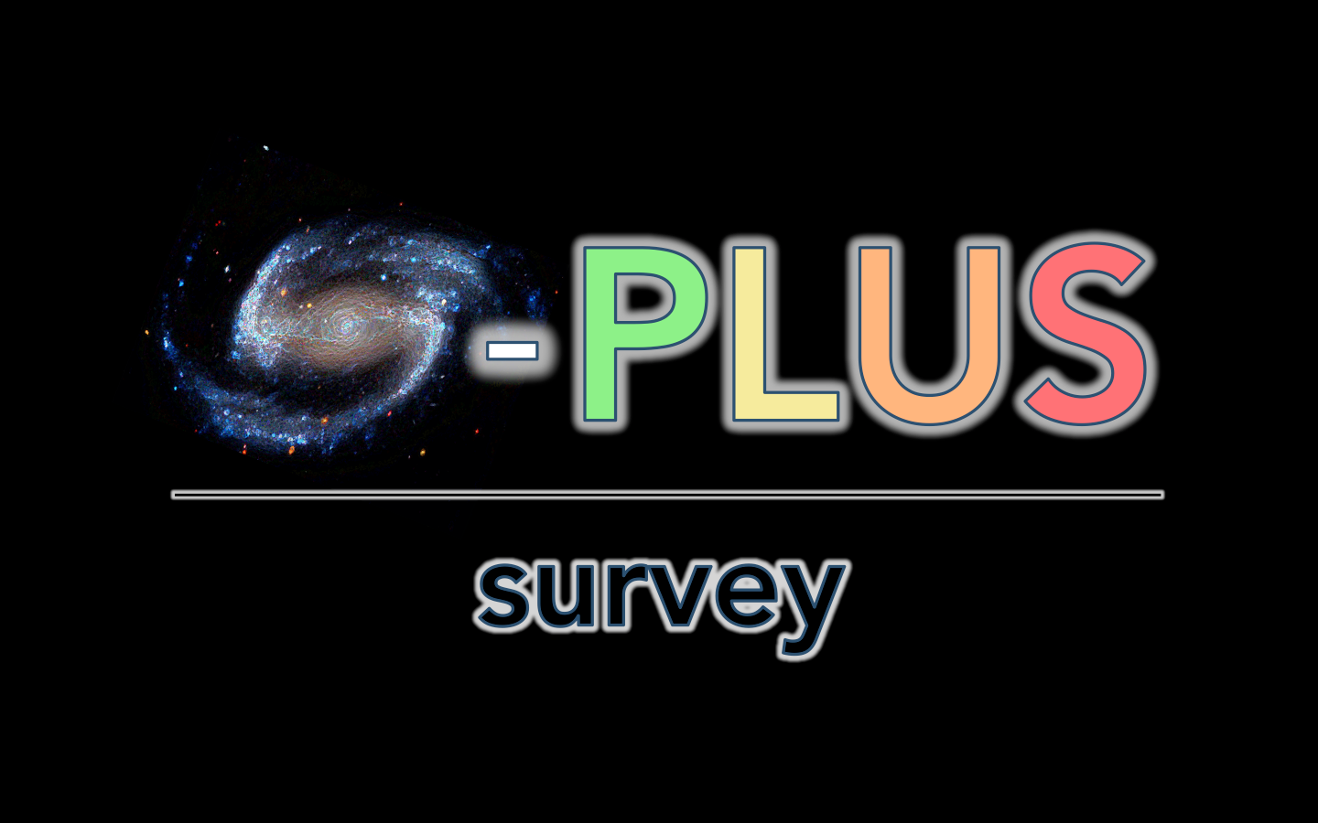
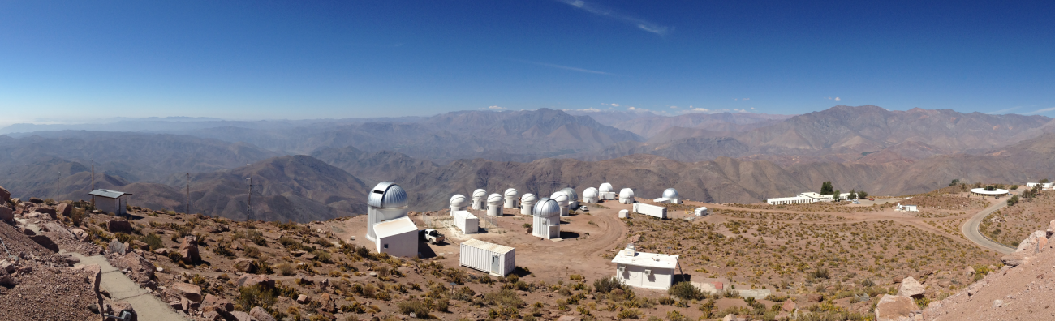

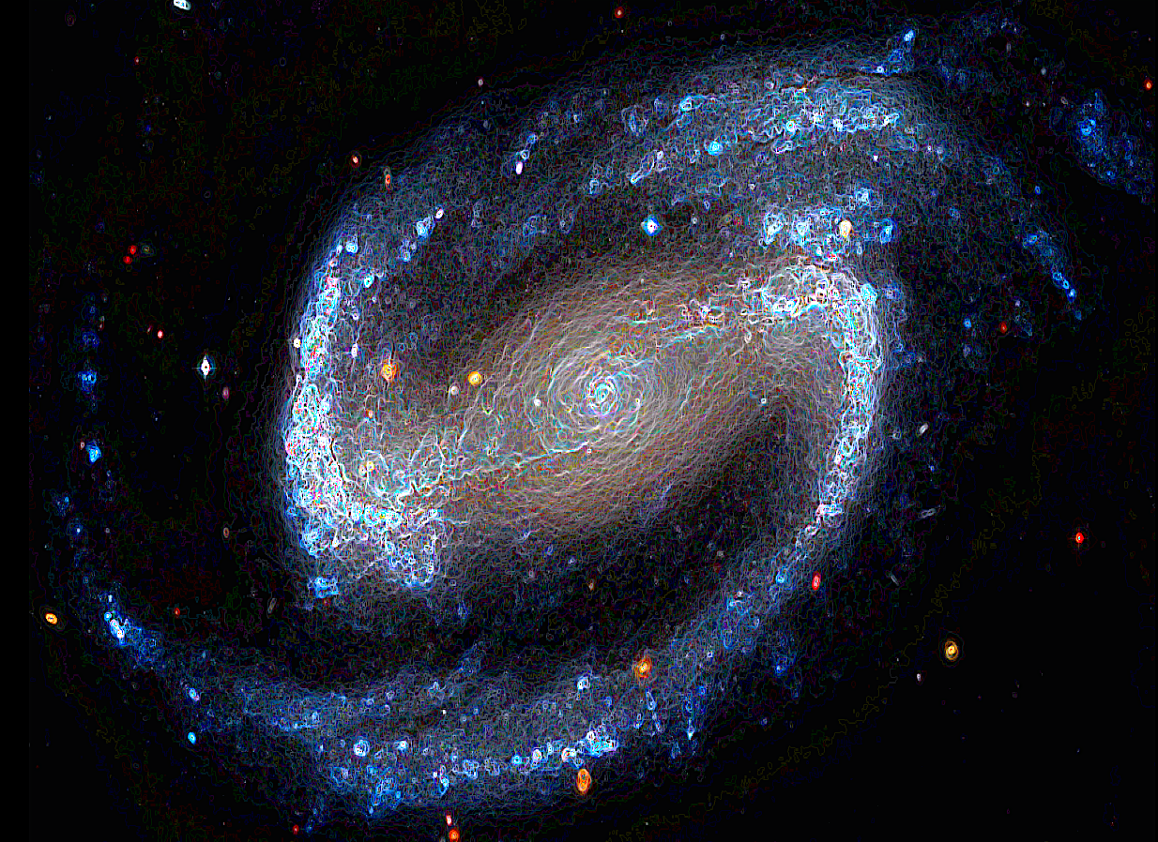
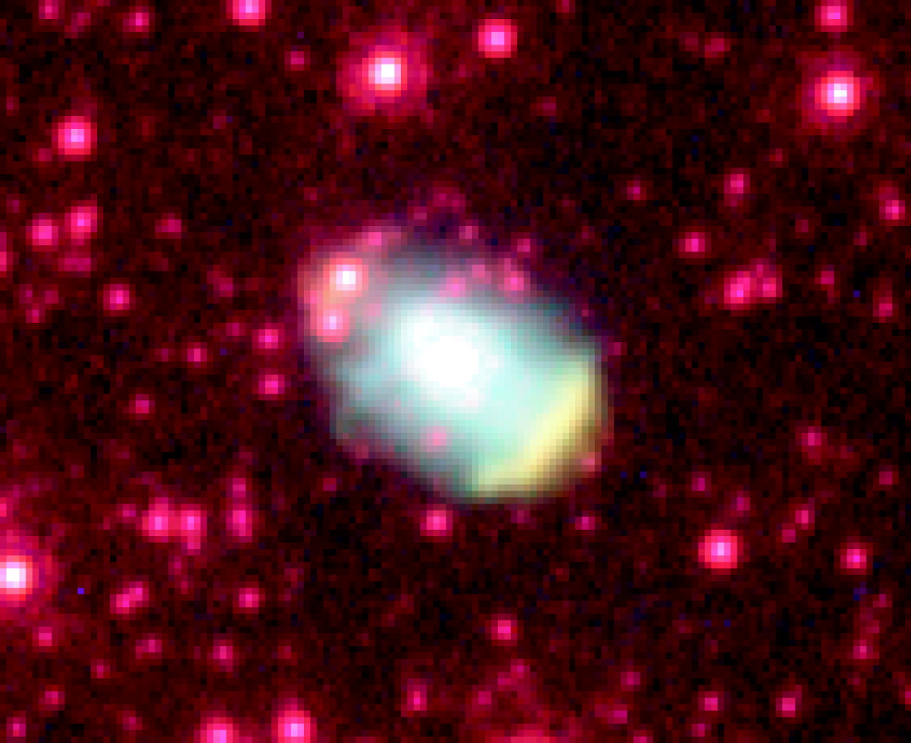
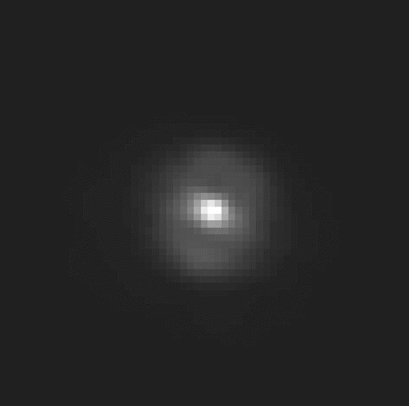
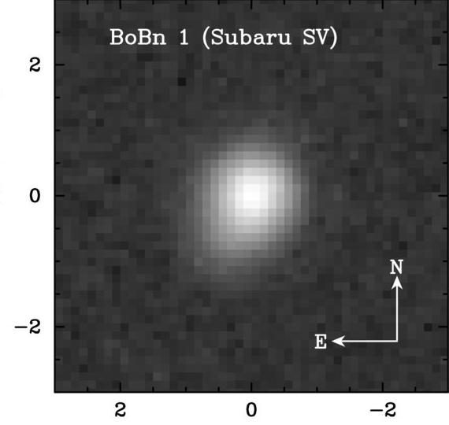
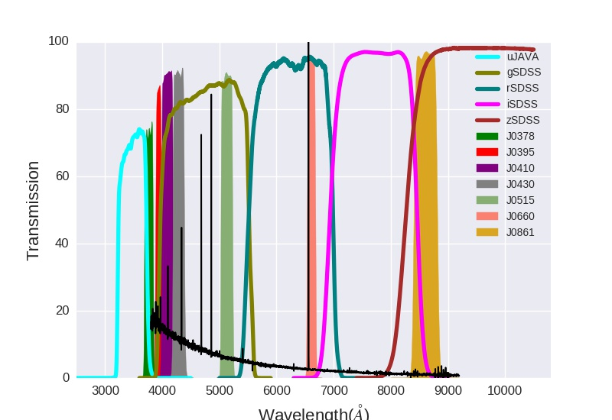
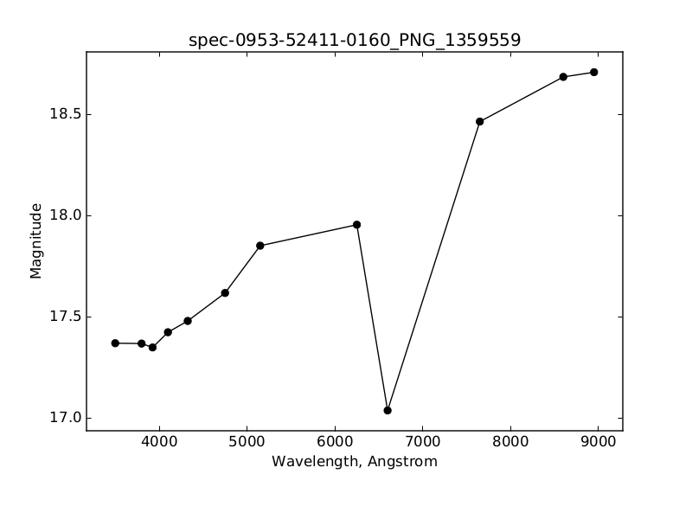
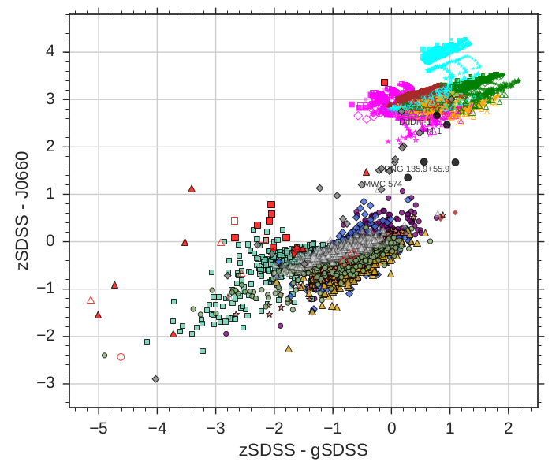
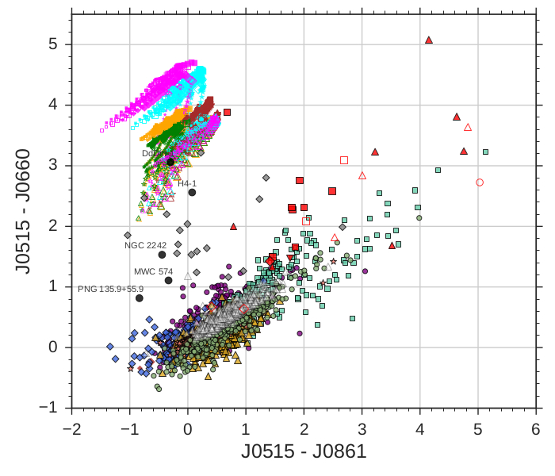
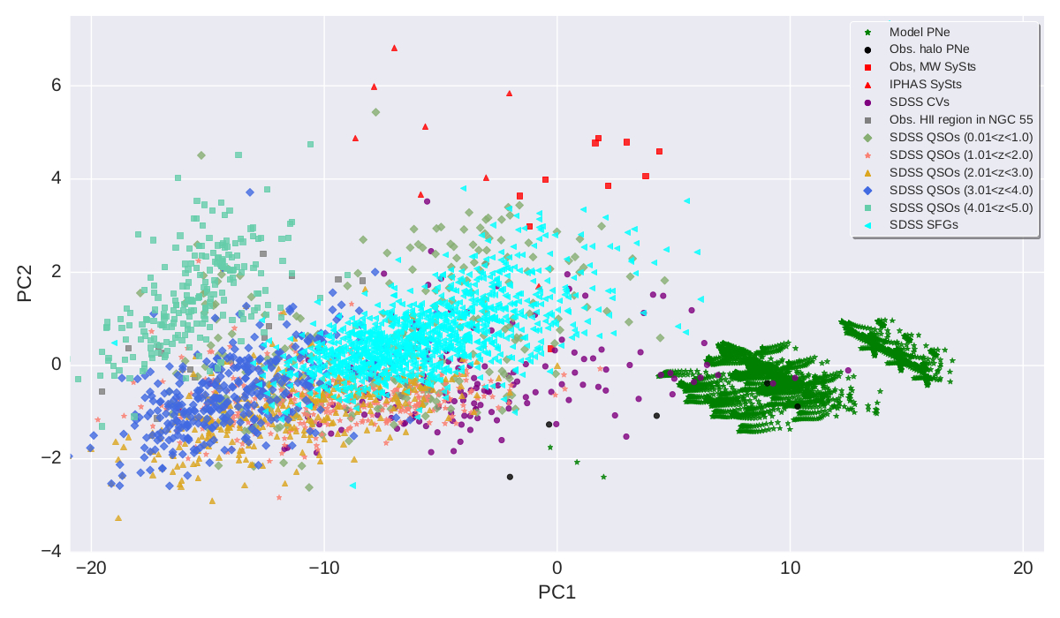
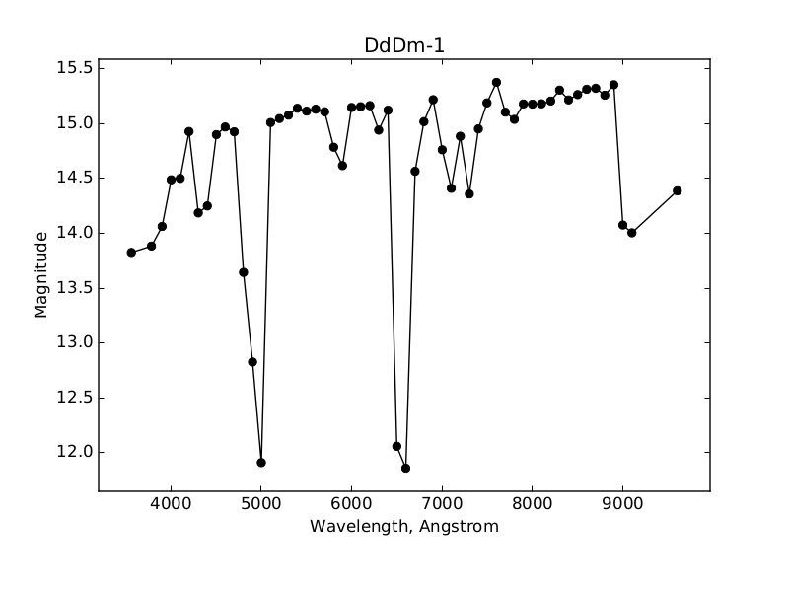
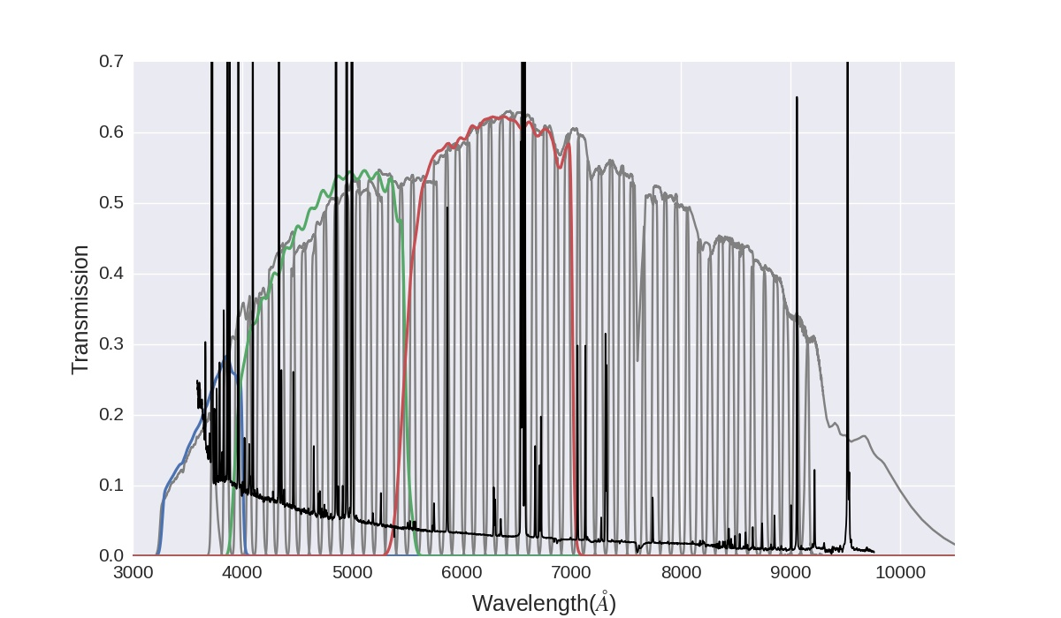
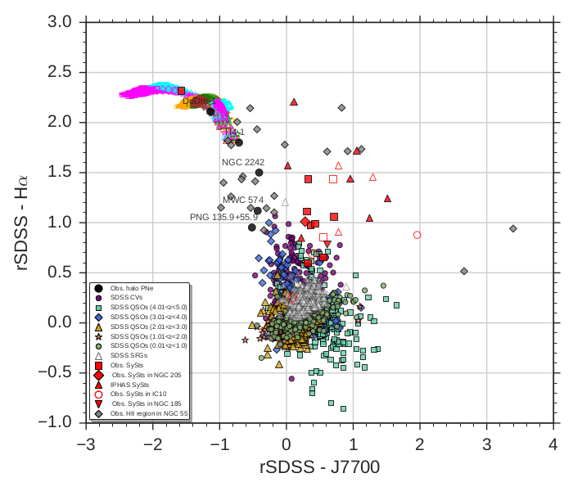
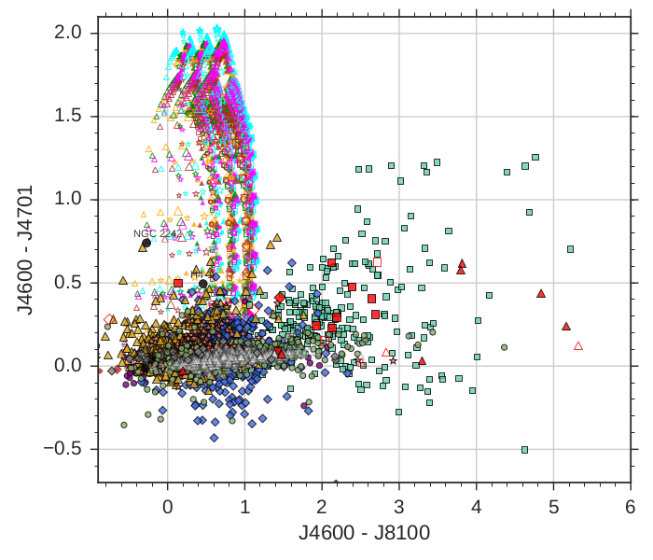
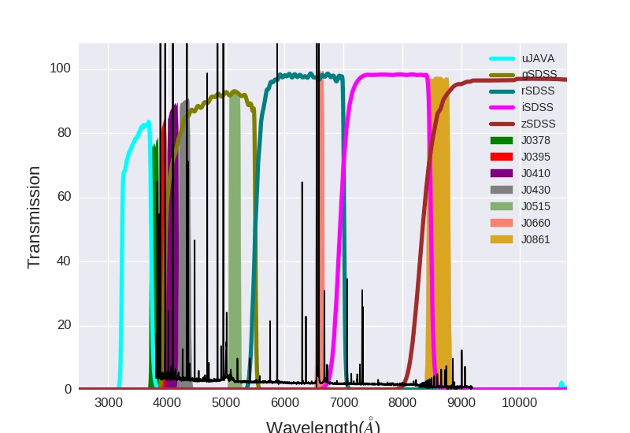
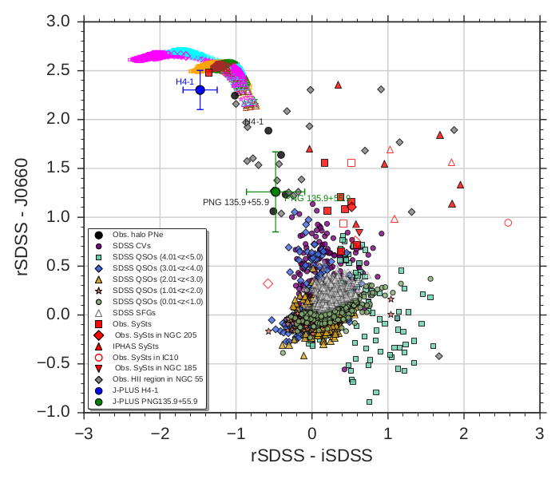
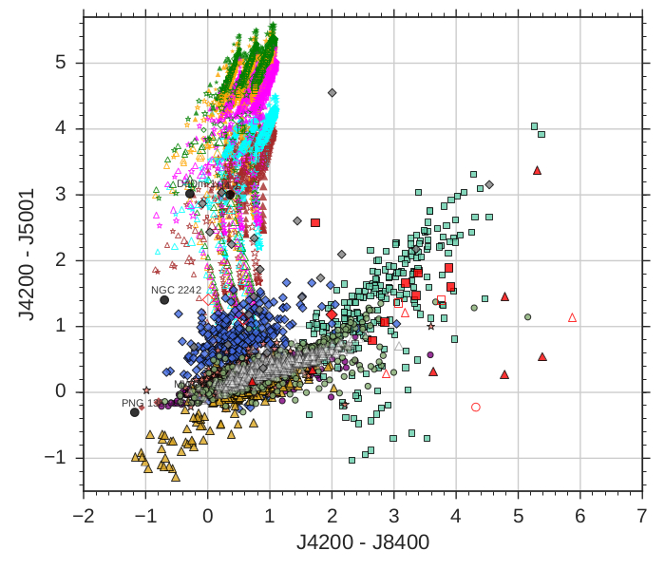
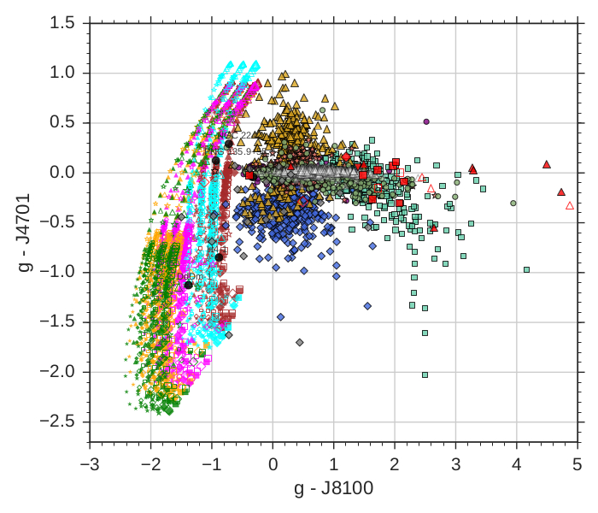
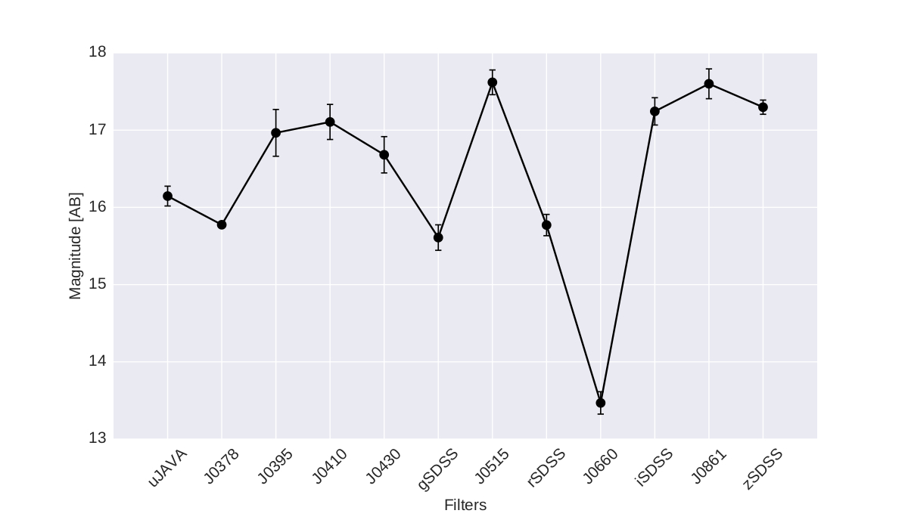
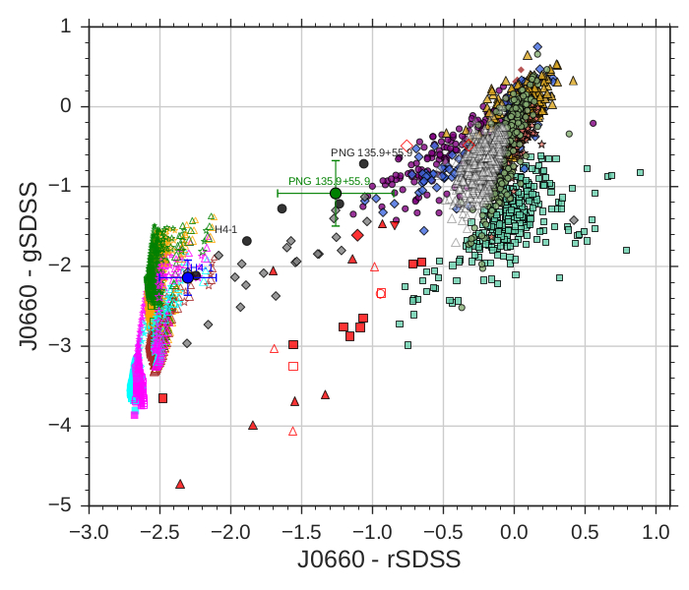
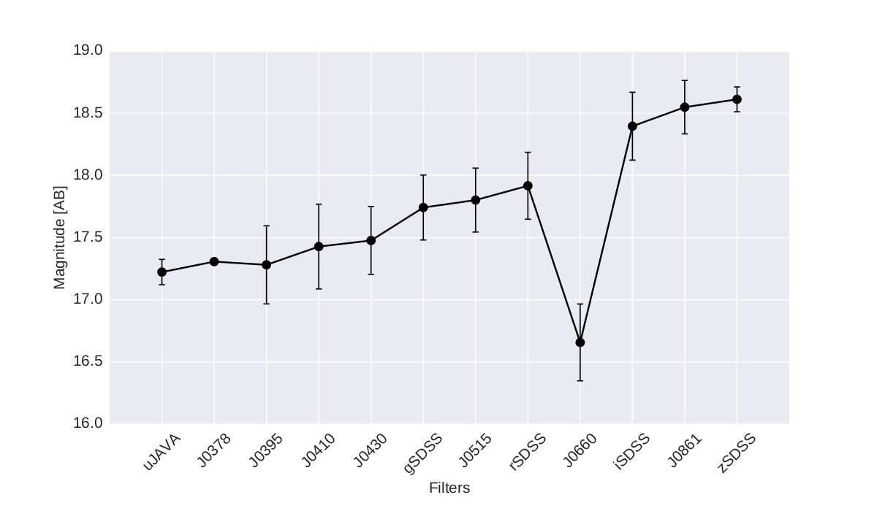


S-PLUS, J-PLUS and J-PAS
search for planetary nebulae
L. Gutiérrez-Soto¹, Denise R. Gonçalves¹, S. Akras², A. Cortesi³ , S. Daflon² , A. Ederoclite⁴, M. B. Fernandes² , C. Mendes de Oliveira³, C. B. Pereira² , L. Sodré³, W. A. Santos Junior³ , K. Viironen⁴ & the S-PLUS, J-PLUS and J-PAS Collaborations
(1) Observatório do Valongo, Universidade Federal do Rio de Janeiro - Brazil
(2) Observatório Nacional, Ministério de Ciência, Tecnologia, Inovações e Comunicações - Brazil
(3) IAG, Universidade de São Paulo, Brazil
(4) Centro de Estudios de Física del Cosmos de Aragón, Spain
ABSTRACT:
Planetary nebulae (PNe) are emission line nebula that represent a short phase on the late evolution of low- and intermediate-mass stars. Since stars with this mass-range are very common, a large number of PNe is expected in the Galaxy. From the approximately 3,000 PNe discovered in our Galaxy, only 14 are found to be members of the halo. We have developed tools to detect such sources in the Javalambre-Physics of the Accelerating Universe Astrophysical Survey (J-PAS) and J-PAS related surveys, S-PLUS and J- PLUS, since they have a great number of narrow- and broad-band filters.
Halo PNe in the Milky Way
DdDm-1
S-PLUS
Synthetic photo-spectrum of the halo PN: PNG 135.9+55.9 (Tovmassian et al. 2001)
K648
Hα
Alves et al. (2000)
(zSDSS- Hα)vs(zSDSS - gSDSS)
Henry et al. (2008)
Otsuka et al. (2010)
Group of
CLOUDY
modelled halo
PNe
Here we propose colour-colour diagrams, based on the spectra of different emission-line objects, which were convolved to the photometry of the three surveys. The diagrams separate halo PN candidates from other emission line sources that resemble PNe (symbiotic stars; star-forming galaxies; cataclysm variables; QSOs and extragalactic H II regions). We also explore the principal component analysis, as an ultimate tool to distinguish PNe from their mimics. We include in our preliminary results, the photometry of a couple of halo PNe actually observed by the J-PLUS survey. Altogether we show it is possible to discriminate halo PNe from other sources using different techniques which enclose important spectral features of the nebulae.
(J0515- Hα)vs(J0515 - J0861)
Principal component analysis (PCA) applied to synthetic photometry. This method also separates halo PNe from the other emission line sources.
PCA
J-PAS
[O III]
Synthetic photo-spectrum of the halo PN: DdDm-1 (Kwitter et al. 1998)
H4-1
Hα
(rSDSS – Hα)vs(rSDSS - iSDSS)
(rSDSS – Hα)vs(rSDSS - iSDSS)
(J4600 – He II)vs(J4600 - J8100)
J-PLUS
REF
(J4200 – [O III])vs(J4200 - J8400)
(g – He II)vs(g - J8100)
Observed photo-spectra
(Hα – gSDSS)vs(Hα - rSDSS)
H4-1
PNG 135.9+55.9
Hα
REFERENCES
Alves, D. R., Bond, H. E., & Livio, M. 2000, AJ, 120, 2044
Benitez, N. et al 2014, ArXiv e-prints
Drew, J. E. Greimel. , Irwin M. J. et al 2005 MNRAS, 362, 753
Gutiérrez-Soto, L. et al., in prep.
Henry, R. B. C., Kwitter, K. B., Dufour, R. J., & Skinner, J. N. 2008, ApJ, 680, 1162
Otsuka, M., Tajitsu, A., Hyung, S., & Izumiura, H. 2010, ApJ, 723, 658
Tovmassian, G. H. et al. 2001, A&A, 370, 456
Viironen, K., Greimel, R., Corradi, R. L. M., Mampaso, A., Rodríguez,, et al. 2009, A&A , 504, 291
The circle symbols with the error bars (blue and green) are the known halo PNe observed by J-PLUS.
ACKNOWLEDGMENT
CONTACT:
We developed the tools to identify halo PN candidates using their characteristic spectral in the three surveys.
lgutierrez@astro.ufrj.br
denise@astro.ufrj.br
stavrosakras@on.br
V

