Slide 1


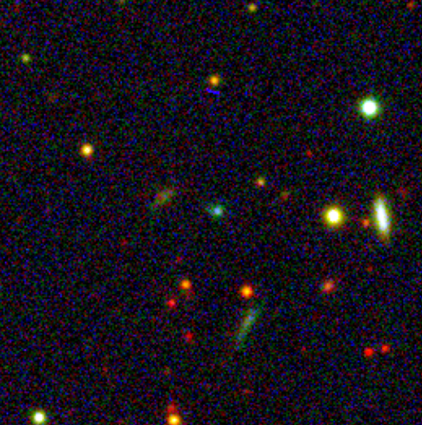
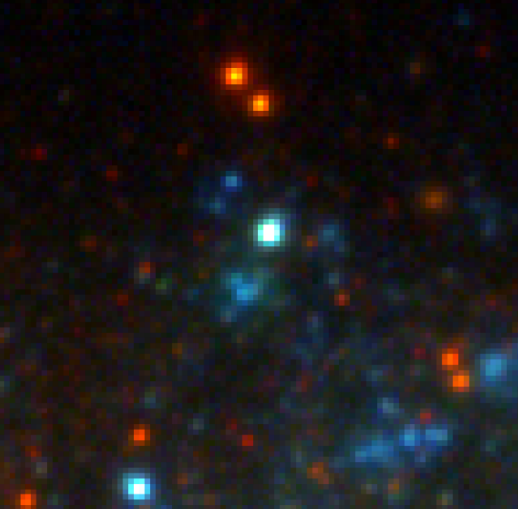
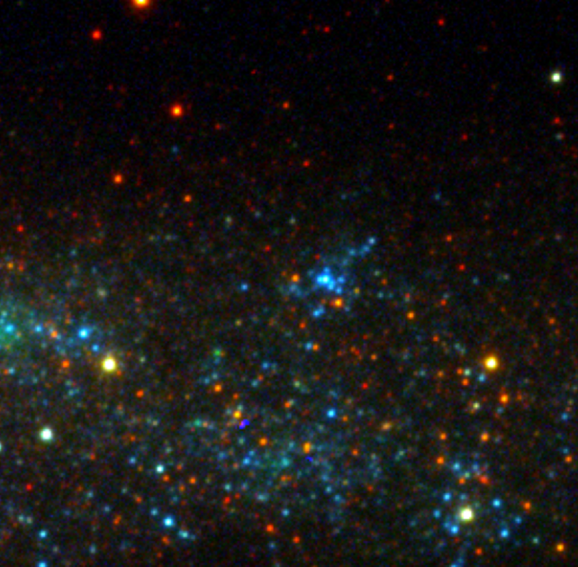
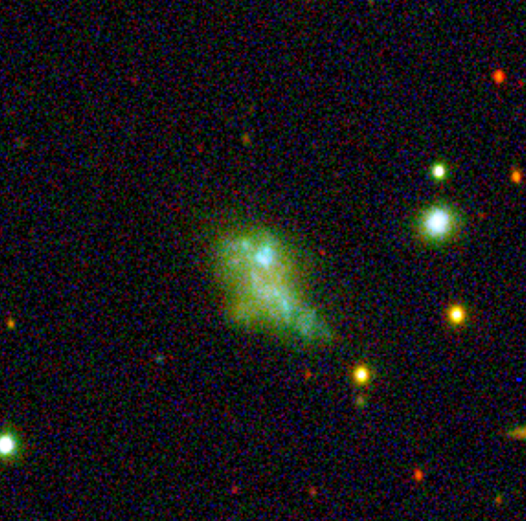
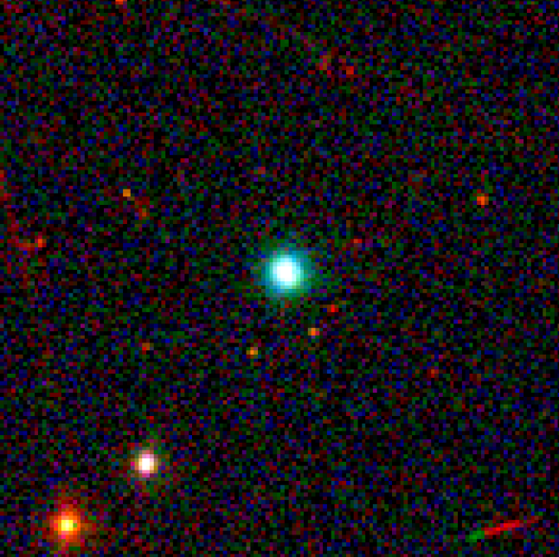
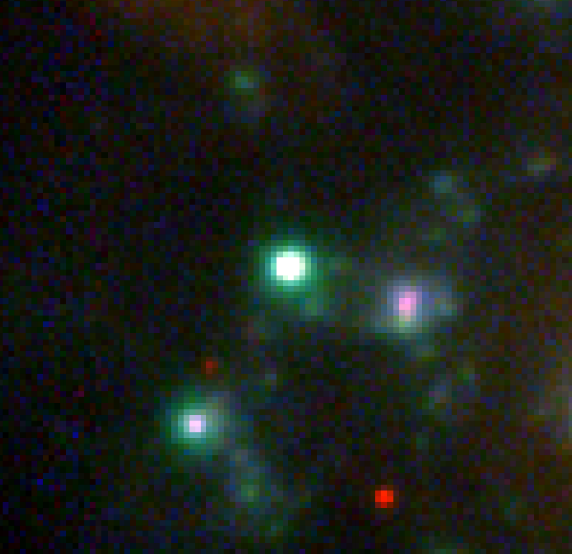
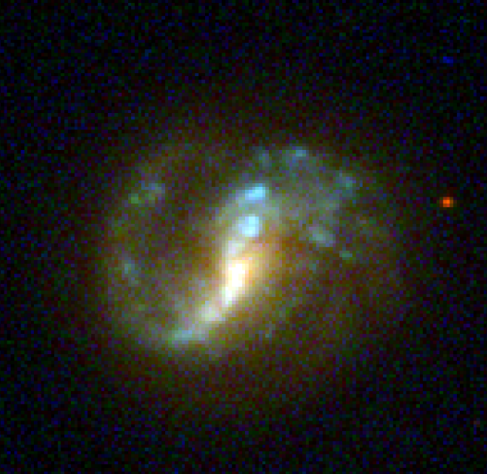
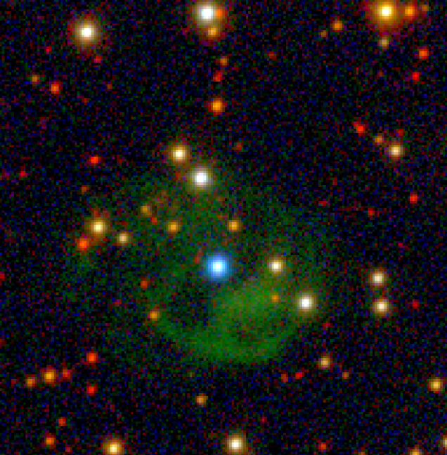
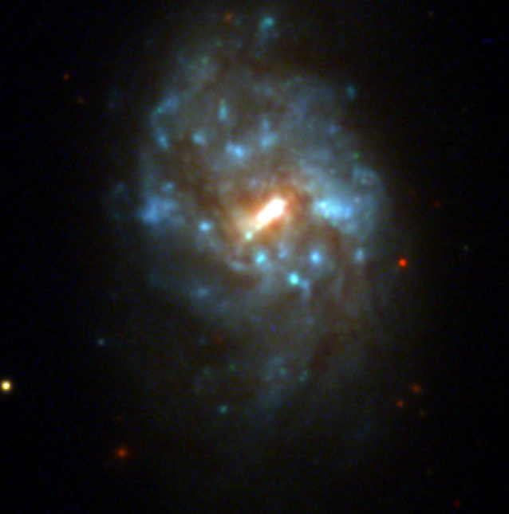
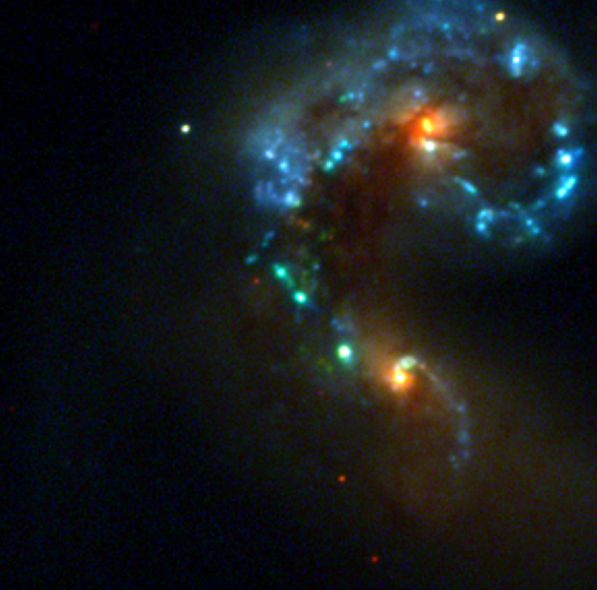
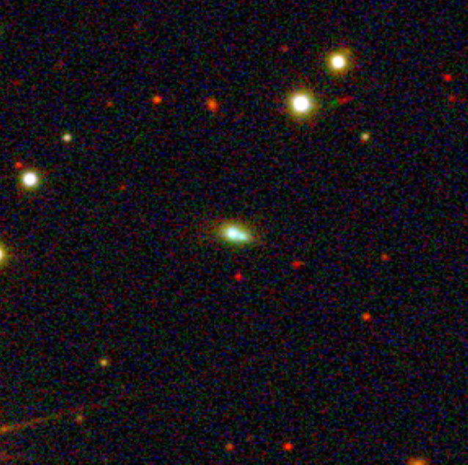
H𝛼 emitters from the Southern Photometric Local Universe Survey (S-PLUS)
Luis A. Gutiérrez Soto, R. Lopes de Oliveira Stavros Akras, Denise R. Gonçalves, C. Mendes de Oliveira & S-PLUS collaboration
16th S-PLUS Meeting
December, 2021

Slide 2

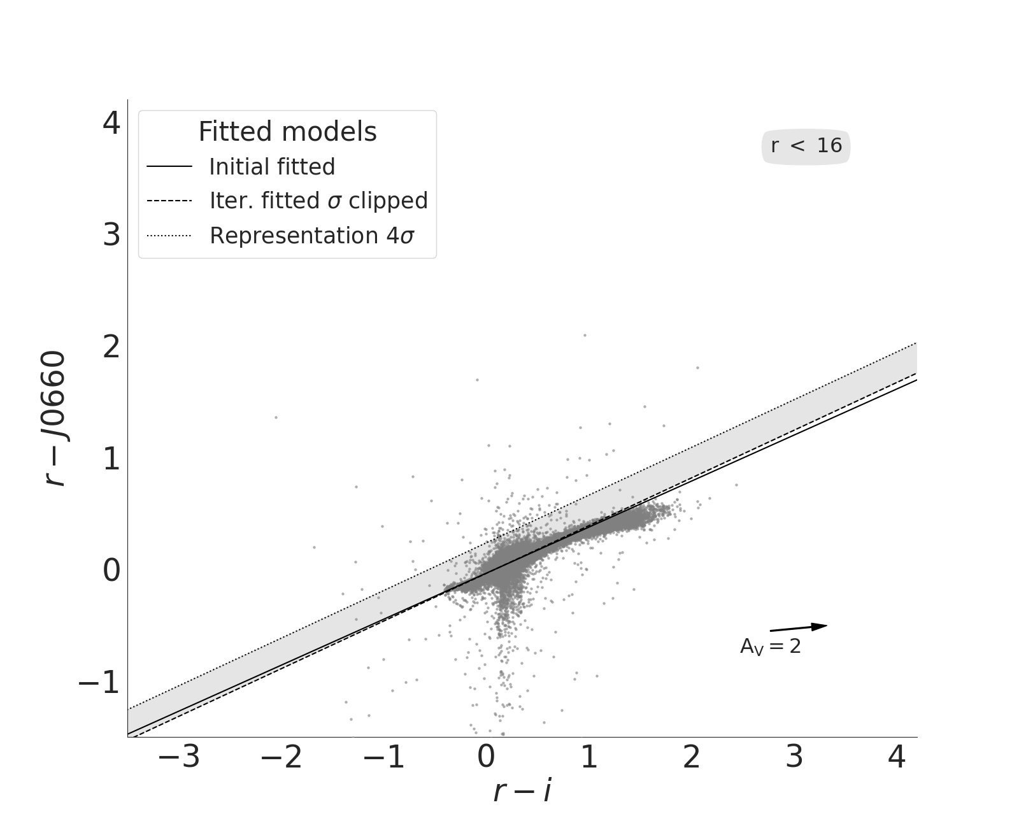
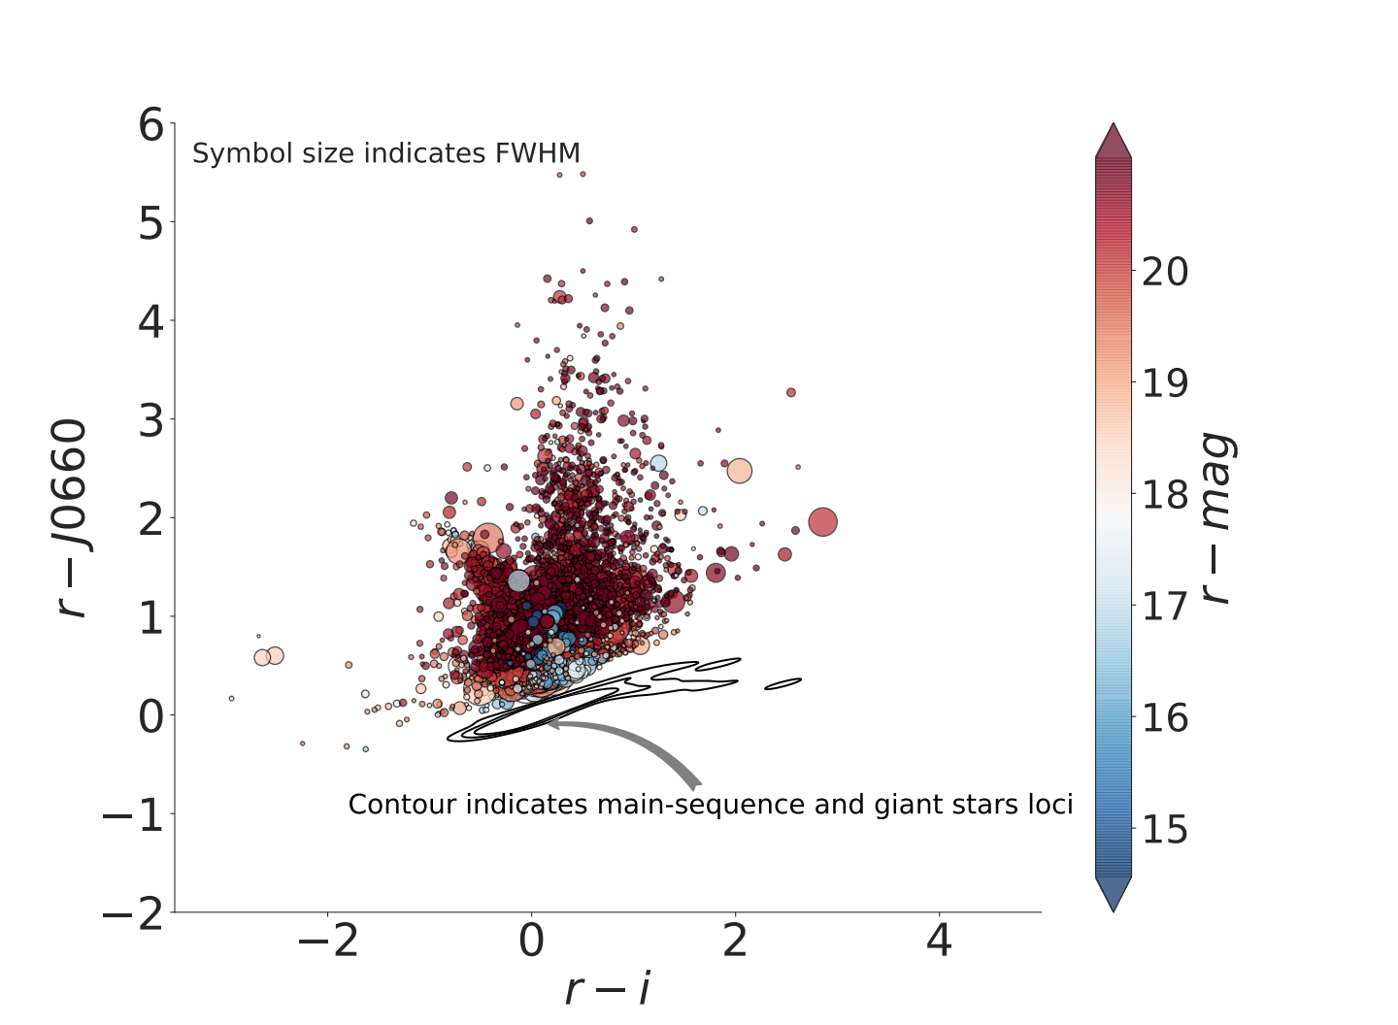
Context
In the way to map 9000 deg² of the Southern hemisphere, the S-PLUS project is also surveying the sky in a proxy of a myriad of astrophysical processes: the H𝛼 transition. Here we explore such a capability from its DR3 to make H𝛼 emitters in evidence from (𝑟 - 𝐽0660) versus (𝑟 - 𝑖) color-color diagram
Selecting the H emitters
The identification of H𝛼 emitters was based on the method applied by Witham et al. (2008).
Iteratively fit the main stellar locus and select all Hα-excess sources hich lie more than 3σ away from the fitted locus.
Gutiérrez-Soto et al. (2022, in prep.)

Slide 3
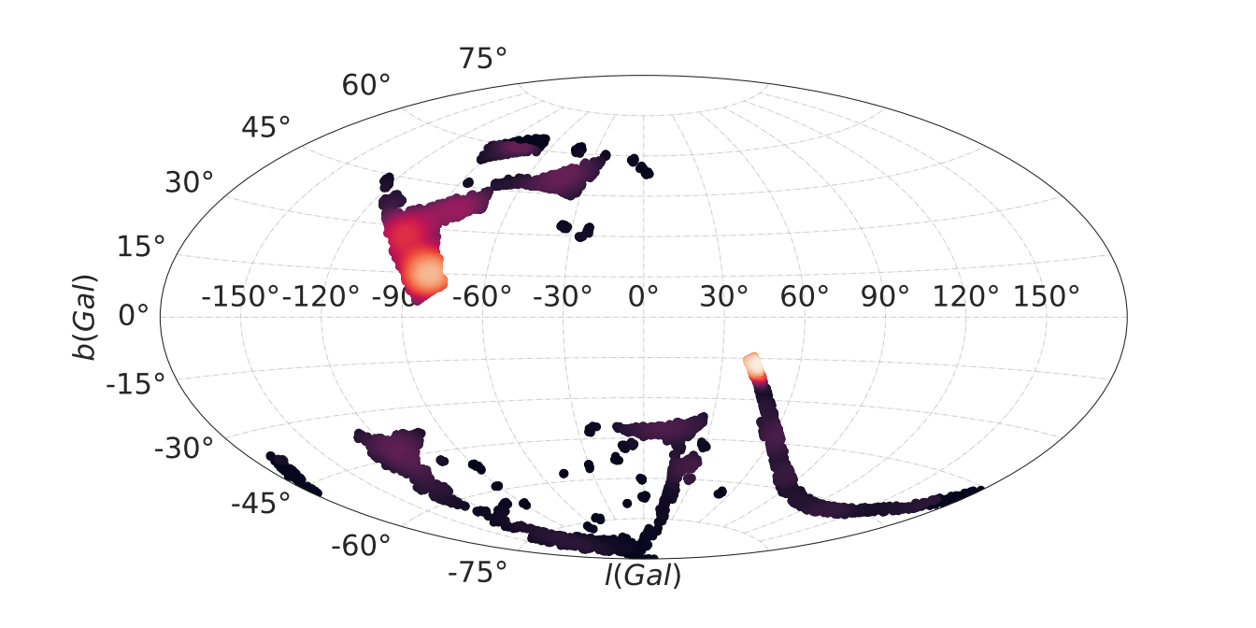
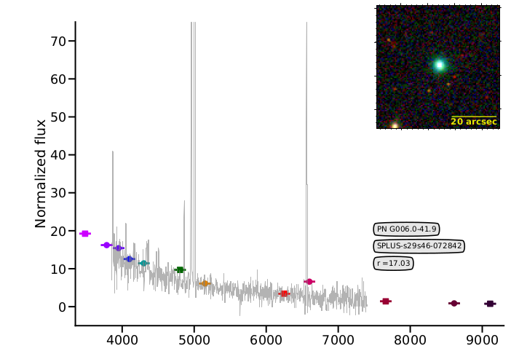
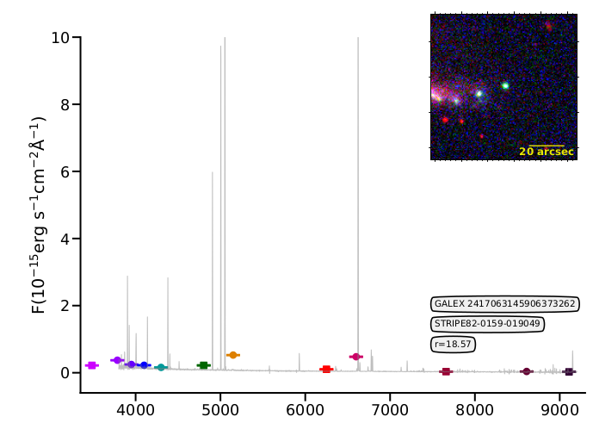
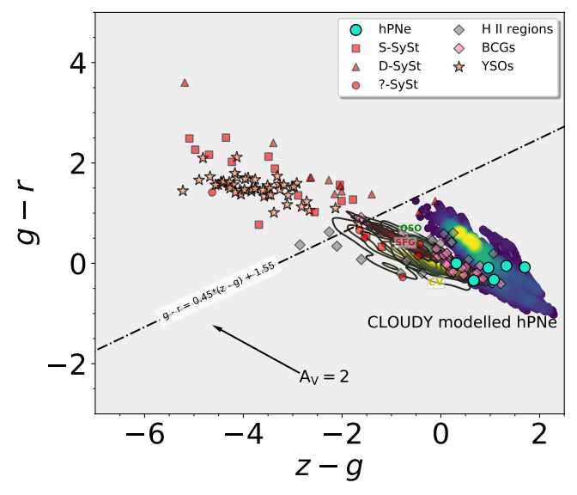
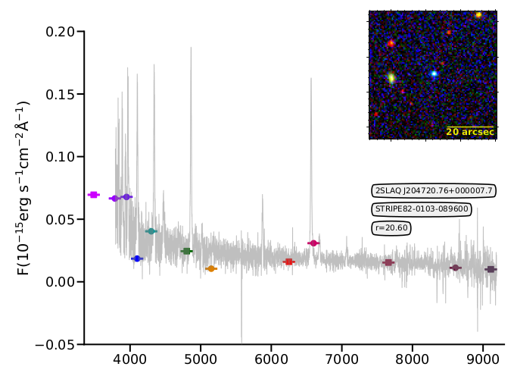
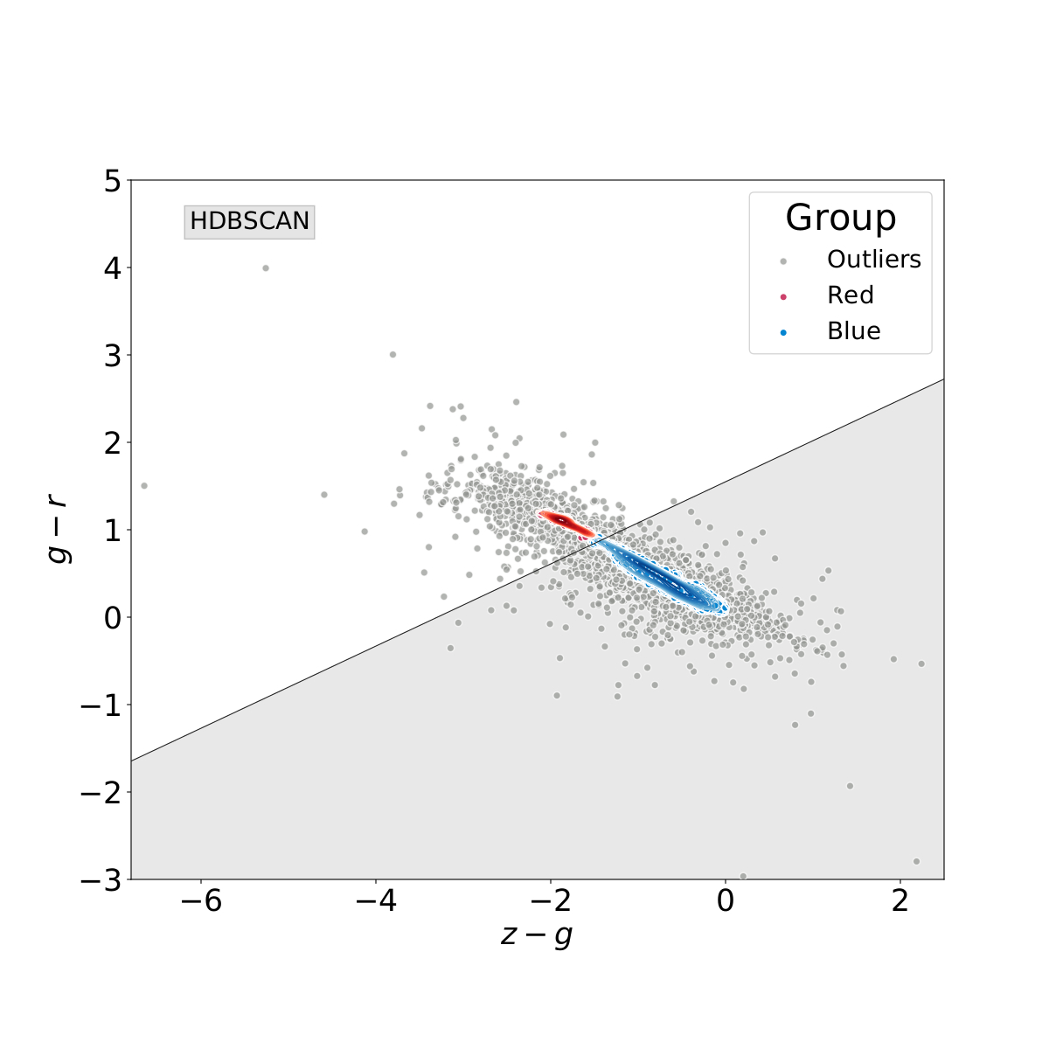
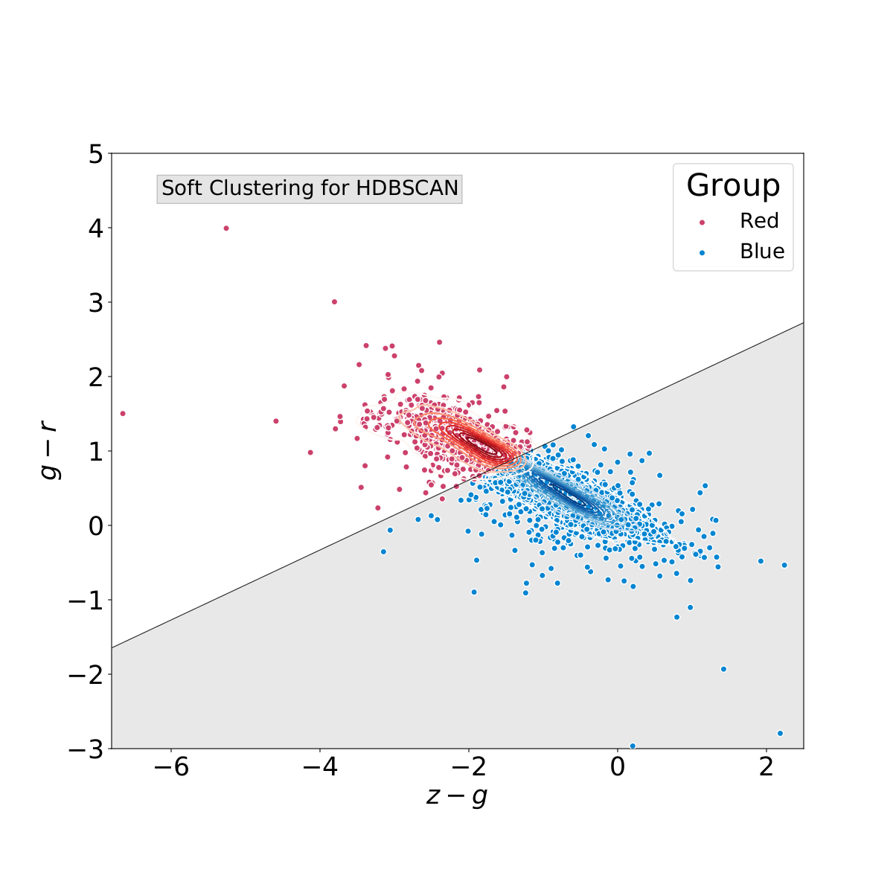
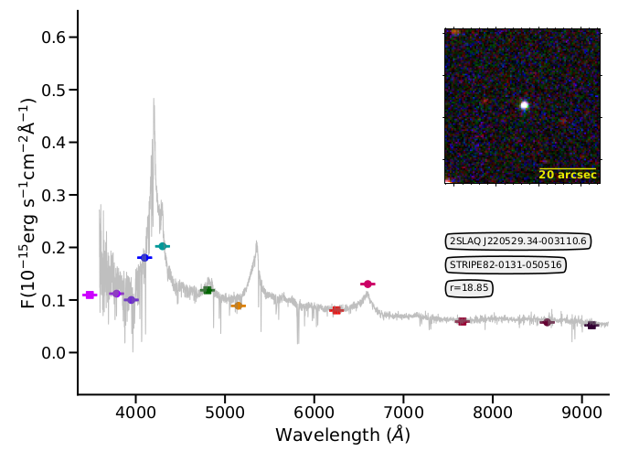
gsoto.angel@gmail.com

Slide 4
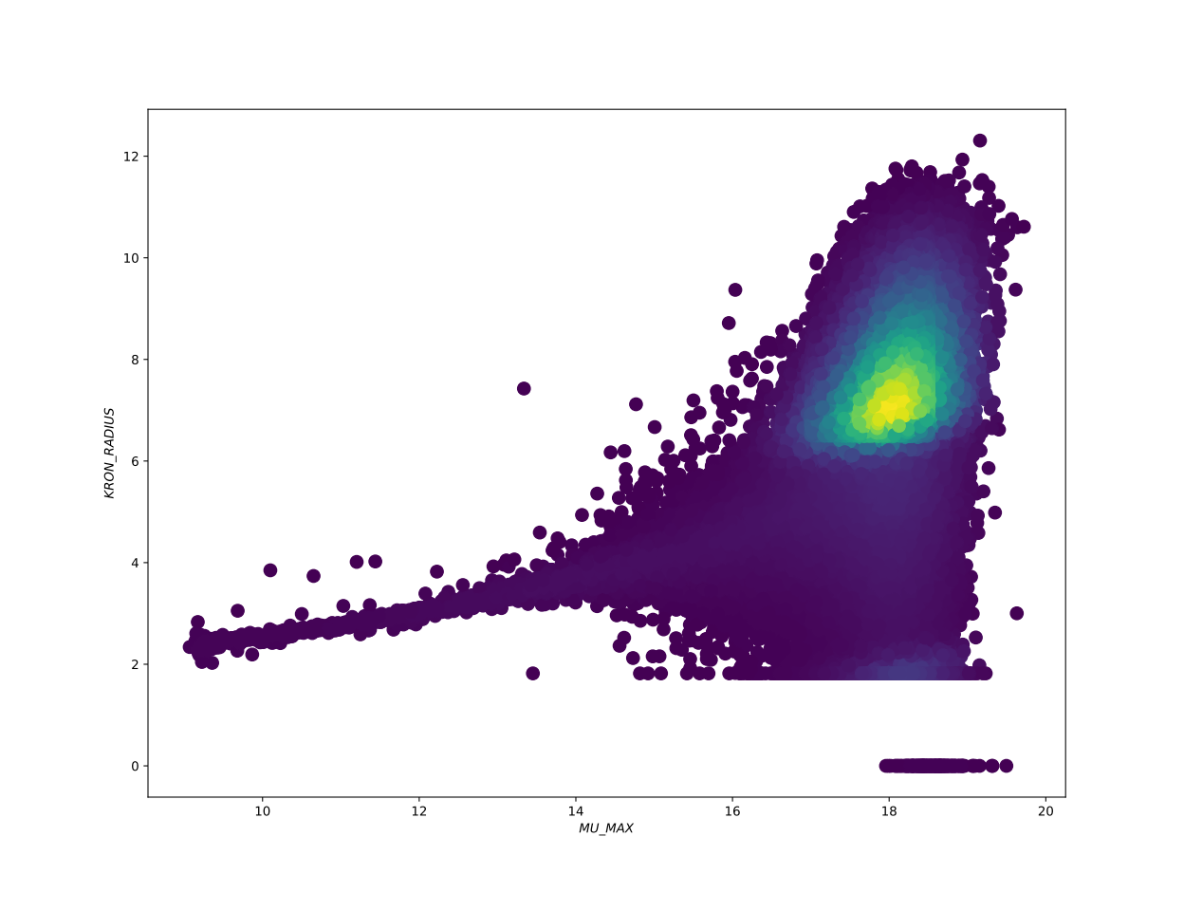
Low surface brightness galaxy
Kron radius vs Mu max
There is a high density regions in the plots

Slide 5
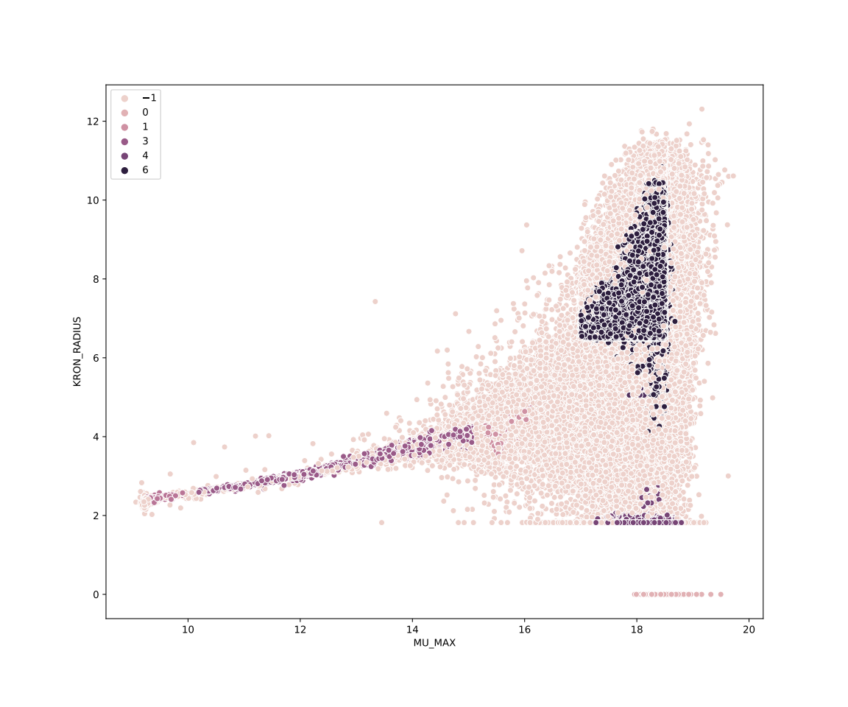
HDBSCAN
Unsupervised/clustering machine learning.
Input data: Mu Max, Kron Radius and r_auto mag

Slide 6
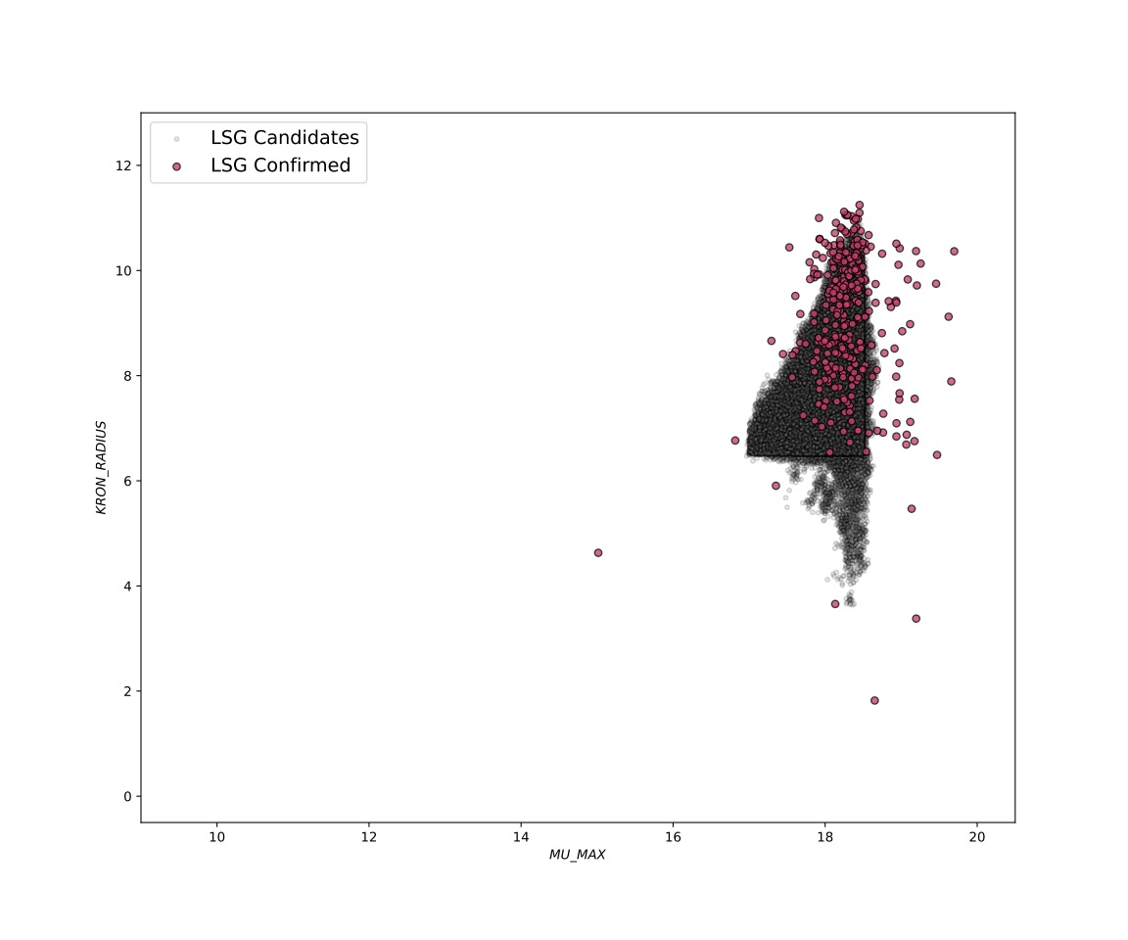
HDBSCAN
Unsupervised/clustering machine learning
Group 6: ~ 80x10³ objects

Slide 7
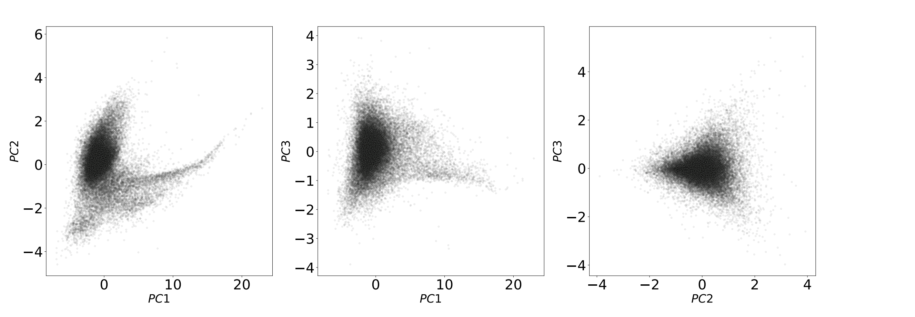
Principal Component Analysis
Variables: “Mu max”, “kron radius”, "J0410", 'J0430', "g", "J0515", "r", "J0660", "i", "J0861" and"z"

Slide 8
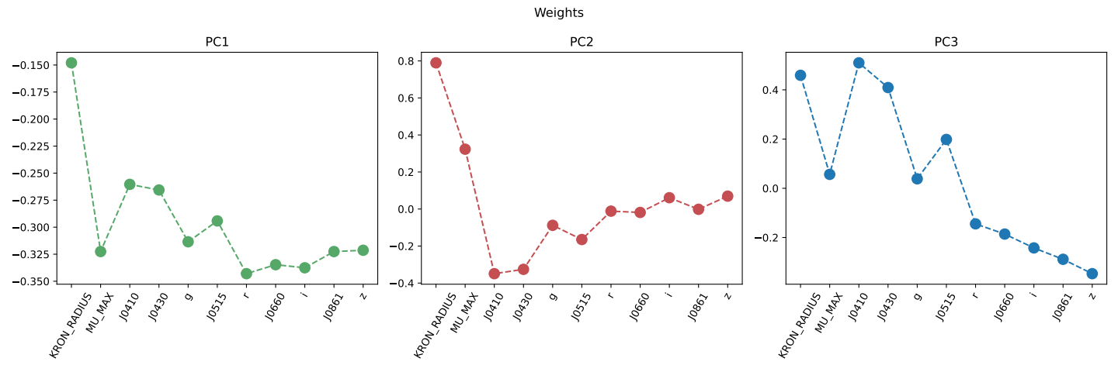
Principal Component Analysis

Slide 9
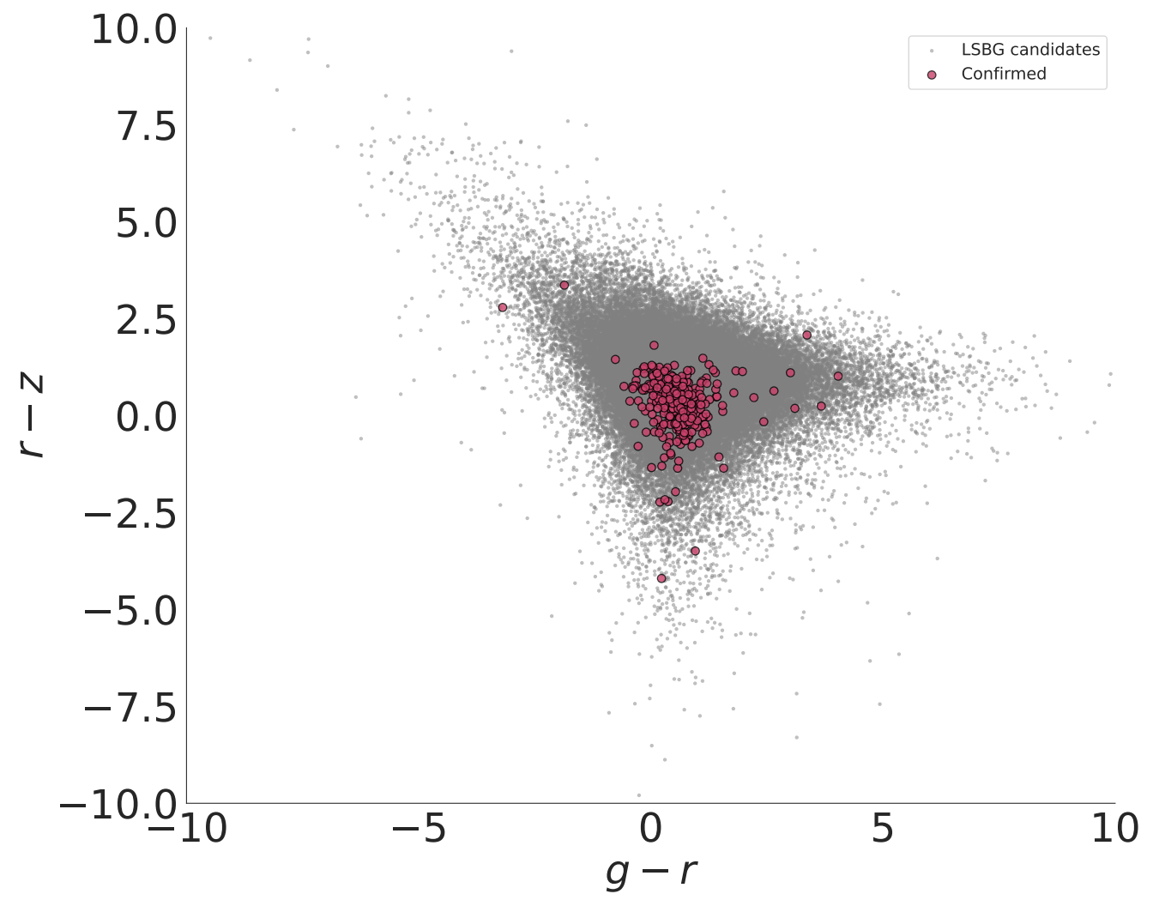
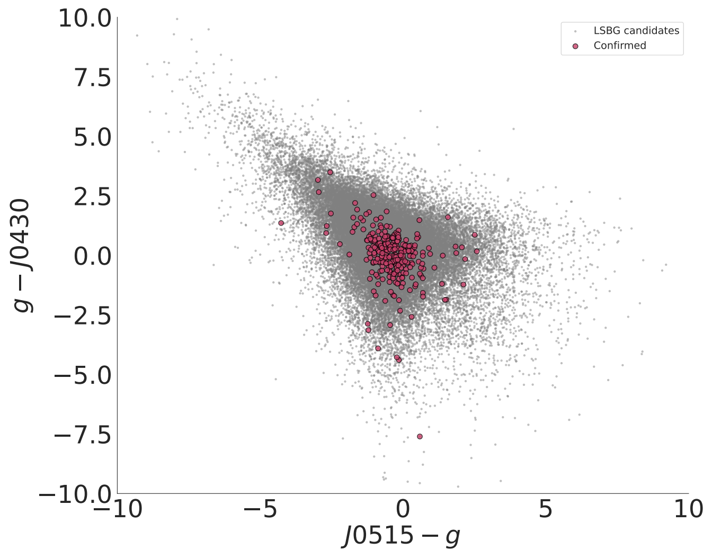
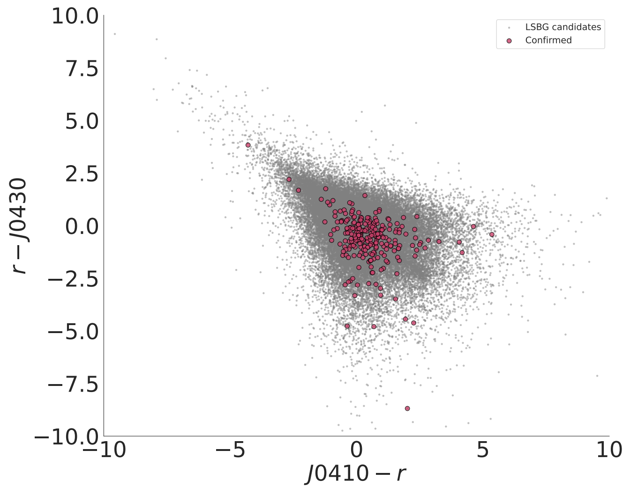
COLOUR CRITERIA
S-PLUS colour-colour diagrams
S

Slide 10
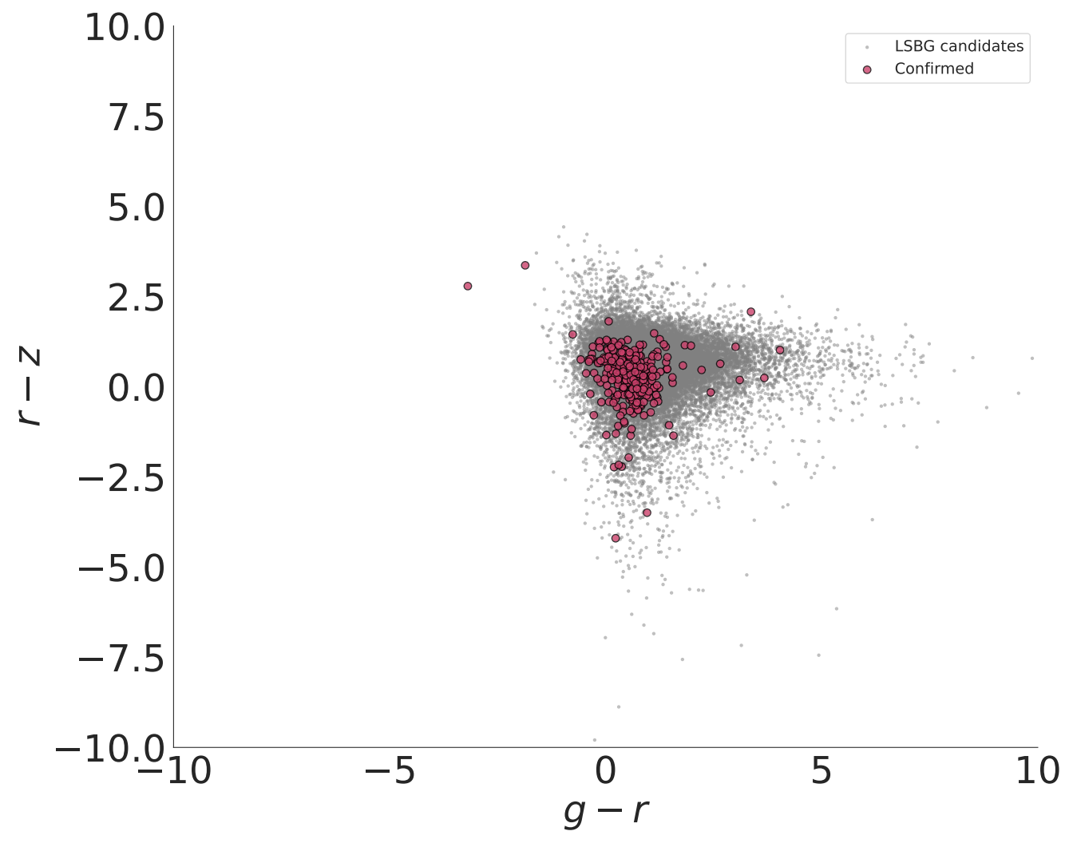
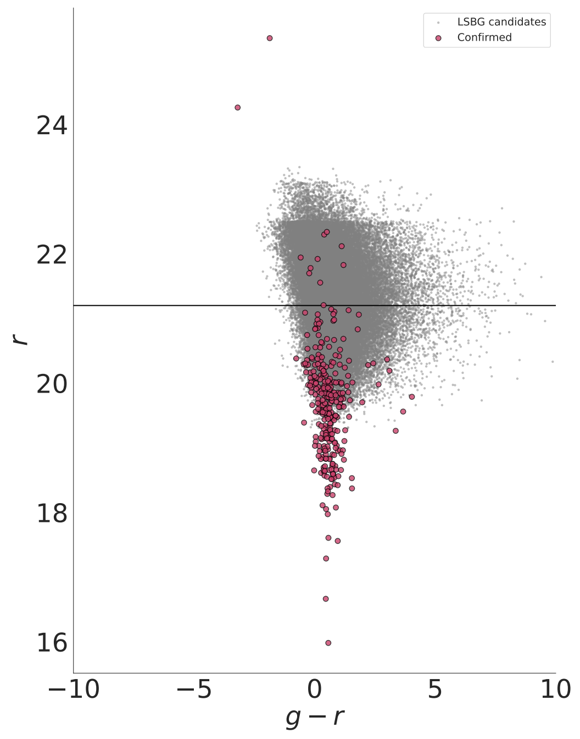
COLOUR CRITERIA
S-PLUS colour-colour diagrams
S
(r – z) vs (g – r) color-color diagram with the HDBSCAN results -- Group 6

Slide 11
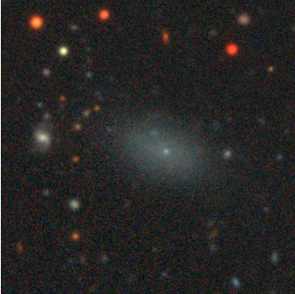
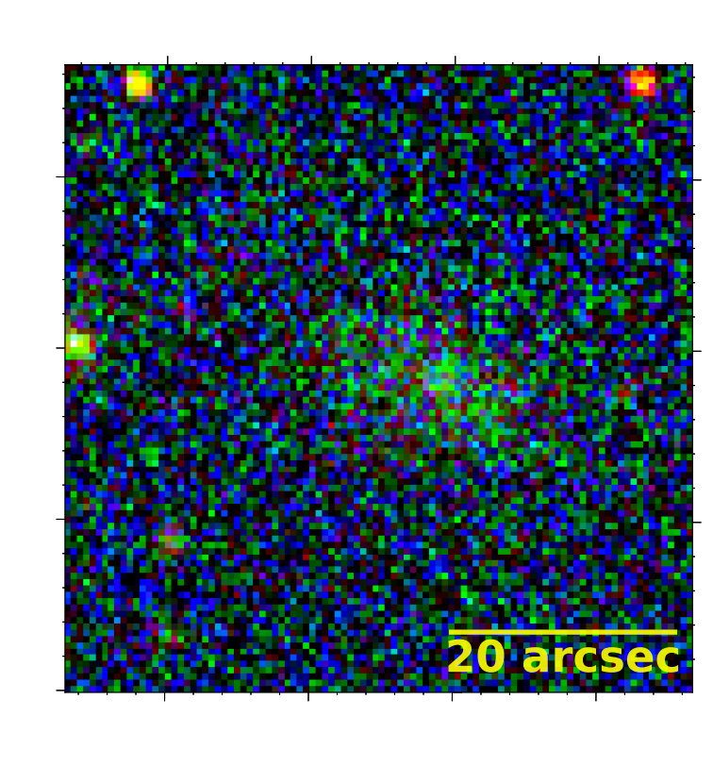
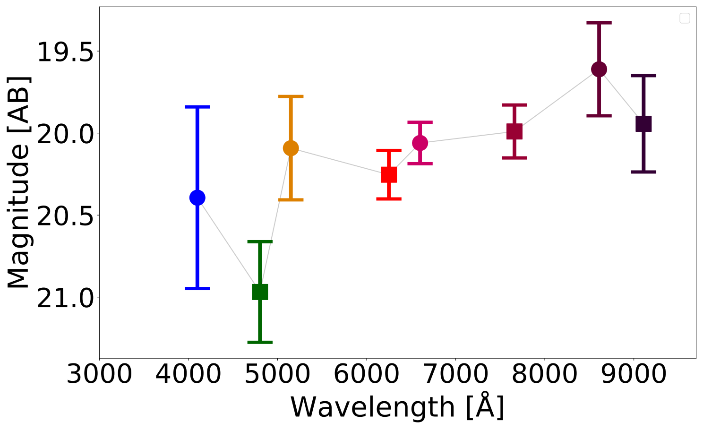
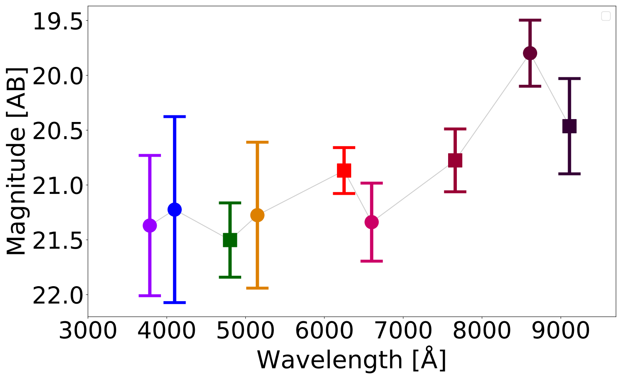
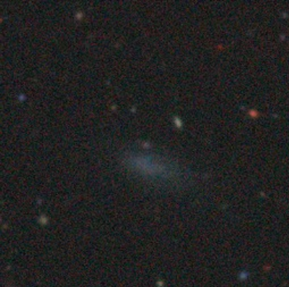
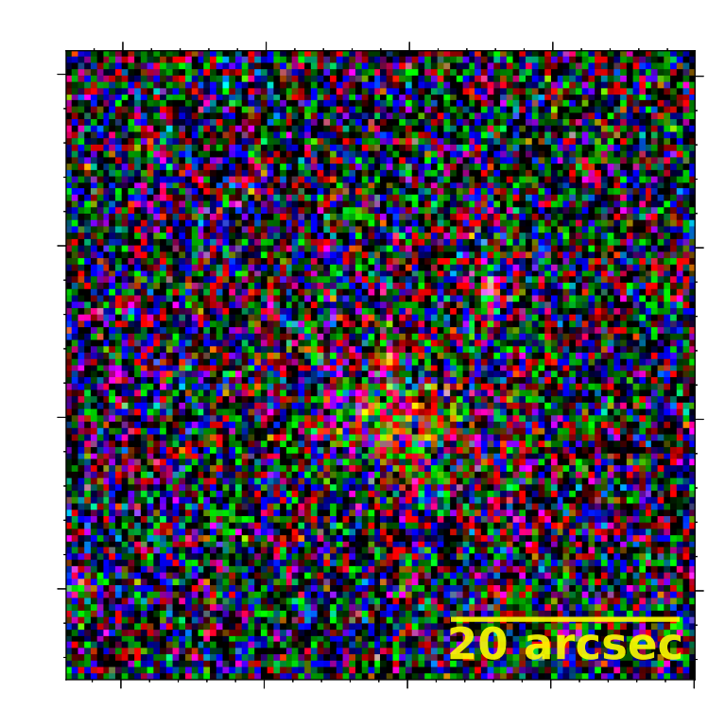
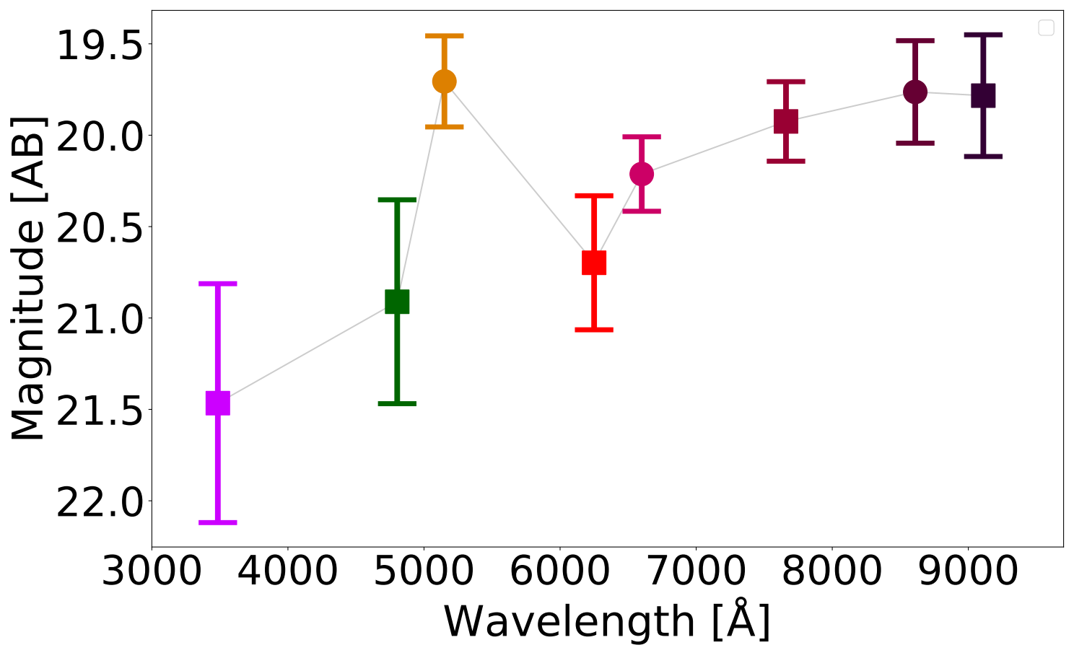
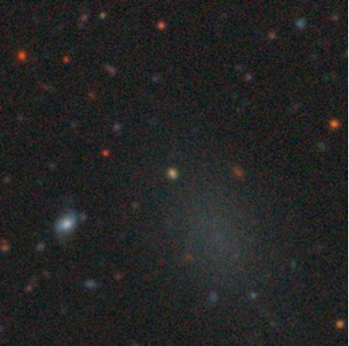
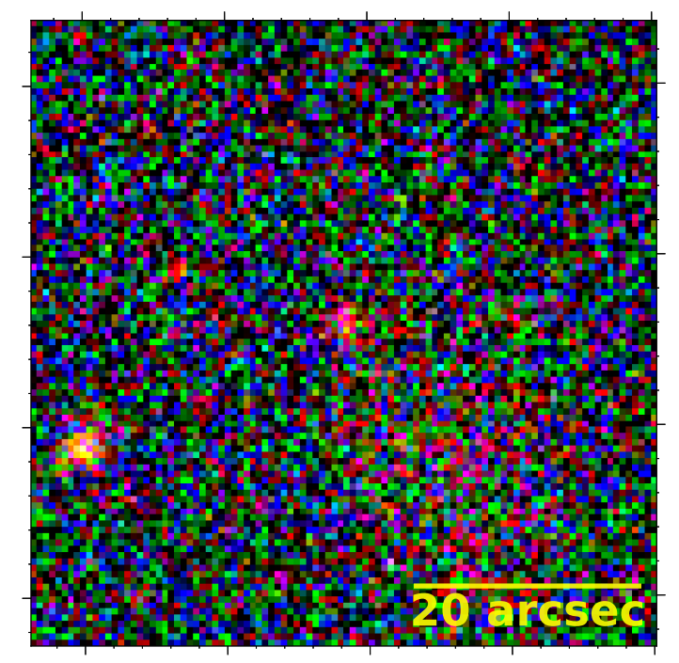
RESULTS
I think that they are good candidates
Legacy
S-PLUS

Slide 12
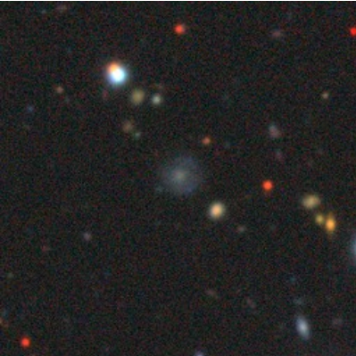
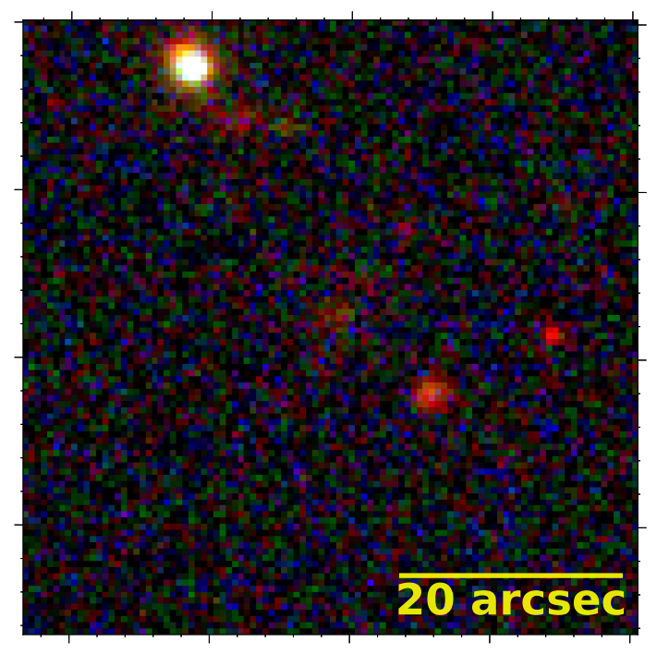
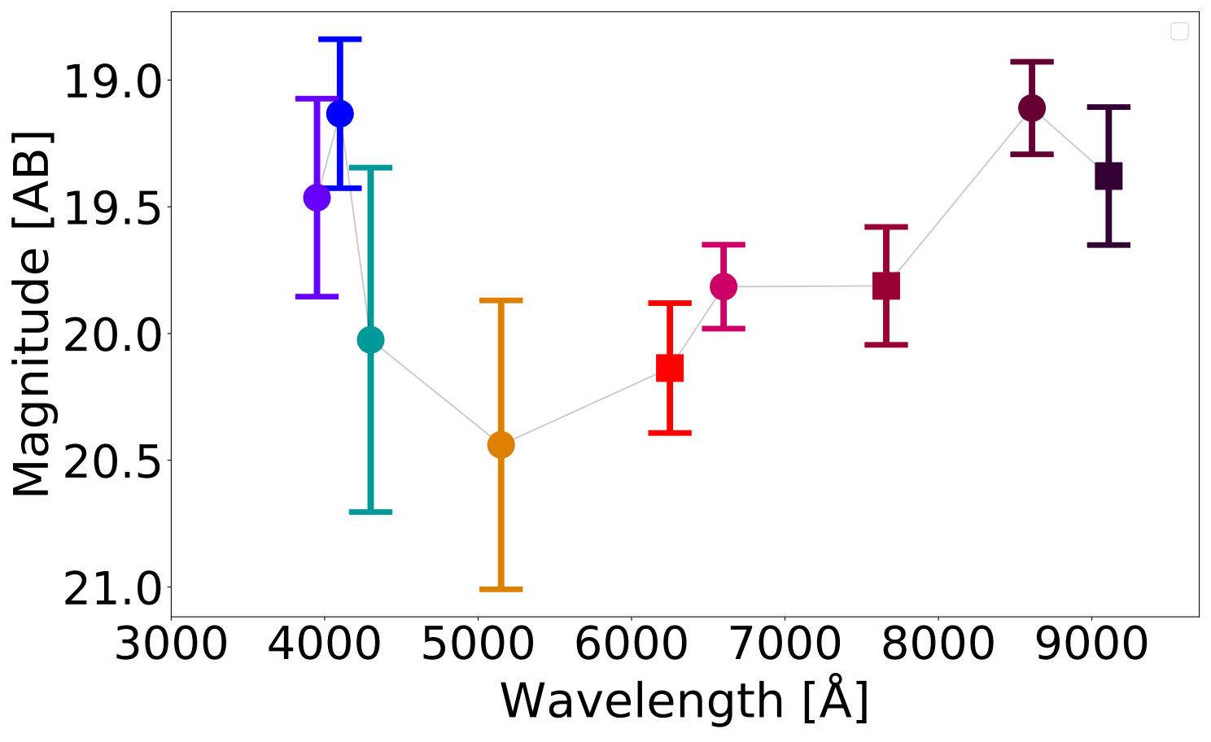
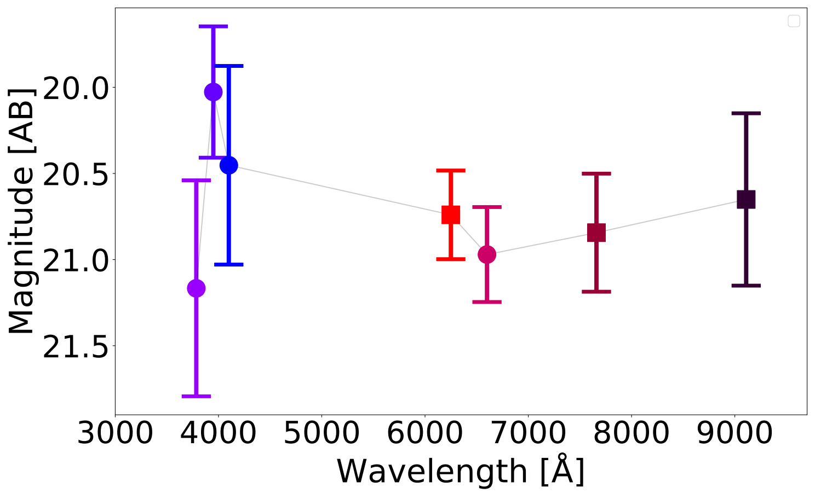
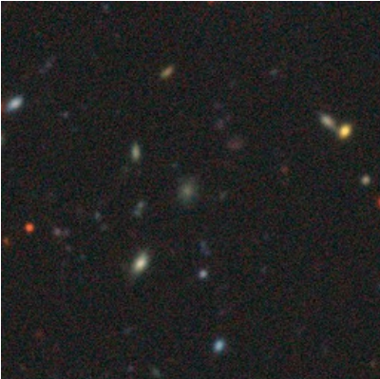
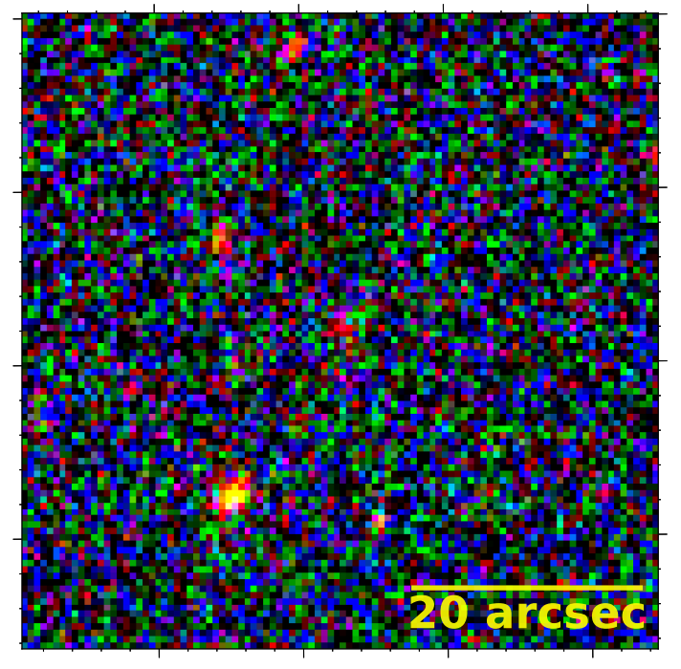
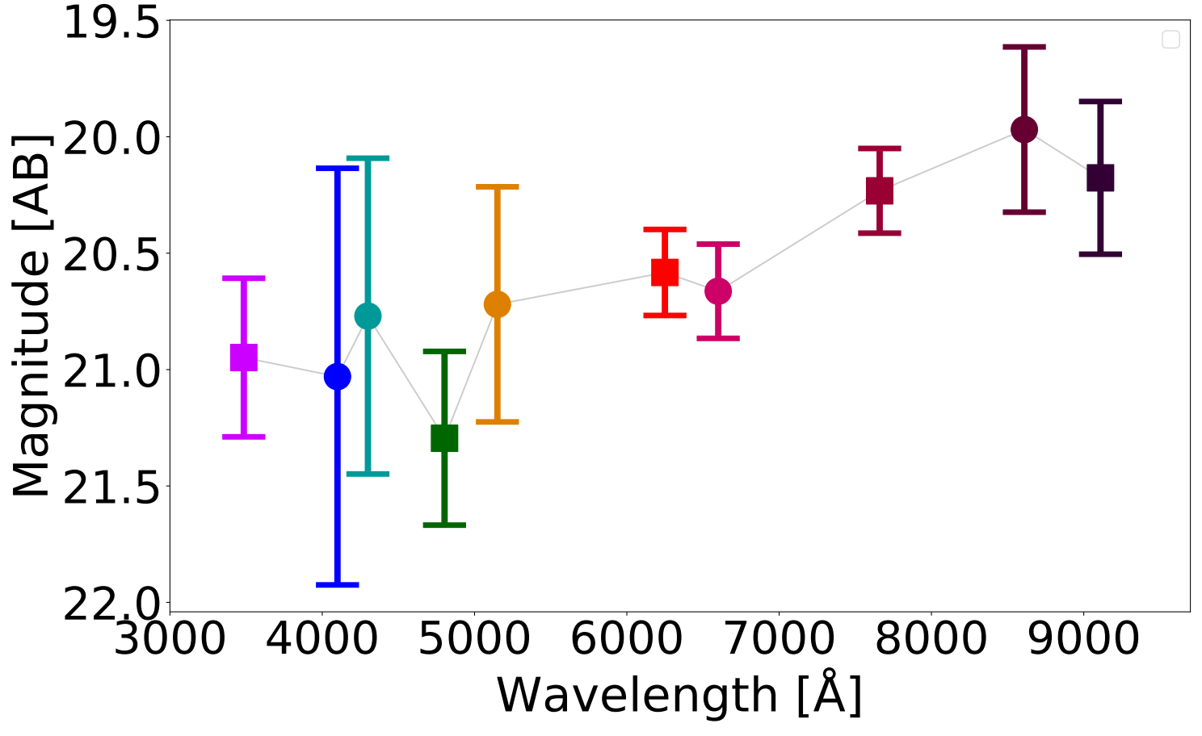
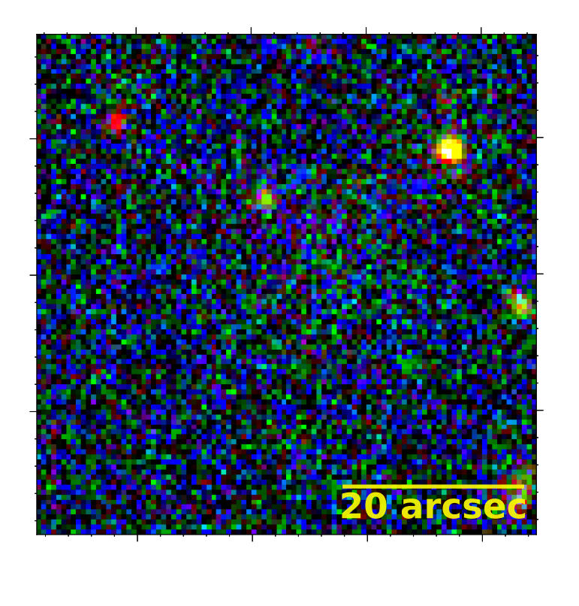
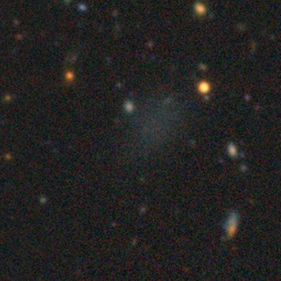
RESULTS
I think that they are good candidates

