Slide 1




HUNTRESS
Mapping Hα-Excess Candidate Point Sources in the Southern Hemisphere Using S-PLUS Data
Luis A. Gutiérrez-Soto & S-PLUS collaboration
S-PLUS Collaboration Meeting
October 21, 2024

Slide 2


Context
As part of mapping 9000 deg² of the Southern Hemisphere, the S-PLUS project surveys the Hα transition, capturing a wide range of astrophysical processes. In this study, we utilize DR4 data, covering 171 low-galactic-latitude fields, 341 fields from the Main Survey, and 150 fields in the Magellanic Clouds region, to highlight Hα-excess point sources using the (r - J0660) vs. (r - i) color-color diagram.

Slide 3
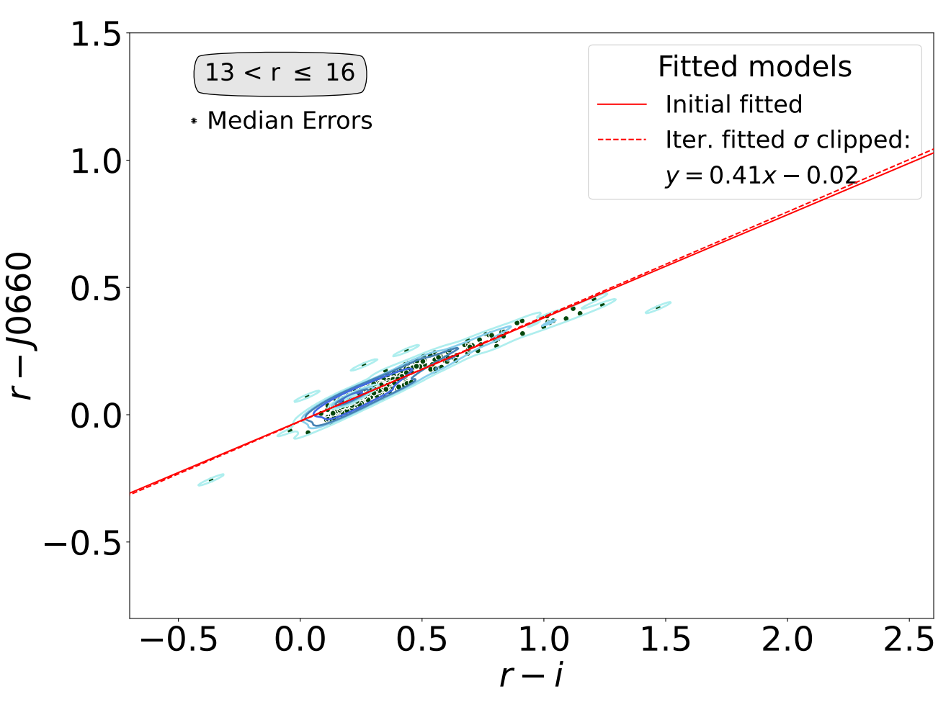
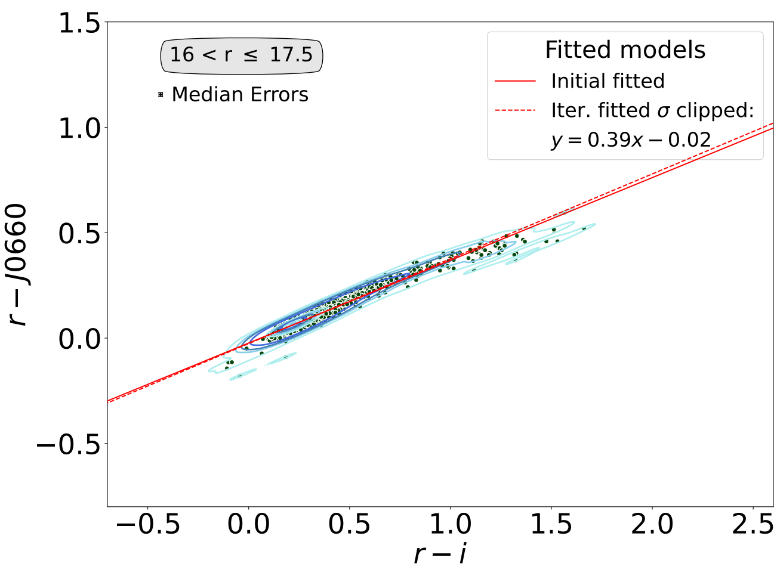
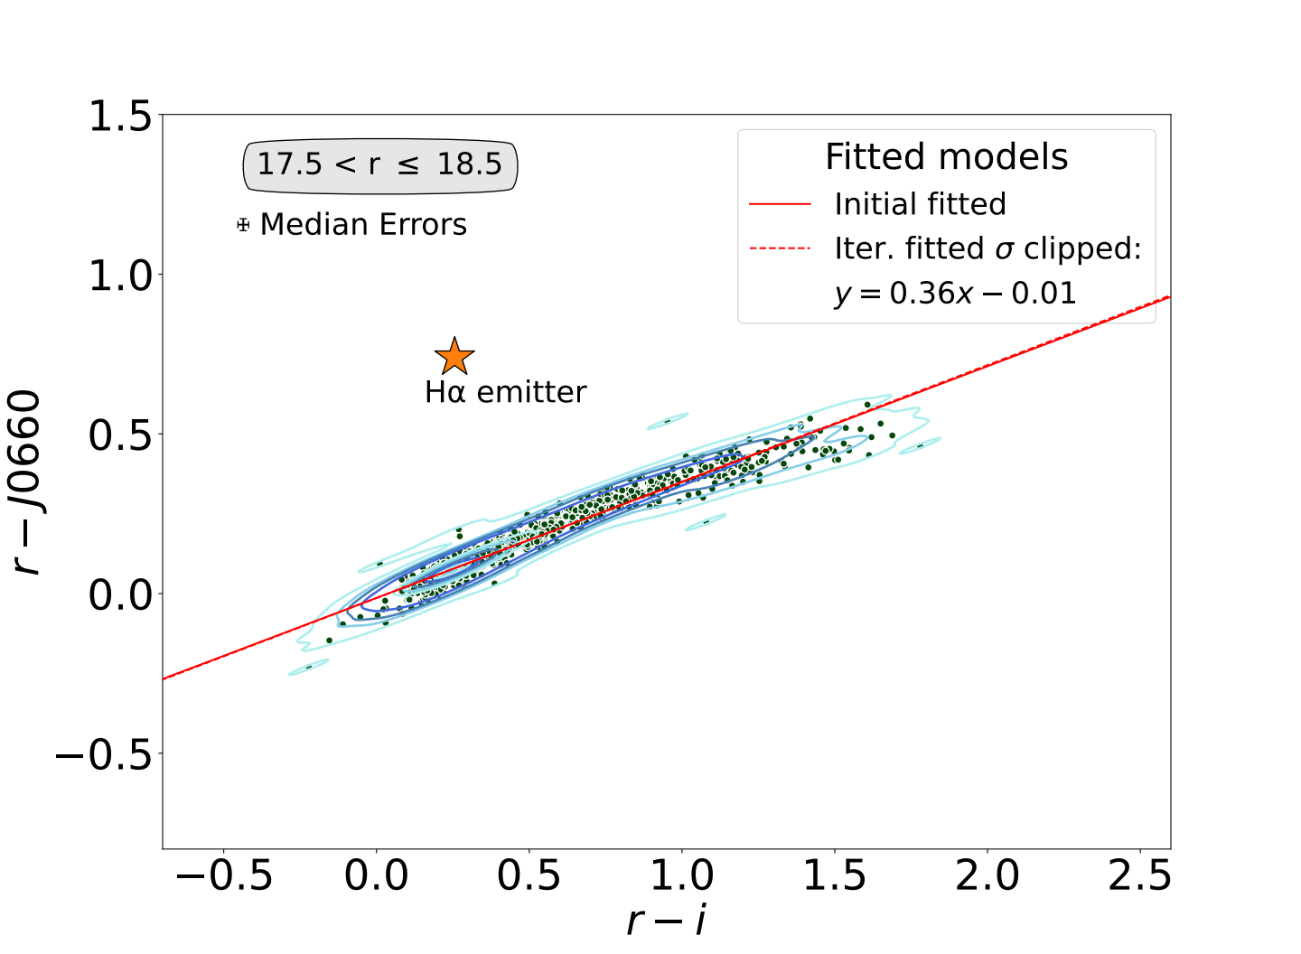
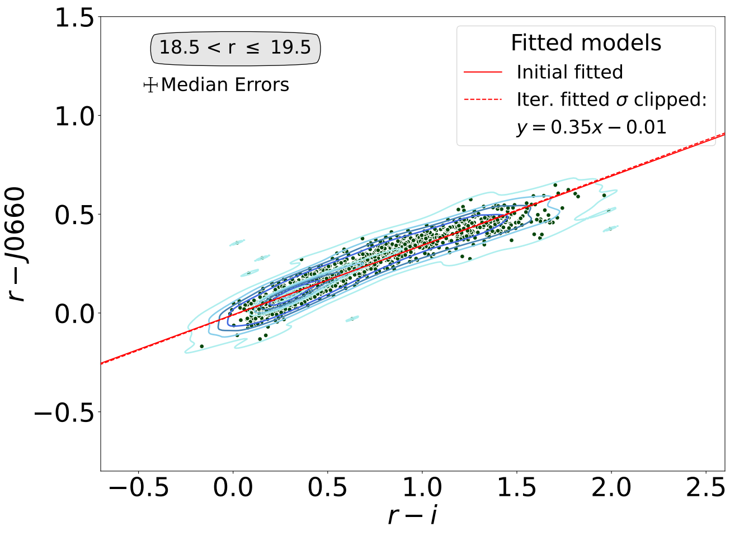
S-PLUS: Hα sources
Selecting the H𝛼 Excess Sources
The identification of H𝛼 emitters was based on the method applied by Witham et al. (2008)
Iteratively fit the main stellar locus and select all Hα-excess sources which lie more than 4σ away from the fitted locus

Slide 4
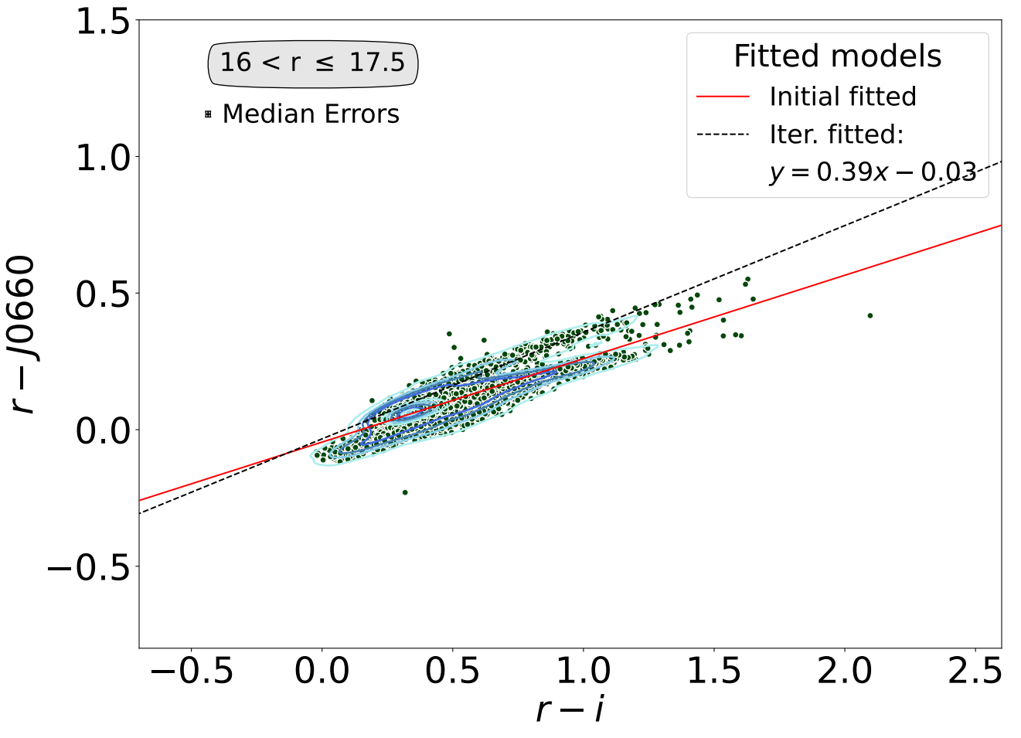
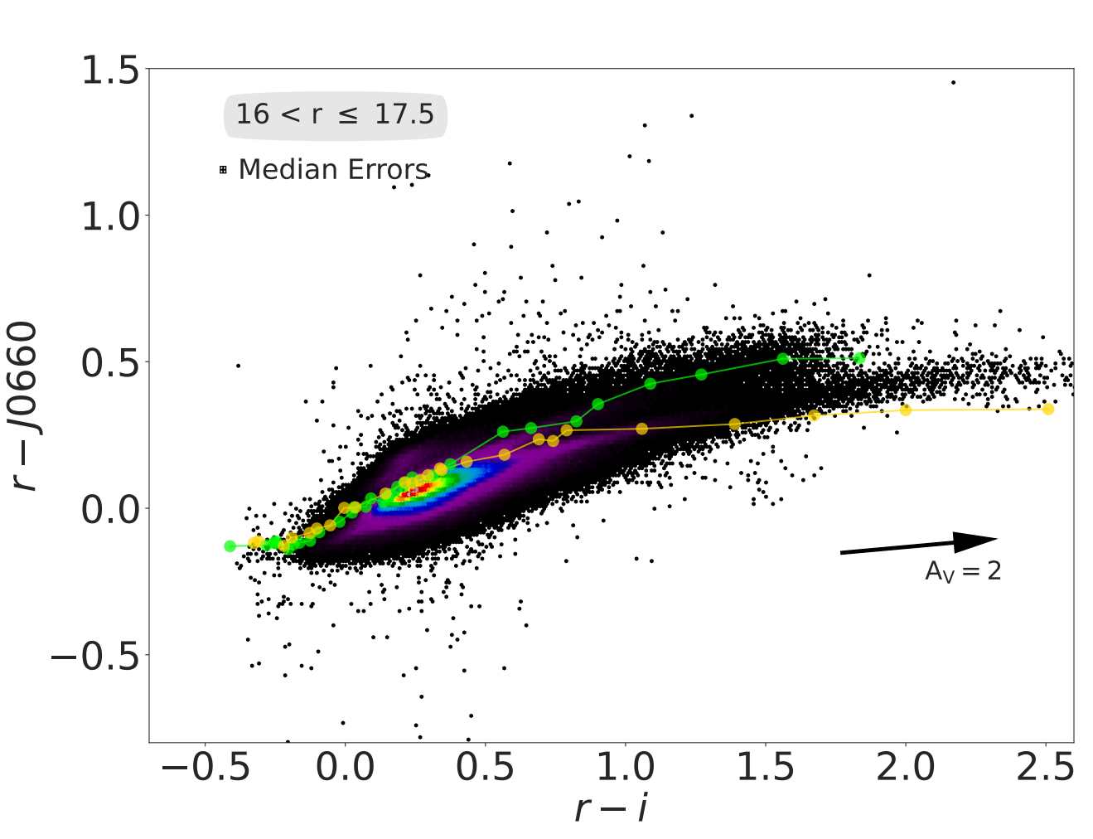
S-PLUS: Hα sources
Galactic Disk Challenges
Stellar Loci Duplication:
Disk fields show two stellar loci due to differential reddening and mixed populations (main-sequence stars and giants).
Fitting Issues:
Initial fit often aligns with the reddened locus, complicating H-alpha excess detection.
Solution:
Adjusted fit upward to align with the unreddened sequence.
Reverted to the original fit if adjustments worsened the accuracy.
Selecting the H𝛼 Excess Sources
Unreddened stellar locus
Dwarfs sinthetic track (Pickles 1998)
Reddened stellar locus
Giants

Slide 5
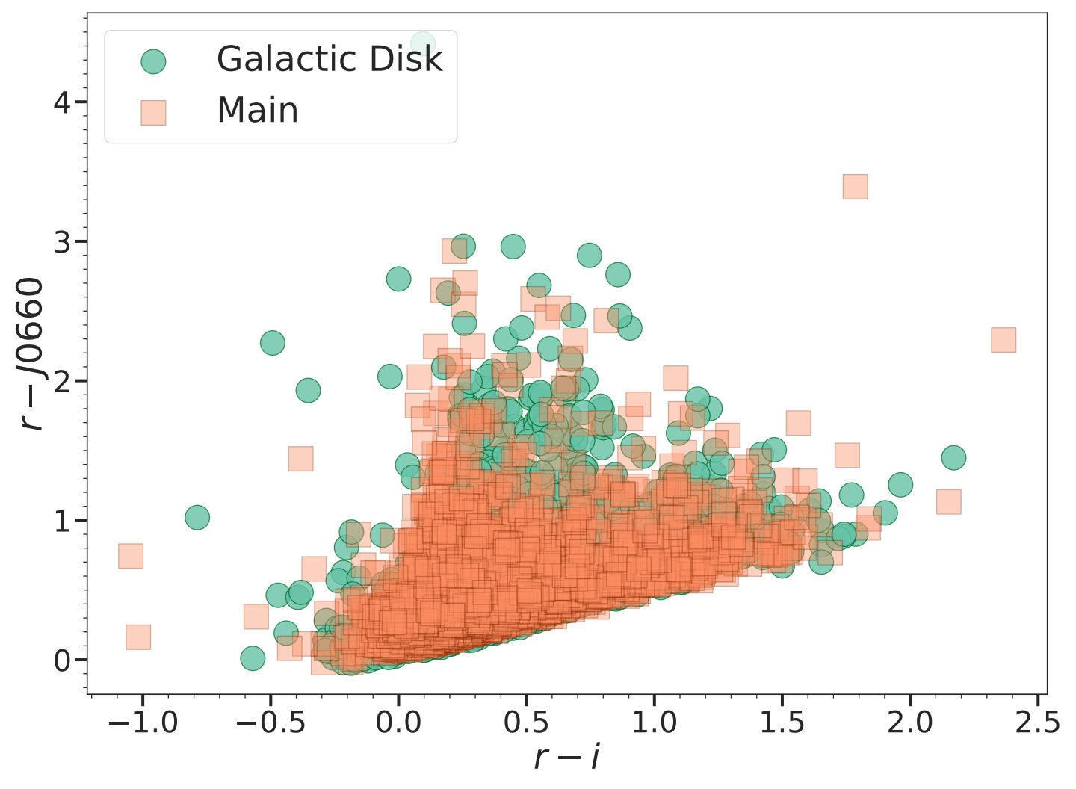
S-PLUS: Hα sources
Selecting the H𝛼 Excess Sources
Identification:
Sources significantly above the locus of main-sequence and giant stars exhibit excess in the J0660 filter, attributed to the H-alpha line.
Current Data:
Main Survey: 3,637 outliers identified.
Galactic Disk: 3,734 outliers identified.
Types of Sources:
In agreement with SIMBAD, these include emission-line stars, PNe, CVs, EB stars, RR Lyrae variable, YSOs, Be stars, QSOs, and galaxies.

Slide 6
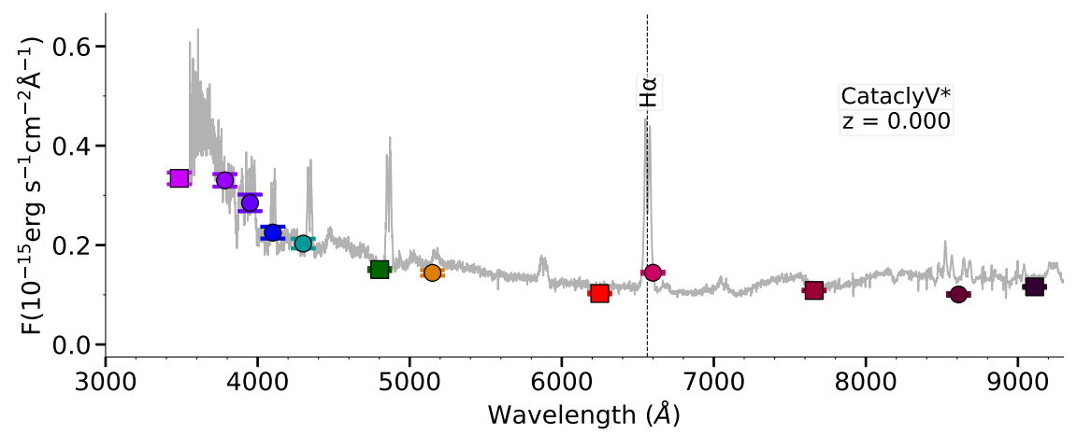
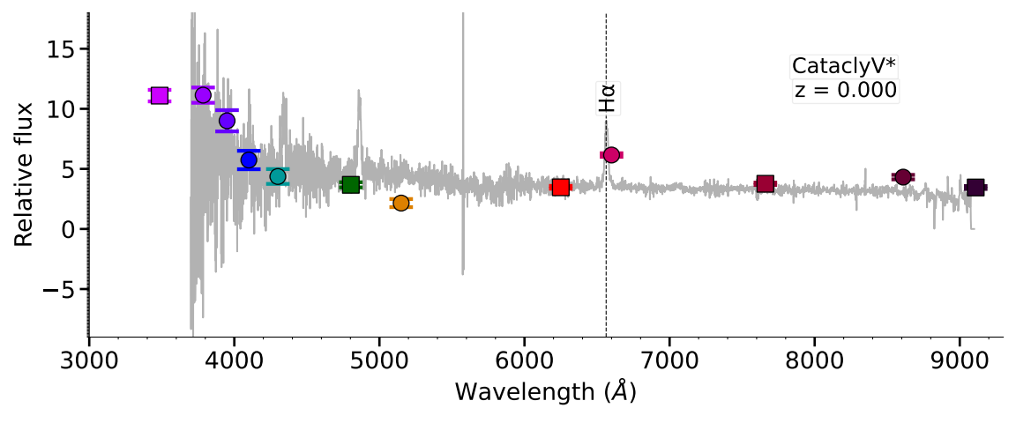
S-PLUS: Hα sources
Example of two Hα Emitters
SDSS
J0660 filter
LAMOST

Slide 7
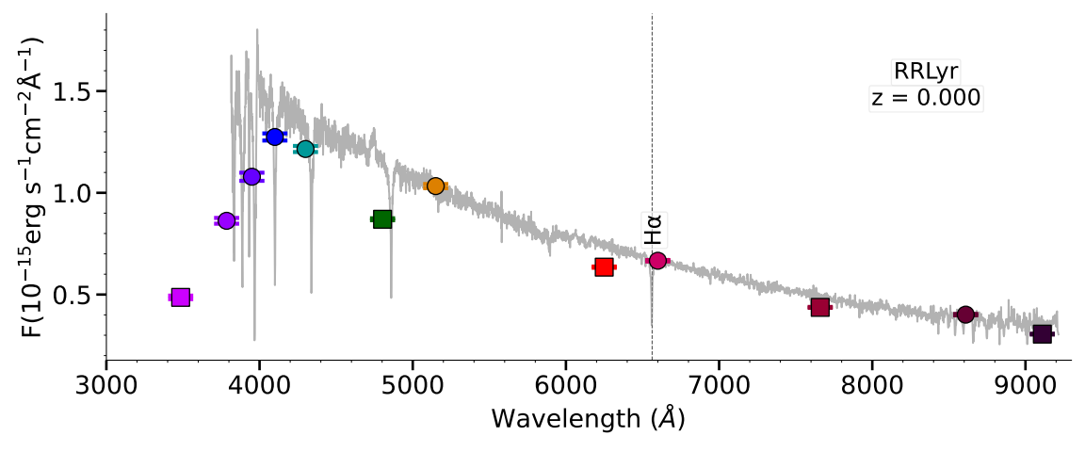
S-PLUS: Hα sources
Example of a Star with Hα Excess
SDSS
LAMOST

Slide 8
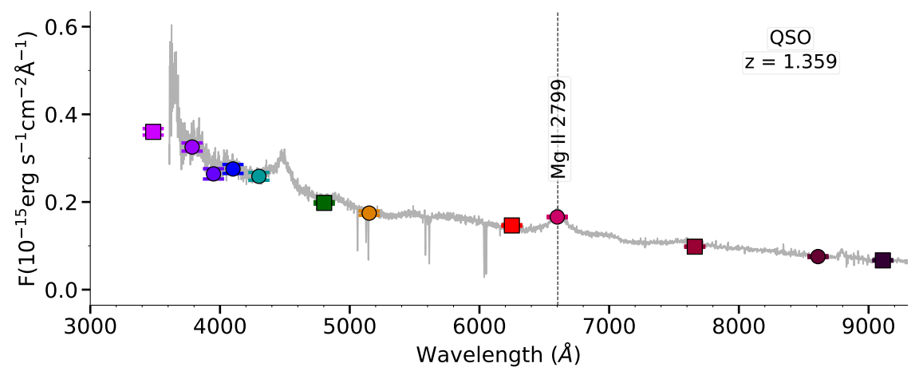
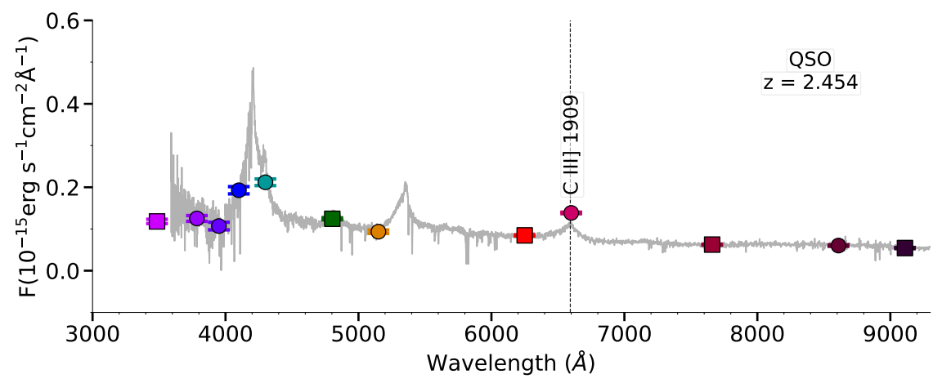
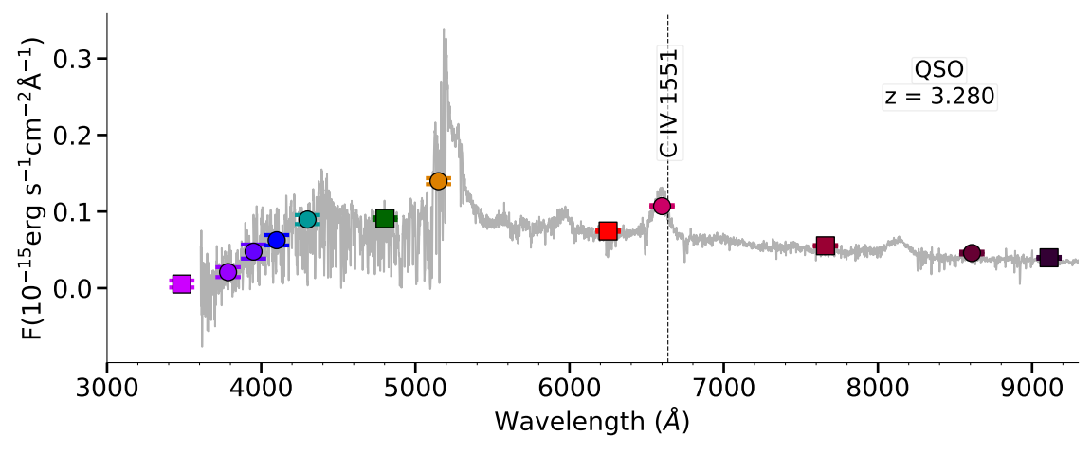
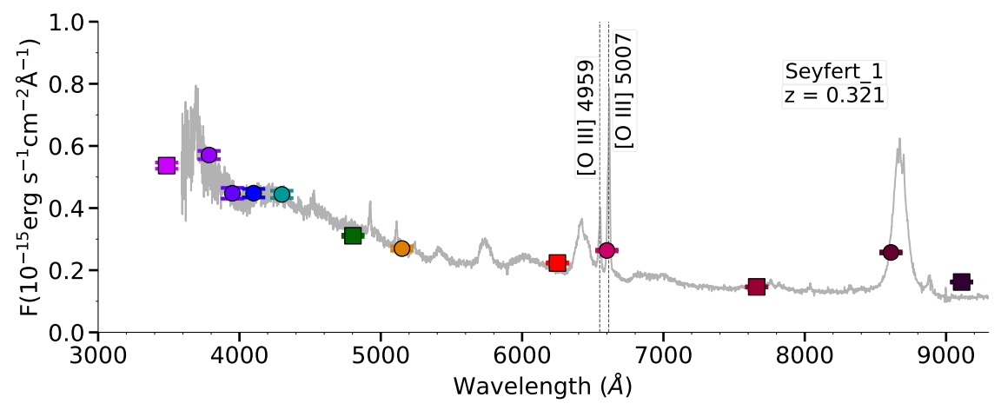
S-PLUS: Hα sources
Extragalactic Compact Sources
Our selection criteria effectively isolated compact sources, minimizing the inclusion of extended sources. In agreement with SIMBAD, only 23 AGN (3.1%) and 9 galaxies (1.2%) were identified in the main survey, while 143 QSOs (19.6%) were selected. The spectra of these QSOs and Seyfert galaxy show other emission lines that fall into the J0660 filter, resulting in a significant Hα excess.

Slide 9
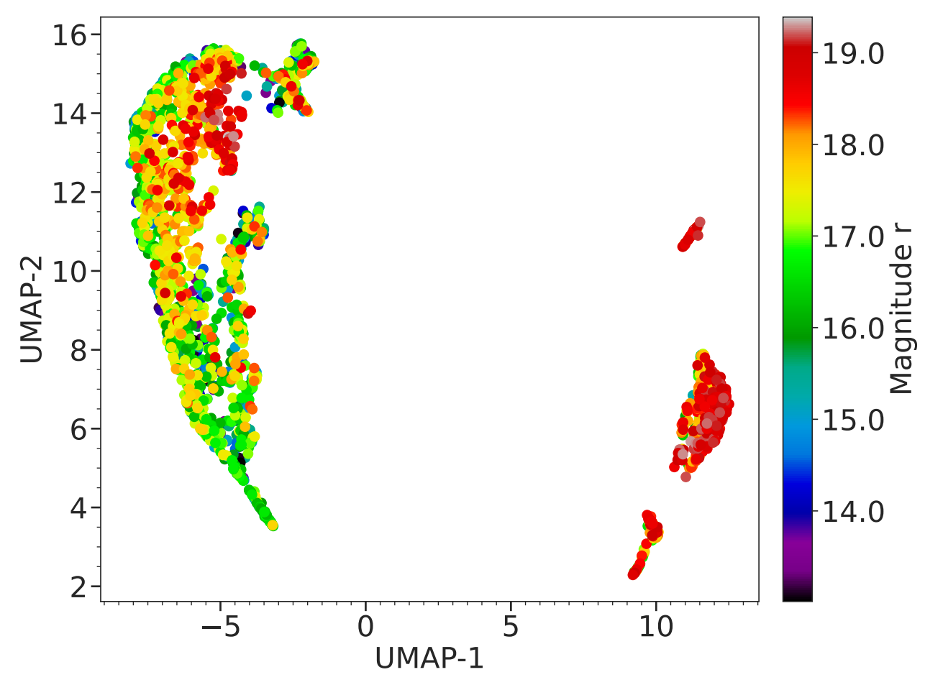
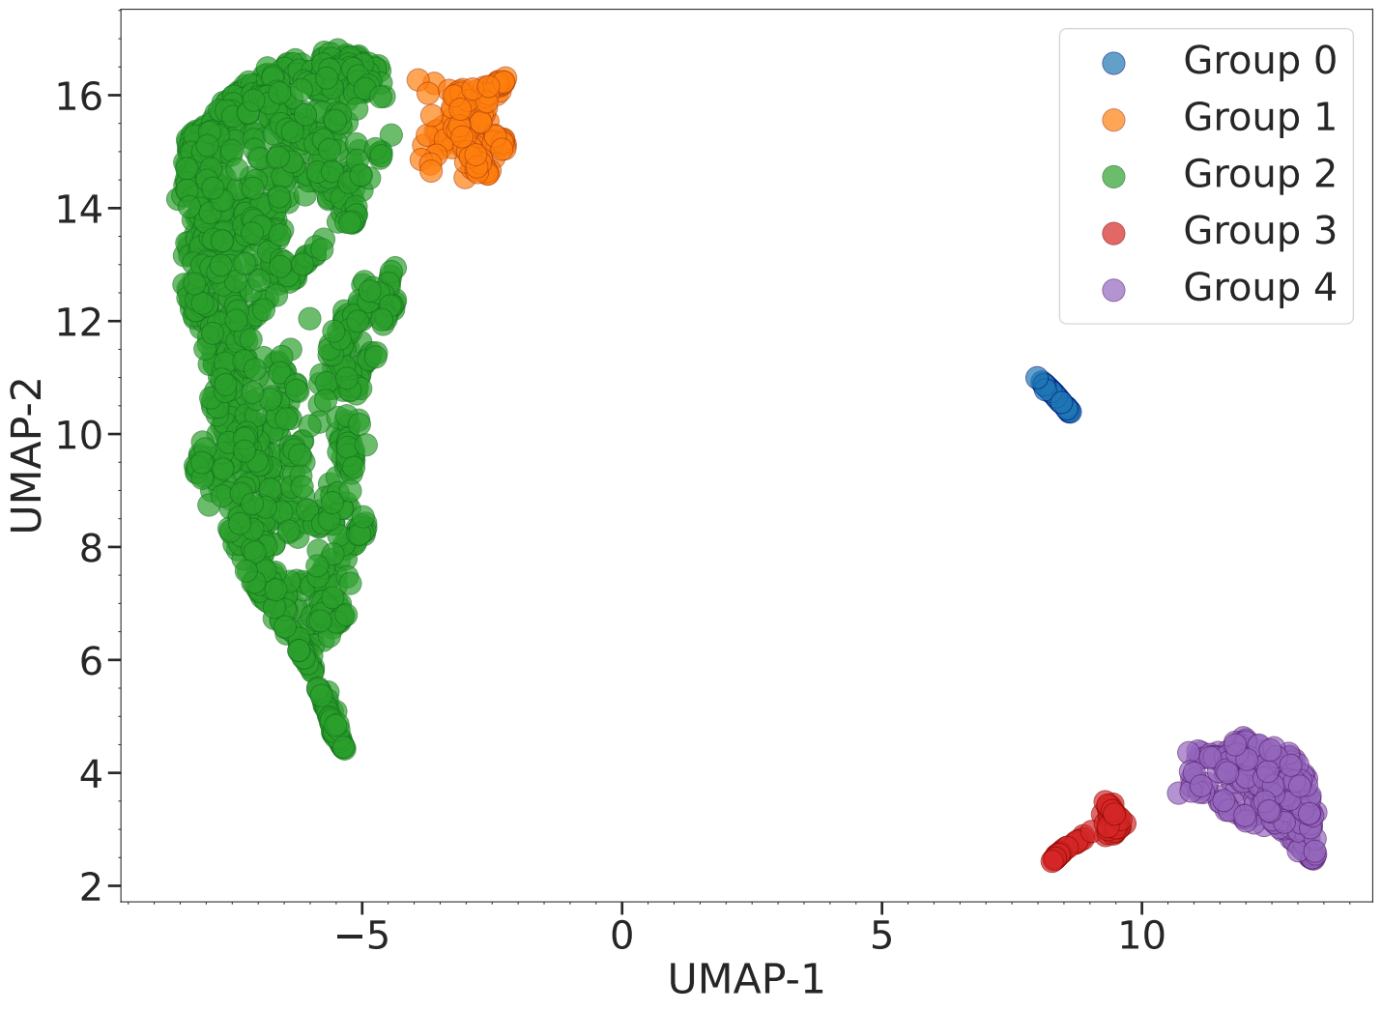
S-PLUS: Hα sources
Machine Learning Approaches
We applied UMAP for dimensionality reduction on S-PLUS data and used HDBSCAN for clustering Hα excess sources. Two experiments were conducted: one using only the 66 S-PLUS colors and another incorporating WISE bands. The results revealed the formation of five distinct groups, effectively separating galactic and extragalactic sources. Results using only the S-PLUS colors are presented here.

Slide 10
S-PLUS: Hα sources
Machine Learning Approaches
We applied UMAP for dimensionality reduction on S-PLUS data and used HDBSCAN for clustering Hα excess sources. Two experiments were conducted: one using only the 66 S-PLUS colors and another incorporating WISE bands. The results revealed the formation of five distinct groups, effectively separating galactic and extragalactic sources. Results using only the S-PLUS colors are presented here.
RR Lyrae
QSOs
Seyfert
QSOs + CVs
Binary stars

Slide 11
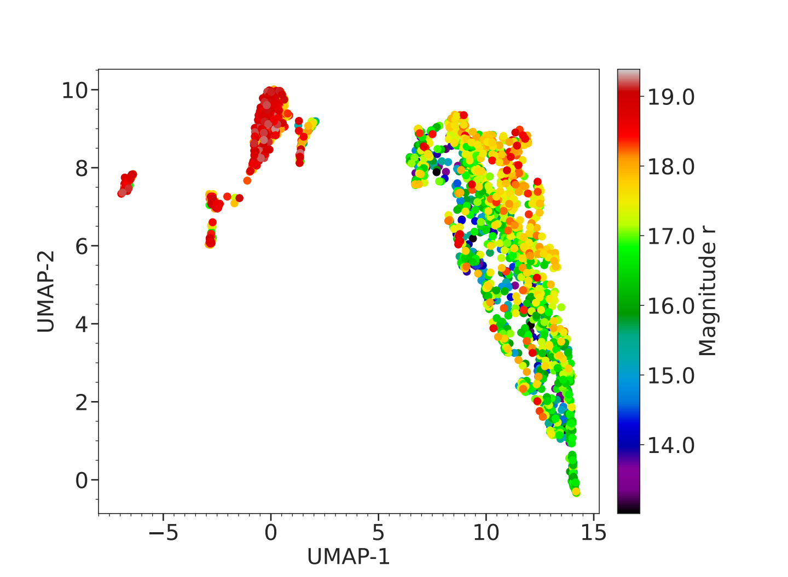
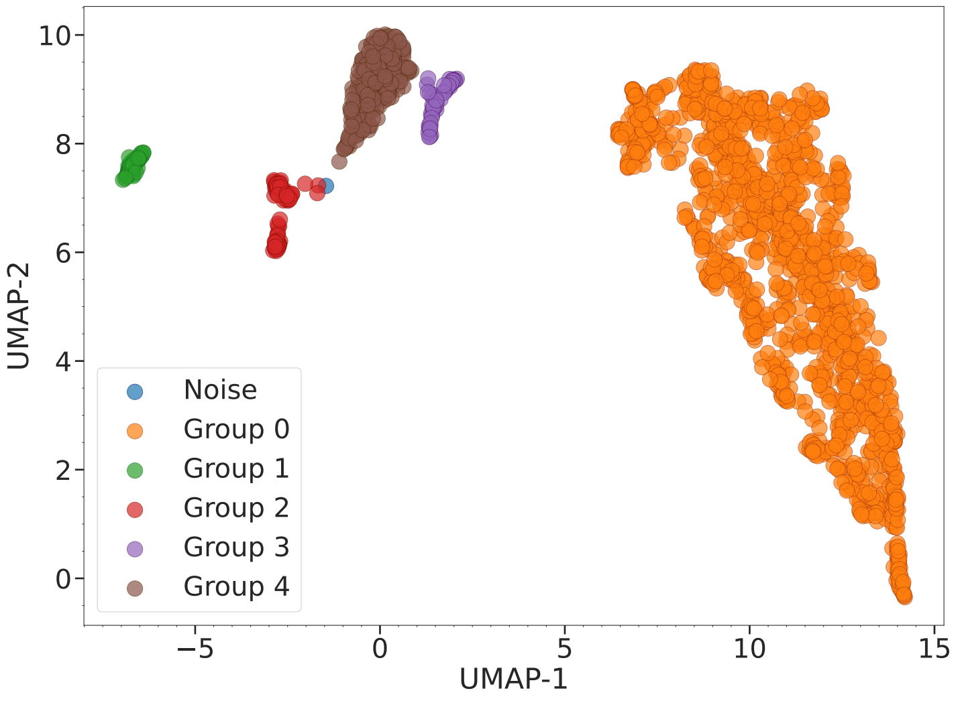
S-PLUS: Hα sources
Machine Learning Approaches
We applied UMAP for dimensionality reduction on S-PLUS data and used HDBSCAN for clustering Hα excess sources. Two experiments were conducted: one using only the 66 S-PLUS colors and another incorporating WISE bands. The results revealed the formation of five distinct groups, effectively separating galactic and extragalactic sources. Results using only the S-PLUS and WISE colors are presented here.

Slide 12
S-PLUS: Hα sources
Machine Learning Approaches
We applied UMAP for dimensionality reduction on S-PLUS data and used HDBSCAN for clustering Hα excess sources. Two experiments were conducted: one using only the 66 S-PLUS colors and another incorporating WISE bands. The results revealed the formation of five distinct groups, effectively separating galactic and extragalactic sources.
Binary Stars

Slide 13
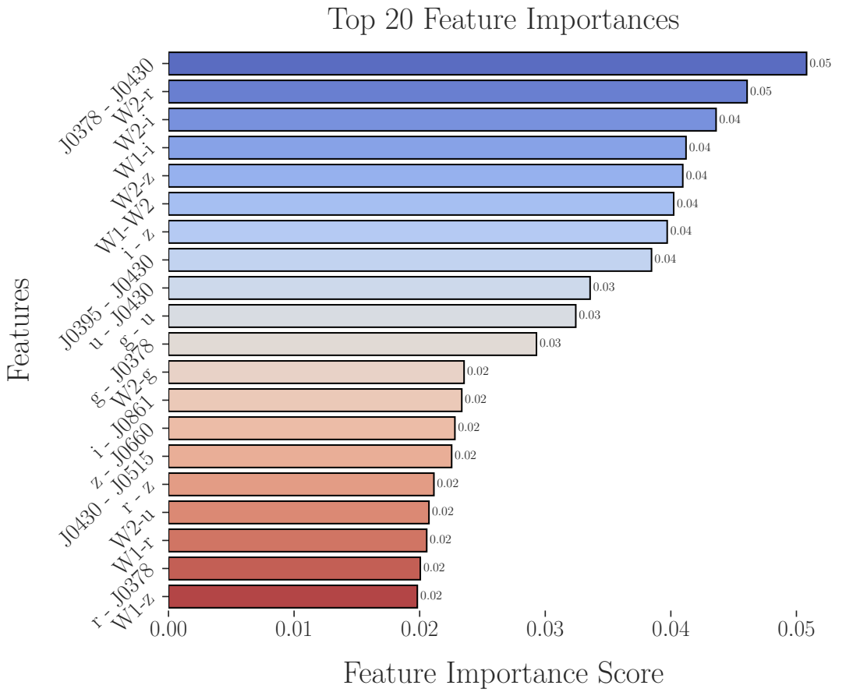
S-PLUS: Hα sources
Extracting Main Features: Color Analysis
Analysis: Key colors from S-PLUS and WISE filters identified by Random Forest as most influential in classifying H-alpha excess objects.
Results: Top 20 features contribute significantly to distinguishing between different object classes identified by UMAP + HDBSCAN.

Slide 14
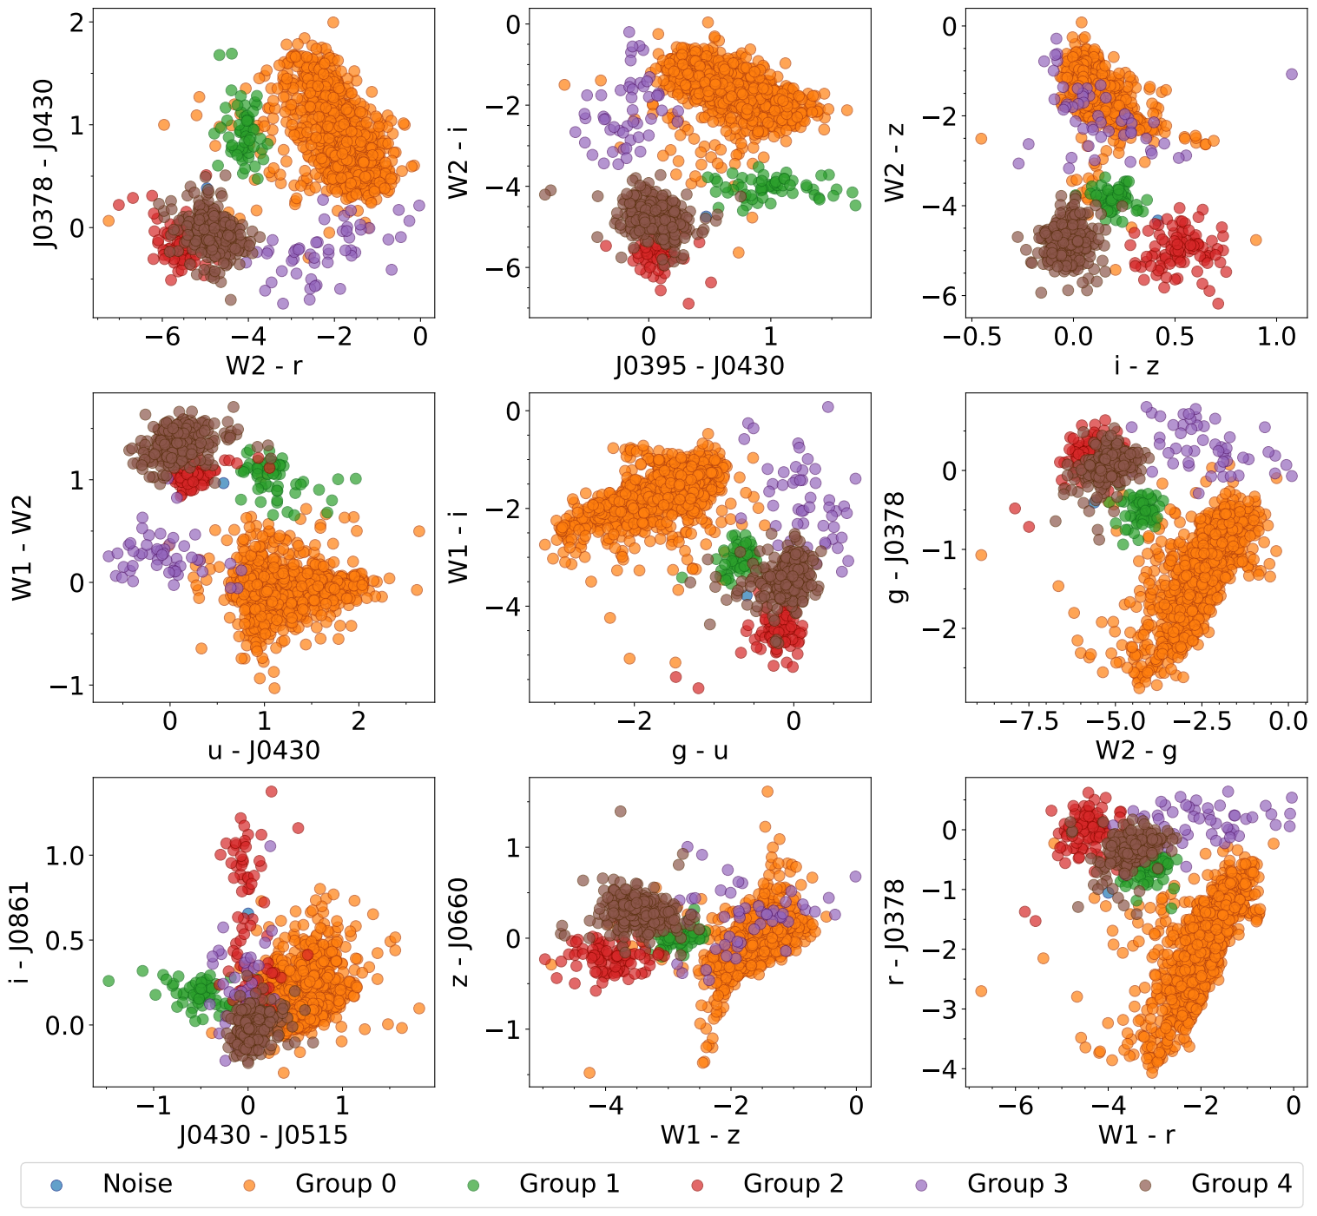
S-PLUS: Hα sources
Extracting Main Features: Color Analysis

Slide 15
Conclusions
Identification of H-alpha Excess Candidates:
7,371 candidates identified using the S-PLUS J0660 filter.
Distribution: 3,637 in the high-latitude main survey and 3,734 in the Galactic disk.
Classification of Objects:
Cross-referencing with SIMBAD: EM stars, YSOs, Be stars, CVs, PNe, QSOs, non-local galaxies, and RR Lyrae stars.
Machine Learning Techniques:
UMAP and HDBSCAN: Effective differentiation between Galactic and extragalactic objects
Challenges in distinguishing cataclysmic variables from QSOs or AGN with z ≈ 1.35.
Integration of WISE Data:
Improved separation of extragalactic and Galactic sources.
Random Forest Model:
WISE data crucial for identifying significant features.
Improved color-color diagrams and understanding of H-alpha related phenomena.

Slide 16
THANK!!

