Slide 1




Mapping Hα-Excess Candidate Point Sources in the Southern Hemisphere Using S-PLUS Data
HUNTRESS
Luis A. Gutiérrez-Soto
March 20, 2025

Slide 2

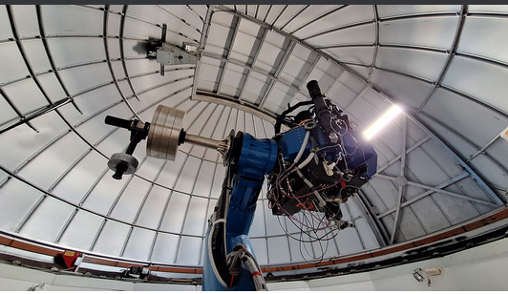
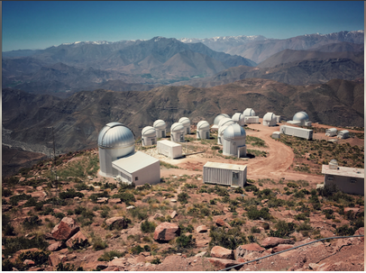
Context
The Southern Photometric Local Universe Survey (S-PLUS) is an international collaboration led by Brazil, Chile, and Spain, with contributions from Argentina, the United States, and other countries. It aims to map ~9300 square degrees of the Southern Sky using the T80-South (T80-Sul), an 83-cm robotic telescope located at Cerro Tololo Inter-American Observatory (CTIO), Chile

Slide 3

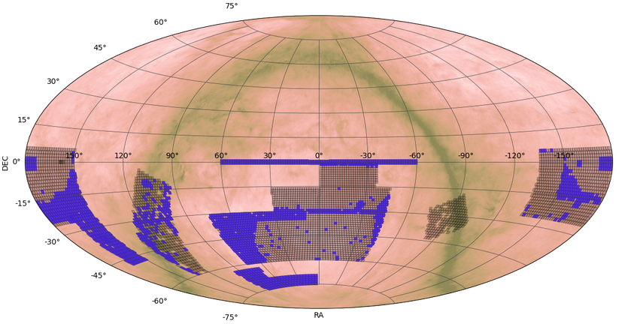
Context
The T80-Sul is equipped with a 12-filter system (five broadband filters: u, g, r, i, z, and seven narrowband filters, including J0660: Hα), enabling precise photometric studies of stars, galaxies, and transient phenomena. S-PLUS has already released Data Release 4 (DR4), covering approximately 3000 square degrees of the southern sky, and has become a cornerstone for studies of the Milky Way, nearby galaxies, and large-scale structure

Slide 4
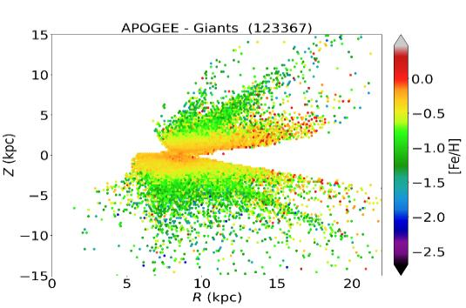
Stellar Parameters for 5 Million Stars
Decoding the Milky Way’s Stellar Populations
Optimized machine learning algorithms to derive stellar parameters (T_eff, log g, [Fe/H]) and chemical abundances for millions of stars. 🌟 First large-scale metallicity map of the Southern Milky Way ([Fe/H] spanning −2.5<[Fe/H]<+0.5). 🌌 Revealed a radial metallicity gradient
Ferreira Lopes, Gutiérrez-Soto, Ferreira Alberice, et al. (2025, A&A, 693, A306)

Slide 5
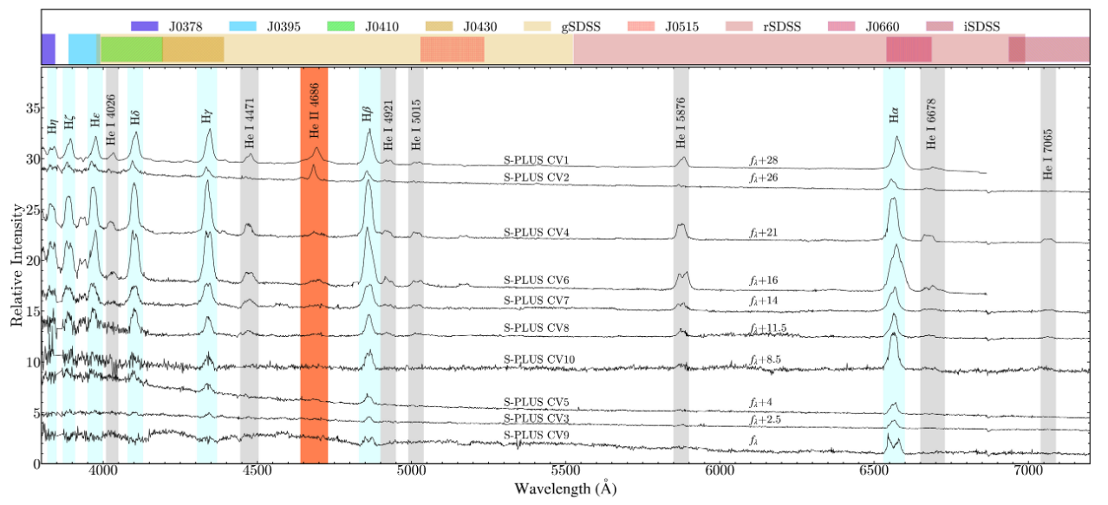
Unveiling Hidden Cataclysmic Variables
S-PLUS 12-Band Photometry Reveals a New Population
Using S-PLUS’s 12-band photometry, we discovered 10 new cataclysmic variables, including rare WZ Sge-type dwarf novae and low-luminosity intermediate polars. Gemini spectra (A) and Swift X-rays (B) validate these systems, missed by traditional surveys
Lopes de Oliveira et al. (2025, ApJL, 981, L1)

Slide 6
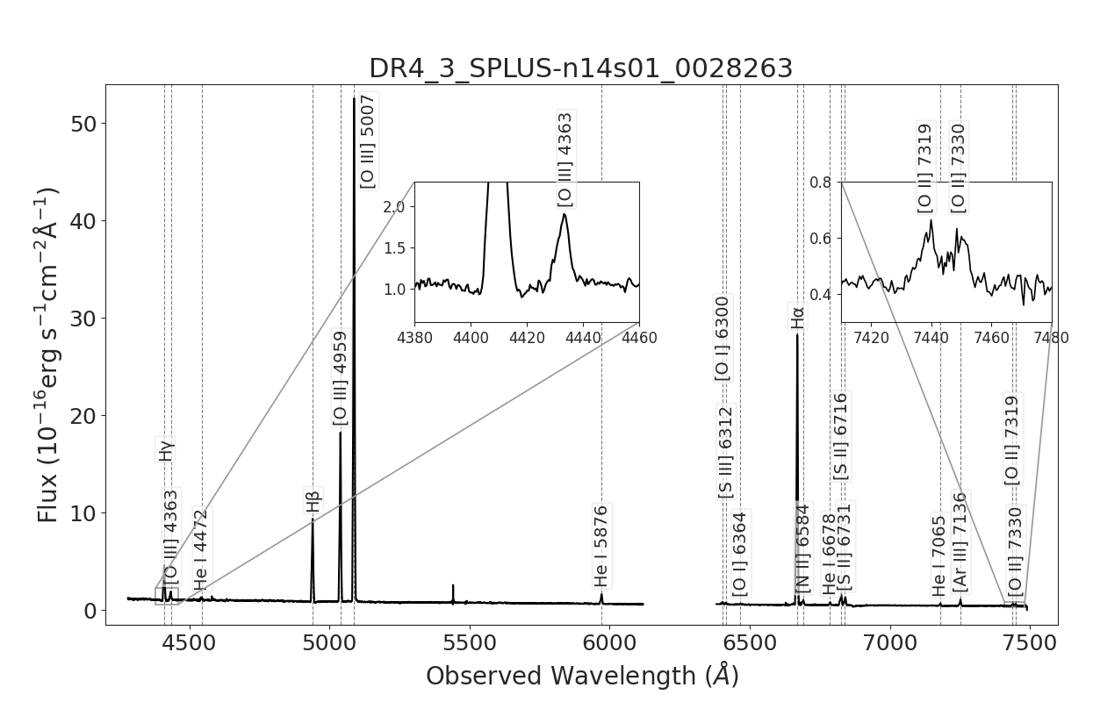
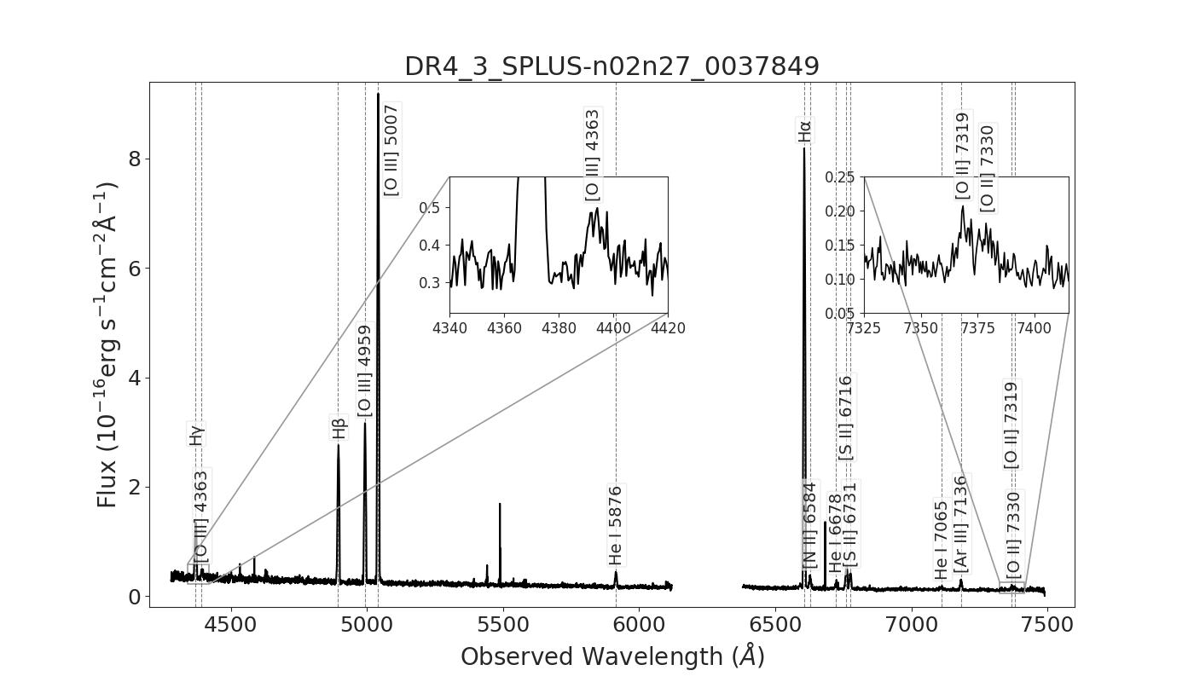
Metal-Poor Dwarf Galaxies
Local Fossils of Galaxy Formation
Using S-PLUS DR3, we identified 50 metal-poor dwarf galaxy candidates with stellar metallicities <10% solar. Gemini/GMOS spectroscopy confirmed extremely low gas-phase abundances (7.35 < 12 + log(O/H) < 7.93, 5–17% solar) and perturbed morphologies, suggesting accretion of pristine gas via dwarf-dwarf interactions.
Grossi, Gonçalves, Krabbe, Gutiérrez-Soto, Telles, et al. (submitted to ApJ, 2025; arXiv:2501.18498)

Slide 7
S-PLUS: Hα sources
Hα Emission: A Universal Tracer of Cosmic Activity
J0660 Filter: Capturing Hα
Hα at rest: λ = 6563 Å
Redshift range: z ≈ 0–0.15 (λ ≈ 6563–7500 Å)
Key Sources with Hα Emission:
Star-forming regions (H II regions, YSOs)
Stellar evolution: Planetary Nebulae (PNe),
Be stars, Symbiotic Stars (SySt)
Accretion/Activity: Cataclysmic
Variables (CVs), AGN
Transient phenomena: Supernovae (SN)

Slide 8
S-PLUS: Hα sources
Hα Emission: A Universal Tracer of Cosmic Activity
Origin of Hα Emission
Photon emission at 6563 Å: Hydrogen’s n=3 → n=2 transition.
Requires ionized gas (H⁺) + recombination.
Key Drivers of Hα
Birth:
Massive stars ionize H II regions (Orion Nebula).
Death:
PNe: Ionized shells around white dwarfs (Ring Nebula).
SN: Shocks heat gas, emitting Hα.
Accretion:
CVs, AGN, YSOs (e.g., jets, disks).
Why Hα Matters
Star formation: LHα​∝SFR.
Stellar evolution: Maps PN shells and Be star disks.
Low-metallicity galaxies: Less dust extinction → stronger Hα.

Slide 9
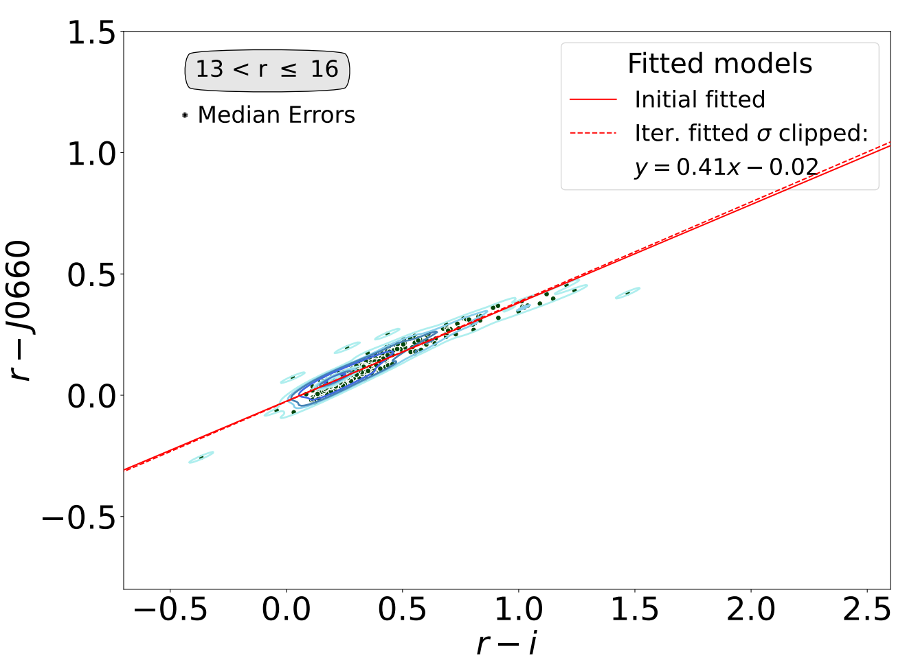
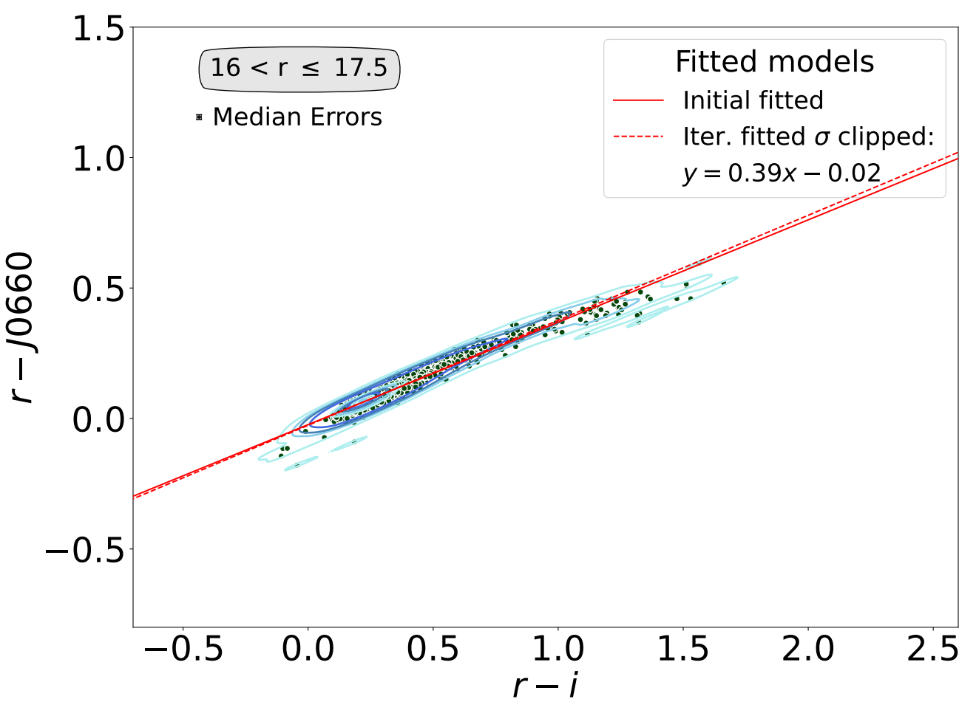
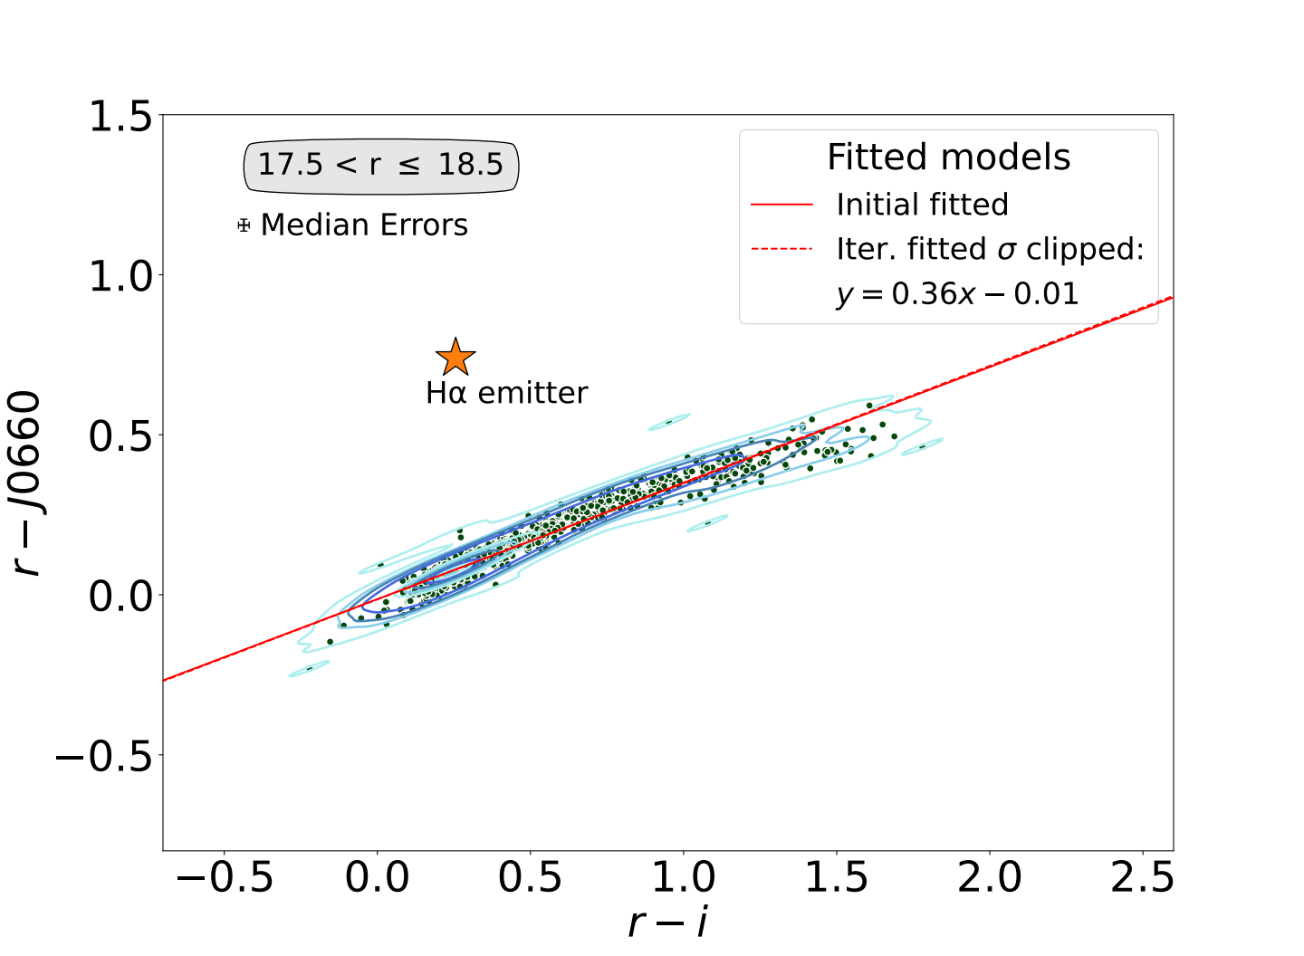
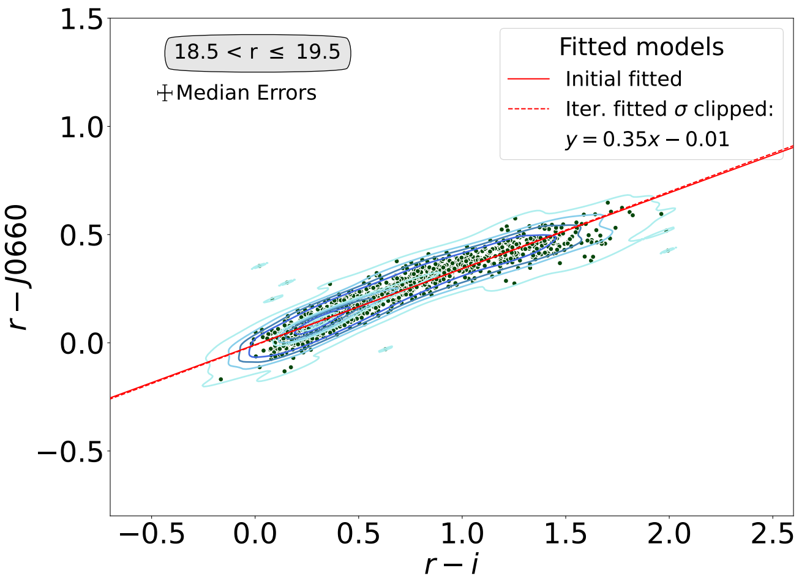
S-PLUS: Hα sources
Selecting the H𝛼 Excess Sources
The identification of H𝛼 emitters was based on the method applied by Witham et al. (2008)
Iteratively fit the main stellar locus and select all Hα-excess sources which lie more than 4σ away from the fitted locus
Grossi, Gonçalves, Krabbe, Gutiérrez-Soto, Telles, et al. (submitted to ApJ, 2024; arXiv:2501.18498)

Slide 10
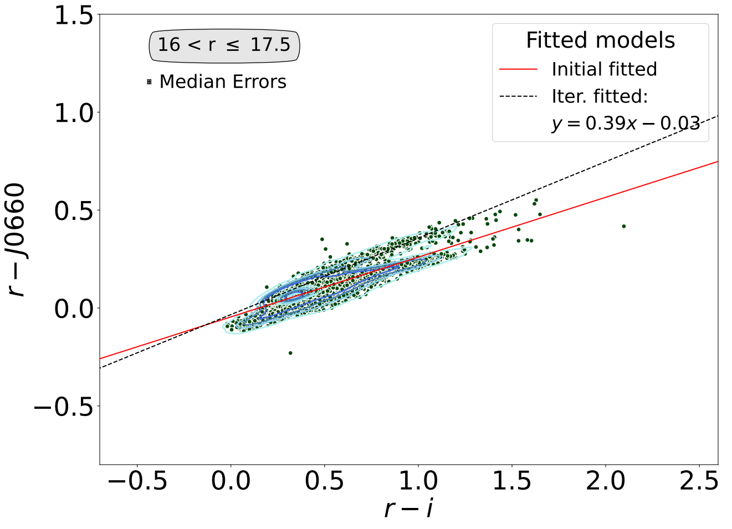
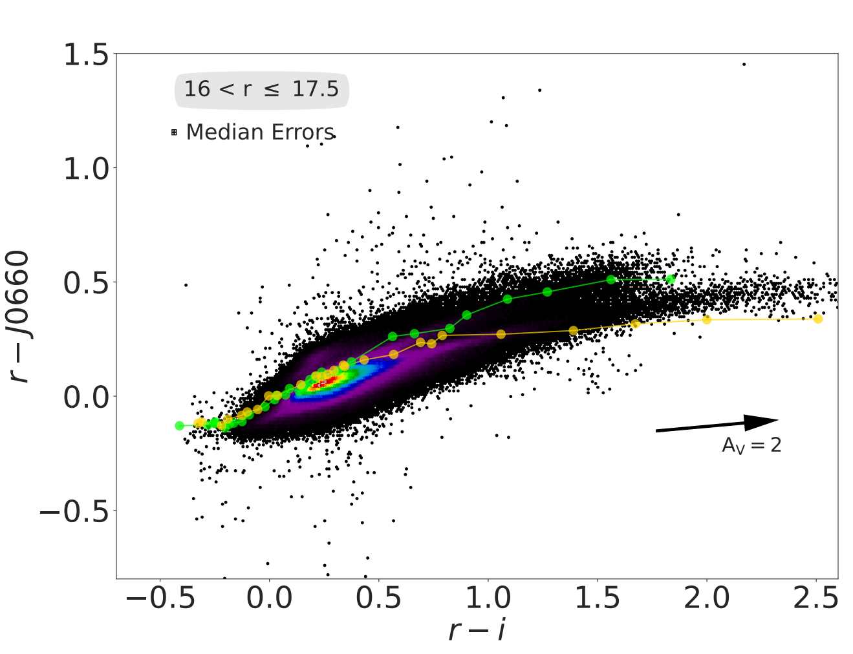
S-PLUS: Hα sources
Galactic Disk Challenges
Stellar Loci Duplication:
Disk fields show two stellar loci due to differential reddening and mixed populations (main-sequence stars and giants).
Fitting Issues:
Initial fit often aligns with the reddened locus, complicating H-alpha excess detection.
Solution:
Adjusted fit upward to align with the unreddened sequence.
Reverted to the original fit if adjustments worsened the accuracy.
Selecting the H𝛼 Excess Sources
Unreddened stellar locus
Dwarfs sinthetic track (Pickles 1998)
Reddened stellar locus
Giants

Slide 11
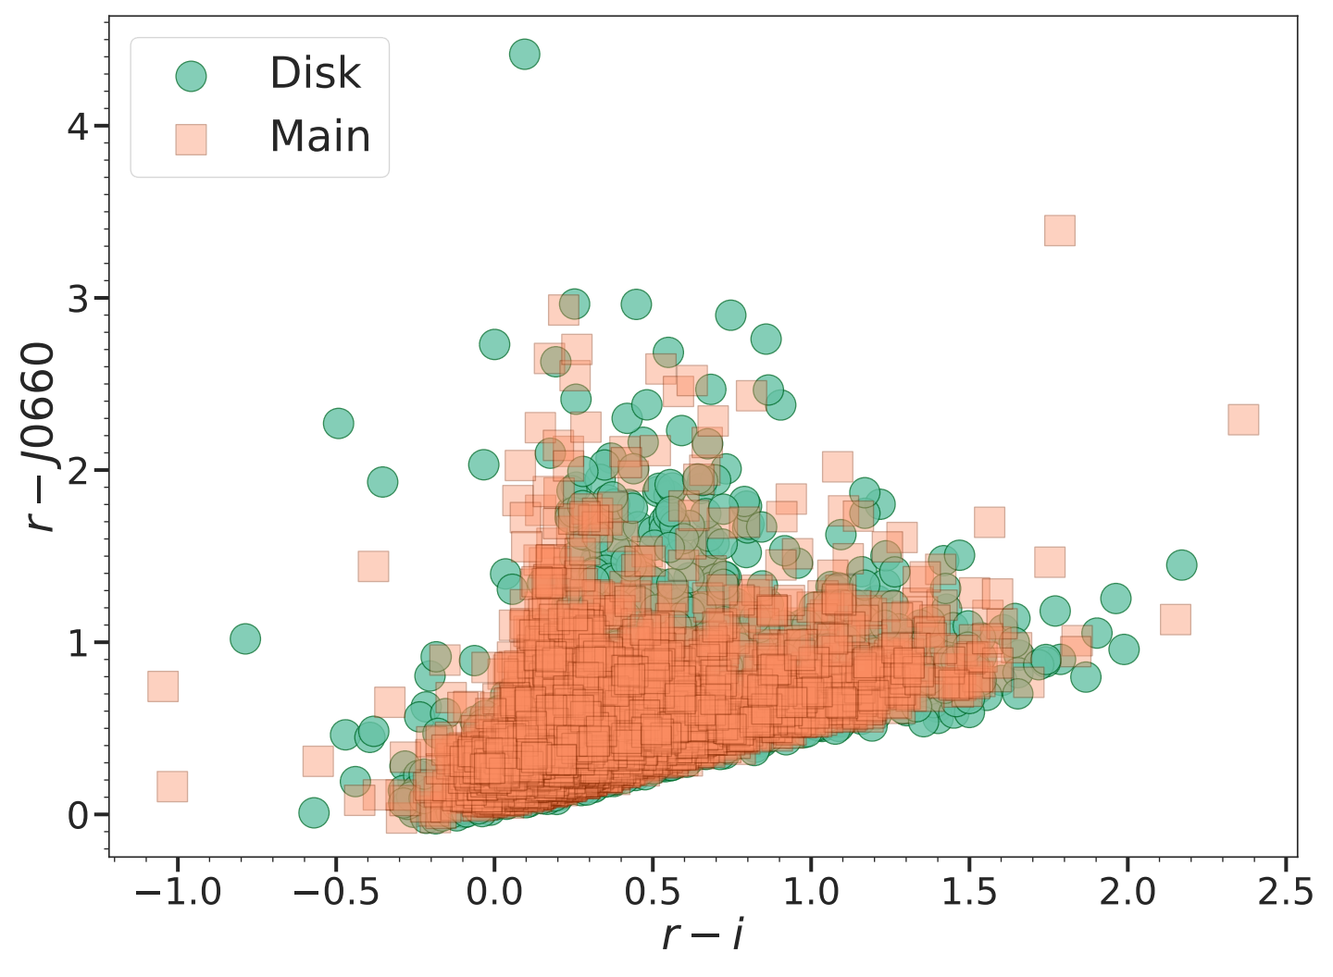
S-PLUS: Hα sources
Selecting the H𝛼 Excess Sources
Identification:
Sources significantly above the locus of main-sequence and giant stars exhibit excess in the J0660 filter, attributed to the H-alpha line.
Current Data:
Main Survey: 3,637 outliers identified.
Galactic Disk: 3,734 outliers identified.
Types of Sources:
In agreement with SIMBAD, these include emission-line stars, PNe, CVs, SySt, YSOs, Be stars, QSOs, and galaxies.

Slide 12
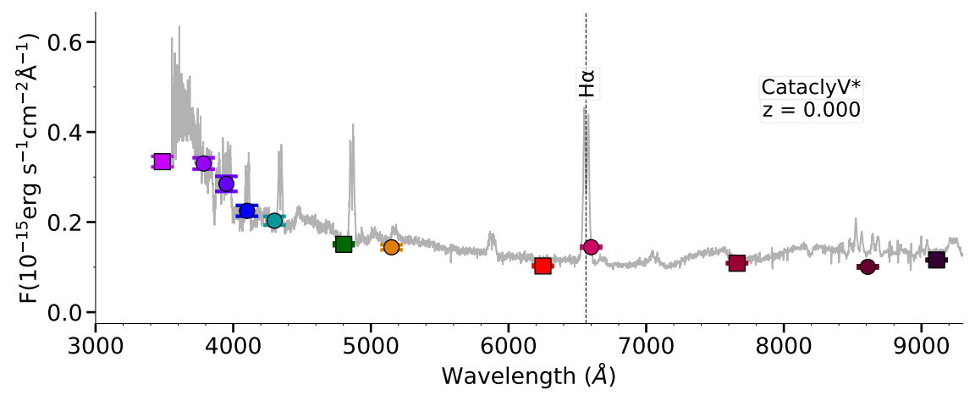
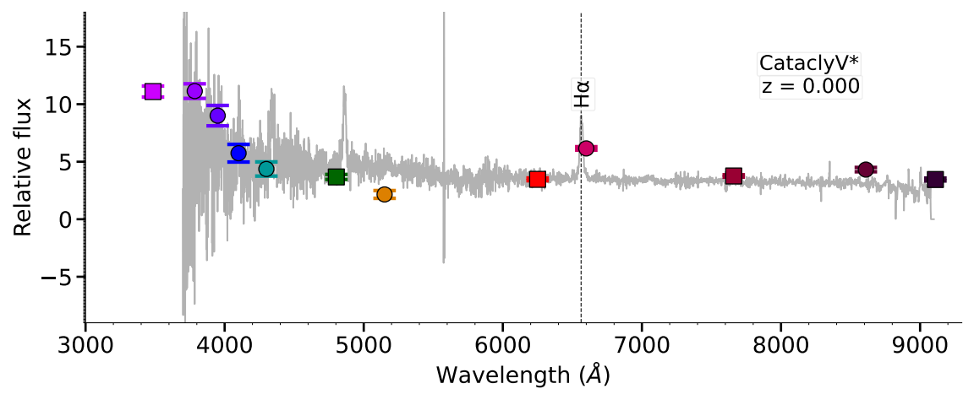
S-PLUS: Hα sources
Example of two Hα Emitters
SDSS
J0660 filter
LAMOST

Slide 13
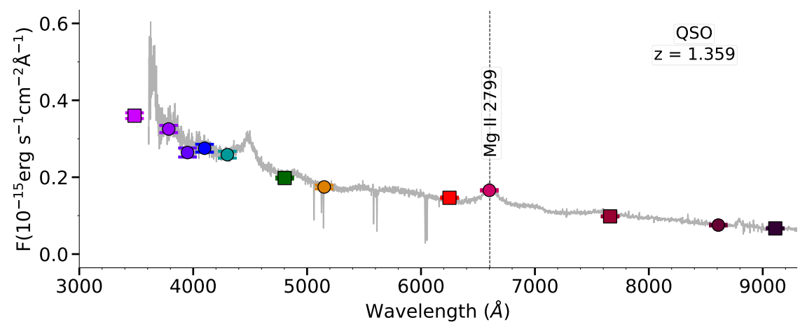
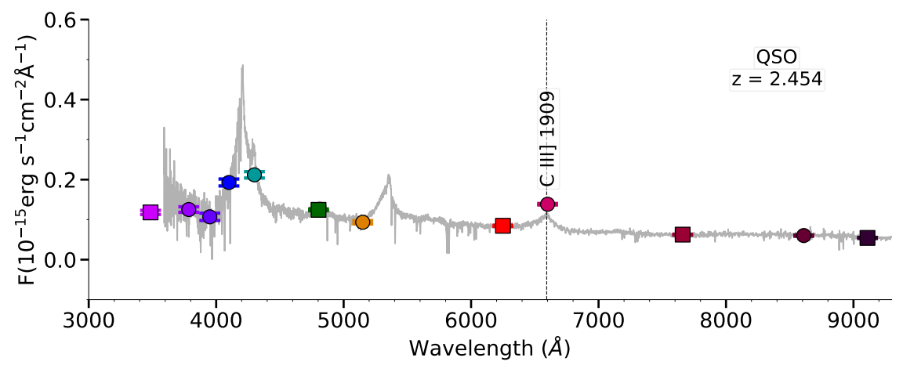
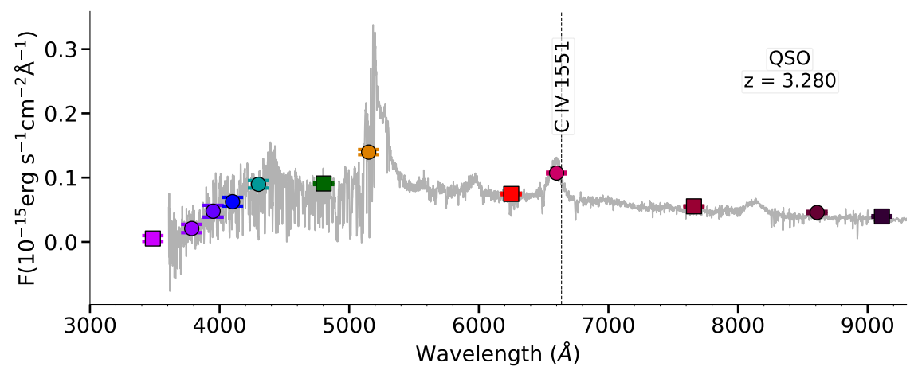
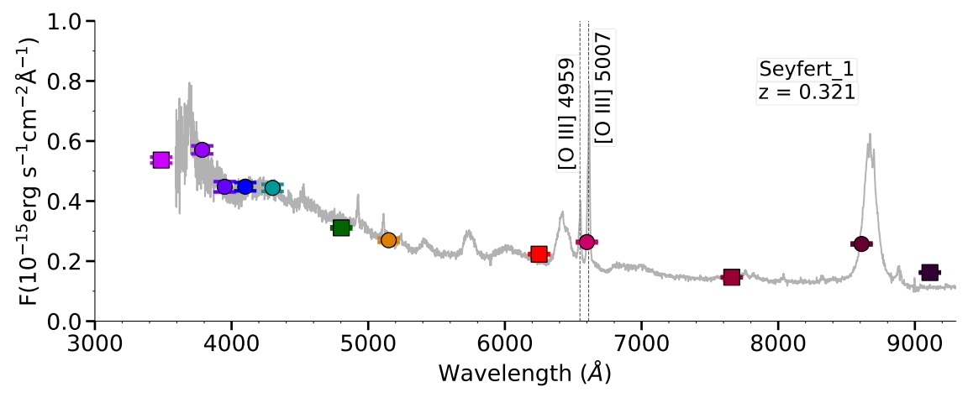
S-PLUS: Hα sources
Extragalactic Compact Sources
Our selection criteria effectively isolated compact sources, minimizing the inclusion of extended sources. In agreement with SIMBAD, only 23 AGN (3.1%) and 9 galaxies (1.2%) were identified in the main survey, while 143 QSOs (19.6%) were selected. The spectra of these QSOs and Seyfert galaxy show other emission lines that fall into the J0660 filter, resulting in a significant Hα excess.

Slide 14
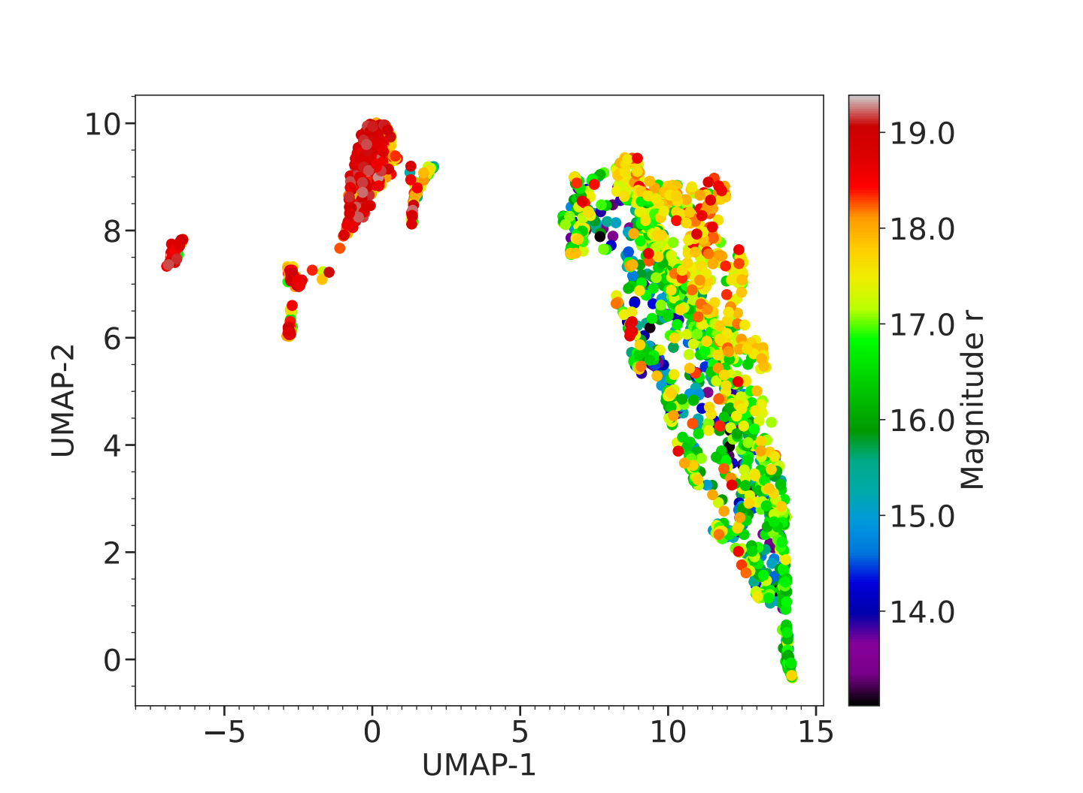
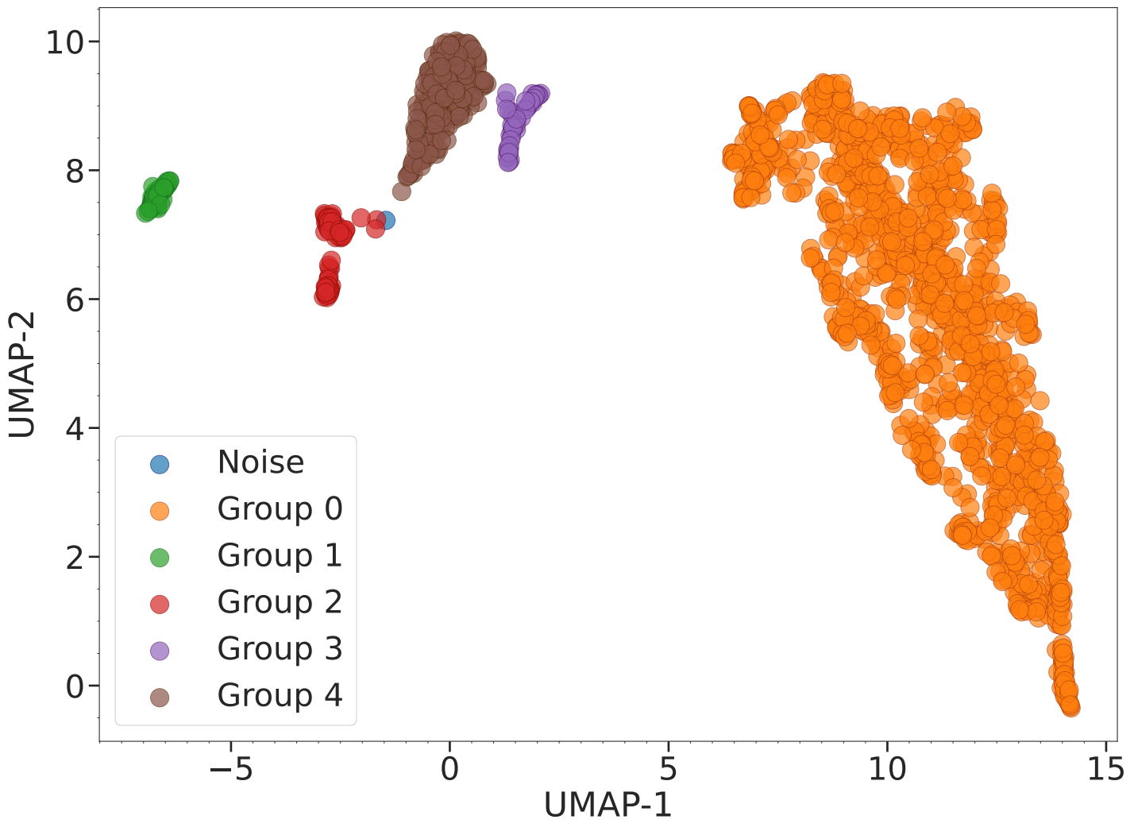
S-PLUS: Hα sources
Machine Learning Approaches
We applied UMAP for dimensionality reduction on S-PLUS data and used HDBSCAN for clustering Hα excess sources. Two experiments were conducted: one using only the 66 S-PLUS colors and another incorporating WISE bands. The results revealed the formation of five distinct groups, effectively separating galactic and extragalactic sources.

Slide 15
S-PLUS: Hα sources
Machine Learning Approaches
We applied UMAP for dimensionality reduction on S-PLUS data and used HDBSCAN for clustering Hα excess sources. Two experiments were conducted: one using only the 66 S-PLUS colors and another incorporating WISE bands. The results revealed the formation of five distinct groups, effectively separating galactic and extragalactic sources.
Stars

Slide 16
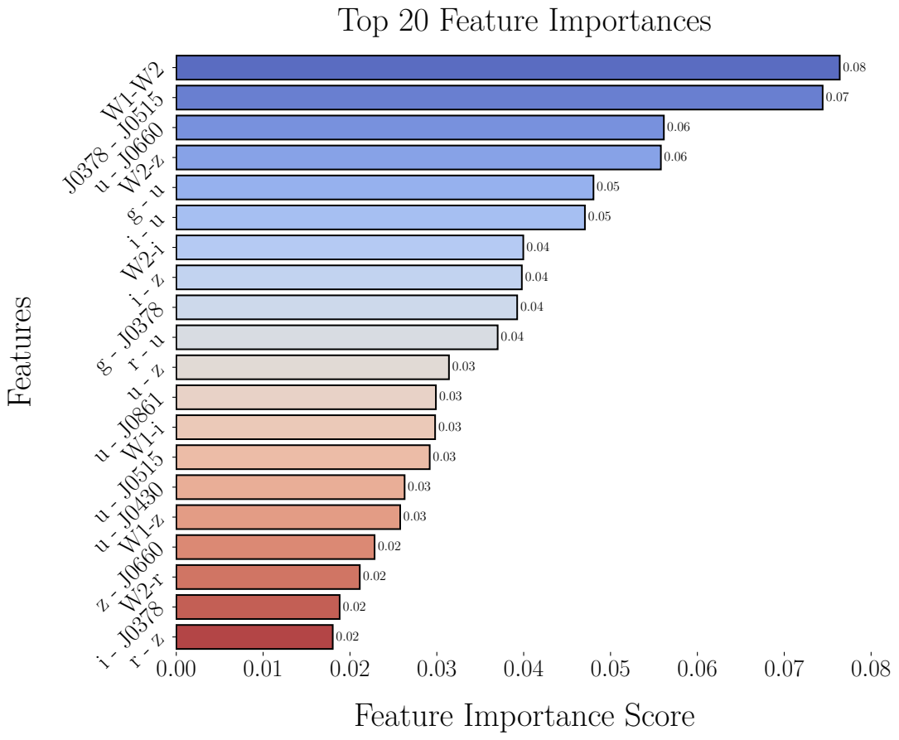
S-PLUS: Hα sources
Extracting Main Features: Color Analysis
Analysis: Key colors from S-PLUS and WISE filters identified by Random Forest as most influential in classifying H-alpha excess objects.
Results: Top 20 features contribute significantly to distinguishing between different object classes identified by UMAP + HDBSCAN.

Slide 17
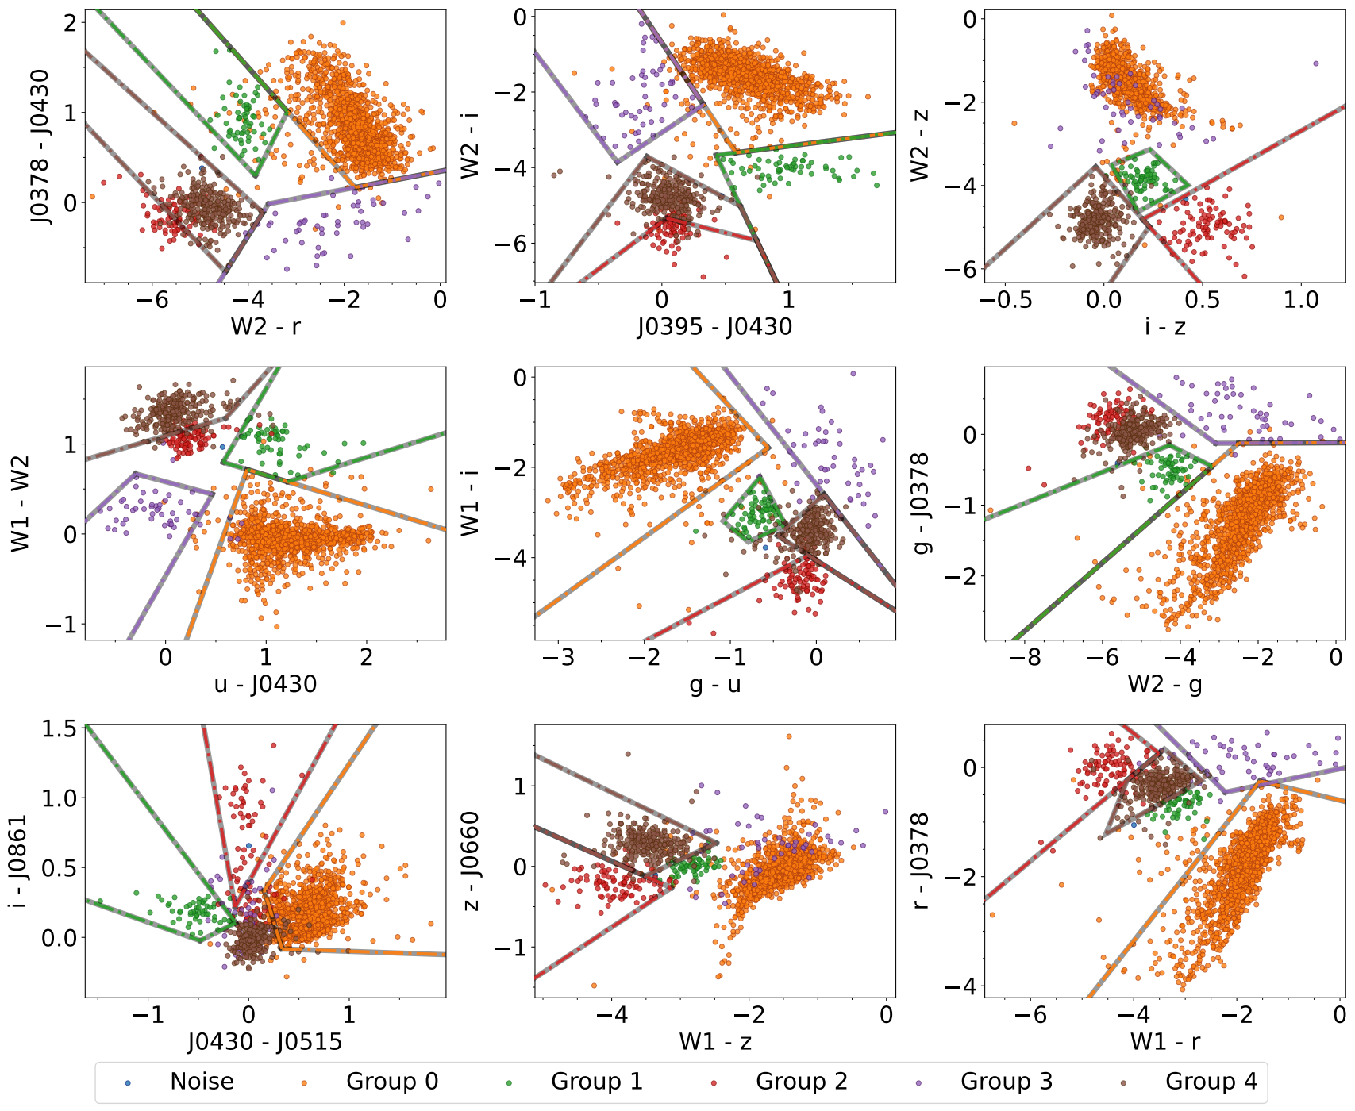
S-PLUS: Hα sources
Extracting Main Features: Color Analysis

Slide 18
Conclusions
Identification of H-alpha Excess Candidates:
7,371 candidates identified using the S-PLUS J0660 filter.
Distribution: 3,637 in the high-latitude main survey and 3,734 in the Galactic disk.
Classification of Objects:
Cross-referencing with SIMBAD: EM stars, YSOs, Be stars, CVs, PNe, QSOs, non-local galaxies, and RR Lyrae stars.
Machine Learning Techniques:
UMAP and HDBSCAN: Effective differentiation between Galactic and extragalactic objects
Challenges in distinguishing cataclysmic variables from QSOs or AGN with z ≈ 1.35.
Integration of WISE Data:
Improved separation of extragalactic and Galactic sources.
Random Forest Model:
WISE data crucial for identifying significant features.
Improved color-color diagrams and understanding of H-alpha related phenomena.

Slide 19
THANK!!

