Slide 1
Database Systems
Manuel Rodriguez-Martinez, Ph.D.
Advanced Relational
Algebra and SQL

Slide 2
Objectives
Describe more advanced operators for relational algebra and SQL
Aggregates
Ordering
Generalized Projections

Slide 3


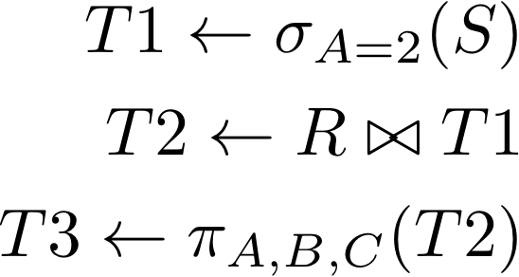
Assignment Operator
Relational expressions tend to become long and complex
Assignment operators allows you to write query in steps
Consider this query:
We can use assignment to write as follows:
Assignment enables the use of temporary variables

Slide 4
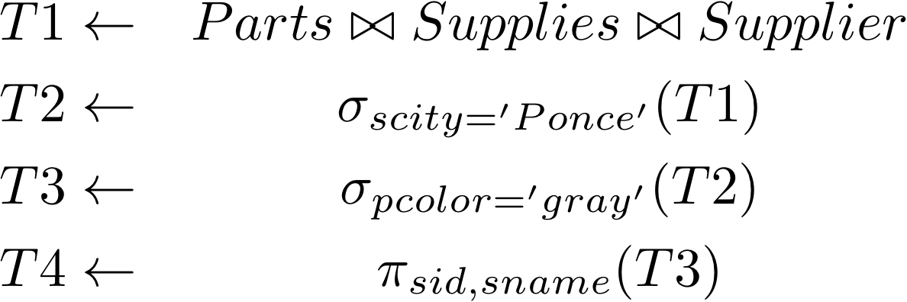
Example:
Get the name and Id for suppliers from Ponce that supply a gray part:

Slide 5
Example 2:
Self test: Get the id, name and price for all parts that are in stock in San Juan.

Slide 6
Example 3:
Get the id, and name for suppliers from San Juan that supply blue or red plastic parts that cost less than $2.

Slide 7
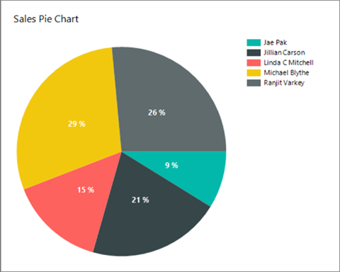
Aggregates
Very often, we need to perform summary statistics on the data
These statistics are displayed in tabular reports or in charts
Get the top 10 selling products
Get the worst selling car
Get the average amount of money spent by customers
Aggregates help you gets these statistics

Slide 8
Aggregates in SQL
SQL provides six built-in aggregate functions
Min – computes the minimum value over a column
Max - computes the maximum value over a column
Average – computes average value over a column
Sum - computes the sum of values over a column
Must be an additive column (e.g., int or float)
Count – count the number of items in a column or in table
A query can have a mix of these aggregates

Slide 9
Examples: Aggregates over whole table
Find the minimum price for a part
select min(pprice)
from parts;
Find the minimum, maximum, and average price for parts
select min(pprice), max(pprice), avg(pprice)
from parts;
Find the total number of suppliers
select count(*)
from supplier
Notice that in each the result is a single tuple

Slide 10
Handling count()
Using count(*) or count(column) will count all occurrences of the values in a column
select count(scity)
from supplier
Produces 6 tuples – one count per city found in column scity
If you only want distinct copies, then you need to use the keyword distinct
select count(distinct scity)
from supplier
Produces 3 tuples – only 3 different city names

Slide 11
Filtering + Joins + aggregation
You can do filtering with a where clause
Also you can aggregate over join results
Ex1: Find the total number of suppliers from SJU
select count(*)
from supplier
where scity = 'SJU'
Ex2: Find the total number of suppliers for part 1
select count(*)
from supplies natural inner join parts
where pid = 1
Ex3: Find maximum price of a grey part
select max(pprice)
from parts
where pcolor = ‘grey'

Slide 12
Grouping with Group by
It is very import to find aggregates of groups of related/similar items. Ex: Find avg price of ACME parts
SQL provides the Group by clause for this
Group by partitions the data by one or more column
Then the aggregate are computed based on those values
Group by partitions the data into disjoint groups
Separate aggregate is computed over each group

Slide 13
Possible uses of Group by queries
Find the average price of parts per supplier city
Find the min price of red parts supplied from SF
Find the min, max, and average price for all aluminum parts costing over $10.
Find the average price of red plastic parts purchased by a customer in SF from a supplier in LA.
Find the total amount of sales per store, city, and country

Slide 14
Aggregation with Group by
Find the minimum price of parts per color
select pcolor, min(pprice)
from parts
group by pcolor
Find the total number of suppliers per city
select scity, count(*)
from supplier
group by scity

Slide 15
Aggregation with Group by (2)
Find the average price of available parts per color and city
select pcolor as color, scity as city, avg(pprice) as avg_price
from Parts natural inner join Supplies natural inner join Supplier
group by pcolor, scity
Notice that we can have multiple columns in the group by clause
NOTE: columns projected must be included in group by clause

Slide 16
Sorting the data – ordered by
It is useful to sort the data along one or more columns
SQL provides the order by clause
Consider this query:
select pcolor, min(pprice)
from parts
group by pcolor
Suppose we want to sort by pcolor
The new query would be:
select pcolor, min(pprice)
from parts
group by pcolor
order by pcolor
By default sorting is ascending
Can be modified to descening
select pcolor, min(pprice)
from parts
group by pcolor
order by pcolor desc

Slide 17
Sorting by multiple attributes
It is possible to sort data by multiple attributes
Ex. Find the information about parts, sorted by material and color:
select *
from parts
order by pmaterial, pcolor
Find the average price of available parts per city and color, ordered by city
select scity as city, pcolor as color, avg(pprice) as avg_price
from Parts natural inner join Supplies natural inner join Supplier
group by scity, pcolor
order by scity

Slide 18
Data Warehousing
Aggregates and group by are the bread and butter of data warehousing
Online Analytical Processing – OLAP
The attributes in the group by are often called dimensions
The statistics are called measures
Data cube operator: computes combinations of aggregates and group by

Slide 19
Data Cube
In this case the dimensions are
Supplier
City
Material
Measure can be average price
Can be more than one
Measure is stored in the cell of the cube
Dimensions index the cells in cube
C[Sears, Mayaguez, Steel]=19.98
19.98
100
2.34
200.50
1.99
0
0
465.23
89.23

Slide 20
Filtering results after aggregation
SQL provides having clause to filter results after aggregation
Think of it as a type of “where” clause applied to measures
Find all the number of parts supplied by suppliers who supply at least 2 parts:
select sid as supplier, count(*) as part_count
from supplies
group by sid
having count(*) >= 2
Note: having must compare aggregate expression not the alias

Slide 21


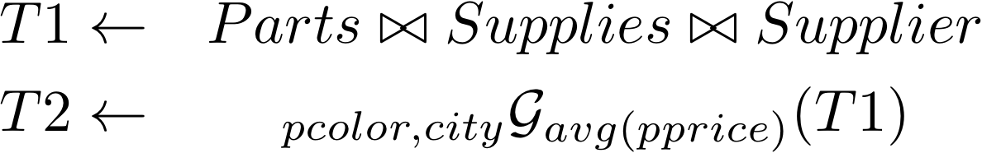
Aggregation in relational algebra
The notation for aggregation is:
Find the minimum price of parts per color:
Find the average price of available parts per color and city

Slide 22

Aggregation in relational algebra (2)
Missing dimensions means aggregate is run on full table
Ex: Find the total number of parts
Find the min and max prices for parts

Slide 23
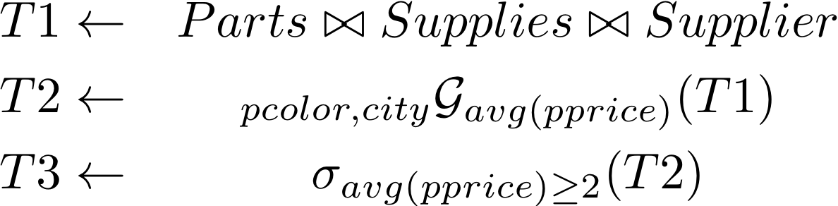
Aggregation in relational algebra (2)
Having is done as a selection
Ex: Find all the number of parts supplied by suppliers who supply at least 2 parts

Slide 24
Generalized projection
A Generalized projection allows you to project an expression or the result of a custom-built value
Find the id, name, price, and 10% discount price for all parts
select pid, pname, pprice, 0.10*pprice as discount
from parts;
You can also create your own functions, if available
PostgreSQL has PL/PGSQL, a SQL-based language

Slide 25
Creating a function is pl/pgsql
Suppose we need to create a function that computes ivu of parts but steel parts are exempt:
Use the create or replace function operation
create or replace function compute_ivu (pmaterial varchar(10) , pprice float) returns float as $$
begin
if (pmaterial = 'steel') then
return 0.0;
else
return 0.115*pprice;
end if;
end;
$$ language plpgsql;

Slide 26
Creating a function is pl/pgsql (2)
This type of function is called user-defined (UDF)
You need to specify
Name
Parameters and types
Return type
Language
Once defined, you can use them in the queries

Slide 27
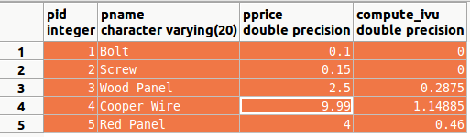
Creating a function is pl/pgsql (3)
Ex. Get the id, name, price and ivu for all parts
select pid, pname, pprice, compute_ivu(pmaterial, pprice)
from parts;

Slide 28
Generalized projections in relational algebra
Generalized projections are expressed as projections
Find the id, name, price, and 10% discount price for all parts
Get the id, name, price and ivu for all parts

Slide 29
Questions ?
Email:
manuel.rodriguez7@upr.edu

