Slide 1
Clave de Examen 3
INEL 4205 FALL 2016

Slide 2
Definición de un literal
Literal - variable negada o no negada que aparece en el término de una función

Slide 3
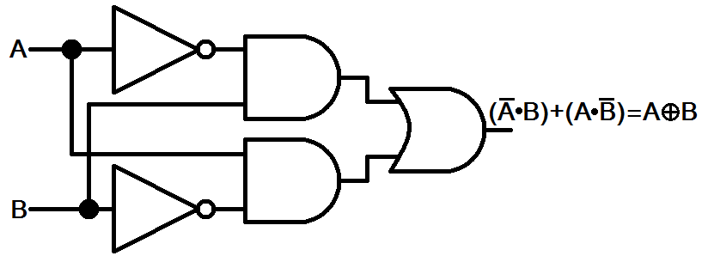
Interpretación de esquemáticos
A’
NOT
A’B
AND
OR
B’
AND
NOT
AB’

Slide 4
Cuantos términos y literales tiene
Ejemplo:
F=A’B +AB’ tiene dos términos y tiene cuatro literales
Los dos términos son:
A’B
B’A
Los cuatro literales son
A’
B
A
B’

Slide 5
Ecuación con los mínimos
Terms | A | B | OUT
m₀ | 0 | 0 | 0
m₁ | 0 | 1 | 1
m₂ | 1 | 0 | 1
m₃ | 1 | 1 | 0
OUT=m₁+m₂

Slide 6
Ecuación con términos máximos
OUT=m₁+m₂
OUT=M₀M₃

Slide 7
Digital Logic Families
Typical Integrated digital logic

Slide 8
Most common integrated Logic Families
TTL transistor-transistor logic
ECL emiter-coupled logic
MOS metal-oxide semiconductor
CMOS complementary metal-oxide semiconductor

Slide 9
TTL
Widespread logic family that has been in operation for some time and is considered as standard
74XX version most commonly used

Slide 10
ECL
ECL has an advantage in systems requiring high-speed operation.
FASTER!!!! Requires more power

Slide 11
Metal Oxide Semiconductor (MOS)
MOS is suitable for circuits that need high component density,

Slide 12
CMOS (Complementary MOS)
CMOS is preferable in systems requiring low power consumption.
No Static power consumed. Longer battery life!!!!

Slide 13
Characteristics for comparison
The characteristics of digital logic families are usually compared by analyzing the circuit of the basic gate in each family.
Fan-out
Power dissipation
Propagation delay
Noise margin

Slide 14
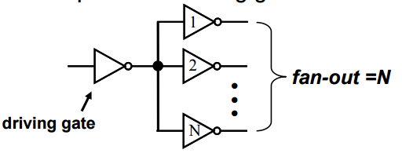
Fan Out
Specifies the number of standard loads that the output of a typical gate can drive without impairing its normal operation.
A standard load is usually defined as the amount of current needed by an input of another similar gate of the same family.
Example- An inverter can drive 10 inverters so The Fan Out is 10.

Slide 15
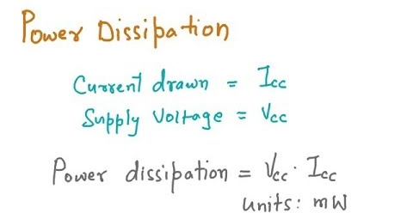
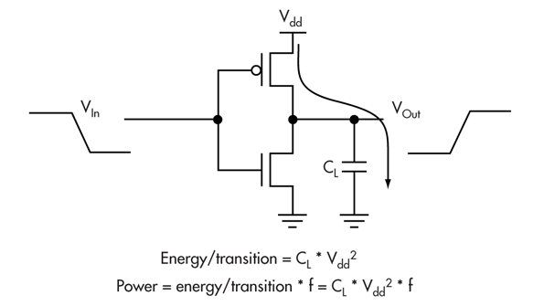
Power dissipation
Power consumed by the gate that must be available from the power supply.

Slide 16
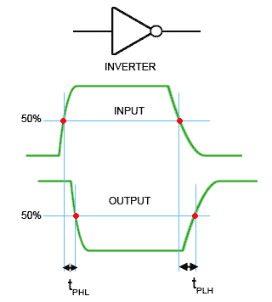
Propagation Delay
The average transition delay time for the signal to propagate from input to output.
The operating speed is inversely proportional to the propagation delay.

Slide 17
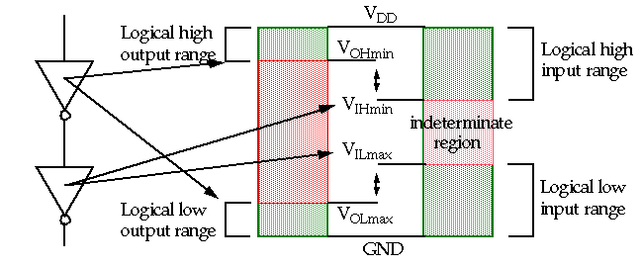
Noise Margin
The minimum external noise voltage that causes an undesirable change in the circuit output.

Slide 18
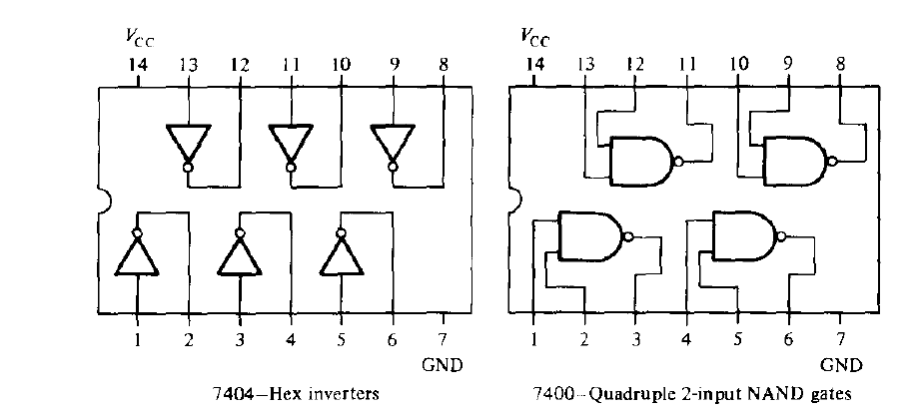
Example of TTL Chips

Slide 19
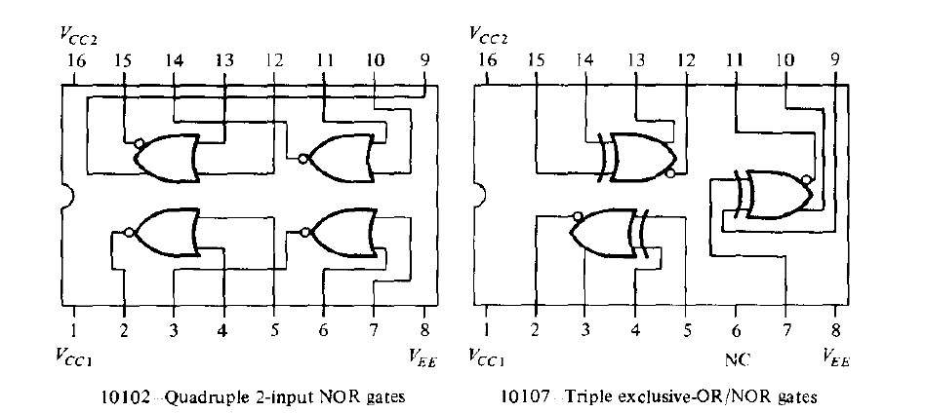
Example of ECL Chips

Slide 20
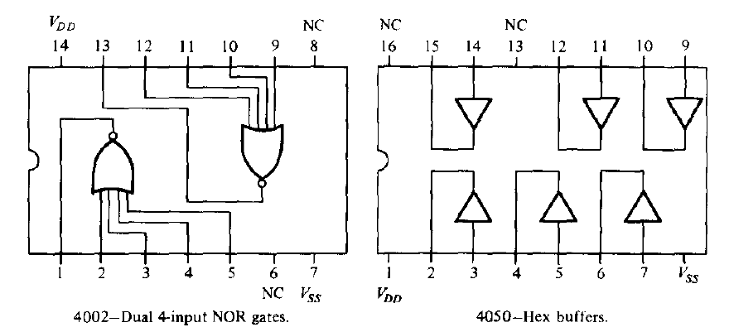
Example of CMOS Chips

Slide 21
Don’t Care Terms
Maximizing the grouping

Slide 22
Don’t Care terms
Unspecified outputs in functions that are not specified to be zeros or ones and they do not affect the outcome (Sect. 3.8)

Slide 23


Example 3.12
Se pueden agrupar con los unos o ceros
Simplifique la función dada en términos mínimos
Que tiene los siguientes terminos “don’t care”
F | yz
wx |  | 00 | 01 | 11 |  | 10
 | 00 | X | 1 | 1 |  | X
 | 01 | 0 | X | 1 |  | 0
 | 11 | 0 | 0 | 1 |  | 0
 | 10 | 0 | 0 | 1 |  | 0
F | yz
wx |  | 00 | 01 | 11 | 10
 | 00 | X | 1 | 1 | X
 | 01 | 0 | X | 1 | 0
 | 11 | 0 | 0 | 1 | 0
 | 10 | 0 | 0 | 1 | 0

Slide 24
Tabular Method
Convenient for simplification of 5 or more variables. (more for computer algorithm)
Consists of two parts,
Search all terms that are candidates for inclusion in the simplified functions (prime implicants)
Choose among prime implicants those that give an expression with the least number of implicants

Slide 25
Recetario
Escribe todos los minterms
Compara cada minterm con cada uno
Si hay dos minterms que solo se diferencian por una variable el programa elimina esa variable por lo tanto hay un termino con un literal menos
Vuelve y compara todos los minterms hasta que no haya cambio en la ecuación
Los que quedan se llaman prime implicants.

Slide 26

Ejemplo 3.13
Simplifique la siguiente función Booleana
1. Escriba todos los minterms
w’x’y’z’ + w’x’y’z +w’x’yz’ + wx’y’z’ + wx’yz’ + wx’yz + wxyz’ + wxyz
Compare cada termino

Slide 27
Agrupación de términos
wxyz | wxyz | Comparisons | wxyz | Comparisons | wxyz
m1 | 0000 | m0,m1 | 000_ | m0m2,m8m10 | _0_0
 |  | m0,m2 | 00_0 | m0m8,m2m10 | _0_0
m1 | 0001 | m0,m8 | _000
m2 | 0010 |  |  | m10m11,m14m15 | 1_1_
m8 | 1000 | m2,m10 | _010 | m10m11,m14m15 | 1_1_
 |  | m8,m10 | 10_0
m10 | 1010 |  |  | F=w’x’y’ +x’z’ +wy
 |  | m10,m11 | 101_
m11 | 1011 | m10,m14 | 1_10
m14 | 1110
 |  | m11,m15 | 1_11
m15 | 1111 | m14,m15 | 111_

Slide 28
Determine los prime implicants para la siguiente función
Si agrupamos los que solo tienen un “1”
m1,m4,m8
Si agrupamos los que tienen dos “1”
m6,m9, m10
Si agrupamos los de tres “1”
m7,m11
Los términos de cuatro “1”
m15

Slide 29
Agrupacion de términos (marque el término que no logró agrupar)
Agrupe los terminos por la cantidad de unos que tenga el termino minimo
wxyz | wxyz | Comparisons | wxyz | Comparisons | wxyz
m1 | 0001 | m1,m9 | _001
m4 | 0100 | m4,m6 | 01_0
m8 | 1000 | m8,m9 | 100_ | m8m9,m10m11 | 10_ _
 |  | m8,m10 | 10_0 | m8m10,m9m11 | 10_ _
M6 | 0110
M9 | 1001 | m6,m7 | 011_
m10 | 1010 | m9,m11 | 10_1 | F=x’y’z + w’xz’ + w’xy + wyz + xyz + wx’
 |  | m10,m11 | 101_
M7 | 0111 | m7,m15 | _111
M11 | 1011 | m11,m15 | 1_11
m15 | 1111

