Slide 1
Dynamic and Domino Logic
INEL 4207

Slide 2
Dynamic Logic: Clocked Logic
Design methodology in combinatory logic circuits, particularly those implemented in MOS technology.
Temporary storage of information in stray and gate capacitances
Two phases
Precharge
Evaluation
Are faster than static logic and required less area, more difficult to design for

Slide 3
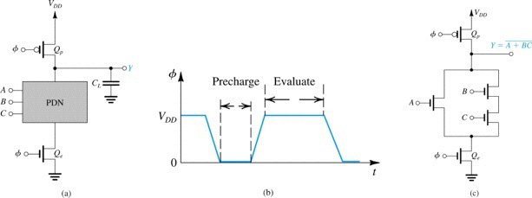
Dynamic logic timing sequence
Figure 14.19 (a) Basic structure of dynamic-MOS logic circuits.
(b) Waveform of the clock needed to operate the dynamic logic circuit.
(c) An example circuit.

Slide 4
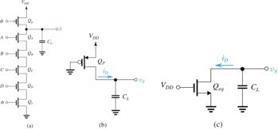
Example 14.20
Fig. 14.20 b)Precharge Phase, φ=0
Y=ABCD
Fig. 14.20 c)Evaluation Phase, φ=1
Fig 14.20 a) Dynamic Logic Circuit

Slide 5
Example Problem 14.20
Assume
V_{DD} = 1.8V : V_{t} = 0.5V
μ_{n}C_{ox} = 4μ_{p}C_{ox} = 0.3mA/V ²
(W/L)_{n} =0.27/0.18 (including Q_{e}),
(W/L)_{p} = 0.54μm/0.18μm (for Q_{p}),
C_{L} =20fF.
a) For the pre-charge operation, with Q_{p}’s gate at 0V and if C_{L} is fully discharged at t = 0, find the time for v_{Y} to rise from 10% to 90% of V_{DD}.
b) For A = B = C = D = 1, find t_{PHL}

Slide 6
Calculation of rise time
Calculating rise time (t_{r}) the signal at the output goes from 10% its final value to 90% its final value.
Final Value is V_{DD}
V_{Y}=0.1V_{DD}=0.18V; Q_{p} is in saturation mode
For rise time we are at precharge

Slide 7
Calculation of rise time
At V_{Y}=0.9VDD=1.62V; Q_{P} is in triode mode

Slide 8
Rise Time
Average Current, I_{av}=(i₁+i₂)/2
I_{av}=119.6uA

Slide 9
Propagation delay High to Low
When A=B=C=D=1,
All N transistors are on.
Replace 5 identical transistor with 1 equivalent transistor.
Q_{eq} has a W/L=1/5(W/L)=0.3
For V_{Y}=V_{DD} Q_{eq} in sat.

Slide 10
Propagation delay High to Low
At V_{Y}=V_{DD}/2;
Q_{eq} is in triode region
I_{av}=72.5 uA

Slide 11
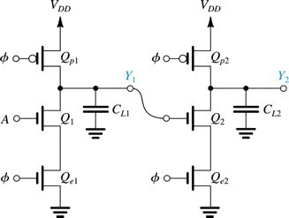
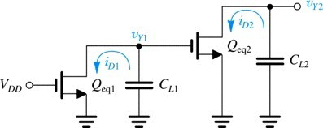
Cascading dynamic logic gates
By the time V_{Y1} drops to V_{t}, C_{L2} can loose a
significant amount of charge causing V_{Y2} to
can be significantly reduced.
Figure 14.22 Two single-input dynamic logic
gates connected in cascade. With the input A high,
during the evaluation phase C_{L2} will partially
discharge and the output at Y2 will fall lower than V_{DD}, which can cause logic malfunction.

Slide 12
Domino Logic
A cascadable Dynamic Logic gate

Slide 13
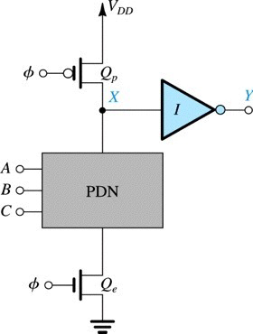
Domino Logic
Figure 14.23. The Domino CMOS logic gate. The circuit consists of a dynamic-MOS logic gate with a static-CMOS inverter connected to the output. During evaluation, Y either will remain low (at 0 V) or will make one 0-to-1 transition (to VDD).

Slide 14
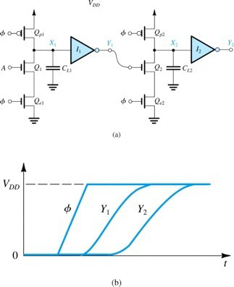
Cascaded Domino Logic Gate
End of Precharge
X1=V_{DD}
Y₁=0; X₂=V_{DD} and Y₂=0
If A=1 as φ goes high
C_{L1} will start discharge through Q1
but Q2 will remain off (C_{L2} charged) until x1 falls below the V_{tn} of the inverter I1,
Y1 goes up Q2 will turn on and then C_{L2} will discharge, not before)

