Slide 1
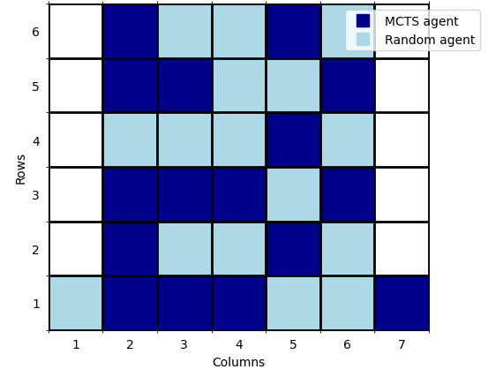
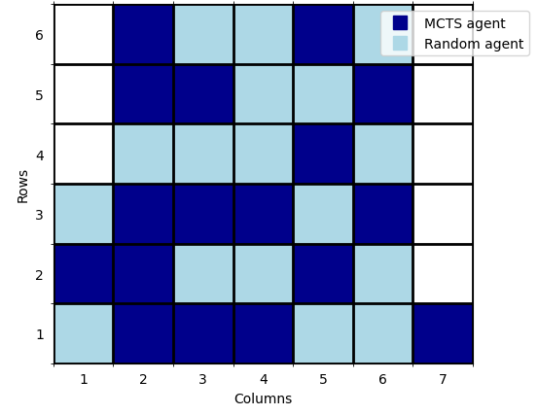
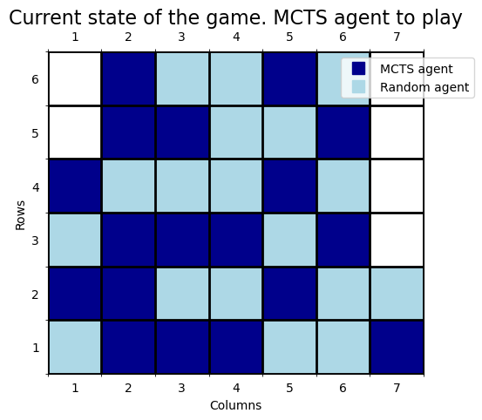
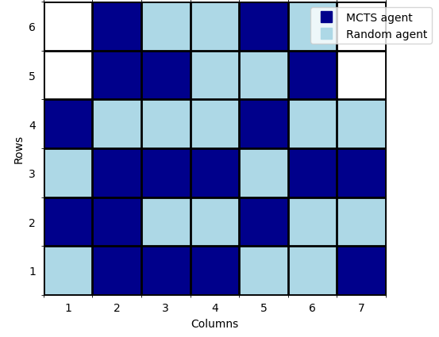
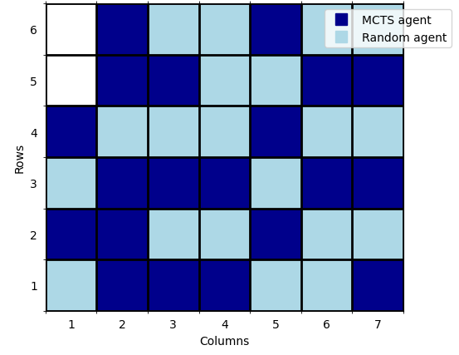
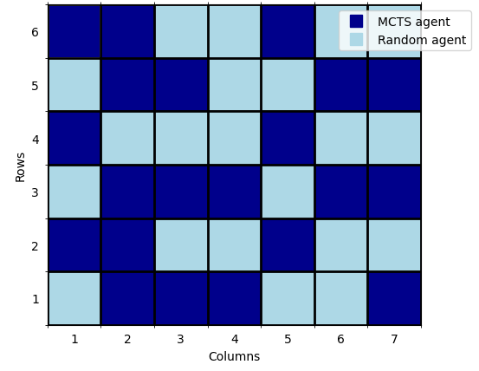
Action statistics at the root node:
Action 1: Reward = 164, Visits = 917, Avg Reward = 0.1788
Action 7: Reward = -10, Visits = 85, Avg Reward = -0.1176
The best move is to play in column 1
Opponent plays column 1
a)
Action statistics at the root node:
Action 1: Reward = -171, Visits = 984, Avg Reward = -0.1738
Action 7: Reward = -18, Visits = 18, Avg Reward = -1.
The best move is to play in column 1
Opponent plays column 7
b)
Action statistics at the root node:
Action 1: Reward = -11, Visits = 21, Avg Reward = -0.4782
Action 7: Reward = 195, Visits = 979, Avg Reward = 0.1992
The best move is to play in column 7
Opponent plays column 7
c)
Action statistics at the root node:
Action 1: Reward = -10, Visits = 19, Avg Reward = -0.5263
Action 7: Reward = 235, Visits = 983, Avg Reward = 0.2391
The best move is to play in column 7
[…]
d)
Action statistics at the root node:
Action 1: Total Reward = 0, Visits = 1001, Avg Reward = 0.0
The best move is to play in column 1
e)

