Slide 1
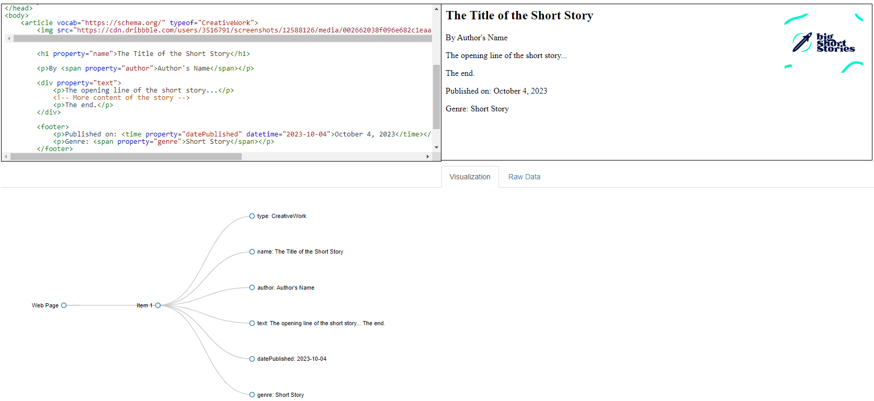
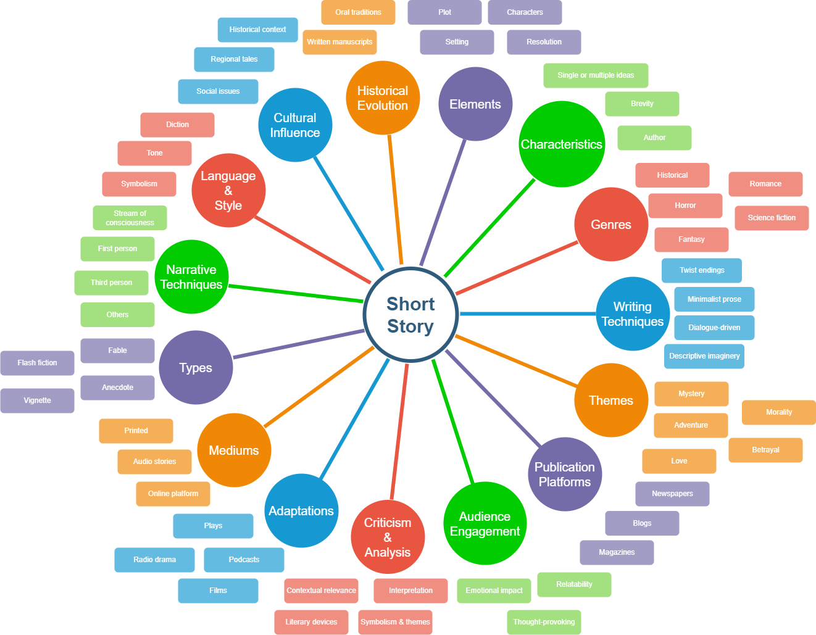
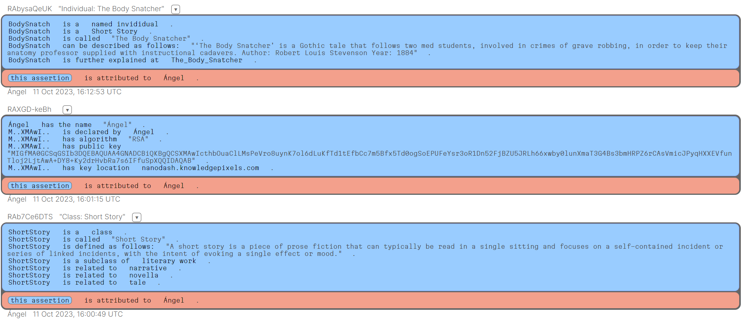
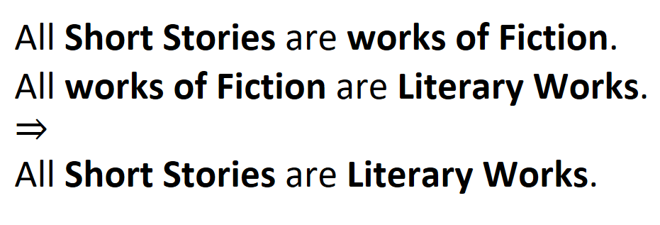
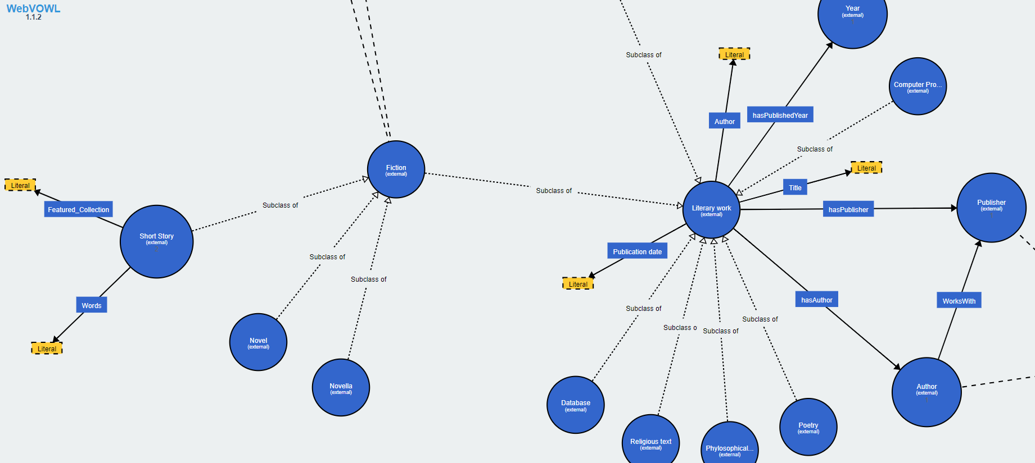
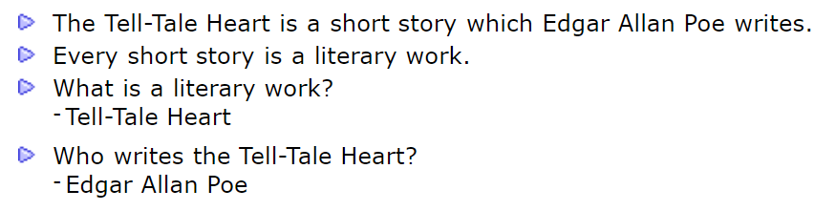
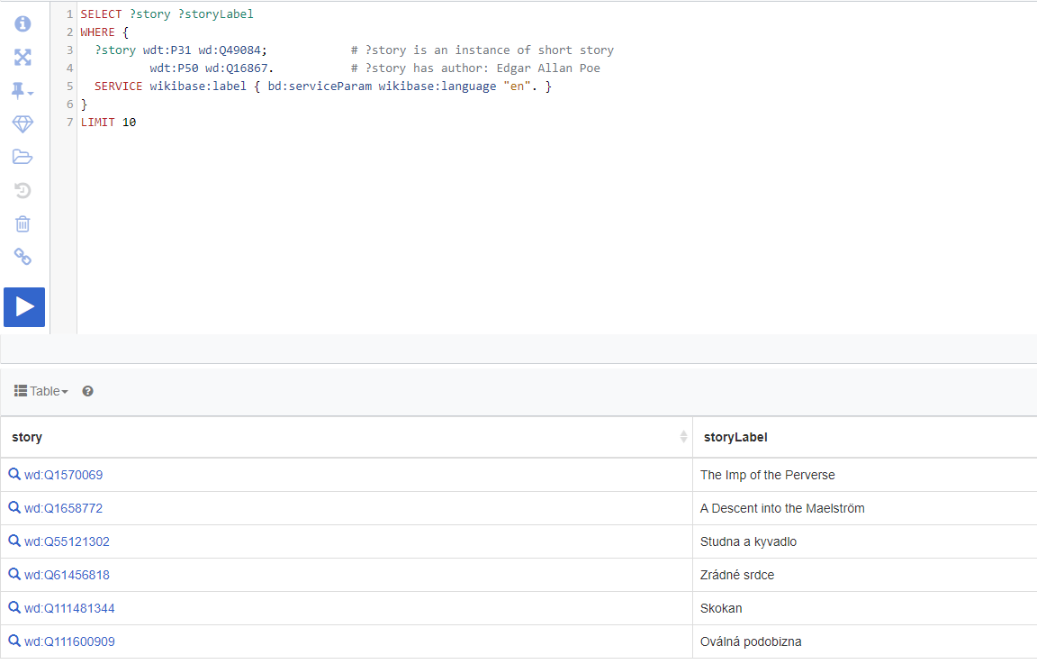
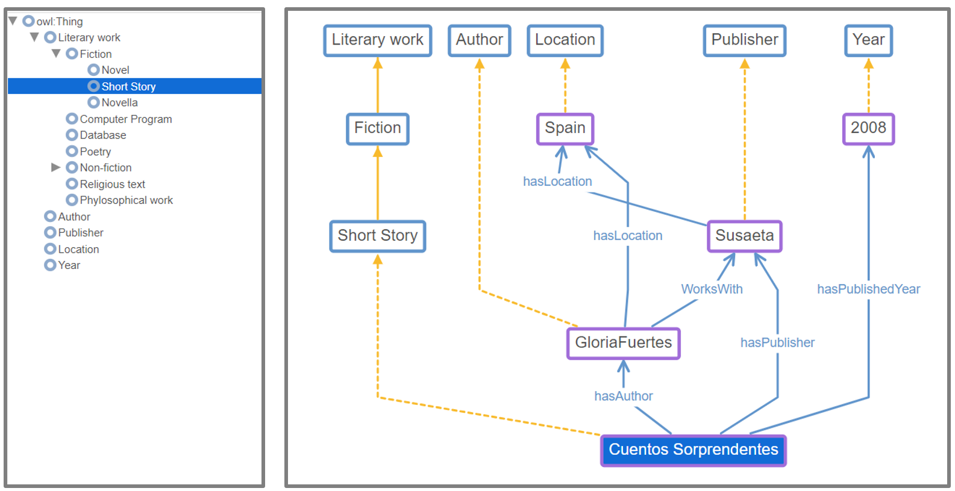
Ángel A. Gil / a.a.gil@student.vu.nl / agi239 / 2788988
A Short Story about Knowledge Organization
Knowledge Organization is the art and science of structuring information to aid in its understanding, retrieval, and application. Allow me to take you on a short journey through its process.
Beginning our journey, mind maps let us brainstorm and visually seize foundational concepts. These become the bedrock for any structured language we aspire to craft.
Beginning our journey, mind maps let us brainstorm and visually seize foundational concepts. These become the bedrock for any structured language we aspire to craft.
Beginning our journey, mind maps let us brainstorm and visually seize foundational concepts. These become the bedrock for any structured language we aspire to craft.
With the foundation set, we venture into WikiData. By executing targeted queries, we unveil deeper insights and patterns that may have remained hidden within the vast universe of short stories.
Ontology is our next frontier. Using Web Protégé, we meticulously model an ontology, capturing the myriad relationships, entities, and intricacies inherent in the domain of short stories
Beginning our journey, mind maps let us brainstorm and visually seize foundational concepts. These become the bedrock for any structured language we aspire to craft.
Stepping further, we dive into the realm of logical reasoning. Crafting syllogisms, we start discerning intricate relations and potential inferences among the associated concepts of our topic.
Moving into a realm of structured precision, Controlled Natural Language via AceWiki allows us to frame short stories in an organized, yet human-readable manner

