Slide 1



Team Artemis
Members:
Couoh Domínguez Libny Abigail
Gonzalez Rincón Ángel
Koh Martin Tyeisha Ivanna
Novelo Tzuc Emily del Rosario
Mota Herrera Yael Iván

Slide 2

What inspired your team to choose this challenge?
My team was interested in the "Space for change" challenge because we want to make a change in marginalised areas that have environmental risks, be it water pollution, air pollution, among others.

Slide 3
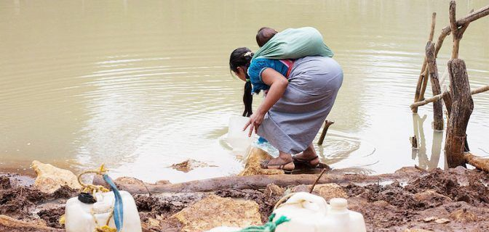
Unjust water resource allocations in Chiapas
The team focused on a specific place, in this case, Chiapas, which we want to solve the water scarcity in that area by means of infrastructures to generate a filter on the water.
By solving this problem, the people of the area will no longer drink contaminated water, they will have better living conditions.
They will also have enough water for their personal use and will no longer have to go far to fetch it.

Slide 4
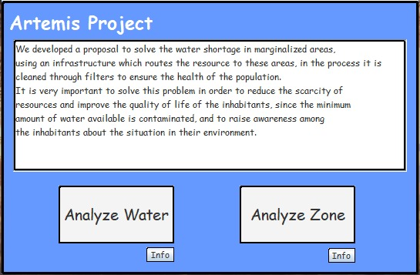
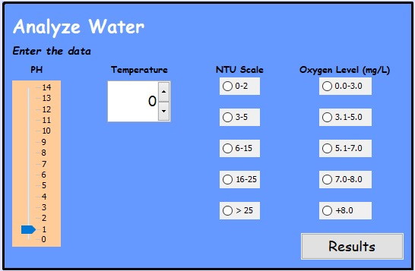
Prototype
This prototype that was created will be used to analyse the areas that would be suitable for the use of the infrastructure, and it will also be used to carry out an analysis of the water, whether it’s contaminated or not.

Slide 5

The handling of Nasa data, satellite data will be used to make an analysis of the areas requiring infrastructure.
The use of drones had also been considered to analyse the subsoil and verify whether the infrastructure can be built.

Slide 6

LOOK INTO THE FUTURE
Our idea will change about other marginalised areas that have water-related problems, to supply water that is clean so that it does not affect people's health.

