Slide 1
BRICK BREAKER
UNIVERSITY OF CRETE - COMPUTER SCIENCE DEPARTMENT
PROJECT FOR THE MULTIMEDIA COURSE (HY474)
NINA SAVETA
ANGELOS KYRIAKOPOULOS

Slide 2
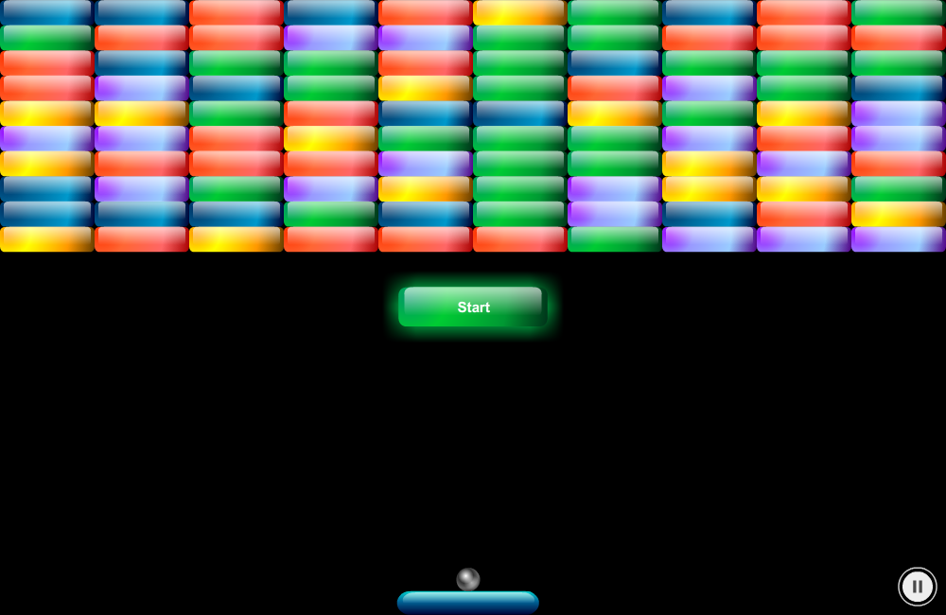
GAME OVERVIEW

Slide 3
IMPLEMENTATION PROGRESS
The Implementation progress goes as follows:
Searched and found graphics for the game
Bricks, paddle & start button during initialization
Added listeners (mouse & keyboard) for the paddle
Inserted the ball and collision detection for it
Created the scoreboard (score & lives count)
Added fruits and anything related with score and life
Added losing & winning screens
Added extra features like pause, soundtrack & restart game

Slide 4
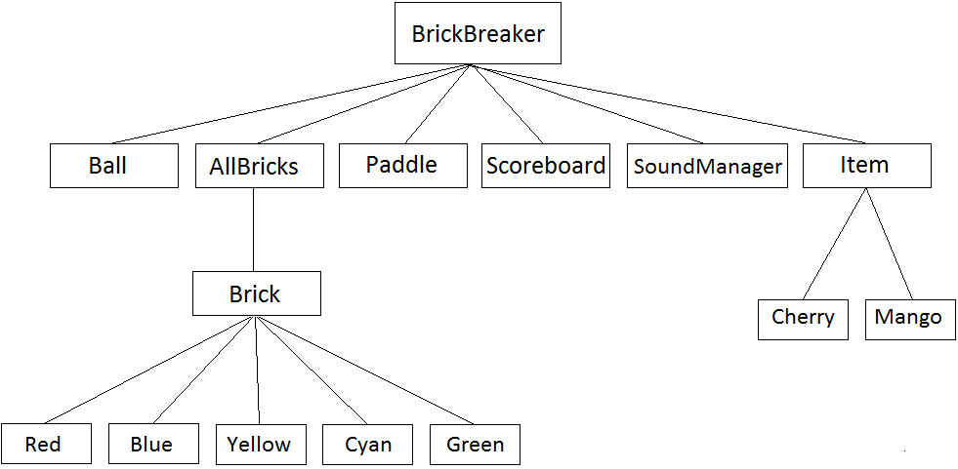
ACTIONSCRIPT CLASSES

Slide 5
THAT’S ALL FOLKS
THANK YOU

