Slide 1
Brick Breaker
University of crete - Computer Science Department Project for the Multimedia COURSE (hy474)
Nina saveta Angelos Kyriakopoulos

Slide 2
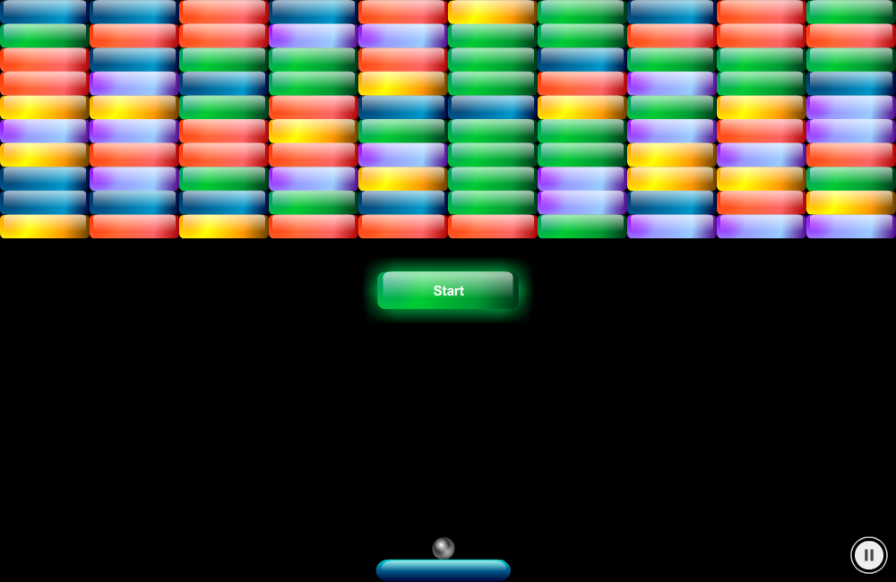
Game Overview

Slide 3
Implementation progress
The Implementation progress goes as follows:
Searched and found graphics for the game
Bricks, paddle & start button during initialization
Added listeners (mouse & keyboard) for the paddle
Inserted the ball and collision detection for it
Created the scoreboard (score & lives count)
Added fruits and anything related with score and life
Added losing & winning screens
Added extra features like pause, soundtrack & restart game

Slide 4
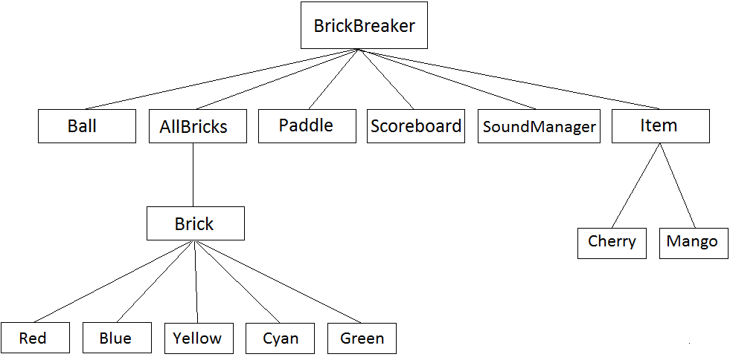
ActionScript Classes

Slide 5
That’s all folks
THANK YOU

