Slide 1

Bank Loan Approval Analysis
Loan Qualification Analysis

Slide 2

Objective
Make use of historical data to determine if clients qualify for a bank loan or not.
Identify trends and factors that influence the approval of a bank loan.
Use machine learning to predict if new clients qualify for a bank based on the historical data.
Provide a simple solution to make predictions and retrieve results.

Slide 3
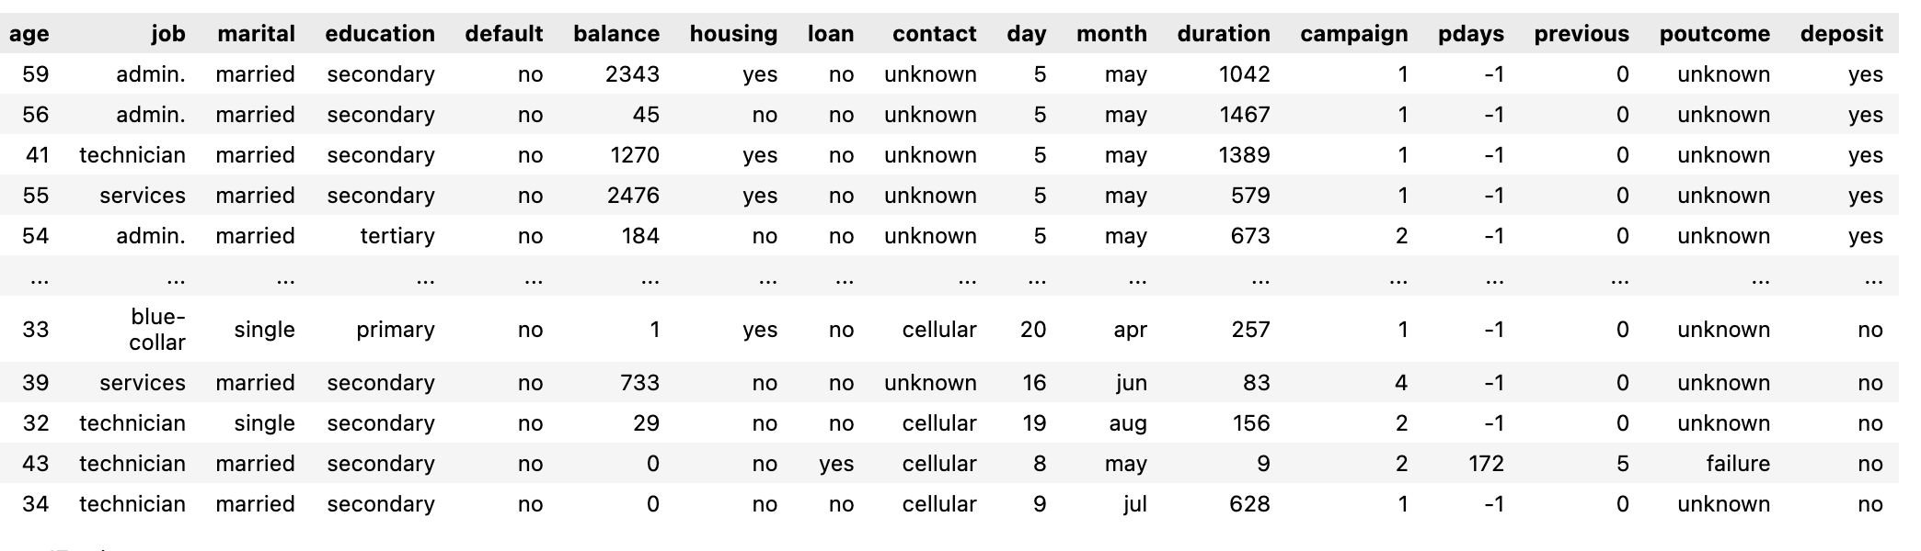
Data Preparation
Dataset contains no nulls or duplicates, so data cleaning is not required.
There are 11162 rows and 17 columns.
Dataset consists of categorical and numerical features.
There are 10 categorical features and 7 numerical features.
Dependent variable will be the loan field.

Slide 4
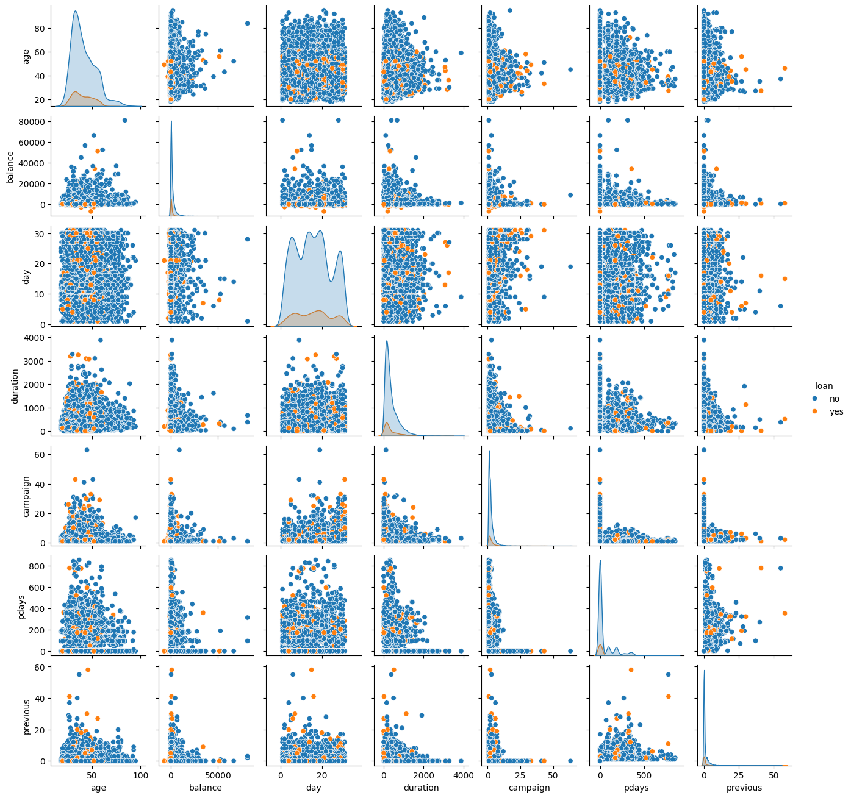
Numerical Features
Based on the pair plot, the day feature has no impact on bank loan approval because the approval status is distributed fairly for all days.
Therefore, this feature will be removed during feature engineering, as it will have no impact on the loan status.

Slide 5
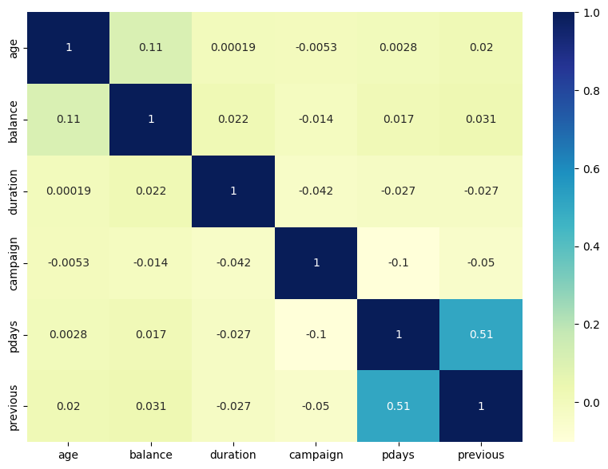
Numerical Features
Based on the correlation matrix, pdays and previous features have a high positive correlation with each other. An assumption could be that the pdays feature stands for the number of previous days a client submitted a bank loan application.
Therefore, one of the features will be removed during feature engineering.

Slide 6
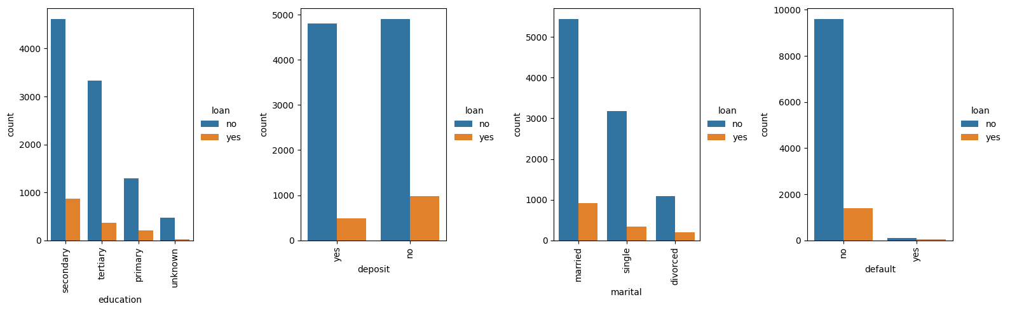
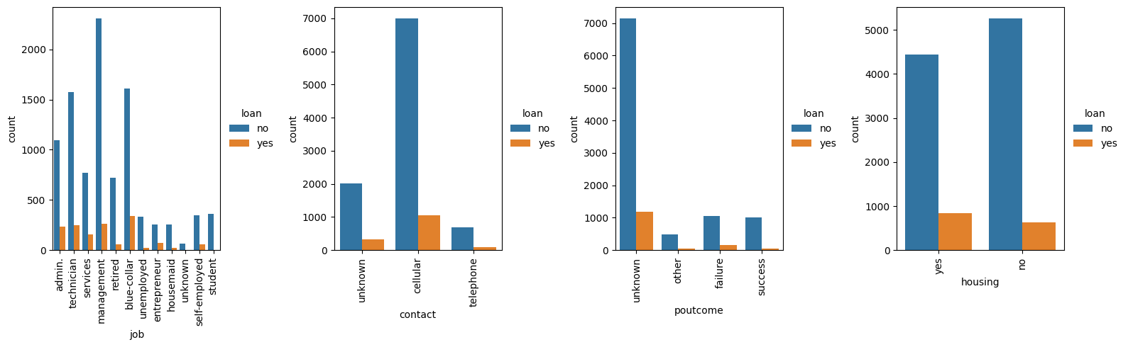
Categorical Features
Based on the bar graphs, default field will be removed during feature engineering because there is not enough data for the approved bank loan class.
education and marital loan approval is based on the number of applications so those fields will be removed during feature engineering.
The most frequent form of contact used was cellular, as a result more loans were approved because of this. So, this field will be removed.
poutcome field consists mostly of unknowns so this field will also be removed during feature engineering.

Slide 7
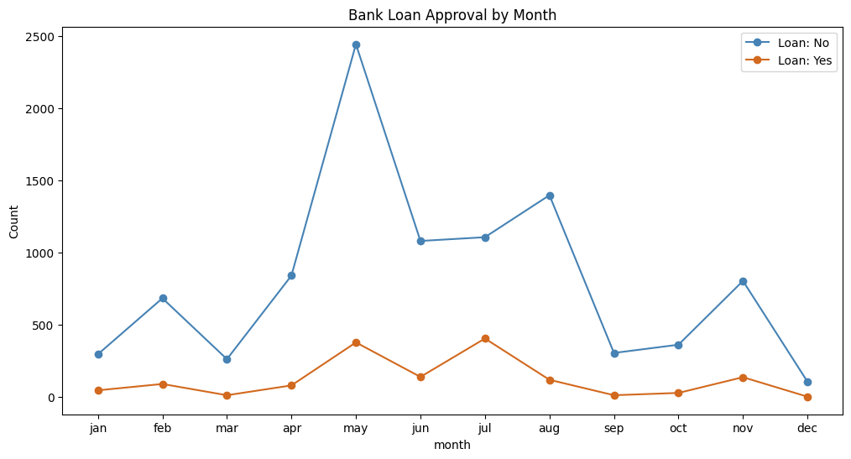
Categorical Features
Based on the line graph, bank loans are likely to be approved in July because the number of approvals is higher, even though the number of applications is lower compared to other months.
Most bank loan applications are made in May.
December has the least amount of bank loan applications.

Slide 8
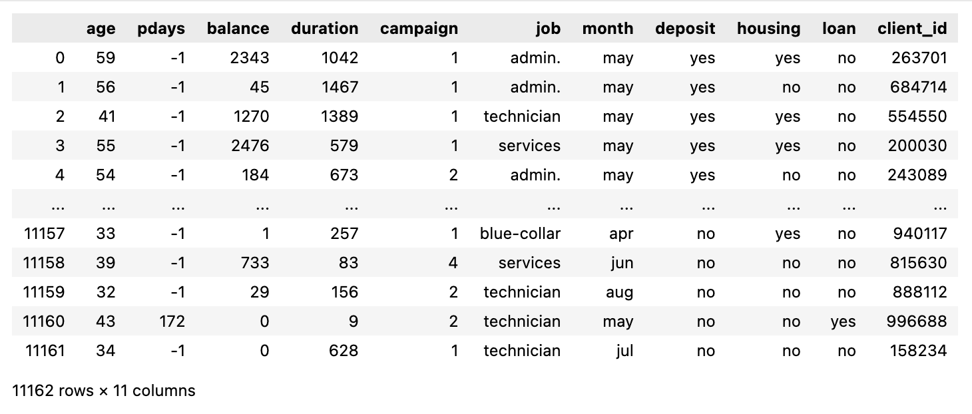
Feature Engineering
New Features Added:
client_id – autogenerated field was added to uniquely identify each clients’ bank loan approval status.
Removed Features:
day, previous, default, education, marital, contact, poutcome.
Final Features for ML models:
client_id, age, pdays, balance, duration, campaign, job, month, deposit, housing and loan.
Label encoder was used to convert categorical features to numerical.

Slide 9
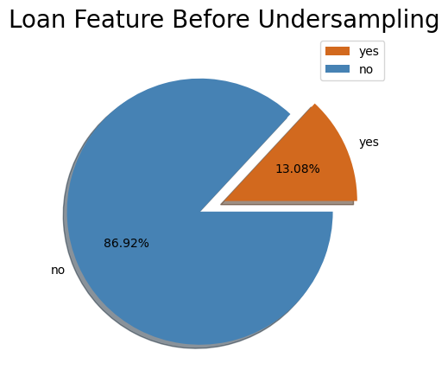
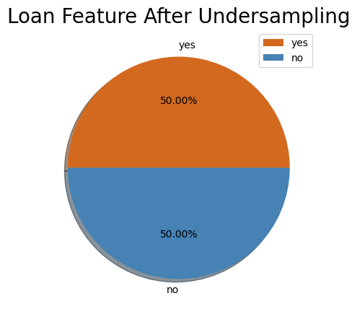
Feature Engineering
Since there was an imbalance between approved and not approved bank loans, under-sampling had to be applied so that the models were not biased.
Under-sampling was chosen over oversampling to ensure the data remains accurate and having ~3000 rows of data is still a good sample.

Slide 10
Machine Learning Algorithms
Random Forest Classifier
K-Nearest Neighbor
Support Vector Machines
Logistic Regression
80% of the dataset went into training and 20% into testing.

Slide 11
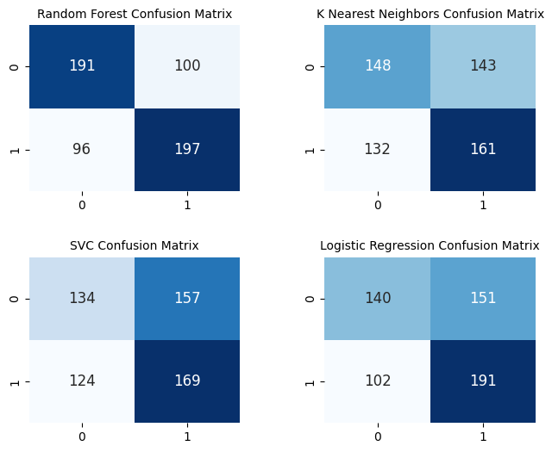
Evaluation of ML Models
Based on the confusion matrix, the Random Forest model had the least number of False Positives.
Having few type 1 errors is important for this analysis because if the model states that clients who don’t qualify for bank loans qualify, then the bank could lose a lot of money due to clients being unable to pay back the loan.

Slide 12
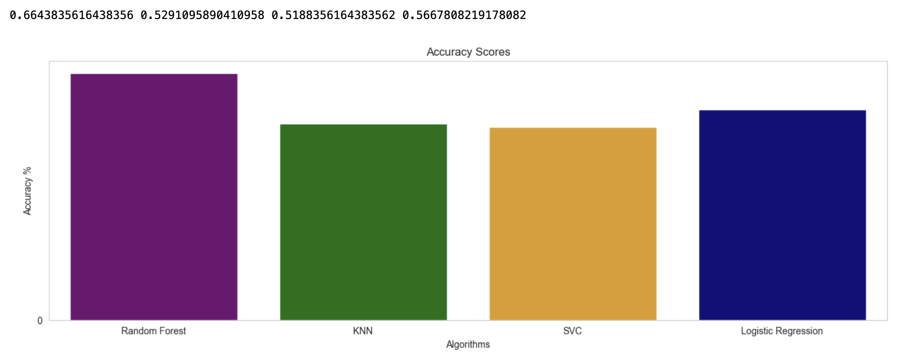
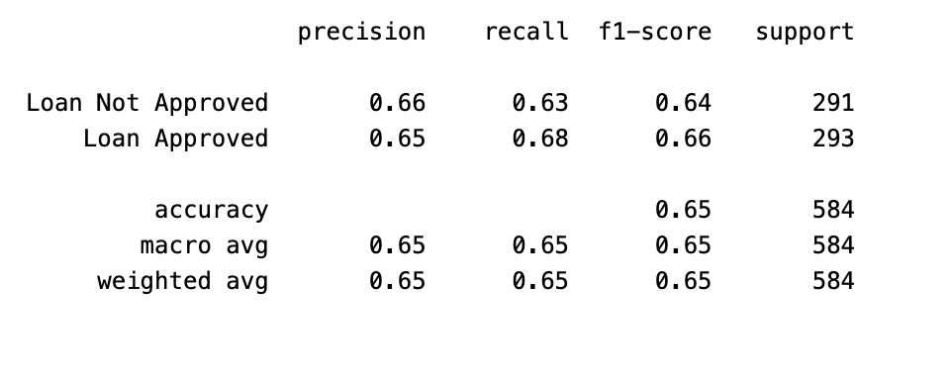
Evaluation of ML Models
Based on the bar graph, the Random Forest model had the highest accuracy score, which was 66%.
Therefore, the Random Forest model was used to make predictions.
Random Forest model classification report

Slide 13
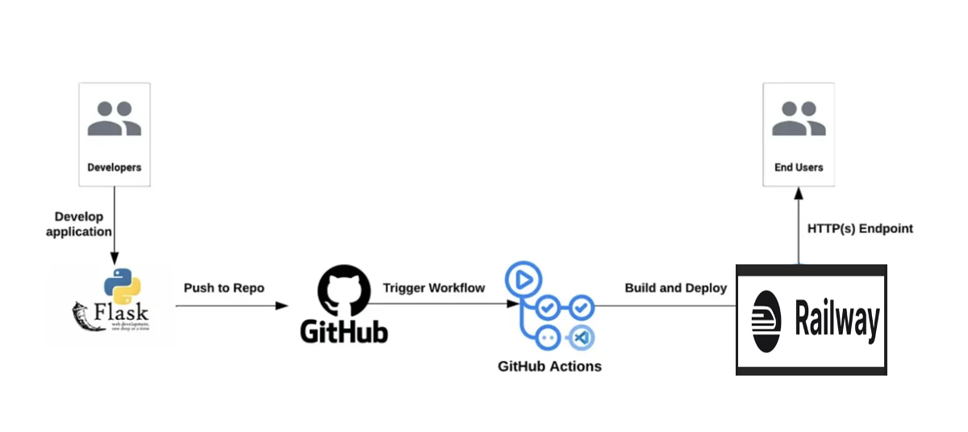
Deployment
Flask was used to create a user interface that allows users to enter the clients’ information and predict if they qualify for a bank loan or not.
Railway was used to deploy the application.
Link to app: https://web-production-18e5.up.railway.app/

Slide 14

Summary and Improvement
The current application works as expected and delivers the desired results.
Next steps would be to improve the performance of the model by using hyper-parameter tuning.
Instead of doing undersampling, oversampling could be done, so that the model is trained with more datasets which could improve the performance.
Make the app accept a csv file and make predictions instead of entering clients’ details manually.
Change app url to user friendly name.

