Slide 1
Hash Tables

Slide 2
Hash Tables
Hash table: another data structure
  Provides virtually direct access to objects based on a key (a unique String or Integer)
    key could be your SID, your telephone number, social security number, account number, …
    Must have unique keys
    Each key is associated with–mapped to–a value

Slide 3
Hash Tables: Runtime Efficient
Lookup time does not grow when n increases
A hash table supports
  fast insertion
  fast retrieval
  fast removal
Could use String keys each ASCII character equals some unique integer
  "able" = 97 + 98 + 108 + 101 == 404

Slide 4
Hashing
Must convert keys such as "555-1234" into an integer index from 0 to some reasonable size
Elements can be found, inserted, and removed using the integer index as an array index
Insert (called put), find (get), and remove must use the same "address calculator"
  which we call the Hash function

Slide 5
Hashing
Can make String or Integer keys into integer indexes by "hashing"
  Need to take hashCode % array size
  Turn “S12345678” into an int 0..students.length
Ideally, every key has a unique hash value
  Then the hash value could be used as an array index, however,
    Ideal is impossible
    Some keys will "hash" to the same integer index
      Known as a collision
    Need a way to handle collisions!
      "abc" may hash to the same integer array index as "cba"

Slide 6
Hash method works something like…
Convert a String key into an integer that will be in the range of 0 through the maximum capacity-1
Assume the array capacity is 9997
hash(key)
AAAAAAAA
8482
zzzzzzzz
1273
hash(key)
A string of 8 chars
Range: 0 ... 9996

Slide 7
Hash method
What if the ASCII value of individual chars of the string key added up to a number from ("A") 65 to possibly 488 ("zzzz") 4 chars max
If the array has size = 309, mod the sum
390 % TABLE_SIZE = 81
394 % TABLE_SIZE = 85
404 % TABLE_SIZE = 95
These array indices index these keys
81
85
95
abba
abcd
able

Slide 8
Collisions
A good hash method
  executes quickly
  distributes keys equitably
But you still have to handle collisions when two keys have the same hash value
  the hash method is not guaranteed to return a unique integer for each key
    example: simple hash method with "baab" and "abba"
There are several ways to handle collisions
  let us first examine linear probing

Slide 9
Linear Probing
Dealing with Collisions
Collision: When an element to be inserted hashes out to be stored in an array position that is already occupied.
Linear Probing: search sequentially for an unoccupied position
  uses a wraparound (circular) array

Slide 10
  A hash table after three insertions
  using the too simple (lousy) hash method
0
insert objects with these three keys:
"abba"
"abcd"
"abce"
...
Keys
80
81
"abba"
82
83
84
85
"abcd"
86
"abce"
...
308

Slide 11
  Collision occurs while inserting "baab"
can't insert "baab" where it hashes to
same slot as "abba"
0
...
80
"baab"
Try [81]
Put in [82]
81
"abba"
82
"baab"
83
Linear probe forward by 1, inserting it
at the next available slot
84
85
"abcd"
86
"abce"
...
308

Slide 12
  Wrap around when collision occurs at end
0
"IKLT"
Insert "KLMP" and "IKLT"
both of which have a hash value of 308
...
80
81
"abba"
82
"baab"
83
84
85
"abcd"
86
"abce"
...
308
"KLMP"

Slide 13
Find object with key "baab"
"baab" still hashes to 81, but since [81] is occupied, linear probe to [82]
At this point, you could return a reference or remove baab
0
"IKLT"
...
80
81
"abba"
82
"baab"
83
84
85
"abcd"
86
"abce"
...
308
"KLMP"

Slide 14
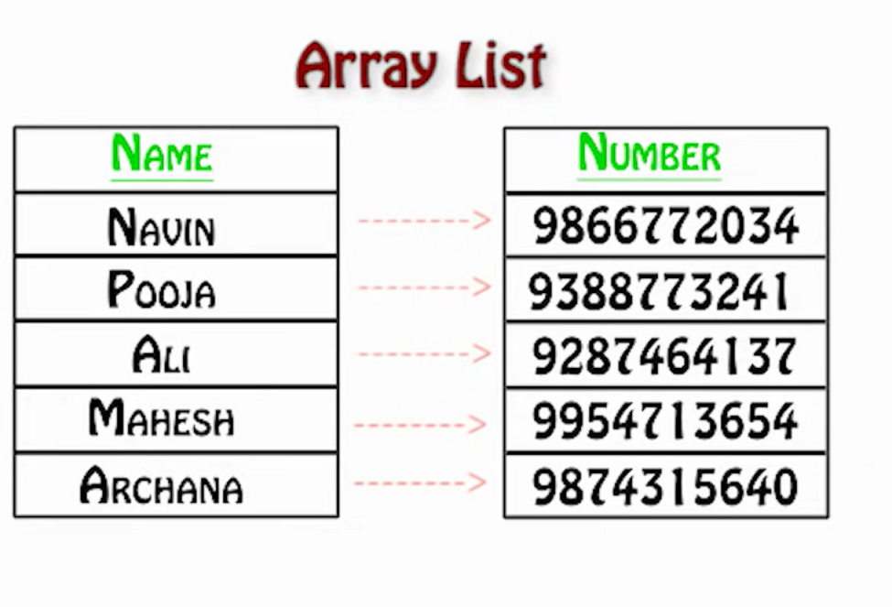
Why we need Hashtable ?

Slide 15
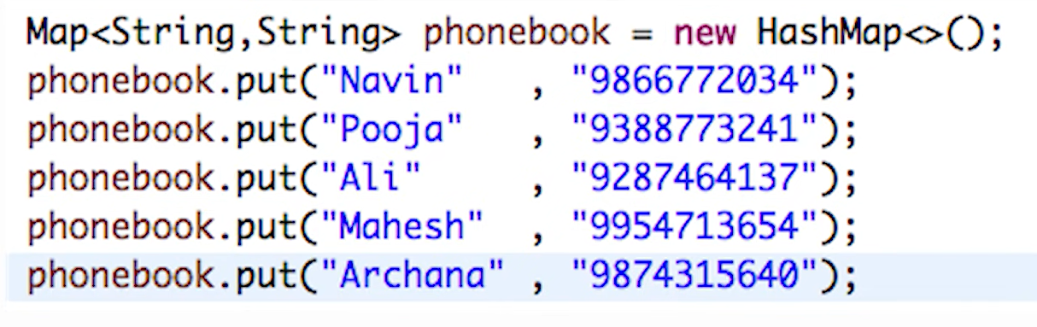
Hashmaps: HashMap is a Map based collection class that is used for storing Key & value pairs, it is denoted as HashMap<Key, Value> or HashMap<K, V>. This class makes no guarantees as to the order of the map. Java HashMap allows null values and the null key. HashMap is an unordered collection.
Using HashMap makes sense only when unique keys are available for the data we want to store. We should use it when searching for items based on a key and quick access time is an important requirement. We should avoid using HashMap when it is important to maintain the same order of items in a collection.

Slide 16
Hashtable Class
It is similar to HashMap, but is synchronized. Hashtable stores key/value pair in hash table. In Hashtable we specify an object that is used as a key, and the value we want to associate to that key. The key is then hashed, and the resulting hash code is used as the index at which the value is stored within the table.
Declaration:
public class Hashtable<K,V> extends Dictionary<K,V> implements Map<K,V>, Cloneable, Serializable

Slide 17
public Class Hashtable
This class implements a hash table, which maps keys to values. Any non-null object can be used as a key or as a value.
To successfully store and retrieve objects from a hashtable, the objects used as keys must implement the hashCode method and the equals method.
An instance of Hashtable has two parameters that affect its performance: initial capacity and load factor. The capacity is the number of buckets in the hash table, and the initial capacity is simply the capacity at the time the hash table is created.
Note that the hash table is open: in the case of a "hash collision", a single bucket stores multiple entries, which must be searched sequentially. The load factor is a measure of how full the hash table is allowed to get before its capacity is automatically increased.

Slide 18
public Class Hashtable Example
This example creates a hashtable of numbers. It uses the names of the numbers as keys:
Hashtable<String, Integer> numbers = new Hashtable<String, Integer>();
numbers.put("one", 1);
numbers.put("two", 2);
numbers.put("three", 3);
To retrieve a number, use the following code:
Integer n = numbers.get("two");
if (n != null) {
System.out.println("two = " + n);
}

Slide 19
Constructors
https://docs.oracle.com/javase/8/docs/api/java/util/Hashtable.html
Constructor and Description
Hashtable()Constructs a new, empty hashtable with a default initial capacity (11) and load factor (0.75).
Hashtable(int initialCapacity)Constructs a new, empty hashtable with the specified initial capacity and default load factor (0.75).
Hashtable(int initialCapacity, float loadFactor)Constructs a new, empty hashtable with the specified initial capacity and the specified load factor.
Hashtable(Map<? extends K,? extends V> t)Constructs a new hashtable with the same mappings as the given Map.

Slide 20
Hash Table Summary
  Hashing involves transforming a key to produce an integer in a fixed range (0..TABLE_SIZE-1)
  The function that transforms the key into an array index is known as the hash function
  When two data values produce the same hash value, you get a collision
    it happens!
  Collision resolution may be done by searching for the next open slot at or after the position given by the hash function, wrapping around to the front of the table when you run off the end (known as linear probing)

