Slide 1
Online Bookstore Data Analysis using SQL
PRESENTED BY SAKA ANGEL SHAINY

Slide 2
INTRODUCTION
This project focuses on creating a relational SQL database for an online bookstore and analyzing it through various SQL queries. By using SQL joins, aggregate functions, and analytical queries, we aim to extract useful insights about customer preferences, best-selling books, and revenue generation

Slide 3
OBJECTIVES
Design and implement an SQL-based database system for an online bookstore.
Manage and analyze data related to books, customers, and orders.
Generate data-driven insights that can help improve decision-making and sales strategies.
Identify top selling books, Customer purchase frequency etc.

Slide 4
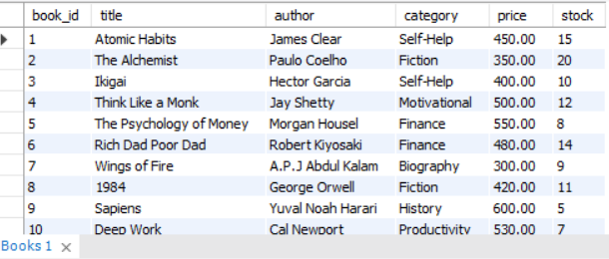
Tables in Database
BOOK’S TABLE
CREATE TABLE Books (
book_id INT PRIMARY KEY,
title VARCHAR(100),
author VARCHAR(50),
category VARCHAR(30),
price DECIMAL(8,2),
stock INT
);

Slide 5
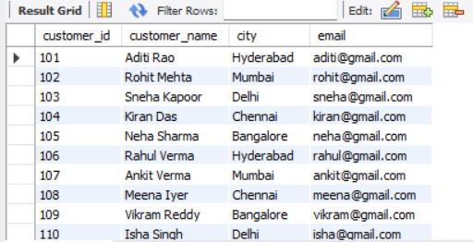
Tables in Database
CUSTOMER’S TABLE
CREATE TABLE Customers (
customer_id INT PRIMARY KEY,
customer_name VARCHAR(50),
city VARCHAR(30),
email VARCHAR(50)
);

Slide 6
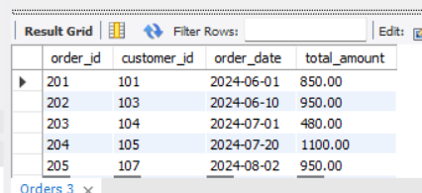
Tables in Database
ORDER’S TABLE
CREATE TABLE Orders (
order_id INT PRIMARY KEY,
customer_id INT,
order_date DATE,
total_amount DECIMAL(10,2),
FOREIGN KEY (customer_id) REFERENCES Customers(customer_id)
);

Slide 7
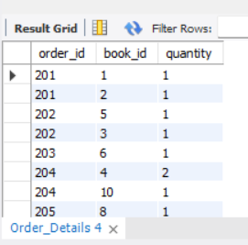
Tables in Database
ORDER_DETAILS
CREATE TABLE Order_Details (
order_id INT,
book_id INT,
quantity INT,
FOREIGN KEY (order_id) REFERENCES Orders(order_id),
FOREIGN KEY (book_id) REFERENCES Books(book_id)
);

Slide 8
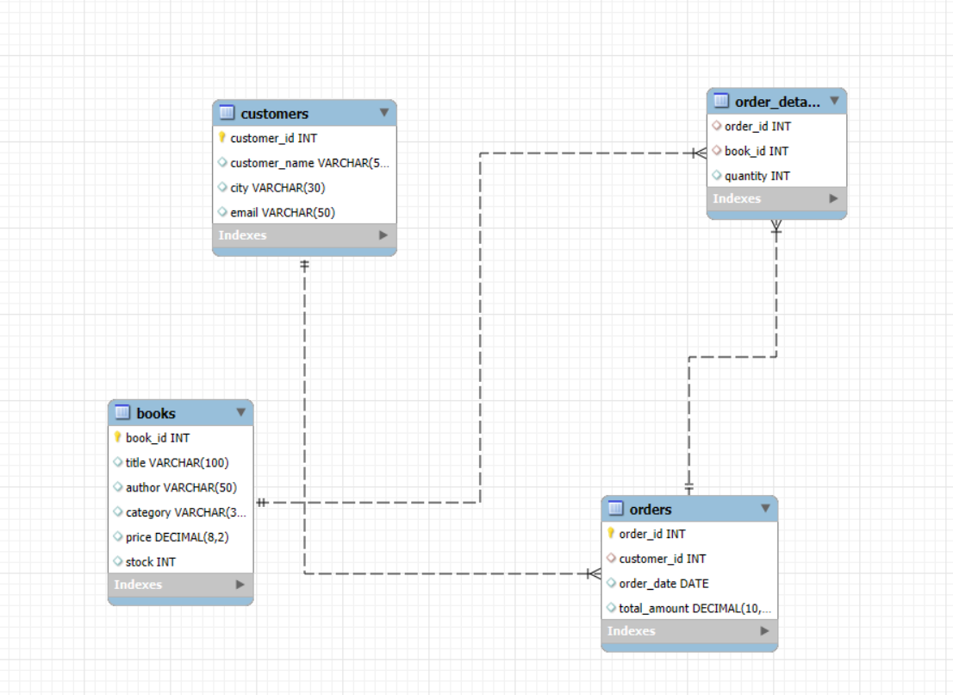
ER DIAGRAM

Slide 9
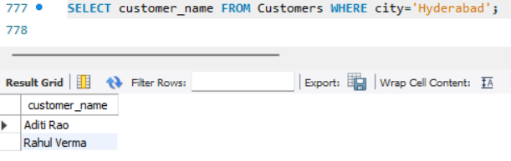
SCENARIO’S
List all customers from Hyderabad.
SELECT customer_name FROM Customers WHERE city='Hyderabad';

Slide 10
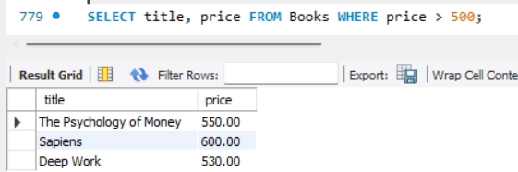
SCENARIO’S
Show books with price greater than 500.
SELECT title, price FROM Books WHERE price > 500;

Slide 11
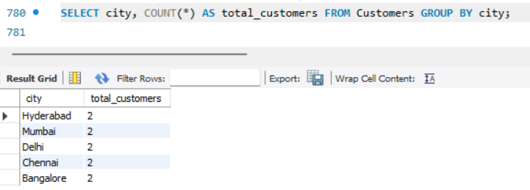
SCENARIO’S
Find how many customers are from each city.
SELECT city, COUNT(*) AS total_customers FROM Customers GROUP BY city;

Slide 12
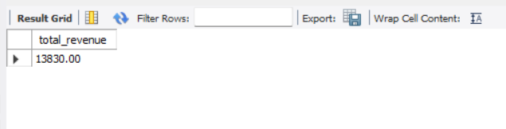
SCENARIO’S
Find total sales revenue
SELECT SUM(total_amount) AS total_revenue FROM Orders;

Slide 13
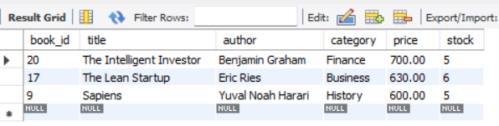
SCENARIO’S
Show top 3 most expensive books.
SELECT * FROM Books ORDER BY price DESC LIMIT 3;

Slide 14
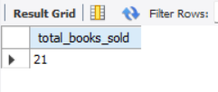
SCENARIO’S
Find total number of books sold
SELECT SUM(quantity) AS total_books_sold FROM Order_Details;

Slide 15
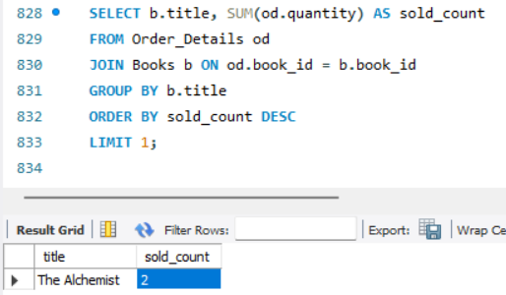
SCENARIO’S
Display the most popular book
SELECT b.title, SUM(od.quantity) AS sold_count
FROM Order_Details od
JOIN Books b ON od.book_id = b.book_id
GROUP BY b.title
ORDER BY sold_count DESC
LIMIT 1;

Slide 16
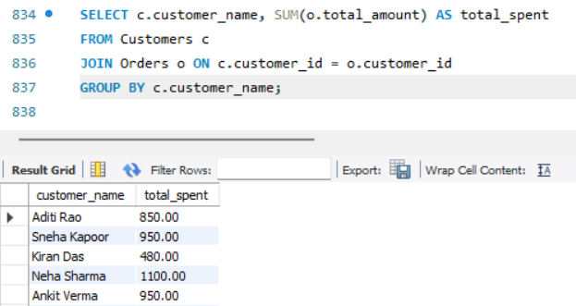
SCENARIO’S
Show customer name with total amount they spent.
SELECT c.customer_name, SUM(o.total_amount) AS total_spent
FROM Customers c
JOIN Orders o ON c.customer_id = o.customer_id
GROUP BY c.customer_name;

Slide 17
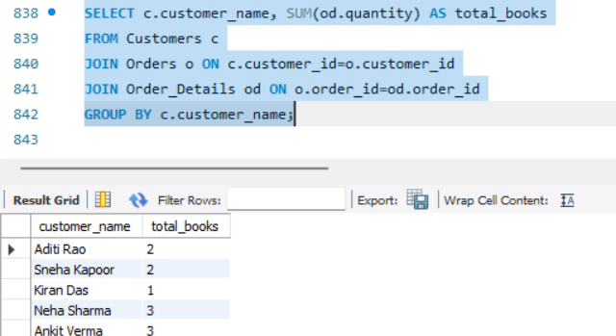
SCENARIO’S
Find the total number of books bought by each customer.
SELECT c.customer_name, SUM(od.quantity) AS total_books
FROM Customers c
JOIN Orders o ON c.customer_id=o.customer_id
JOIN Order_Details od ON o.order_id=od.order_id
GROUP BY c.customer_name;

Slide 18
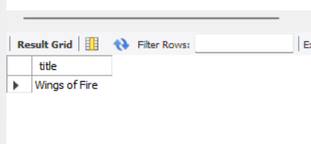
SCENARIO’S
List books that were never sold.
SELECT title FROM Books WHERE book_id
NOT IN (SELECT DISTINCT book_id FROM Order_Details);

Slide 19
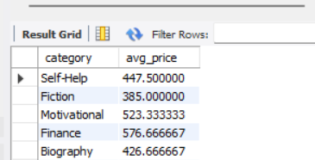
SCENARIO’S
Display category-wise average price of books.
SELECT category, AVG(price)
AS avg_price FROM Books GROUP BY category;

Slide 20
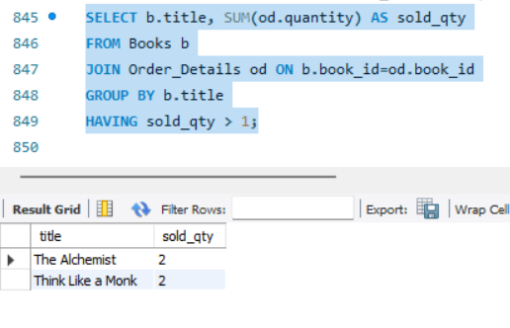
SCENARIO’S
Find books that have sold more than 1 copy.
SELECT b.title, SUM(od.quantity) AS sold_qty
FROM Books b
JOIN Order_Details od ON b.book_id=od.book_id
GROUP BY b.title
HAVING sold_qty > 1;

Slide 21
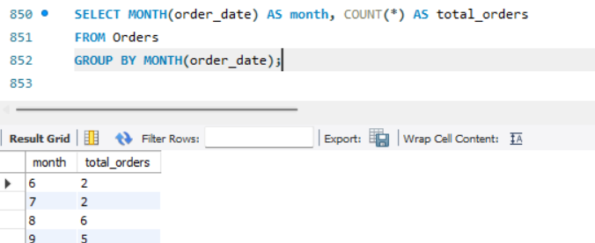
SCENARIO’S
Show total orders per month
SELECT MONTH(order_date) AS month, COUNT(*) AS total_orders
FROM Orders
GROUP BY MONTH(order_date);

Slide 22
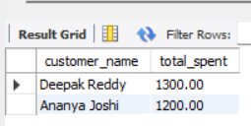
SCENARIO’S
Find the top 2 customers who spent the most money.
SELECT c.customer_name, SUM(o.total_amount) AS total_spent
FROM Customers c
JOIN Orders o ON c.customer_id = o.customer_id
GROUP BY c.customer_name
ORDER BY total_spent DESC
LIMIT 2;

Slide 23
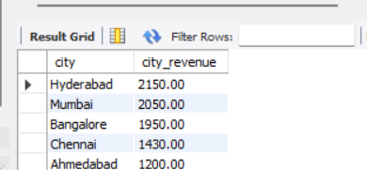
SCENARIO’S
Calculate total revenue generated by each city.
SELECT c.city, SUM(o.total_amount) AS city_revenue
FROM Customers c
JOIN Orders o ON c.customer_id = o.customer_id
GROUP BY c.city
ORDER BY city_revenue DESC;

Slide 24
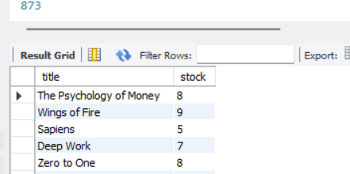
SCENARIO’S
Find books that are low in stock
SELECT title, stock
FROM Books
WHERE stock < (SELECT AVG(stock) FROM Books);

Slide 25
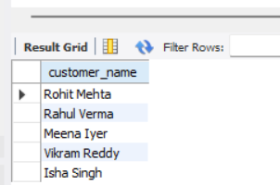
SCENARIO’S
List customers who haven’t placed any orders.
SELECT customer_name
FROM Customers
WHERE customer_id NOT IN (SELECT DISTINCT customer_id
FROM Orders);

Slide 26
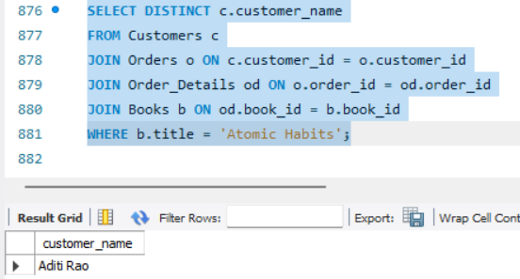
SCENARIO’S
Find customers who ordered the book “Atomic Habits.”
SELECT DISTINCT c.customer_name
FROM Customers c
JOIN Orders o ON c.customer_id = o.customer_id
JOIN Order_Details od ON o.order_id = od.order_id
JOIN Books b ON od.book_id = b.book_id
WHERE b.title = 'Atomic Habits';

Slide 27
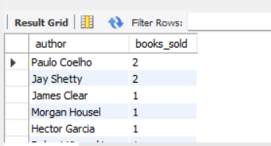
SCENARIO’S
Calculate total books sold by each author.
SELECT b.author, SUM(od.quantity) AS books_sold
FROM Books b
JOIN Order_Details od ON b.book_id = od.book_id
GROUP BY b.author
ORDER BY books_sold DESC;

Slide 28
CHALLENGES FACED
Ensuring proper foreign key relationships among multiple tables.
Handling NULL values and preventing data redundancy.
Designing a balanced dataset with realistic data (not too large).
Writing queries with multiple joins for insights.
Maintaining category consistency while inserting book data.

Slide 29
CONCLUSION
This Online Bookstore SQL Project successfully demonstrates how SQL can be used to design and analyze an e-commerce system. Through queries and data analysis, we extracted valuable insights on sales performance, customer patterns, and product trends.
The project highlights the importance of structured databases and analytical SQL queries in supporting business growth and customer satisfaction in online retail environments.

