Slide 1
CRC 16 CCITT Software Implementation and Error Detection
By Angel Solis

Slide 2
Generate CRC values
Convert string to bytes
Set a poly to 0x1021
Initialize CRC to zero
Run though string
Current byte vs current bit
XOR =1 if first CRC bit is 1
Shift CRC
If Current byte and Current bit
CRC +1 => insert next bit
While loop to append zeros at the end
Return crc&0xFFFF //Mask to reveal CRC

Slide 3
Generate Random Strings
Create a pool of all possible upper and lowercase characters along with all possible digits
Grab a random element from the pool without repeating characters
Append the chosen element to a string
Do this until the desired string length is reached
Return the string

Slide 4
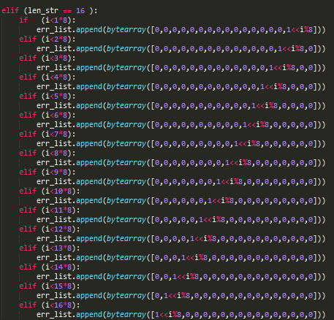
Generate All Possible Errors

Slide 5
Test Results (Single Random Message Errors)
Longer strings give for better error detection
4 random single bit errors are detected the least
It gives us our experimental Hamming Distance of 4
Example Output:
Number of errors generated: 10 String lengths: 16
…
461471: text: BHGIM1XyEy6PKTws text w/ err: @LEI7XyM{6PKTw3 CRC16: 2ff1 Error on: 0000
00000200000000000000000000000000
00000000000000000800000000000000
00040000000000000000000000000000
00000000400000000000000000000000
00000000000200000000000000000000
00000000000400000000000000000000
02000000000000000000000000000000
00000000000000000002000000000000
00000000100000000000000000000000
00000000000000000000000000000040
14/500000 errors were not detected
Runtime = 0:01:07.333000

Slide 6
Test Results (Random CRC Errors)
CRC errors are always detected
If (X != Y) // x = remainder, y is incorrect CRC
=> X - Y != 0
Example Output:
008186: text: 8ZXcfA CRC16: baf8 CRC16 w/ err: 7b64 Output: c19c
0000
0010
0008
0400
0001
0800
0000

Slide 7
Test Results (Burst Random Message Errors)
Attempted burst errors were always detected
=> This CRC was specifically made to detect burst errors [1]
Example output:
048627: text: Co7JGD text w/ err: L∩7JGD CRC16: e366 Error on:e7d3
008000000000
010000000000
020000000000
040000000000
080000000000
[1] http://www2.hawaii.edu/~tmandel/papers/CRCBurst.pdf

