Slide 1
Iot Vibration Sensor For Washing Machine
Angel Solis

Slide 2
Goal
Main Goal
The goal was to create an embedded application to inform the user when the laundry was done.
Objectives
This goal was accomplished by interfacing a vaibration sensor with the NodeMCU(esp8266) which would then transmit the data to the BeagleBone Black.

Slide 3
Outcome - Accomplishments
Outcome
The vibration sensor detects when the washer is running by emitting a voltage to the NodeMCU
The NodeMCU uses an ADC to convert the value from the vibration sensor to determine when the machine has stopped. Then the message “wash” is sent to the BeagleBone
The BeagleBone looks for a message containing “wash” though the MQTT broker mosquitto. When the message is received an email is sent to the user.
Short-term usefulness of this project is reminding the users when the washer is done.
Long-term usefulness would be adding another node to inform when the dryer is also done.

Slide 4
Components Used in Design
Grove - Piezo Vibration Sensor [1]
NodeMCU [2]

Slide 5
Tools used in Design
Bash scripts [3]
Arduino IDE [2]
MQTT: Mosquitto [4]

Slide 6
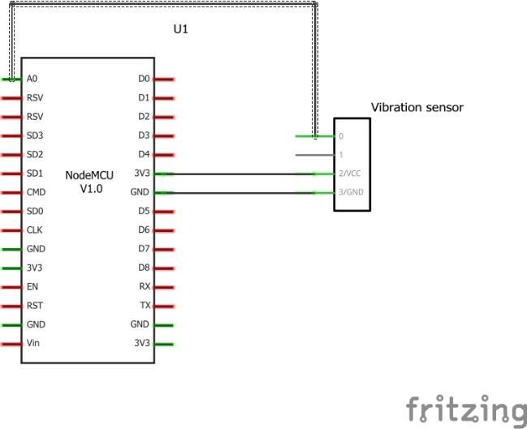
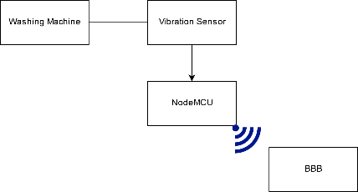
Schematics

Slide 7
Pre-requisites used in Design
Prerequisites
Arduino IDE with NodeMCU & MQTT
BBB with MQTT
Commands to install MQTT on BBB
$ vi /etc/apt/sources.list
add deb http://httpredir.debian.org/debian stretch main contrib non-free
apt-get update
apt-get install mosquitto
apt-get install mosquitto-clients
$ vi /etc/apt/sources.list remove added deb

Slide 8
Pre-requisites used in Design
Commands to edit conf file for MQTT
In /etc/mosquitto/mosquitto.conf add
allow_anonymous true
listener port 1883
Commands to install MQTT on Arduino
In Arduino package manager install
ESP8266 HttpClient
ESP8266 WiFi
Adafruit MQTT Library
PubSubClient

Slide 9
Implementation Details
Knowing when washer is done:
NodeMCU periodically checks to see if ADC value is over 50 and until keep checking.
When ADC value is over 50 periodically check back to see when the machine has stopped.
When it has stopped Publish a message though MQTT
client.setServer(HOST, PORT);
client.connect("ESP8266Client")
if(client.loop())
client.publish(topic, "wash", true);

Slide 10
Implementation Details
Receiving the MQTT message (bashscript):
Continuosly check for message containing “wash” Then Email the users.
#!/bin/bash
while :
do
if mosquitto_sub -t wash -C 2 | grep "wash"; then
echo "Wash"
cat wash.txt | sendmail -t
fi
done

Slide 11
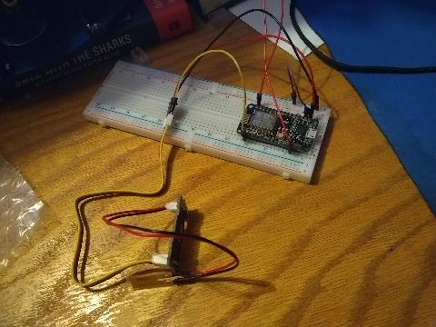
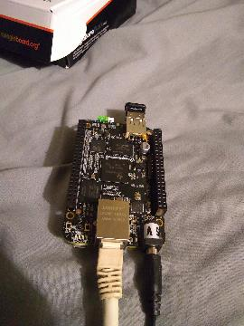
Actual project set-up
Screenshot of the project will all components

Slide 12
Demo
https://youtu.be/yWMe8QvAheA

Slide 13
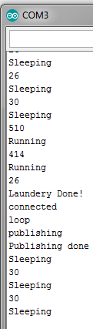
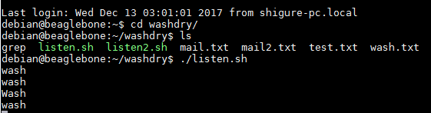
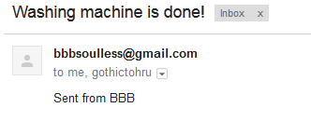
Results and Conclusions
Fig[2]
Example output from BeagleBone
Fig[3]
Example email
Fig[1]
Example output from NodeMCU

Slide 14
Reference
Grove – Piezo Vibration Sensor
Programming NodeMCU Using Arduino
Bash scripting tutorial
mqtt with BBB and NodeMCU

