Slide 1
An Exploration of Data Mining Tools
Angel Trifonov
Course Project Presentation

Slide 2
Overview
Project
Tasks, Tools and Datasets
Example: Computing Association Rules

Slide 3
Project
Main goal: evaluate data-mining tools on a particular task
Write down process complexity
Compare results and see who performs the best
Try to conclude which tool works best for a the current experiment

Slide 4
Tasks, Tools and Datasets
Four tasks
Building a Receiver Operating Characteristic (ROC) curve
Building a Decision Tree
Comparison of Supervised Methods
Computing Association Rules
Three tools
Weka – a popular suite of machine learning software written in Java
Tanagra – a machine learning suite, which supports most data mining techniques
Orange – component-based data mining and machine learning software suite, implemented in C++/Python
Four datasets
Logistic Regression Library (values)
Heart conditions
Breast cancer
Voting

Slide 5
Example: Computing Association Rules
Overview:
Dataset: Voting
Algorithm: APRIORI
Steps
Import dataset
Select descriptors
Set the minimal support and the minimal confidence
Execute the algorithm and visualize the rules
Results
14 (identical) rules from Weka and Tanagra
4 rules from Orange
Observations
All three tools are simple to use for generating association rules
Want to use huge dataset – gets tricky
Orange seems to prefer shorter rules
Personal opinion of best tool for the job: Weka

Slide 6
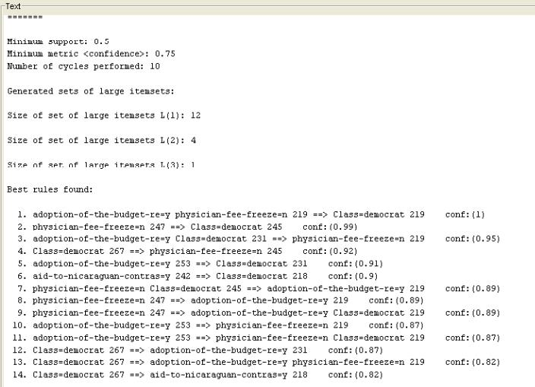
Generated WEka Rules

Slide 7
Questions?

