Slide 1

Weekly report 1/26-1/30
Angel10_tseng

Slide 2
Agenda
PR/PO 流程, Susan交辦事項, Ben 交辦事項
各項事務SOP 公司版
Keep learning Basic electronic
Weekly global news summary
Generate PPT by AI tools

Slide 3
What is inside a PCB

Slide 4

The 3 most
common components
LED Light Emitting Diode
What it does:
Lights up when current flows in one direction
Smooths voltage
Blocks DC, passes AC (for now: “filters noise”)
Capacitor
What it does:
Stores a small amount of charge
Smooths voltage
Blocks DC, passes AC (for now: “filters noise”)
Resistor
What it does:
Limits current
Drops voltage
Protects components.

Slide 5
The 3 most common components
Resistor
Capacitor
LED Light Emitting Diode
What it does:
Limits current
Drops voltage
Protects components
*Without a resistor, many components would burn.
What it does:
Stores a small amount of charge
Smooths voltage
Blocks DC, passes AC (for now: “filters noise”)
*A shock absorber for voltage
What it does:
Lights up when current flows in one direction
Important rules:
Has polarity (+ and −)
Always needs a resistor

Slide 6
The 3 most common components
Resistor
Capacitor
LED Light Emitting Diode
What it does:
Limits current
Drops voltage
Protects components
*Without a resistor, many components would burn.
What it does:
Stores a small amount of charge
Smooths voltage
Blocks DC, passes AC (for now: “filters noise”)
*A shock absorber for voltage
What it does:
Lights up when current flows in one direction
Important rules:
Has polarity (+ and −)
Always needs a resistor

Slide 7
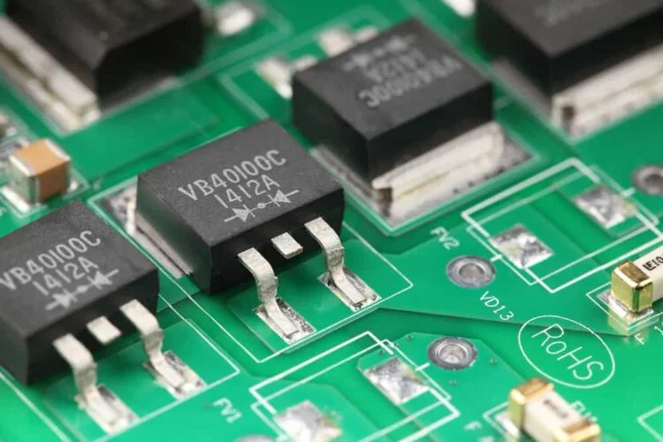
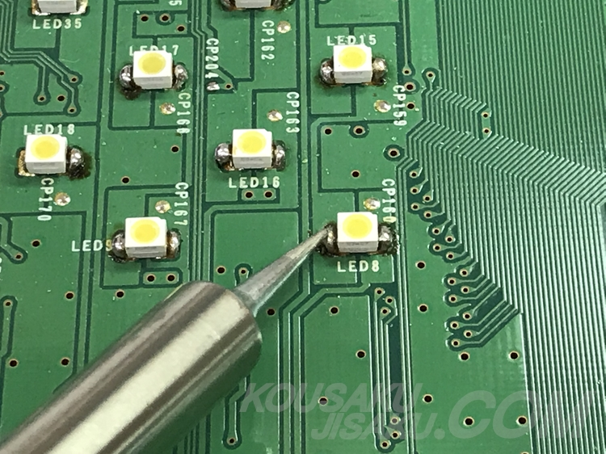
Diode vs LED
Diode
LED
What it does:
Allows current to flow in one direction only
Used for protection and rectification
Beginner intuition:
A one-way door for electricity
A diode that emits light
Needs current limiting resistor
Has polarity:
Anode (+)
Cathode (−)
📌 On real LEDs:
Long leg = + / Flat side = −

Slide 8
Switches & Buttons
What a switch really does
It opens or closes a circuit
No electricity flows if the circuit is open
Simple switch symbol
---o/ o---
Important beginner idea
Switches do NOT “push voltage”
— they only allow or block current
Batteries vs Power Supplies
🔋 Battery
Fixed voltage
Limited current
Slowly drains
🔌 Power supply
Stable voltage
Can supply more current
Used in labs and real products
Reference voltage adjustment

Slide 9
Polarity
Component | Has polarity?
Resistor | ❌
Capacitor (electrolytic) | ✅
Diode / LED | ✅
Battery | ✅

Slide 10
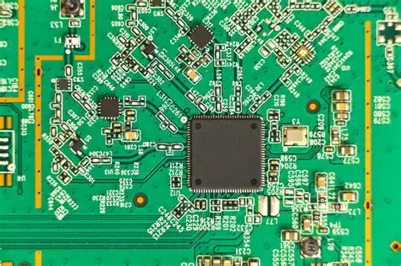
Decoupling capacitors
Near every IC, Why?
ICs need stable voltage
Capacitors absorb noise and spikes
Beginner takeaway:
Capacitors are “local energy buffers”

Slide 11
Decoupling capacitors
Near every IC, Why?
ICs need stable voltage
Capacitors absorb noise and spikes

Slide 12
When the switch/transistor is open
→ signal is pulled HIGH
When the switch/transistor is closed to ground
→ signal becomes LOW
The resistor limits current so you don’t short Vcc to ground.
Pull-up resistors
Nothing driving the line
→ resistor pulls signal LOW
Switch or output drives to Vcc
→ signal becomes HIGH
The resistor limits current and prevents a short
Pull-down resistors

Slide 13
Power block
Regulator
Capacitors
Protection diode
Input block
Connector
Resistor
Filter capacitor
Common schematic blocks
Processing block
IC
Supporting parts
Output block
Transistor / IC pin
Load (LED, motor)

Slide 14
When the switch/transistor is open
→ signal is pulled HIGH
When the switch/transistor is closed to ground
→ signal becomes LOW
The resistor limits current so you don’t short Vcc to ground.
Nothing driving the line
→ resistor pulls signal LOW
Switch or output drives to Vcc
→ signal becomes HIGH
The resistor limits current and prevents a short
Pull-up resistors
Pull-down resistors
Nothing driving the line
→ resistor pulls signal LOW
Switch or output drives to Vcc
→ signal becomes HIGH
The resistor limits current and prevents a short
Nothing driving the line
→ resistor pulls signal LOW
Switch or output drives to Vcc
→ signal becomes HIGH
The resistor limits current and prevents a short
Pull-down resistors
Pull-down resistors

Slide 15
Polarity

Slide 16
Polarity

Slide 17
Polarity

Slide 18

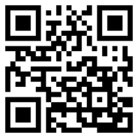
Thank You
For Listening
Stay in touch!
Notes:
Thank you. We are Accton. Let’s stay in touch!

