Slide 1

Book Chair
Student names:
Angel Jovanovski 215058
Aleksandra Ignatova 221254
Ana Georgievska 223101
Teo Vrondeliev 225113
Mentor:
Boban Joksimoski
Institution:
Faculty of Computer Science & Engineering

Slide 2
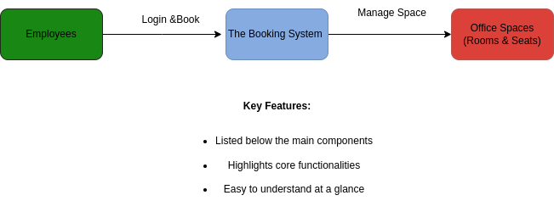
Introduction
Office Space Booking System
Modern solution for managing office space utilization
- Streamlines desk booking process for employees
- Ensures efficient use of office resources
- Tracks employee attendance and space usage

Slide 3
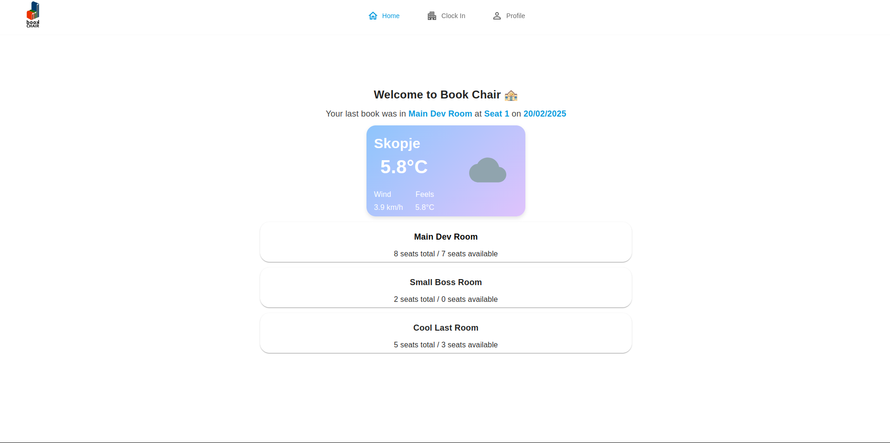
System Features
Key Features
Secure employee login system
- Three distinct room selections
- Multiple desk booking options
- Flexible booking durations:
* Single day booking
* Multi-day options (3, 5, 7 days)
* Custom date selection
[Visual: Feature icons or interface screenshot]

Slide 4
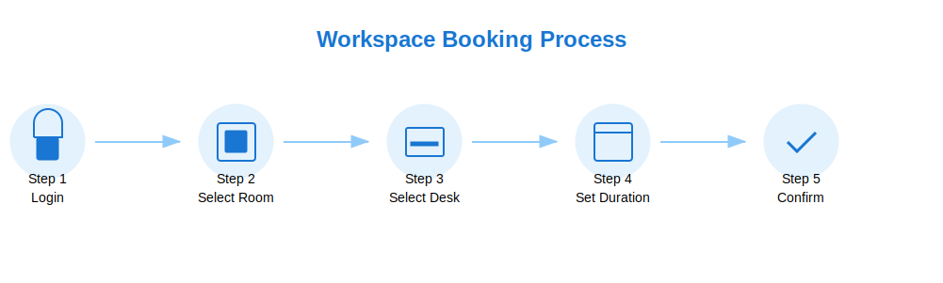
Booking Process
How It Works
1. Employee logs into the system
2. Selects desired room from three options
3. Views available desks in selected room
4. Chooses booking duration
5. Confirms reservation

Slide 5
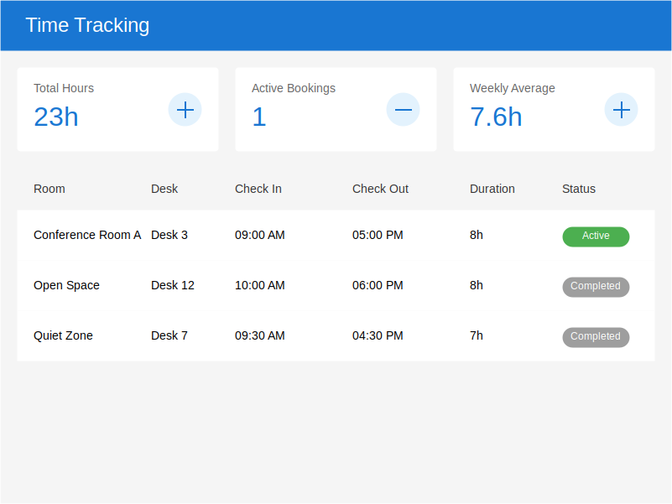
Time Tracking
Attendance Management
Clock In/Out functionality
Tracks employee work hours
Maintains attendance records
Real-time status updates

Slide 6
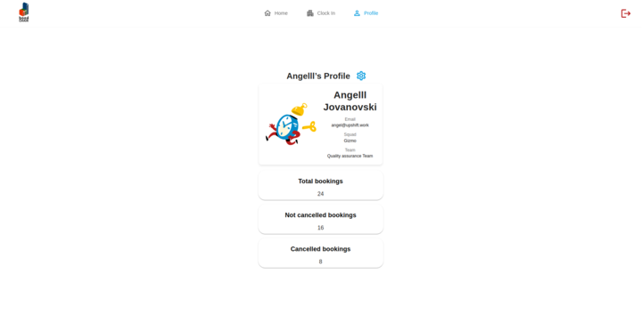
User Management
Profile Features
- Personal profile management
- Edit profile capabilities
- Booking history view
- Cancellation management

Slide 7
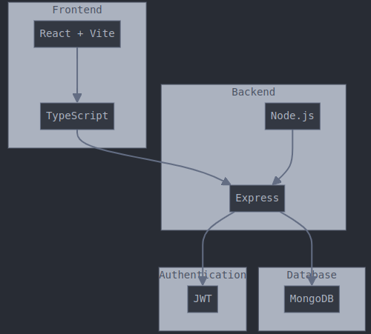
Technical Implementation
Technology Stack
Frontend: React + Vite + Typescript
Backend: Nodejs + express
Database: MongoDB
Authentication: JWT

Slide 8
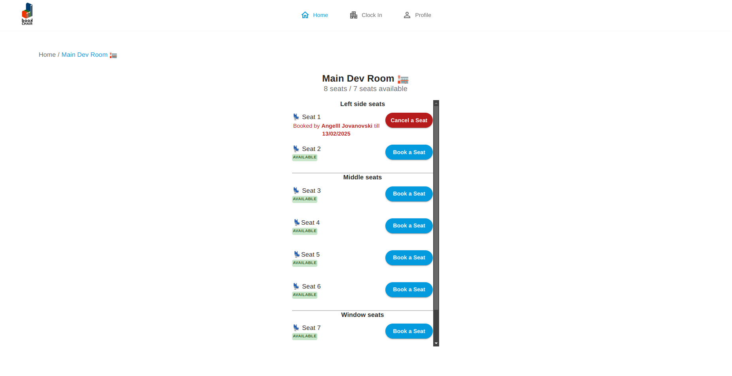
System Demo
Live Demonstration
Room selection interface
Desk booking process
Calendar integration
Booking management

Slide 9
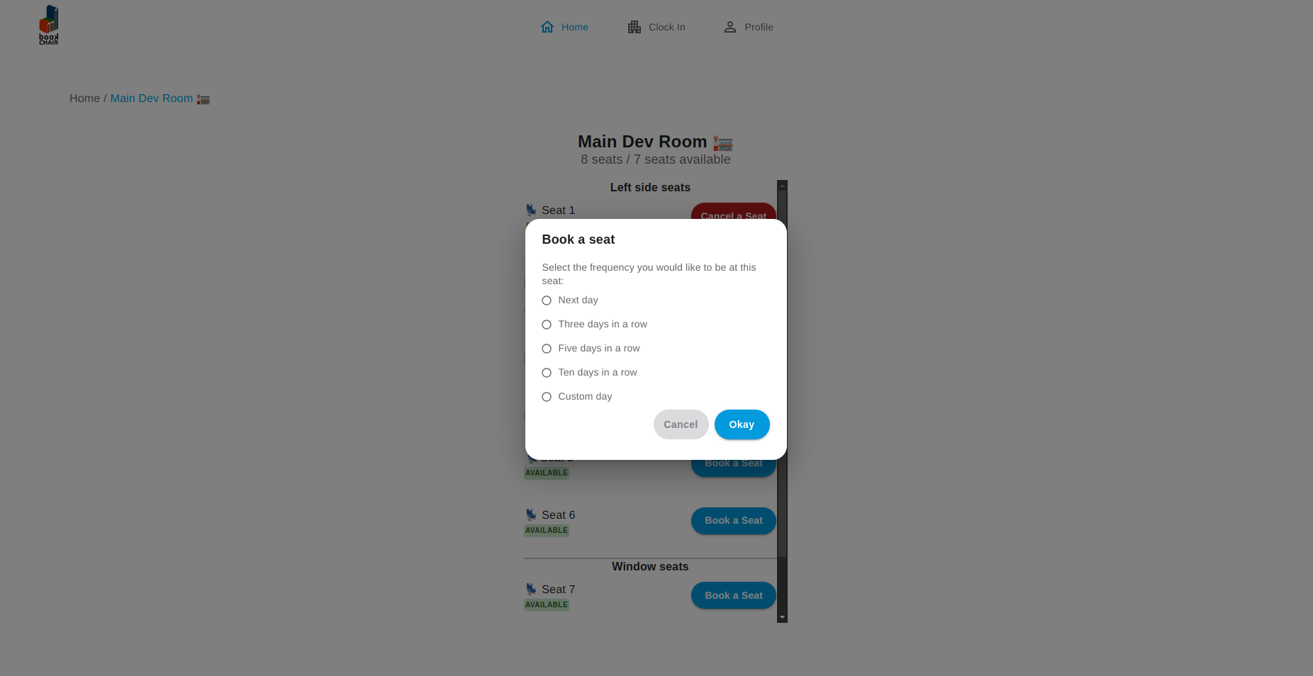
Benefits
System Advantages
Efficient space utilization
Reduced booking conflicts
Easy attendance tracking
User-friendly interface
Flexible booking options

Slide 10
Conclusion
Thank You
- Project Summary
- Future Enhancements:
* Mobile application
* Analytics dashboard
* Additional features

