Slide 1
Introduction to R
CIRC Summer School
August 12-14, 2025
Angel M. Villegas-Cruz

Slide 2
Objectives
Exploring the basics of R programming
Learning some fundamentals about how coding languages work
Performing common data analysis activities
Overall goal
  Learn something, not everything!

Slide 3
About Me
Angel M. Villegas-Cruz
Senior Institutional Research Analyst in the Office of Data Insights and Reporting
  ~1 year at U of R
Ph.D. in Political Science and Asian Studies from Penn State
  Quantitative analysis and computational social science
More information here: https://angelvillegascruz.github.io/

Slide 4
About You
Name?
Experience with R?
Experience with other programming languages or statistical software?
  C++, SQL, Python, JavaScript, STATA, SPSS, SAS, MATLAB, etc.
Experience with data science?

Slide 5
Coding Fundamentals: Languages
Your computer only understands machine code (1s and zeros)
All coding languages are essentially three things:
  The language itself (a set of keywords and syntax rules)
  A way to translate human language into machine code that your machine can run
  Often, but not always, a standard library (a bunch of pre-written code for that language that covers basic usage that most people need)

Slide 6
Coding Fundamentals:
Compiled vs Interpreted
Compiled: (C, C++, Rust, Go, Fortran)
  Compiler converts your entire program to an executable file
  Compiler never sees the program “run”
  They offer faster execution speed, but hard to troubleshoot
Interpreted: (R, Python, Ruby, PHP, Bash, JavaScript)
  Interpreter translates and executes your program line by line
  Interpreter constantly runs, and your program runs “through” it
  They are slower but easier to troubleshoot

Slide 7
What is R?
Programming language based on S
  Created by Ross Ihaka and Robert Gentleman as a “free” version of S in the 1990s
Interpreted language
Excellent for statistical and graphical techniques
  Linear and nonlinear modeling, classical statistical tests, time-series analysis, classification, clustering, etc.
  Popular among data scientists, statisticians, academics, researchers, etc.

Slide 8
Coding Fundamentals: IDEs
If you want to type an essay, you use Microsoft Word
If you want to type code, you use an Integrated Development Environment (IDE). This will usually include:
  A file browser
  A file editor (syntax highlighting)
  A terminal window
Other various code-specific windows (like a “console”)
  Examples:
    RStudio (designed for R)
    VS Code (general purpose, extension-based IDE)

Slide 9
What is RStudio?
2010: Developed by J. J. Allaire as a free and open-source integrated development environment (IDE)
2022: Rebranded to “Posit” to signify their expansion to data science in all languages
  Have a large library of open-source tools and enterprise services

Slide 10
Why R?
Highly extensible
  Comprehensive R Archive Network (CRAN)
Easy to install R packages
  Examples: tidyverse, dplyr, ggplot2, stringr, etc.
Other tools
  R Markdown
  R Shiny
  The R Journal

Slide 11
R is Portable
Runs on Desktop systems (Mac OS X, Windows, Linux, BSD, etc.)
Apps for iOS and Android
Graphical User Interface (GUI) not required
Runs on Linux clusters and supercomputers
  BlueHive

Slide 12
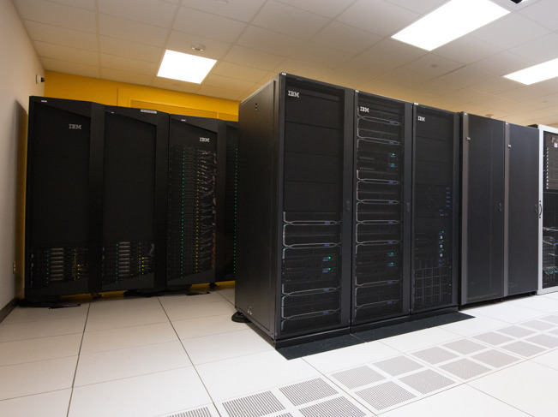

Slide 13
BlueHive Specifications
CIRC’s primary Linux cluster for demanding computations
  General Compute Nodes
    Approximately 480 compute nodes
    96 cores per node
    Ranges in memory from 20 GB to 3TB
You can run R on BlueHive

Slide 14
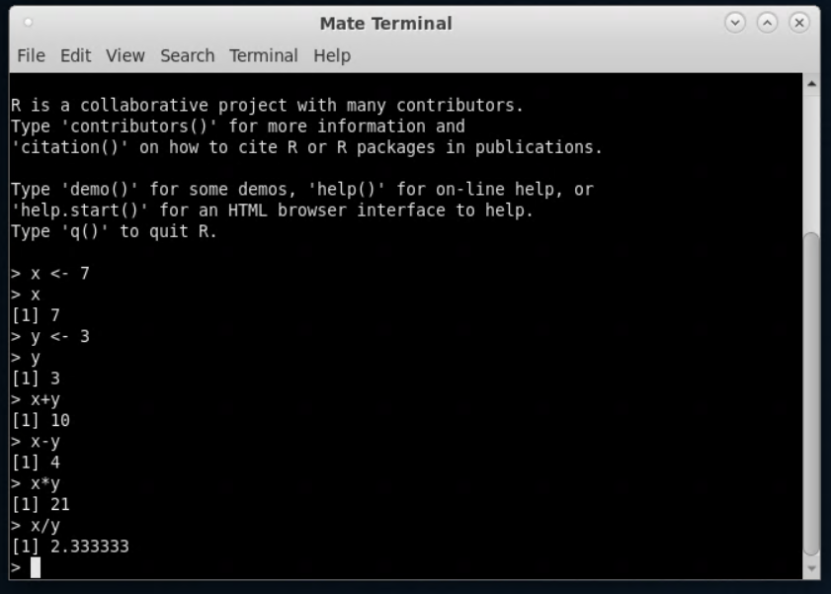

Slide 15
Class Materials
https://gitlab.circ.rochester.edu/
angel.villegascruz/
2025-circ-r-course-avc

Slide 16
Install Programs
Installing R
  Go to https://cran.rstudio.com/ and download the latest version of R for your os
Installing RStudio Desktop
  Go to https://posit.co/download/rstudio-desktop/ and download the latest RStudio desktop

Slide 17
RStudio
Open the file examples/1_r_cmd_line.R and it will open with RStudio
You will find windows with:
  Text editor (R script)
  Console and a Terminal
  File browser
  Current “environment”

Slide 18
Objects and Basic Types
An object is data stored in the computer
If we want to be able to reference this object later, we can assign it a name using the assignment operator
  <- or =
Each object has a type. Basic data types:
  Numeric or doubles: 5 or 2.3
  Integer: 5L or 10L
  Complex: (3 + 2i)
  Character or String: “hello” or “Canada”
  Logical: True or False

Slide 19
Composite Data Types
There are data types that can store several related objects:
  Vectors: 1-dimensional. all the same data type (homogeneous)
  Factor: a special type of vector for categorical data
  List: can be heterogeneous
  Matrices: 2-dim. homogenous
  Arrays: n-dim. homogenous
  Data Frames: homogeneous columns

Slide 20
RStudio
Open the file examples/2_objects_and_data_types.R

Slide 21
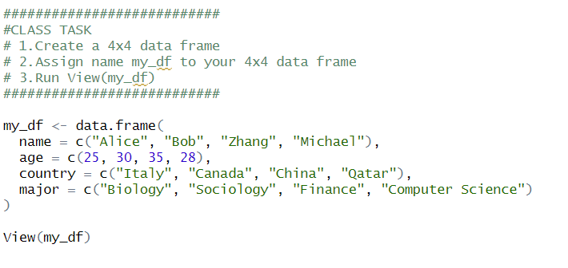

Slide 22
Ifs, Loops, and Functions
Ifs
  Conditional statements, such as if and else
Loops
  Repetition of code until a condition is met or a set number of times
  for loop: Iterates over a sequence
  while loop: Repeats while a condition is TRUE
  repeat loop: Runs indefinitely unless explicitly stopped
Functions
  Blocks of reusable code that perform a task and may return a value

Slide 23
RStudio
Open the file examples/3_functions_and_control.R

Slide 24
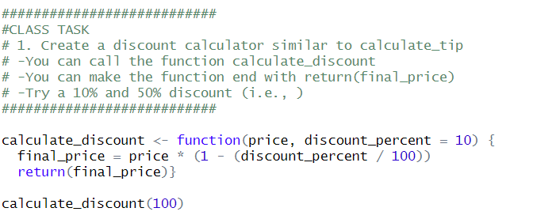

Slide 25
Importing Files
CSV files
  read.csv() in base R
  read_csv() in readr package
Excel (.xlsx) files
  read_excel() in readxl package
Stata (.dta) files
  read_dta() in haven package
Txt. files
  read_delim() in readr package

Slide 26
RStudio
Open the file examples/4_dataframe.R

Slide 27
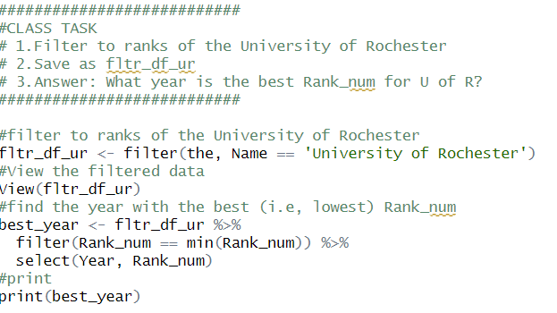

Slide 28
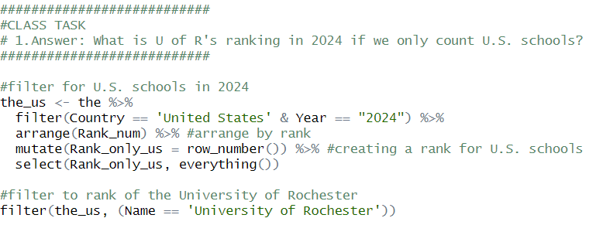

Slide 29
RStudio
Open the file examples/5_vizualiations.R

Slide 30
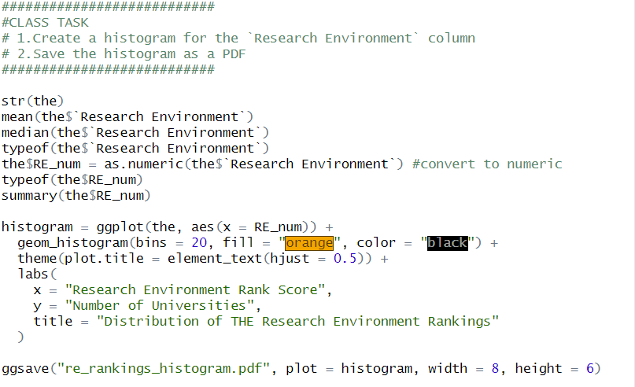

Slide 31


